Slide 1
AI-Driven Confidential Computing across Edge-to-Cloud Continuum
Sm Zobaed
Advisor: Dr. Mohsen Amini Salehi
High Performance Cloud Computing Lab (HPCC)
School of Computing and Informatics
University of Louisiana Lafayette
November 7, 2022

Slide 2
Outline
Introduction: Edge-cloud for Confidential Computing
Challenges of Secure Data Processing in Edge-Cloud
Prior research: Confidential Computing & Cloud
Contribution 1: Clustering Encrypted Data on Cloud
Contribution 2: Encrypted Search across Edge-Cloud
Contribution 3: Improve Edge Efficiency
Conclusion & Future Research Directions

Slide 3
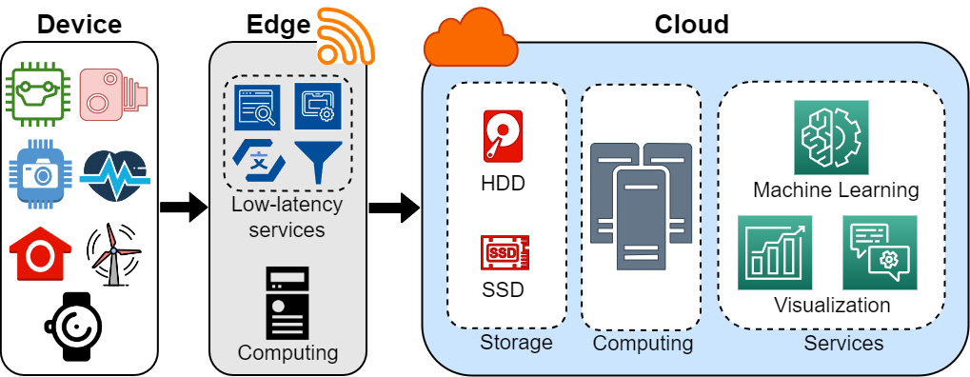
Edge-to-Cloud Continuum

Slide 4
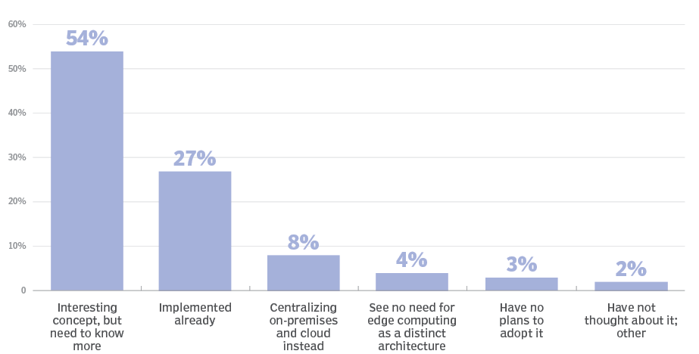
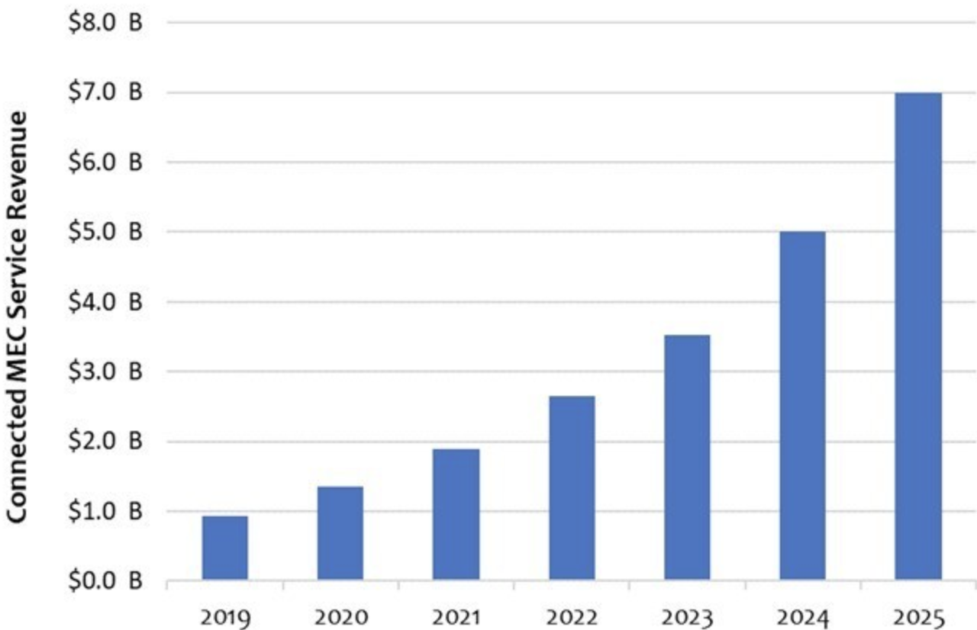
Industry Adoption of Edge-Cloud Continuum
>70% are interested to edge
Revenue forecast:2B to 7B
https://www.techtarget.com/searchdatacenter/definition/edge-computing
4

Slide 5
Challenges of Edge-Cloud Systems
Trust

Slide 6
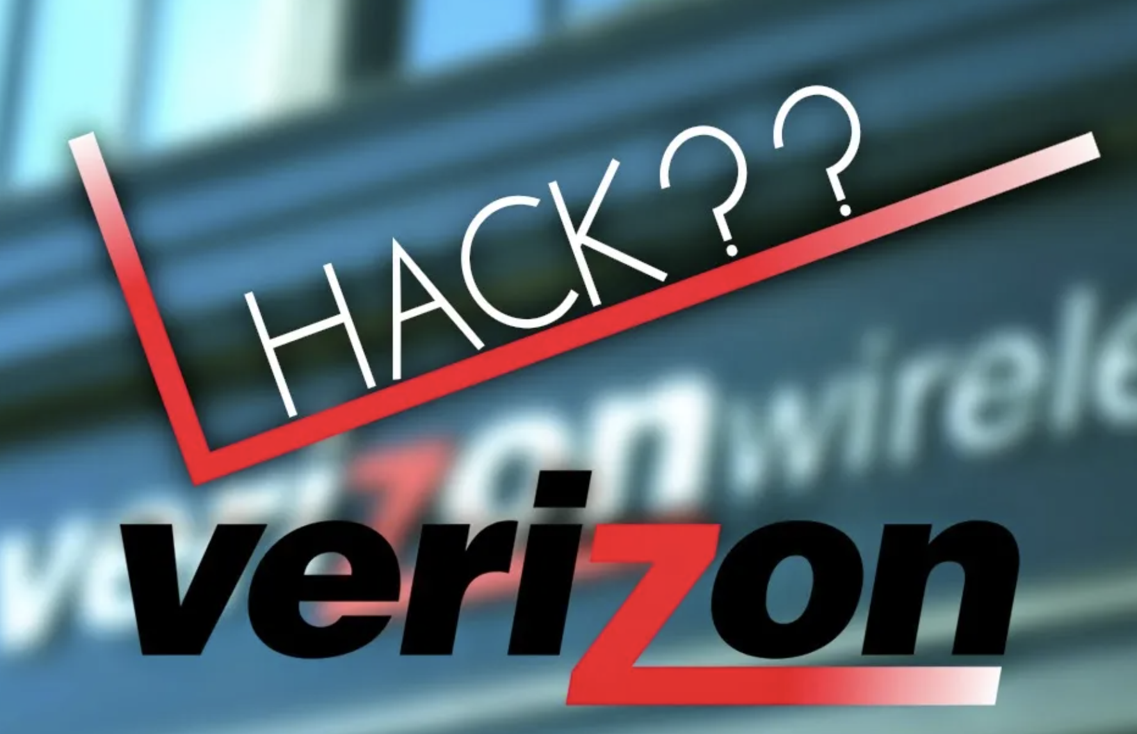
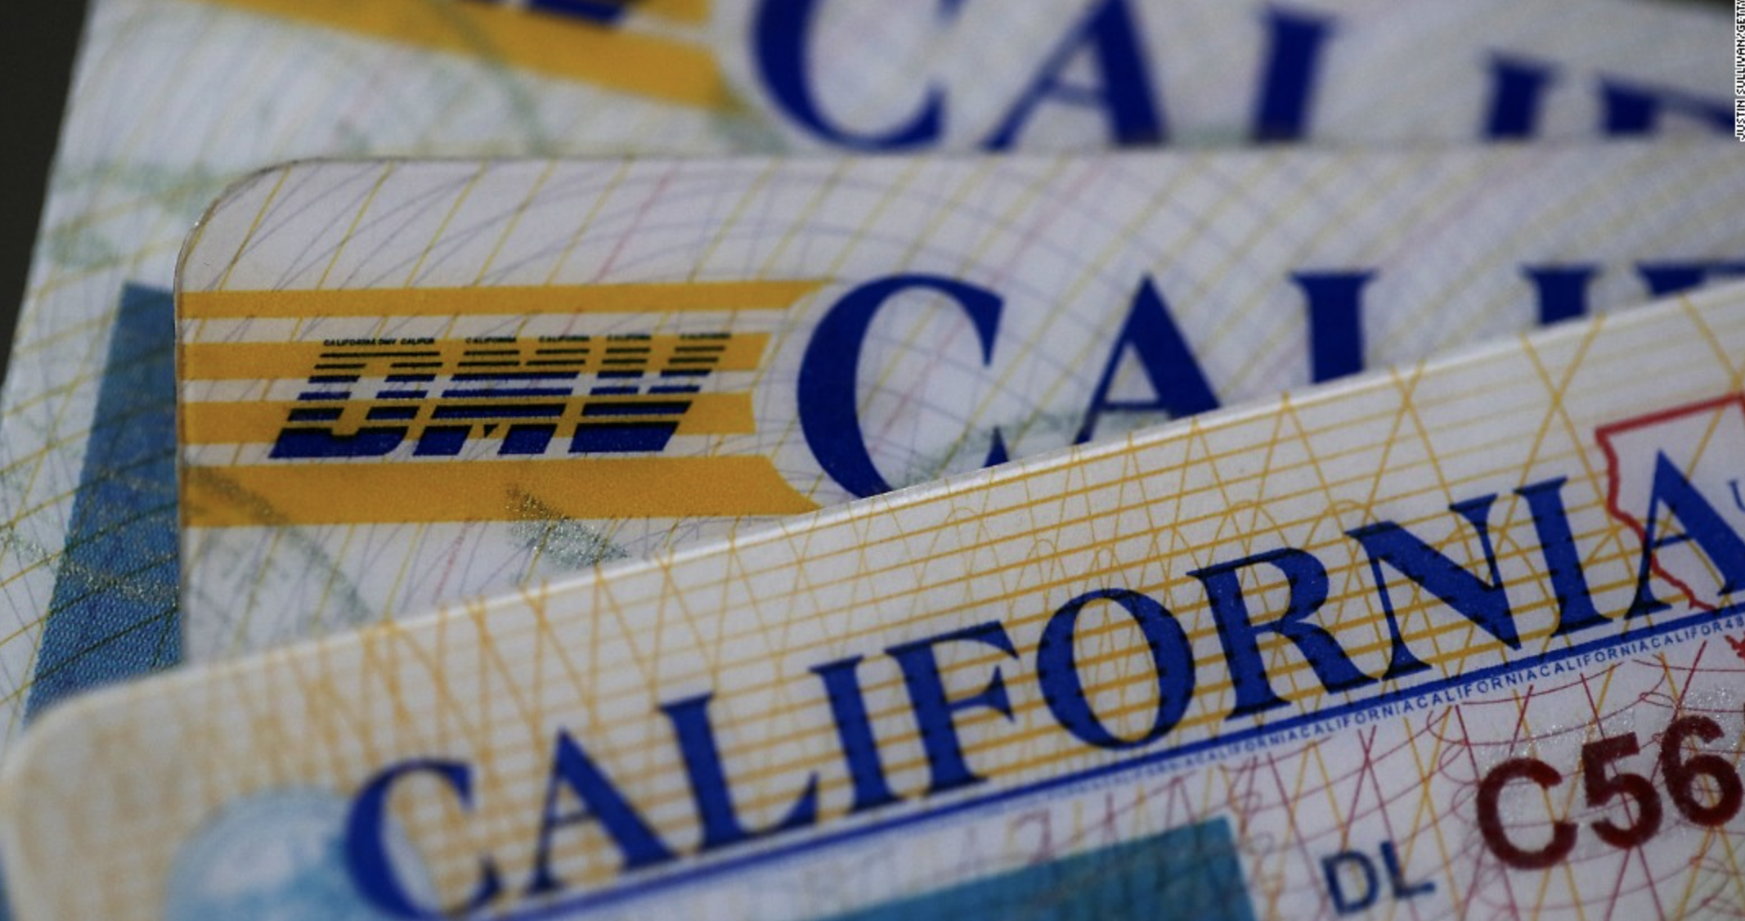
Challenges of Edge-Cloud Systems
Clouds are convenient but lack security
Prone to cyber attacks
Drives away businesses!
2021
2021
2017
2021 & 2019
2017
http://techgenix.com/elasticsearch-data-breach/
https://www.identityforce.com/blog/2021-data-breaches
Notes:
Link: 214 million Personal identity info CA: 20months under attack 2021, 38 million records hacked from ca dmv database 2019
319 million iCloud accounts and factory reset millions of iPhones and iPads in 2017
6 Million Verizon Customers Data Leaked online Due to Misconfigured File Repository 2017

Slide 7
What to Do?
Sensitive data needs to be stored & processed securely
Confidential computing!
Provides HW-enforced trusted execution environment (TEE)
Isolates sensitive data during processing
Text is not SVG - cannot display

Slide 8
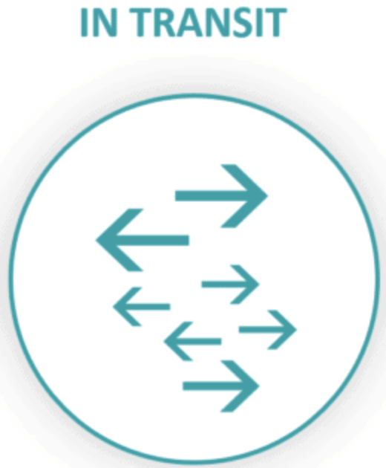
How to Protect Sensitive Data on Cloud?
Cloud-side encryption – Still unsecure
User-side encryption – better protection!
Restricts processing capabilities (e.g., clustering, search)
Involves high space/time overhead
Notes:
Widely known solution for at rest & use.
Data is vulnerable in use state
Cloud side encryption doesn’t tackle inside attack

Slide 9
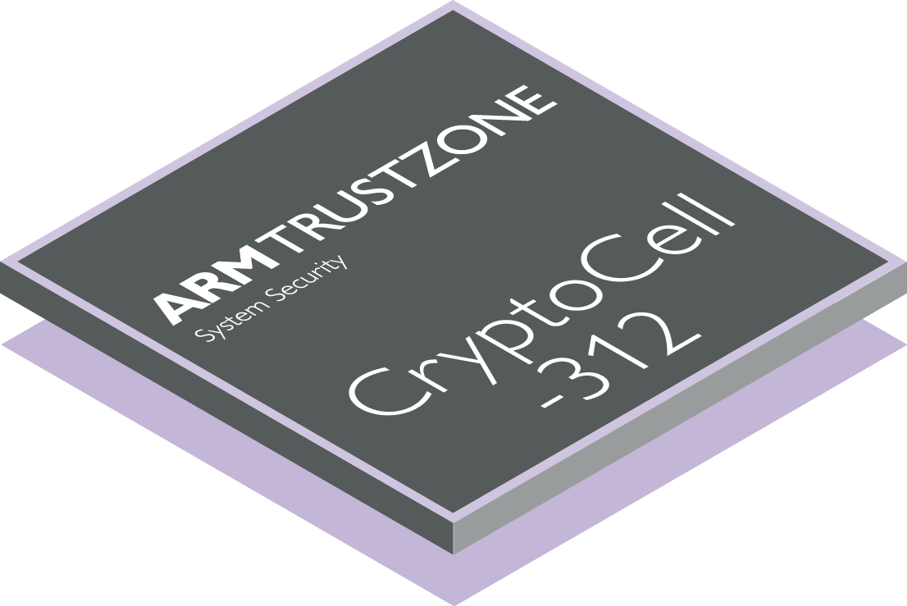
What to Do?
Sensitive data needs to be stored & processed securely
Confidential computing!
Provides HW-enforced trusted execution environment (TEE)
Isolates sensitive data during processing
Untrusted World
Trusted World
Trusted Applications
User Applications
TEE Internal APIs
TEE Client API
Secure Provision
Secure
Storage
TEE Comm- unication
Trusted I/O path
Generic (Rich) OS
Trusted Kernel
Communication
Secure Scheduling
Separation Kernel
Root of Trust
Secure boot
Hardware Layer
Secure Hardwares
Text is not SVG - cannot display

Slide 10
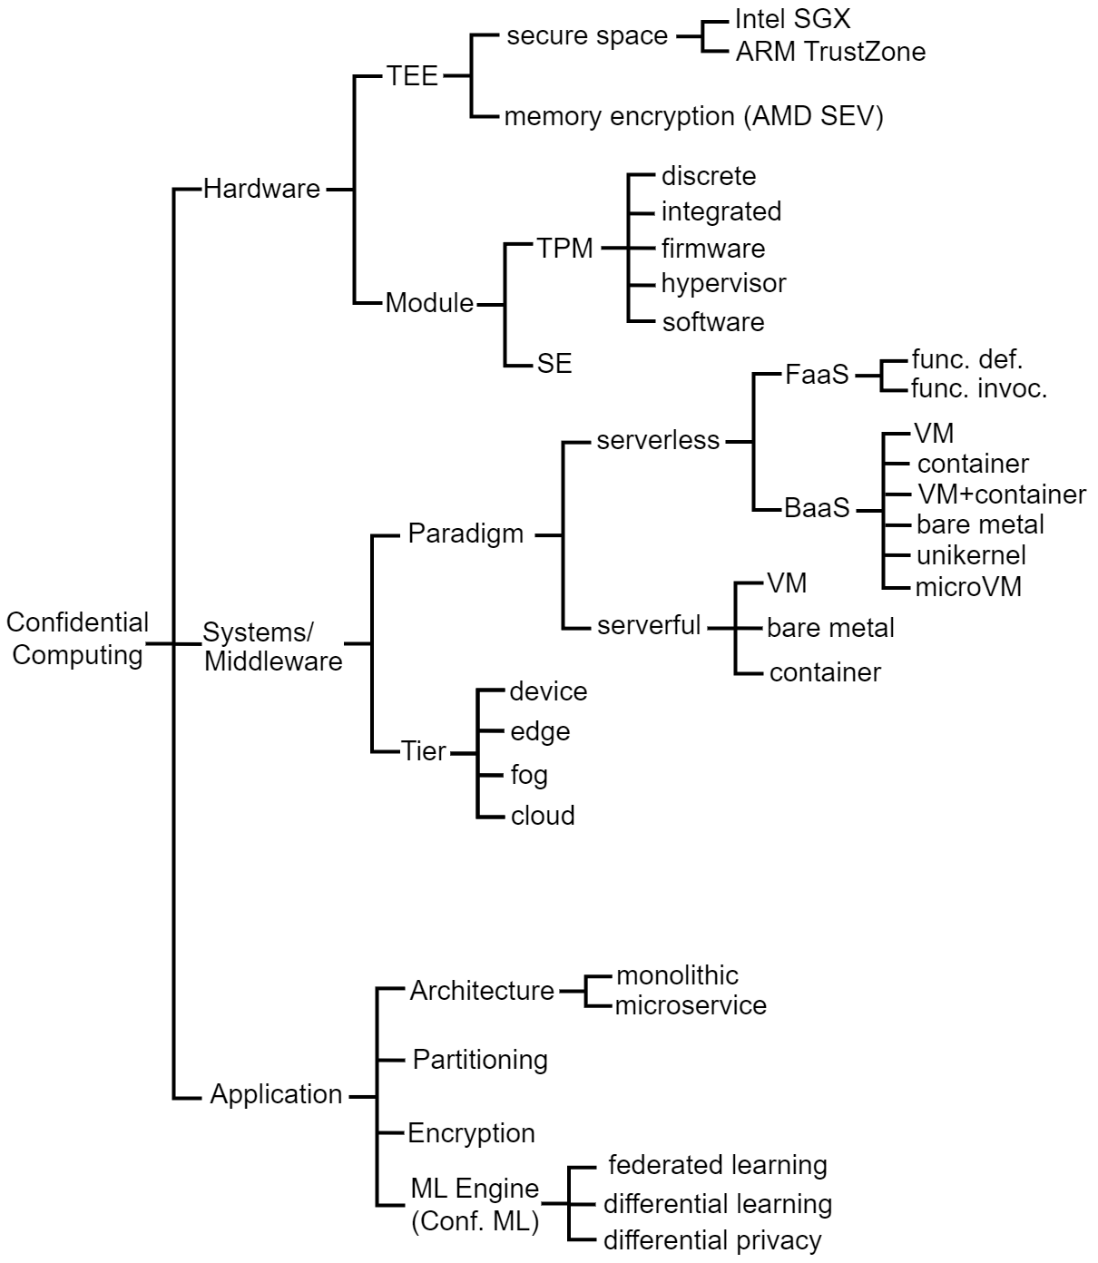
Prior Research and Positioning of Our Work
Notes:
SE- secure

Slide 11
Motivational Scenario
Law enforcement searches encrypted criminal records
Look up related crimes
Use handheld device (e.g., phone) on duty
Expect personalized ranking on search results
Prior works solved searching problem utilizing encrypted central index
Robbery
Robbery…
2. Break In..
3. Theft…
4. Mugging…
5. Stickup…
Notes:
A company we are working with has a need to let cops search encrypted police reports.
Needs related crimes to not have to search for every case
Needs ranking to get to the most relevant crimes quick
Needs to use limited overhead for extended life on small device.

Slide 12
Challenges in Cloud-based Confidential Computing
How to confidentially process data on cloud?
How edge-cloud continuum can be leveraged for user-driven confidential computing on cloud?
How to improve efficiency of edge systems for user-driven confidential computing?

Slide 13
Key Contributions
Confidential data clustering solutions on cloud
Clustering static, semi-dynamic, & fully-dynamic data
ClusPr: Open-source implementation available in GitHub
Personalized confidential search service via smart edge
SAED: open-source implementation in GitHub
Improving edge efficiency to host smart services
Edge-MultiAI: open-source implementation in GitHub
Survey of confidential computing across edge-cloud

Slide 14
Involved Tiers in Contribution
SAED
(Contrib. 2)
Edge-MultiAI
(Contrib. 3)
ClustCrypt
(Contrib. 1)
Device
Edge
Cloud
ClusPr
(Contrib. 1)
Notes:
Need to hide other contrib. via animation

Slide 15
Challenges in Cloud-based Confidential Computing
How to confidentially process data on edge-cloud? -> e.g., clustering, classification
How edge-cloud systems can be leveraged for user-driven confidential data processing on cloud?
How to improve efficiency of edge systems for user-driven confidential computing?

Slide 16
Contribution1: Clustering Encrypted Data on Cloud (ClustCrypt & ClusPr)
ClustCrypt
(Contrib. 1)
Device
Edge
Cloud
ClusPr
(Contrib. 1)
Notes:
Need to hide other contrib. via animation

Slide 17
1. How to Confidentially Process Data on Cloud?
How to cluster privacy-preserving data?
How to estimate no. of clusters?
How to distribute tokens (a.k.a. keywords) across clusters?

Slide 18
Central Index Approach & Its Problems
Searching is performed through central index
keeps track the keywords’ occurrences and frequency in the dataset
The keywords in the index are all hashed
Huge index has to be searched
Poor solution for Big Data
For 50 PB dataset, the index size ≈ 150 GB
Solution? Prune searched index
Divide into topic-based shards before searching
Index Terms
1fv3- Hacking
S8^d- Big Data
Wd2^$- AI
Ds^qd$- Maths
&fi- Cloud Computing
^$dq- Graphics
#2ki- Video Streaming
*23- Encryption
4%5l- Hashing
bh2- Virtual Reality
cnjdds6l- Oculus
K5jhdl- AWS
3vfe5l- Public Key
Security

Slide 19
Contribution 1: Clustering Encrypted Data on Cloud
We propose Cluspr: Topic based encrypted unstructured data clustering approach
Dynamically estimates optimal no. of clusters
Clusters encrypted keywords considering only statistical characteristics
Does not require either actual meaning or true semantics

Slide 20
Clustering Dynamic Datasets
Data could be-
Static (unchanged)
Semi-dynamic- Fully-dynamic
Proposed three Clustering Schemes:
Static: S-ClusPr
Semi-dynamic: SD-ClusPr
Fully-dynamic: FD-ClusPr
Clusters need to be updated upon changes in datasets

Slide 21
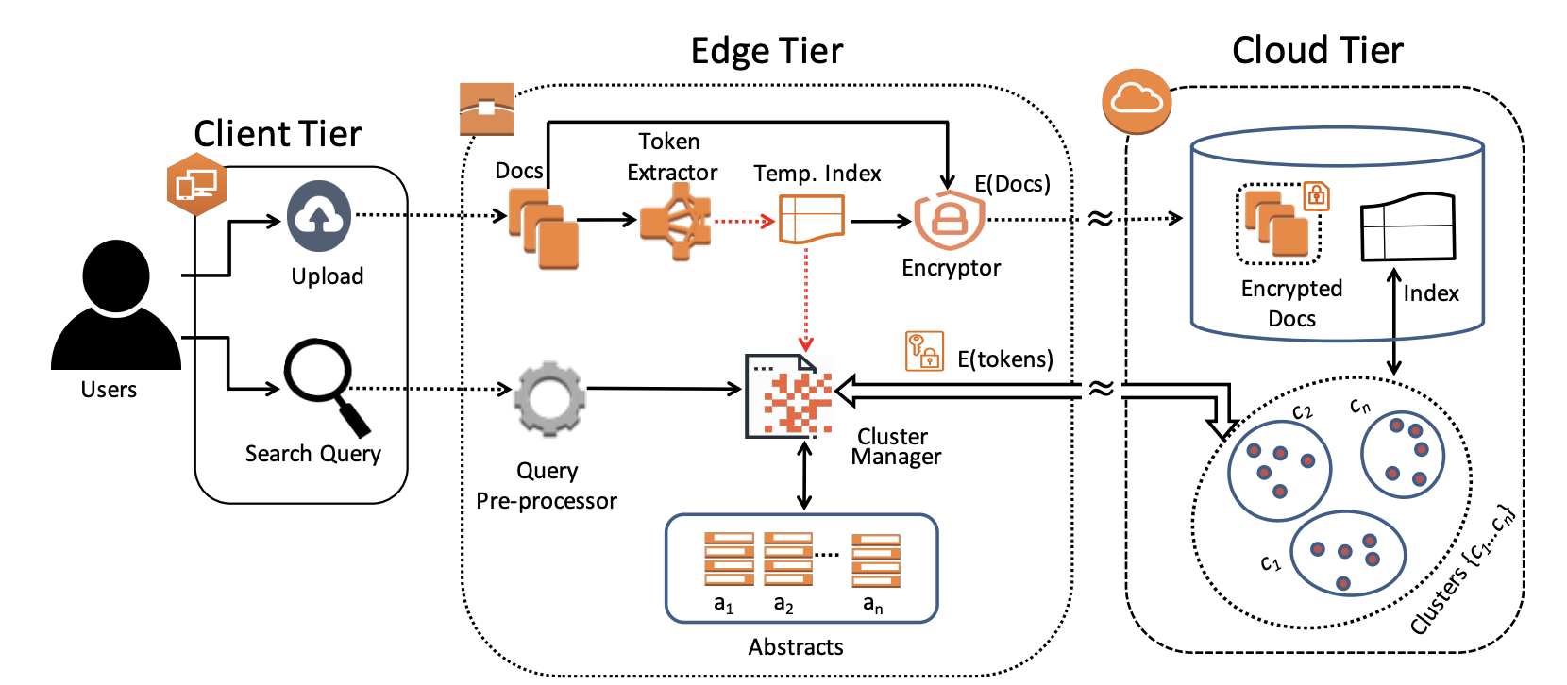
Expanding to Three-tier Architecture
Notes:
Basd on sze of temp. In. , reclstr decsn

Slide 22
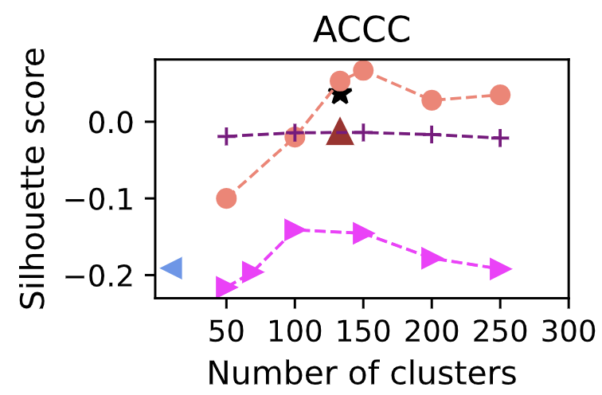
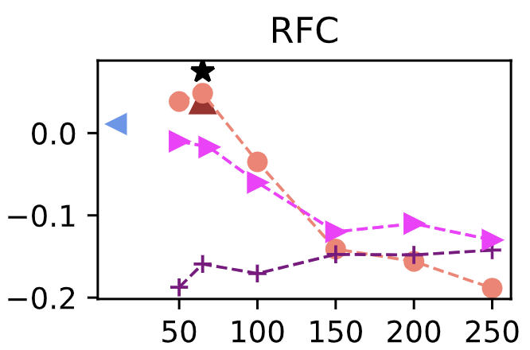
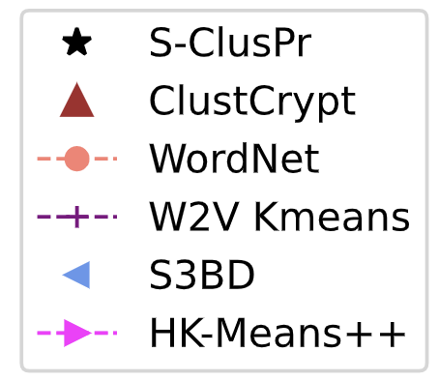
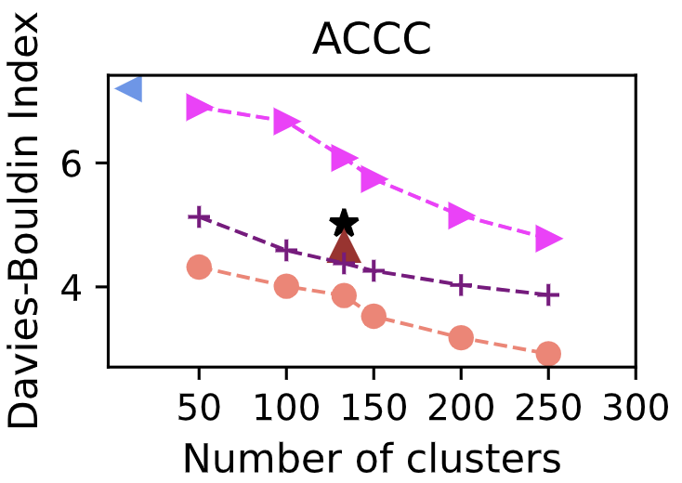
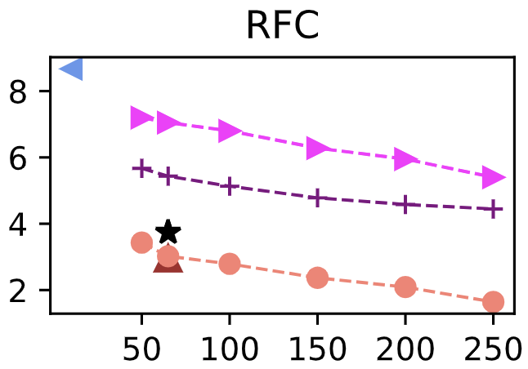
Experimental Result: Goodness of Clustering
Plain-text
Encrypted
Same no. of clusters for S-ClusPr and ClustCrypt
Top performer: WordNet
Hard to beat plain-text-based
No semantics, dictionary
S-ClusPr, yet competitive!
Outperforms all encrypted!
SS: [-1,1]
DI: [∞,0]
gg

Slide 23
ClusPr is applied with and without re-clustering
Improves coherency of clustering even for dynamic dataset
BBC:100% ; ACCC: 35%
Notes:
Update, U = < (U₁, 25), (U₂, 50), (U₃, 100), (U₄, 20), (U₅, 200) >
Intentionally larger update: U₃ and U₅
We report mean and 95% CI of the analysis

Slide 24
Summary
Perform topic-based clustering of unstructured sensitive data
Search accuracy is improved by ≈ 35%
Search time overhead is decreased by ≈ 78%

Slide 25
Publications of Contribution 1
Sm Zobaed, M A Salehi, Privacy-Preserving Clustering of Unstructured Big Data for Cloud-Based Enterprise Search Solutions, Published in Journal of Concurrency and Computation: Practice and Experience (CCPE), volume 34, issue 22, 2022.
Sm Zobaed, S Ahmad, R Gottumukkala, M A Salehi, Clustcrypt: Privacy-preserving clustering of unstructured big data in the cloud, Published in proceedings of the 21st IEEE International Conference on High Performance Computing and Communications (HPCC'19), China, 2019.
Sahan Ahmad, Sm Zobaed, R Gottumukkala, M A Salehi, Edge Computing for User-Centric Secure Search on Cloud-Based Encrypted Big Data, Published in proceedings of the 21st IEEE International Conference on High Performance Computing and Communications (HPCC'19), China, 2019.

Slide 26
Challenges in Cloud-based Confidential Computing
How to confidentially process data on cloud?
How edge-cloud systems can be leveraged for user-driven confidential data processing on cloud?
How to improve efficiency of edge systems for user-driven confidential computing?

Slide 27
Contribution2: Encrypted Search across Edge-Cloud
SAED
(Contrib. 2)
Edge-MultiAI
(Contrib. 3)
ClustCrypt
(Contrib. 1)
Device
Edge
Cloud
ClusPr
(Contrib. 1)
Notes:
Need to hide other contrib. via animation

Slide 28
Enterprise Search Service
ES2 offers retrieving data from anywhere to users
AWS Kendra offers real-time search using NLP+ ML
Provides the functionality to search application over variety of files (e.g., .txt, .rtf, .html, .docx, .pptx, and .pdf).
It indexes owner's documents directly or from your third-party repository
intelligently serves relevant information to your users.
Kendra does not
search over encrypted data
offer personalized search

Slide 29
Motivations for Encrypted Search Service
Kendra does not
search over encrypted data
offer personalized search
Adding an extension improves Fall shorts!

Slide 30
Towards Our Vision

Slide 31
Research Questions
How to search semantically over encrypted data with minimum overhead?
How to develop a trustful encrypted ES2?
Notes:
A company we are working with has a need to let cops search encrypted police reports.
Needs related crimes to not have to search for every case
Needs ranking to get to the most relevant crimes quick
Needs to use limited overhead for extended life on small device.

Slide 32
Contribution 2: Intelligence on Edge! Exhaustive Processing On Cloud!
Developed SAED:
Offers search intelligence in the form of semantic and personalization
Strictly maintains data privacy
Pluggable to existing ES2 (AWS Kendra)
Works both with encrypted and plain-text data

Slide 33
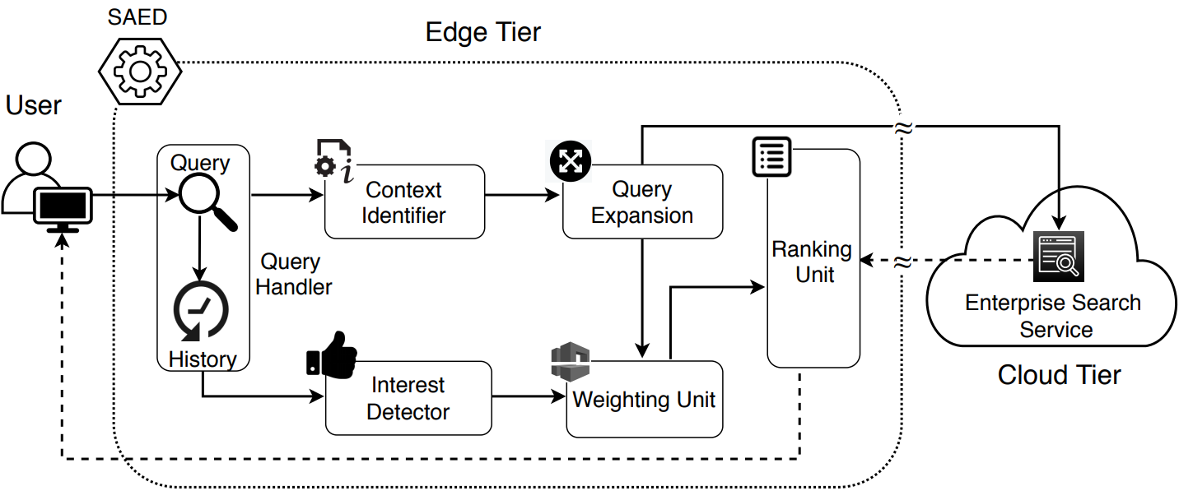
SAED: Architecture
Interface to input search query, Q
Store search history
Search interest prediction from
history data
Assign weight W.R.T query-keyword importance and interest
Identify context, C of the query (Sense detection)
Rank the retrieved result (cloud) W.R.T weighted TF-IDF
Searches with expanded query by following existing search mechanism
Add synonyms for ▽q W.R.T. C

Slide 34
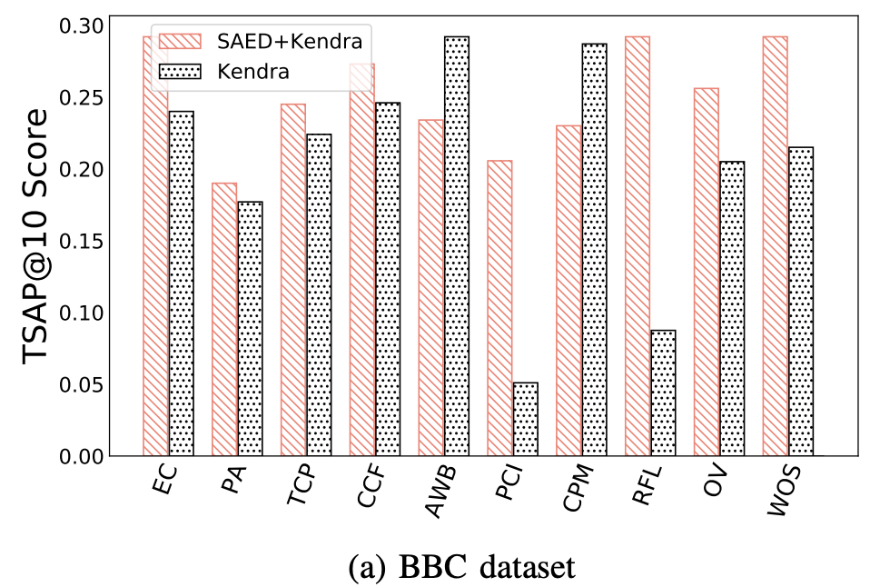
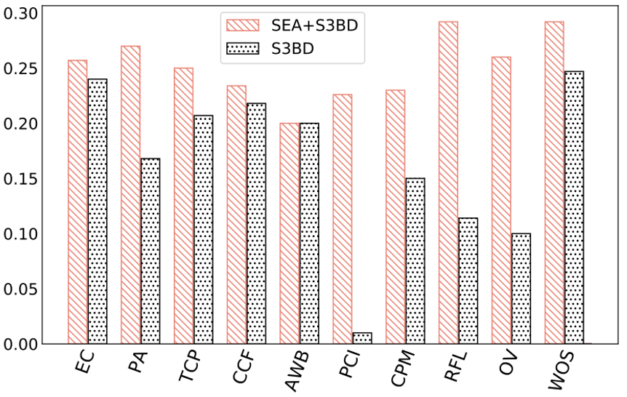
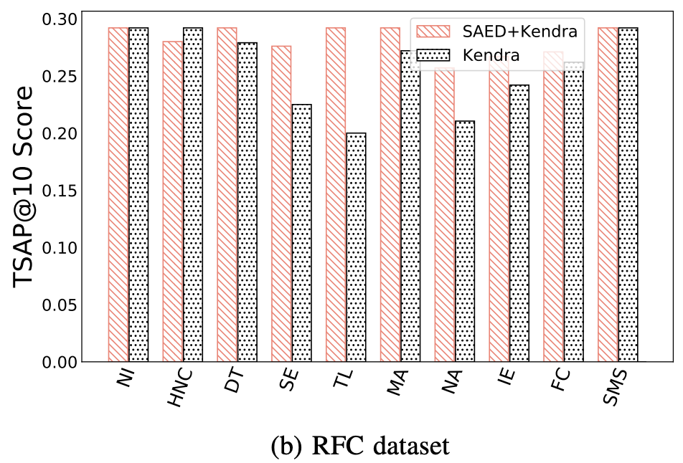
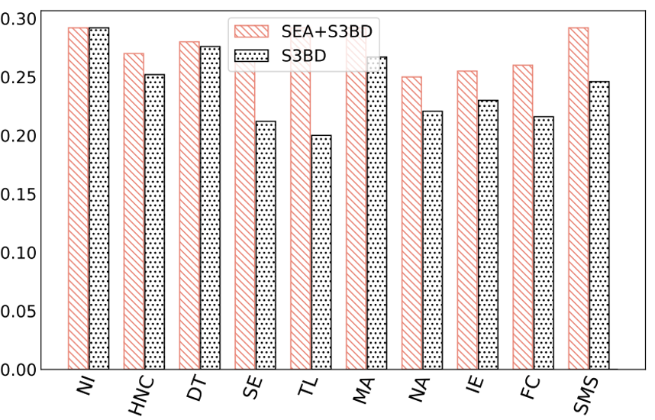
Evaluation: Search Accuracy (Plain-Text data)
Fewer exact query keywords are found
Clear accuracy improvement:
Beats Kendra!
Fig: TSAP@10: [SAED+Kendra vs Kendra] Fig: [SAED+S3BD vs S3BD]
ABOUT TSAP@10

Slide 35
Evaluation: Search Accuracy (Encrypted data)
No exact match
Fig: TSAP@10: SAED+Kendra vs AWS Kendra with encrypted data
SAED-plugged Kendra outperforms Kendra-only service by >70%
Reason?
- Kendra results in based on exact pattern matching of encrypted query

Slide 36
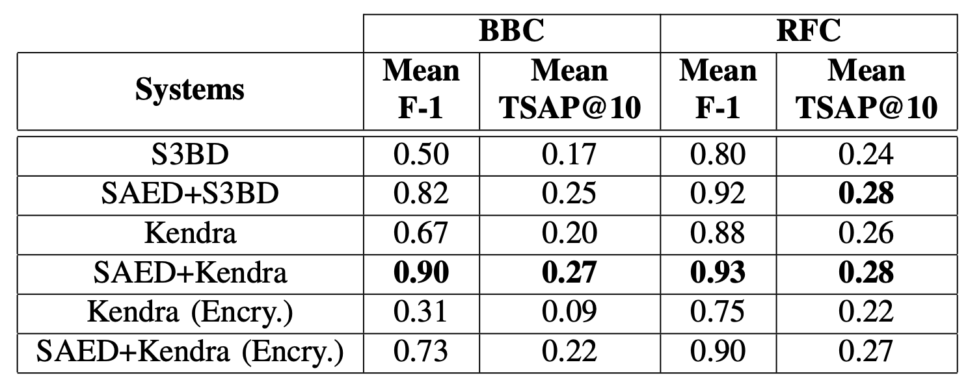
Evaluation: Overall Performance of Search Accuracy
TSAP and F1 needs to predefine
@10

Slide 37
Summary of Contribution 2
Developed context-aware, personalized, and privacy-preserving pluggable search service module
Edge tier makes SAED as a lightweight solution
Search Result
Last week Robbery
Flew with others car
Doubtful objects
Break in
Recent Robbery

Slide 38
Publication of Contribution 2
Sm Zobaed, M A Salehi, R Buyya, SAED: Edge-Based Intelligence for Privacy-Preserving Enterprise Search on the Cloud, Published in proceedings of the 21st ACM/IEEE International Conference on Cluster Cloud and Grid Computing (CCGrid ’21), Australia, 2021.
Sm Zobaed, M E Haque, M F Rabby, M A Salehi, Senspick: Sense Picking for Word Sense Disambiguation, Published in proceedings of the 15th IEEE International Conference on Semantic Computing (ICSC'21), Online, 2021.

Slide 39
Challenges in Cloud-based Confidential Computing
How to confidentially process data on cloud?
How edge-cloud systems can be leveraged for user-driven confidential data processing on cloud?
How to improve efficiency of edge systems for user-driven confidential computing?

Slide 40
Contribution 3: Improving Edge Efficiency to Host Smart Services (Edge-MultiAI)
SAED
(Contrib. 2)
Edge-MultiAI
(Contrib. 3)
ClustCrypt
(Contrib. 1)
Device
Edge
Cloud
ClusPr
(Contrib. 1)
Notes:
Need to hide other contrib. via animation

Slide 41
Motivations to Improve Edge Efficiency
Microservice-based architecture make edge exhaustive!
Causes cold-starts and interrupt execution
Rapid development of DL-apps/services targeting edge
Parallel execution on edge devices is crucial
Maintaining latency-sensitivity of one app can affect the other executions!
Model loading time affects latency-sensitive execution
Frequently used app models could be in memory

Slide 42
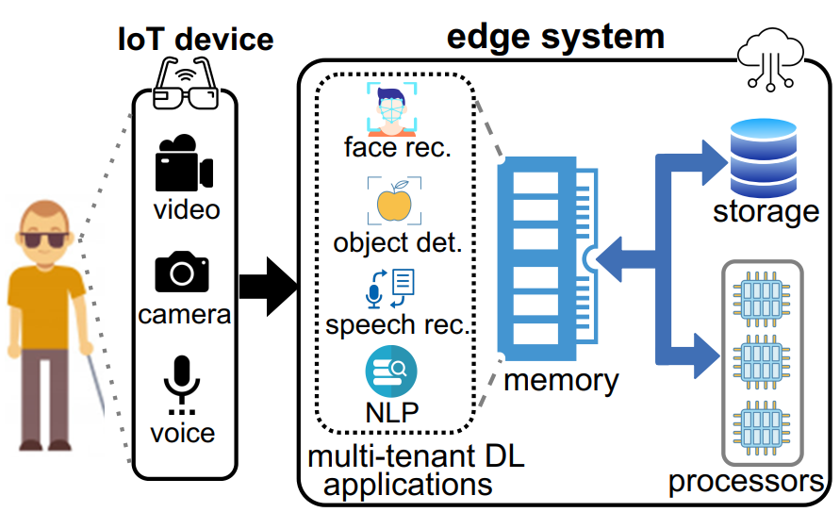
Towards Our Vision: SmartSight
SmartSight: IoT-based system that
continuously receives various inputs from smartglass
processes them via multi-tenant DL applications running on edge

Slide 43
Hypothesis Towards Solution
Model compression and optimally managing edge memory enhance the multi-tenancy with minimal impact.

Slide 44
Problem Statement
How to maximize warm-start inferences for multi-tenant DL apps execution with maximum accuracy on edge?

Slide 45
Objective function
Minimizing cold-start
Maximizing warm-start
Preliminaries:
$M^{∗}$-> currently loaded NN models
S-> occupied memory
$C_{i}{(M}^{∗},t)$ -> cold start in${ A}_{i}$
${\text{χ}}_{i }^{∗}$-> inference acc. of ${ A}_{i}$
Notes:
Cold start-> when there is no available model in memory

Slide 46
Contribution 3: Model Management Framework (Edge-MultiAI)
Proposed Edge-MultiAI
An edge-friendly framework to support multi-tenant execution
Dynamically loads the high-precision model for current execution request
Proposed heuristics as model eviction policy (iWS-BFE)
Selecting suitable model for application performing inference
Decision of memory allocation for it
Notes:
Iws-bfe- Intell. Warm-st aware- best fit evict.

Slide 47
Architecture: Edge-MultiAI

Slide 48
How to Allocate space for Execution?
To prevent cold-start for $A_{i}$that is predicted to perform inference at t
→NN model has to be loaded at time ($t_{i}$ − ∆ − ${\text{θ}}_{i}$) and kept in memory until ($t_{i}$ − ∆)
minimal state
maximal state
To load$M_{i}^{j}$in memory:
Not considered apps that are in maximal state)
Provide score to select minimal state applications
$r_{j}$
the probability of occurring during current request window
Notes:
∆ is obtained from profiling past request predictions and calculating the mean difference of actual arrival time and the predicted ones across all applications.
Solid lines expresses the event that has already happened and dashed lines after “now” are the request predictions.
Not consider -> maximal state
rj denote an unexpected request

Slide 49
Benchmarks for Experiments

Slide 50
Experiment: Degree of Multi-tenancy

Slide 51
Experiments: Cold-start Inferences

Slide 52
Experiments: Inference Accuracy

Slide 53
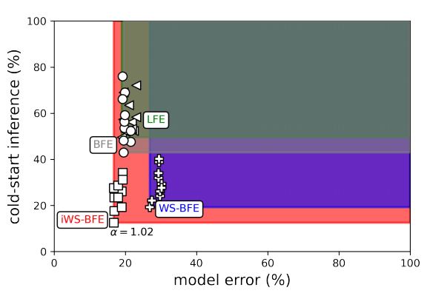
Experiment: Bi-Objective Analysis
Notes:
WS-BFE intelligent heurists perform better
We show the efficiency of our heuristic

Slide 54
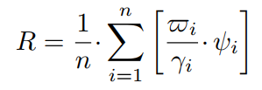
Experiment: Robustness Against Uncertainty
tot. warm start inference
mean pred. acc.
tot. request
Notes:
ratio of warm start inferences (denoted VARPI ϖi) to the total number of requests (denoted GAMMA γi), and the mean prediction accuracy (PSI ψi) of each application i throughout the simulation period

Slide 55
Summary
Accelerates multi-tenant DL executions without compromising latency & accuracy
Provides 2x multi-tenancy and 60% more warm-start inferences
Implemented a simulator to support future research

Slide 56
Publications of Contribution 3
Sm Zobaed, Ali Mokhtari, Jaya Prakash Champati†, Mathieu Kourouma, Mohsen Amini Salehi, Edge-MultiAI: Multi-Tenancy of Latency-Sensitive Deep Learning Applications on Edge, Accepted in proceedings of the 15th ACM/IEEE International Conference on Utility and Cloud Computing (UCC’22), USA, 2022.
Sm Zobaed, M A Salehi, Big Data in the Cloud published in Encyclopedia of Big data, Springer, ISBN: 978-3-319-32009-0.
Sm Zobaed, M A Salehi, A Survey on Confidential Computing over Edge to Cloud Continuum, [submission preparation].

Slide 57
Conclusion
Secure access to third-party cloud services
Maintain trust throughout Edge-to-Cloud continuum
Attack surface does not impact secure processing
We proposed solutions for privacy-preserving clustering of encrypted indexed data in the cloud
We proposed encrypted search service that overcomes privacy by separating intelligence aspect from pattern matching
We proposed model management framework for edge-friendly executions
Aims to maximize multi-tenancy
Notes:
intelligence aspect of search from its pattern matching

Slide 58
Future Work
Introducing elasticity in confidential search
Bare minimum search intelligence in absence of edge
Inclusion of energy in model management heuristics
Current bi-objective (latency vs. cold-start) does not consider energy
Expansion of bi-objective optimization to tri-objective!
Active Learning in on-premise edge
Classifier from clusters
Notes:
AL for increasing use-cases (supervised)

Slide 59
THANK YOU

Slide 60
Photo by: Emily Morter

Slide 61
BACK UP SLIDES

Slide 62
Probability of Unexpected request

Slide 63
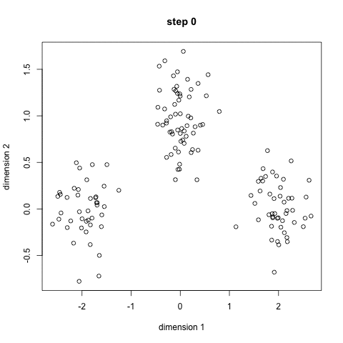
Background: Clustering Steps
Initializing number of centroids
Choosing random centroids from index
Compute distance between encrypted terms
Stop when centers will not be shifted
63

Slide 64
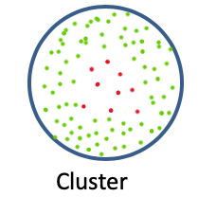
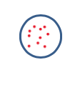
Background: Creating Abstracts from Clusters
Abstracts: Summary version of each cluster
Send abstract to the client
Abstracts enable searching on a subset of clusters
Abstract
Notes:
based on query relevance

Slide 65
Clustering Encrypted Data
Clustering requires to specify no. of clusters (k)
Always keeping same no. affects clustering
Need to estimate clusters based on data characteristics
The cluster sizes can vary significantly.
Provides identical search time
Hampers clusters’ coherency
Need to cluster terms topically regardless cluster size
Notes:
Clustering requires to specify no. of clusters (k) statically to initiate clustering (e.g, k-Means, S3BD).

Slide 66
A Typical Encrypted Search System Architecture Integrating Clustering
User
Client Tier
Cloud Tier
Documents
Encryption Engine
Storage
Central Index
Search Query
Uploads
Abstract Form
Of Clusters
Clusters {c₁…c_{n}}
c₂
c_{n}
Key Phrase
Extractor
c₁
66

Slide 67
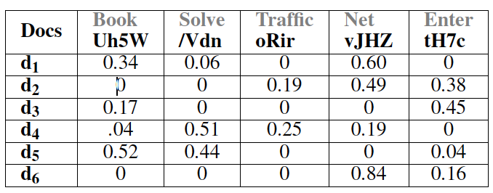
Estimate no. of Clusters (k) of a Dataset
Build Term-Document Frequency Matrix M from index
Generate normalized matrix N from M
Calculate the importance (τ_{ij}) of term t_{i} to document d_{i} and build R matrix
Calculate the importance of d_{j} for t_{i}, denoted by δ_{ji} and build S matrix

Slide 68
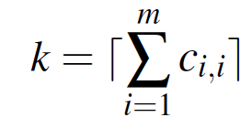
Estimate no. of Clusters (k) of a Dataset (cont.)
5. Determine no. of Clusters:
Multiply R and S to create C Matrix
C -> Term-Term relationship matrix
C_{ii} represents the separation factor of each term
Summation of C_{ii} can approximate the number of clusters (k)

Slide 69
Determining Clusters’ Centers
Calculate uniqueness ⍵_{i} for each term
Choose K cluster center based on their centrality Φ_{i}
Insert each (i, Φ_{i}) pair in a max -heap
Extract K pairs from the heap
Notes:
For a dataset with n data points, k clusters, I iterations, and m attributes, the time complexity of k-means is O(n×k×I ×m), which is not scalable for big data [1], [33]. In contrast, after determining k, ClustCrypt populates clusters by achieving the two following steps. First, from the set of data points, we find appropriate centers for each cluster and assign each token to proper cluster. The overall time complexity of the two steps is O(n 2 ).

Slide 70
Clustering Terms
To cluster a term t, we calculate relatedness of t with center ϒ
Relatedness is obtained by multiplying two factors.
Contribution
Co-occurrences
Relatedness
Contribution
Co-occurrences

Slide 71
How to Update Semi-dynamic Clusters
New inputs could impact the clusters’ topic
Pearson’s χ² testing to determine high input
H₀ -> “Need to keep the existing cluster”
H₀ is rejected, if diff (# new, #existing) files is not significant
Existing clusters can be kept or deleted
Use or Perform re-cluster by following static approach
Notes:
Pearson's chi-squared test is used to determine whether there is a statistically significant difference between the expected frequencies and the observed frequencies in one or more categories of a contingency table. Rejected if (P<0.05)

Slide 72
Datasets and Baseline Methods
Amazon Common Corpus Crawl (ACCC)
Size: 500 GB of docs (subset of 150 TB)
Characteristics: Not domain specific-different web contents
Request For Comments (RFC)
Size: 247 MB
Characteristics: Domain specific-internet & comm. Network
BBC
Size: 5MB
Characteristics: Not domain specific
Baseline methods from literature:
Plain-text: Wordnet, W2V KMeans,
Encrypted: HK-Means++, S3BD
Notes:
Pearson's chi-squared test is used to determine whether there is a statistically significant difference between the expected frequencies and the observed frequencies in one or more categories of a contingency table.

Slide 73
Benchmark Queries

Slide 74
Appendix-How to calculate Uniqueness
Let ω a token, I_{ω} the set of docs associated with ω, U the set of documents current centroids have appeared in
$\text{Ω}\text{ω}=\frac{\text{|}\text{I}\text{ω}\text{ \backslash } \text{U}\text{|}}{\text{|}\text{I}\text{ω}\text{∩} \text{U}\text{|}}$
Choose ω as a centroid, no. of documents unique to I_{ω} must be more than the no. of documents in the intersection of I_{ω} and U

Slide 75
Appendix: Contribution-co-occurrence
Let t be a token in document d of dataset D with frequency denoted as f(t,d). Then, contribution of d to t, denoted as κ(d,t), is defined:
κ(d,t) = $\frac{\text{f}\text{(}\text{t}\text{,}\text{d}\text{)}}{\sum_{\text{j}\text{∈}\text{D}}{\text{f}\text{(}\text{t}\text{, }\text{j}\text{)}}}$
Co-occurrence of t with center γ_{x} in d (denoted ρ(t,d, γx)) is defined as a ratio of sum of frequencies of t and γ_{x} in d to the total frequencies of t and γ_{x} throughout the dataset.
ρ(t,d, γ_{x}) $=\frac{\text{f}\text{(}\text{t}\text{,}\text{d}\text{) + }\text{f}\text{(}\text{γ}\text{x}\text{,}\text{d}\text{)}}{\sum_{\text{j}\text{∈}\text{D}}{\text{(}\text{f}\text{(}\text{t}\text{, }\text{j}\text{) + }\text{f}\text{(}\text{γ}\text{x}\text{, }\text{j}\text{))}}}$

Slide 76
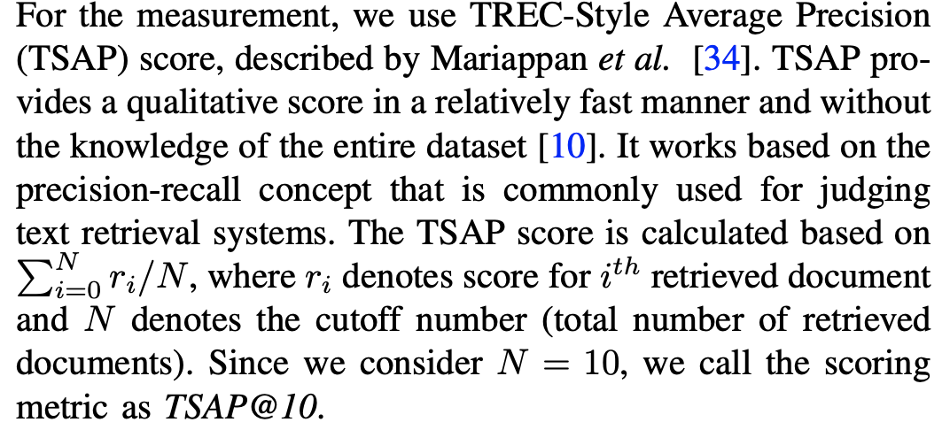
Appendix-TSAP@10

Slide 77
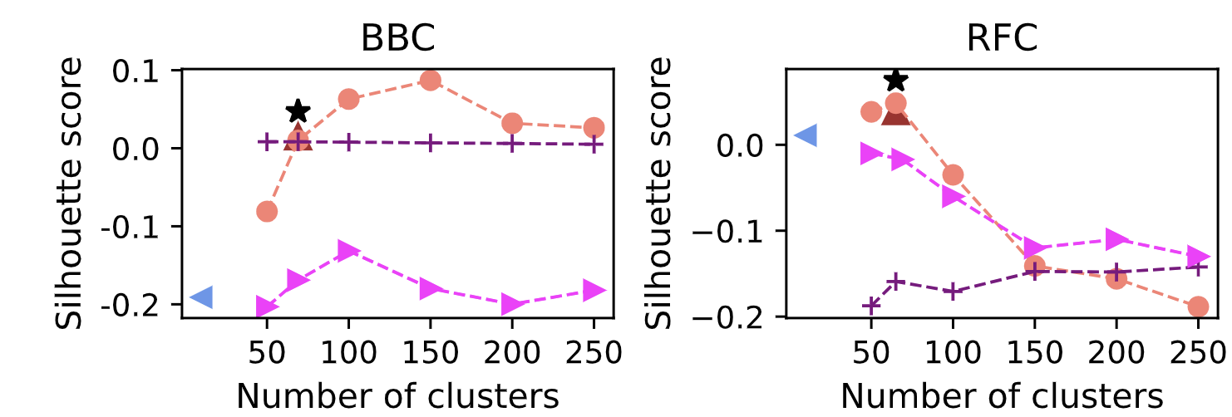
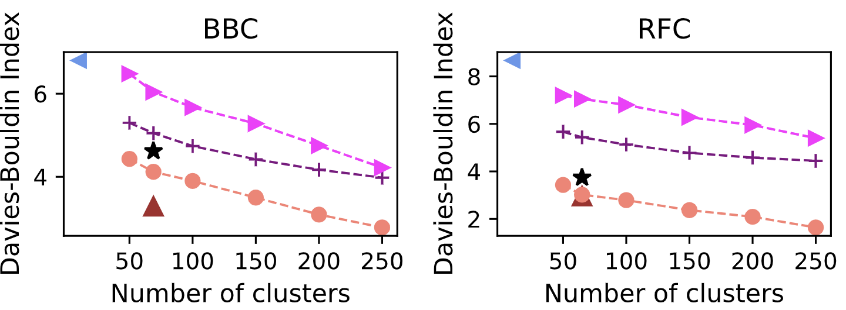
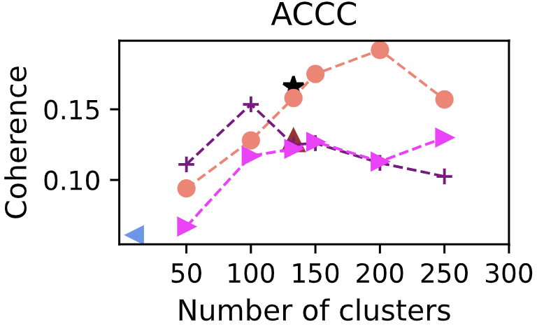
Appendix-Experimental Result: Goodness of Clustering
SS: [-1,1]
DI: [∞,0]
CS: [0,1]
Notes:
Hard to beat unencrypted approach
No usage of dictionary
No semantics!

Slide 78
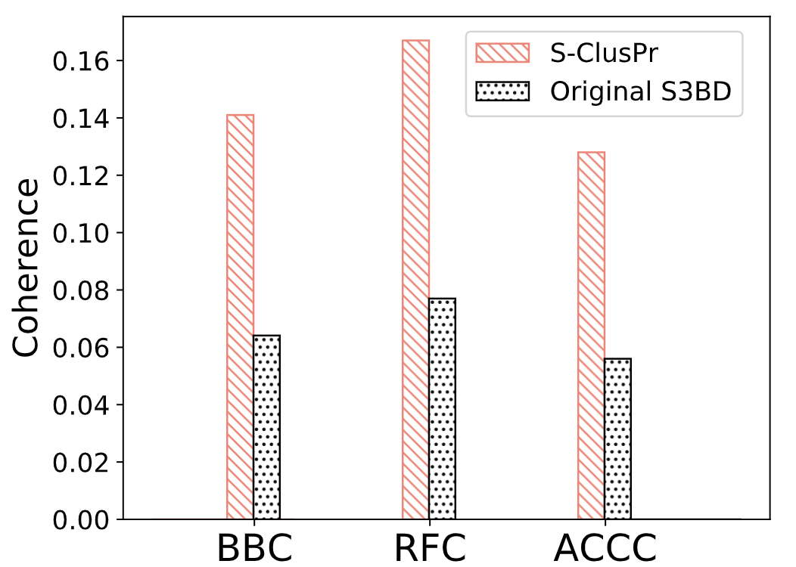
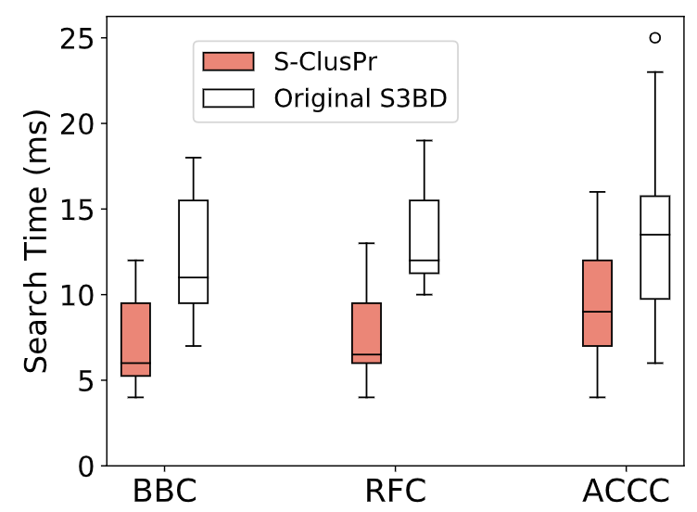
Evaluating Coherency, Search Relevancy, and Search Time
Fig: Coherency Comparison
Fig: Search time Comparison
Outperforms traditional (S3BD) approach
2X Coherence improvement
Search time overhead is decreased by 75%

Slide 79
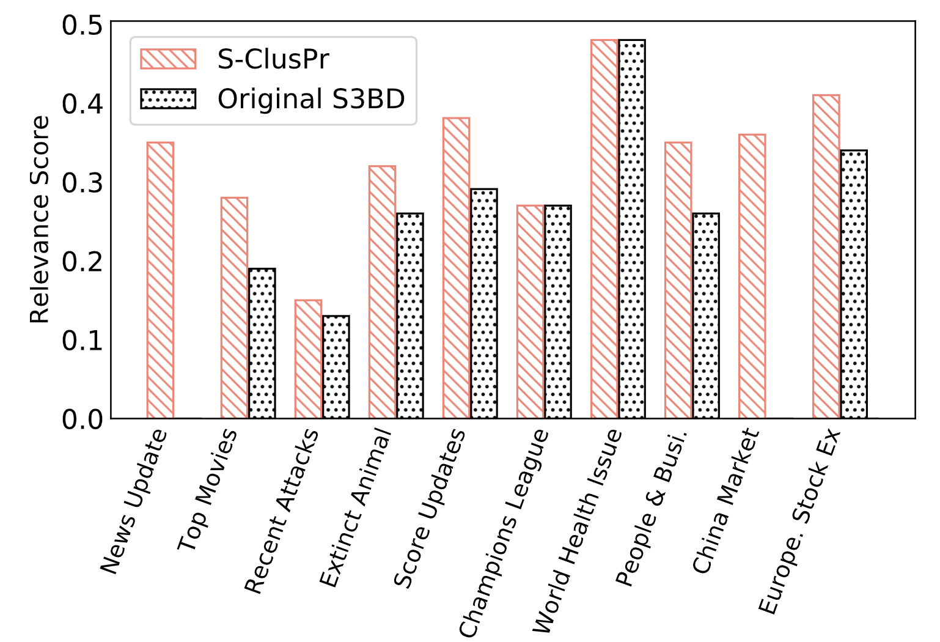
Appendix-Evaluating Coherency, Search Relevancy, and Search Time
Outperforms traditional approach
Improves search accuracy up to 35%
Leads to accurate and relevant semantic search results on encrypted unstructured data
Fig: Search relevancy comparison (based on TSAP@10)

Slide 80
Appendix-Similarity Score
Use W2V 300d mode for representation
Cosine similarity and provides the score (−1 ≤ similarity score ≤ 1) for any two given tokens.

Slide 81
Appendix-CI

Slide 82
Objective Func Ext.

Slide 83
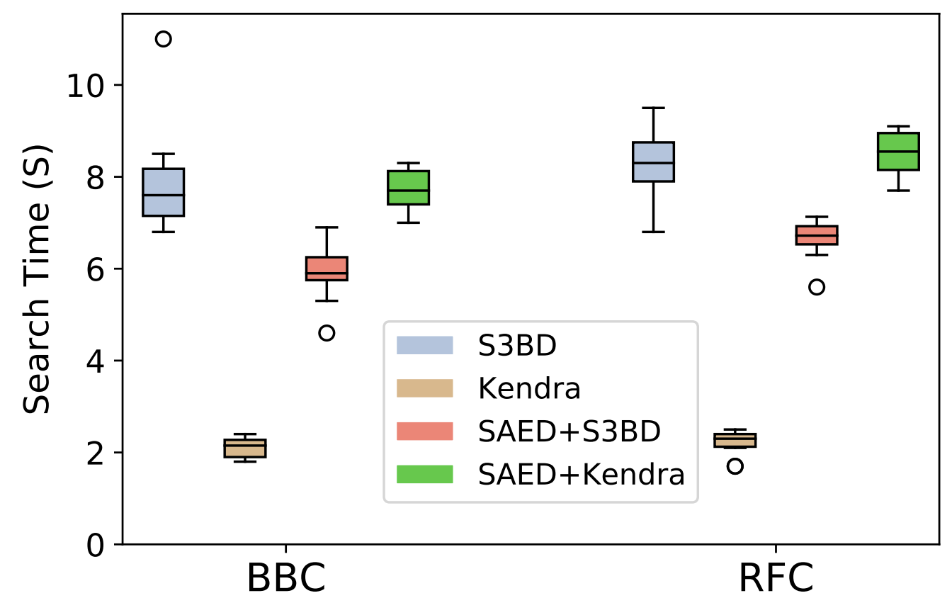
Appendix-Evaluation Search Time Overhead
SAED+Kendra causes 4X more time overhead than original Kendra
Reason?
- Query Processing + weighting + re-ranking time

Slide 84
Appendix- Estimate no. of Clusters (k) of a Dataset (cont.)
5. Determine no. of Clusters:
Multiply R and S to create C Matrix
C -> Term-Term relationship matrix
C_{ii} represents the separation factor of each term
Summation of C_{ii} can approximate the number of clusters (k)

