Slide 2
High Performance On-Demand Video Transcoding Using Cloud Services
Xiangbo Li
Dr. Magdy A. Bayoumi (Advisor)
Dr. Mohsen A. Salehi (Co-Advisor)

Slide 3
Agenda
What is Video Transcoding?
Why “on-demand” video transcoding?
What are the challenges in on-demand video transcoding?
What have already been done by others?
What aspects does my thesis focus on?
What are the future directions?

Slide 4
Video Transcoding

Slide 5
Video Streams
Streaming Providers
Client Devices

Slide 6
Video Streaming Services

Slide 7
Cloud-based
Video Transcoding
Notes:
200+ devices, millions subscribers

Slide 8
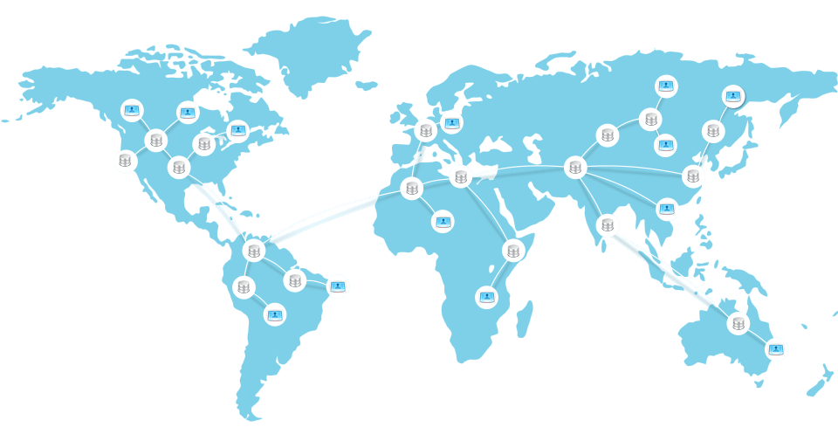
Video
Contents
Streaming
Service
Providers
Content Delivery Network (CDN)
Viewer Devices
Notes:
200+ devices, millions subscribers

Slide 9
Video Streams
Streaming Providers
Client Devices

Slide 10
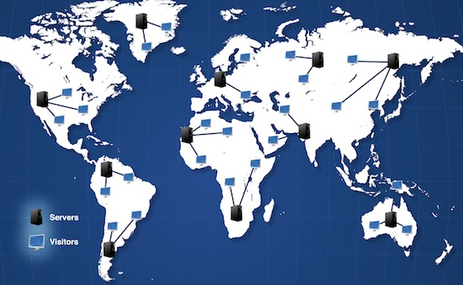
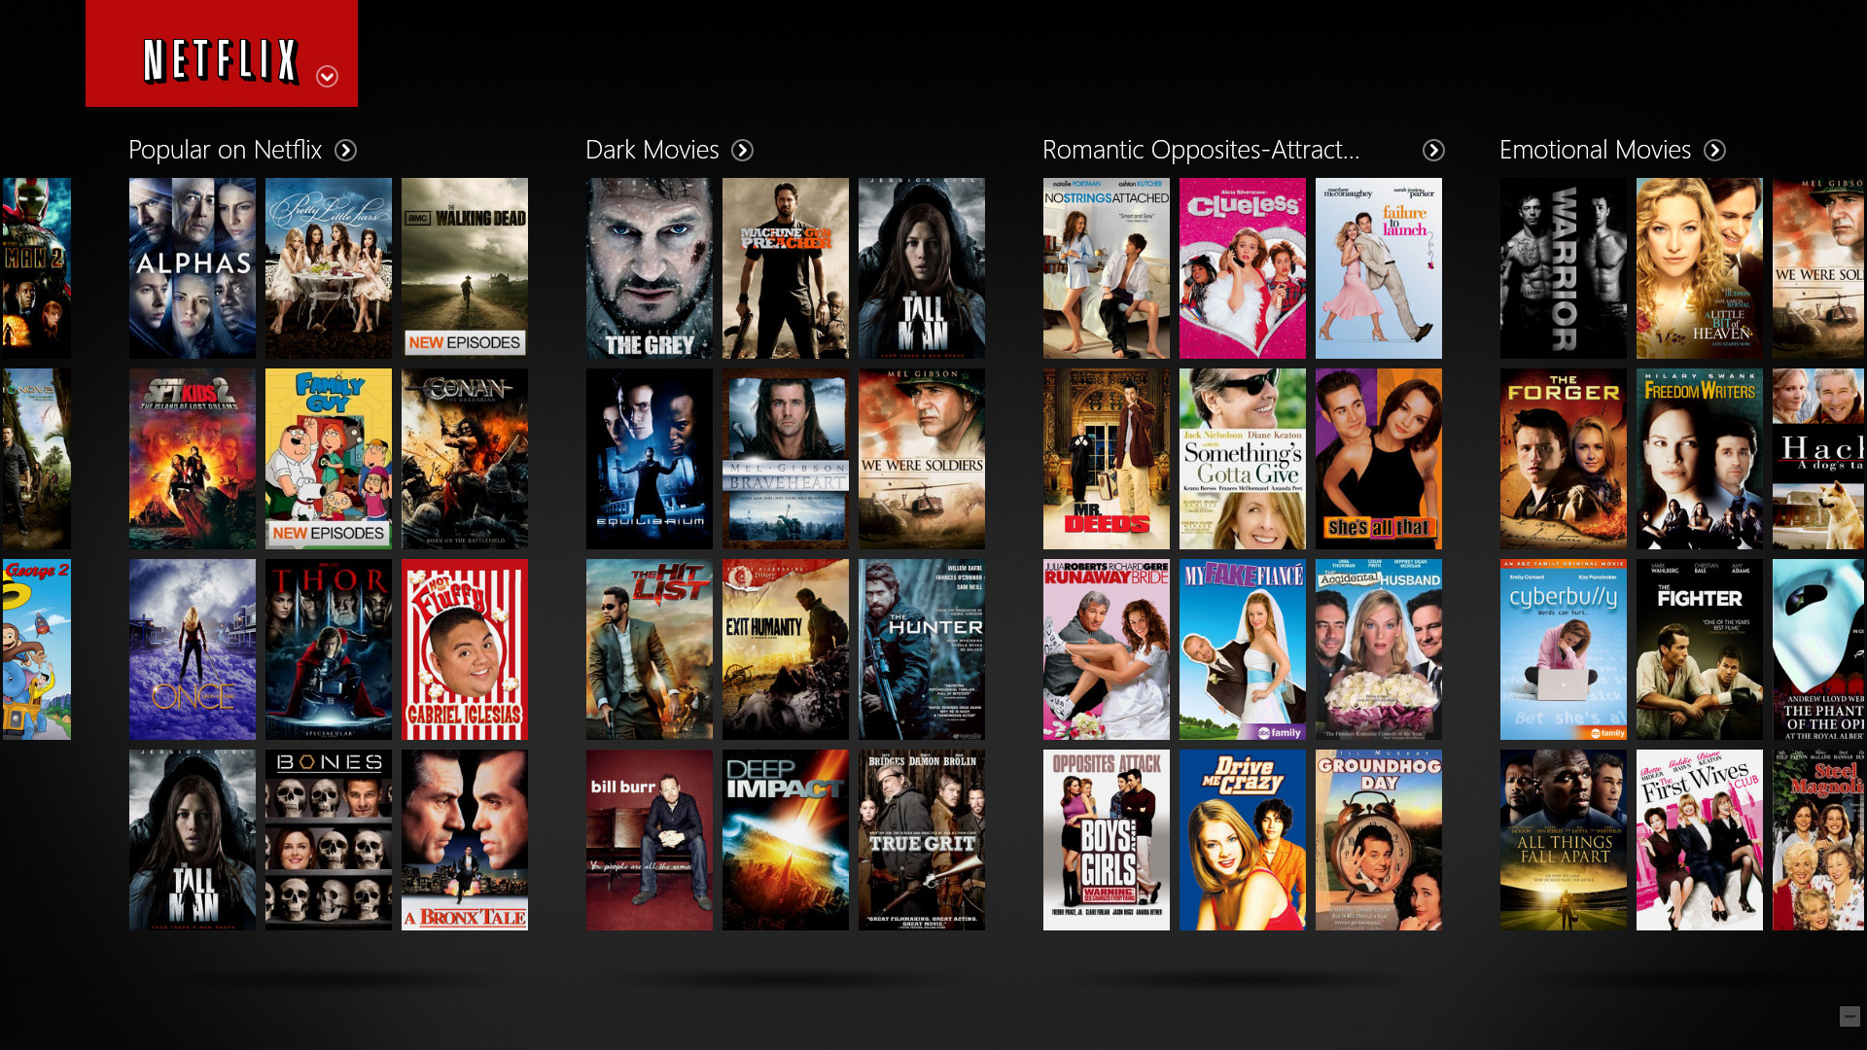
Client Reqest
Content Delivery Network (CDN)
Netflix Server

Slide 11
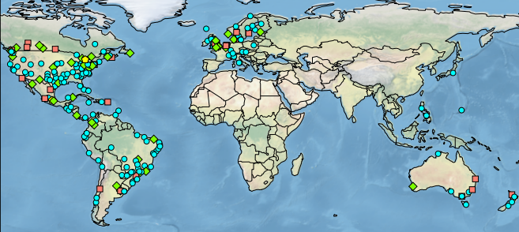
Netflix Solution
4 formats supported
1 VC, 3 H.264
Multiple bit rate per format
40-50 versions of the original video
Several petabytes of storage

Slide 12
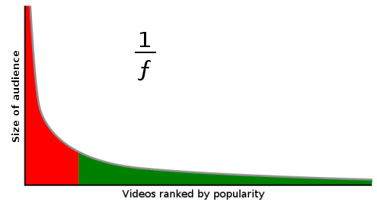
Long Tail Property of Video Streaming
Trendy videos

Slide 13
Why not transcode them on-demand?

Slide 14
Questions
What is Video Transcoding?
Why “on-demand” video transcoding?
What are the challenges in on-demand video transcoding?
What have already been done by others?
What aspects does my thesis focus on?
What are the future directions?

Slide 16
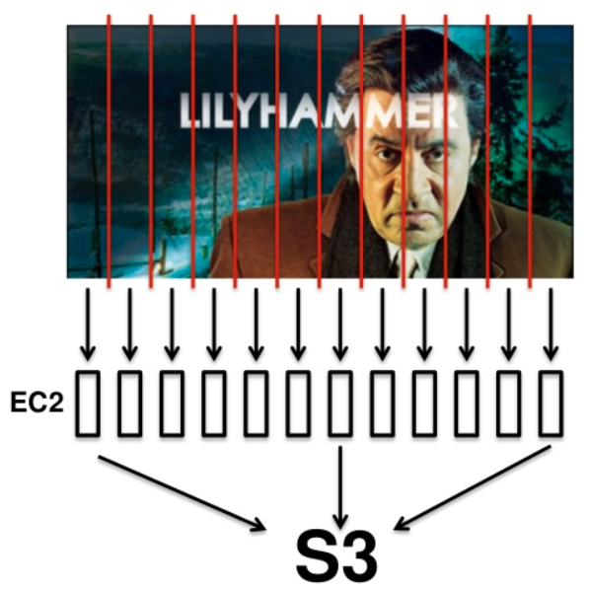
Video Transcoding is Time-Consuming
It takes days to transcode
It only takes hours/minutes

Slide 17
Virtual Machines are Heterogeneous
Compute-Optimized
General Purpose
Micro Instances
Memory-Optimized
Storage-Optimized
GPU Instances

Slide 18
On-Demand Video Transcoding Challenges
Improve Quality of Service (QoS)?
Startup delay
Deadline miss rate
Minimize Cloud Resource Cost
Computing cost
Storage cost

Slide 19
Questions
What is Video Transcoding?
Why “on-demand” video transcoding?
What are the challenges in on-demand video transcoding?
What have already been done by others?
What aspects does my thesis focus on?
What are the future directions?

Slide 20
Video Transcoding on the Cloud
Video On Demand (VOD)
Live Streaming
Pre-Transcoding
On-Demand Video Transcoding
Video Segmentation
[1][2]
Load Balance
[3][4]
Resource Provisioning
[4][6]
Storage and Computation Trade-off [7]
QoS Violation
Resource Provisioning
Homogeneous Cloud
Heterogeneous Cloud

Slide 21
Video Transcoding on the Cloud
Video On Demand (VOD)
Live Streaming
Pre-Transcoding
On-Demand Video Transcoding
Video Segmentation
[1][2]
Load Balance
[3][4]
Resource Provisioning
[4][6]
Storage and Computation Trade-off [7]
QoS Violation
Resource Provisioning
Homogeneous Cloud
Heterogeneous Cloud

Slide 22
Questions
What is Video Transcoding?
Why “on-demand” video transcoding?
What are the challenges in on-demand video transcoding?
What have already been done by others?
What aspects does my thesis focus on?
What are the future directions?

Slide 23
Thesis Contributions
QoS-aware On-Demand Video Transcoding Using Homogeneous Cloud Services
Performance Analysis and Modeling of Video Transcoding Using Heterogeneous Cloud Services
Cost-Efficient On-Demand Video Transcoding Using Heterogeneous Cloud Services
Live Streaming Video Transcoding Using Cloud Services

Slide 24
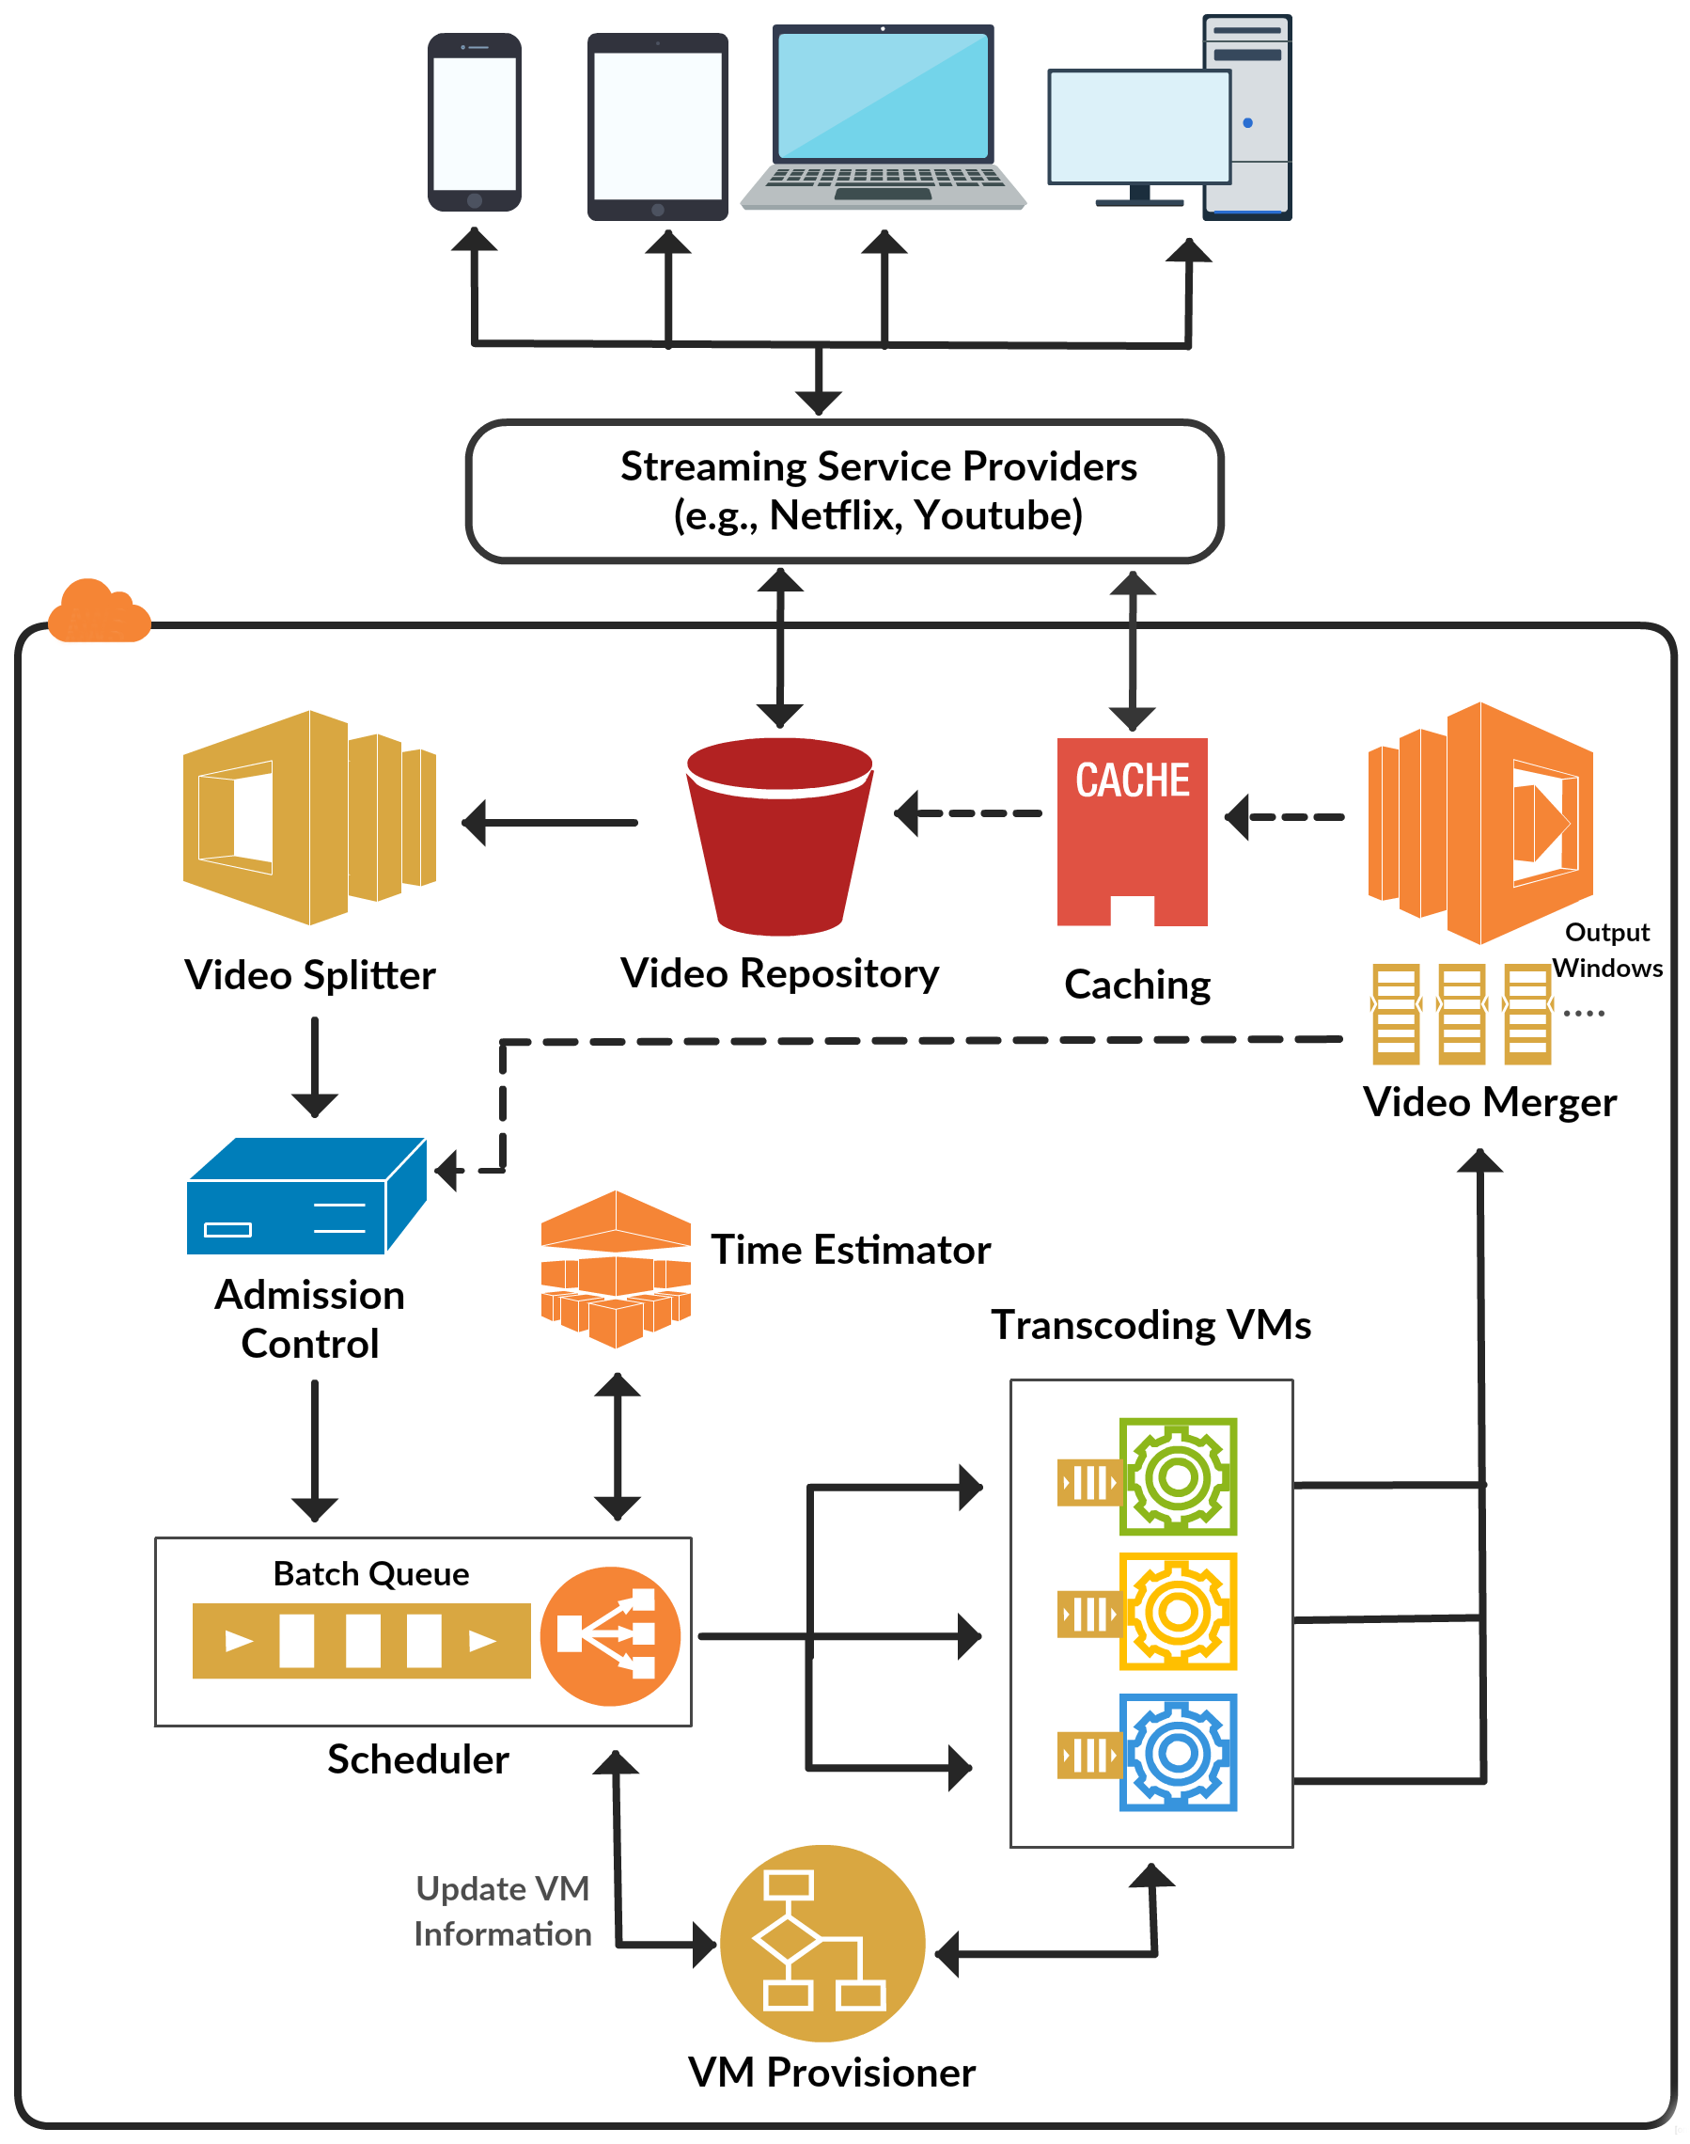
CVSS: Cloud-based Video Streaming Service Architecture

Slide 25
QoS-Aware On-Demand Video Transcoding Using Homogeneous Cloud Services
Contribution 1

Slide 26
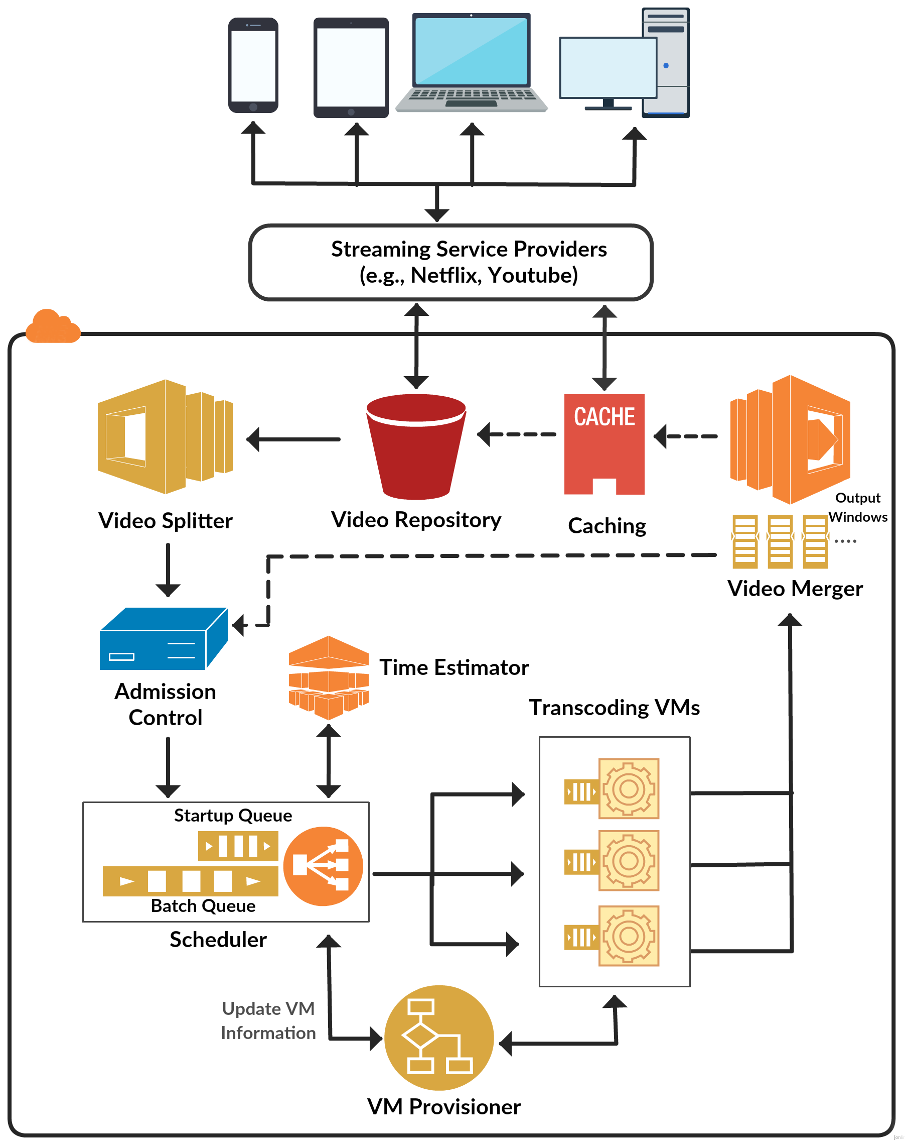
Video Segmentation and Transcoding Tool
QoS-Aware Scheduling Method
Dynamic cost-efficient provisioning policy

Slide 27
How to Segment Video?

Slide 28
Video Stream Architecture
Seq 1
Seq 2
Seq 3
Seq 4
Seq 5
Seq Header
GOP 1
GOP 2
GOP 3
…..
…..
GOP Header
I
P
P
B
P
Macroblock (MB)

Slide 29
Video Segmentation and Transcoding Tool
Split Video into GOPs
Perform Transcoding
Obtain Metadata
GOP transcoding time
GOP presentation time
GOP frame number
GOP input size
GOP output size

Slide 30
On-Demand Video Transcoding Challenges
Improve Quality of Service (QoS)?
Startup delay
Deadline miss rate
Minimize Cloud Resource Cost
Computing cost
Storage cost

Slide 31
QoS-Aware Scheduling Method
G_{video#,GOP#}
VM1
Startup Queue
G_{4,1}
G_{4,0}
…..
15s
VM2
…..
G_{1,9}
G_{2,6}
G_{4,4}
G_{3,4}
G_{2,5}
G_{1,8}
10s
Batch Queue
VM3
20s

Slide 32
On-Demand Video Transcoding Challenges
Improve Quality of Service (QoS)?
Startup delay
Deadline miss rate
Minimize Cloud Resource Cost
Computing cost
Storage cost

Slide 33
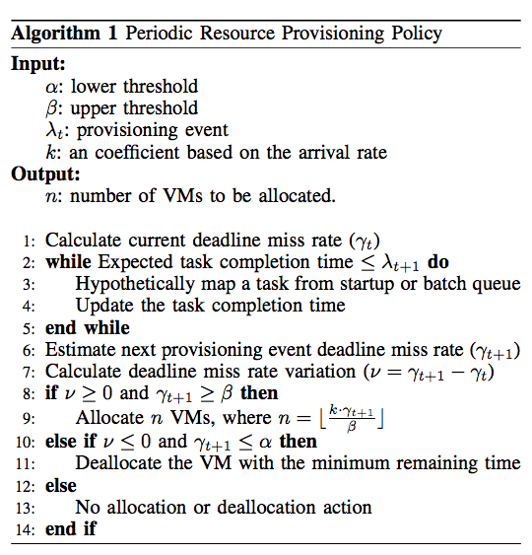
Dynamic Cost-Efficient Provisioning Policy
User define QoS violation tolerance
Predict deadline miss rate
Allocate/Deallocate VMs based on predicted deadline miss rate

Slide 34
Remedial Provisioning Policy
Startup Queue
G_{7,0}
G_{6,0}
G_{5,0}
G_{4,1}
G_{4,0}
Video number in the startup queue
…..
…..
…..
G_{1,9}
G_{2,6}
G_{4,4}
G_{3,4}
G_{2,5}
G_{1,8}
Batch Queue
Constant factor
QoS violation upper thredshold

Slide 35
Experiment Setup
We modeled our system based on the characteristics of VMs in Amazon EC2
Using CloudSim to model our system and evaluate the performance of scheduling and resource provisioning policies.
We uniformly selected videos from the range of [10 , 600] seconds from a set of benchmark videos which can be downloaded from https://goo.gl/TE5iJ5

Slide 36
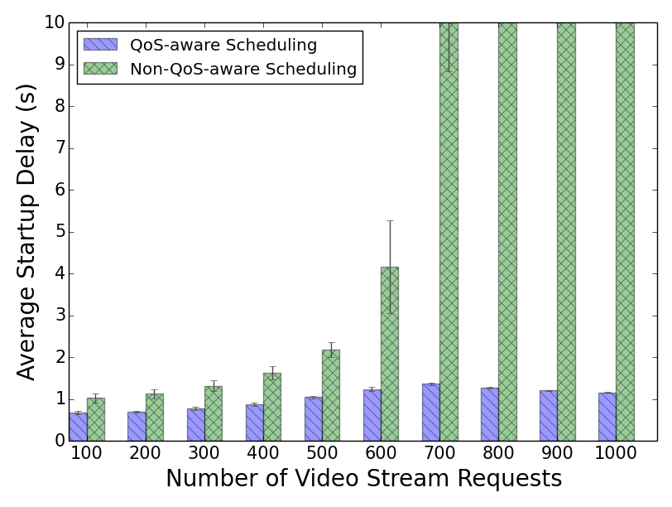
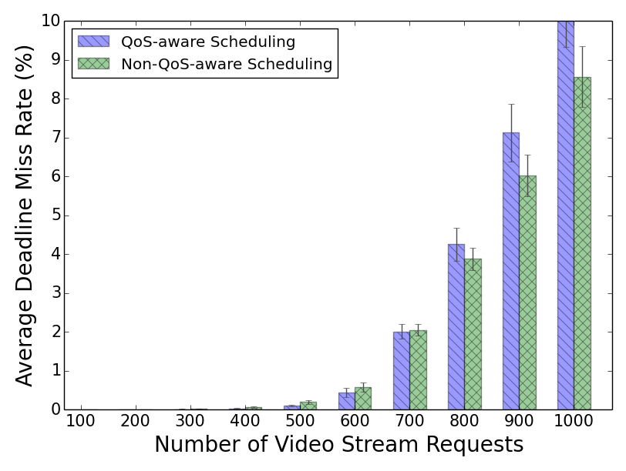
Performance Evaluation
Minimized startup delay without major impact on deadline miss rate

Slide 37
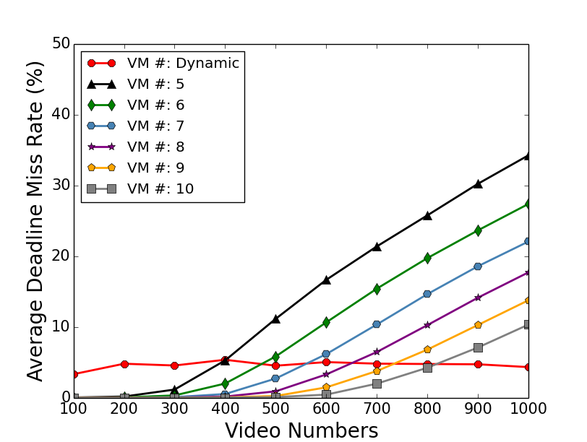
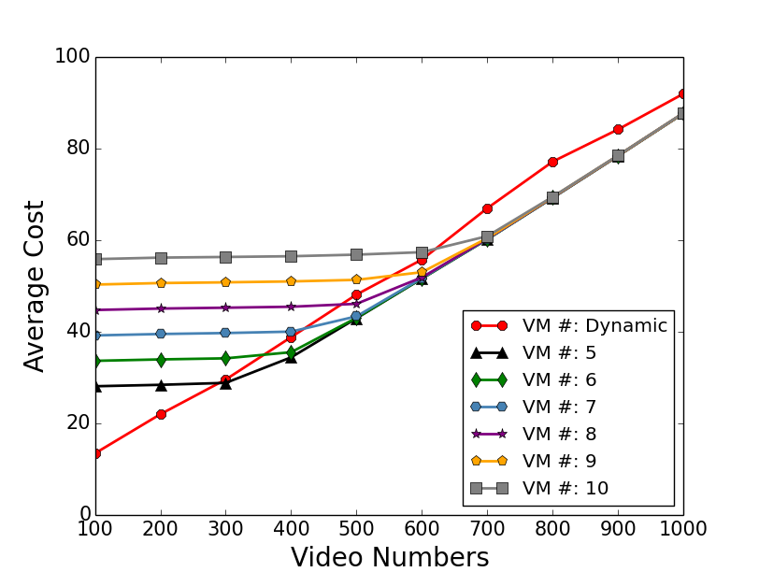
Static vs. Dynamic
Our dynamic system keeps the QoS
violation constantly low and Stable
in compare with static method.
Our method save the cost when
the system is not oversubscribed.
Notes:
We have run all transcoding operations on Amazon EC2 to get the real transcoding data, and then we use these data to simulate on CloudSim.
Our dynamic system keeps the QoS violation constantly low and stable in compare with static method
Our method save cost when the system is not oversubscribed.

Slide 38
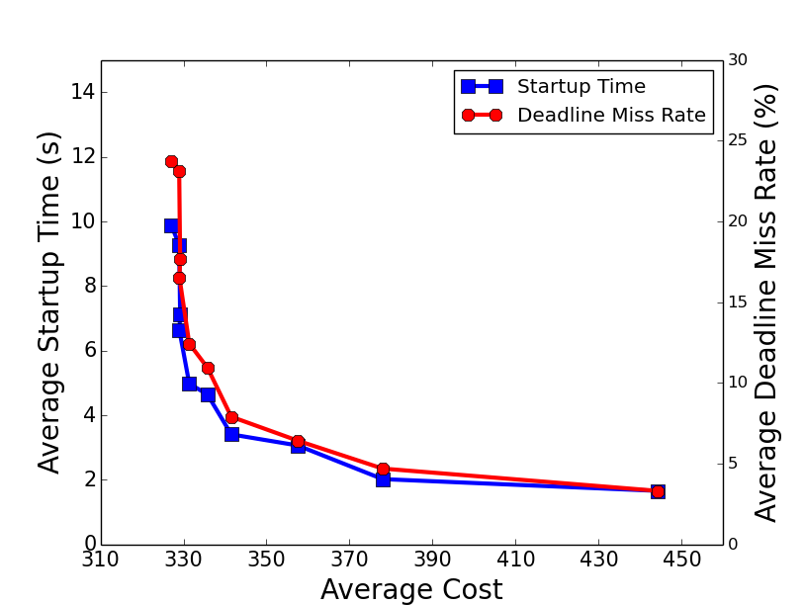
At some point, streaming service providers can pay reasonable
price to gain good QoS.
Notes:
The correlation between cost and QoS is not linear, that means at some point with our system, streaming service provider can pay low price to get good QoS.

Slide 39
Publications
Xiangbo Li, Mohsen Amini Salehi, Magdy Bayoumi, Rajkumar Buyya, “CVSS: A Cost-Efficient and QoS-Aware Video Streaming Using Cloud Services”, in the IEEE/ACM Cluster Cloud Grid Conference (CCGrid ’16), Columbia, May 2016.
Xiangbo Li, Mohsen Amini Salehi, Magdy Bayoumi, “High Performance On-Demand Video Transcoding Using Cloud Services”, in the IEEE/ACM Cluster Cloud Grid Conference (CCGrid ’16), Columbia, May 2016.
Xiangbo Li, Mohsen Amini Salehi, Magdy Bayoumi, “High Performance On-Demand Video Transcoding Using Cloud Services”, filed for Patent, Aug. 2016.
Xiangbo Li, Mohsen Amini Salehi, Magdy Bayoumi, “Cloud-Based Video Streaming for Energy- and Compute-Limited Thin Clients”, in Stream2015 Workshop at Indiana University, Indianapolis, USA, Oct. 2015.
All experiment results are available in Appendix

Slide 40
Performance Analysis and Modeling of Video Transcoding Using Heterogeneous Cloud Services
Contribution 2

Slide 41
Video Streams
Streaming Providers
Client Devices

Slide 42
Amazon EC2 Instance - Families
Compute-Optimized
General Purpose
Micro Instances
Memory-Optimized
Storage-Optimized
GPU Instances

Slide 43
What’s the Affinity of Transcoding Performance on Heterogeneous VMs?

Slide 44
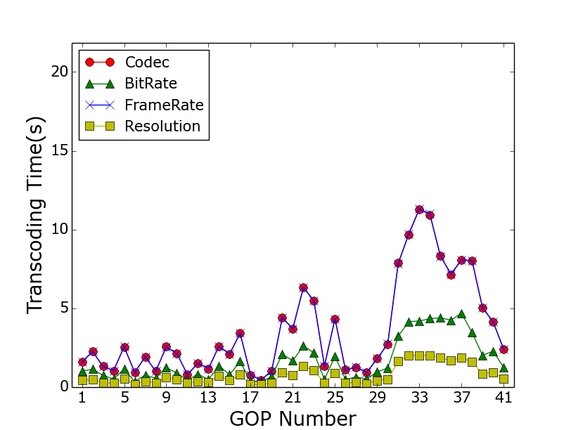
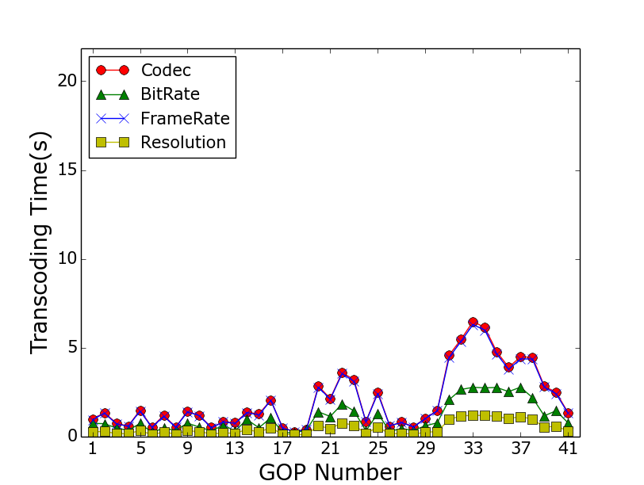
Transcoding Types
CPU-Optimized Instance
GPU Instance
Transcoding time follows a pattern
This pattern applies to all VM types

Slide 45
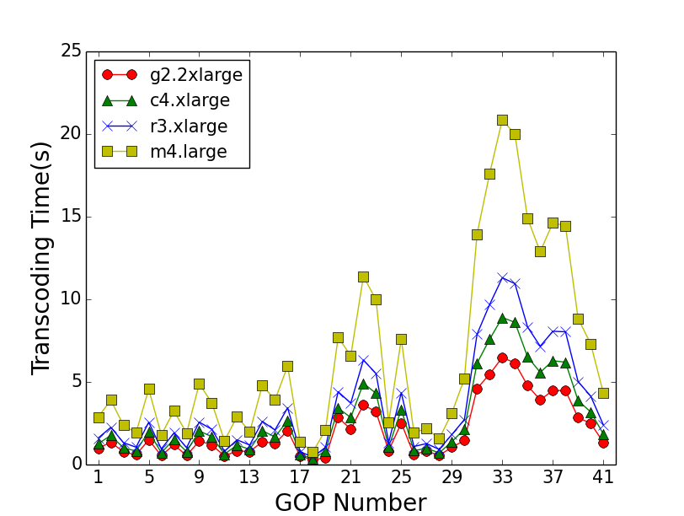
VM Instance Types
In general, GPU is better
The difference is minor sometime
Why?
Transcoding Codec

Slide 46
Video Types
Small time difference for fast motion video
Large time difference on slow motion video

Slide 47
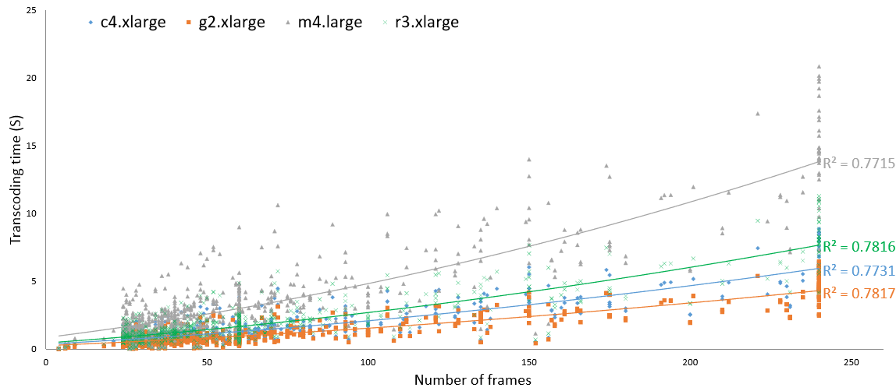
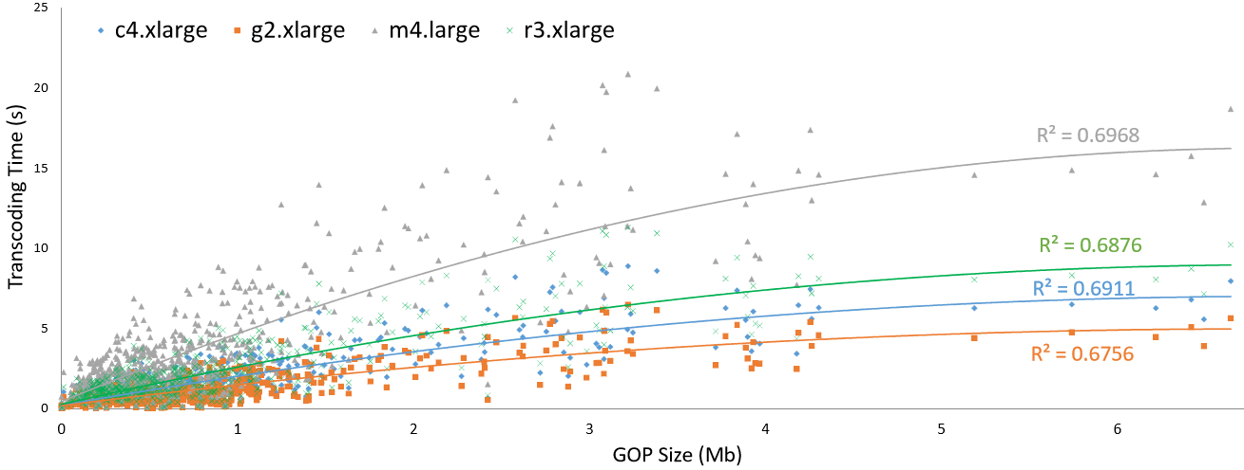

Slide 48
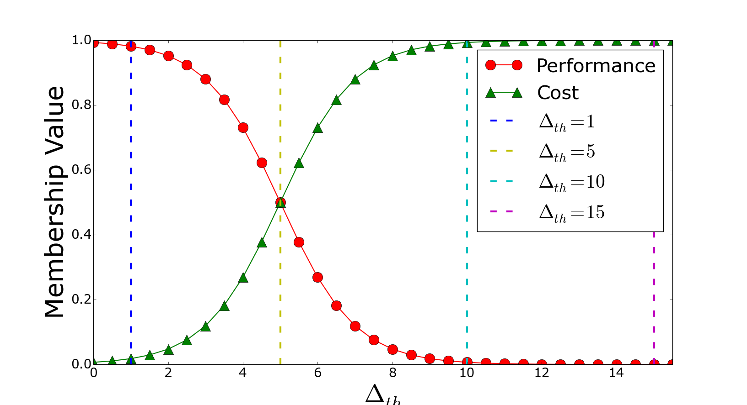
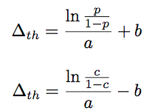
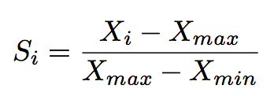
GOP Suitability Matrix

Slide 49
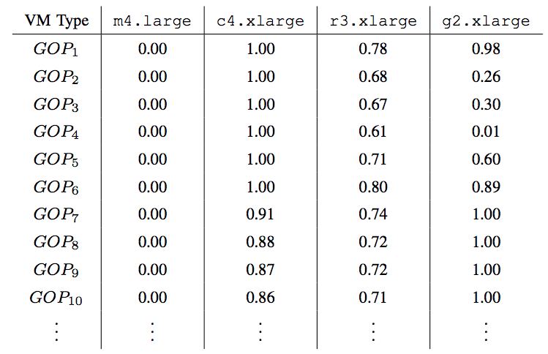
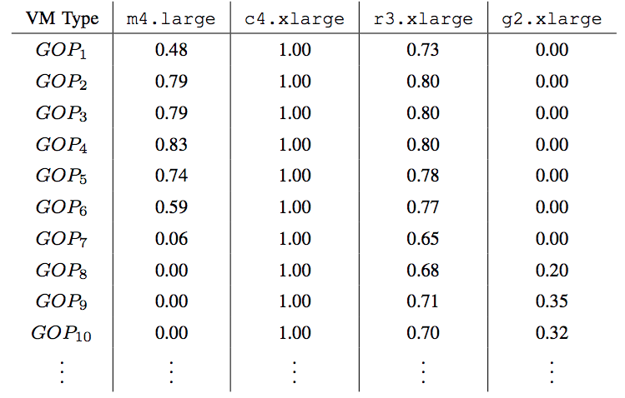
Suitability Matrix
Save cost
The suitability of low cost m4.large increase
The suitability of high performance g2.xlarge decrease

Slide 50
Publications
Xiangbo Li, Yamini Joshi, Mahmoud K. Darwich, Brad Landreneau, Mohsen Amini Salehi, and Magdy Bayoumi, “Performance Analysis and Modeling of Video Transcoding Using Heterogeneous Cloud Services”, ready to submit to IEEE Transaction on Cloud Computing (TCC), Oct. 2016
All experiment results are available in Appendix

Slide 51
Cost-Efficient On-Demand Video Transcoding Using Heterogeneous Cloud Services
Contribution 3

Slide 52
Heterogeneous Transcoding VMs
Utility Function Based Batch Scheduling Method
Adaptive
Elastic Resource Provisioning Policy

Slide 53
Why Remove Startup Queue?
Startup Queue
Priority
G_{4,1}
G_{4,0}
Priority
…..
GOP #
GOP #
…..
Startup Queue
Utility Function
G_{1,9}
G_{2,6}
G_{4,4}
G_{3,4}
G_{2,5}
G_{1,8}
Batch Queue
GOP utility function:
where alpha is constant factor, i the order
number of the GOP in that video

Slide 54
Utility Function Based
Batch Scheduling Method
G_{video#,GOP#}
G_{2,7}
G_{3,3}
G_{1,10}
G_{1,9}
G_{2,6}
G_{4,0}
G_{3,2}
G_{2,5}
G_{1,8}
…..
Batch Queue
G_{4,0}
G_{3,2}
G_{2,5}
G_{1,8}
Priority Queue
1.0
0.8
0.5
0.3

Slide 55
30s
25s
GPU
15s
G_{4,0}
G_{3,2}
G_{2,5}
G_{1,8}
CPU
Optimized
1.0
0.8
0.5
0.3
GPU: 10s
10s
CPU: 20s
Memory
Optimized
Memory: 25s
20s
MM: Minimum completion time, Minimum completion time
MSD: Minimum completion time, Shortest Deadline
MMU: Minimum completion time, Minimum utility
MMUT, MSDUT, MMUUT

Slide 56
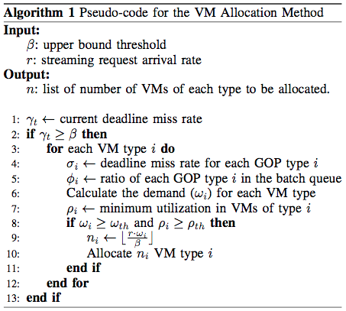
Adaptive Elastic Resource Provisioning Policy
Allocation Policy
When?
Which type of VM?
How many?
Current Time
Last Period
Future
Deadline miss rate
GPU: 20%
CPU: 50%
Memory:30%
Portion in the bath queue
GPU: 60%
CPU: 20%
Memory:20%

Slide 57
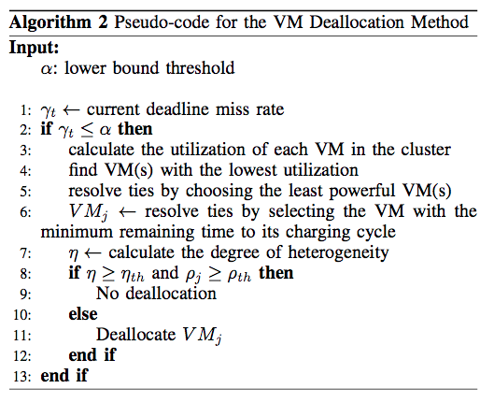
Deallocation Policy
When?
Which one?
Find the minimum utilization VMs
Find the lowest cost ones (least powerful ones)
Find the minimum remaining time VM
If T2’s minimum utilization < 0.2
Deallocate
T2, T2, C4, R3
T2, T2
T2

Slide 58
Performance Evaluation

Slide 59
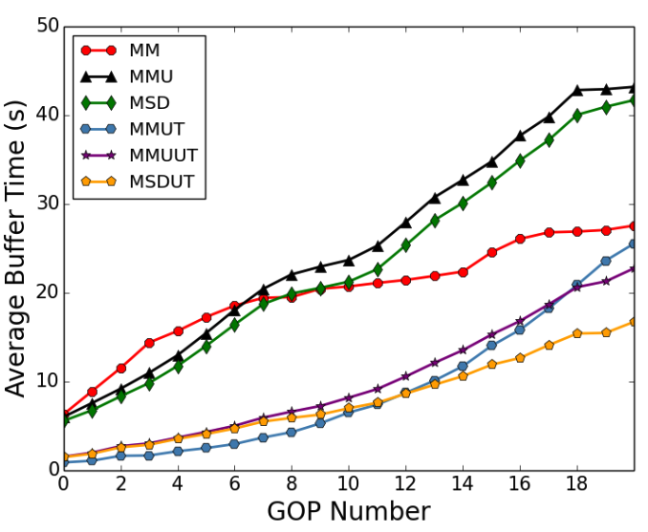
Early GOP Completion Time
The impact of utility based scheduling on minimizing completion/buffer time of GOPs , especially those in the beginning of the stream

Slide 60
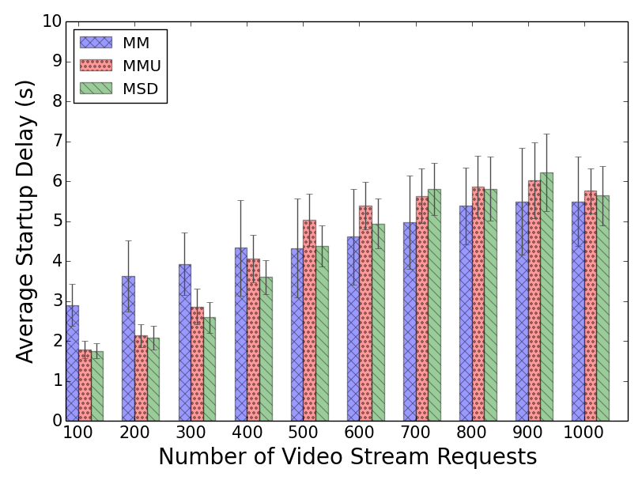
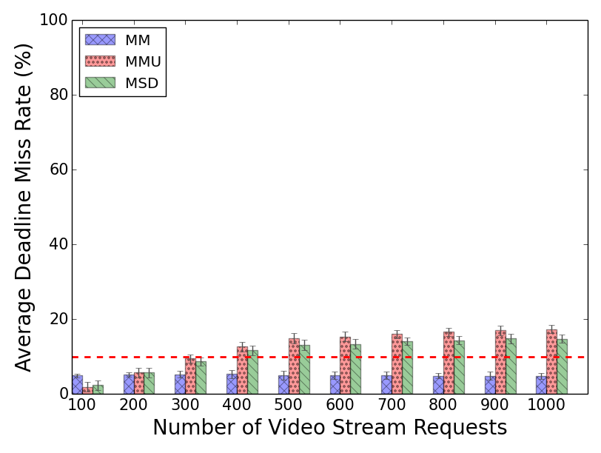
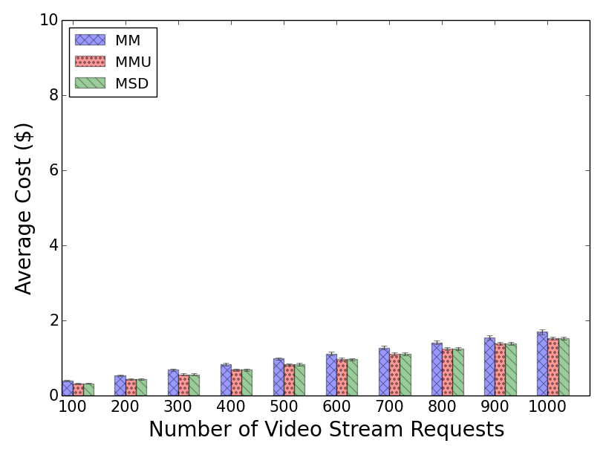
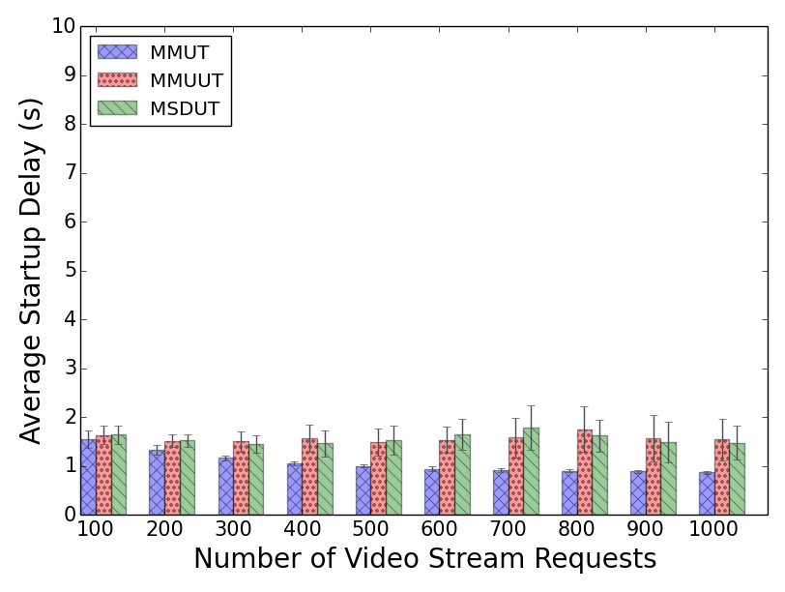
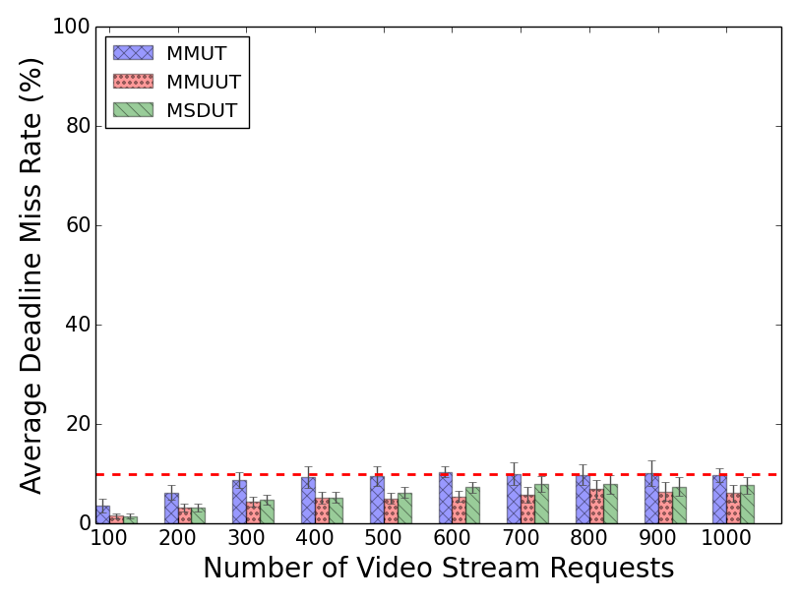
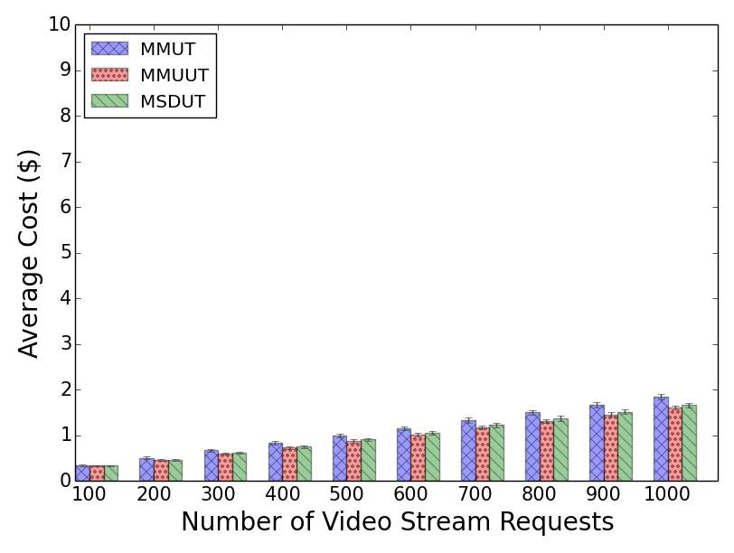
Scheduling with Dynamic Provisioning
Notes:
The incurred cost has significantly reduced (up to ~80% when the system is not oversubscribed) regardless of the mapping heuristic applied.
Startup delay has in general increased (mainly in a) but it is more stable in compare with figure a in static. This is because the EM adapt itself to the workload intensity to satisfy QoS demands. However, in (d) even the startup delay is in a lower range.
Similarly, dmr has become more stable and low when we utility based mapping heuristics are used.
Why MSDUT and MMUUT perform better DMR than MSD and MMU?
The reason is not virtual queue base on old experiment. The reason is not heuristic nature because of static experiment e

Slide 61
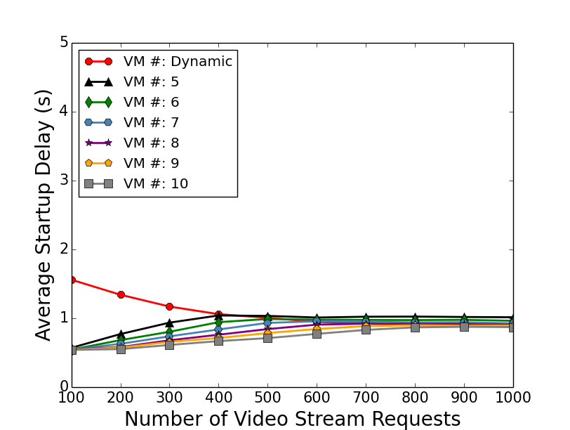
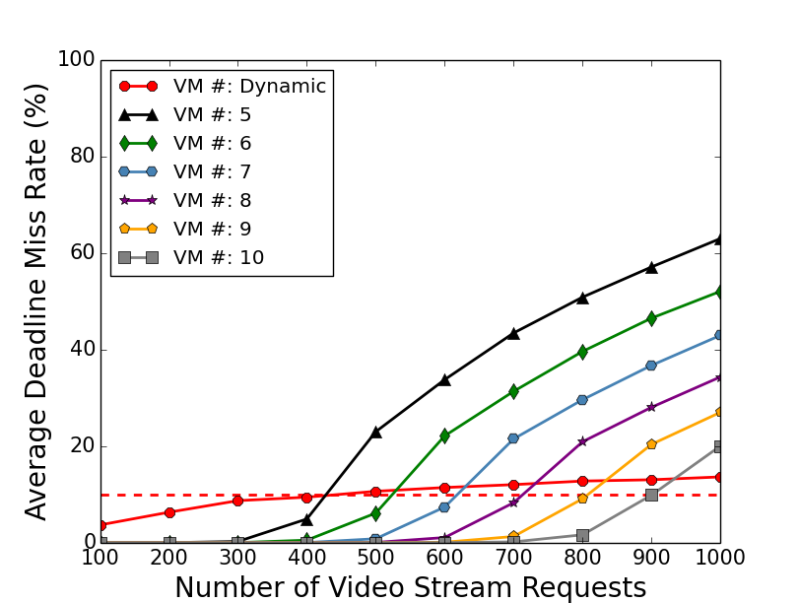
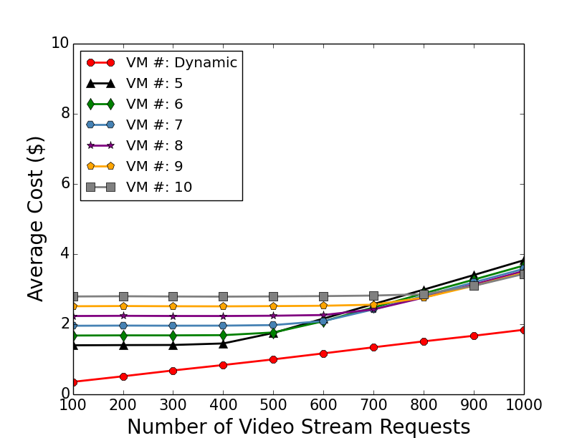
Static GPU vs. Dynamic Heterogeneous
Low and stable Startup time
Low and stable deadline miss rate
Save up to 85% cost when system is not oversubscribed

Slide 62
Publications
Xiangbo Li, Mohsen Amini Salehi, Magdy Bayoumi, Nian-Feng Tzeng and Rajkumar Buyya, “Cost-Efficient and Robust On-Demand Video Transcoding Using Heterogeneous Cloud Services”, submitted to IEEE Transaction on Parallel and Distributed Systems (TPDS), Aug. 2016
All experiment results are available in Appendix

Slide 63
Live Streaming Video Transcoding Using Cloud Services
Contribution 4

Slide 64
Architecture for On-Demand Transcoding of Live-Stream Videos
Efficient transcoding time estimation model
Drop those GOPs who missed their deadline

Slide 65
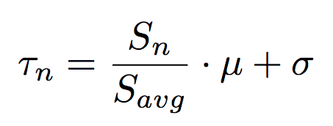
Transcoding Time Prediction Model
Current GOP size
Startup Queue
Standard deviation
G_{4,1}
G_{4,0}
…..
…..
G_{1,9}
G_{2,6}
G_{4,4}
G_{3,4}
G_{2,5}
G_{1,8}
Average GOP transcoding time
Batch Queue
Average previous GOP size

Slide 66
QoS-Aware Scheduling Method
G_{video#,GOP#}
VM1
Startup Queue
G_{4,1}
G_{4,0}
…..
15s
VM2
…..
G_{1,9}
G_{2,6}
G_{4,4}
G_{3,4}
G_{2,5}
G_{1,8}
10s
Batch Queue
VM3
20s

Slide 67
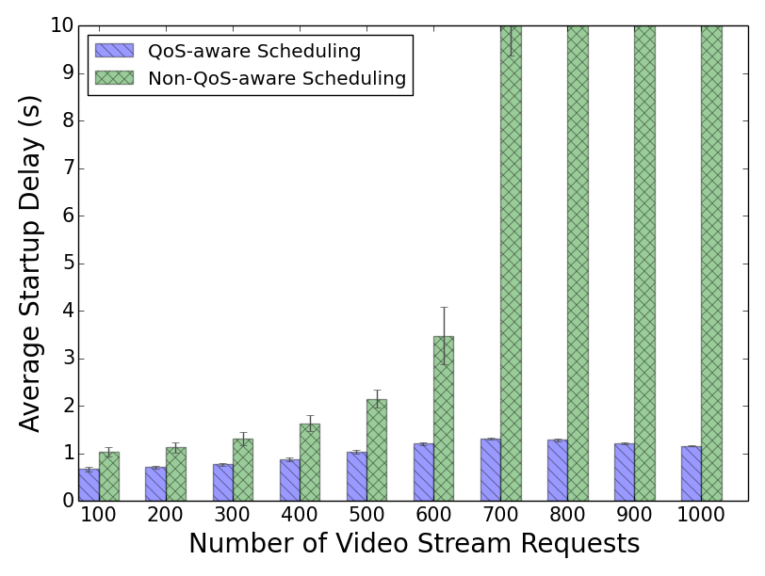
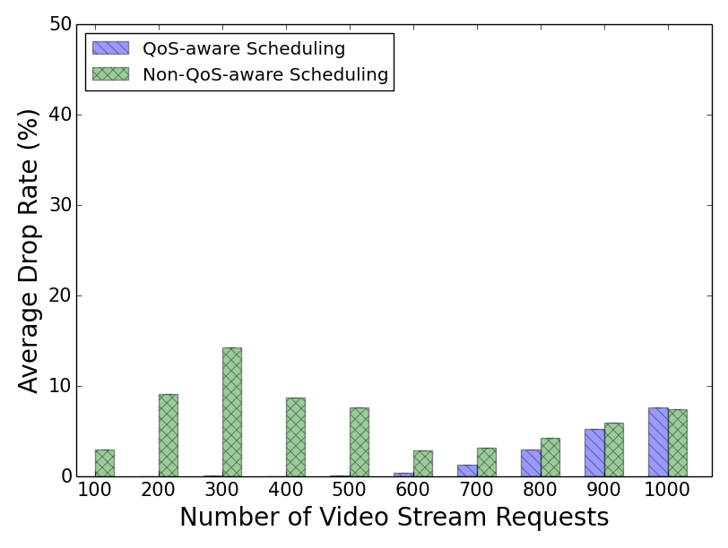
Performance Evaluation
Low and stable startup time
Decrease video drop rate.
Notes:
We have run all transcoding operations on Amazon EC2 to get the real transcoding data, and then we use these data to simulate on CloudSim.
Our dynamic system keeps the QoS violation constantly low and stable in compare with static method
Our method save cost when the system is not oversubscribed.

Slide 68
Publications
Xiangbo Li, Mohsen Amini Salehi, Magdi Bayoumi, “VLSC: Video Live Streaming Based on Cloud Services”, accepted to the 6th IEEE International Conference on Big Data and Cloud Computing Conference (BDCloud ’16), Atlanta, GA, USA, Oct. 2016.
Mohsen Amini Salehi, Xiangbo Li, “HLSAAS: High-Level Live Video Streaming As a Service ”, in Stream2015 Workshop at Washington DC, USA, March 2016.
All experiment results are availabe in Appendix

Slide 69
Questions
What is Video Transcoding?
Why “on-demand” video transcoding?
What are the challenges in on-demand video transcoding?
What have already been done by others?
What aspects does my thesis focus on?
What are the future directions?

Slide 70
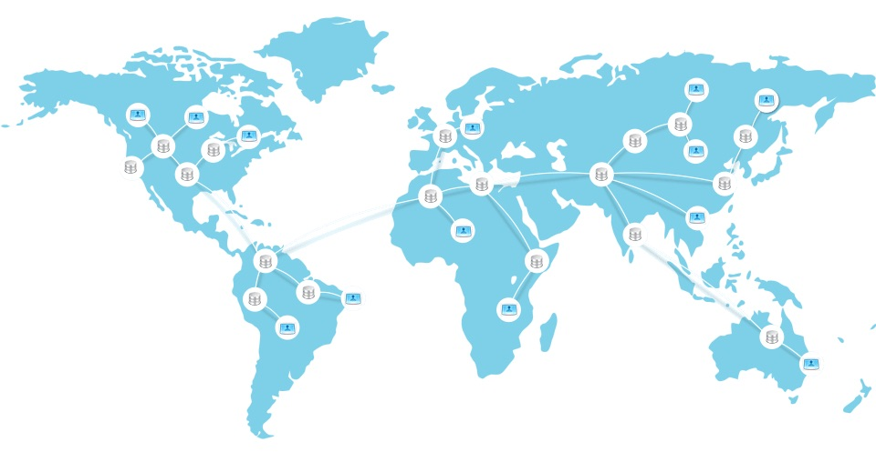
Future Directions
Storage Cost
Computing Cost
Machine Learning

Slide 71
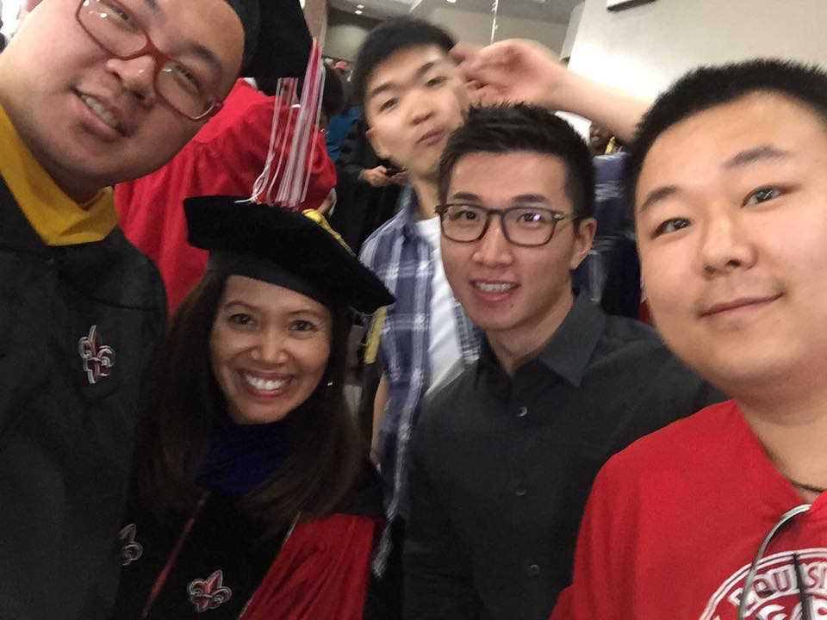
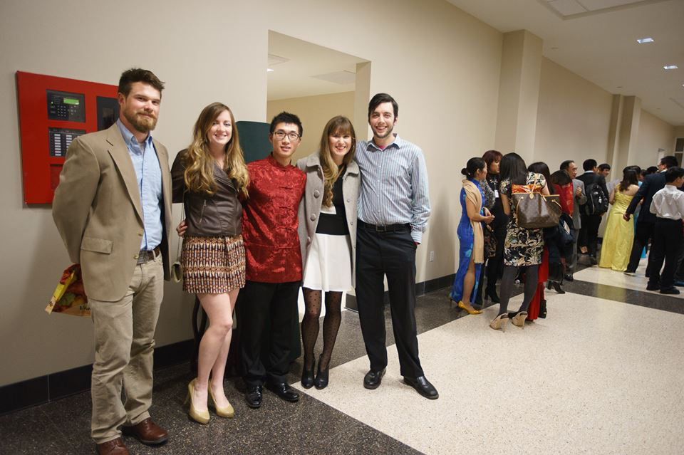
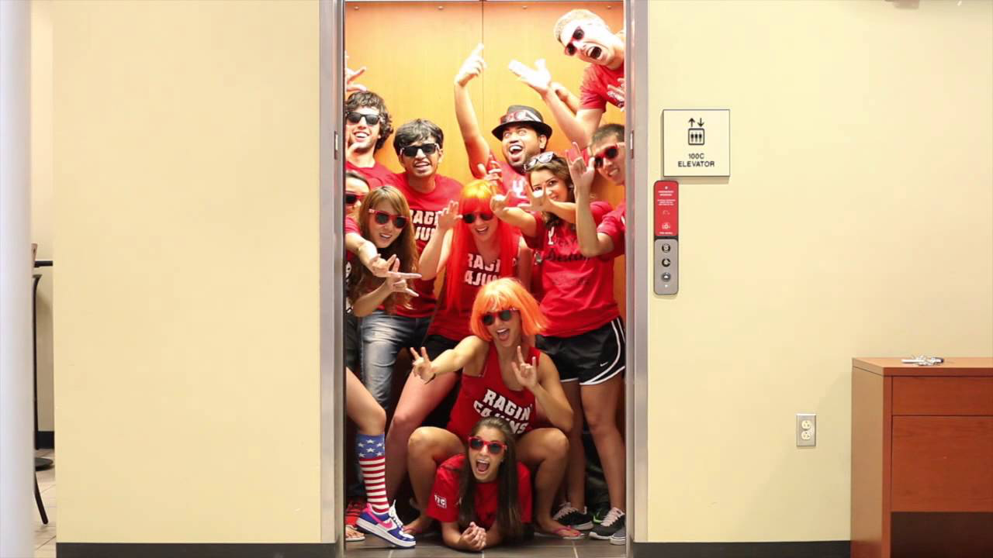
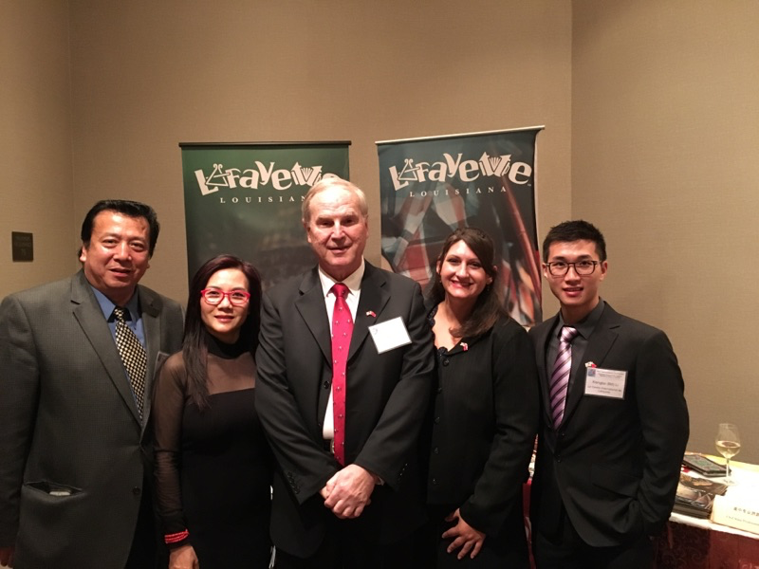
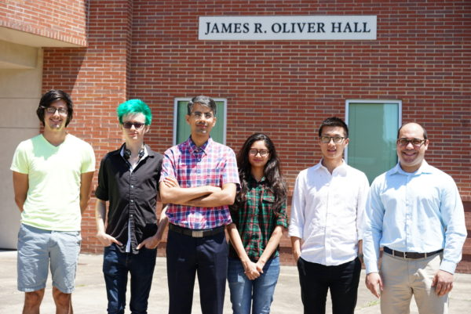
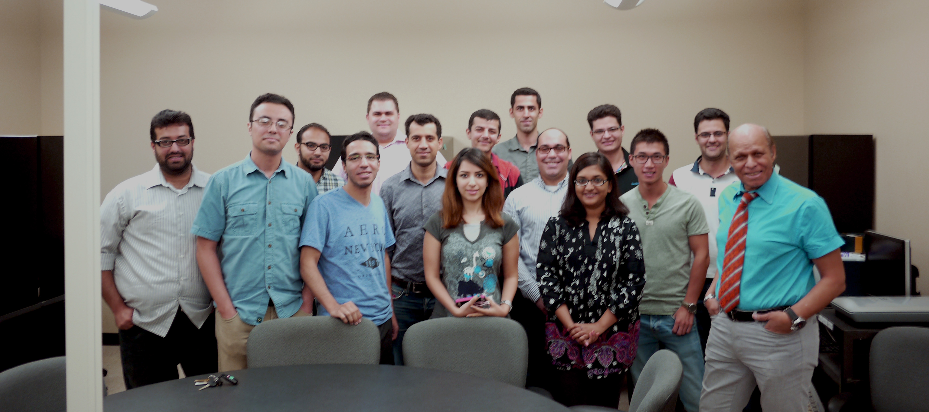
Acknowledgement

Slide 72
Reference
Garcia, Adriana, and Hari Kalva. "Cloud transcoding for mobile video content delivery." Proceedings of the IEEE International Conference on Consumer Electronics (ICCE). Vol. 379. 2011.
F. Jokhio, T. Deneke, S. Lafond, and J. Lilius, “Analysis of video segmentation for spatial resolution reduction video transcoding,” in Proceedings of IEEE International Symposium on Intelligent Signal Processing and Communications Systems (ISPACS), pp. 1–6, 2011.
S. Lin, X. Zhang, Q. Yu, H. Qi, and S. Ma, “Parallelizing video transcoding with load balancing on cloud computing,” in Proceedings of the IEEE International Symposium on Circuits and Systems (ISCAS), pp. 2864–2867, 2013.
Tewodors Deneke, Habtegebreil Haile, Se ́bastien La- fond, and Johan Lilius, “Video transcoding time pre- diction for proactive load balancing,” in Proceedings of IEEE International Conference on Multimedia and Expo (ICME), pp. 1–6, 2014.
F. Jokhio, A. Ashraf, S. Lafond, I. Porres, and J. Lilius, “Prediction- based dynamic resource allocation for video transcoding in cloud com- puting,” in Proceedings of the 21st Euromicro International Conference on Parallel, Distributed and Network-Based Processing (PDP), pp. 254–261, 2013.
A. Ashraf, F. Jokhio, T. Deneke, S. Lafond, I. Porres, and J. Lilius, “Stream-based admission control and scheduling for video transcoding in cloud computing,” in Proceedings of the 13th IEEE/ACM Interna- tional Symposium on Cluster, Cloud and Grid Computing (CCGrid), pp. 482–489, 2013
F. Jokhio, A. Ashraf, S. Lafond, and J. Lilius, “A computation and storage trade-off strategy for cost-efficient video transcoding in the cloud,” in Proceedings of the 39th IEEE Conference on Software Engineering and Advanced Applications (SEAA), pp. 365–372, 2013.

Slide 73
Appendix

Slide 74
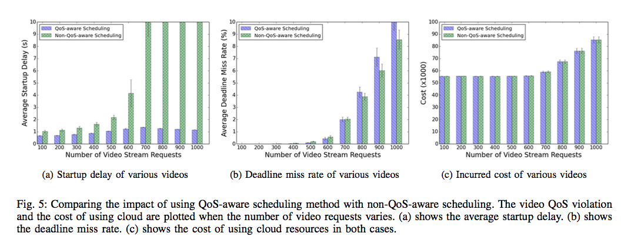
Experiment Results

Slide 75
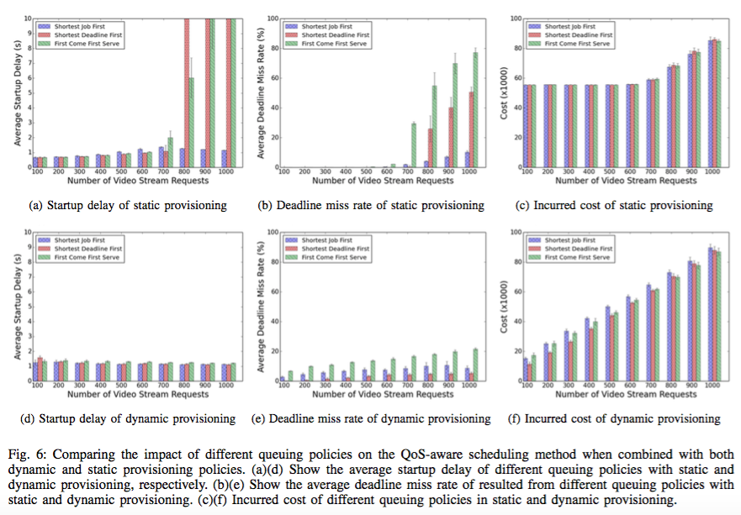

Slide 76
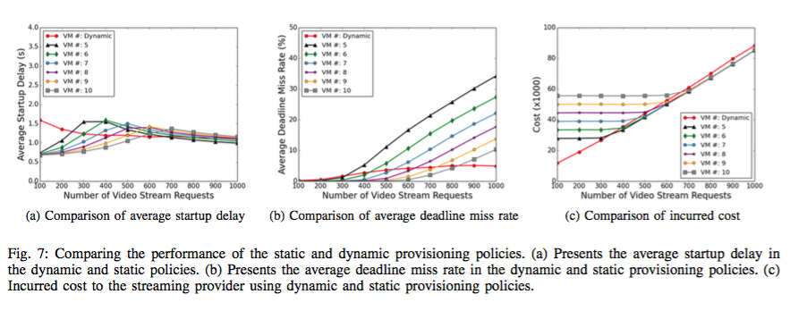
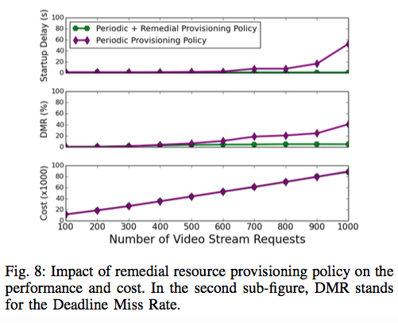

Slide 84
Thank You!

