Slide 1
Fog Computing for Low Latency, Interactive Video Streaming
Vaughan Veillon
Dr. Mohsen Amini Salehi (advisor)

Slide 2
Outline
Current video streaming practices
Introducing interactive video streaming and its challenges
Explaining contributions of this thesis
Conclusion and the future directions of the work

Slide 3
Outline
Current video streaming practices
Introducing interactive video streaming and its challenges
Explaining contributions of this thesis
Conclusion and the future directions of the work

Slide 4
Introduction: Motivations
Video Streaming occupies 75% of the total Internet bandwidth
Increasing demand for high quality video (4K Ultra HD) and more advanced video streaming options (dynamic subtitles, 360 degree)
Notes:
*Growth is persisting
*Becoming more commonly offered, they require more computational resources

Slide 5
Introduction: Motivations (cont.)
Each video can exists in many possible version
  Type of processing
  Heterogeneity in viewers’ devices
Most videos are rarely viewed (only 5% are hot, per YouTube)

Slide 6























Introduction
Video Streams
Streaming Providers
Client Devices
Video Streaming occupies 75% of the total Internet bandwidth

Slide 7
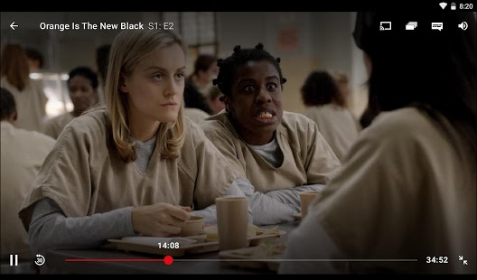

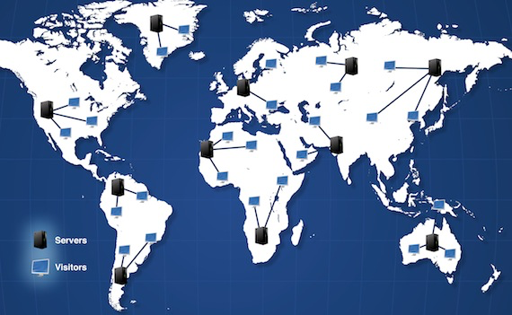
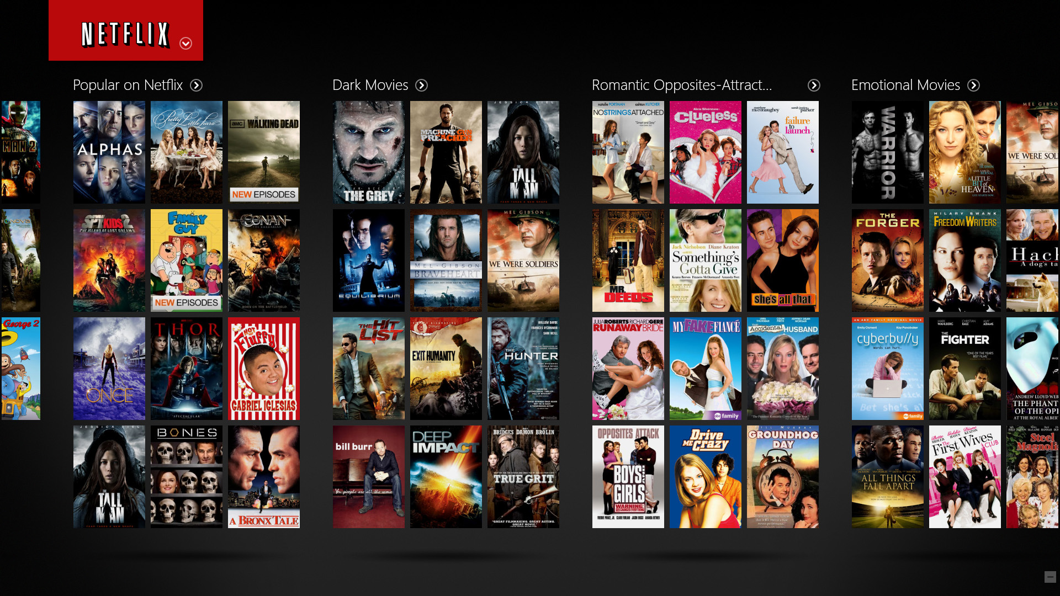
Current Streaming Practices
Client Request
Content Delivery Network (CDN)
Netflix Server

Slide 8









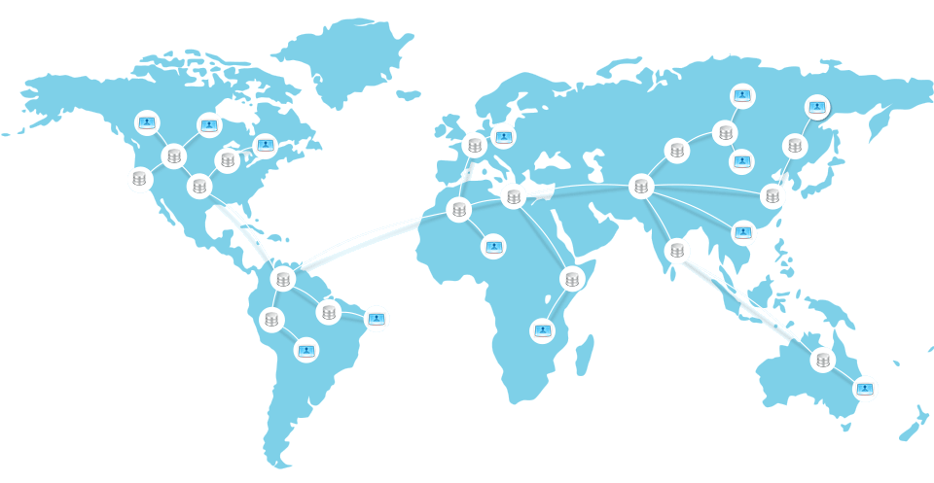



Current Streaming Practices
Video
Contents
Streaming
Service
Providers
Content Delivery Network (CDN)
Viewer Devices
Notes:
200+ devices, millions subscribers

Slide 9
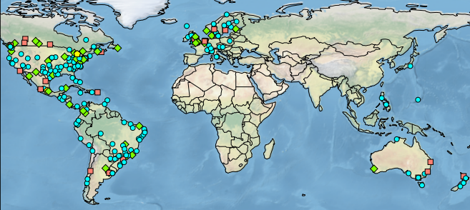
Netflix Solution
4 formats supported
  1 VC, 3 H.264
  Multiple bit rate per format
Note: Each additional format and service (i.e. bitrate, framerate) is a direct multiplier to the number of video versions
40-50 versions of the original video
Several petabytes storing pre-processed videos

Slide 10
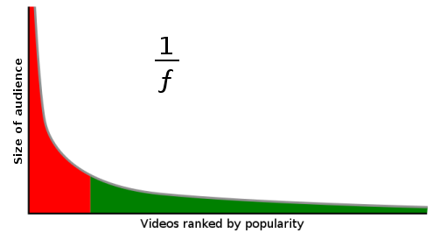

Long Tail Property of Video Streaming
Only 5% of videos are “hot”, per YouTube
Trendy videos

Slide 11
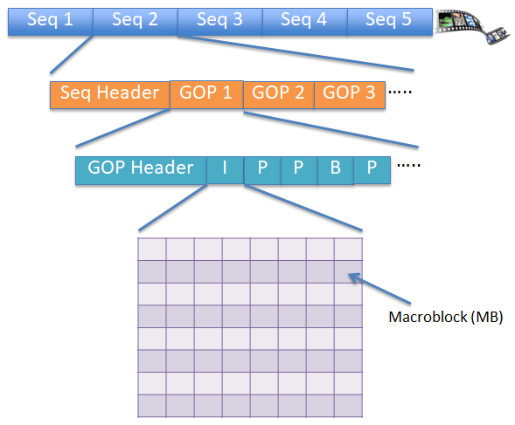
Structure of a Video Stream
A Group of Pictures (GOP) is the basic unit of video stream processing
Can be processed as independent tasks

Slide 12
Outline
Current video streaming practices
Introducing interactive video streaming and its challenges
Explaining contributions of this thesis
Conclusion and the future directions of the work

Slide 13
What is Interactive Video Streaming?
The ability to provide any form of processing for viewers, enabled by the stream service provider
Offer advanced video options (i.e. dynamic subtitles, facial recognition, etc) in addition to basic operations (i.e. resolution, bitrate)

Slide 14
Challenges in Interactive Video Streaming
1) Is it feasible to provide interactive video streaming using cloud resources?
2) How to achieve interactive video streaming while maintaining low latency independent of viewers’ location?

Slide 15
Outline
Current video streaming practices
Introducing interactive video streaming and its challenges
Explaining contributions of this thesis
Conclusion and the future directions of the work

Slide 16
Challenges in Interactive Video Streaming
1) Is it feasible to provide interactive video streaming using cloud resources?
2) How to achieve interactive video streaming while maintaining low latency independent of viewers’ location?

Slide 17
Contribution 1
To address the first challenge, we developed CVSE (Cloud-based Video Streaming Engine)
Notes:
CVSE

Slide 18
Goals of CVSE
Extend the platform with new video processing services of any type (even by 3rd parties)
Update the platform with new services in a real-time manner
Allocate appropriate amount of resources

Slide 19













Introduction: CVSE
Features of CVSE
Cloud Provider
1) On-demand processing
2) Partial caching of popular videos
3) Extendable video processing services
Video Contents
Cloud Storage
Viewers
Streaming Requests
CVSE
Core
CVSE
Processed Streams
Newly defined Video Processing Service
Video Streaming
Service Provider
Computational Resources
Chosen CVSE Services
Defined Video Processing Services
(Task Types)

Slide 20











CVSE Architecture
Streaming provider
Viewers’ devices
Extended video processing service
Chosen CVSE services
Video Streaming Cloud
Ingestion Processor
CVSE Core
Service repository
Video Repository
Caching
Admission
Control
Time Estimator
Resource Provisioner
Video
Merger &
Output
Windows
Streaming tasks
Task Scheduler
Compute Engine

Slide 21
Extensibility of CVSE
Monthly
Pay as you watch
Key CVSE features:
Billing Policy Interface
1) Modular
CVSE CORE
Local
2) Dynamic
Extended 3rd Party Service
Video Segment Caching Service
Streaming Task Scheduling Service
Video Segment Admission Control
Service
Cloud
Resolution
Video Processing Interface
Deployment Interface
Video Service Repository
Edge
Subtitles
Federated
Elastic Resource Provisioning Service
Compute Engine Interface
Emulation
Local Thread
Cloud
VM
Container

Slide 22
Video Processing Interface (cont.)
Allows CVSE to perform any type of video processing
Existing services in Video Service Repository
Stream service providers can extend new service and add to Video Service Repository

Slide 23
Compute Engine Interface (cont.)
Allocation of worker nodes in CVSE
  Emulation
  Local Threads
  VM
  Container

Slide 24
Deployment Interface (cont.)
Method in which CVSE is deployed
  Local
  Cloud
  Edge
  Federated

Slide 25
Billing Interface (cont.)
Form is which viewers’ accounts are charged
  Monthly subscription
  Pay as you watch

Slide 26
Experimental Setup
CVSE utilized in emulation mode
Worker nodes of compute engine are modeled from AWS g2.2xlarge VMs
Show importance of proper resource allocation

Slide 27
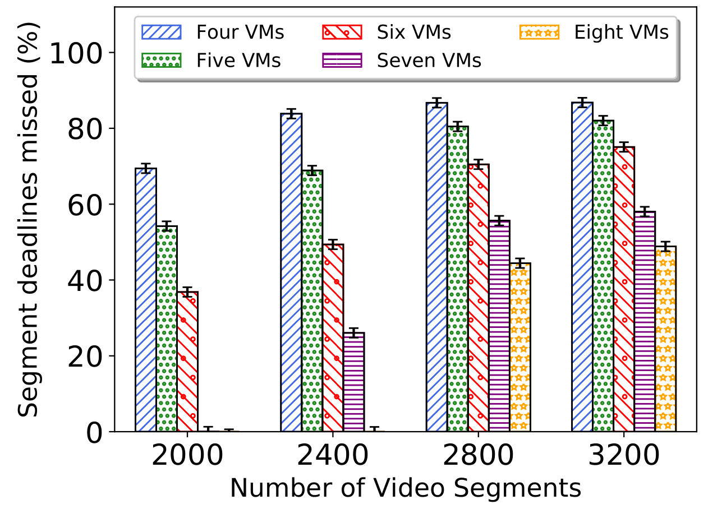
Analyzing Worker Node Cluster Size
Crucial for Resource Provisioner to allocate enough worker nodes
26%
0%

Slide 28
Local Web Implementation
Coded in Java
Runs as webservice that receives streaming requests
Stream requests sent from web page hosted by local web server
Container creation video

Slide 29
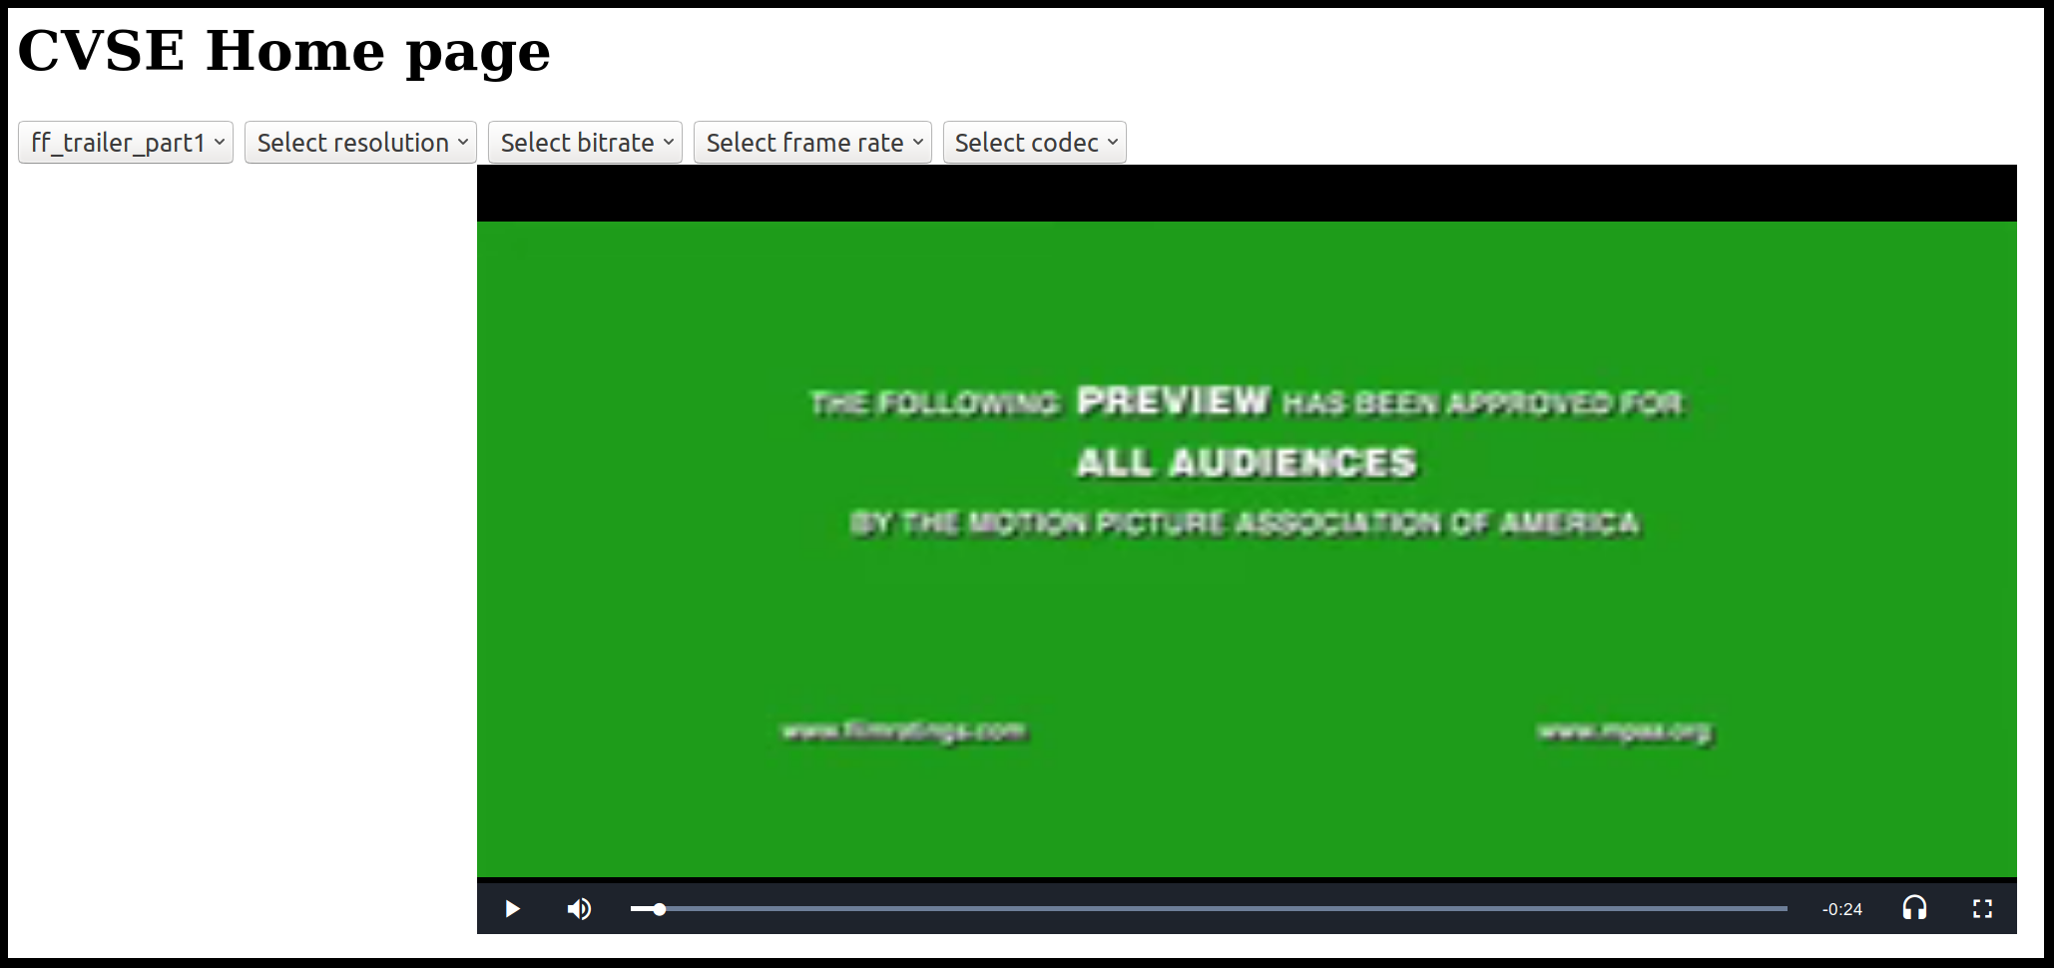
Examples of Video Processing

Slide 30
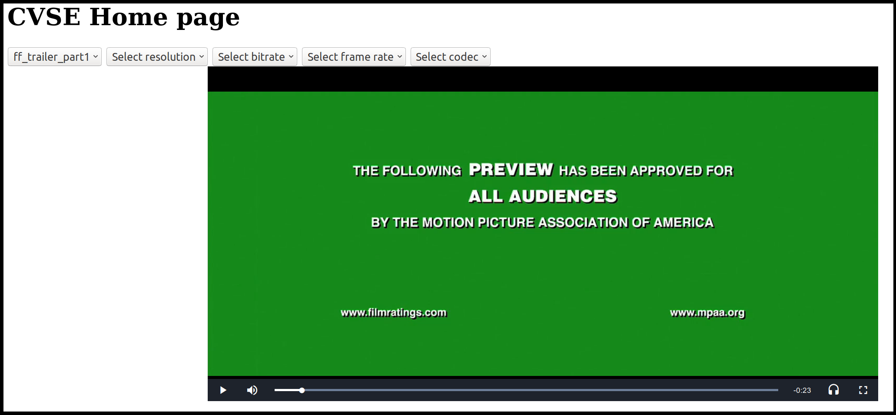
Examples of Video Processing

Slide 31
Summary of Outputs for Contribution 1 (CVSE)
Developed CVSE platform, that enables interactive video streaming
Extensible
  Billing
  Deployment
  Processing Services
Transparent
Preparing a Journal Paper on “Interactive Cloud-based Video Streaming Engine”

Slide 32
Challenges in Interactive Video Streaming
1) Is it feasible to provide interactive video streaming using cloud resources?
2) How to achieve interactive video streaming while maintaining low latency independent of viewers’ location?

Slide 33
Concerns when using Cloud Resources
Provide large amounts of computational and storage resources
Accessing more centrally located cloud servers can have significant latency
  Especially for viewers in geographically distant areas

Slide 34
Netflix’s Content Delivery Network (CDN)
Uses AWS (Amazon Web Services) to host its main site and handle incoming stream requests
  Pre-processes all the versions of videos
A number of edge servers called OCA’s (Open Connect Appliance) to deliver video content

Slide 35
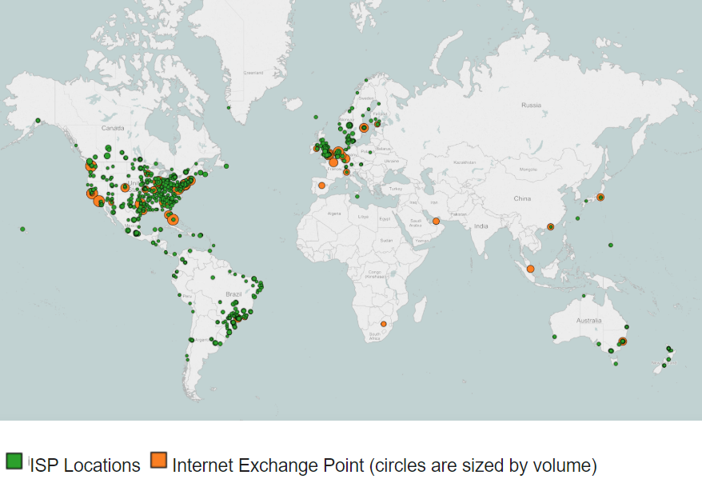
Netflix CDN Infrastructure
OCA servers circa 2016
Notes:
CITE IMAGE

Slide 36
Limitations of Existing CDN Architecture
Edge servers
  File transfer
  File caching
  Only caches entire video (0-1)
  No processing is performed at edge
  Entire video streamed is delivered from the same edge server

Slide 37
Federated: Fog Delivery Networks
Perform processing at edge level through CVSE deployment
Provide partial video caching
Leverage neighboring FDN cached contents

Slide 38
Contribution 2
To address the second challenge, we developed F-FDN (Federated-Fog Delivery Networks)

Slide 39
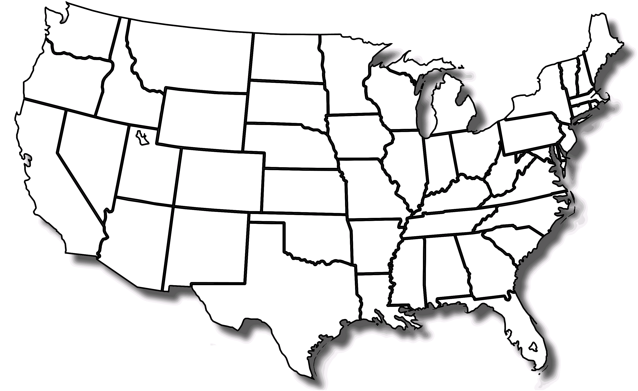




High Level of F-FDN
FDN
Viewers
Video Content
Central Cloud
Local Cache
Processed On-Demand
Streaming decisions are made on a segment-by-segment basis
Each viewer can receive its stream from multiple sources
Neighboring Cache

Slide 40






F-FDN Architecture
Central Cloud
Video Stream Requests
Ingestion Processor
Metadata Manager
Fog Monitor
Video Repository
FDN
Segment Cost Estimator
Request Queue
Request Processor
Viewers
Neighboring FDN
Video Merger and Output Window
Worker Nodes
Final Video Content
CVSE
Cached Video

Slide 41
Streaming decisions
3 ways a video segment can be streamed
  1) Local FDN’s cache
  2) Processed on-demand by local FDN
  3) Retrieved from Neighboring FDN to local FDN, then streamed to viewer
We evaluate each option by using normal distributions
  In case 2 and 3 we convolve multiple distributions into a single comparable distribution

Slide 42
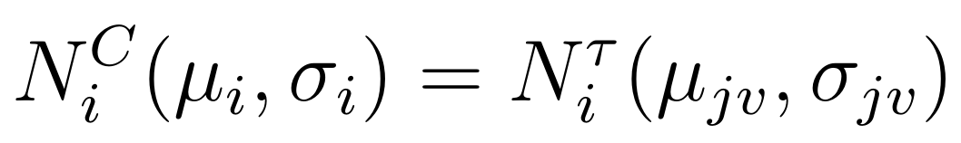
Local FDN’s Cache
Criteria to account for:
  The transfer time to deliver segment i from local FDN j to viewer v

Slide 43
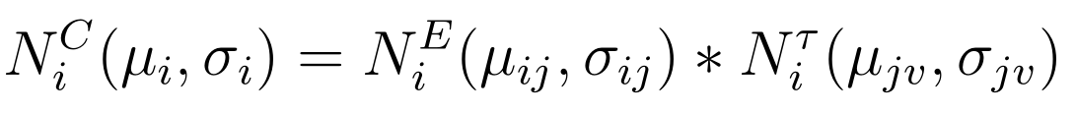
Processed on-demand in Local FDN
Criteria to account for:
  The execution time to process segment i on local FDN j
  The transfer time to deliver segment i from local FDN j to viewer v

Slide 44
Retrieved from Neighboring FDN then streamed from Local FDN
Criteria to account for:
  The transfer time to transfer segment i from Neighboring FDN k to local FDN j
  The transfer time to deliver segment i from local FDN j to viewer v

Slide 45
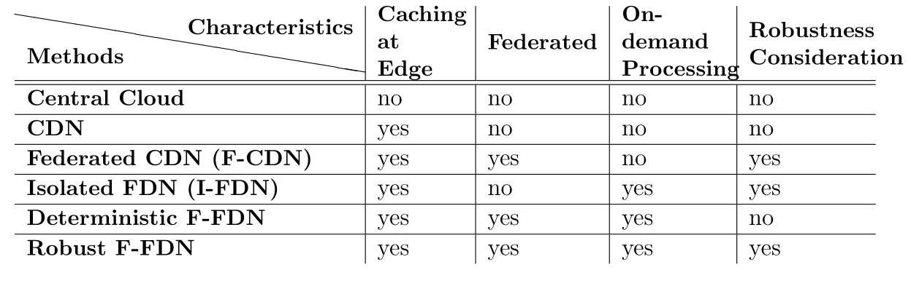
Evaluating F-FDN: Alternative Streaming Methods
CDN represents the standard video streaming architecture
Robust F-FDN is our fully featured F-FDN platform

Slide 46
Experimental Setup
Run in emulation mode
Central Cloud has 100% caching of pre-processed videos
CDN has 75% caching at edge server
  Contains Central Cloud server
FDN systems (except I-FDN) consists of 3 total FDN
  Contains Central Cloud server

Slide 47
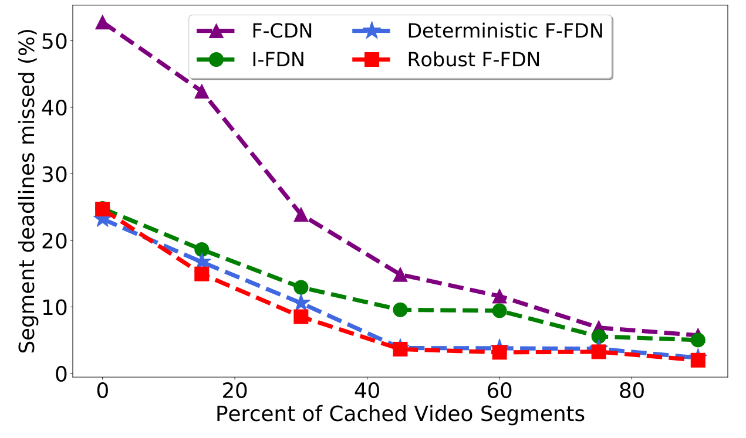
Evaluating F-FDN: Suitable Cache Size for FDNs
We consider a caching level of 30% for FDN systems in later experiments

Slide 48
Evaluating F-FDN: Suitable Cache Size for FDNs (cont.)
Analyze all FDN systems
Considerable difference between F-CDN and other systems
Based on the experiment, we chose a caching level of 30% for FDNs

Slide 49
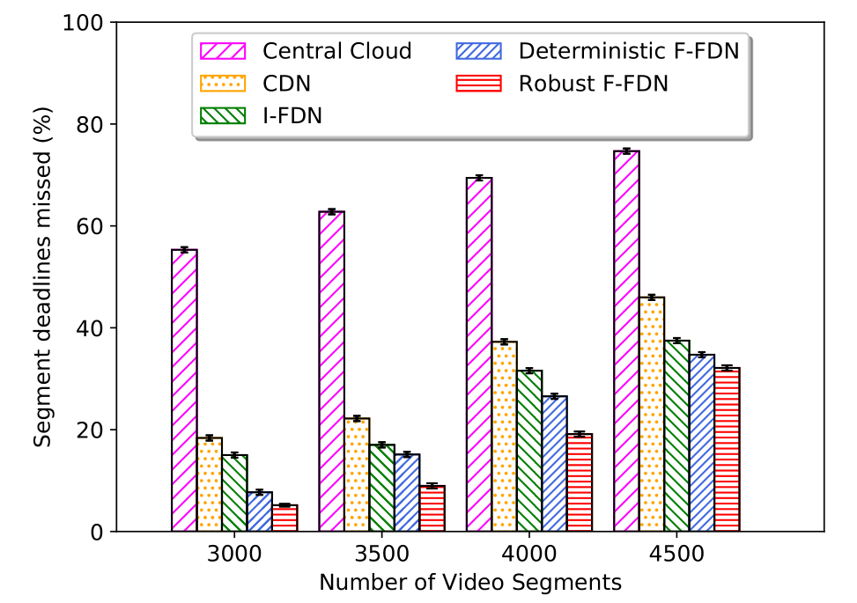
Evaluating F-FDN: Impact of Oversubscription
On average, Robust F-FDN performs 52% better than CDN
Robust F-FDN
CDN
Notes:
Comparing CDN to Central Cloud
Comparing I-FDN to CDN
Comparing Det F-FDN to Robust F-FDN

Slide 50
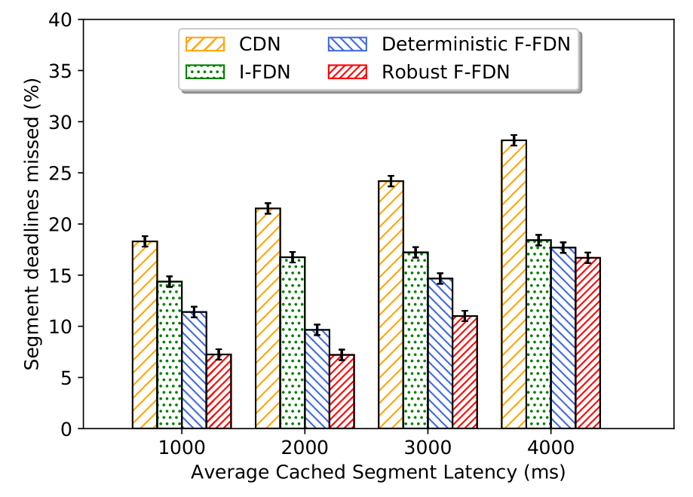
Evaluating F-FDN: Impact of Network Latency
Retrieval from Neighboring FDN is less reliable, so on-demand processing is more utilized as the latency increases
As the average latency increases, the difference between the FDN systems decreases
Notes:
Comparing CDN to I-FDN
Comparing Det F-FDN to Robust F-FDN

Slide 51
Summary of Outputs for Contribution 2 (F-FDN)
Developed platform F-FDN that ultilizes CVSE to enable interactive video streaming
Low latency to geographically spread viewers
Multi-source streaming
Up to 52% improvement compared to traditional streaming practices (namely CDN)
Vaughan Veillon, Chavit Denninnart, Mohsen Amini Salehi, “F-FDN: Federation of Fog Computing Systems for Low Latency Video Streaming”, in Proceedings of the 3rd International Conference on Fog and Edge Computing (ICFEC 2019), Larnaca, Cyprus, May 2019.

Slide 52
Outline
Current video streaming practices
Introducing interactive video streaming and its challenges
Explaining contributions of this thesis
Conclusion and future works

Slide 53
Conclusion
We developed the CVSE platform interactive video streaming
We developed the F-FDN platform which utilizes CVSE, to provide interactive video streaming with low latency
  Shows improvements when compared to existing systems

Slide 54
Future Works
Heterogeneous Container Types
On-demand Processing of 360 degree videos
Dynamic Billing
Multi-tier F-FDN Architecture

Slide 55
Heterogeneous Container Types
Currently, each container is general, all-purpose use
Provide a mixture container types in compute engine:
  Often used, long running containers
  Specialized containers for processing types that are requested less often
    Created when needed, and destroyed when processing is completed

Slide 56

On-demand Processing of 360 degree videos
360 degree videos are becoming more common
Consists of multiple viewing areas stitched together
All viewing areas are not observed at the same time
Process the actively observed area on-demand at full resolution
Use assumptions and historical data to predict likely viewing area of videos

Slide 57
Dynamic Billing
Enable stream service providers to offer pay-as-you-watch model when charging customers
Many factors that would affect billing:
  Availability of video version
  Resources used for processing
  Duration of viewing session

Slide 58

Multi-tier F-FDN platform
Central Cloud
Caching
Security
Regional FDN
Processing
Power
Latency
Local FDN

Slide 59
Questions?

Slide 60
Thank you

