Slide 1
Federated Fog Computing to Support Remote Industry 4.0 Applications
Razin Farhan Hussain
High Performance Cloud Computing Lab (HPCC)
School of Computing and Informatics
University of Louisiana Lafayette
11/07/2022

Slide 2
Outline
Introduction & background
Motivation & research roadmap
Contributions of this dissertation:
Identifying the scope of Industry 4.0 applications across edge-fog-cloud systems
Performance analysis of smart Industry 4.0 applications in fog & Cloud
Proposing federated fog computing systems to resource provisioning of remote Industry 4.0 applications
Developing resource allocation for Industry 4.0 workflows across federated fog systems
Conclusion & future research direction

Slide 3
Industrial revolution:
The path to Industry 4.0
Introduction of stream & water power
Production with electrical power
Automation, IT , and Robotics
Smart Factory, Machine Learning
Key technologies
IoT Tech
Edge & Fog computing
5G Connectivity
Deep Learning
Our Focus
Remote Industry 4.0
Notes:
There are many solutions for Industry 4.0 but remote industries are not considered properly. Hence we focus on remote industries.
Transform Industries
Agile & aware
Efficient
Intelligent
Safe
Sustainable
Offshore Oil and Gas sites
Remote Manufacturing Plants
Intelligent Transportation

Slide 4
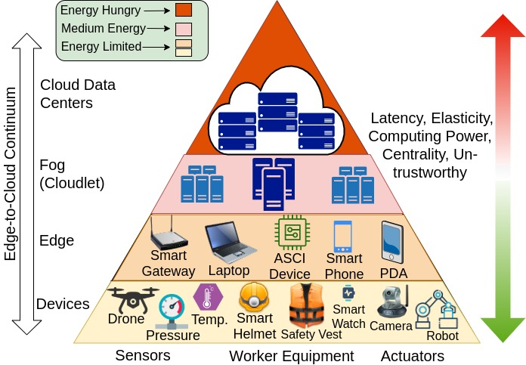
Edge-Fog-Cloud Continuum for Industry 4.0
Why Edge & Fog?
Low latency
Privacy
Vicinity to data in remote areas
Lack of elasticity!
Remote Industry 4.0
Multiple Edge/Fog places nearby
Notes:
Many cloud applications provide elasticity features to accommodate scalability and adapt to changes in demand. Unlike in the cloud, implementing elasticity for IoT applications in the fog is not an easy task,
Challenges of Fog
Limited resources
Lack of elasticity
Oversubscription
One Solution:
Federating nearby fog systems

Slide 5
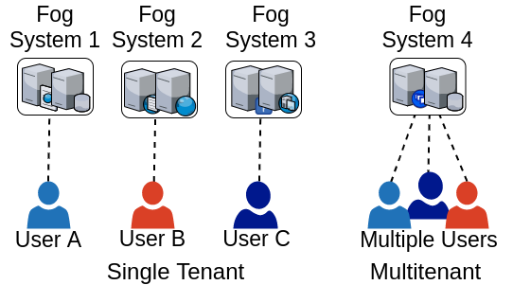
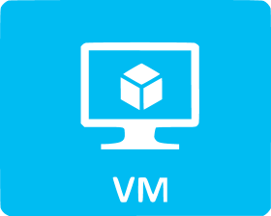
Challenges of Edge-Fog-Cloud continuum
Heterogeneous Resources
Uncertainties
Computation
Communication
FPGA
Multitenancy
The support of co-existing applications requested by different tenants
Multi-virtualization technology coexistence

Slide 6
Outline
Introduction & background
Motivation & research roadmap

Slide 7
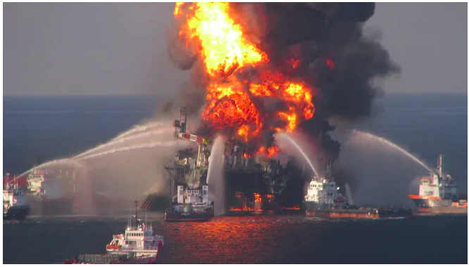
Motivation: Remote O&G disasters
O&G in Louisiana
Formation & Hydrocarbon reservoir - offshore Gulf
O&G contributed $73B to Louisiana’s 2019 GDP (~26%)
Biggest disasters in Gulf
Deep Water Horizon – 2010
In Louisiana, erosion rates doubled
killed 11 workers & took 87 days to control
Causes:
Safety failures
Late Oil Spill Detection
Notes:
Erosion: reduce fertility of land
Pictures of fire, oil fields, remote oil field
Add more images

Slide 8
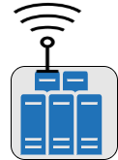
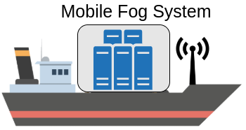
Motivation: Coordinating activities to cope with disaster
Satellite
Cloud Datacenter
High Latency
Fog System on Oil Rig
Fire
Oil Spill Incident
Notes:
Disaster scenario – Oil Spill
Oil Rig – Fog computing
Multiple Synchronize application
Helper ships coming
Nearby rigs
Cloud is satellite based

Slide 9
Research challenges and our approach
What is the execution behaviors of Industry 4.0 applications?
We model the stochastic behavior of ML-based applications
How to enable cloud-like services without having cloud access?
We develop the notion of federating fog systems
How to provision resources for latency-sensitive smart applications?
We develop resource allocation solutions for monolithic and micro-service applications
Notes:
Synchronization – Dispatch drone, collect data, monitoring, coordinating emergency, evacuation, running simulation

Slide 10
Research Roadmap & Contributions
Identify scope of Industry 4.0 applications across edge-fog-cloud
Feasibility analysis
Performance analysis of Industry 4.0 Applications
Application level
Monolithic resource allocation across fog federation
System level
Smart software
structure aware federated fog
Future work
Notes:
Revise image in powerpoint
Animation one by one

Slide 11
Outline
Introduction & background
Motivation & research roadmap
Contribution:
Identifying the scope of Industry 4.0 applications across edge-fog-cloud systems

Slide 12
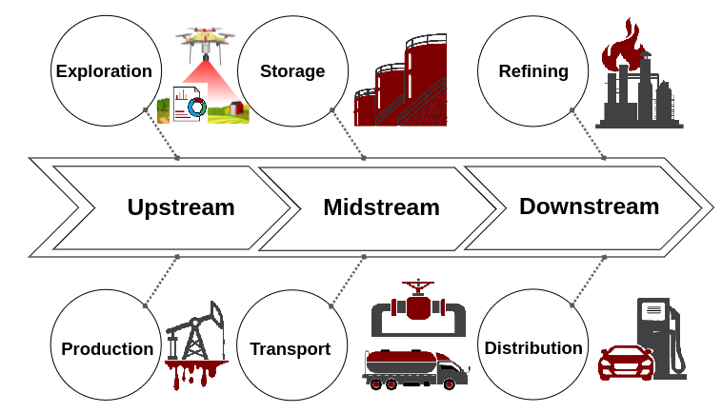
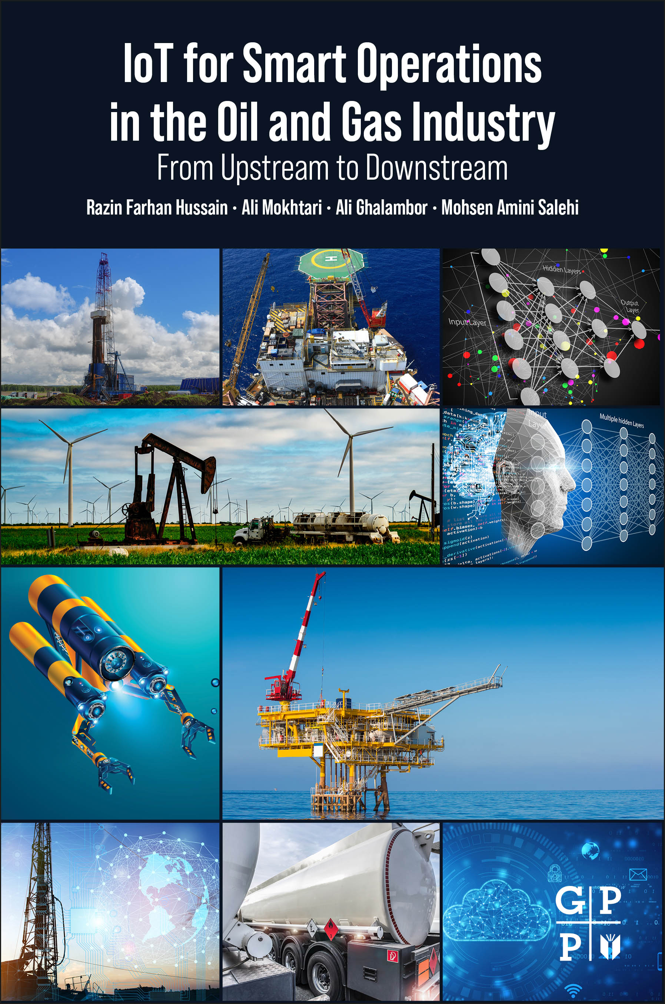
Identify the scope of edge-cloud & smart solutions in remote Oil & Gas
A detail survey on computing aspects of O&G
Upstream
Midstream
Downstream
Systematic and categorical taxonomies
Smart solutions with advanced analytics (ML,DNN,AI) and edge-cloud
Various use cases & pictorial examples
Identify problems & propose smart solutions
Downsides of smart solutions
Details in the book
IoT for Smart Operations in the Oil and Gas Industry From Upstream to Downstream
1st Edition - September 20, 2022
eBook ISBN: 9780323998444

Slide 13
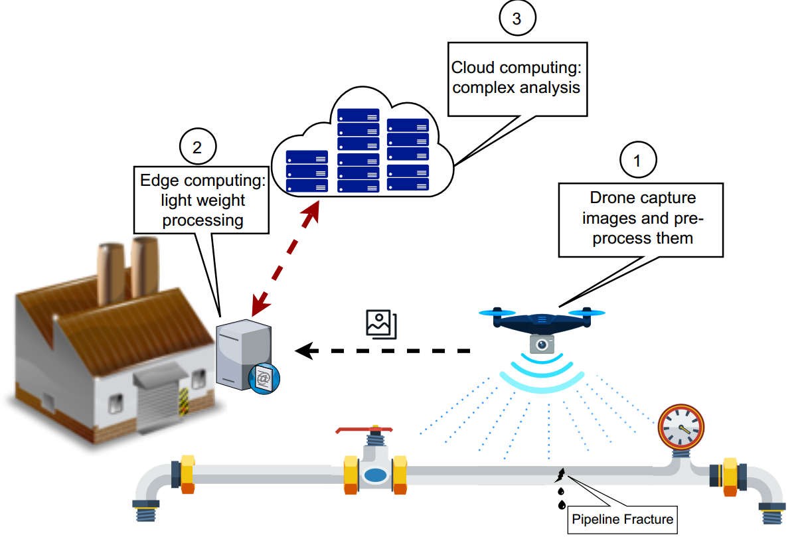
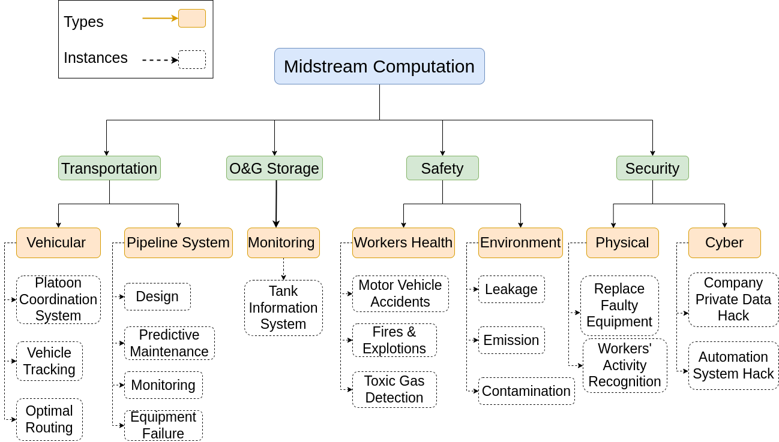
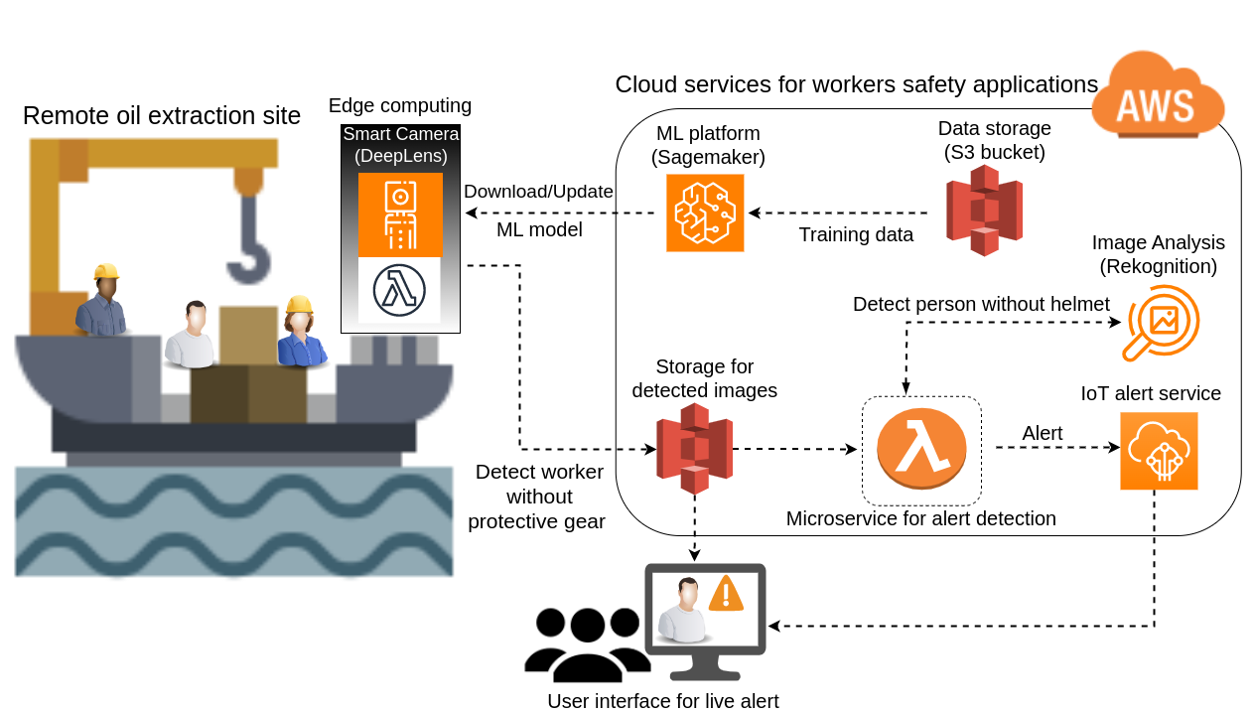
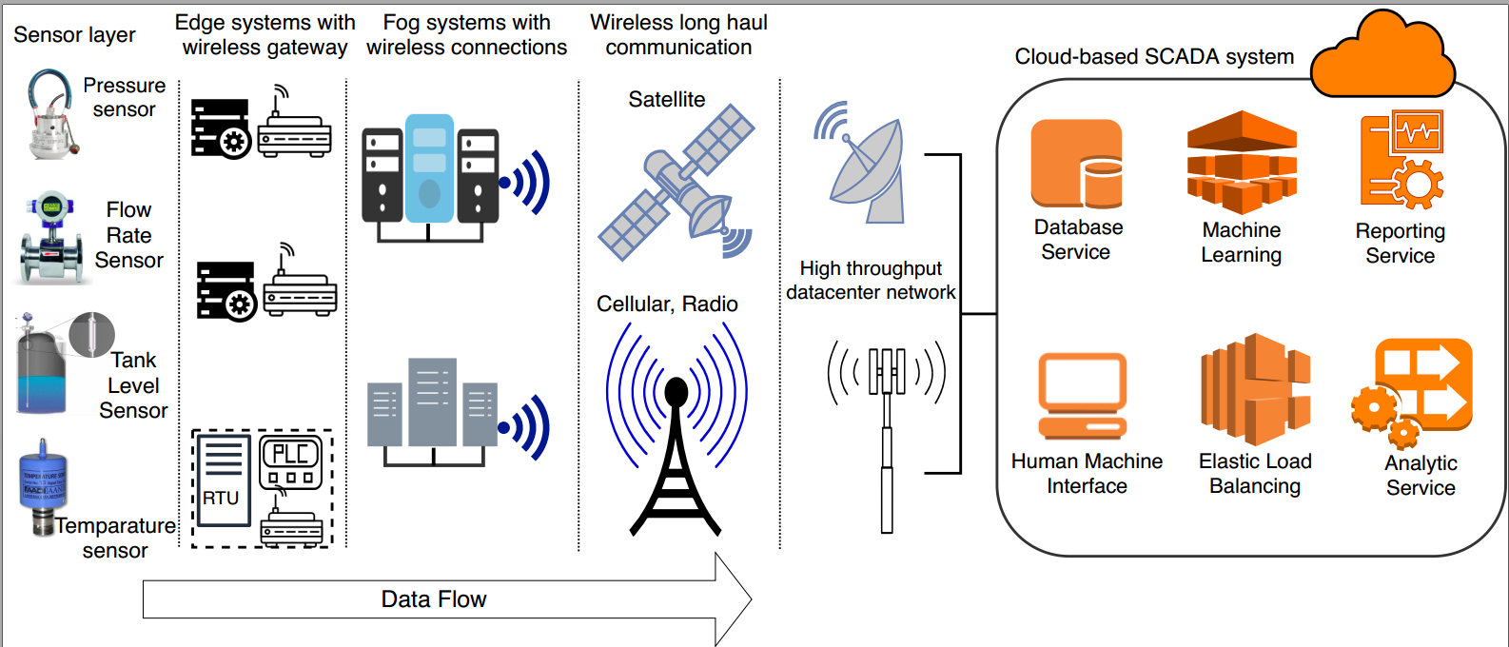
Various use cases of smart solutions in remote Industry 4.0
Drone-based inspection
AWS DeepLense
Edge SCADA System

Slide 14
Computational Taxonomy of edge-cloud for Industry 4.0
Our Contributions
Federated Fog
Data Management
Automation Management
Acquisition
Pre-processing
Analytics
Detection
Decision
Surveys
Cleaning
Descriptive
Descriptive
Anomaly Detection
Resource Allocation
Anomaly
Detection
Resource Allocation
Logs
Integration
Predictive
Predictive
Transformation

Slide 15
Publication for contribution 1
Razin Farhan Hussain, Ali Mokhtari, Mohsen Amini Salehi, and Ali Ghalambor IoT for Smart Operations in the Oil and Gas Industry published by Elsevier as a Book (ISBN: 9780323998444)
Notes:
Razin Farhan Hussain, Omid Semiari, and Mohsen Amini Salehi Robust Resource Allocation Using Edge Computing for Vehicle to Infrastructure (V2I) Networks published in Proceedings of The IEEE 3rd International Conference on Fog and Edge Computing (ICFEC ’19)

Slide 16
Outline
Introduction & background
Motivation & research roadmap
Contributions:
Identifying the scope of Industry 4.0 applications across edge-fog-cloud systems
Performance Analysis of Smart Industry 4.0 Applications in Fog & Cloud

Slide 17
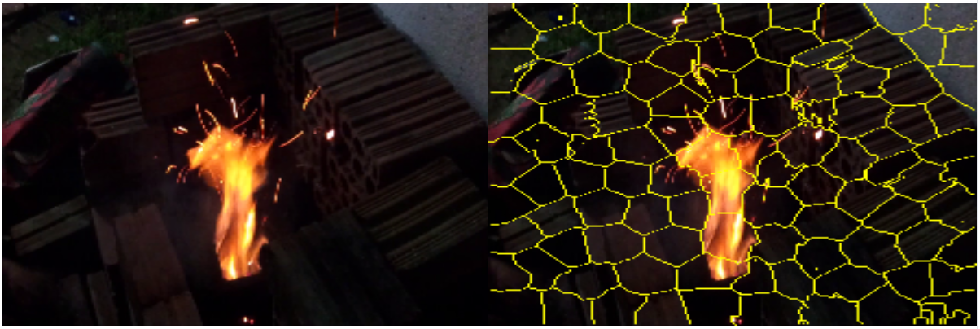
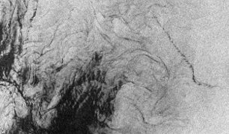
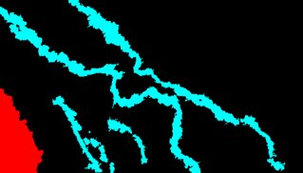
DNN-based applications with real-world data in remote smart oil fields
Fire Detection (Fire)
240 videos of 2 sec. Each with different backgrounds
Human Activity Recognition (HAR)
Smart phone sensor – 30 volunteers
Acoustic Impedance Estimation (AIE)
Complex acoustic 2-D data set based on the geology
of Angola
Oil Spill Detection (Oil)
Synthetic Aperture Radar (SAR) images collected from Sentinel-1 European Satellite missions
Fire Detection
Original Image
Ground Truth
Notes:
More details about workloads – datasets and MKlab specially

Slide 18
Various DNN-based applications for Industry 4.0
Latency-sensitive inference execution
Accuracy
Deadline constraints
Execution time is stochastic
Multi-tenancy
Resource heterogeneity
App Type | DNN Model | Input Type | Scope | Code base
Fire Detection | Customized Alexnet | Video Segment | Control & Monitoring | Tensorflow
Human Activity Recognition | Customized Seq. Neural Network | Motion Sensors | Workers Safety | Keras
Oil Spill Detection | FCN-8 | SAR Images | Disaster Management | Keras
Acoustic Impedance Estimation | Temporal Convolutional Network | Seismic Data | Seismic Exploration | Pytorch
To develop robust Industry 4.0 solutions
Explore the behavior of execution time
Capture the stochasticity

Slide 19
AWS cloud and chameleon fog
Cloud computing platform
AWS – SSD
Machine Type | VM Config | vCPU | GPU | Mem. (GB)
Mem. Opt | r5d.xlarge | 4 | 0 | 32
ML Opt | inf1.xlarge | 4 | 0 | 8
GPU | g4dn.xlarge | 4 | 1 | 16
Gen. Purpose | m5ad.xlarge | 4 | 0 | 16
Com. Opt. | c5d.xlarge | 4 | 0 | 8
Fog computing platform
Chameleon server
Unreliable – Transient Failures
Less variation in VMs
VM Config | vCPU | Mem. (GB)
m1.xlarge | 8 | 16
m1.large | 4 | 8
m1.medium | 2 | 4
m1.small | 1 | 2
Notes:
The DRL agent maintains an experience replay buffer D, a
policy π(akjsk; θa) (the actor network) and an estimate of the
value function V (sk; θv) (the critic network), where θa and
θv are the parameters of the actor network and critic network,
respectively.

Slide 20
Motivation: Preliminary experiment
Heterogeneous machines –> stochastic inference execution time
Number of Attempts
The oil spill detection application is executed 30 times in heterogeneous machines of AWS
Result: Inference time highly stochastic

Slide 21
Experimental setup for performance modeling
Cloud as a dynamic (online) system loaded with pre-trained DNN-based applications
Tensorflow, Keras, and other dependencies
Hot start inference time
VMs of cloud platforms utilize Ubuntu 18.04
Capture the randomness found from initial experiment
Each application executed 30 times

Slide 22
Application-Centric analysis of inference time: Normality Test
Identify underlying statistical distribution of inference execution time
Shapiro-Wilk test to verify the normality
Does not follow normal distribution
Notes:
Improve screenshots

Slide 23
Application-Centric analysis of inference time: Insights
Insights
Shapiro-Wilk test for AWS and Chameleon rejects normality assumption
The K-S test reflects the dominance of Student’s t-distribution
Various configurations of input data is decisive on the statistical distribution of the inference time

Slide 24
Application-Centric analysis of inference time: Central tendency
ML Optimized & GPU instances often outperform other AWS machine types
Fire and Oil experience a higher standard deviation
characteristics of their input data
AWS offers a lower inference time than Chameleon
Utilization of SSD

Slide 25
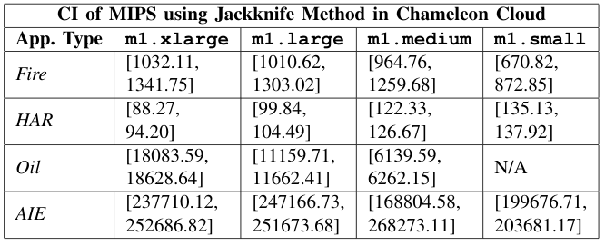
Resource-Centric analysis of inference time: Confidence interval
Model MIPS (as a rate-based performance metric) of the heterogeneous machines for each application
Confidence intervals (CI) of MIPS
Jackknife
Bootstrap
Wide range
More uncertainty

Slide 26
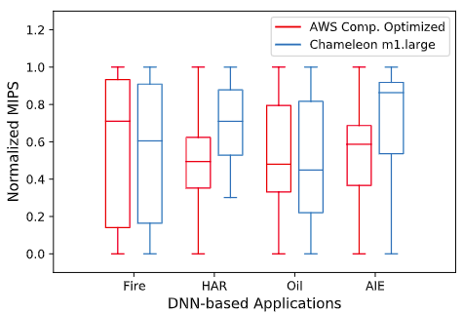
Resource-Centric Analysis of Inference Time: cross-platform analysis
A broad CI range for Fire detection
The 1st and 3rd quartiles of the CI range in Chameleon is larger than AWS
Transient failures
Wide range indicates
Variations in the input data
The reliability of underlying resources

Slide 27
Publications for contribution 2: Application level
Razin Farhan Hussain, Alireza Pakravan, and Mohsen Amini Salehi, Analyzing the Performance of Smart Industry 4.0 Applications on Cloud Computing Systems published in proceedings of 22nd IEE International Conference on High Performance Computing and Communications (HPCC '20)

Slide 28
Outline
Introduction & background
Motivation & research roadmap
Contributions:
Identifying the scope of Industry 4.0 applications across edge-fog-cloud systems
Performance Analysis of Smart Industry 4.0 Applications in Fog & Cloud
Proposing federated fog computing systems to resource provisioning of remote Industry 4.0 applications

Slide 29
Federated fog to support latency-sensitive tasks
Fog federation, a potential computational platform
Quality of Service: Successful completion of latency sensitive monolithic tasks
Disastrous situation -> Surge in computing demand
Latency sensitive tasks have deadline constraints
How to design a dynamic federated fog system in remote Industries?
Robust against uncertainties -> communication and computation
Can handle surges in demand during a disaster
Identify end-to-end latency of a task
Communication
Computation

Slide 30
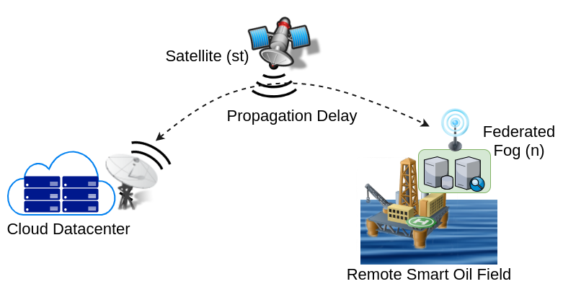
Estimating communication latency
Distance
Communication latency
transmission latency
propagation latency
Speed
: Uplink transmission latency
: Downlink transmission latency
Transmission latency for task ''t'' of type ''i'' between two fog systems m, and n
= +

Slide 31
Estimating computing latency
Task completion time influenced by
Waiting time in queue
Task execution time->Stochastic
Different task types
Characteristics of machines
Model the computational latency using statistical distribution
PDF, built upon historical completion time information (ETC)
Notes:
animations

Slide 32
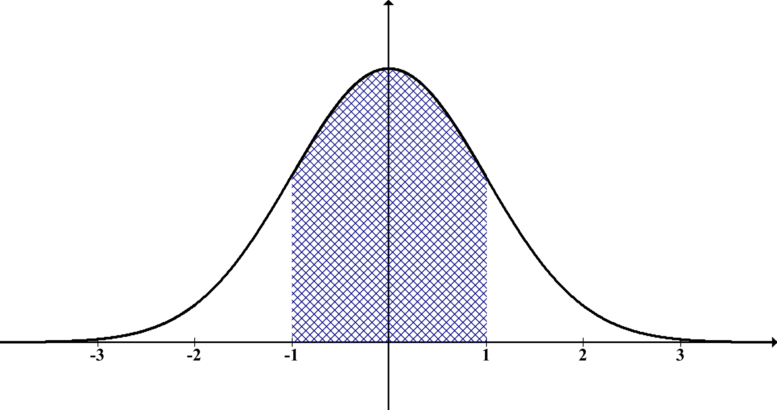
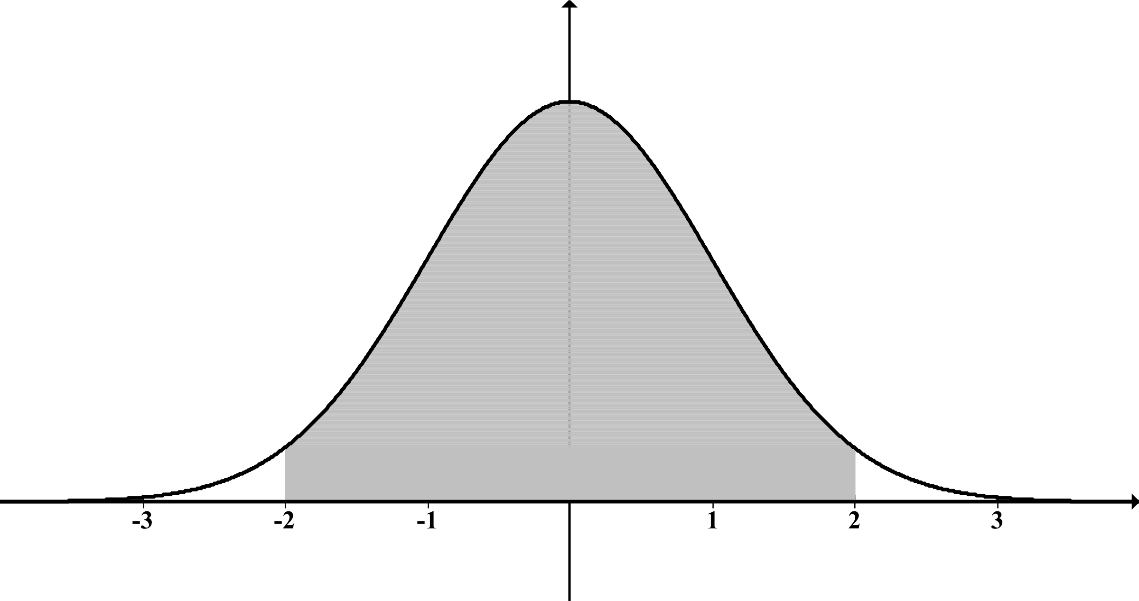
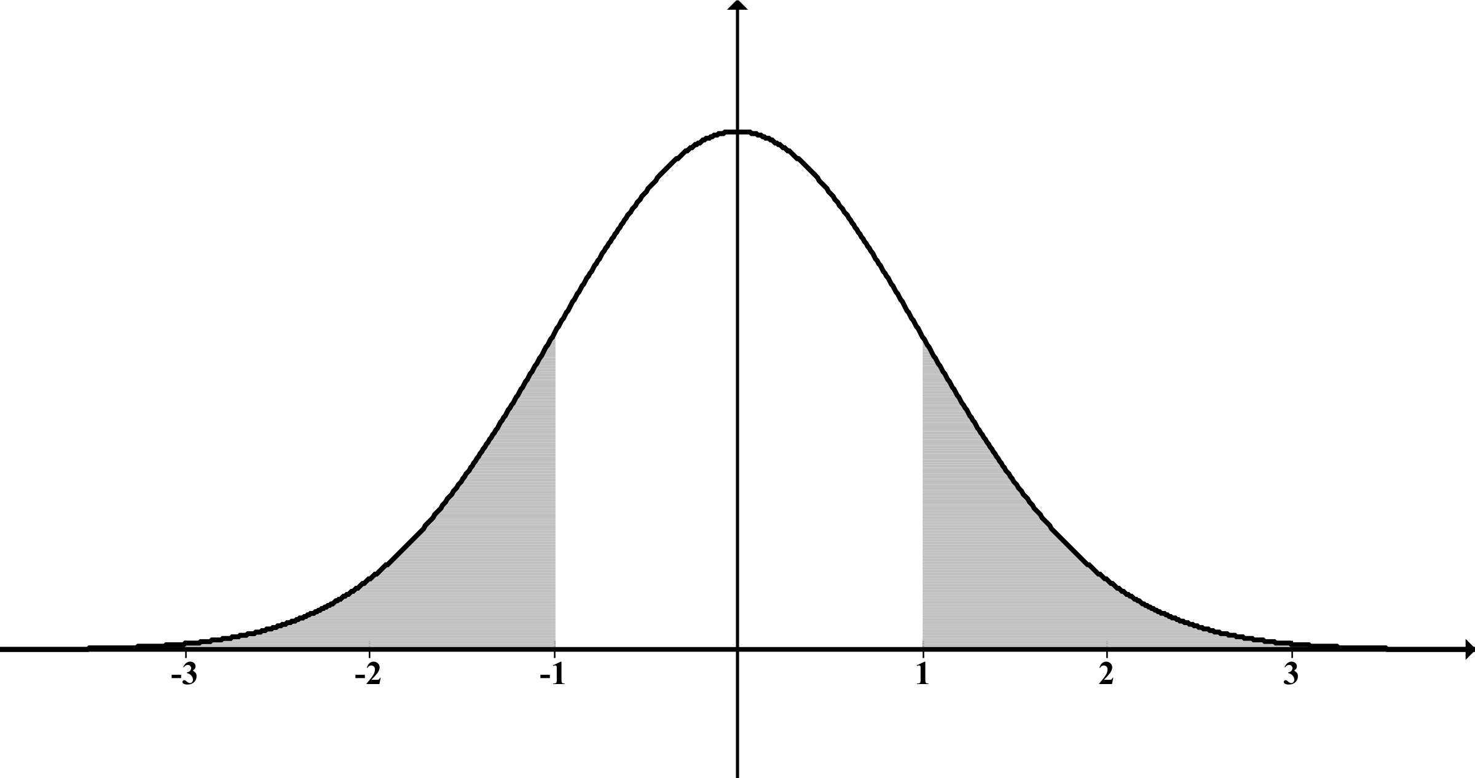
Estimating end-to-end latency
Compound latency
communication and computation = end-to-end latency
Convolution
PDF of communication latency (ETT)
PDF of the computational latency (ETC)
*
=
N_{i} : PDF of task's communication latency
M_{i} : PDF of task's computational latency
The end-to-end latency for t_{i}: E_{i} = N_{i} * M_{i}
Notes:
Similar to earlier slide

Slide 33
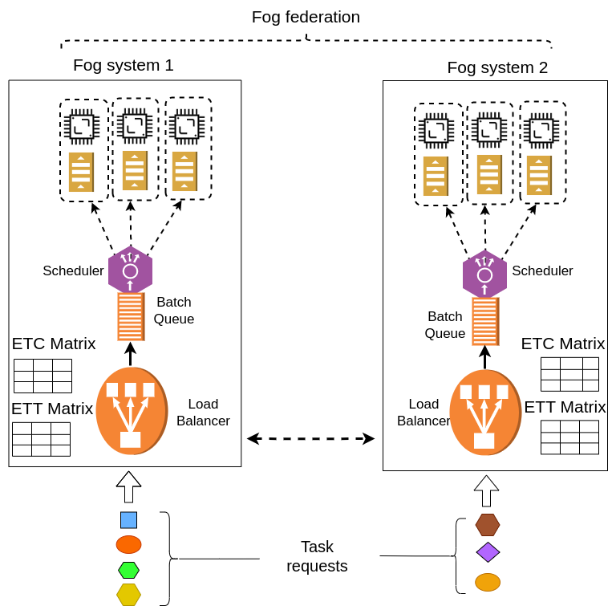
Resource provisioning using ETC and ETT matrix in load balancer
 | Fog 1 | Fog 2
Task Type 1
Task Type 2
computation latency
Communication latency
Notes:
Need picture revision

Slide 34
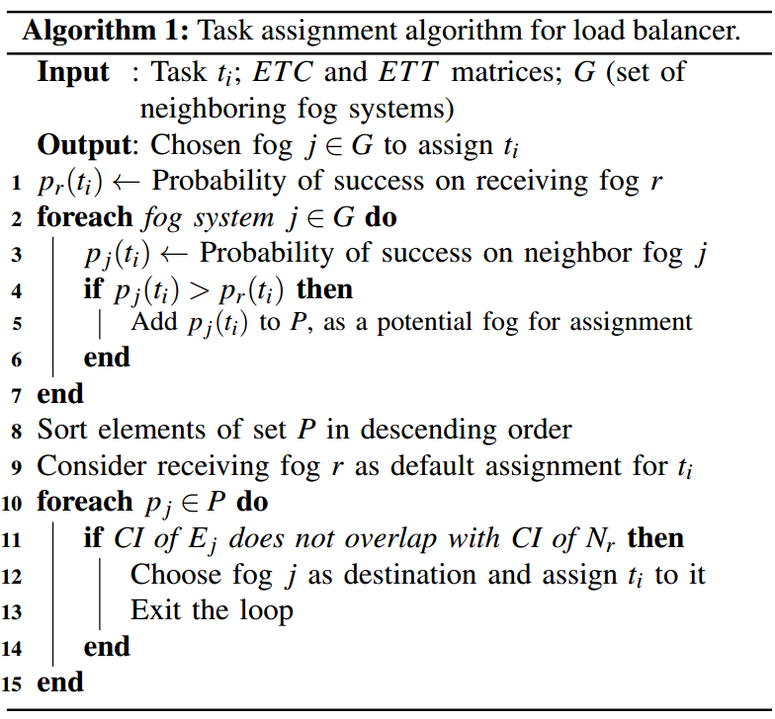
Task allocation algorithm to provision resources in load balancer
Fog system has computation (ETC) & communication (ETT) latency distributions for each task type
LB estimate probability of success of receiving task
Highest probability of success
Receiving fog: Immediate assignment
Neighbor Fog: Check CI overlap to find significantly better fog

Slide 35
Performance evaluation: Baseline heuristics
Minimum Expected Completion Time (MECT)
Utilizes ETC matrix to choose suitable fog system within federated fog
Maximum Computation Certainty (MCC)
Calculate the difference between the task’s deadline and average completion time(called certainty)
Choose the fog with maximum certainty
Edge Cloud (EC)
Heuristic operates based on conventional edge computing model where no federation is recognized
It randomly choose a fog system

Slide 36
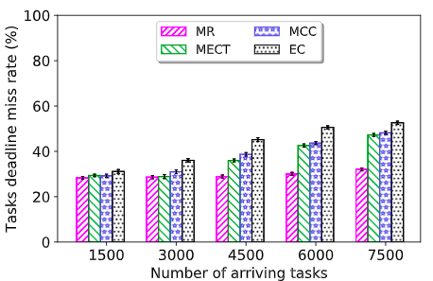
Performance evaluation of load balancer: Deadline miss rate
Observation:
For 7,500 tasks, MR offers
~16% lower deadline miss rate than MECT and MCC
~ 21% better than EC
Reason:
MR captures end-to-end latency & proactively utilizes federation
Notes:
Minimum Expected Completion Time (MECT)
Maximum Computation Certainty (MCC)
Edge Cloud (EC)

Slide 37
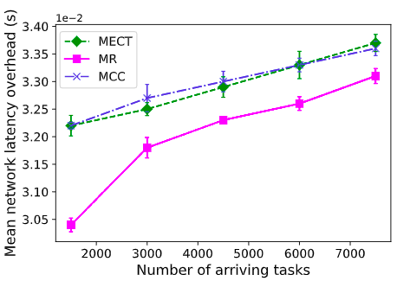
Analyzing communication overhead of federated fog
Observation:
MECT and MCC cause higher average communication latency
Reason: Not consider the communication latency and aggressively redirect tasks – network congestion

Slide 38
Publications for contribution 3: System level
Razin Farhan Hussain, Mohsen Amini Salehi, Anna Kovalenko, and Omid Semiari, Federated Edge Computing for Disaster Management in Remote Smart Oil Fields published in Proceedings of the 21st IEEE International Conference on High Performance Computing and Communications (HPCC '19)
Razin Farhan Hussain, Omid Semiari, and Mohsen Amini Salehi Robust Resource Allocation Using Edge Computing for Vehicle to Infrastructure (V2I) Networks published in Proceedings of the 3rd IEEE International Conference on Fog and Edge Computing (ICFEC ’19)
Razin Farhan Hussain, Mohsen Amini Salehi, and Omid Semiari Serverless Edge Computing for Green Oil and Gas Industry published in Proceedings of the IEEE Green Technologies Conference(GreenTech’19)

Slide 39
Outline
Introduction & Research Roadmap
Background on Federated Fog Computing
Contributions:
Identifying the scope of Industry 4.0 applications across edge-fog-cloud systems
Performance Analysis of Smart Industry 4.0 Applications in Fog vs Cloud
Feasibility of Resource Allocation of Monolithic Applications Across Federated Fog Systems
Adapting Remote Industry 4.0 Smart Micro-Services to Federated Fog Systems

Slide 40
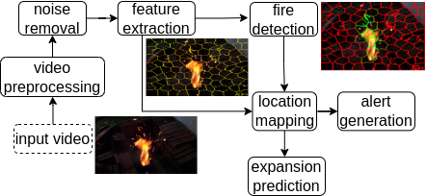
Micro-service workflow applications in Industry 4.0
Monolithic architecture
Modern software architecture
Micro-service: micro-level services
Follow workflow pattern
Automated deployment process
Least amount of administration
Legacy applications
Tightly coupled
Run as a single independent service
Fire Safety Application
How to support micro-service workflows across federated fog systems?
Notes:
Focus on micro-service workflow - Independent components that run each application process as a service
Although legacy applications that are monolithic and naturally independent
Examples: Seismic analysis, Alert generation, Web based visualization

Slide 41
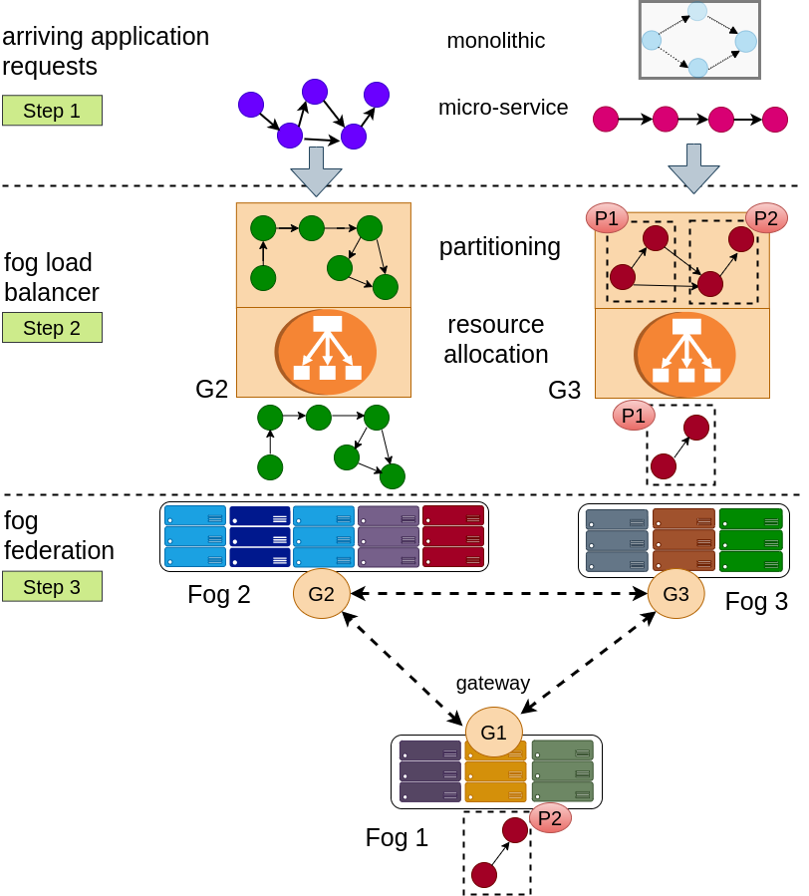
Provision micro-service workflows across federated fog
Applications with different software architecture
Load-balancer partitioning micro-services and estimate relevant fog across federation
Fog systems executing partitioned micro-services
Notes:
A fog load balancer
Partitioning if needed
Software architecture
Distribute partitions across fog federation
Stochastic execution latencies of receiving applications

Slide 42
Micro-service workflow partitioning method
Micro-service workflow "w"
[deadline]
[computing latency - ETC ]
Min-cut partition
Two subgraphs
Using ETC and ETT estimate chance of success for above two subgraphs across federation
Repeat min-cut if chance of success is low or having single micro-service

Slide 43
Performance evaluation: Baseline micro-service partitioning methods
Graph-cut: A Cut partitions graph`s vertices (micro-services) into two disjoint subsets
Minimum cut: A cut having minimum number of edges that cross the cut (unweighted) or minimal in terms of the weights of the edges that cross the cut (weighted)
Least data transfer:
Consider those links that transfer least data generated from one micro-service to another to partition

Slide 44
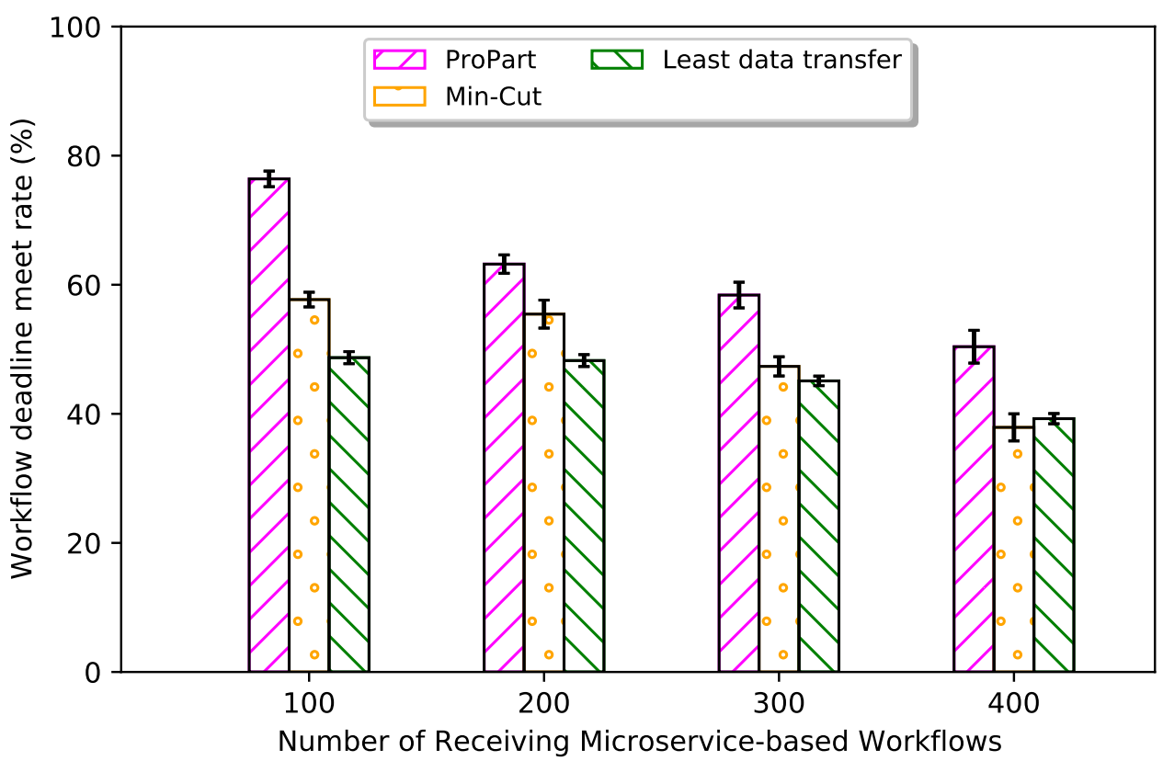
Performance evaluation: Partitioning smart applications
Result
Deadline meet rate decreases with increasing computing demand
Performance improvement
Less oversubscribed: 25%
High oversubscribed: 18%
constant performance
Observation
Statistical assessment of each partition’s success
Repeated probabilistic estimation
Notes:
incorporating micro-service partitioning does not decrease performance of fog federation
Successful adaption of micro-service workload
5% performance Improvement than monolithic task allocation

Slide 45
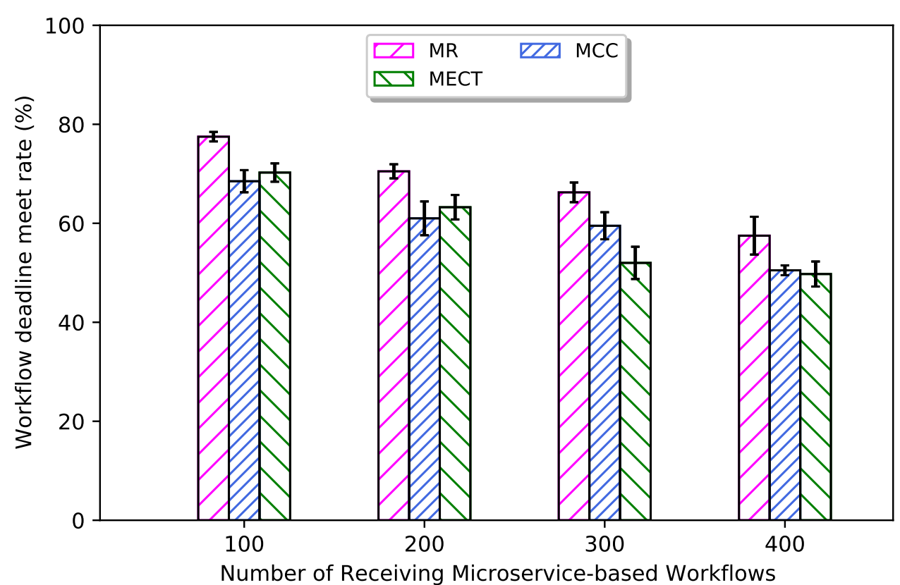
Resource allocation comparison using "ProPart" partitioning
Result:
MR outperform constantly
Not significant performance drop
Observation:
"MR" is aware of the uncertainty in the computation and communication latencies
"MECT" is only cognizant of computation
"MCC" utilizes deadlines - lacks communication information

Slide 46
Impact of fog federation scale up using "ProPart" & "MR"
Significant performance improvement
Propart efficiently utilize federation

Slide 47
Publications for contribution 4: System level
Razin Farhan Hussain and Mohsen Amini Salehi, Adapting Remote Industry 4.0 Applications to Federated Fog Computing Systems prepared to submit in Future Generation Computer Systems Journal

Slide 48
Outline
Introduction & Research Roadmap
Background on Federated Fog Computing
Contributions:
Performance Analysis of Smart Industry 4.0 Applications in Fog vs Cloud
Feasibility of Resource Allocation for Monolithic Applications Across Federated Fog Systems
Adapting Remote Industry 4.0 Smart Micro-Services to Federated Fog Systems
Conclusion & future works

Slide 49
Conclusion
Main objective: Identify, evaluate, and manage robust execution of Industry 4.0 applications
Explore the behavior of execution time for DNN-based applications in Industry 4.0
Introduce a real-world workload of inference time
Github Link: https://github.com/hpcclab/Benchmarking-DNN-applications-industry4.0
Addressing the potential benefits of federated fog systems
Real-time monolithic applications
Micro-service workflow applications
HPCC LAB
Notes:
https://github.com/hpcclab/Benchmarking-DNN-applications-industry4.0
Interesting thing about last point: cloud-like services for remote industry 4.0 that users don't realize the service distruptions. DeepLense

Slide 50
Future Works
Resource allocation for Industry 4.0 applications across federated fog systems using reinforcement learning
Autonomous agents to make sound decisions to changing conditions in environment – capture uncertain completion time
Data locality aware resource allocation across federated fog systems
Initial input data's localization impacts on fog platforms' performance
Dynamic Fault-Tolerant Federated Fog Systems for Industry 4.0
A fog system (super fog) that provides fault-tolerant fog services across the federated fog systems to improve the efficiency of the federation.
The Cognitive Aspects of Human-Machine Interaction for Smart Industry 4.0 Solutions
Fog Computing and Advanced Analytics for Human-Machine Interaction in Industrial Sector
Notes:
RL: Accordingly, the field of reinforcement learning (RL) has emerged as an important subset of machine learning because it enables autonomous agents to make sound decisions in response to changing conditions in their environment. Hence, uncertain execution behavior can be addressed effectively using RL technique

Slide 51
Questions?

Slide 53
Example of monolithic app

Slide 54
Remaining Steps
Robust Resource Allocation for Industry 4.0 Smart Applications Across Fog federation
Improve the resource allocation scheme
Using realistic workload in heterogeneous fog system
Adopting software architecture in task allocation to support Industry 4.0 smart application
Finish the book: IoT for Smart Operations in the Oil and Gas Industry – Published by Elsevier on 20th September, 2022

Slide 55
Future Works
Customized Loss Function to Mitigate Class Imbalance of Federated Learning in Federated Fog
Federated Worker Fog Selection Technique in Semantic Segmentation DNN-based Applications
Federated Learning to Detect Carbon emission in Industry 4.0
Oil Spill Spread & Direction Prediction

Slide 56
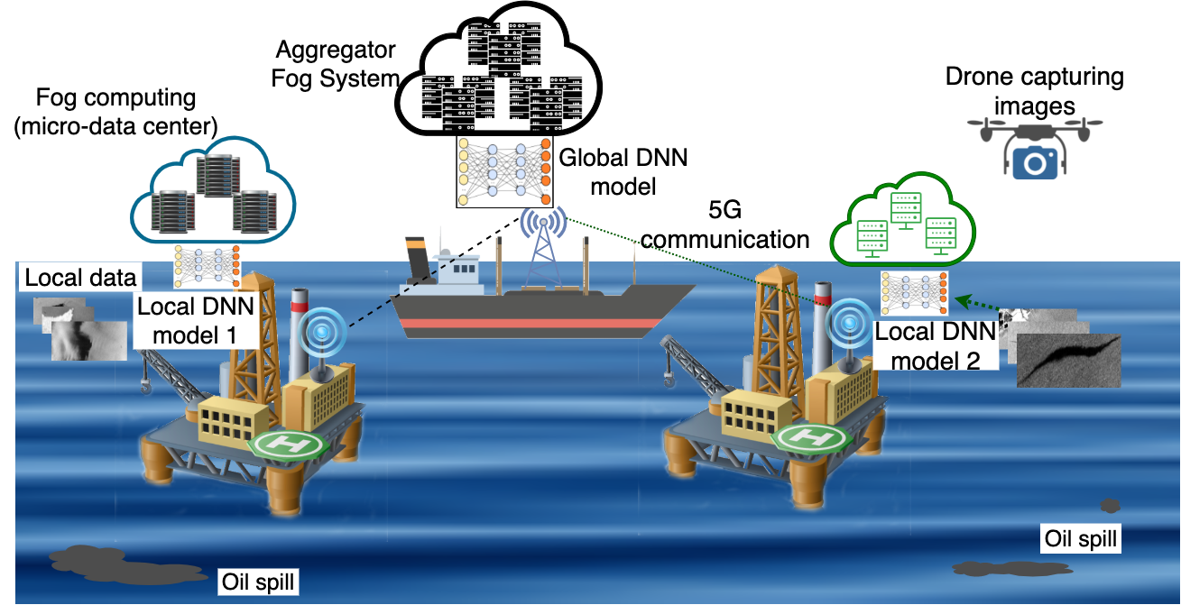
Motivation & Problem Definition
Challenges in Federated Fog:
Lack of data
Low probability event
Privacy preserving
Data ownership
Cost
Data acquisition: Satellite, Drones
One Solution
Federated learning

Slide 57
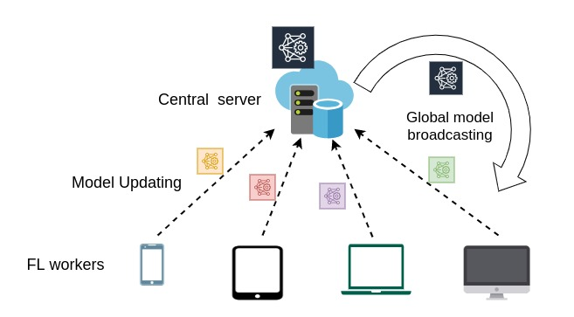
Federated Learning Technique
Workers (edge/fog) accept participation invitation & download global model
Federation formed
Worker train the model with local data
Updated model is sent back to central server
Central server update the global model
Fog Federation

Slide 58
Class Imbalance Issue
Oil Spill Dataset
Training dataset can have imbalance class distribution
Class Imbalance
FL training
workers local dataset suffer from class imbalance
The aggregation consideration
Workers with less class imbalance
Class | Pixels (Million)
Sea Surface | 797.7
Oil Spill | 9.1
Look alike | 50.4
Ship | 0.3
Land | 45.7

Slide 59
Appendix
DNN-applications Datasets
Fire Detection (Fire)
240 videos of 2 sec. Each with different backgrounds
Human Activity Recognition (HAR)
Smart phone sensor – 30 volunteers
Source: UCI machine learning repository
Acoustic Impedance Estimation (AIE)
Complex acoustic
2-D data set based on the geology
of Angola
Source: Stanford Exploration Project
Oil Spill Detection (Oil)
Synthetic Aperture Radar (SAR) images collected from Sentinel-1 European Satellite missions
Source: MKLab – A Computer Vision Research Institution in Greece

Slide 60
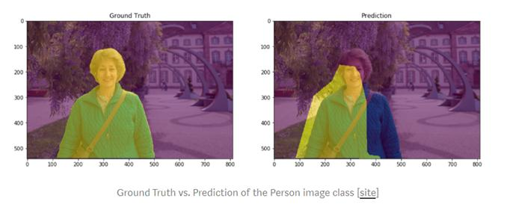
Intersection Over Union (IoU)

Slide 61
Mask RCNN for Oil Spill Detection

Slide 62
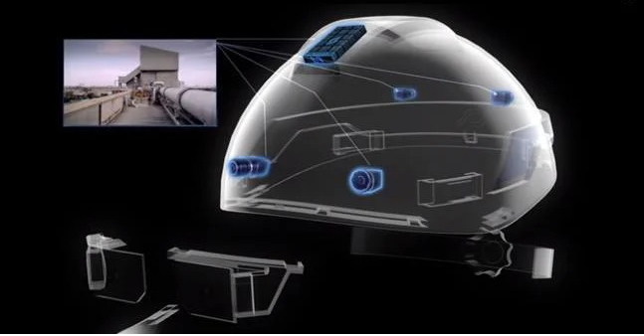
Use Case of Using Fog Federation in Industry 4.0
A significant processing delay
Confuses a process engineer to perform any fault intolerant work
Leads to an accident
AR system supported by fog computing can maximize throughput and reduce latency
Processing
Transmission
Design and implement a wearable cognitive assistance spanning [HCH+14]
Backed up by Google Glass and Cloudlet (Fog)
Assist the user by providing hints for social interaction via real-time scene analysis
Oil Spill Detection in Remote Offshore oilfield
Early detection of source of oil spill
Oil spill trajectory detection
Smart Helmet
Notes:
Taxonomy on Fog Federation & DNN

Slide 63
Scopes of Fog Federation
Smart Industry 4.0 with smart sensor, and IoT devices
Data pre-processing and noise filtering
Augmented Reality (AR) simulation
Security and Safety
Surveillance and monitoring
Anomaly detection
Live video stream
real-time video processing (inference) and feedback

Slide 64
Summary & Discussion of Performance Analysis
Accurately estimating the inference time of latency-sensitive DNN-based application
Robustness and safety of Industry 4.0
Application centric analysis
Inference times across the two computing platforms often follow Student’s t-distribution
Resource-centric analysis
Input type has much influence on execution time in Chameleon (Fog System)
Fog (Chameleon) systems are more uncertain than Cloud (AWS)

