Slide 1
Natively-Heterogeneous Design of Distributed Computing Systems
PhD Prospectus Exam
Ali Mokhtari
April 2023
Notes:
Present my works and studies that I’ve done so far towards my PhD program

Slide 2
Outline
Heterogeneity in Distributed Computing Systems
A Natively Heterogeneous Design for Cost- and QoS-aware Distributed Systems
Heterogeneity-aware Task Scheduling
Heterogeneity-aware Admission Control
Summary and Remaining Steps
Notes:
An introduction to heterogeneous computing systems
I’ll talk about the heterogeneous-native design for cost and qos aware distributed systems
Here, I’ll propose a performance-driven heterogeneity measure, then I used that measure to design a HC systems such that the desired QoS satisfied with minimum cost
Then, I’ll introduce a heterogeneity-aware task scheduling method that targets Fairness and Energy objectives in HC systems, and even improving the QoS
Next, I’ll employ a heterogeneity-aware admission control to maintain the robustness of HC systems against uncertainties in tasks’ execution time and arrival time
Finally, I conclude the presentation and talk about the remaining steps

Slide 3
Heterogeneity in Distributed Computing Systems

Slide 4
Heterogeneity
What is heterogeneity in distributed computing systems?
Notes:
Let me give you some examples to clarify our definition of heterogeity, later I formally define what I mean by heterogeneous computing system

Slide 5
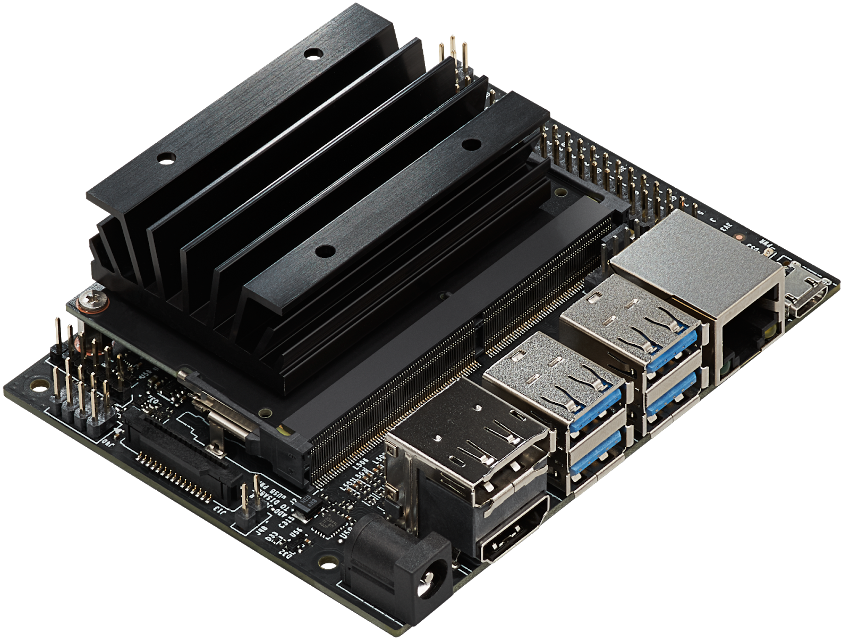
Machine Heterogeneity : Edge
GTX 20 series
GTX 30 series
GTX 40 series …
Inference
Inference Time
Variation in Execution Time
Face Recognition
Edge Computing System
Jetson Nano
. . .

Slide 6
Machine Heterogeneity : Cloud
Inference Time
Variation in Execution Time
Inference
Face Recognition
. . .
Inference

Slide 7
Task Heterogeneity
20 msec
Face Recognition
Inference Time
Variation in Execution Time
60 msec
Speech Recognition
AWS EC2 Instance
200 msec
inference time
NLP

Slide 8
Machine and Task Heterogeneity
100,20, 50 msec
Face Recognition
Inference Time
120, 60, 80
Speech Recognition
AWS EC2 Instances
500, 200, 350
inference time
NLP

Slide 9
System Heterogeneity Dimensions
System Heterogeneity
Machine Heterogeneity
Task Heterogeneity
The variation in the execution times of a given task across all the machines
The variation in the execution times of tasks for a given machine
CPUs
GPUs
FPGA
Object Detection
Speech Recognition
Video Transcoding

Slide 10
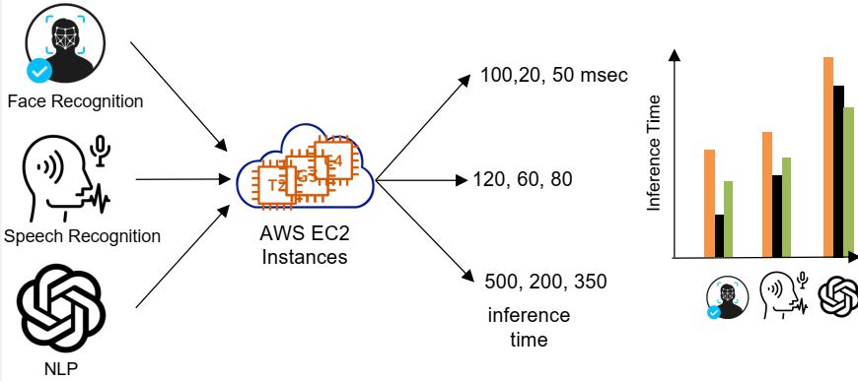
Heterogeneous Computing (HC) Systems
A computing system is heterogeneous if and only if :
“Execution time of at least one [task, machine] pair differs from others”
Variation in Execution Time
 | g3s.xlarge | t2.2xlarge | C4.xlarge
Face Recognition | 20 | 300 | 50
Speech Recognition | 50 | 400 | 100
ChatGPT | 100 | 1000 | 150
Variation in Execution Time

Slide 11
Performance Model of HC Systems
EET (Expected Execution Time) Matrix
Machine types
Machine Types Task Types | M₁ | M₂ | o o o | M_{m}
T₁ | $$e_{11}$$ | $$e_{12}$$ | o o o | $$e_{1m}$$
T₂ | $$e_{21}$$ | $$e_{22}$$ | o o o | $$e_{2m}$$
o o o | o o o | o o o | o o o | o o o
T_{n} | $$e_{n1}$$ | $$e_{n2}$$ | o o o | $$e_{nm}$$
Task types
Expected Execution Time (EET) of task type T₁ on machine type M₂

Slide 12
Heterogeneity in EET Matrix
EET (Expected Execution Time) Matrix
Machine Types Task Types | M-1 | M-2 | M-3 | M-4
TT-1 | 2.8 | 6.5 | 3.7 | 7.1
TT-2 | 2.5 | 6.4 | 5.0 | 6.5
TT-3 | 3.1 | 6.2 | 3.7 | 7.9
TT-4 | 3.1 | 8.1 | 4.5 | 7.8
Machine Heterogeneity
The execution time of a given task varies across machines
Task Heterogeneity
A given machine has different expected execution time for different tasks

Slide 13
Why Heterogeneity Matters in System Design?
Heterogeneity impacts the system performance
Homogeneous System
Heterogeneous System
Solution A
Solution B
Solution A
Solution B
Solution A
Solution B
System Performance concerning QoS/Cost objective

Slide 14
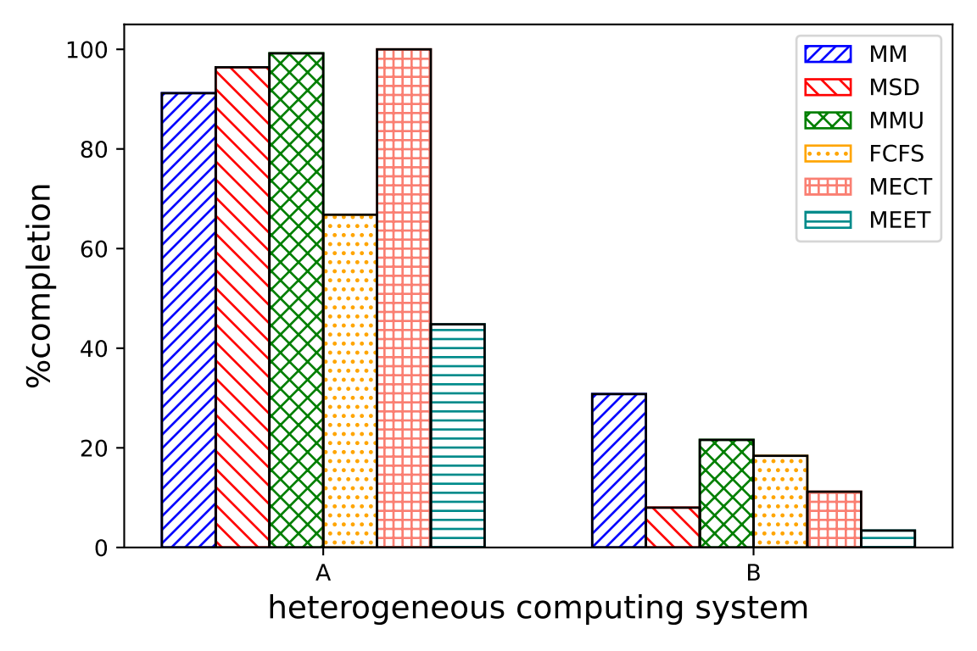
Heterogeneity Matters in Task Scheduling!
MMU > MSD > MM > FCFS
HC System A → B
MM > MMU > FCFS > MSD

Slide 15
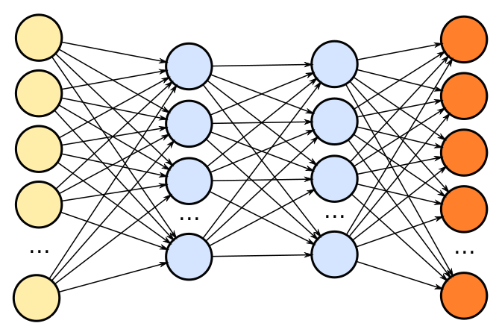
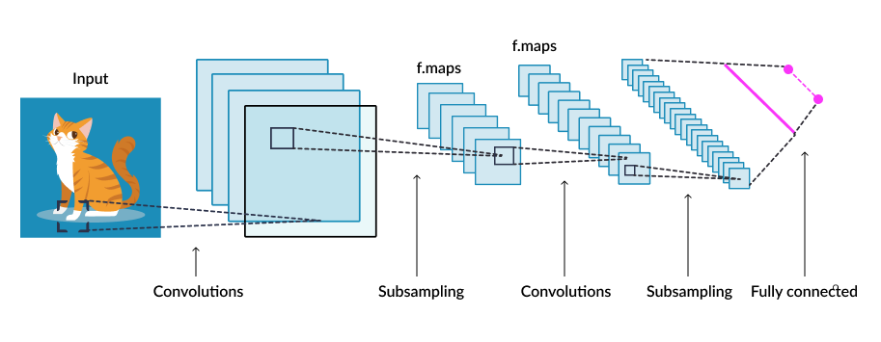
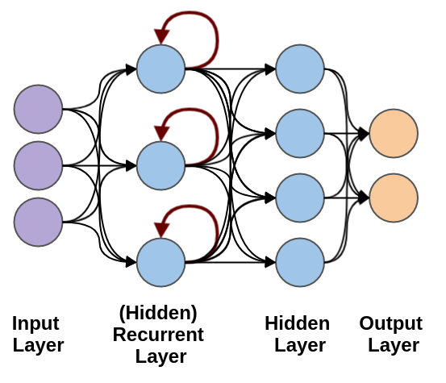
Why Heterogeneity is important?
Heterogeneity Matters in System Configuration!
ML Inference Queries
Heterogeneous Cloud VMs
Objectives
QoS Constraint
Minimized Cost

Slide 16
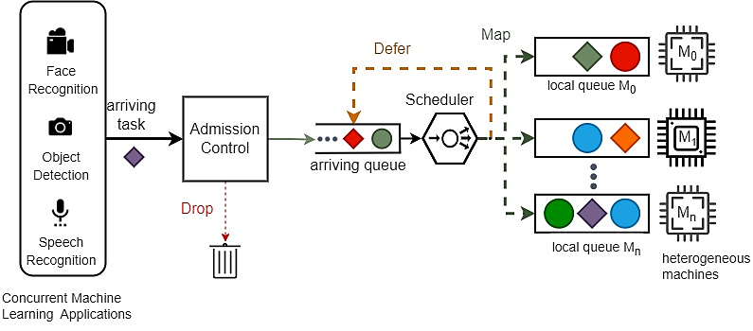
Contributions Overview
(2) Heterogeneity-aware Scheduler
(3) Heterogeneity-aware Admission Control
(1) A Natively Heterogeneous Design for Cost- and QoS-aware Distributed Systems
Notes:
Heterogeneous as First Class Citizen

Slide 17
A Natively Heterogeneous Design for Cost- and QoS-aware Distributed Systems
Ali Mokhtari, Pooyan Jamshidi, Mohsen Amini Salehi, Performance-driven Quantification of Heterogeneity in Distributed Systems, (pending)

Slide 18
Mapping a Heterogenous Space into a Homogeneous Space
$$T^{∗}$$
$$M^{∗}$$
Face Recognition
Mapping Function
$$T^{∗}$$
$$M^{∗}$$
Speech Recognition
$$M^{∗}$$
$$T^{∗}$$
NLP
Machines
Machines
Heterogeneous Computing System
Homogeneous Computing System

Slide 19
How Mapping Function Helps in Heterogeneous-native System Design?
Simplification
Estimate the QoS
$$T^{∗}$$
$$M^{∗}$$
Face Recognition
QoS
$$T^{∗}$$
$$M^{∗}$$
$$\hat{QoS}$$
Speech Recognition
$$M^{∗}$$
$$T^{∗}$$
Mapping Function
Machines
NLP
Machines
Heterogeneous Computing System
Homogeneous Computing System

Slide 20
How Mapping Function Helps in Heterogeneous-native System Design?
Heterogeneity Measure
Comparison across HC systems
$$\hat{QoS_{B}}$$
$$QoS_{B}$$
Workload
?
Estimated QoS once HC systems mapped via mapping function
$$≈$$
$$QoS_{A}$$
<
$$\hat{QoS_{B}}$$
HC System B
$$\hat{QoS_{A}}$$
$$QoS_{B}$$
Unknown prior completing the workload
We can predict both HC systems will perform similarly without processing the workload
$$QoS_{A}$$
$$\hat{QoS_{A}}$$
HC System A

Slide 21
Speedup due to Machine Heterogeneity
Slowest machine type
$$M_{1}$$
$$t_{homo}$$
Inference Requests
Makespan
Workload
$$M_{2}$$
$$M_{1}$$
$$t_{hete}$$
Total time to complete the workload
$$M_{3}$$
$$M_{1}$$
$$Speedup due to heterogeneity=\frac{t_{homo}}{t_{hete}}$$
Machines
Homogeneous computing System
Heterogeneous computing System

Slide 22
Speedup due to Machine Heterogeneity
Baseline machine
The slowest machine type for that task type
Slowest machine type for task type “i”
$$S_{i,j}^{M}=\frac{\max_{j}{e_{i,j}}}{e_{i,j}}$$
Execution time of of task type “i” on machine type “j”

Slide 23
Example
EET Matrix
Machine Tasks | M-1 | M-2 | M-3 | M-4
TT-1 | 2.8 | 6.5 | 3.7 | 7.1
TT-2 | 2.5 | 6.4 | 5.0 | 6.5
TT-3 | 3.1 | 6.2 | 3.7 | 7.9
TT-4 | 3.0 | 8.1 | 4.5 | 7.8
$$S_{1,1}^{M}=\frac{7.1}{2.8}=2.5$$
$$S_{1,2}^{M}=\frac{7.1}{6.5}=1.1$$

Slide 24
Speedup due to Task Heterogeneity
Slowest task type executing on machine
Inference Requests
$$t_{homo}$$
Makespan
$$M_{1}$$
$$t_{hete}$$
Total time to complete the workload
Workload trace of tasks
$$Speedup due to heterogeneity=\frac{t_{homo}}{t_{hete}}$$
Heterogeneous computing System
Homogeneous computing System

Slide 25
Speedup due to Task Heterogeneity
Baseline task type
The task which has the largest execution time on machine type “j”
Slowest task type on machine “j”
$$S_{i,j}^{T}=\frac{\max_{i}{e_{ij}}}{e_{i,j}}$$
Execution time of of task type “i” on machine type “j”

Slide 26
Example
EET Matrix
Machines Tasks | M-1 | M-2 | M-3 | M-4
TT-1 | 2.8 | 6.5 | 3.7 | 7.1
TT-2 | 2.5 | 6.4 | 5.0 | 6.5
TT-3 | 3.1 | 6.2 | 3.7 | 7.9
TT-4 | 3.0 | 8.1 | 4.5 | 7.8
$$S_{1,1}^{T}=\frac{3.1}{2.8}=1.1$$
$$S_{2,1}^{T}=\frac{3.1}{2.5}=1.2$$

Slide 27
Speedup Matrices due to Heterogeneity

Slide 28
Mean Speedup due to Heterogeneity
$$\overline{S^{M}}$$
Mean speedup due to machine heterogeneity
$$\overline{S^{T}}$$
Mean speedup due to task heterogeneity
Notes:
The interaction of variables in a complex stochastic system can be replaced by the average interactions between those variables
As such, we can use mean to represent the speedup behavior of the all (𝑡𝑎𝑠𝑘, 𝑚𝑎𝑐ℎ𝑖𝑛𝑒) pairs in both $S^{M}$ and $S^{T}$

Slide 29
Mean Speedup due to Heterogeneity
Central Tendency Measures
Arithmetic Mean
Geometric Mean
Harmonic Mean
Mean Speedup due to Machine Heterogeneity for a Task Type
Mean Speedup due to Task Heterogeneity for a Machine Type
Real speedup due to heterogeneity

Slide 30
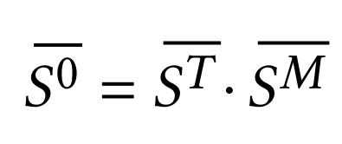
Overall Speedup due to System Heterogeneity
In practice, both machine and task heterogeneity coexists
Their speedup impacts on the QoS are compounded
The overall speedup due to system heterogeneity

Slide 31
Overall Speedup due to System Heterogeneity
Speedup matrix due to machine heterogeneity
Each row of $S^{M}$ is condensed to the arithmetic mean value
Arithmetic Mean
Harmonic Mean
Arithmetic Mean
Harmonic Mean
EET matrix that models the HC system
Speedup matrix due to task heterogeneity
Each column of $S^{T}$ is condensed to the harmonic mean value

Slide 32
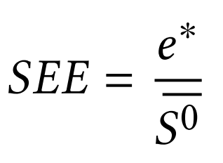
SEE Score: Our Measure of Heterogeneity
“A representative of the Execution Time Behavior of the HC System”
expected execution time of the slowest counterpart homogeneous system
Overall Speedup due to heterogeneity

Slide 33
Mapping a Heterogenous Space into a Homogeneous Space
Heterogeneous System
Homogeneous System
 | $$M_{1}$$ | $$M_{2}$$ | $$M_{3}$$
$$T_{1}$$ | $$e_{11}$$ | $$e_{12}$$ | $$e_{13}$$
$$T_{2}$$ | $$e_{21}$$ | $$e_{22}$$ | $$e_{23}$$
$$T_{3}$$ | $$e_{31}$$ | $$e_{32}$$ | $$e_{33}$$
 | $$M^{∗}$$ | $$M^{∗}$$ | $$M^{∗}$$
$$T^{∗}$$ | $$SEE$$ | $$SEE$$ | $${SEE}^{∗}$$
$$T^{∗}$$ | $$SEE$$ | $$SEE$$ | $$SEE$$
$$T^{∗}$$ | $$SEE$$ | $$SEE$$ | $$SEE$$
QoS-wise
EET
EET

Slide 34
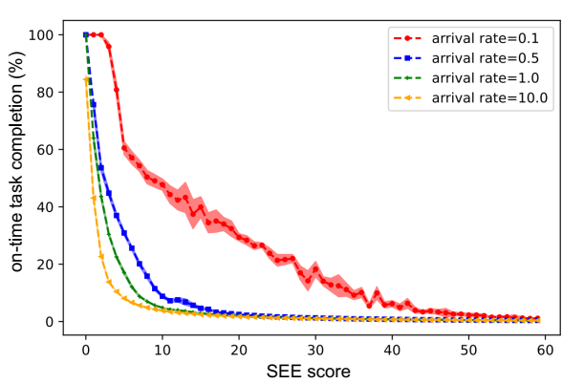
Validating SEE Score as a Heterogeneity Measure
Narrow Confidence Interval Proves that HC systems with similar SEE scores yield similar QoS value
SEE score as a measure to “compare different HC systems
QoS-SEE characteristic curves
Lower SEE Score, Better Performance
Each point represents multiple HC System with the Same SEE Score
Notes:
Results demonstrate QoS–SEE characteristic curves for heterogeneous systems with 4 machines.
In fact, QoS-SEE characteristic curves describe the QoS of systems with certain number of machines as a function of SEE score and the arrival rate

Slide 35
Speedup due to Heterogeneity vs. Task Arrival Rates
Speedup gradually increases
Similar Makespan for Heterogeneous and Homogeneous Systems
Proposed mathematical model can accurately describe the true speedup due to system heterogeneity
Heterogeneity is fully utilized
No Speedup due to Heterogeneity
Makespan is decreasing for HC systems but remains constant for homogeneous
Makespan Dominated by the Idle Times

Slide 36
SEE Score: How Does It Help in System Design?
SEE-Price Optimizer
Arrival rate
 |  |  |  | Price | SEE
6 | 0 | 0 | 0 | 5
1 | 1 | 4 | 1 | 15
o o o |  | . . .
4 | 0 | 2 | 1 | 8
Upper bound for SEE Score
QoS
Constraint
4 | 0 | 2 | 1
Optimal Configuration
Pool of Machine Types

Slide 37
Heterogeneity-aware task scheduling
Ali Mokhtari, Md Abir Hossen, Pooyan Jamshidi, Mohsen Amini Salehi, FELARE: Fair Scheduling of Machine Learning Applications on Heterogeneous Edge Systems, in Proceedings of 15th IEEE International Conference on Cloud Computing (CLOUD), Barcelona, Spain, July 2022

Slide 38
Heterogeneity-aware Task Scheduling
Heterogeneous-native task scheduler targeting fairness and energy objectives
Cost-optimized Heterogeneous Edge Computing (HEC) System with QoS Constraint

Slide 39
Problem Statement
How to design a fair task scheduler such that the on-time task completion rate is maximized within the energy constraint of the HEC system?

Slide 40
Energy-aware Task Scheduling in HEC System
Wasted Energy in HEC Systems
Unsuccessful task completion
Inefficient task scheduling
Drop a task misses its deadline
Defer unlikely-to-succeed
Mapper minimizes energy consumption in its mapping decisions
Notes:
Mapping a task to a machine where the task misses its deadline
The extra energy consumed (wasted) by a machine to complete a task that could be otherwise successfully completed on another machine with less consumed energy

Slide 41
Energy-aware Task Scheduling
Phase-I
Feasible [task; machine] pair that incurs minimum energy usage is singled out and considered as the feasible and efficient pair for that task
It is possible that multiple tasks become feasible for a machine in the system
Phase-II
Map the feasible pair that incurs the minimum expected energy consumption

Slide 42
Fairness Across Task Types
A fair task scheduler is unbiased in allocating resources to the tasks of the same priority
The scheduler should not prioritize task types based on their execution time or any other system level metric other than those explicitly defined by the user

Slide 43
Task Type-based Completion Rate
Completion rate of different task types
$$cr_{i}=\frac{\#completed tasks of type \text{i}}{\# tasks of type \text{i} arrived to the system}$$
In an ideal and fair resource allocation, the completion rate of all task types is one ($∀i cr_{i}=1$)

Slide 44
Fairness in Completing Task Types
Fairness
Task Type Completion rate
Task Types

Slide 45
Suffered Task Types
Task types with low completion rates
We define a limit below the mean task type-based completion rates
If the task type-based completion rate of a task type is less than the fairness limit the task is considered as suffered task type

Slide 46
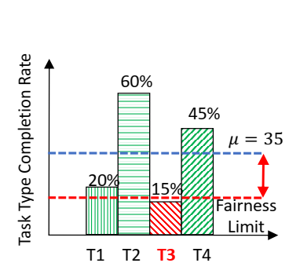
Suffered Task Types
Acceptable range
Suffered task type

Slide 47
FELARE: Fair Energy- and Latency-Aware Resource Allocation
Prioritizing the suffered tasks in the mapping events
Drop non-suffered tasks in favor of infeasible suffered tasks to make them feasible

Slide 48
FELARE: Fair ELARE
The completion rate variance is diminishing from left to right, as a result of FELARE mapping heuristic

Slide 49
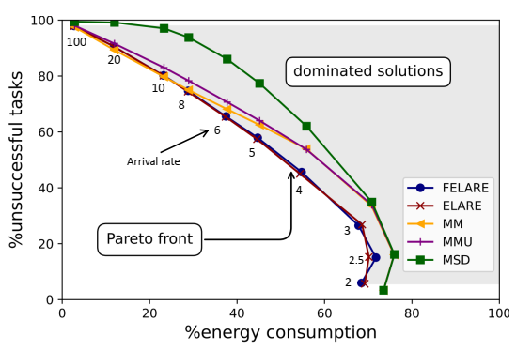
Energy vs Latency: Trade-off in a Bi-Objective Optimization
At high arrival rate all methods exhibits similar
The system is highly oversubscribed and tasks are missed regardless of the mapping heuristic
However, FELARE dominates other heuristics at lower arrival rates

Slide 50
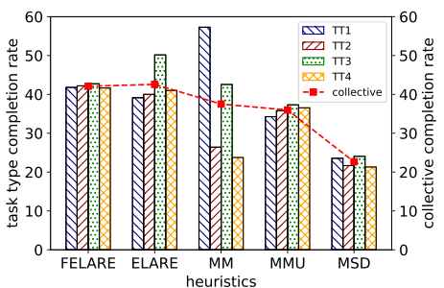
Analyzing Fairness Across Task Types
FELARE could considerably improve the fairness with negligible degradation in the total completion rate

Slide 51
Heterogeneity-aware Admission Control
Ali Mokhtari, Chavit Denninnart, Mohsen Amini Salehi, Autonomous Task Dropping Mechanism to Achieve Robustness in Heterogeneous Computing Systems, in 29th Heterogeneity in Computing Workshop (HCW 2020), in the Proceedings of the IPDPS 2020 Workshops and PhD Forum (IPDPSW), New Orleans, USA, May 2020

Slide 52
Uncertainties in Heterogeneous Computing Systems
Tasks Execution Time
Poor Resource Allocation Decisions
Lack of Robustness
Tasks Arrival Time

Slide 53
Robustness
“The ability to maintain system performance in face of uncertainties”
Number of tasks completed on-time is a measure of system performance

Slide 54
Stochastic Execution Time
Execution time as a discrete random variable
$e_{ij}\left(t\right)$: probability that task type “i” on machine type “j” takes “t” time units to execute
Execution time distribution can be learned from historic execution time information
Chance of success
The probability that task “i” completed before its deadline

Slide 55
Stochastic Execution Time
Execution time distribution can be learned from historic execution time information
probability that task type “i” on machine type “j” takes “t” time units to execute
Probability
Execution Time

Slide 56
Chance of Success
Convolve execution time distribution with the completion time of task (i-1)
Exclude the impulses of completion time of task (i-1) greater than deadline
1
Add directly the excluded part of the completion time dist. Of task “i-1” to the resulted dist. From step 2.
2
3
?
$$Chance of Success=0.36+0.42=0.78$$
Excluded Part
0.6
0.6
$$∗$$
0.42
Probability
0.4
Probability
Probability
0.36
0.24
0.2
0.15+0.05
0.3
0.15
0.18
0.12
0.05
0.05
0.02
0.03
1
2
10
11
12
13
11
12
13
14
Time
$$δ_{i}$$
Time
$$δ_{i}$$
Time
Execution Time PMF of Task “i”
Completion Time PMF of Task “i-1”
Completion Time PMF of Task “i”
56

Slide 57
Task Dropping Mechanism
Proactively drops tasks that are unlikely to complete on time
Why?
Reduces the incurred cost of using resources
Increases the chance of success for the remaining tasks

Slide 58
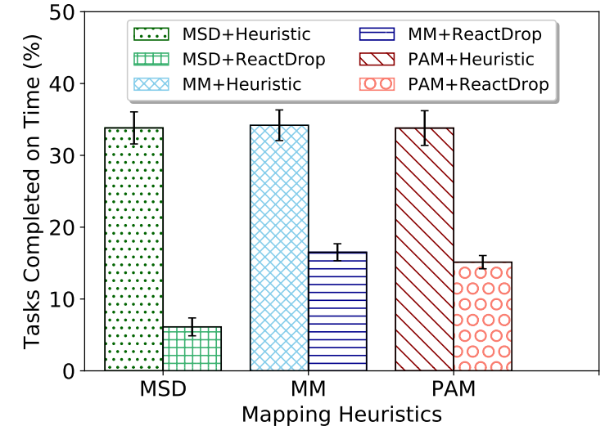
The Impact of Proactive Task Dropping on Different Mapping Heuristics
All three mapping heuristics provide almost the same robustness with proactive task dropping mechanism
Proactive task dropping mechanism prunes tasks whose chance of success is low

Slide 59
Summary and Remaining Steps

Slide 60
Summary
SEE score: System heterogeneity measure
FELARE: Fair energy- and latency- aware task scheduling in HEC
Proactive Task Dropping Mechanism: Heterogeneity-aware admission control that captures the uncertainty in tasks’ execution time and arrival time
Notes:
Provide a measure to quantify the system heterogeneity with respect to the performance metric of the system.
SEE score can be used to predict the QoS of a heterogeneous computing system at a certain arrival rate.
We proposed FELARE to address fairness and both energy and latency objectives in task scheduling in heterogeneous computing systems
To attain robustness goal, we proposed a heterogeneity-aware admission control that captures the uncertainty in tasks’ execution time and arrival time and proactively drops tasks whose chance of success is low.

Slide 61
Remaining Steps
Utilize the idea of SEE score to configure the most cost-efficient heterogeneous system that satisfies QoS constraint on a real-world system
Target: ACM SoCC 23 (Submit by August 2023)
Amdahl’s law for heterogeneous computing systems
Target: TPDS (submit by December 2023)

Slide 62
Other Activities
Book
Razin F. Hussain, Ali Mokhtari, Mohsen Amini Salehi, and Ali Ghalambor, IoT for Smart Oil and Gas Industry: from Upstream to Downstream Sectors, Elsevier, 2022 (ISBN: 9780323911511)

Slide 63
Other Activities
E2C Simulator
Ali Mokhtari, Drake Rawls, Tony Huynh, Jeremiah Green, and Mohsen Amini Salehi, E2C: A Visual Simulator to Reinforce Education of Heterogeneous Computing Systems, in 13th NSF/TCPP Workshop on Parallel and Distributed Computing Education (EduPar), May 2023

Slide 64
Other Activities
SM Zobaed, Ali Mokhtari, Jaya Prakash Champati, Mathieu Kourouma, Mohsen Amini Salehi, Edge-MultiAI: Multi-Tenancy of Latency-Sensitive Deep Learning Applications on Edge, in Proceedings of 15th IEEE/ACM International Conference on Utility and Cloud Computing (UCC), Vancouver, Washington, USA, December 2022

Slide 65
Other Activities
Chavit Denninnart, James Gentry, Ali Mokhtari, Mohsen Amini Salehi, Efficient Task Pruning Mechanism to Improve Robustness of Heterogeneous Computing Systems, Journal of Parallel and Distributed Computing (JPDC), Volume 142, August 2020, Pages: 46– 61

Slide 66
Appendix

Slide 67
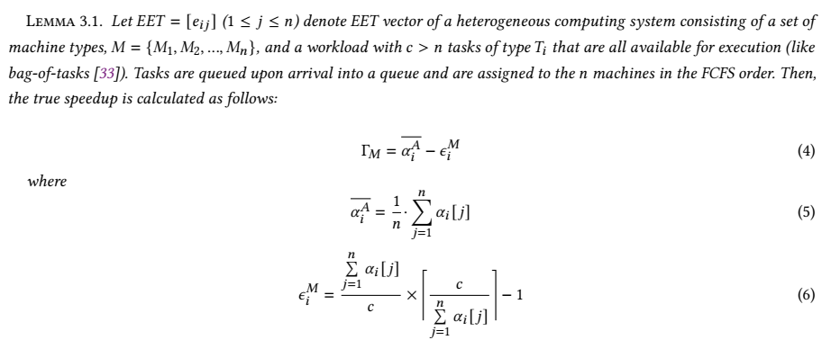
Mean Speedup due to Machine Heterogeneity

Slide 68
Heterogeneous Machines Single FCFS Queue
 | EET Matrix (Vector)
 | M1 | M2 | M3
Task Type | 0.1 | 1 | 10
M1
$$e_{1}=0.1$$
Arrival Time of all tasks is zero (bag of tasks)
M2
$$e_{2}=1$$
FCFS Queue
Tasks
M3
$$e_{3}=10$$
Machines

Slide 69
Slowest Homogeneous Counterpart System
M3
Task
$$e_{3}=10$$
M3
Task
$$e_{3}=10$$
1
M3
Task
$$e_{3}=10$$
3 tasks are executed by 3 machines at each moment

Slide 70
Heterogeneous System with One Task Type
100
M1
$$e_{1}=0.1$$
10
M2
$$e_{1}=1$$
1
M3
Task
$$e_{1}=10$$
Executing a task on machine 3 : 100 + 10 + 1 = 111 tasks execution

Slide 71
Arithmetic Mean of Speedup due to Machine Heterogeneity
 | EET Matrix (Vector)
 | M1 | M2 | M3
Task Type | 0.1 | 1 | 10
 | $$S^{M}$$
 | M1 | M2 | M3
Task Type | 100 | 10 | 1
heterogeneous system makespan = 2* 10 = 20
homogeneous system makespan = (222/3)*10 = 740
True Speedup = 740/20 = 37
Arithmetic mean of $S^{M}$ = (1/3) * (111) = 37
Given high arrival rate (e.g. bag of tasks), we prove that the true speedup due to machine heterogeneity for a task type is accurately represented by the arithmetic mean of $S^{M}$ for that task type

Slide 72
Mean Speedup due to Machine Heterogeneity: Low Task Arrival Rate

Slide 73
Mean Speedup due to Machine Heterogeneity: Low Task Arrival Rate
 | EET Matrix (Vector)
 | M1 | M2 | M3
Task Type | 0.1 | 1 | 10
M1
$$e_{1}=0.1$$
Low Arrival Rate
M2
$$e_{2}=1$$
FCFS Queue
Tasks
M3
$$e_{3}=10$$
Machines

Slide 74
Slowest Homogeneous Counterpart System (low arrival rate)
M3
$$e_{3}=10$$
M3
$$e_{3}=10$$
1
M3
Task
$$e_{3}=10$$
1 tasks are executed by only 1 machines at each moment

Slide 75
Heterogeneous System with One Task Type (low arrival rate)
M1
$$e_{1}=0.1$$
M2
$$e_{1}=1$$
M3
$$e_{1}=10$$
Executing only one task at any given time

Slide 76
Heterogeneous System with One Task Type (low arrival rate)
M1
$$e_{1}=0.1$$
M2
$$e_{1}=1$$
M3
$$e_{1}=10$$
Executing only one task at any given time

Slide 77
Heterogeneous System with One Task Type (low arrival rate)
M1
$$e_{1}=0.1$$
M2
$$e_{1}=1$$
M3
Task
$$e_{1}=10$$
Executing only one task at any given time

Slide 78
Harmonic Mean of Speedup due to Machine Heterogeneity (low arrival rate)
 | EET Matrix (Vector)
 | M1 | M2 | M3
Task Type | 0.1 | 1 | 10
 | $$S^{M}$$
 | M1 | M2 | M3
Task Type | 100 | 10 | 1
heterogeneous system makespan = (222/3)*0.1 + (222/3)*1 + (222/3)*100= 821.4
homogeneous system makespan = 222*10 = 2220
True Speedup = 2220/821.4 = 2.70
Harmonic mean of $S^{M}$ = 2.70
Given low arrival rate (e.g. only one busy machine at any time), we prove that the true speedup due to machine heterogeneity for a task type is accurately represented by the harmonic mean of $S^{M}$ for that task type

Slide 79
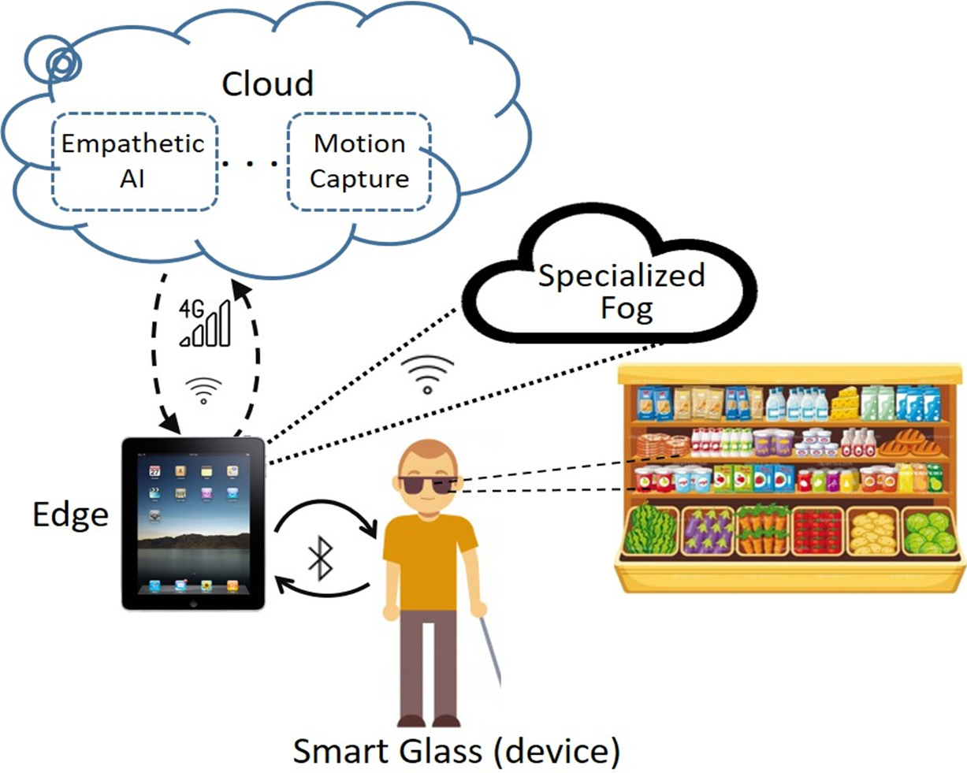
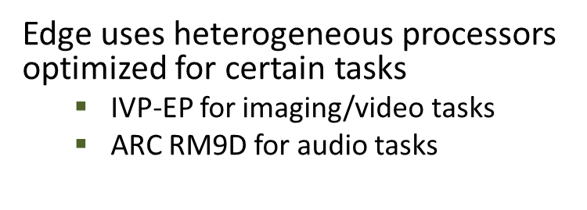
SmartSight Project

Slide 80
Map Heterogeneous Machines to Homogeneous Machines
Heterogeneous Machines for $T_{i}$
Homogeneous Equivalent Machines for $T_{i}$
 | $$M_{1}$$ | $$M_{2}$$ | $$M_{3}$$
$$T_{i}$$ | $$e_{i,1}$$ | $$e_{i,2}$$ | $$e_{i,3}$$
 | $$M^{∗}$$ | $$M^{∗}$$ | $$M^{∗}$$
$$T_{i}$$ | $$\overline{e_{i,:}}$$ | $$\overline{e_{i,:}}$$ | $$\overline{e_{i,:}}$$
Speedup due to machine heterogeneity
$$\overline{e_{i,:}}=\frac{e_{i,:}^{∗}}{\overline{S_{i}^{M}}}$$
$$e_{i,:}^{∗}=\max_{j}{e_{i,j}}$$
 | $$M_{1}$$ | $$M_{2}$$ | $$M_{3}$$
$$T_{i}$$ | $$\frac{e_{i,:}^{∗}}{e_{i,1}}$$ | $$\frac{e_{i,:}^{∗}}{e_{i,1}}$$ | $$\frac{e_{i,:}^{∗}}{e_{i,1}}$$
Arithmetic Mean
 | $$M^{∗}$$ | $$M^{∗}$$ | $$M^{∗}$$
$$T_{i}$$ | $$\overline{S_{i}^{M}}$$ | $$\overline{S_{i}^{M}}$$ | $$\overline{S_{i}^{M}}$$
$$\overline{S_{i}^{M}}=\frac{e_{i,:}^{∗}}{n}\sum_{j=1}^{n}{e_{i,j}}$$

