Slide 1



Cost Efficient Cloud-Based Video
Streaming Through Quantifying
Video Stream Hotness
Mahmoud Darwich
Dr. Magdy A. Bayoumi (Co-Advisor)
Dr. Mohsen A. Salehi (Co-Advisor)

Slide 2
Outline
What is Video Transcoding?
Why Video Transcoding on Cloud?
What have been done so far?
My thesis focus
Conclusion

Slide 3
Outline
What is Video Transcoding?
Why Video Transcoding on Cloud?
What have been done so far?
My thesis focus
Conclusion

Slide 4


Different Characteristics Display Devices
Over 16.1 Billion display devices 2020
Notes:
In the last dacade, the number of mobiles increased tremendously and keep increasing, by 2020 the to number will reach over 6 billions,
These mobiles device include an large of variety in terms of size, resolution and networkbandwith

Slide 5


Different Formats of Videos
By 2019, online video will account for 84% of all online traffic
40-50 formats
YouTube has 1.1 Billion videos
Notes:
However, the original video should be converted to another formats to fill all users mobiles charactersitics,
There Video streaming providers try to keep many versions of the same video in their repository.
Usually video streaming providers stores 40 to 50 formats of the same video in their repository.
YouTube itself has over one billion videos available for viewers around. So imagine that if we would convert this huge number of videos into several formats, how much powerful servers are needed to do the job and how storage servers are need to store all videos and all their formats

Slide 6
Background: Video Stream Structure
Video Stream
Seq 1 | Seq 2 | Seq 3 | Seq 4 | Seq 5
…..
Seq Header | GOP1 | GOP2 | GOP3
…..
GOP header | I | P | P | P | B | P
…..
Macroblock

Slide 7

Video Transcoding
Computational intensive
VSP pre-transcode
Storage intensive
Notes:
This conversion of video into another format is called video transcoding.
Video transcoding is hunger of computation process and time consuming

Slide 8

Storing all Formats of the Same Video
8X storage overhead!
YouTube Storage ~one ExaBytes 2016
1 ExaBytes= 1000 PetaBytes=10⁶ TB= 10⁹ GB
Notes:
Storing all formats for all videos requires a very huge space and storing all formats can occupy 8X storage more than storing the original format.
Having these huge storing servers requires regular maintenance which more cost

Slide 9
Storage Requirements for Video Stream
large capacity
  Different formats
  Different videos
high throughput
  Support concurrent accesses of viewers to same video
Notes:
The main challenges faced by video transcoding and storing on real servers: high throughput, large capacity and need for powerful transcoding servers.
the current storage servers face scalability and reliability
problems in addition to high cost of storage hardwares. this also imposes maintenance needs and
requires expertise people to deploy and con€gure the storage servers

Slide 10
Storage and Distribution of Video Streams
In house Storage
Storage of
Video Streams
Cloud Storage
Content Delivery Network (CDN)
Distribution of Video Streams
Peer to Peer (P2P)

Slide 11
Comparison of Different Technologies for Storing Video Stream

Slide 12
Challenges in On-Demand Computation of Transcoding
Real-time video stream transcoding
Significant incurred Cost to buy infrastructure
Maintenance and Update

Slide 13


Video Transcoding in Cloud!!
Notes:
Video

Slide 14

Advantages of Cloud for Video Streaming
  Elastic computational resources (VMs)
  Enables transcoding in real time (or near-real time)
Video transcoding process is time consuming may take hours /minutes
Video transcoding process is time consuming may take days

Slide 15
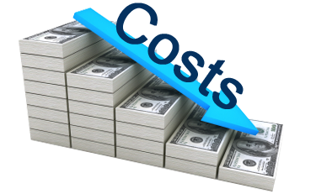
Challenges of Using Cloud Services
  How to Minimize Incurred Costs?
    Computing cost
    Storage cost
YouTube storage cost ~ $100 million per year

Slide 16
Outline
What is Video Transcoding?
Why Video Transcoding on Cloud?
What others have been done so far?
My thesis focus
Conclusion

Slide 17
Video On Demand (VOD) Transcoding
Partial Pre-transcoding
Lazy Video Transcoding
(re-transcoding)
Pre-Transcoding
Repository level
Video level
Segment
GOP
Video-based hotness
GOP-based hotness
GOP threshold

Slide 18
Outline
What is Video Transcoding?
Why Video Transcoding on Cloud?
What have been done so far?
Focus of this thesis
Conclusion

Slide 19
Cost Efficient partial Pre-Transcoding of Video Streaming
Notes:
I focus on partial pre-transcoding of video streams based on quantifying their hotness

Slide 20

Recap on Definitions
Two approaches for transcoding
  Pre- Transcode:
    store a format of video in repository.
  Re-transcode:
    transcode video format upon request

Slide 21

Problem Definition
When to pre-transcode a video?
When to re-transcode a video?
When to apply partial pre-transcoding on videos?
Notes:
Here are the problem definitions: when do we perform pre-transcoding on a video stream
When we re-transcode it, what are the criteria to apply partial pre-transcoding on video stream. In other other when we store a portion of a video and not the whole video stream. How can a video be hot? And if it is, how we can measure the percentage of its hotness

Slide 22
Intuitive Solution
Pre-transcode all hot videos
Re-transcode all cold (non-hot) videos
But, what is a hot video?
Is there any way to quantify the hotness of a video?

Slide 23
Summary of Contributions
Providing a formal method to measure hotness of video streams.
Proposing cost-saving methods to reduce the incurred cost of cloud-based video streaming using the hotness measure.
Proposing methods to reduce the execution overhead time of cost-saving method
Analyzing the impact of the proposed methods on video streaming with different access models.

Slide 24
Definition of Hot Video Stream
  We define a video as hot, when it is worth to pre-transcode it
  Video i is called “hot” when:
  cost of pre-transcoding i ≤ cost of re-transcoding i
We define cost-ratio for video i (R_{i}) as:
R_{i} = (storage cost) _{i} / [(transcoding cost) _{i} .(views) _{i} ]
Video i is defined as “hot” when its cost-ratio ≤ 1

Slide 25

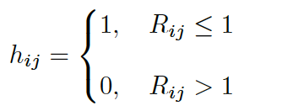

Quantifying Hotness of GOP
Hotness of a video stream depends on the hotness of its GOPs
  Thus, we extend the definition of hotness of video to GOP
We define cost-ratio for GOP j of video i (R_{ij}) as:
Hotness of GOP G_{ij} is defined as:
Pre-transcoding cost of GOP G_{ij}
Estimated views of GOP G_{ij}
Re-transcoding cost of GOP G_{ij}

Slide 26



Quantifying Hotness of a Video Stream

Slide 27
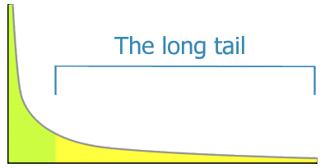
Access Pattern to Video Streams in a Repository
Distribution of access to video streams in a repository follow long-tail pattern
Few video streams in the beginning of curve are accessed frequently
Most of video streams are rarely accessed
Frequently accessed videos
Number of views
Videos in repository
Rarely accessed videos

Slide 28

  Access Pattern Within Each Video Stream
  Distribution of the views within a video (GOPs) stream follows a long tail distribution
  Beginning segments (GOPs) are watched more frequently then the rest of the video
  Therefore, we can estimate GOP view information using Power-Law distribution
Number of views
$G_{ij }$is GOP number j and alpha is constant equal to 0.1
GOPs within video
Estimated number of views for GOP j in video i
Total number of views received by video I in a period time

Slide 29

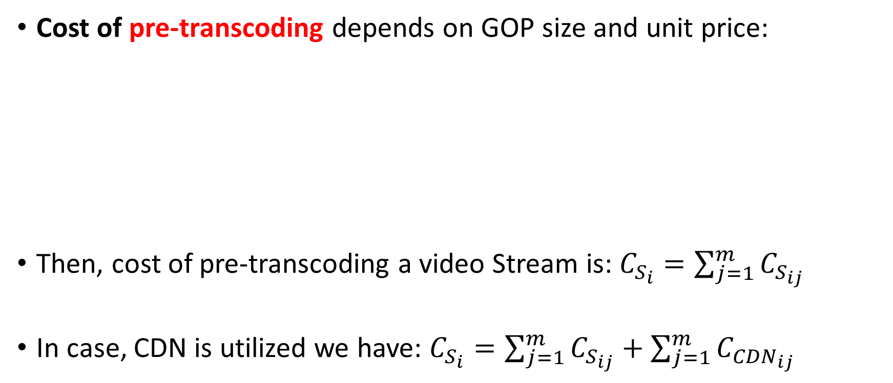
Cost of Pre-transcoding of a Video Stream
Cost of pre-transcoding depends on GOP size and unit price:
Then, cost of pre-transcoding a video Stream is: $C_{S_{i}}=\sum_{j=1}^{m}{C_{S_{ij}}}$
In case, CDN is utilized we have: $C_{S_{i}}=\sum_{j=1}^{m}{C_{S_{ij}}+\sum_{j=1}^{m}{C_{{CDN}_{ij}}}}$
Pre-transcoding cost of GOP j of video i
Cloud storage unit price
Size of GOP j of video i

Slide 30

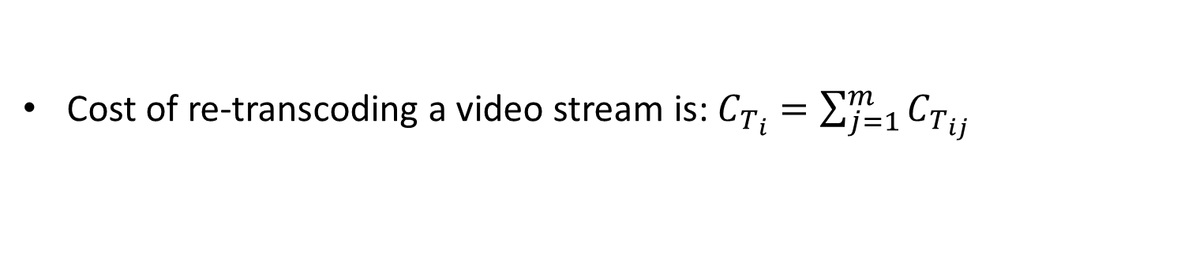
Cost of Re-transcoding of a Video Stream
Cost of re-transcoding a GOP depends on transcoding time and unit price
Re-transcoding cost of GOP j video i
Transcoding time of GOPj of video i
Cloud Transcoding unit price
Cost of re-transcoding a video stream is: $C_{T_{i}}=\sum_{j=1}^{m}{C_{T_{ij}}}$

Slide 31
Algorithms for Partial Pre-transcoding

Slide 32
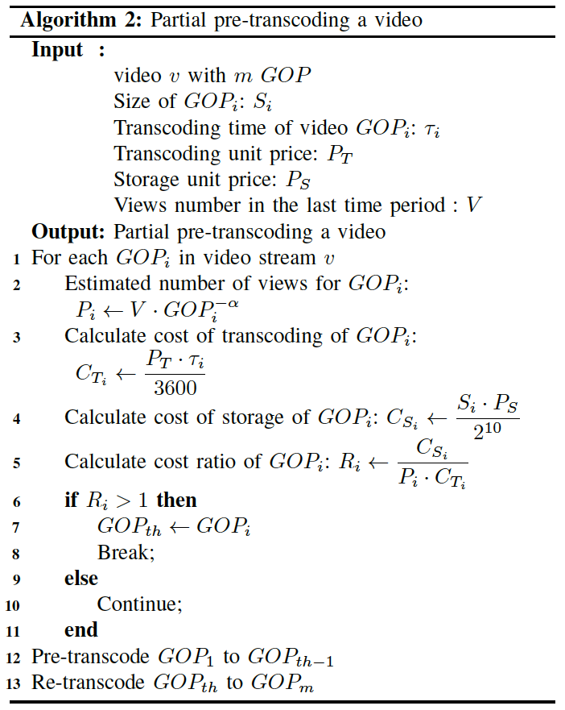
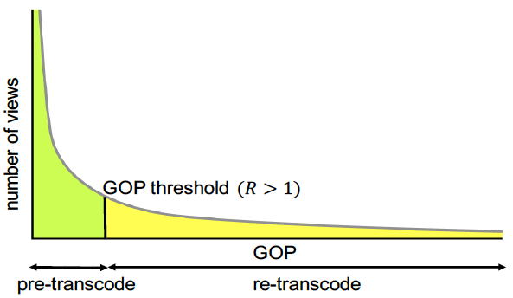
GOP-based Threshold algorithm (GBTh)
GOP information in each video and cloud price
Calculate the threshold point
Store GOPs before threshold and transcode on demand GOPs after it

Slide 33
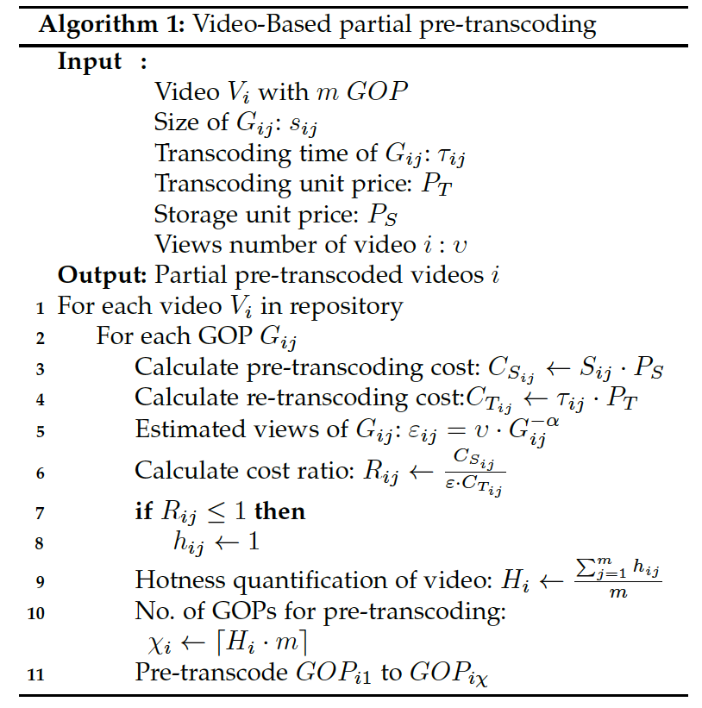
Video-based hotness algorithm (VBH)
GOP information in each video and cloud price
Hot part
Hi
Cold part
Calculate hotness of video
Pre-transcode the hot part of the video

Slide 34
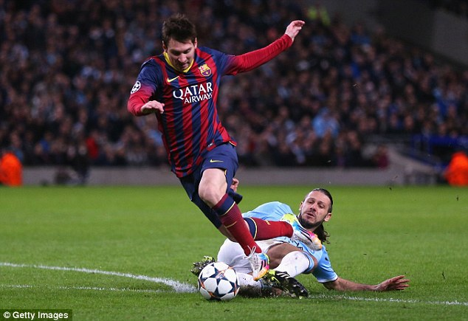
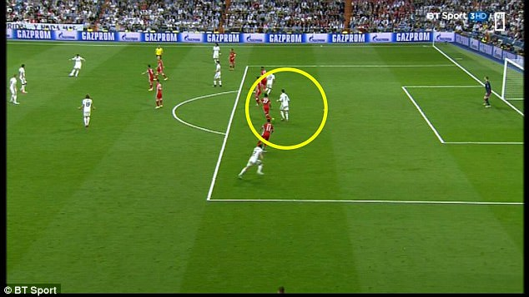
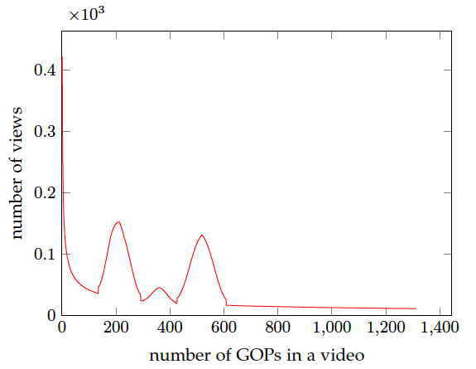

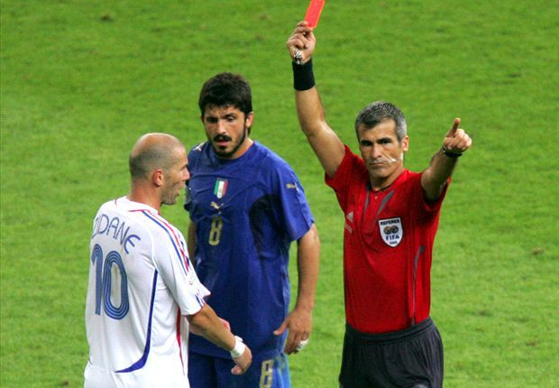
  Video Stream Access Pattern – non Long tail

Slide 35
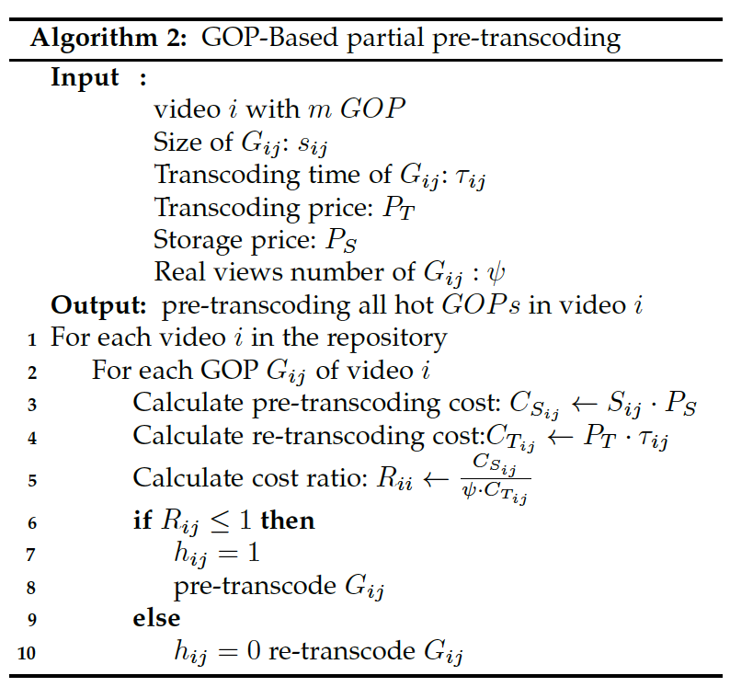
GOP-based hotness algorithm (GBH)
GOP information in each video and cloud price
Calculate hotness of each GOP
Pre-transcode hot GOPs
Re-transcode non hot GOP

Slide 36
How to Reduce the Time Overhead of Partial-Pre-transcoding Methods?
The proposed methods have to consider all videos in the repository.
  This is time consuming
  How can we improve the execution time of these methods?

Slide 37
Clustering Video Streams Based on Hotness
We classify video streams in a repository based on their hotness.
This algorithm partitions the repository into three subsets of video streams
We run partial pre-transcoding algorithm on the subset that contains partially hot videos

Slide 38

Jenks Natural Breaks Optimization
Algorithm for Video Streams Clustering
Generate 3 clusters of video streams.
Maximize Goodness of Variance fit : $0<GOV<1$
Sum of squared deviation of number of views for video streams in repository
Sum of squared deviation of number of views among clusters
Standard deviation of number of views of video streams in repository
Number of views of video i
Standard deviation of Number of views of videos in cluster k
Number of views of videos in cluster k

Slide 39

Experimental Setup
We need large number of videos with their number of views to evaluate the proposed methods.
Collecting such large number of videos with their views is time consuming and costly
Therefore, we synthesize our own videos repository.

Slide 40
Experimental Setup (Cont.)
In order to synthesize videos, we need to know the characteristics of videos.
We downloaded 100 videos from YouTube including fully movies, soccer game, public speech, News
we transcoded those videos to get transcoding time and GOP size

Slide 41
Experimental Setup (Cont.)
Why do we need transcoding time and size for GOP?
Because we need to use GOP size in storage cost equation and transcoding time is transcoding cost equation

Slide 42
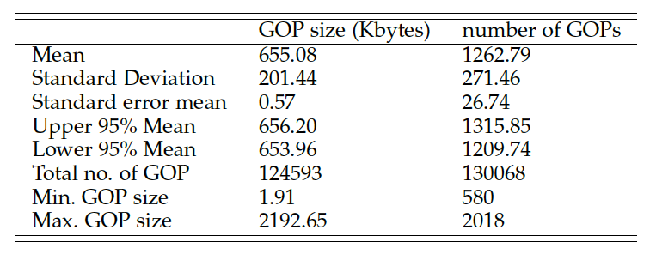
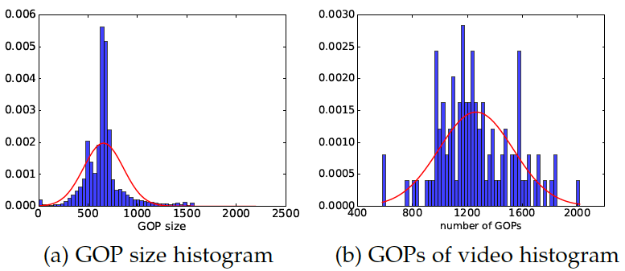
Experimental Setup: Analysis of GOP Number and their size
We did data analysis on GOP Size and Number of GOPs all 100 files of transcoded videos

Slide 43
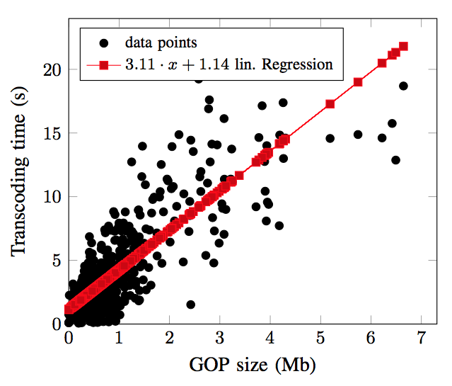
Experimental Setup: Correlation Between GOP Size & Transcoding Time
Applying Linear Regression analysis on transcoding time and size of GOPs of all transcoded videos

Slide 44
Experimental Setup: Video Synthesis
Video Synthesis :
  we use the equation of linear regression to generate transcoding time as function of GOP size.
  We assign number of views for each synthesized video by apply Power-law equation.

Slide 45
Generating Video Repositories:
Generate several videos repositories, each contains 100,000 videos
Modeling video access pattern in a repository by applying a Weibull Function and adjust its parameters to follow a long tail as shown in table
We consider synthesized videos with long tail and non long tail access
For each experiments we repeat it 50 times with confidence interval 95%

Slide 46
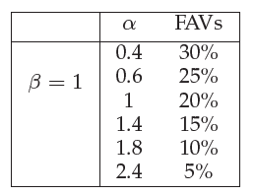
Workload Setup: Change % of hot videos
Changing shape parameter alpha of Weibull function to control the percentage of FAVs (hot) videos in repository.

Slide 47
Methods Used For Comparison
VBH : Video Based Hotness
VLT: Video Level Transcoding (either store or transcode full video)
GBTh: GOP Based Threshold
GBH: GOP Based Hotness

Slide 48
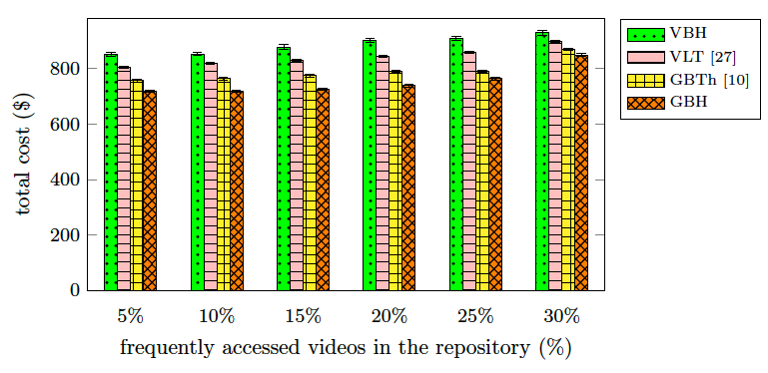
Experimental results: Impact of changing percentage of FAVs in repository
Proposed GBH outperforms all other methods and reduces the cost up by 15% over all other methods at 5% of FAVS .
As the percentage of FAVs in the repository increases, the outperformance decreases. When 30% of FAVs , GBH outperforms other by 6%
Notes:
This is because when a repository contains high percentage
of Frequently Accessed Video Streams , most of the
Frequently Accessed Video Streams are pre-transcoded
and partial pre-transcoding methods is applied on
few video streams, hence, reducing its impact.

Slide 49
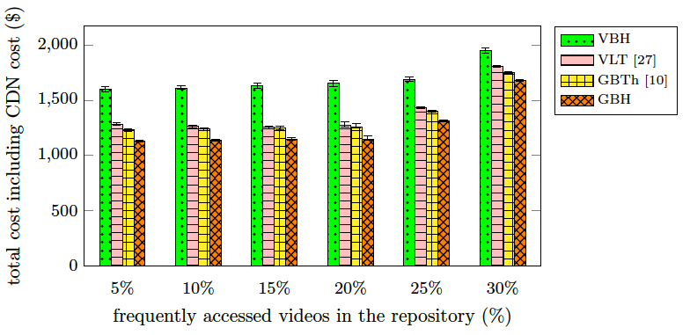
Experimental results: Impact of changing percentage of FAVs video in repository including CDN in the cost
We can observe that, in general, the incurred cost has increased due to using CDN.
Again, GBH incurs the minimum cost when compared with other methods.
when 5% of repository is Frequently Accessed Video Streams , GBH reduces the cost by up to 10% and 15%, when compared with GBTh and VLT.

Slide 50
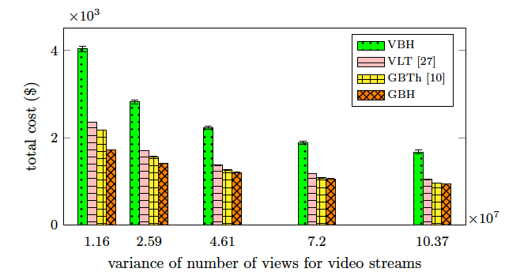
Experimental results: Impact of changing variance number of views
when the variance is 1.16 X 10^7 GBH saves 67% and 21% in the total costs when compared with VBH, and GBTh.
when the variance is 10.37 X10^7 , GBH saves 44% when compared with VBH and incurs approximately the same cost when compared with GBTh.
Notes:
in this experiment, our aim is to evaluate the behavior of the proposed
partial pre-transcoding methods under different long-
tail patterns. For that purpose, we alter the variance
of number of views to video streams in the repository.
Higher values of variance express a repository in which
few videos are viewed very frequently while the rest of
video streams are barely viewed. Alternatively, lower
values of variance express a repository in which the
difference between number of views of cold and hot
videos is low. We alter the values of variance from
1: 16 107 to 10: 37 107
and create multiple repositories.
Then, for each repository, we estimate the total incurred
cost when different partial pre-transcoding methods are
used. In all repositories 20% of videos are considered as
hot videos. Also, in all of them, 30% of video streams
have non-long-tail access pattern.
The reason is that when the variance is high video stream are either hot or cold.

Slide 51
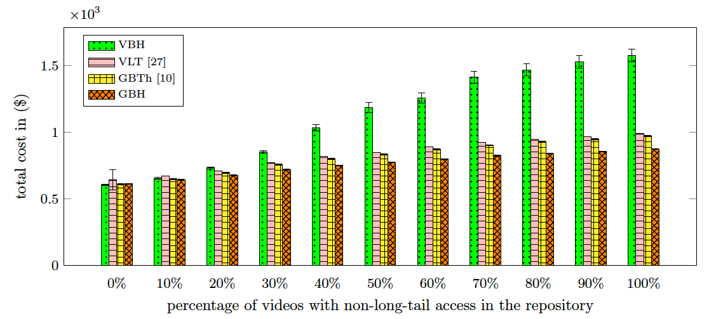
Experimental results: Impact of changing percentage of video streams with non long tail access in repository
GBH has the least increase in the incurred cost when compared with other methods.
When percentage of video with non long tail access is 0: VBH, GBTh, and GBH perform equally
When this percentage increase till 100%, GBH outperforms all other methods up by 15%
Notes:
As mentioned earlier, the distribution of views within
some video streams do not follow the long-tail pattern.
That is, there are portions of the video streams that
are not necessarily in the beginning of it but receive a
large number of views in compare with the rest of the
video stream

Slide 52
Experimental results: effectiveness of the clustering method on reducing the execution time overhead of the GBH method.
As we expected, when the clustering method is not applied, the execution time overhead of GBH does not change for different percentages of Frequently Accessed Video Streams
For 5% and 30% of Frequently Accessed Video Streams , the execution time overhead is reduced by 72% and 59%, respectively.
Notes:
Although GBH, in general, outperforms other partial
pre-transcoding methods, it imposes the highest execution
time overhead. The reason for its high overhead is processing each GOP for each video stream in the
repository.
we conduct an experiment by generating repositories
with varying percentage of Frequently Accessed Video
Streams in them. For each repository, we measure the
execution time overhead of the GBH method in two
scenarios: (A) when the clustering method is applied
and (B) without the clustering method.

Slide 53
Proposed Methods Comparison
Methods | Computation | Accuracy | cost | Video Metadata storing | GOP Metadata storing
VLT [17] | fair | Less high | fair | yes | no
Video Based Hotness (VBH) | slow | high | fair | yes | no
GOP Based Threshold (GBT) [17] | slow | high | low | yes | ~yes
GOP Based Hotness (GBH) | slowest | highest | lowest | yes | yes

Slide 54
Outline
What is Video Transcoding?
Why Video Transcoding on Cloud?
What have been done so far?
My thesis focus
Conclusion

Slide 55
Conclusion
The goal of this research is to reduce the incurred cost of cloud-based video streaming through pre-transcoding , re-transcoding , or partially pre-transcoding of video streams.
Proposed GBH method is performs better than other methods.
When repository includes only videos with long tail, VBH, GBTh, and GBH perform equally.
For repositories that has low FAVs, GBH performs better than the others.

Slide 56
Future Directions of Research
Prediction of hotness
Hierarchy of video streams storage
Video Summarization

Slide 57
Publications
Darwich M., Beyazit E., Amini Salhi M., Bayoumi M. (2017) “Cost Efficient Cloud-Based Video Streaming Based on Quantifying Video Hotness ” Manuscript ready to submit.
Darwich M., Beyazit E., Amini Salhi M., Bayoumi M. (2017) “Cost Efficient Repository Management for Cloud-based On-Demand Video Streaming” IEEE 5th International Conference on Mobile Cloud Computing, Services and Engineering, 7-9 April 2017, San Francisco, USA.
Darwich M., Abdelgawad A., Bayoumi M. (2016) “A Survey on the Power and Robustness of FinFET SRAM” IEEE 59th International Midwest Symposium on Circuits and Systems (MWSCAS), 16-19 October 2016, Abu Dhabi, UAE.
Li X., Joshi Y., Darwich M., Landrenau B., Amini Salehi M., Bayoumi M., “Performance Analysis and Modeling of Video Transcoding Using Heterogeneous Cloud Services”. Manuscript submitted.
Li X., Darwich M., Amini Salehi M., Bayoumi M., “Cloud-Based Video Streaming Services: A Survey” Manuscript in preparation.

Slide 58
Questions?

Slide 59
Thank you

Slide 60
Appendix

Slide 61
Experimental Results
Total cost of all methods when percentage of FAVs varying

Slide 62
Experimental Results

