Slide 1
Secure Semantic Search Over Encrypted Big Data in the Cloud
Jason Woodworth
Advisor: Dr. Mohsen Amini Salehi

Slide 2
Outline
Why semantically search encrypted data?
What have others done?
Core architecture
Enabling Secure Semantic Search (S3C)
Secure Semantic Search on Big Data (S3BD)
Conclusion and Future Directions
Working Demo!

Slide 3
Outline
Why semantically search encrypted data?
What have others done?
Core architecture
Enabling Secure Semantic Search (S3C)
Secure Semantic Search on Big Data (S3BD)
Conclusion and Future Directions
Working Demo!

Slide 4



Cloud Storage & Problems
Convenient, but lacks security.
  Vulnerable to attack
    PRISM leak was internal
  Drives away business
    Only 33% of businesses are embracing cloud! ¹
1. http://www.businessnewsdaily.com/7661-businesses-wary-of-cloud.html
Notes:
Lack of security in clouds drives away businesses with sensitive data.
Solvable by encrypting locally and sending only encrypted data to the cloud.
Restricts search capability, can only see garbage data.
Search is important for big data, imagine looking through 1 TB of data.

Slide 5



How to Make Cloud Storage Secure?
Solution?
  Client-side encryption.
Disadvantages:
  Restricts processing capabilities (e.g. search!)
  Involves high space/time overhead

Slide 6




Motivation Scenario
Police searching encrypted criminal records.
  Needs to look up related crimes.
  Needs to use small device on the move.
  Needs ranking on search results.
Burglary
Robbery
2. Break In
3. Theft
4. Mugging
5. Stickup
Notes:
A company we are working with has a need to let cops search encrypted police reports.
Needs related crimes to not have to search for every case
Needs ranking to get to the most relevant crimes quick
Needs to use limited overhead for extended life on small device.

Slide 7


Semantic Search
Practically, people need semantic search
  Hard to remember exact keywords
  Search should support multi-phrase
  Search should rank results
  Search should be real-time
Flight To Berlin
S3C Search
1. Trip to Berlin
2. Flight to Germany
3. Airplane to Berlin
4. Trip to Europe
Notes:
As your dataset gets infinitely large, it’s harder to remember exact keywords.
Users may want to see things related to the terms they search for.

Slide 8



Problem Definition
How to search multi-phrase query over encrypted data in cloud?
  How to rank results based on semantic similarity to a query?
  How to use limited storage/ processing overhead?

Slide 9
Outline
Why semantically search encrypted data?
What have others done?
Core architecture
Enabling Secure Semantic Search (S3C)
Secure Semantic Search on Big Data (S3BD)
Conclusion and Future Directions
Working Demo!

Slide 10
Unstructured Searching
Plaintext
Secure/Encrypted
Clustering
Semantic
Keyword
Semantic
Random Shards
Topic-Based Shards
Regular Expression
Fuzzy Keyword
Word Stemming
Ontological Similarity

Slide 11
Outline
Why semantically search encrypted data?
What have others done?
Core architecture
Enabling Secure Semantic Search (S3C)
Secure Semantic Search on Big Data (S3BD)
Conclusion and Future Directions
Working Demo!

Slide 12



















User
Semantically Expands Query
Parse Uploaded Documents
Search
Upload
Three part cloud model
Client Application:
  Parses uploaded documents
  Modifies user query
  Encrypts documents and queries
Cloud Processing Server:
  Constructs hashed index
  Partitions index into shards
  Ranks files by search
Cloud Storage:
  Stores encrypted documents
File Parser
Query Modification
Client Application
Extracted Ontological Terms
Split Query
Synonyms
Structured Key File
Encrypted Documents
Weighting Function
Q
K
Secure Encrypting Function
Q’
K’
Partitions Index Into Shards
Construct Central Index
Ranks Documents
Search Results
Shards
Partitioner
Central Index
Cloud Side
Ranking Engine
Search Engine
Cloud Storage
Cloud Processing Server
Notes:
Architecture uses standard 3 part cloud storage model.
Client communicates with cloud server, which communicates with cloud storage

Slide 13
Outline
Why semantically search encrypted data?
What have others done?
Core architecture
Enabling Secure Semantic Search (S3C)
Secure Semantic Search on Big Data (S3BD)
Conclusion and Future Directions
Working Demo!

Slide 14


S3C Procedure Overview
Two Main Operations
Upload Document
Search

Slide 15

Client Upload Operation
Parse Document on Client.
  Extract keywords + frequencies.
  Hash key information.
  Encrypt document.
User
Upload
File Parser
Structured Key File
Encrypted Documents
F452.txt
F452.key
Licklider (12)
Transmission (16)
Protocol (14)
intended (4)
serve (2)
reliable (6)
convergence (1)
…
F452.key
5b4e7 (12)
8dfcf (16)
4b736 (14)
8a386 (4)
52646 (2)
b97a2 (6)
6ae48 (1)
…
“… The Licklider Transmission Protocol (LTP) is intended to serve as a reliable convergence layer over single-hop deep-space radio frequency (RF) links… “
Secure Hashing Function

Slide 16
Cloud Upload Operation
Index on Cloud
  Add keywords to central hashed index.
  Add encrypted document to bin storage.
Secure Hashing Function
Encrypted Documents
Hashed Index
Cloud Storage
F452.key
5b4e7 (12)
8dfcf (16)
4b736 (14)
8a386 (4)
52646 (2)
b97a2 (6)
6ae48 (1)
…
Hashed Index
8dfcf | F341 (10)
4b736 | F341 (8), F910 (20)
8a386 | F745 (1), F401 (9), F842 (11)
52646 | F910 (3), F757 (6), F310 (3), F872 (8)
b97a2 | F754 (9), F310 (5)
6ae48 | F757 (2)
…
Hashed Index
5b4e7 | F452 (12)
8dfcf | F341 (10), F452 (16)
4b736 | F341 (8), F452 (16), F910 (20)
8a386 | F452 (4), F745 (1), F401 (9), F842 (11)
52646 | F910 (3), F757 (6), F310 (3), F452 (2), F872 (8)
b97a2 | F754 (9), F310 (5), F452 (6)
6ae48 | F757 (2), F452 (1)
…

Slide 17
Client Search Operation
Query Modification on Client
  Query split.
  Web search for query synonyms and related terms
  Weight terms to give higher contribution to original query terms.
  Hash all terms
Licklider, Transmission, Protocol, communication, transportation, code, contract
Licklider Transmission Protocol
Licklider, Transmission, Protocol
Licklider, Transmission, Protocol, communication, transportation, code, contract, LTP, deep-space
Licklider (1), Transmission (1), Protocol (1), communication (.5), transportation (.5), code (.5), contract (.5), LTP (.5), deep-space (.5)
5b4e7 (1), 8dfcf (1), 4b736 (1), 28tr7 (.5), bfpk7 (.5), ghe5e (.5), 34ret (.5), itop3 (.5), b6w5o (.5)

Slide 18
Cloud Search Operation
Index Search on Cloud
  Query checked against hashed index.
  BM25 equation used for ranking.
Hashed Index
5b4e7 | F452 (12)
8dfcf | F341 (10), F452 (16)
4b736 | F341 (8), F452 (16), F910 (20)
8a386 | F452 (4), F745 (1), F401 (9), F842 (11)
52646 | F910 (3), F757 (6), F310 (3), F452 (2), F872 (8)
b97a2 | F754 (9), F310 (5), F452 (6)
6ae48 | F757 (2), F452 (1)
…
5b4e7 (1), 8dfcf (1), 4b736 (1), 28tr7 (.5), bfpk7 (.5), ghe5e (.5), 34ret (.5), itop3 (.5), b6w5o (.5)

Slide 19

Implementation Schemes
Selective or thorough keyword extraction?
What level of security is required?
Determines what information to expose
Depends on type of dataset
Notes:
Types of data: Long vs short, full documents vs. short status updates or media tags

Slide 20
Naïve Implementation – Full Document Scope (FKSS)
Considers all document terms minus stopwords.
Term frequency is necessary.
F452.txt
F452.key
Licklider (12)
Transmission (16)
Protocol (14)
intended (4)
serve (2)
reliable (6)
convergence (1)
…
“… The Licklider Transmission Protocol (LTP) is intended to serve as a reliable convergence layer over single-hop deep-space radio frequency (RF) links… “

Slide 21
Space Efficient Implementation – Selected Keyphrases (SKSS)
Pick only the “most important” phrases.
  10 phrases considered.
Don’t include term frequency
  All phrases are important, may be considered equal.
  Less information leaked.
F452.txt
“… The Licklider Transmission Protocol (LTP) is intended to serve as a reliable convergence layer over single-hop deep-space radio frequency (RF) links… “
F452.key
Licklider Transmission Protocol
Licklider
Protocol
Deep-space
LTP
…

Slide 22
Space Efficient, Accuracy Driven – Keyphrases with Frequency (KSWF)
Sacrifice some security for accuracy.
Combination of previous implementations.
F452.txt
“… The Licklider Transmission Protocol (LTP) is intended to serve as a reliable convergence layer over single-hop deep-space radio frequency (RF) links… “
F452.key
Licklider Transmission Protocol (4)
Licklider (6)
Protocol (7)
Deep-space (4)
LTP (12)
…

Slide 23
Experiment Setup
Metrics:
  Relevance of search results
  Performance of system
  Scalability of system
Datasets:
  RFC – Small, used for relevance
  Common Crawl Corpus – Used for scalability

Slide 24
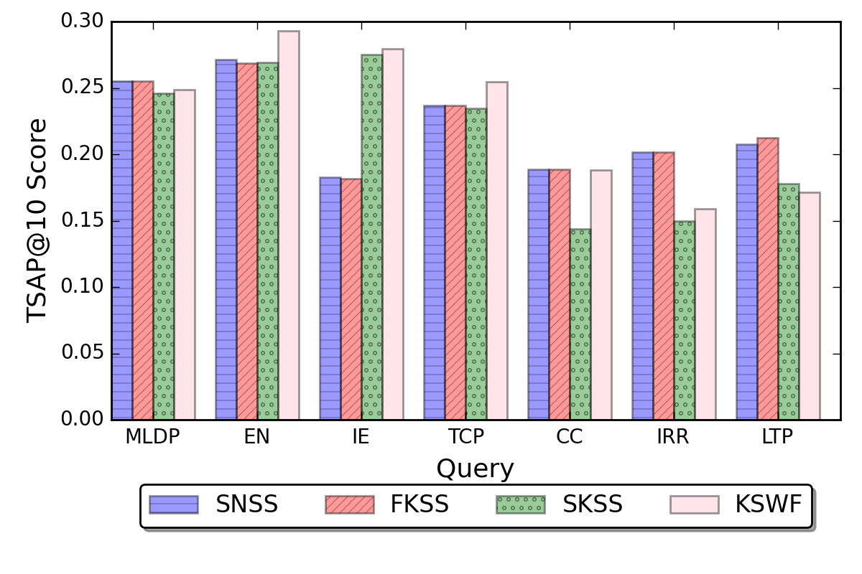
Relevance Testing
How relevant are the ranked results?
Relevance for SKSS & KSWF remain high despite missing most of the text.

Slide 25
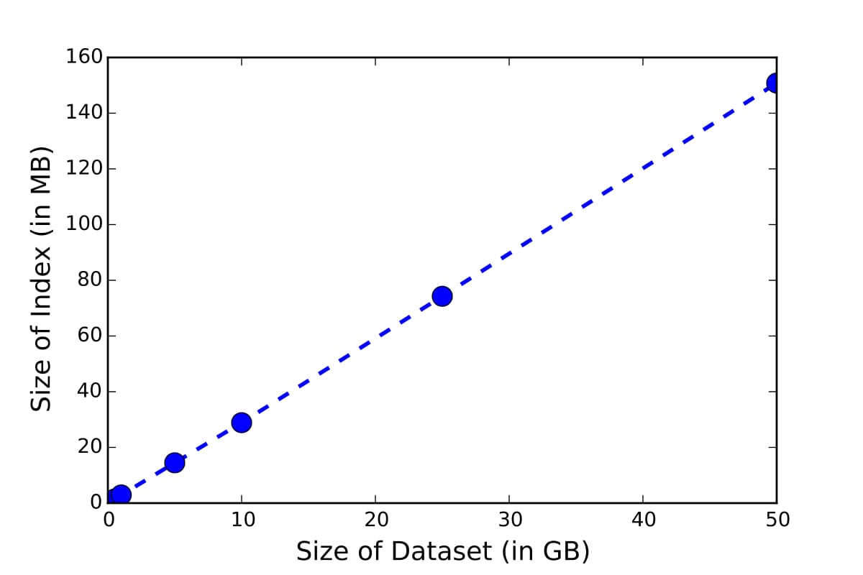
Scalability
How does the index size scale?
Index size increases at a rate of only ~0.3%

Slide 26
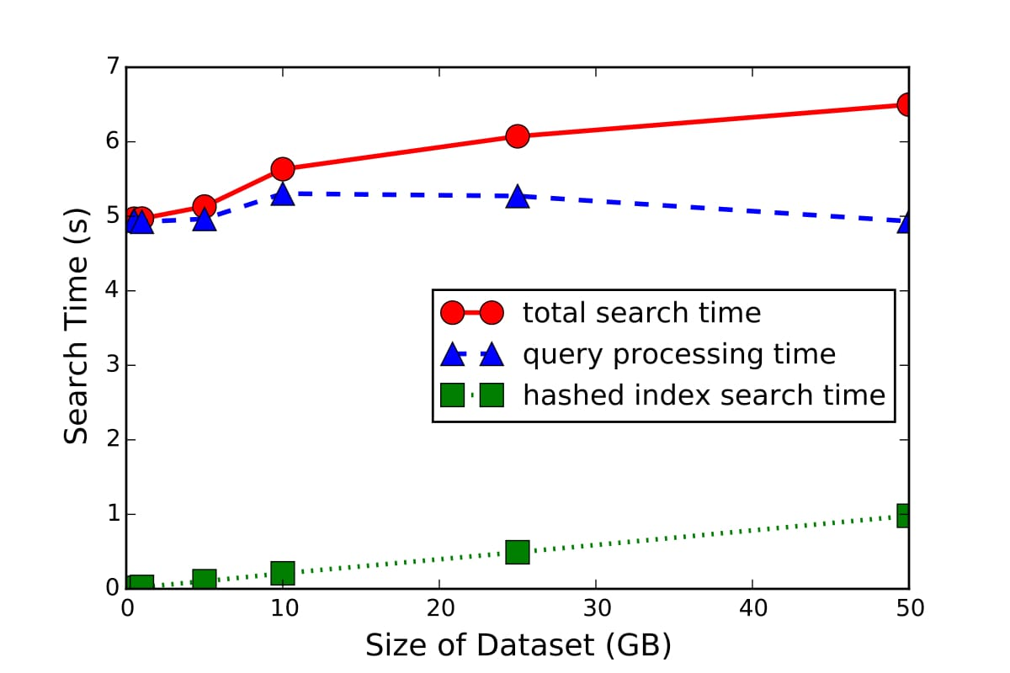
Scalability
How does search time scale?
An increase of 50 GB only increases search time by ~1 sec

Slide 27


S3C Result Summary
Storage overhead of ~0.3% of data set.
Multiple search schemes for different scenarios.
  FKSS for small documents or media tags.
  SKSS & KSWF for longer documents.
Accurate search results for all schemes.
BUT! Central index not great for big data

Slide 28
Outline
Why semantically search encrypted data?
What have others done?
Core architecture
Enabling Secure Semantic Search (S3C)
Secure Semantic Search on Big Data (S3BD)
Conclusion and Future Directions
Working Demo!

Slide 29

Central Index Problem
S3C approach uses central index
Huge index searched
  Pulls more results than necessary
  Bad for Big Data
Solution? Prune searched index.
  Divide into topic-based shards.
  Cluster into shards; some will be pruned
Index Terms
Computer Science
Big Data
AI
Mathematics
Cloud Computing
Graphics
Video Streaming
Encryption
Hashing
Virtual Reality
Data Mining
AWS
Public Key
Security

Slide 30
Pruning Process Requirements
Partition Into Shards
Cluster on Index
  Pick starting centroids
  Compute distance between encrypted Index data
Pick Shards To Search
Client must know about shards
  Abstract Index data

Slide 31
Naïve Index Partitioning Method
Split randomly and parallelize search
  Cuts search time, but requires the same amount of computation overhead
Random Shard #1
Computer Science
Big Data
AI
Mathematics
Random Shard #2
Cloud Computing
Graphics
Video Streaming
Encryption
Random Shard #3
Hashing
Virtual Reality
Data Mining
AWS
Public Key

Slide 32
Topic-Based Clustering Method
Split based on topic; parallel search on relevant shards
  Cuts search time and minimizes overhead
Cloud Computing
Cloud Computing
Video Streaming
Encryption
Hashing
AWS
Public Key
Computer Science
AI
Mathematics
Computer Science
Big Data
Big Data
AWS
Data Mining
Virtual Reality
Virtual Reality
Graphics

Slide 33
Problem: No Semantic on Encrypted Keywords!
All data (including keywords) in the cloud are encrypted
  Hard to associate terms semantically
Topic #1
%tGFK3
OP(*#j
14JPI3
^63PI
*FJP3#
JFKp3
Topic #2
dii99
46290
IPJ#jp
Topic #3
OP#99
JKL;@
PO#ND
Virtual Reality
AWJP(
IP339

Slide 34
Clustering Encrypted Data
How to create topic-based shards when data is encrypted?
  Adapt K-Means clustering algorithm
  Clusters based on statistical semantics

Slide 35
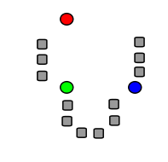
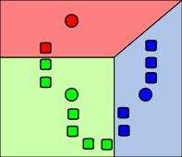
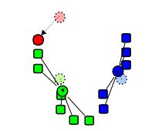
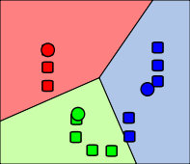
K-Means Clustering Method
Clusters data points around closest ‘means’
  Picks k initial centroids; computes closest centroid per data point
We must define:
  Picking initial centroids
  Distance between two index terms
Notes:
In this, the terms in the index are our data points

Slide 36
Initial Centroids
Pick k terms with the most files associated
Only pick a term if it contributes more unseen terms than seen.
  Ensures cluster diversity
Encrypted Index
52646 | F910 (3), F757 (6), F310 (3), F452 (2), F872 (8)
8a386 | F452 (4), F910 (1), F310 (9), F842 (11)
4b736 | F341 (8), F452 (16), F585 (20)
b97a2 | F754 (9), F310 (5), F452 (6)
8dfcf | F341 (10), F452 (16)
6ae48 | F757 (2), F452 (1)
5b4e7 | F452 (12)
…

Slide 37
Distance Between Terms
Clustering Hypothesis states that objects that appear together are related
If two words appeared in the same file, they could be considered related.
Distance defined as co-occurrence in files
Encrypted Index
5b4e7 | F452 (12)
8dfcf | F341 (10), F452 (16)
4b736 | F341 (8), F452 (16), F910 (20)
8a386 | F452 (4), F745 (1), F401 (9), F842 (11)
52646 | F910 (3), F757 (6), F310 (3), F452 (2), F872 (8)
b97a2 | F754 (9), F310 (5), F452 (6)
6ae48 | F757 (2), F452 (1)
…

Slide 38
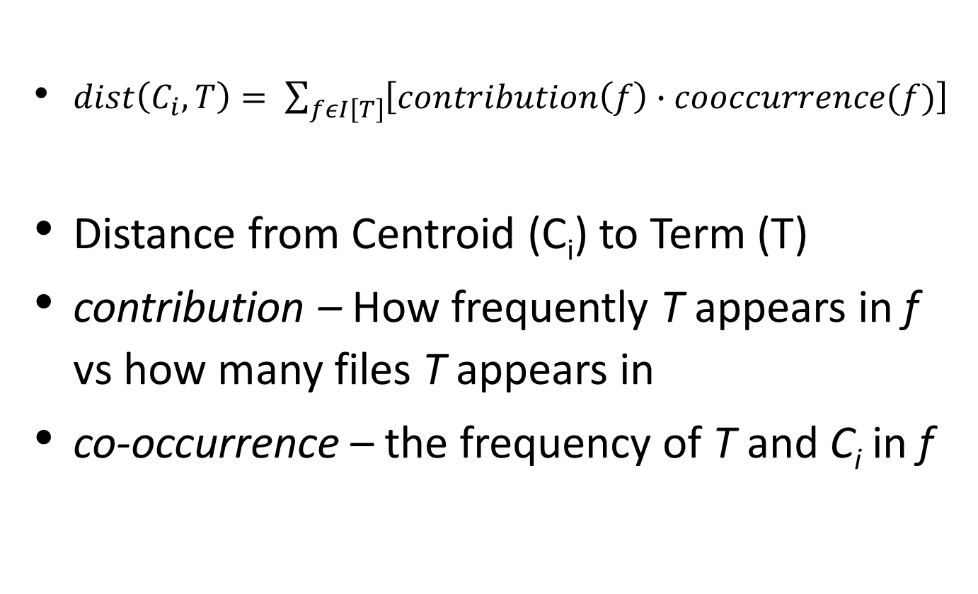
Computing Distance
$dist\left(C_{i}, T\right)= \sum_{fεI\left[T\right]}{\left[contribution\left(f\right)∙cooccurrence(f)\right]}$
Distance from Centroid (C_{i}) to Term (T)
contribution – How frequently T appears in f vs how many files T appears in
co-occurrence – the frequency of T and C_{i} in f
Notes:
dist = SUM(contribution * co-occurrence)

Slide 39
Client Abstracts
To determine proper shards to search, client must know about shards.
Send small “Abstracts” to client for decryption
Topic #1
%tGFK3
OP(*#j
14JPI3
^63PI
*FJP3#
JFKp3
AWJP(
Topic #2
dii99
46290
IPJ#jp
JPO$4
IP339
Topic #3
OP#99
JKL;@
PO#ND
FRE2D
Topic #3 Abstract
Morality
Skinner
Topic #2 Abstract
Delta Airlines
American Airlines
Topic #1 Abstract
Data Mining
AWS
Notes:
Client will determine from these abstracts how to search
Once on the client, these abstracts can be decrypted.

Slide 40
How to Form Abstracts?
Naïve method: pick x random terms
  Might not be indicative of the whole cluster
  Too many “fringe” terms
Instead, pick x terms from the centroid list
  Centroid is just a list of files
  We have associated terms from each file
Notes:
Random terms do not represent the shard well.

Slide 41
Initiate Pruning at Client Side
Prune/limit search to only relevant clusters to enable real-time search
Pruning can be initiated at the client side at search time
Abstracts are used to determine which shards to search
  Find semantic similarity between query and abstracts

Slide 42
Pruning Algorithm
For each keyword in the search query
  Use WuPalmer to identify semantic similarity between query terms and abstract terms
  WuPalmer computes distance in semantic graph
Pick the N highest ranking abstracts; inform cloud.
Abstract #1 (Score = .7)
Computer
Data
Abstract #2 (Score = .3)
Space
Stars
Licklider Transmission Protocol
Abstract #2 (Score = .2)
Cooking
Fish
Abstract #4 (Score = .5)
TCP
Communicate

Slide 43
Experiment Setup
Expanding sets of Common Corpus Crawl data
Time measured for different numbers of shards

Slide 44
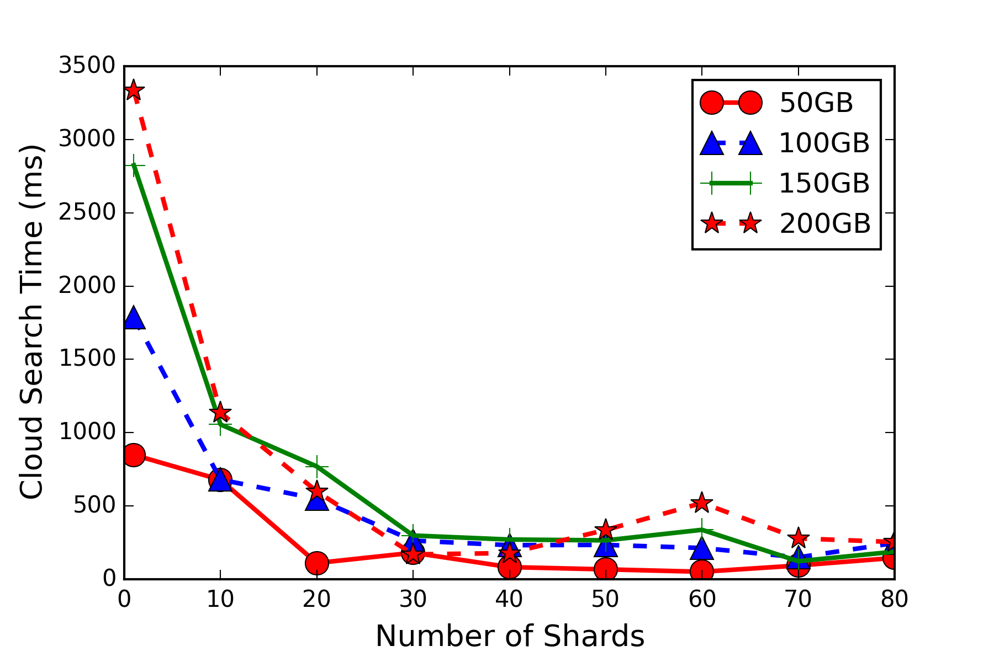
Scalability Results
Partitioning into only 30 shards reduces search time by >90%

Slide 45
S3BD Result Summary
Partitioning can reduce search times by >90%.
Partitioning is done on encrypted data, plaintext never needs to be used.
Search method is much better for big data.

Slide 46
Outline
Why semantically search encrypted data?
What have others done?
Core architecture
Enabling Secure Semantic Search (S3C)
Secure Semantic Search on Big Data (S3BD)
Conclusion and Future Directions
Working Demo!

Slide 47
Conclusion
Main goals:
  Search encrypted data
  Make search semantic
  Make search responsive/real-time
Main methods:
  Extract and encrypt key phrases from uploaded documents
  Modify user query at search time to inject semantic data
  Partition central index into topic-based shards

Slide 48
Future Works: Search-Level Access
Data owner may not want users to have full access
  Officers should not be able to read full police reports
Instead, only let user see search results
  Possibly expand with summary-level access

Slide 49
Future Work: Dynamic Shard Creation
S3BD requires operator to specify number of clusters and initiate partitioning
Instead, have system dynamically update shards
  Add new documents to shards upon upload
  Split shards when they get too big

Slide 50
Outline
Why semantically search encrypted data?
What have others done?
Core architecture
Enabling Secure Semantic Search (S3C)
Secure Semantic Search on Big Data (S3BD)
Conclusion and Future Directions
Working Demo!

Slide 51
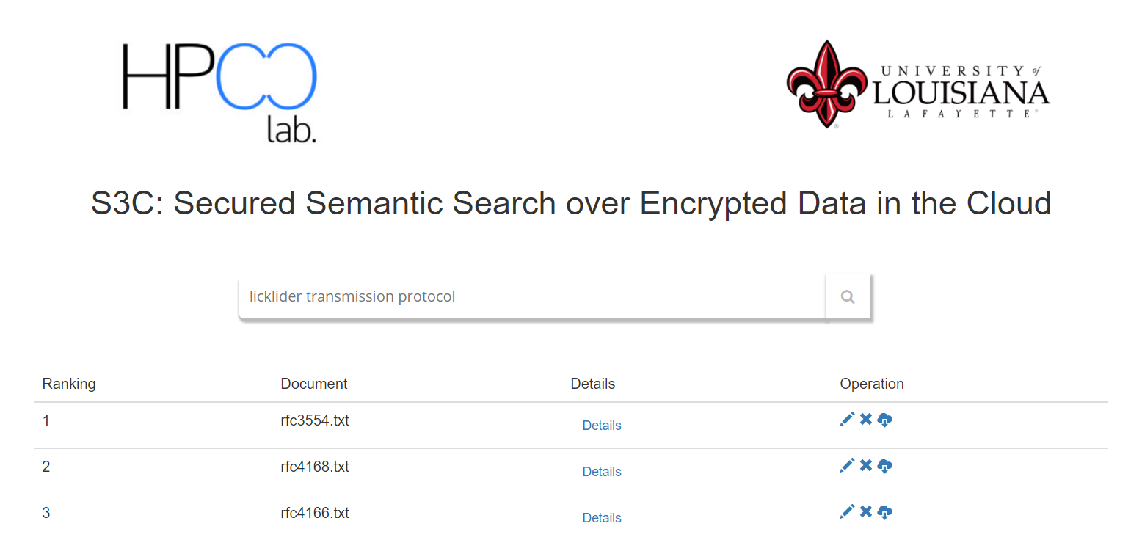
S3C Web Demo
http://ec2-54-89-198-86.compute-1.amazonaws.com/SemanticSearchClient/home.php

Slide 52
Appendix – Weighting Function
Original query q = 1
Split query terms = 1 / n (n = number of terms derived from splitting)
Synonyms/related terms of query term Q_{i} = W(Q_{i}) / m (W(Q_{i}) = weight of Q_{i} and m = number of synonyms/related terms)

Slide 53
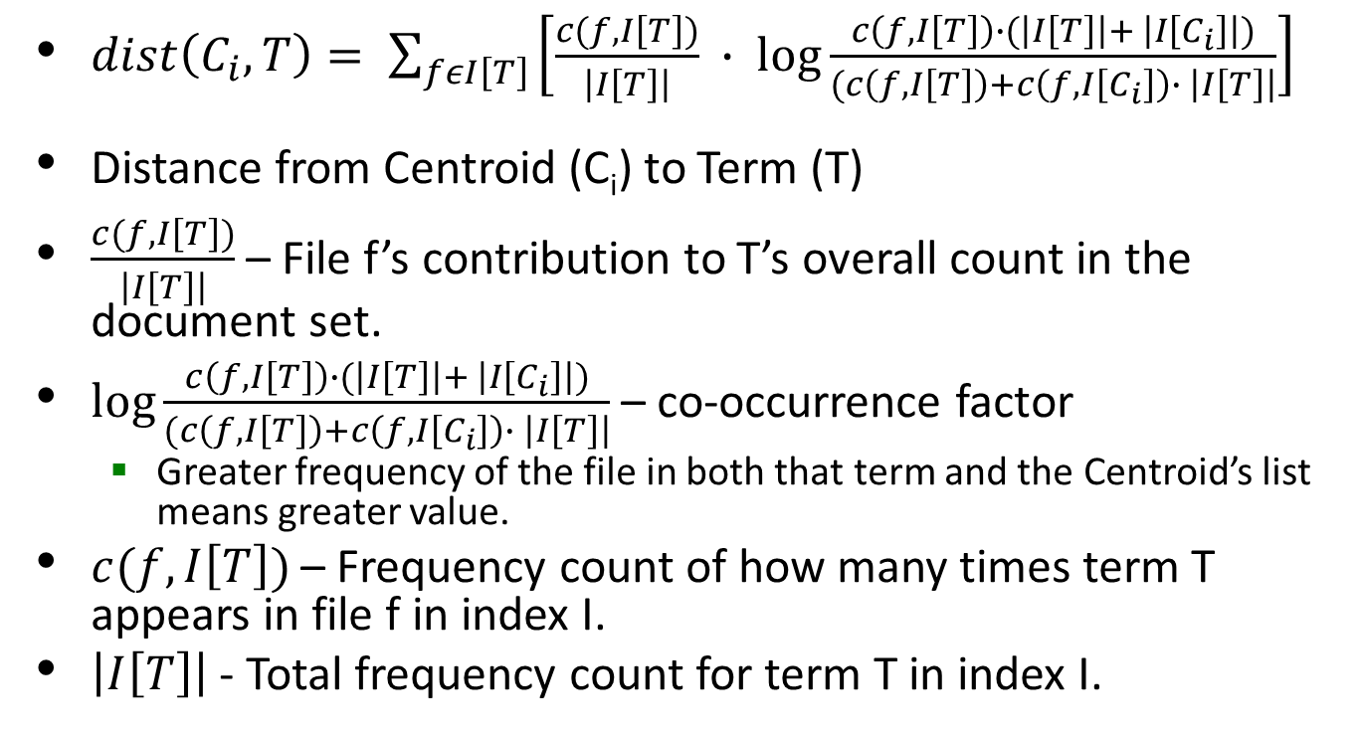
Appendix – Distance Function
$dist\left(C_{i}, T\right)= \sum_{fεI\left[T\right]}{\left[\frac{c(f, I\left[T\right])}{\left|I\left[T\right]\right|} ∙ \log{\frac{c\left(f, I\left[T\right]\right)∙(\left|I\left[T\right]\right|+ \left|I\left[C_{i}\right]\right|)}{(c\left(f, I\left[T\right]\right)+c\left(f, I\left[C_{i}\right]\right)∙ \left|I\left[T\right]\right|}}\right]}$
Distance from Centroid (C_{i}) to Term (T)
$\frac{c(f, I\left[T\right])}{\left|I\left[T\right]\right|}$ – File f’s contribution to T’s overall count in the document set.
$\log{\frac{c\left(f, I\left[T\right]\right)∙(\left|I\left[T\right]\right|+ \left|I\left[C_{i}\right]\right|)}{(c\left(f, I\left[T\right]\right)+c\left(f, I\left[C_{i}\right]\right)∙ \left|I\left[T\right]\right|}}$ – co-occurrence factor
  Greater frequency of the file in both that term and the Centroid’s list means greater value.
$c(f, I\left[T\right])$ – Frequency count of how many times term T appears in file f in index I.
$\left|I\left[T\right]\right|$ - Total frequency count for term T in index I.
Notes:
dist = SUM(contribution * co-occurrence)

Slide 54
Unstructured Searching
Plaintext
Secure/Encrypted
Keyword
Semantic…
Clustering…
Regular Expression
Semantic
Fuzzy Keyword
Word Stemming
Ontological Similarity

