Slide 1
Robust Resource Allocation of Independent Tasks in Heterogeneous Computing Systems via Probabilistic Task Pruning
James Gentry
High Performance Cloud Computing Lab (HPCC)
School of Computing and Informatics
University of Louisiana Lafayette
June 4th, 2018

Slide 2
Introduction
Introduction
Motivation
Related Work
Background
Experimental Setup
Contributions
Conclusion

Slide 3

Introduction
Heterogeneity is diversity
In distributed computing, heterogeneity can be present in both resources and in tasks

Slide 4
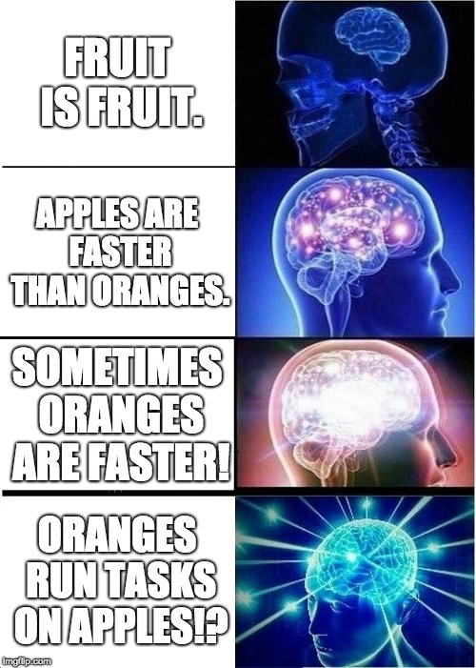
Introduction: Two Heterogeneities
Consistent
  Machine A is faster for all tasks than Machine B
Inconsistent
  Machine A is faster at some tasks, and Machine B is faster at others

Slide 5
Introduction: Robustness
Incoming tasks have deadlines
  Map arriving heterogeneous tasks to available heterogeneous resources
Task Robustness is the likelihood of meeting a deadline mapped to a given machine
  How can distributed heterogeneous systems best meet these deadlines?

Slide 6
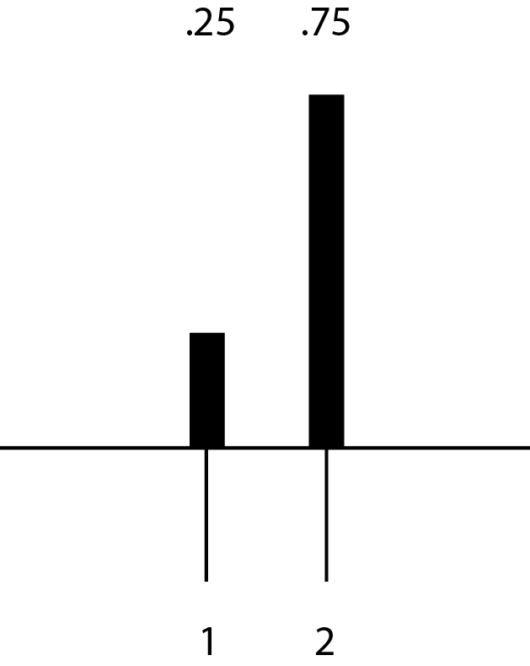
Introduction: Uncertainty
Uncertainty exists in the execution time of tasks that are in a system
Can be modeled via a probability mass function (PMF)
probability
time

Slide 7

Introduction: Goal
Subscription level of distributed system varies
  Oversubscription is when not all tasks can complete by their deadline
Deployment of additional resources not always possible (cost concerns, static clusters and grids, etc)
Our goal in this research is to make the system robust against oversubscription in the HC system

Slide 8
Motivation
Introduction
Motivation
Related Work
Background
Experimental Setup
Contributions
Conclusion

Slide 9























Motivation: Live video streaming
9

Slide 10

Motivation: Live video streaming
Perfect Live Streams
  High resolution
  High framerate
  Low latency

Slide 11
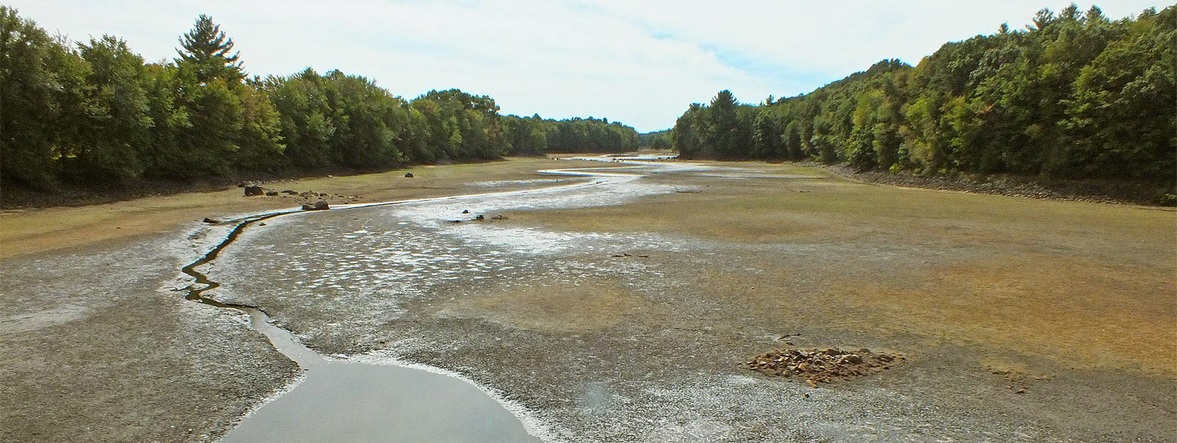
Motivation: Live video streaming
Sometimes this doesn’t work out.

Slide 12

Motivation: Live video streaming
Need liveness above all? Drop Frames!

Slide 13
Motivation: Live video streaming
Tasks with hard individual deadlines
Task-types vary (e.g. resizing, muxing, encoding)
Machine-types vary (e.g. CPU optimized, GPU optimized, memory optimized)

Slide 14
Motivation: Live video streaming
Task Dropping: When a tasks misses its deadline, it is no longer useful
Continued processing of useless tasks
  Adds to delays
  Adds to cost
  Reduces future quality of live streaming

Slide 15
Recap: System Model
Inconsistent Heterogeneity
Dynamic Arrival of Tasks
Tasks have hard deadlines
  Tasks can be dropped
Uncertainty in execution times
  Modeled by PMF
Goal is to maximize number of tasks completing before deadline
Notes:
Assumptions in our system

Slide 16
Problem Definition and Hypothesis
How to make an HC system robust against uncertainty in execution time and subscription level of the system?
Our hypothesis is to prune tasks that are unlikely to succeed (meet their deadline) to maximize the chance of other tasks’ success

Slide 17
Related Work
Introduction
Motivation
Related Work
Background
Experimental Setup
Contributions
Conclusion

Slide 18
Related Work: ETC
Task Execution Time Modeling for Heterogeneous Computing Systems
  Consistent and inconsistent heterogeneities
  ETC Matrix synthesis and analysis
Notes:
Shoukat Ali et al

Slide 19
Related Work: Robustness
Stochastic Robustness Metric and its Use for Static Resource Allocation
  Modeling uncertainty
  Combining execution and completion time distributions via convolution
Notes:
Vladimir Shestak et al

Slide 20
Related Work: Dropping Tasks
Stochastic-based Robust Dynamic Resource Allocation for Independent Tasks in an Heterogeneous Computing System
  Uses ETC/robustness/convolution to map tasks
  Drops past deadline tasks
Notes:
Mohsen Amini Salehi et al

Slide 21
Background
Introduction
Motivation
Related Work
Background
Experimental Setup
Contributions
Conclusion

Slide 22
Background: Modeling Uncertainty in Tasks’ Execution Time
Task execution time is a source of uncertainty in Heterogeneous Computing (HC) systems.
  Same task with different data has different execution times
Execution time uncertainty sampled and modeled via probability mass functions (PMF) called an execution time distribution
  These PMFs come from previous tasks on the machines in question.

Slide 23
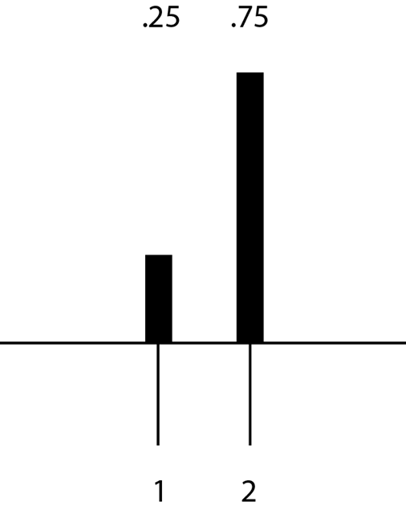
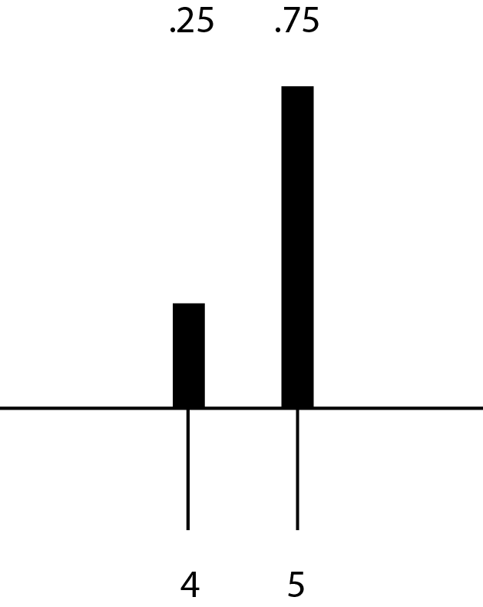
Background: Execution Time vs Completion Time
Unmapped task
Executing task
probability
probability
time
Starting at time 3
time
Notes:
For a single task

Slide 24
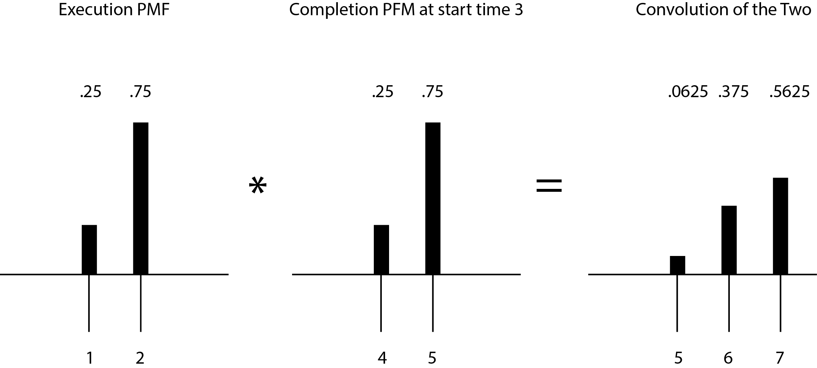
Background: Completion Time of a Series of Tasks
probability
probability
probability
time
time
time

Slide 25
Background: Probabilistic Dropping
For each task, from executing task, calculate robustness (i.e., probability of meeting deadline for task i)
Notes:
Stochastic-based robust dynamic resource allocation for independent tasks in a heterogeneous computing system
MOVE THE RED STUFF TO A LATER SLIDE

Slide 26
Background: Modeling Inconsistent Heterogeneity (PET)
The execution time distribution mapping of all machines/tasks is a Probabilistic Execution Time matrix (PET)
Generated from historical data of a system

Slide 27
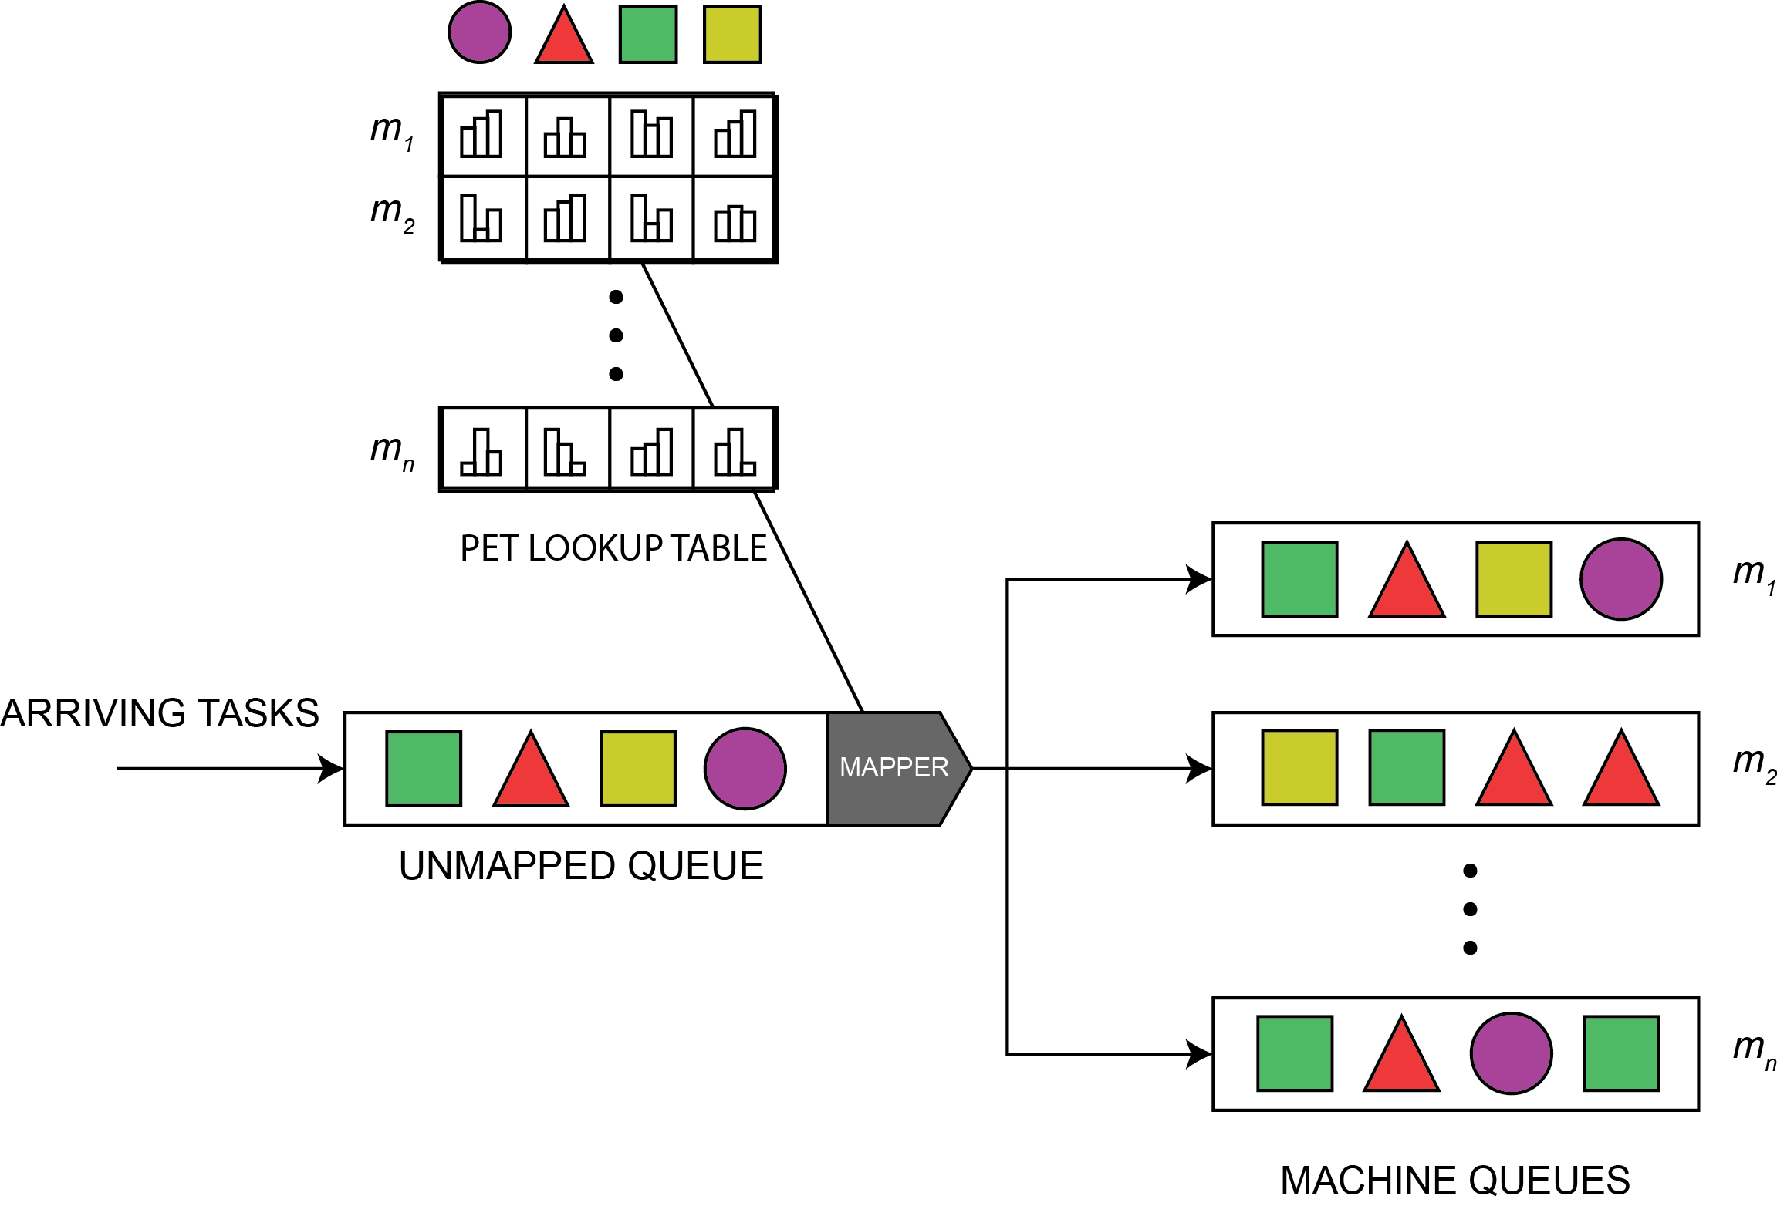
Background: Task Mapper
This is used by the task mapper to create optimal pairs of machine-task mappings

Slide 28
System Model: Mapping Events
Tasks arrive with deadlines, and are entered into a queue
Any unmapped tasks past their deadline are dropped
Mapping Events map tasks to FCFS machine queues

Slide 29
System Model: Mapping Events
Using the PET, a temporary (virtual) queue of mappings
Heuristics attempt to map batches of tasks at a time
The best pair from the virtual queue is physically assigned, repeat
Once mapped to a machine, the mapping is forever

Slide 30
Background
Introduction
Motivation
Related Work
Background
Experimental Setup
Contributions
Conclusion

Slide 31
Experiment Setup: Batch Heuristics
Min Min (MinMin)
  Find machine offering minimum completion time for all tasks
  Find minimum completion time for each machine
Min Soonest Deadline (MSD)
  Find machine offering minimum completion time for all tasks
  Find soonest deadline for each machine
Notes:
http://www.itl.nist.gov/div898/handbook/eda/section3/eda35b.htm

Slide 32
Experiment Setup: Batch Heuristics
Min Max Urgency (MMU)
  Find machine offering minimum completion time for all tasks
  Find task with maximum urgency (i.e. inverse of [deadline – completion time]) for each machine
Max On-time Completions (MOC)
  Find machine offering maximum robustness for all tasks
  From highest robust tasks, find task with minimum completion time for each machine
Notes:
Salehi et al

Slide 33
Experiment Setup: Immediate Heuristics
First Come First Served (FCFS)
Minimum Expected Execution Time (MET)
  Select machine offering MET
Minimum Expected Completion Time (MCT)
  Select machine offering MCT
K-Percent Best (KPB)
  Select machine offering MCT from k-percent of machines offering MET
Maximum Robust (MR)
  Like KPB, but selecting MR from k-percent of machines offering MET
Notes:
http://www.itl.nist.gov/div898/handbook/eda/section3/eda35b.htm

Slide 34
Experiment Setup: Task Data Generation
Task Arrival List Synthesis
  The distributions and parameters are constant across tests
PET synthesized from benchmarks
  The matrices are constant across tests
12 task types and 8 machines

Slide 35
Contributions
Introduction
Motivation
Related Work
Background
Experimental Setup
Contributions
Conclusion

Slide 36
Contributions of the Thesis
Probabilistic Task Pruning: Deferring and Dropping
  Develop Pruning Aware Mapping method
Apply pruning to current heuristics
Exploring strategies to improve robustness of the pruning mechanism

Slide 37
Probabilistic Pruning
Introduction
Motivation
Related Work
Background
Experimental Setup
Contributions
  Probabilistic Pruning
  Applying Pruning to Existing Methods
  Improving Pruning
Conclusion

Slide 38
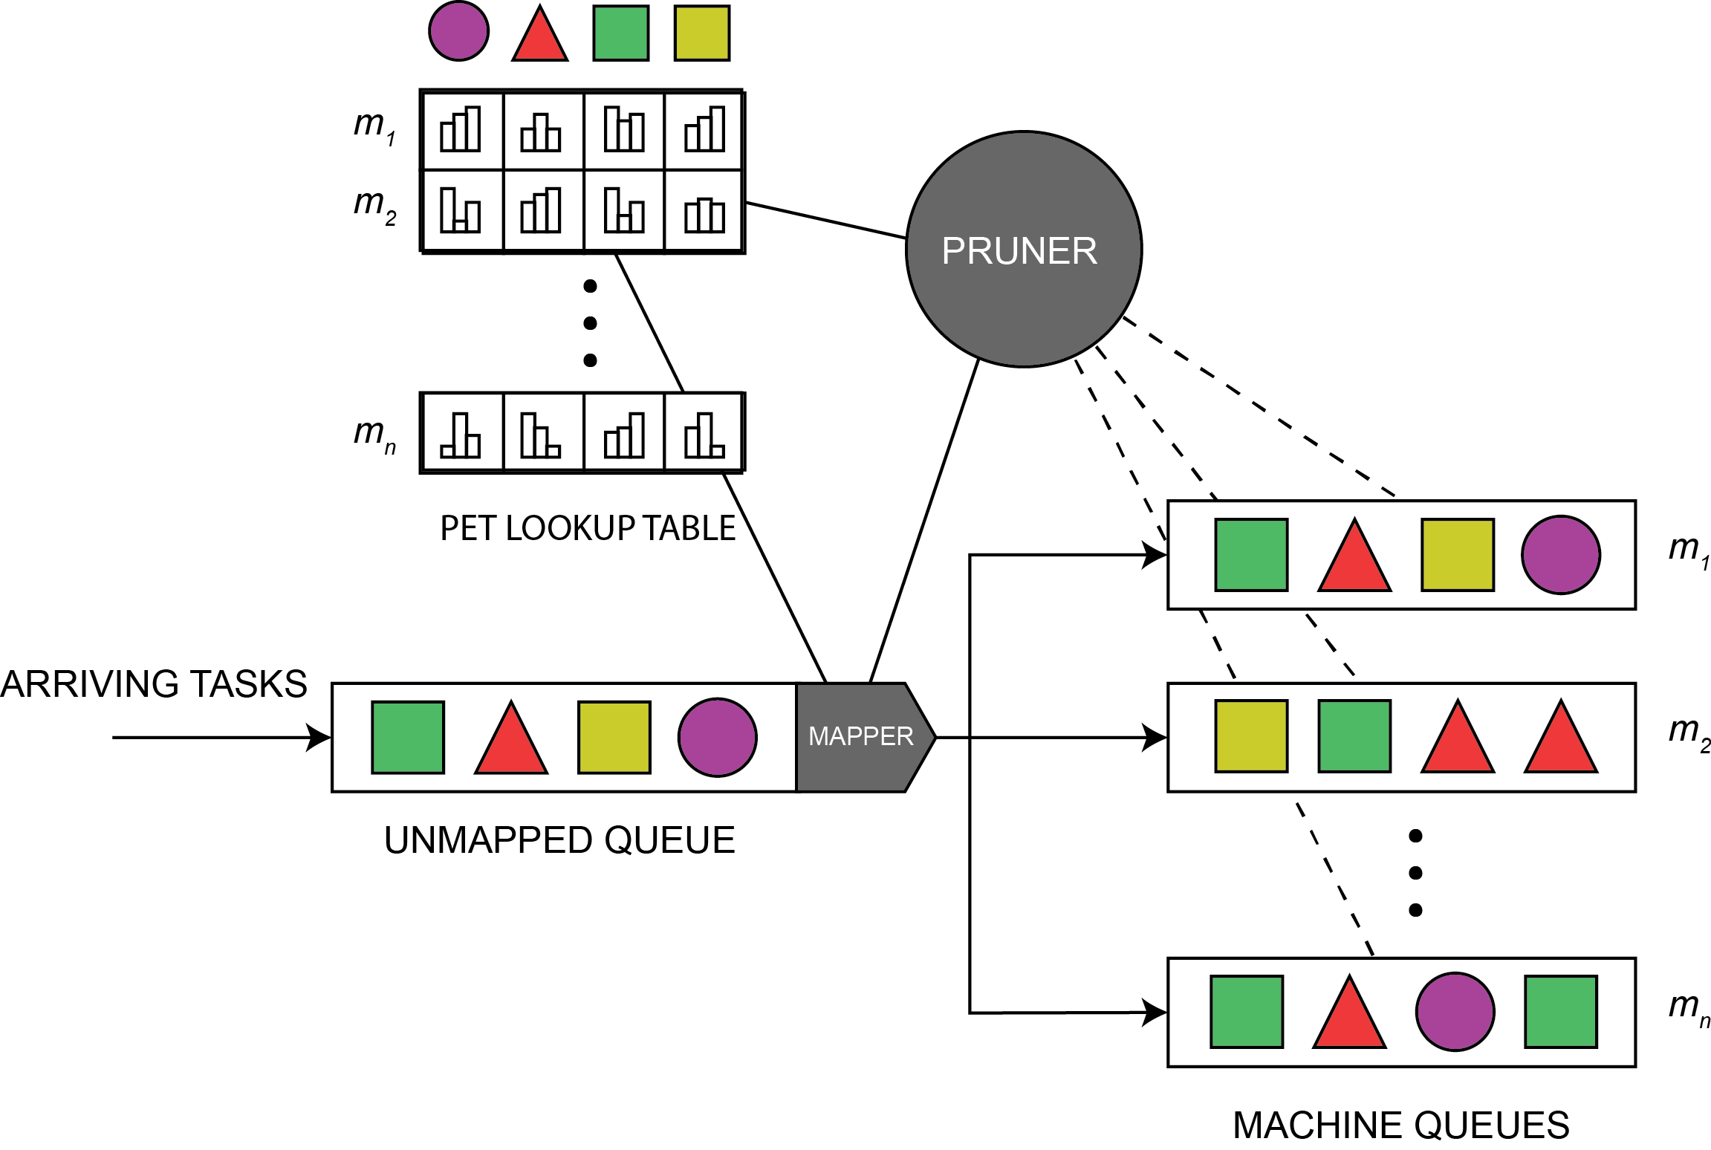
Task Pruning Mechanism

Slide 39
Pruning: Dropping
Before a mapping event, machine queues are examined
  For each task in a queue: completion time PMF & robustness calculated
Prune tasks that have low robustness
  frees resources for remaining tasks
  minimizes the overall number of deadline misses

Slide 40
Pruning: Dropping from Machine Queues
Traversing the queue from executing task allows us to judge each task’s robustness in isolation
Dropped tasks improve the robustness of the remaining tasks
  reduces the compound uncertainty
Entire queue is examined to make the most robust mappings

Slide 41
Pruning: Deferring
Before mapping tasks, potential mapping pairs are examined
  Robustness calculated
Defer tasks that have low robustness
  Allows the mapper to wait for mappings with better affinity
  Higher probability mappings, though starting later, will maximize the number of successful tasks

Slide 42
Pruning: Oversubscription Problems
How to determine when to drop, based on the oversubscription level of the system
At what robustness threshold do we drop and defer tasks?

Slide 43
Engaging Pruning: Factors for Consideration – Macro Level
As oversubscription (arrival rate) increases, probability of misses increases
Recent Deadline Misses
  These are used as an indicator of the success of our system thus far. The number of missed deadlines can be a signal for enabling dropping

Slide 44
Pruning: Dropping Algorithm

Slide 45
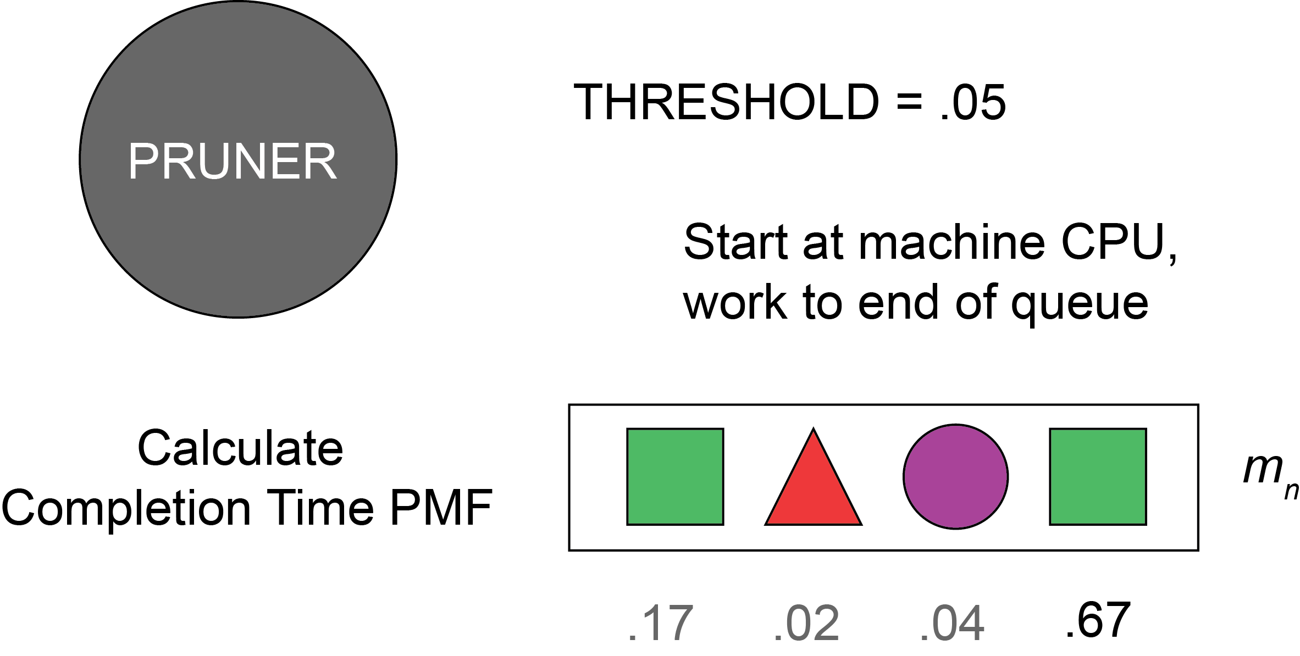
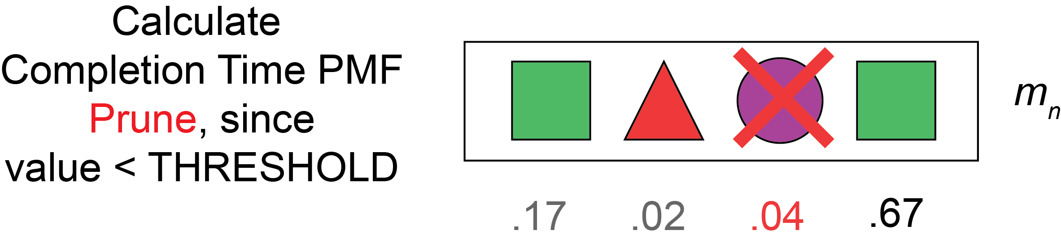
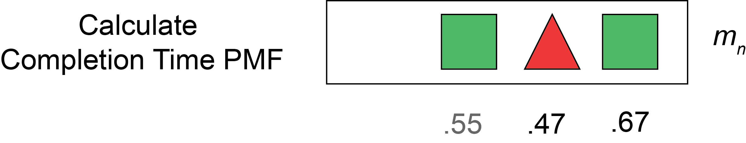

Pruning: Dropping Details

Slide 46
Pruning: Pruning Aware Mapper
A “two” phase batch mode task-machine mapping heuristic
First maximize robustness for all tasks
First & ¾ defer tasks under pruning threshold
Second schedule task with minimum completion time for each machine
Repeat

Slide 47
Pruning: PAM Algorithm

Slide 48
Results: Finding a threshold
Notes:
http://www.itl.nist.gov/div898/handbook/eda/section3/eda35b.htm

Slide 49
Results: Pruning Toggle
Notes:
http://www.itl.nist.gov/div898/handbook/eda/section3/eda35b.htm

Slide 50
Results: Awareness
Notes:
http://www.itl.nist.gov/div898/handbook/eda/section3/eda35b.htm

Slide 51
Results: Oversubscription
Notes:
http://www.itl.nist.gov/div898/handbook/eda/section3/eda35b.htm

Slide 52
Applying Pruning to Existing Methods
Introduction
Motivation
Related Work
Background
Experimental Setup
Contributions
  Probabilistic Pruning
  Applying Pruning to Existing Methods
  Improving Pruning
Conclusion

Slide 53
Applying Deferring to Existing Methods

Slide 54
Applying Dropping to Existing Methods

Slide 55
Applying Both to Existing Methods

Slide 56
Applying Dropping to Immediate Mode Heuristics

Slide 57
Improving Pruning
Introduction
Motivation
Related Work
Background
Experimental Setup
Contributions
  Probabilistic Pruning
  Applying Pruning to Existing Methods
  Improving Pruning
Conclusion

Slide 58
Results: Decoupling Dropping and Deferring
Threshold to defer a task will be a small percentage higher than dropping threshold
Will allow the benefits of both dropping and deferring to be magnified
Notes:
http://www.itl.nist.gov/div898/handbook/eda/section3/eda35b.htm

Slide 59
Results: Decoupling Dropping and Deferring
Notes:
http://www.itl.nist.gov/div898/handbook/eda/section3/eda35b.htm

Slide 60
Improved Pruning: Recognizing Oversubscription
The pruner should not react to acute spikes in deadline misses, but to an ongoing state of oversubscription
A decaying average of deadline misses will give the pruner access to history in decision making

Slide 61
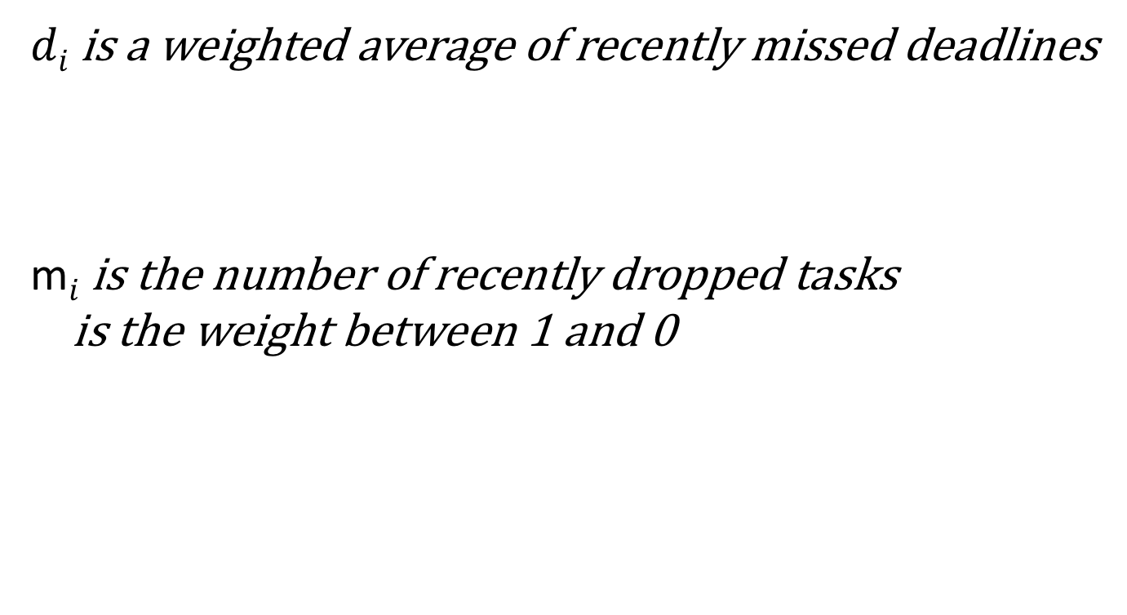
Improved Pruning: Recognizing Oversubscription
  $di$ is a weighted average of recently missed deadlines
  m$i$ is the number of recently dropped tasks
  is the weight between 1 and 0
Notes:
Holding k at 1 for initial tests

Slide 62
Improved Pruning: Recognizing Oversubscription
Have two dropping toggle-values
  High for switching on
  Low for switching off
Based on Schmitt trigger concept
Notes:
Holding k at 1 for initial tests

Slide 63
Results: Recognizing Oversubscription
Toggle 1
Toggle 2
Toggle 3
Notes:
http://www.itl.nist.gov/div898/handbook/eda/section3/eda35b.htm

Slide 64
Improved Pruning: Dynamic
Per-Task Dropping Threshold
Negative skewness indicates left tail
Positive skewness indicates right tail
Notes:
http://www.itl.nist.gov/div898/handbook/eda/section3/eda35b.htm

Slide 65
Improved Pruning: Dynamic
Per-Task Dropping Threshold
Two task-level considerations on required robustness
  Position in machine queue
  Skewness of PMF
Notes:
http://www.itl.nist.gov/div898/handbook/eda/section3/eda35b.htm

Slide 66
Improved Pruning: Skewness Example
To demonstrate the effects of skewness on convoluted robustness:
  Left ETD for task i+1 with a deadline of 4
  Middle CTD for executing task i, considered for dropping, with a deadline of 2
  Right CTD of both tasks executing to completion

Slide 67
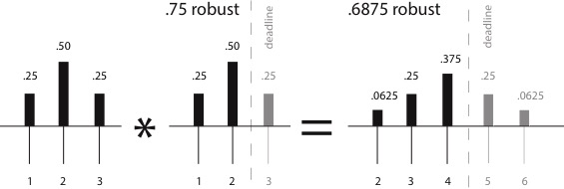
Improved Pruning: Skewness for a task with no skew
probability
probability
probability
time
time
time

Slide 68
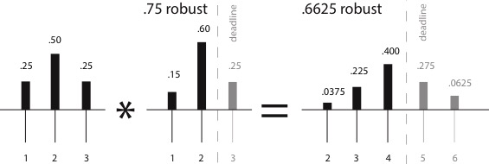
Improved Pruning : Skewness for a task with a left skew
probability
probability
probability
time
time
time

Slide 69
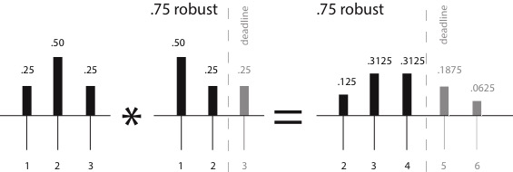
Improved Pruning : Skewness for a task with right skew
probability
probability
probability
time
time
time

Slide 70
Improved Pruning: Dynamic
Per-Task Dropping Threshold
The effect of j (position of task in queue) rises inverse to position of task in machine queue
Because skewness is considered large at +/- 1, we clamp s between -1 and 1
The effect is inversely correlated to the sign of s

Slide 71
Results: Dynamic
Per-Task Dropping Threshold

Slide 72
Improved Pruning : Fairness Among Dropped Task Types
A small relaxation of the required probability is given to task types when they are dropped by the system
  Allow them more access to the system

Slide 73
Results: Fairness
Notes:
http://www.itl.nist.gov/div898/handbook/eda/section3/eda35b.htm

Slide 74
Etc: Analyzing Cost of Pruning
An additional benefit to pruning unlikely tasks is not paying to process tasks that are unlikely to be successful
Notes:
http://www.itl.nist.gov/div898/handbook/eda/section3/eda35b.htm

Slide 75
Results: Cost
Notes:
http://www.itl.nist.gov/div898/handbook/eda/section3/eda35b.htm

Slide 76
Conclusion
Introduction
Motivation
Related Work
Background
Experimental Setup
Contributions
  Probabilistic Pruning
  Applying Pruning to Existing Methods
  Advanced Pruning
Conclusion

Slide 77
Conclusion
Pruning is effective in increasing on-time
Can be applied effectively to other mapping systems
Conservative mapping (deferring) with relatively relaxed dropping increases oversubscribed system robustness

Slide 78
Future Work
Dynamic Per-task Threshold
  Bespoke arrival patterns and ETC
Priority
Preemption
Approximate Computation
Implementation Optimization
  Test in real system
  Mitigate complexity from growing machine queue size
Notes:
http://www.itl.nist.gov/div898/handbook/eda/section3/eda35b.htm

Slide 79
Thanks!
Any Questions?
Notes:
http://www.itl.nist.gov/div898/handbook/eda/section3/eda35b.htm

Slide 80
Appendix: Dropping Pending Tasks
Notes:
Stochastic-based robust dynamic resource allocation for independent tasks in a heterogeneous computing system

