Slide 1
Cost- and QoS-Efficient Serverless Cloud Computing
Chavit Denninnart
High Performance Cloud Computing Lab (HPCC)
School of Computing and Informatics
University of Louisiana Lafayette
October 30, 2020

Slide 2
Outline
Introduction
Background and Positioning of the Work
Contribution 1: Evaluating Benefits of Reusing
Contribution 2: Achieving Task Reusing
Contribution 3: Achieving Approximate Processing
Contribution 4: SMSE Implementation and Demo
Conclusion and Future Works
Notes:
Platform Implementation and Demo is contribution 4?

Slide 3
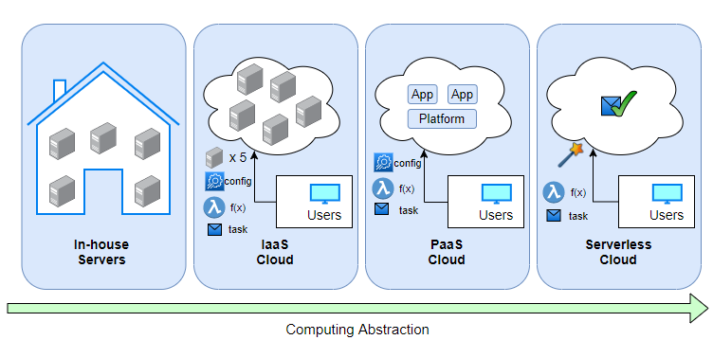
Serverless Cloud:
Next Step in Cloud Evolution!
Notes:
Come one by one
In hourse etc. bold

Slide 4
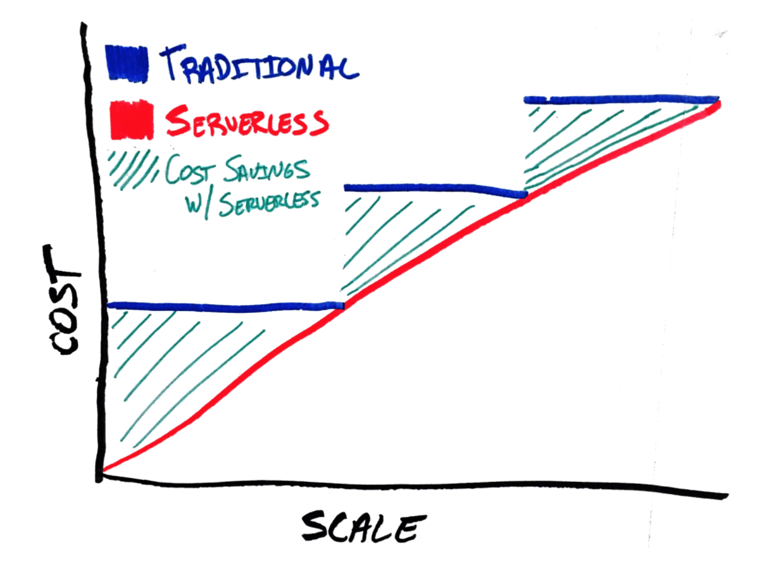
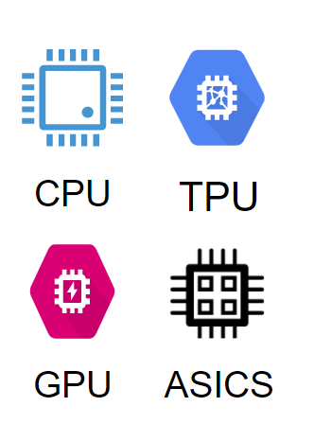
Serverless Cloud Computing
Users define functions (micro-services) and generate Tasks
  Execution details are transparent
  Cost is charged for real resource usage
Cloud handles resource allocation and task execution
  Resource pools are shared across users
  Heterogeneous machines are used for efficiency

Slide 5
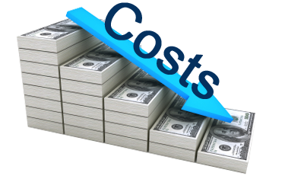


Goals of Serverless Clouds
Making serverless clouds more
cost-efficient (and energy-efficient )
Improving user-perceived QoS of services (tasks)
  Tasks often have deadlines
  QoS is compromised by missing tasks’ deadlines
Notes:
It can make the cloud greener and help the environment

Slide 6
Redundant Computation: Opportunity to Achieve the Goals
Problem: different forms of redundant computation exist in serverless clouds
Identical/Similar tasks exist
    Strategy: Computational reuse of tasks (Contribution 1 and 2)
Unnecessary/pointless tasks are processed
    Strategy: Approximating the output stream (Contribution 3)
Notes:
First one is tasks whose chance of deadline is low must be dropped → what are the benefits: saving cost (energy) and giving time to others….
Second one → can save cost

Slide 7




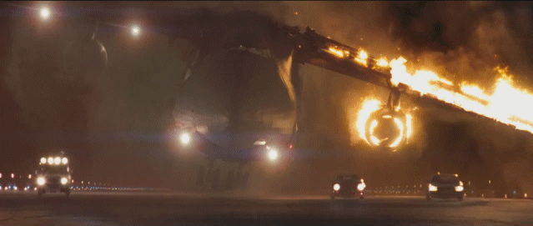
Motivational Context:
Interactive Serverless Media Streaming
Streaming provider
Request
Media Repository
Notes:
How many different versions of the same video can CDN holds?
How many video versions are accessed?

Slide 8
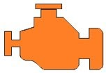





Motivational Context:
Interactive Serverless Media Streaming
Streaming provider
Interactive Media
Processing Service
Media Repository
Notes:
How many different versions of the same video can CDN holds?
How many video versions are accessed?

Slide 9
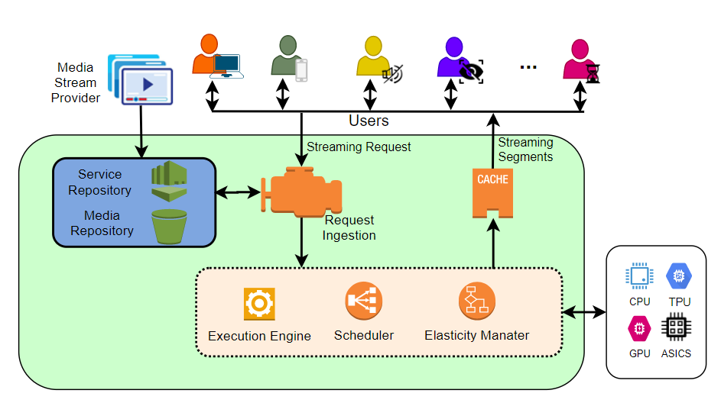
Bird Eye-View of the Media Streaming Engine We Aim to Create (Contribution 4)
Cloud
Machines
Serverless Media Streaming Engine (SMSE)

Slide 10
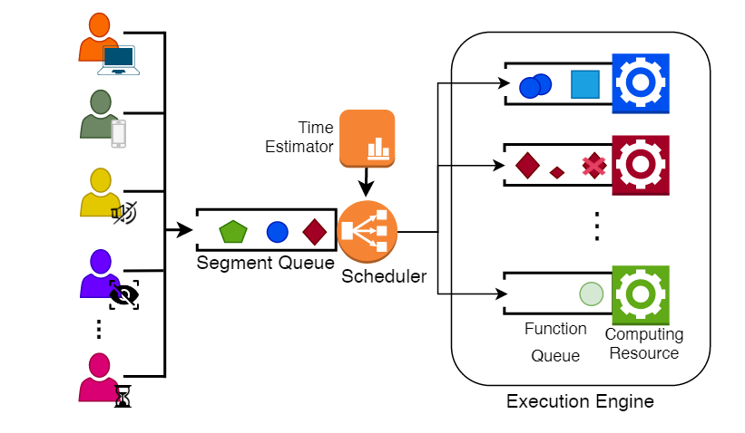
BG: Computational Reusability in Serverless Computing
Notes:
Shared Segment queue and execution engine, so resources are sharable

Slide 11
Outline
Introduction
Background and Positioning of the Work
Contribution 1: Evaluating Benefits of Reusing
Contribution 2: Achieving Task Reusing
Contribution 3: Achieving Approximate Processing
Contribution 4: SMSE Implementation and Demo
Conclusion and Future Works

Slide 12
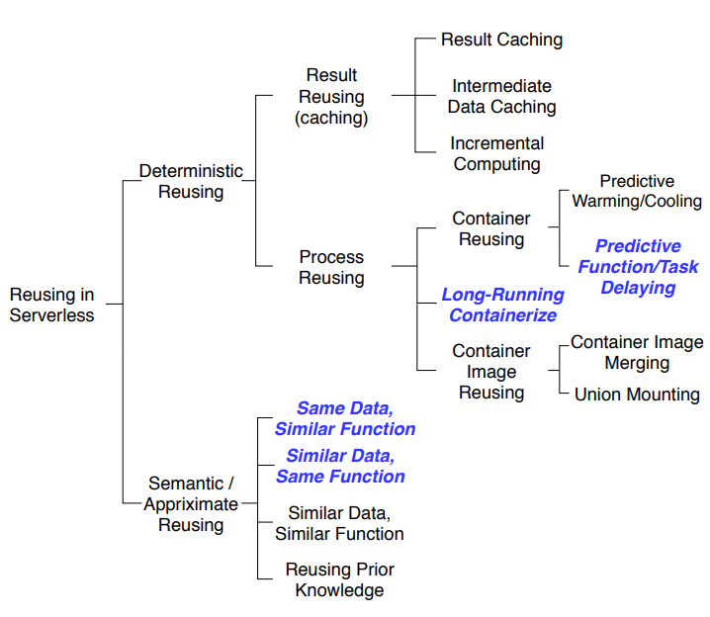
Reusing in Serverless Systems

Slide 13
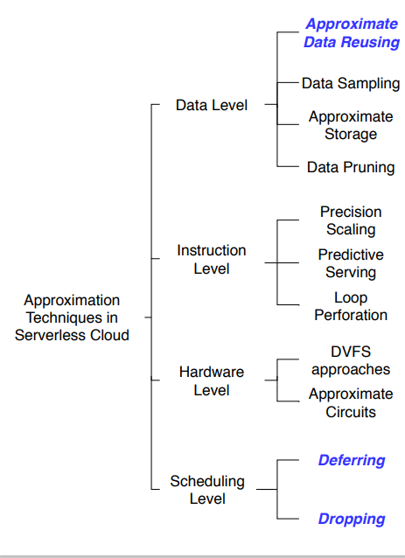
Approximating in Serverless Systems
Notes:
Spend 2 minutes in chapter 2

Slide 14
Outline
Introduction
Background and Positioning of the Work
Contribution 1: Evaluating Benefits of Reusing
Contribution 2: Achieving Task Reusing
Contribution 3: Achieving Approximate Processing
Contribution 4: SMSE Implementation and Demo
Conclusion and Future Works
Notes:
Platform Implementation and Demo is contribution 4?

Slide 15
Strategy 1: Computational reuse
Contribution 1: Evaluating Benefits of Reusing in Serverless Clouds
Notes:
Descriptive and Predictive Analysis of Aggregating Functions in Serverless Clouds: the Case of Video Streaming

Slide 16
Assumptions and Objective
Heterogeneous tasks
Similar/identical task exists
The objective is to:
Reuse computation via merging similar tasks to reduce cost and improves QoS
Notes:
Heterogeneous in both task type and size

Slide 17
Problem Definition
What is the saving magnitude we can expect from task merging?
What is the influential factors on the execution-time saving of merged tasks?
How to create a resource-saving predictor engine?

Slide 18
Some Notations in the Slides…
Different geometry signify different services (task types)
Different sizes show different execution time
Different colors signify different data sources
Example:
Changing
Codec
Changing
resolution
Creating Subtitle
Censoring
Example:
3s
6s
8s
Example:
News
Cartoon
Live Camera

Slide 19
Data Collection: Task Definition
Benchmark 100 video stream
  Each stream has up to 60 video segments
    Each video segment is 2 seconds long
    For a total of 3,159 video segments.
Perform 4 different operations to the video
  Each operation also has 3-5 configurations
  Nearly 100k data point

Slide 20
Data Collection: Execution Scenario
For each video:
  Execute each task individually
    Non-merging baseline
  Execute aggregated tasks consist of two to five parameters of the same operation
    Task merging with the same operation
  Execute aggregated tasks consist of two to four operations
    Task merging with different operation

Slide 21
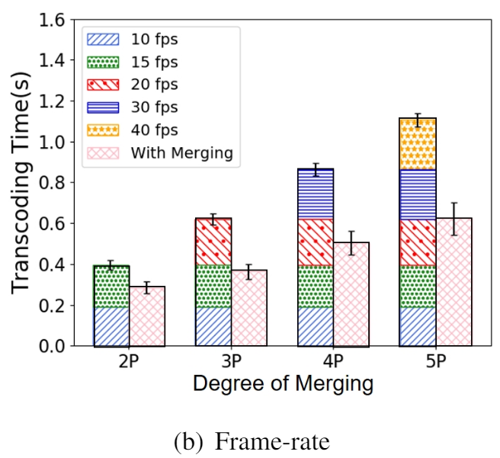
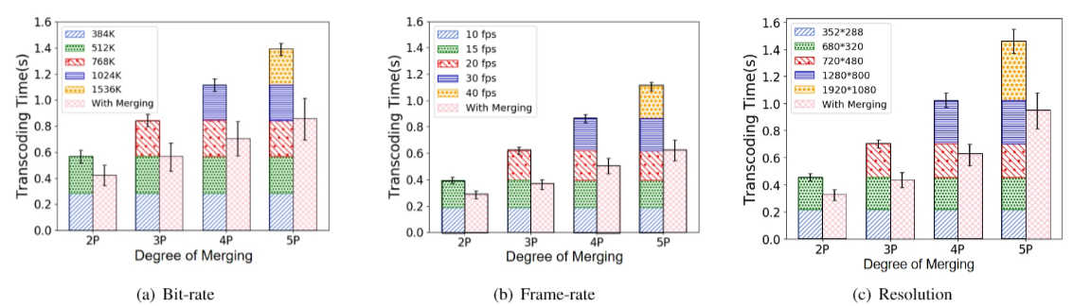
Measuring Execution-Time
Saving of Video Merging
Saves up to 45%
Notes:
Take away message written in red

Slide 22
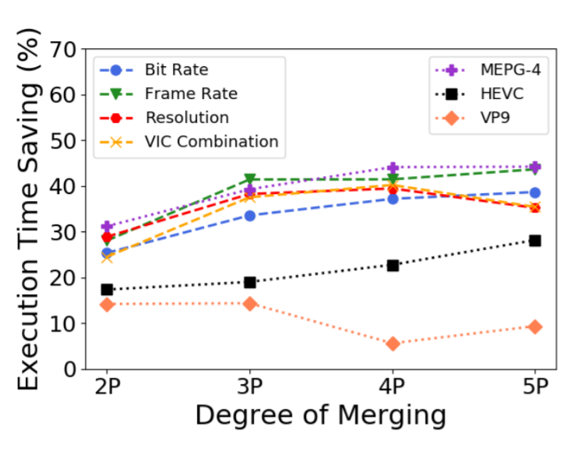
Measuring Execution-Time
Saving of Video Merging
High variation
>3 merging can be bad
Notes:
Saving is inconsistence

Slide 23
Training Resource Saving Predictor
Use the results to train a variant of decision tree called
“Gradient Boosting Decision Tree”
Notes:
Can show if interested, but otherwise, let skip minor details

Slide 24
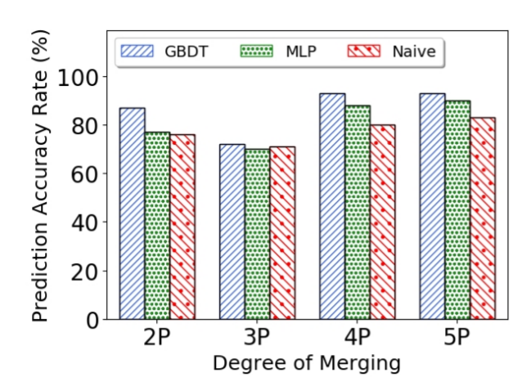
Accuracy of the Prediction Engine

Slide 25
Summary
Task aggregation can save the resource by up to 45%
Merge saving gain is maximized on the first three tasks
  Larger group gain minimal extra benefits
Merge saving prediction engine is created with up to 93% accuracy

Slide 26

Publications of Contribution 1
Shangrui Wu, Chavit Denninnart, Xiangbo Li, Yang Wang, Mohsen Amini Salehi, Descriptive and Predictive Analysis of Aggregating Functions in Serverless Clouds: the Case of Video Streaming, Accepted in IEEE International Conference on High Performance Computing and Communications (HPCC ’20)
Publicly available video benchmarking dataset and the prediction engine
  Link to GitHub repository:
    https://github.com/hpcclab/Merge-Saving-Prediction
    https://github.com/hpcclab/VideoStreaming_Workload

Slide 27
Outline
Introduction
Background and Positioning of the Work
Contribution 1: Evaluating Benefits of Reusing
Contribution 2: Achieving Task Reusing
Contribution 3: Achieving Approximate Processing
Contribution 4: SMSE Implementation and Demo
Conclusion and Future Works
Notes:
Platform Implementation and Demo is contribution 4?

Slide 28
Strategy 1: Computational reuse
Contribution 2: Achieving Task Reusing in Serverless Clouds
Notes:
Descriptive and Predictive Analysis of Aggregating Functions in Serverless Clouds: the Case of Video Streaming

Slide 29
Problem Definition
How to perform task aggregation?
When to apply task aggregation such that other tasks are not affected?
The aggregation must be done with minimal overhead

Slide 30
Performing Aggregation
Based on Task Similarity Levels
X
Task Level Similarity
  Same Data, same process, same parameters
    Deduplication, no extra overhead for merging
Data-Operation Level Similarity
  Same Data, same Process
Data-Only Level Similarity
  Same Data

Slide 31
Steps to Achieve Task Aggregation
Find mergeable tasks
Determine merge appropriateness
  (optional) determine position to place merged task back to the queue
Perform task aggregation
Notes:
Focus on first two
Not task aggregation: it is application-specific. We have impeleted for on-demand vi

Slide 32
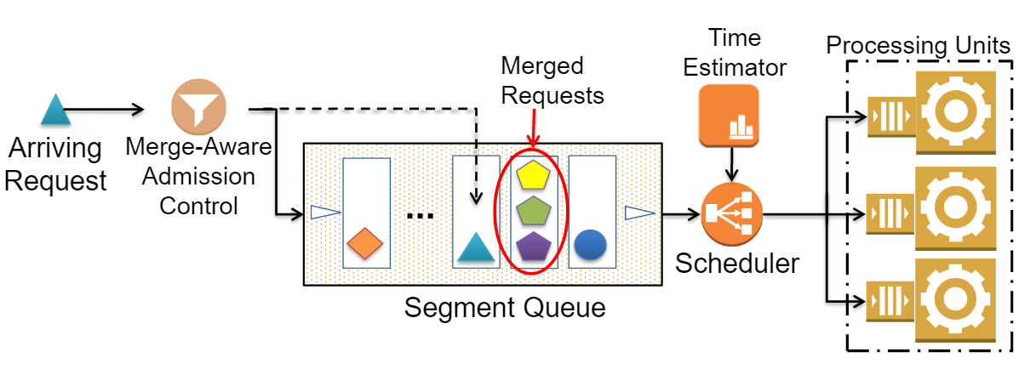
Admission Control
Notes:
Now, how to do it?

Slide 33

Mergeable Tasks Detection
Using three hash-tables using task keys
  Key are generated based on task characteristics
Merge upon arrival to Admission Control
Constant time
Complexity
UPDATE
Merge-Aware Admission Control
Batch queue

Slide 34
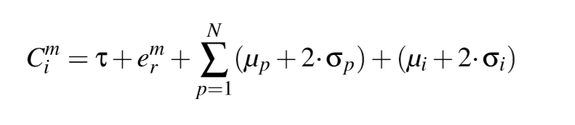
Merge Impact Evaluation
Estimate number of deadline misses if task is merged or not merge
  Require task execution profile
  Require merge saving predictor
Consider worst case analysis of each task’s completion time

Slide 35
Merged Task Positioning in the Scheduling Queue
Merged Task positioning in FCFS task queue can impact deadline miss-rate
  Other scheduling policy has its own task sorting criteria
Merged task start later
Delay fewer tasks
Merged task start earlier
Delay more tasks
Segment queue

Slide 36
Merged Task positioning
Strategy: Schedule the merged task as late as possible without missing its deadline
How to obtain:
  Logarithmic Search
  Linear Search
Observation:
  Linear Probe is faster
    Allow more computational reuse
Notes:
O(n) vs O(nlogn)

Slide 37
Merge Aggressiveness Factor
In oversubscribed condition, merge causing deadline violation can still be beneficial
  How to determine oversubscribed condition?
  How to use the Aggressiveness factor?
Deadline miss: 2
Completion: 12s
Deadline miss: 1
Completion: 14s
Notes:
2nd work in this contribution found that reaching short term optimal doesn’t result in long term optimal

Slide 38
Merge Aggressiveness Factor
Merge Aggressiveness ≅ Oversubscription level
Oversubscription level
  Measured by average of
    (Task Completion time – Task Deadline) / (Task Length)

Slide 39
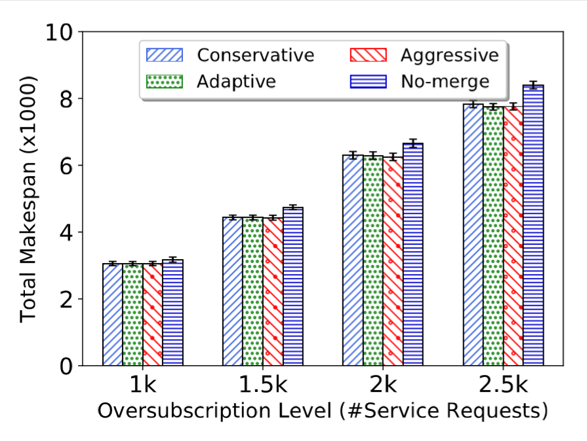
The Impact of Task Aggregation on Makespan
9% Saving in Makespan
less amount of resource usage time for the same amount of work
Notes:
14% saving
Makespan in Seconds

Slide 40
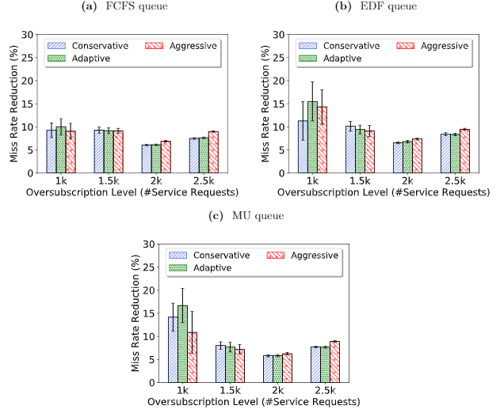
The Impact of Task Aggregation on QoS
Notes:
DMR = Dealine Miss Rate

Slide 41
Summary
Mergeable task can be detected in constant time complexity using hash-table
Short term optimal does not lead to long term optimal
  Heuristic should adapt to oversubscription condition

Slide 42
Publications of Contribution 2
Chavit Denninnart, Mohsen Amini Salehi, Improving Cost-Efficiency and QoS of Serverless Computing via Computational Reuse , Submitted to IEEE Transactions on Parallel and Distributed Systems (TPDS)
Chavit Denninnart, Mohsen Amini Salehi, Adel Nadjaran Toosi, and Xiangbo Li, Leveraging computational reuse for cost- and qos-efficient task scheduling in clouds, International Conference on Service-Oriented Computing (ICSOC), Nov. 2018, pp. 828–836
Publicly available simulation in this project
  Link to GitHub repository:
  https://github.com/hpcclab/adaptivemerging

Slide 43
Outline
Introduction
Background and Positioning of the Work
Contribution 1: Evaluating Benefits of Reusing
Contribution 2: Achieving Task Reusing
Contribution 3: Achieving Approximate Processing
Contribution 4: SMSE Implementation and Demo
Conclusion and Future Works
Notes:
Platform Implementation and Demo is contribution 4?

Slide 44
Strategy 2: Approximating Processing
Contribution 3: Achieving Approximate Processing in Serverless Clouds
Notes:
Descriptive and Predictive Analysis of Aggregating Functions in Serverless Clouds: the Case of Video Streaming

Slide 45
Assumptions
Media Stream = multiple independent tasks
Tasks have hard individual deadlines
  In live streaming, a missed segment has no use
  Processing it add cost and delay to other tasks
Notes:
Each task can be processed or dropped individually

Slide 46
Objective
Proactively prune tasks with low
chance of on-time completion to
reduce cost and improves QoS

Slide 47
Problem Definition
How to perform proactive task pruning such that the incurred cost is minimized and overall QoS is improved?
(And) the approach should incur minimal overhead

Slide 48
Modeling Inconsistent Heterogeneity (PET)
Matrix of PMF forms Probabilistic Execution Time matrix (PET)
Generated from historical data of a system
Notes:
Such as data from Contribution 1

Slide 49
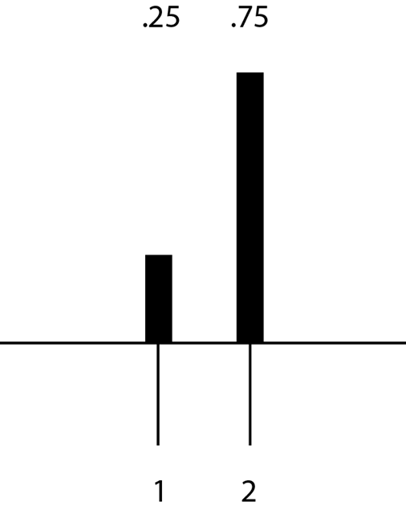
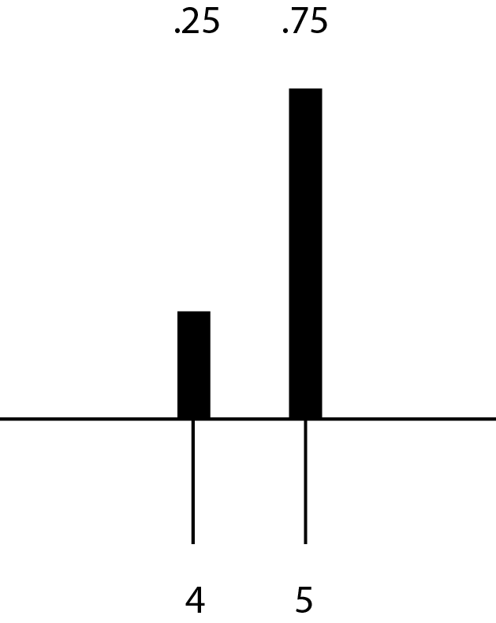
Execution Time vs
Completion Time
Unmapped task
Executing task
probability
probability
time
Starting at time 3
time
Notes:
Too much detail, move or remove

Slide 50
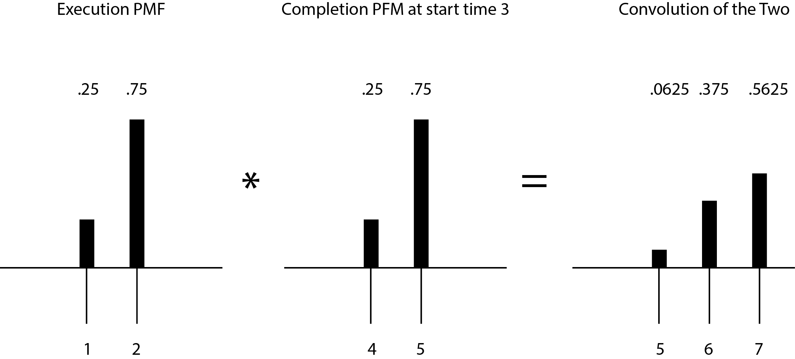
Completion Time of a Series of Tasks
probability
probability
probability
time
time
time
Notes:
Too much detail, move or remove

Slide 51
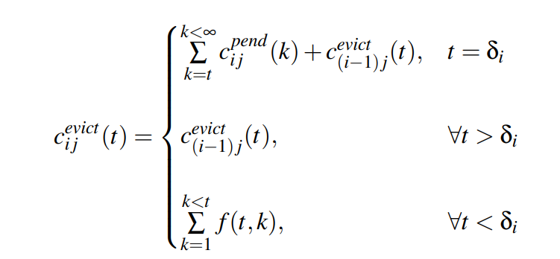
Completion Time of a Series of Droppable Tasks
Notes:
Conditional convolution
Not permutable

Slide 52
Chance of Success
Chance of success is the probability of meeting task’s deadline
Notes:
Systematicaly calculate chance of success, then?

Slide 53
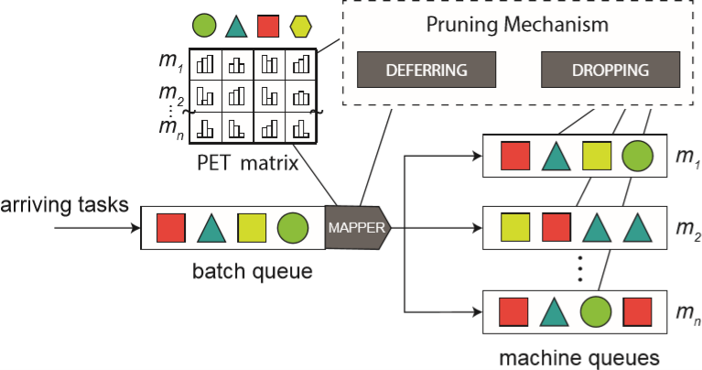
Task Pruning Mechanism

Slide 54
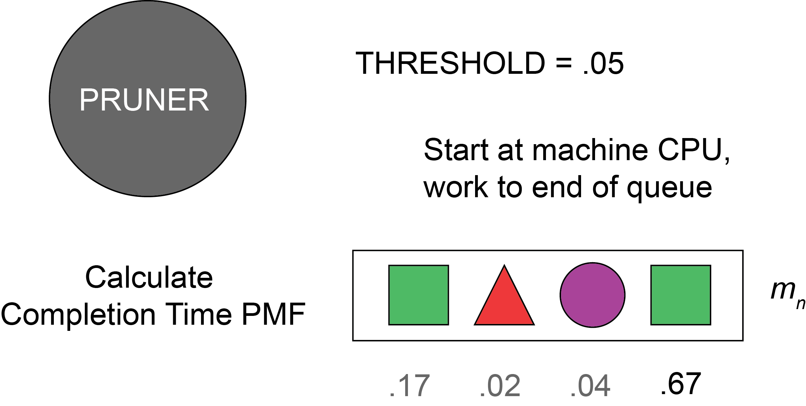
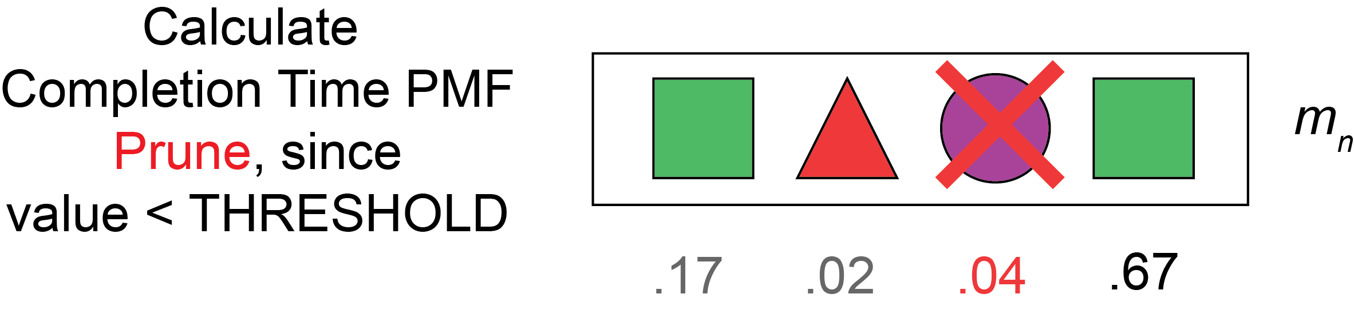
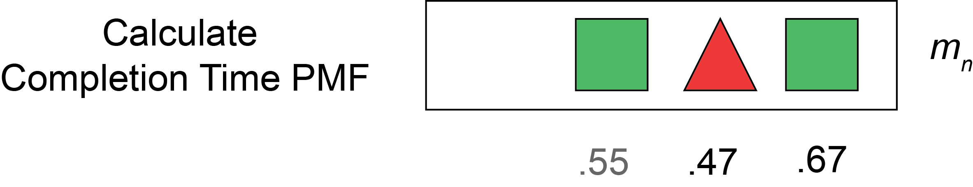

Pruning: Task Dropping
Before each mapping event:
  Drop all tasks with chance of success below threshold
Notes:
from machine queues Frees resources for remaining tasks
Minimizes the overall number of deadline misses

Slide 55
Dropping Toggle
Dropping is not always beneficial
  unless oversubscribed
Perform Dropping when
oversubscription level > Dropping Toggle
  Oversubscription level = DMR of recent time window
.99 1.0 .99 .12 .95

Slide 56
Pruning: Task Deferring
In each mapping event, don’t consider mapping choices which
chance of success < threshold
Benefits:
  Only utilize resource for task with decent chance of being beneficial
  Allows the task to wait for other mapping event with better affinity
Notes:
Higher probability mappings, though starting later, can maximize the number of successful tasks
-infinite deferring
Based on threshold

Slide 57
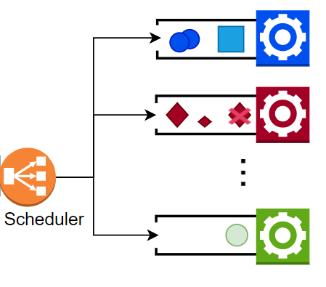
Pruning: Task Deferring
m₁
Chance .99 1.0 .99 .12 .95
Destination m₁ m₂ m_{n} m₁ m₂
m₂
Length 5s 6s 3s 2s 4s
m_{n}

Slide 58
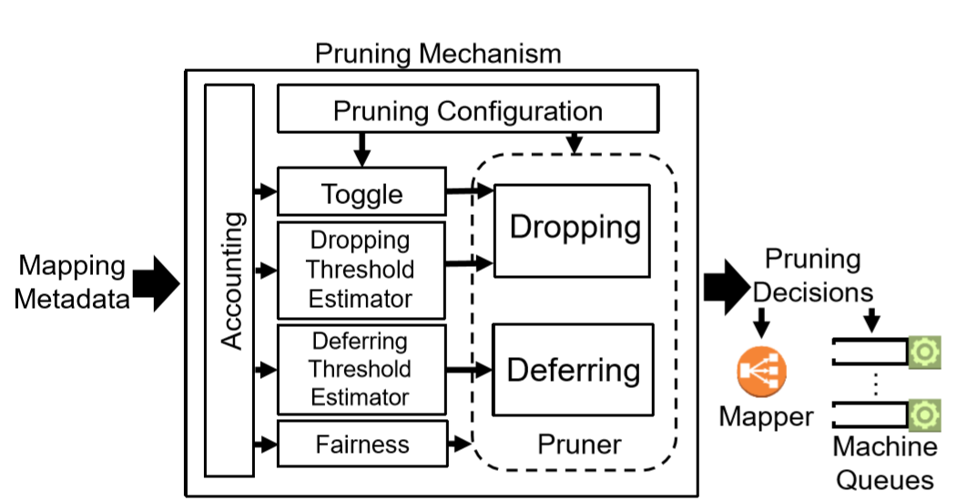
Pruning Mechanism

Slide 59
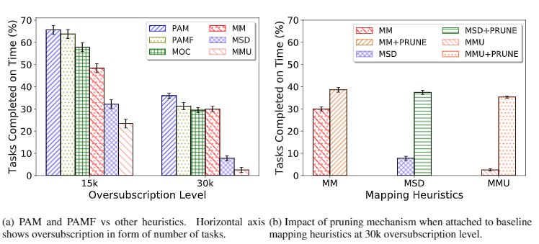
Results: Number of Tasks
Meeting Deadlines

Slide 60
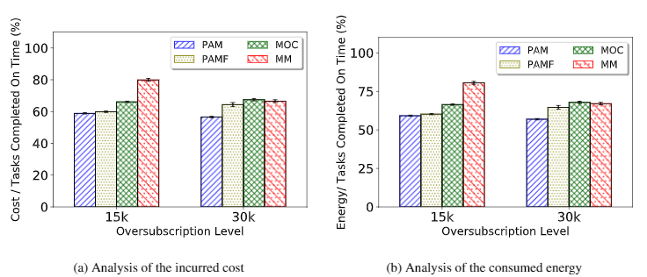
Results: Cost & Energy

Slide 61
Pruner Works, But too Slow!
Solution:
  Caching partial calculation
  Approximate the PMF
  Optimize chance of success determination algorithm

Slide 62
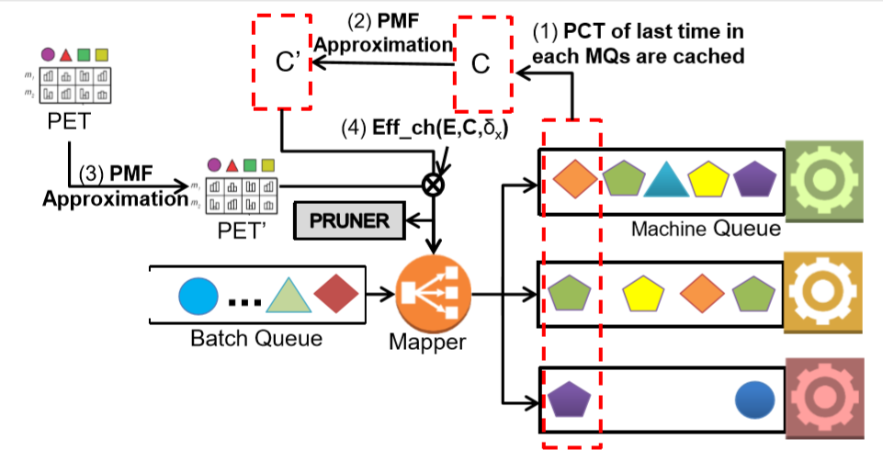
Pruning System Optimization
Task

Slide 63
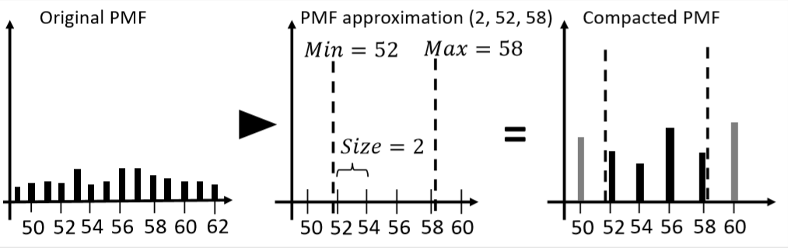
Approximation

Slide 64
Chance of Success
Determination Algorithm
Complete convoluted PMF is not needed
Chance of on-time completion of a task
  =ch
( , δ_{x} )
E, C
  Prune E and C’s impulses that is > δ_{x}
  Memoization between iteration
  sliding window summation

Slide 65
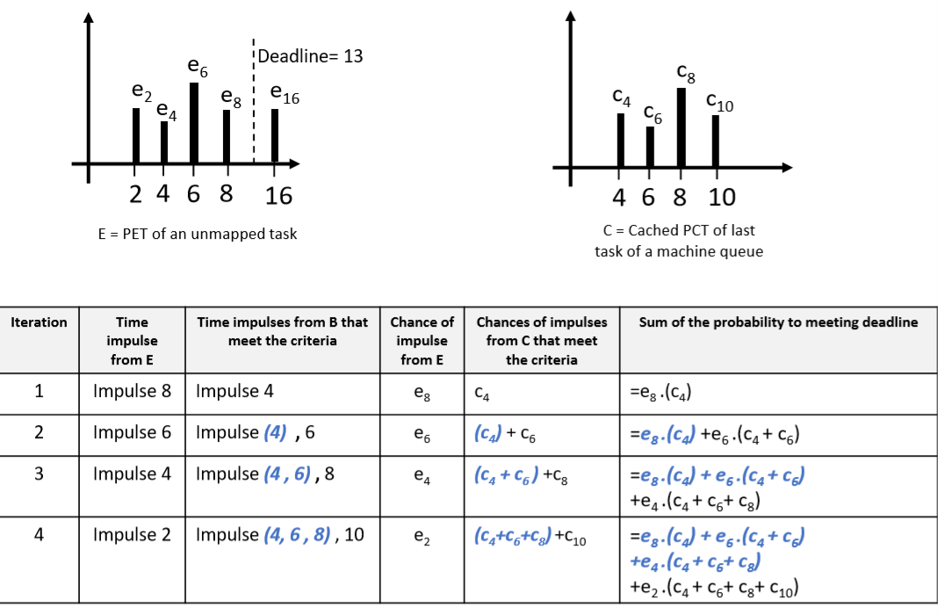
Algorithm Optimization

Slide 66
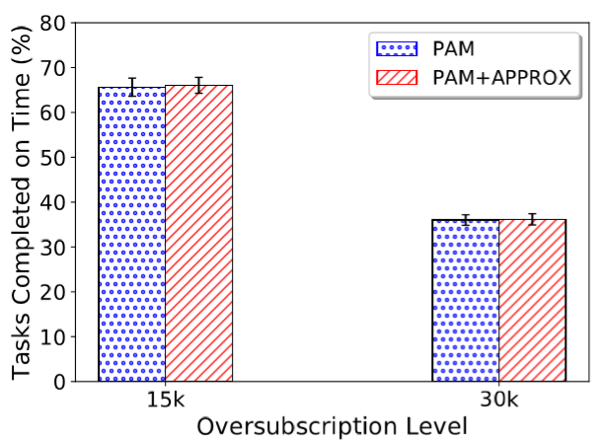
Measuring Error Rate of Optimized Algorithm
With optimization: 12x faster, same mapping performance
Notes:
All 3 technique combined, the simulation time is 12 times faster

Slide 67
Publications of Contribution 2
Chavit Denninnart, James Gentry, Ali Mokhtari, and Mohsen Amini Salehi, Efficient Task Pruning Mechanism to Improve Robustness of Heterogeneous Computing Systems, Journal of Parallel and Distributed Computing (JPDC), 2020
Chavit Denninnart, James Gentry, and Mohsen Amini Salehi, Improving robustness of heterogeneous serverless computing systems via probabilistic task pruning, 28th Heterogeneity in Computing Workshop (HCW 2019), in the proceedings of the IPDPS 2019 Workshops & PhD Forum (IPDPSW), May 2019
James Gentry, Chavit Denninnart, and Mohsen Amini Salehi, Robust dynamic resource allocation via probabilistic task pruning in heterogeneous computing systems, Proceedings of the 33rd IEEE International Parallel &Distributed Processing Symposium, IPDPS ’19, May 2019, (Nominated for best paper award)
Notes:
GitHub link:
https://github.com/hpcclab/hetcomp

Slide 68
Outline
Introduction
Background and Positioning of the Work
Contribution 1: Evaluating Benefits of Reusing
Contribution 2: Achieving Task Reusing
Contribution 3: Achieving Approximate Processing
Contribution 4: SMSE Implementation and Demo
Conclusion and Future Works
Notes:
Platform Implementation and Demo is contribution 4?

Slide 69
Contribution 4: SMSE Implementation and Demo

Slide 70
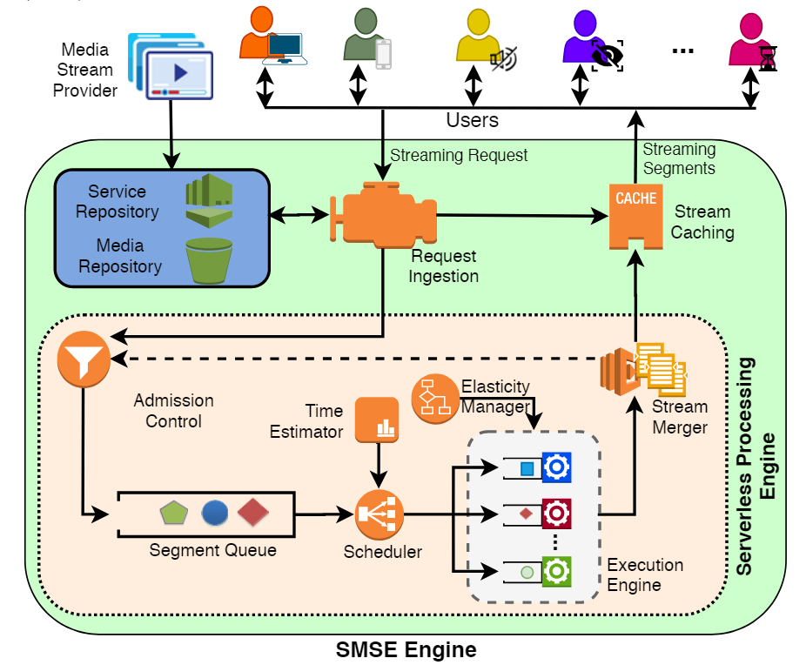
Architecture
Expandable
Service and Media Repo.
Emulation Run
Heterogeneous Resources
Real Processing
Notes:
Sim mode, real mode

Slide 71
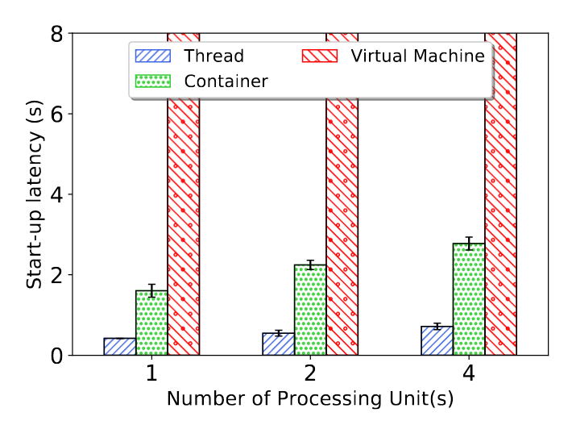
Worker Start-up Latency

Slide 72
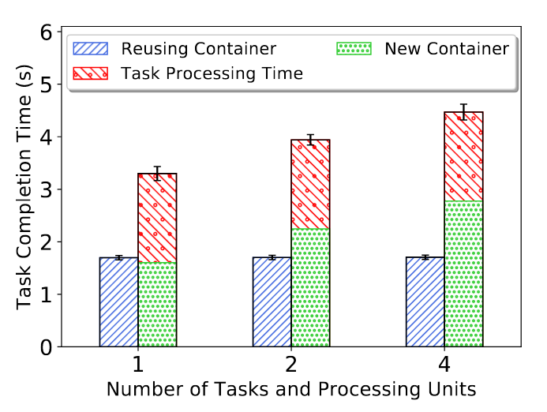
Container Reuse

Slide 73
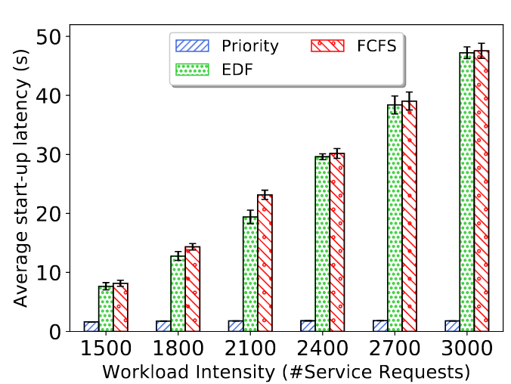
Verifying Scheduling Policies
Notes:
Stream Starting Delay

Slide 74
Demo

Slide 75
Publicly available video streaming engine
  Link to GitHub repository:
  https://github.com/hpcclab/CVSS_impl

Slide 76
Outline
Introduction
Background and Positioning of the Work
Contribution 1: Evaluating Benefits of Reusing
Contribution 2: Based on Reusing Services
Contribution 3: Based on Pruning Services
Contribution 4: SMSE Implementation and Demo
Conclusion and Future Works
Notes:
Platform Implementation and Demo is contribution 4?

Slide 77
Conclusion
Computational Reuse and Approximation significantly improves Serverless computing platform cost-efficiency
When a system is highly oversubscribed
  Sacrifice some minor rewards for bigger ones
Notes:
Above, do it moderately
Below, greedy

Slide 78
Future Works
Improving SMSE
  Billing system for serverless usage with computational reuse/approximation incentive
  Better Web-based media player
  Automated containerization of functions
Multiple-dependency in service workflow
Secure and fault-tolerant serverless computing system
Improve task merging logic for heterogeneous system
Notes:
Fairness in serverless computing system

Slide 79


Slide 80
BG:
Task Mapping Heuristics
Task Mapping Heuristics
Heterogeneous System
Homogeneous System
Immediate-Mode
Batch-Mode
RR
MET
MCT
KPB
MM
MSD
MMU
FCFS-RR
EDF
SJF

Slide 81
Position Finder
If Scheduler do not have task positioning policy in batch queue
  FCFS ✔ Shortest-Job-First X
  Where to place merged task back to batch queue for best scheduling result?

Slide 82
Position Finder
Back to the position of a merge candidate
New position
  Logarithmic search
  Linear search

Slide 83
Logarithmic Search: Finding Position for the Merged Task
Merged task start later
Delay fewer other tasks
Merged task start earlier
Delay more tasks
Segment queue

Slide 84
Logarithmic Search: Finding Position for the Merged Task
Merged task is on time, miss# is not high -> found a position
Merged task miss, miss# is not high -> Consider Right half
Merged task is on time, miss # is too high -> Consider Left half
Merged task is miss, miss# is too high -> No appropriate position
Consider
Consider
Consider
Probe
Probe
Probe
Segment queue

Slide 85
Logarithmic Probe to Find Merging Position in the Scheduling Queue
Probe log(n) positions
Each probe virtual assign n tasks
Total cost: nlog(n)
Notes:
Verifying procedure (deadline miss counting) is costly

Slide 86
Linear Probe to Find Merging Position in the Scheduling Queue
Linearly find last position that merged task is not missing its own deadline
Based on verifying procedure
Search
Segment queue

Slide 87
Linear Probe to Find Merging Position in the Scheduling Queue
One search through tasks in the scheduling queue -- O(n)
Linear Probe incur less overhead than Logarithmic Probe

Slide 88
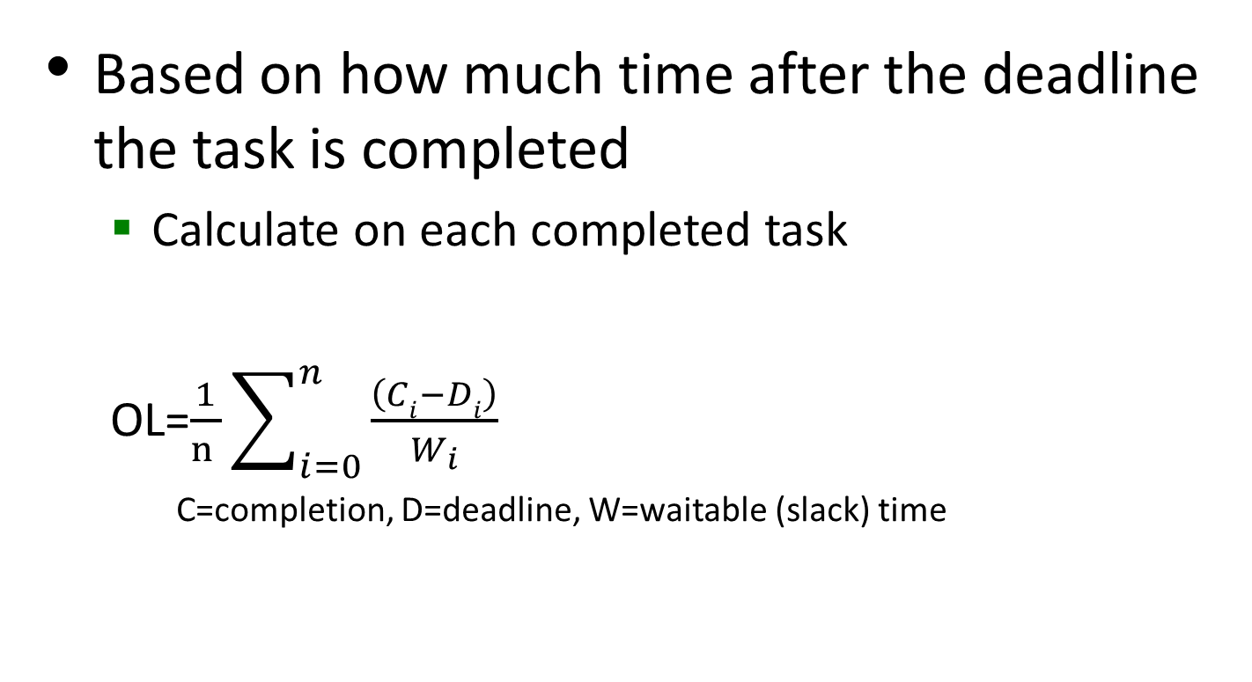
Measuring Oversubscription Level
Based on how much time after the deadline the task is completed
  Calculate on each completed task
  OL=$\frac{1}{n }\sum_{i=0}^{n}{\frac{\left(Ci−Di\right)}{W_{i}}}$
    C=completion, D=deadline, W=waitable (slack) time
Notes:
UL=$\frac{1}{n}\sum_{i=0}^{n}{\frac{\left(Di−Ci\right)}{W_{i}}}.$is also calculated but not currently used

Slide 89
Determining Merge Aggressiveness
Through changing SD coefficient when estimate execution time
  Instead of considering worse case with SDc=2…
  SDc = 2 − 4·OL
Merge Aggressiveness Approach
  Aggressive: always merge when possible
  Conservative: Evaluate with SDc = 2
  Adaptive: Evaluate with adaptive SDc

Slide 90
Observations
For highly oversubscribed condition:
  Aggressive Merging with Linear Position Finder perform best
Otherwise:
  Adaptive Merging cause less deadline violation

Slide 91
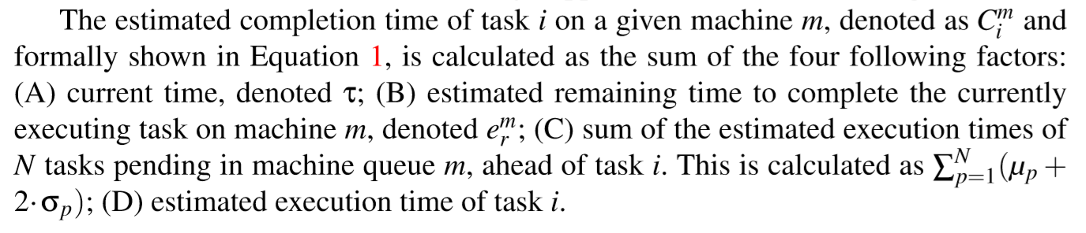
Merge Appropriateness Evaluation

Slide 92
Pruning: Pruning Aware Mapper
A two-phase batch mode task-machine mapping heuristic that prioritize mapping tasks with high chance of success
First: for each task, select preferred machine with maximum chance of success
Second: for each machine, map task with minimum completion time
Repeat

Slide 93
Details on Pruning
Dropping threshold must be lower than deferring threshold
Thresholds can be dynamically adjusted
  Based on
    Skewness of distribution
    Fairness treatment

Slide 94
Dropping and Deferring Thresholds
Notes:
http://www.itl.nist.gov/div898/handbook/eda/section3/eda35b.htm

Slide 95
Improved Pruning: Dynamic
Per-Task Dropping Threshold
Negative skewness indicates left tail
Positive skewness indicates right tail
Notes:
http://www.itl.nist.gov/div898/handbook/eda/section3/eda35b.htm

Slide 96
Improved Pruning: Dynamic
Per-Task Dropping Threshold
The effect of j (position of task in queue) rises inverse to position of task in machine queue
Because skewness is considered large at +/- 1, we clamp s between -1 and 1
The effect is inversely correlated to the sign of s

Slide 97
Dropping Threshold

Slide 98
Task Mapping Heuristics
Task Mapping Heuristics
Heterogeneous System
Homogeneous System
Immediate-Mode
Batch-Mode
RR
MET
MCT
KPB
MM
MSD
MMU
FCFS-RR
EDF
SJF

Slide 99
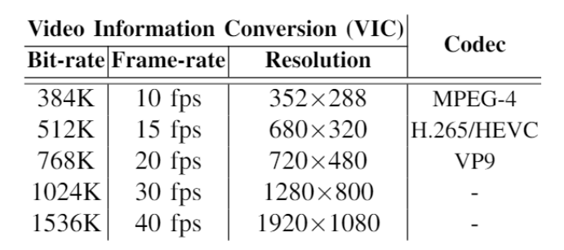
Data Collection: Task Definition

Slide 100
5 hyper parameters to maximize accuracy
  Learning rate
  Number of trees
  Maximum (tree) depth
  Minimum sample to split internal node
  Minimum sample to create leaf node

Slide 101
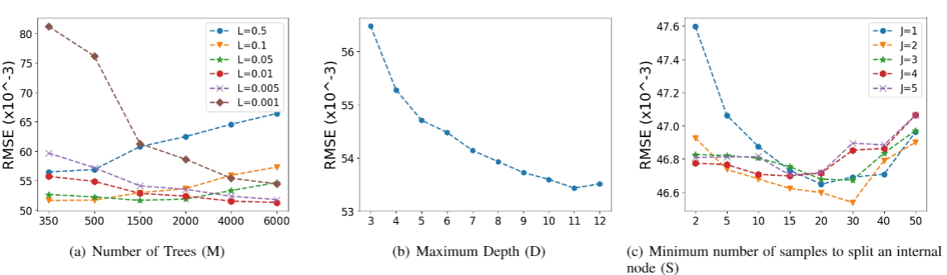
Observation
All parameters have their optimal number to minimize the error rate
Slow learning rate require high number of trees
Observe overfitting when using fast learning rate with high number of trees

Slide 102
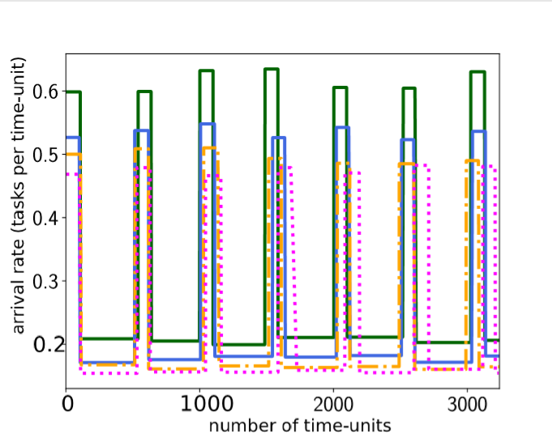
Appendix:
Task Arrival Modelling
Uniform arrival rate
On-peak, Off-peak
Two-peaks
  Baccour et al found live video
  streaming rate to follow
  two peaks pattern

Slide 103
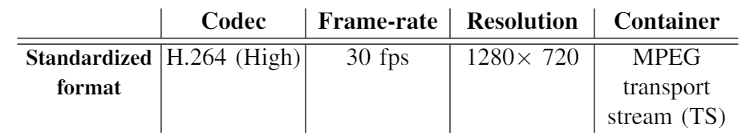
Appendix:
Standardized Video Format
Notes:
All video segments are prepared in standardize format

Slide 104
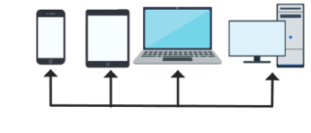










Appendix: SVSE old figure
Video
Repository
Request
Ingestion
Caching
Merge-Aware Admission Control
Video
Merger &
Output
Windows
Serverless Streaming Engine
Elasticity Manager
Serverless Computing
Cloud
Time Estimator
Batch Queue
Scheduler
Processing
Units
Notes:
Animation…

Slide 105



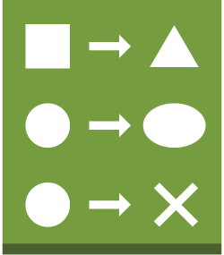


Internal Architecture of
Merge-Aware Admission Control
Merge Appropriateness Identifier
Task Similarity
Detector
Position
Finder
Merge Impact Evaluator
Workload Assessor
Service Request(Task)
check
Segment Queue
update
Task
Merger
Task Similarity
Hash-tables
Merge-Aware Admission Control
Notes:
Animation…

Slide 106
Pruning: Dropping Algorithm

Slide 107
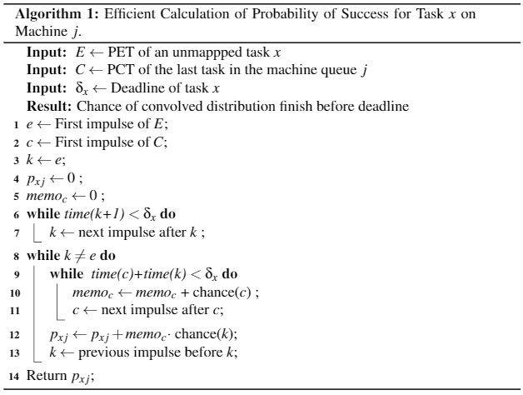
Algorithm Optimization

Slide 108
Appendix:
SMSE Experimental Setup
SMSE run in simulation mode
  Simulate 8 VMs, VM scaling turned off
  Do real scheduling, but not actually transcoding
  Sampling transcoding time with mean and SD gathered from benchmark the transcoding operations on g2.2xlarge Amazon on each individual GOPs
  Compare between system with merging and without task merging
  Experiment on three scheduling policies
    FCFS
    EDF
    Max Urgency (MU)
Notes:
8 threads, scaling off
Max urgency means sorted based on the latest time they can be stared and meet the dealine

Slide 109
Appendix: Batch Mode Homogeneous Mapping
Round Robin (RR) In RR, incoming tasks are assigned in a round robin manner
Minimum Expected Execution Time (MET) In MET, the incoming task i is assigned to the machine that offers the minimum expected execution time

Slide 110
Appendix: Batch Mode Homogeneous Mapping
Minimum Expected Completion Time (MCT) In MCT, the incoming task is assigned to the machine that offers the minimum expected completion time. The completion time is obtained based on the accumulated expected execution time of tasks queued in a given machine.
K-Percent Best (KPB) KPB is a combination of MCT and MET. It only considers MCT amongst the K percent of machines with the lowest expected execution times for an incoming task.

Slide 111
Appendix: Batch Mode Heterogeneous Mapping
MinCompletion-MinCompletion (MM): In the first phase of the heuristic, the virtual queue is traversed, and for each task in that queue, the machine with the minimum expected completion time is found, and a pair is made. In the second phase, for each machine with a free slot, the provisional mapping pairs are examined to find the machine-task pair with the minimum completion time, and the assignment is made to the machine queues. The process repeats itself until all machine queues are full, or until the batch queue is exhausted.

Slide 112
Appendix: Batch Mode Heterogeneous Mapping
MinCompletion-Soonest Deadline (MSD) Phase one is as in MM. Phase two selects the tasks for each machine with the soonest deadline. In the event of a tie, the task with the minimum expected completion time is selected. As with MM, after each machine with an available queue slot receives a task from the provisional mapping in phase two, the process is repeated until either the virtual machine queues are full, or the unmapped task queue is empty.

Slide 113
Appendix: Batch Mode Heterogeneous Mapping
MinCompletion-MaxUrgency (MMU)
Urgency of task I on machine j is defined as Uij= 1/(δi−E[Cij]), where δi is the deadline of task i, E[Cij] is the expected completion time of task I on machine j. Phase one of MMU is the same as MM.

Slide 114
Appendix: Batch Mode Heterogeneous Mapping
Max Ontime Completions (MOC)
MOC uses the PET matrix to calculate robustness of task-machine mappings. The first mapping phase finds, for each task, the machine offering the highest robustness value. The culling phase clears the virtual queue of any tasks that fail to meet a pre-defined (30%) robustness threshold. The last phase finds the three virtual mappings with the highest robustness and permutes them to find the task-machine pair that maximizes the overall robustness and maps it to that machine’s virtual queue. The process repeats until either all tasks in the batch queue are mapped or dropped, or until the virtual machine queues are full

Slide 115
Related Work: ETC
ETC Matrix synthesis and analysis
Stochastic Robustness Metric and its Use for Static Resource Allocation
  Modeling uncertainty
  Combining execution and completion time distributions via convolution
Notes:
Shoukat Ali et al
Vladimir Shestak et al

Slide 116
Mergeable Tasks Detection
Three hash tables with keys of all tasks in the queue
  One table per similarity Level
  Value of hash entry point to task object
Merge tasks upon arrival to admission control
  create 3 keys from request signature to check for identical existing hash values.

Slide 117
Mergeable Tasks Detection
Search the key in hash tables in levels from maximum reusability to least reusability, Task -> Operational -> Data
  If the hash entry exist, we found a merge candidate
  O(1)
Hash table maintaining:
  removing entry from hash table when they are executed
  Update hash table when we merge a task

Slide 118
System Environment
Caching system co-exists but not aware by our system
  Already cached video segment do not become a transcoding task
System get oversubscribed without scaling up/out our resources to cope with workload
  The system may get oversubscribed during peak hours.
  Users may have limited budget, limited available resource scaling

Slide 119
(Simple) Merge Appropriateness Evaluation
Procedure:
  Two scenarios will be checked:
    candidate tasks are merged
    candidate tasks stay separated (i.e. not aggregated).
  Estimate completion time of each task
    Merging imposes additional deadline misses over non-merged scenario.
      DO NOT MERGE
    Merging does not cause additional deadline misses.
      MERGE

