Slide 1
Contention-aware Resource Provisioning in Federated Computational Grids
Mohsen Amini Salehi
Supervisors:
Professor Rajkumar Buyya
A/Professor Jemal Abawajy
Cloud Computing and Distributed Systems (CLOUDS) Laboratory,
Department of Computing and Information Systems,
The University of Melbourne, Australia
August 2012

Slide 2
Introduction
Resource sharing environments enable sharing and aggregation of resources across distributed systems.
Benefits of resource sharing:
Users can access larger resources that are not available locally.
Resource providers can increase their resource utilization by accepting external requests.
Quality of Service (QoS) demands of user applications can be met.
Redundancy of resources lead to higher fault tolerance.
When there is a surge in demand, requests from different sources contend to access resources.
Notes:
Such paradigm has several benefit for an organization

Slide 3
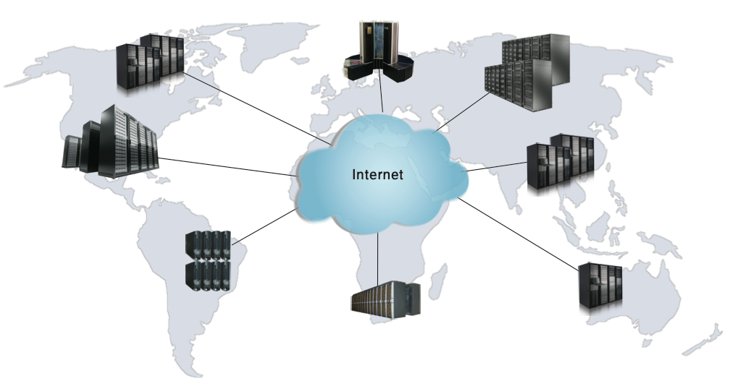
Resource sharing environments

Slide 4
Outline
Introducing federated Grids as resource and resource contention.
What is the problem?
Positioning of this thesis
Contributions of this thesis
Conclusions and future directions

Slide 5
InterGrid
Provides an architecture for resource sharing between Grids.
The architecture is based on Gateways (IGGs) that coordinate resource acquisition across the interconnected Grids.
Each Grid is composed of several resource providers (RPs).
RPs contribute resources to the InterGrid, while need to respect their local users’ demands.
Local requests in RPs have priority over external ones.

Slide 6
RP2
RP1
RP3
Grid A
LRMS
LRMS
LRMS
IGG1
IGG2
IGG3
Grid C
Grid B
LRMS
LRMS
LRMS
LRMS
RP1
RP2
RP1
RP2

Slide 7
Lease based Resource Provisioning in InterGrid
A lease is an agreement between resource provider and consumer whereby the resources are allocated to the consumer based agreed lease terms.
Virtual Machine (VM) technology is a way to implement lease-based resource provisioning.
VMs are able to get suspended, resumed, stopped, or even migrated.
InterGrid makes one lease for each user request.

Slide 8
Resource Contention
Occurs when a local request cannot be admitted, because resources are occupied by other requests.
Preemption mechanism is a solution for contentious situation.
It stops running request(s) and free resources for a higher priority request.
Preemption is promising mechanism due to the prevalence of virtual machine (VM) technology.

Slide 9
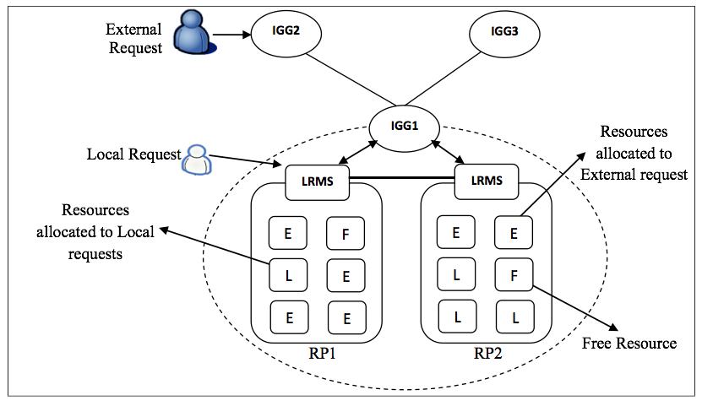
Resource Contention in the InterGrid

Slide 10
Outline
Contention in resource sharing environments.
What is the problem?
Contributions of this thesis
Conclusions and future directions

Slide 11
Research Problem
How resource providers can share resources to the InterGrid without disrespecting their local users?
Preemption mechanism: our approach for handling contention.
External requests are preempted in favor of local requests.
Notes:
Needs more description regarding preemption…or QoS of external??

Slide 12
Preemption Side-effects
Users do not like it!
Increases the waiting time of the external requests.
Time overhead imposed on the system for preempting VMs.
Varies based on the type of operation performed on the VMs.

Slide 13
Research Objectives
Modeling side-effects of preempting virtual machines.
Investigate scheduling techniques to avoid or minimize preemption.
Explore techniques to handle the side-effects of preemption.

Slide 14
Research Contributions
Resolving resource contention in the InterGrid using preemption mechanism.
Dealing with the side-effects of preempting requests:
Overhead cost of preempting VMs is modeled based on different possible operations on them.
Policies that determine the proper set of lease(s) for preemption are investigated.

Slide 15
Research Contributions
We investigate a proactive scheduling policy in the IGG to avoid resource contention.
We propose an admission control policy to handle long waiting time for external requests.
We investigate how energy management mechanism can affect contention.
We present the implementation of the contention-aware scheduling in the InterGrid.

Slide 16
Outline
Introducing federated Grids as resource and resource contention.
What is the problem?
Positioning of the thesis
Contributions of this thesis
Conclusions and future directions

Slide 17
Contention Management in Distributed Systems
DiffServ
Partitioning
Auction-based
Request-
initiated
Economic
Fairness
Utility-based
Outsourcing
Global Scheduling
Inter-domain-
initiated
Incentive-based
Resource
Contention
Token-based
Full
Preemption
Partial
Origin-
initiated
Partitioning
Several Queue
Hybrid

Slide 18
Contention Management in Resource Management Systems*
Job-based
Provisioning
Model
VM-based
Lease-based
Local Scheduling
Level
Off-line
Scheduling
Global Scheduling
Contention
Management
in Resource
Management
System
Reactive
On-line
Operational
Model
Proactive
Global management
level
Admission
Control
Local management
level
Energy
Management
Outsourcing
M. Amini Salehi, Jemal Abawajy, and R. Buyya, Taxonomy of Contention Management in Interconnected Distributed Computing Systems, Computing Handbook Set, CRC Press, 2012 (In Print).

Slide 19
Outline
Introducing federated Grids as resource and resource contention.
What is the problem?
Positioning of the thesis
Contributions of this thesis
Conclusions and future directions

Slide 20
Problem 1*: Is preemption a good approach?
How much is its overhead?
How the response time of external (low priority) requests are affected?
Does selecting different leases for preemption influence the side-effects?
M. Amini Salehi, B. Javadi, and R. Buyya, Resource provisioning based on leases preemption in InterGrid. submitted to Journal of Future Generation Computing Systems (FGCS), 2012.
M. Amini Salehi, B. Javadi, and R. Buyya, Resource provisioning based on leases preemption in InterGrid. In Proceedings of the 34th Australasian Computer Science Conference (ACSC’11), pages 25–34, Perth, Australia, 2011.

Slide 21
How much is the imposed overhead?
Depends on the operation performed on the VMs of a lease:
Cancelling:
Imposes the minimum time overhead.
overhead pertains to the time needed to stop VMs of the lease.
Is independent from the VM characteristics, such as memory size of the VM.
Suspending
Migrating

Slide 22
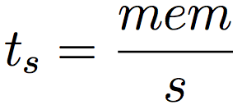
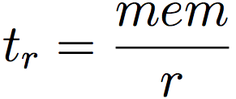
Suspension and Resumption Overheads
Suspending VMs of a lease can:
Network connections between VMs may lost.
Lead to inconsistent situation for the running job
Pause VMs before suspend and unpause before resume!
Pause operation is very fast!
It is done sequentially.
Steps for suspend and resume:
Pause VMs
Suspend on the disk
Reschedule the lease
Resume VMs
Unpause VMs

Slide 23
Migration Overheads
Steps:
Pausing
Suspending
Rescheduling
Transferring:
Resuming
Unpausing
Suspending operation can be overlapped with Resuming:
First suspend and last resume cannot be overlapped.

Slide 24
What is the impact of preemption policy?
Node
2
2
1
6
1
4
2
2
2
Time
t1
t2

Slide 25
Preemption Policy
Policy1. Minimum Overhead Policy (MOV)
Policy 2. Minimum Leases Involved Policy(MLIP)
Policy 3. Minimum Overhead Minimum Lease Policy (MOML)

Slide 26
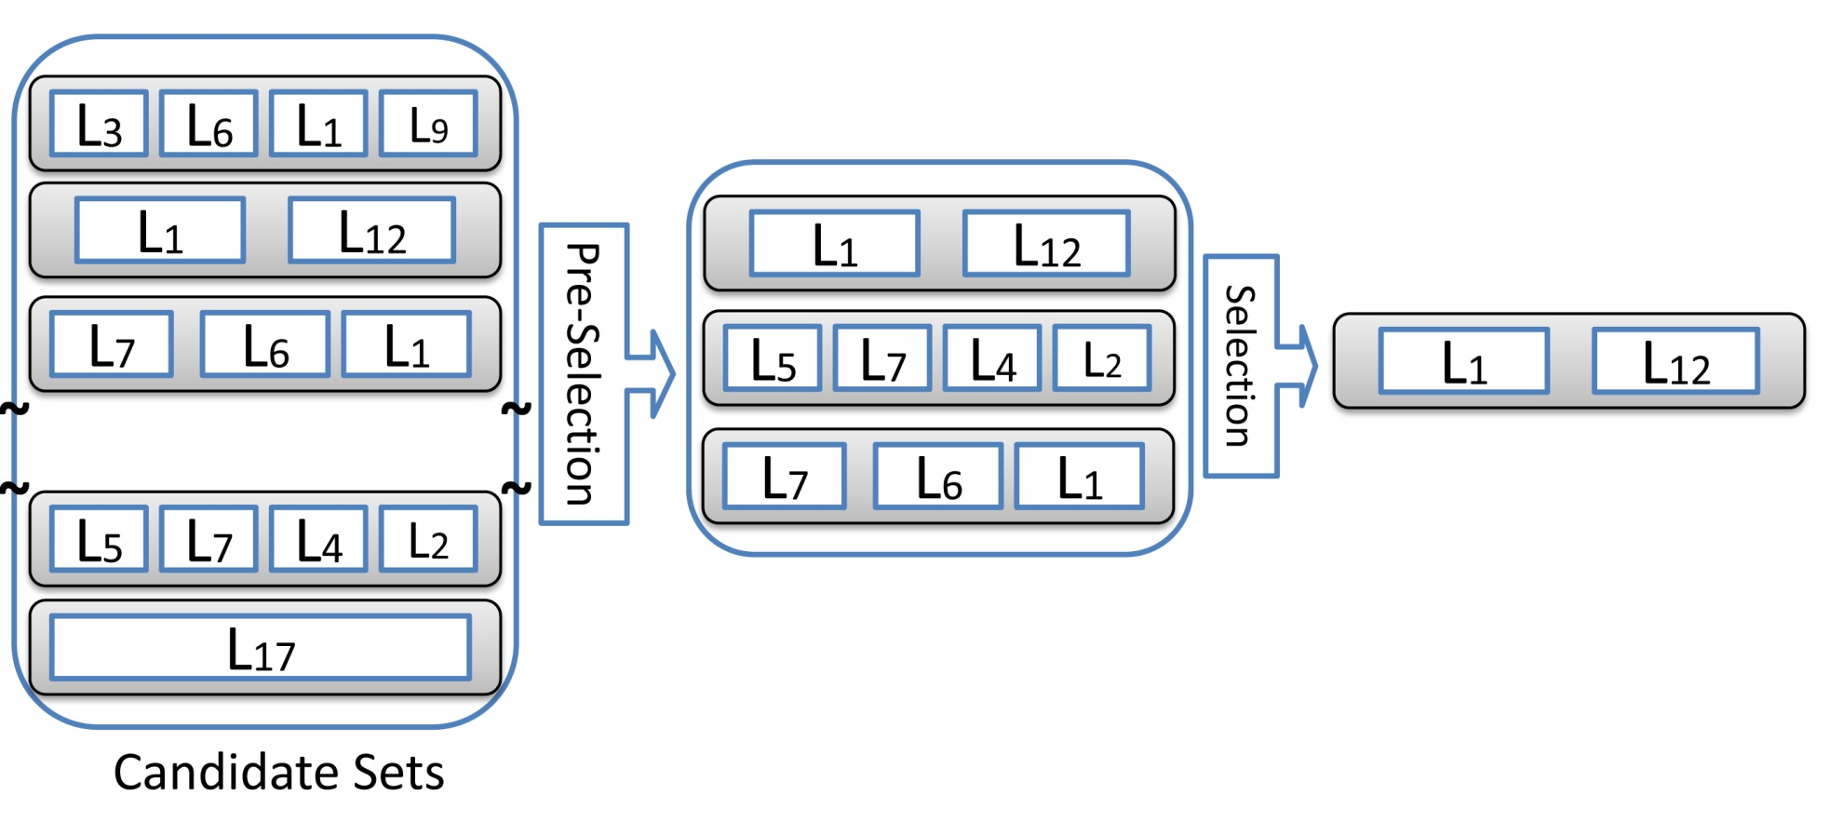
Preemption Policy…
MOML is a trade-off between user and system centric criteria.

Slide 28
Performance Evaluation
Goal of the evaluation is to show the impact of preemption on:
Resource Utilization.
Number of contentions (number of preemption).
Response time for external requests.
Lublin99 from SDSC workload.
Request types are generated uniformly and assigned them to the generated requests.

Slide 29
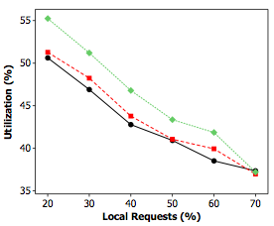
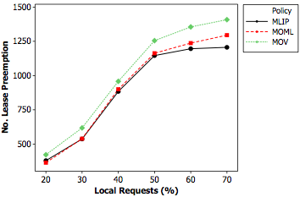
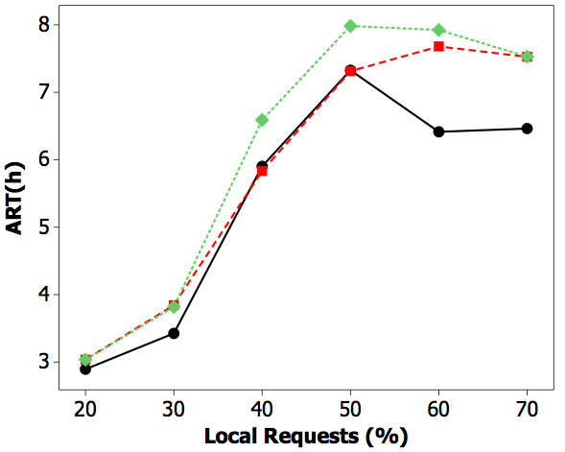
Notes:
The reason for stable situation in ART more than 50% is that there are many local requests that collide. Therefore, the number of local requests does not change after that point because of rejection of so many local requests thus the impact of the number of preemption and ART is not significant.

Slide 30
Problem 2: How to avoid resource contention?
We propose a proactive, probabilistic scheduling policy in the IGG:
It determines the fraction of external requests for each resource provider.
An analytical model provided based on queuing theory.
Sub-problem: How to reduce the likelihood of contention for more valuable external requests?
We consider external requests as best-effort and deadline-constraint (more valuable).
We propose a dispatch policy that decreases contention for more valuable external requests.

Slide 31
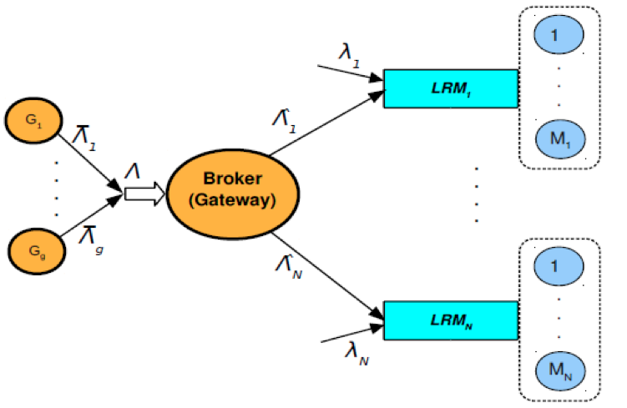
Problem Statement 2*
M. Amini Salehi, B. Javadi, and R. Buyya, QoS and preemption aware scheduling in federated and virtualized grid computing environments. Journal of Parallel and Distributed Computing (JPDC), 72(2):231– 245, 2012.
M. Amini Salehi, B. Javadi, and R. Buyya, Performance analysis of preemption-aware scheduling in multi-cluster grid environments. In Proceedings of the 11th International Conference on Algorithms and Architectures for Parallel Processing (ICA3PP’11), pages 419– 432, Australia, 2011.

Slide 32
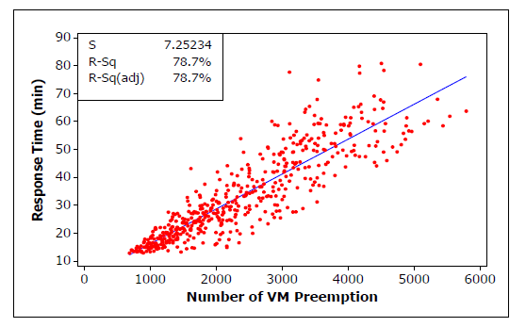
Analysis: Correlation of Response time and Number of preemption
Therefore, if we decrease response time the number of preemption also decreased!

Slide 33
Analysis: Minimizing the Average Response Time
Where the constraint is:
Response time of External requests for each resource provider
j (M/G/1 queue with preemption):
The input arrival rate to each provider by using Lagrange multiplier:

Slide 34
Load of each provider is calculated
Heavily loaded providers are excluded
Arrival rate of external requests to each provider is determined

Slide 35
How to reduce contention for more valuable external requests?
The scheduling policy does not provide a deterministic sequence for dispatching external request.
Some external requests are more valuable.
A mixture of different request types should exist in each resource provider.
We propose a dispatch policy that considers more valuable external requests.

Slide 36
Dispatch Policy
We use Billiard strategy as the dispatching policy.
Billiard provides a deterministic sequence for dispatching external requests
It uses the probabilities worked out in the scheduling policy.
The sequence is generated as follows:

Slide 37
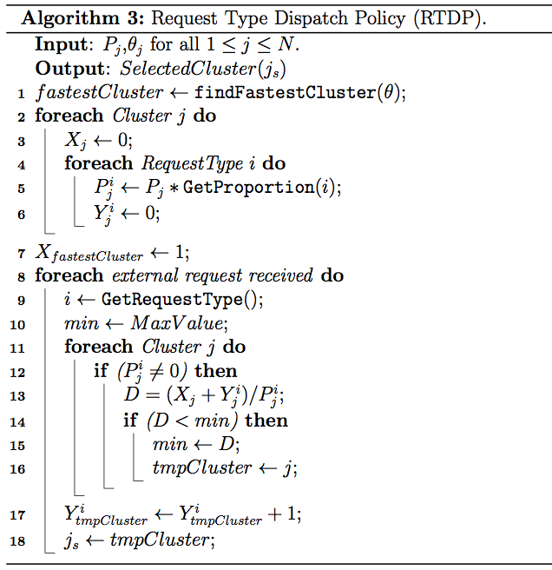
Determining the probability of sending different request types to various resource providers
For each external request determine the appropriate provider.
Keep the memory of request submitted, by updating the counters

Slide 38
Performance Evaluation
The objective is to evaluate the impact of global scheduling on the contention and its consequences.
3 heterogeneous resource providers with 64,128, 256 nodes.
DAS-2 workload model by changing:
Number of requests’ nodes
Request duration
Inter-arrival rate external requests.
Inter-arrival local requests.
Baseline Policies:
Round Robin (RR)
Least Rate First (LRF)
Biggest Cluster First (BCF)

Slide 39
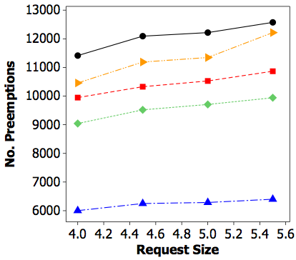
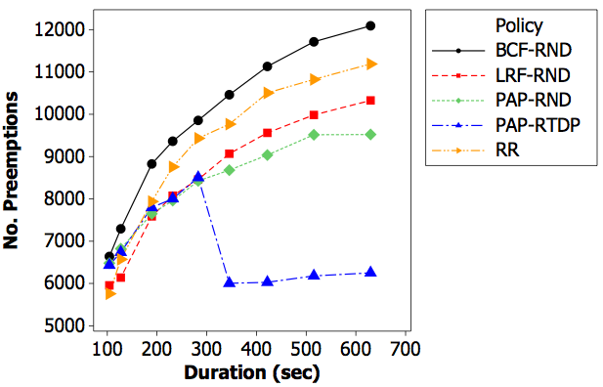
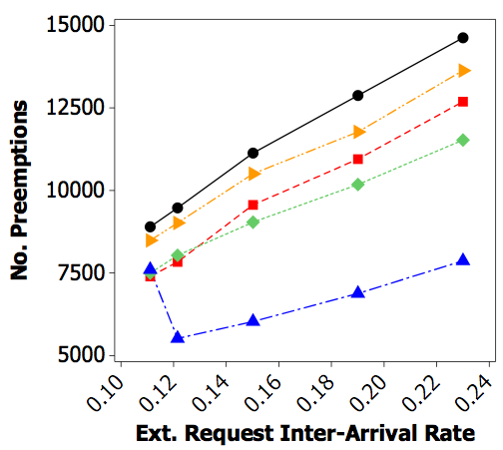
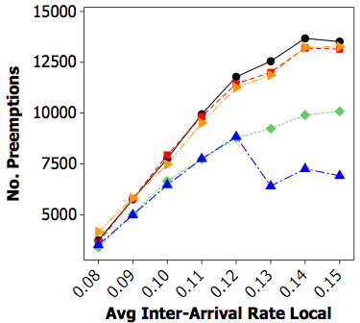
Notes:
in the case of PAP-RTDP, better sequencing of the external requests has resulted in balanced allocation which leads to fewer preemptions and contentions.
Specially when the requests are longer the placement is more important because the chance of contention is more and better placement can show its impact. It seems that when requests are short applying different scheduling policies is not effective because basically there is not that much contention.

Slide 40
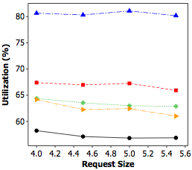
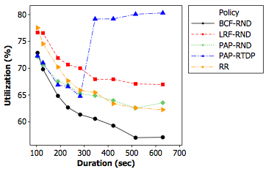
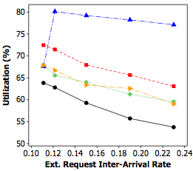
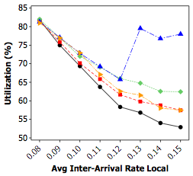
Experimental Results: Resource Utilization

Slide 41
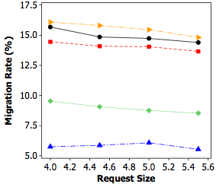
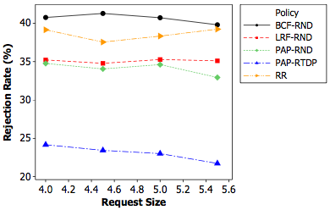
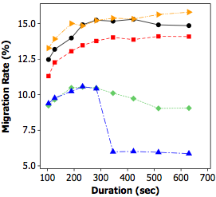
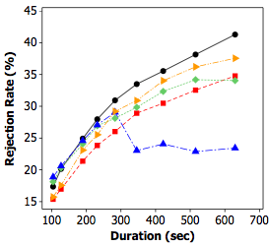
Respecting Valuable Users

Slide 42
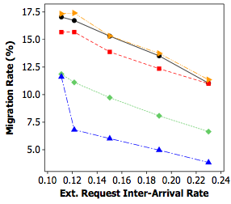
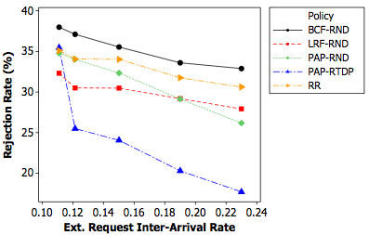
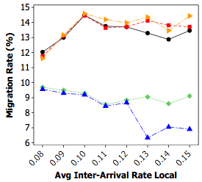
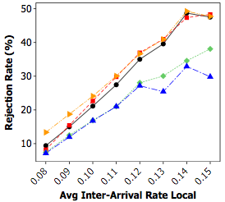
Respecting Valuable Users

Slide 43
Problem 3*: What is the ideal number of external requests in a provider
Resource providers tend to accept many external requests to increase their utilization.
This increases response time of external request and leads to resource starvation.
Objectives:
The number of accepted external requests is maximized.
Resource starvation for external requests is avoided.
M. Amini Salehi, B. Javadi, and R. Buyya, Preemption-aware ad- mission control in a virtualized grid federation. In Proceeding of 26th International Conference on Advanced Information Networking and Applications (AINA’12), pages 854–861, Japan, 2012.

Slide 44
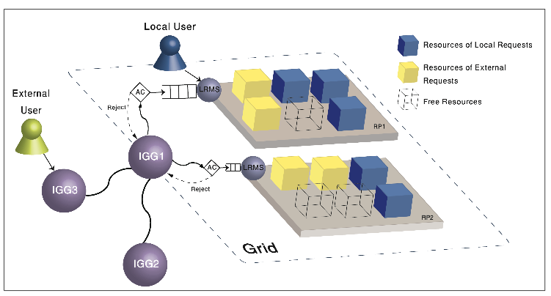
Admission Control

Slide 45
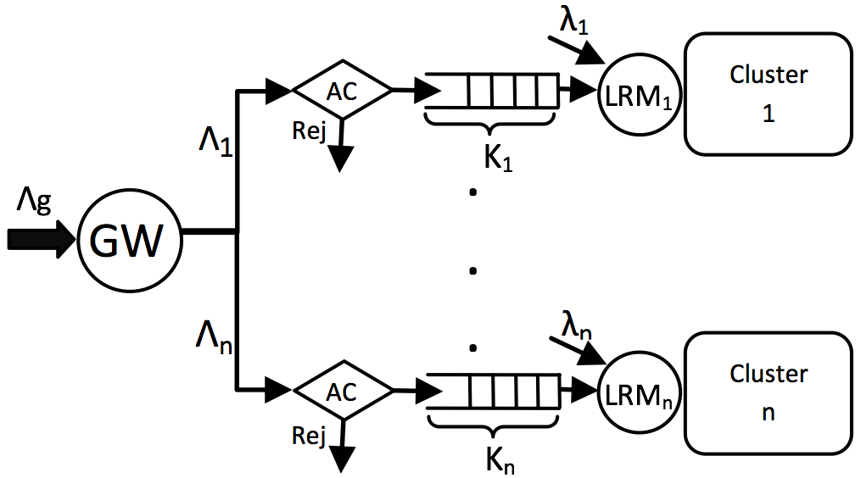
Problem Statement
What is the optimal queue length (K_{j}) for external requests in resource provider j?
Analytical modeling of preemption for external requests in a provider.

Slide 46
Analytical Model
The primary objective function is:
If an external request with runtime ω encounters n preemptions, the service time is:
Arrival rate of local requests (λ_{j}) follows Poisson distribution, so n follows Gamma distribution:
Average waiting time of external requests is determined based on the waiting time in a M/G/1/K queue.
Notes:
Expected (average) response time is sum of expected waiting time+expected service time that should be less than deadline. In this equation we know deadline but not waiting time and service time. In the next formulas we work out these two…Remember this equation as XXX
Service time ext. job in cluster j is the sum of local requests that interrupt the execution of ext. request+executions of different pieces of the ext. request
Average number of preemptions is arrival rate of local requests multiply by the runtime of the ext. job

Slide 47
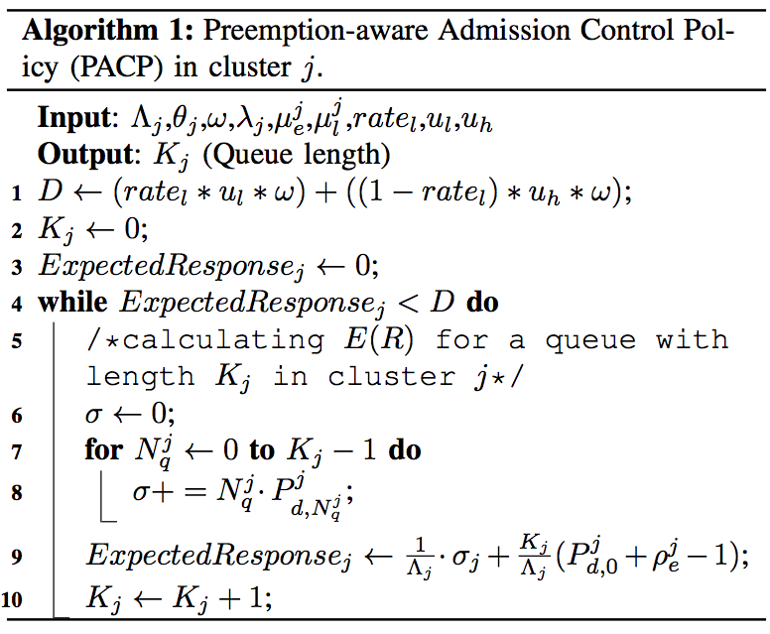
Contention-aware Admission Control for Resource Provider j
The loop continues until the estimated response time is less than starvation threshold
Estimate average response time of external requests for the updated queue length

Slide 48
Performance Evaluation
The goal of evaluation is to find out how the proposed policy prevents long waiting time.
3 providers with 64, 128, and 256 nodes and different computing speeds.
Conservative Backfilling for scheduling.
Grid Workload Archive (GWA) is used.

Slide 49
Baseline Policies
Conservative Admission Control Policy (CACP):
Admits as many requests as assigned by the IGG.
Aggressive Admission Control Policy (AACP):
Each provider accepts one external request at any time.
Rate-based Admission Control Policy (RACP):
Queue length is determined based on the service rate for external requests and local request arrival rate in a provider.

Slide 50
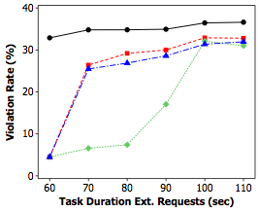
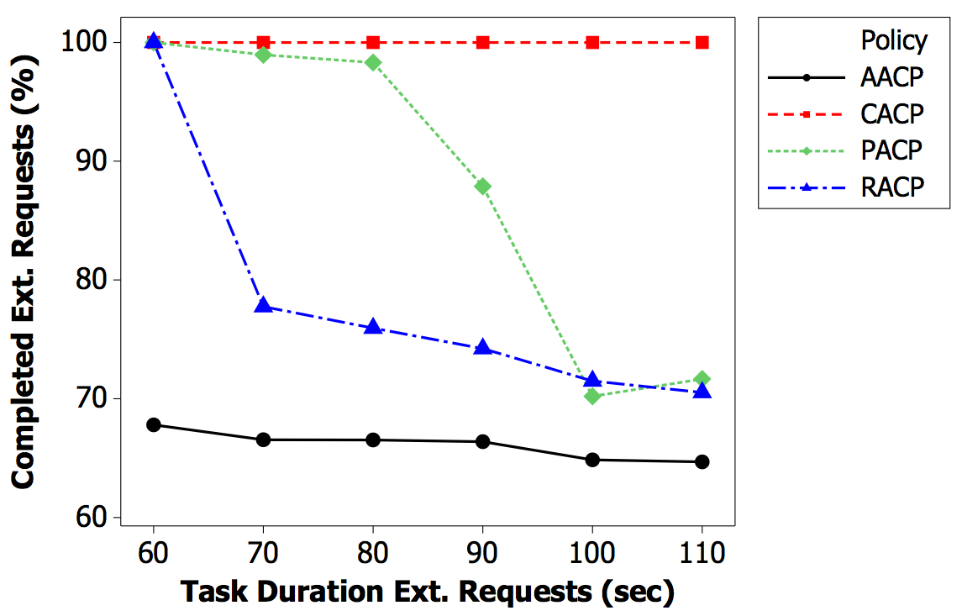
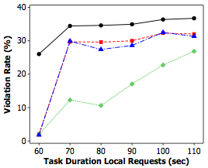
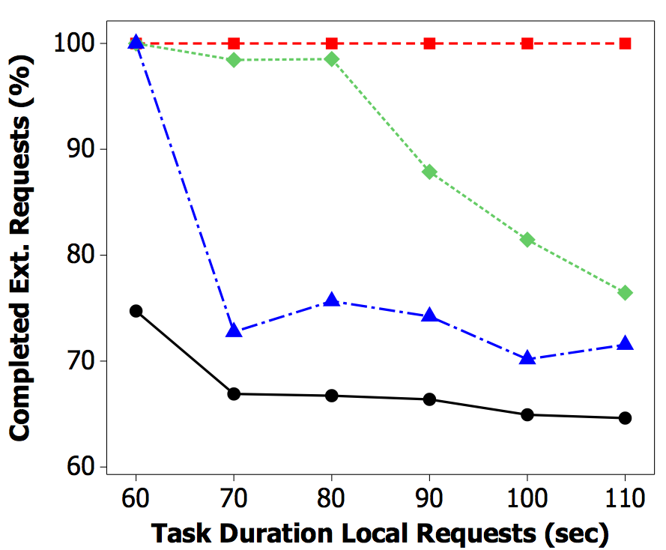
Notes:
We can see that in general PACP resulting in less violation
First picture indicates that when the external requests are long, the queuing policies cannot affect the violation rate significantly.
This experiment also expresses that although AACP accepts few external requests, its DVR is the highest. This is because in DVR Equation, the number of rejections is very high and, therefore, the value of r dominates the result.
AACP leads to the least number of completed external requests (because of too many rejections) whereas CACP results in the most number of completed external requests (always 100%) because it does not reject any of the external requests.
We see that PACP, almost in all cases outperforms RACP. Superiority of PACP is particularly remarkable when the local/external requests are not long.
Since PACP adaptively decreases the queue length, deadline violation rate is minimized.

Slide 51
Problem 4*: How to establish a starvation-free energy management in a resource provider?
An energy management policy limits the number of active resources in a provider:
It is prone to contention and long waiting time for external requests.
Our proposed energy management policy is contention-aware and considers the starvation.
The policy determines how to allocate a request:
Preemption
Switching on resources
Consolidation.
M. Amini Salehi, P. R. Krishna, K. S. Deepak, and R. Buyya, Preemption-aware energy management in virtualized datacenters, in Proceedings of 5th International Conference on Cloud Computing (IEEE Coud’12), USA, 2012.

Slide 52
Adaptive Energy Management Policy
We define a Starvation Threshold for external requests.
Average waiting time of external requests should be less than the Threshold.
Fuzzy logic is appropriate to adapt the output based on the current situation.
The structure of the fuzzy system:
Fuzzy Inference
Engine
Input 1:
Risk of violating
Starvation Threshold
Output:
Drives the decision:
Switched on,
Preempted
Consolidated
Input 2:
How efficiently current
resources are being used
Notes:
We use fuzzy logic to propose an adaptive energy management policy. The proposed fuzzy system has two inputs and one output.
Inputs are risk of violating starvation threshold by best-effort requests. This input tries to consider the waiting time of best-effort requests in the decision (output).
The other input relates to power consumption. In fact, it says how efficiently the current switched on resource are utilized.
The output of the system determines the appropriate decision which can be preempting, switching on or switching off resources.

Slide 53
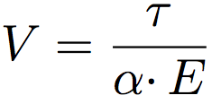
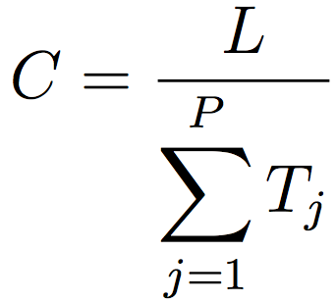
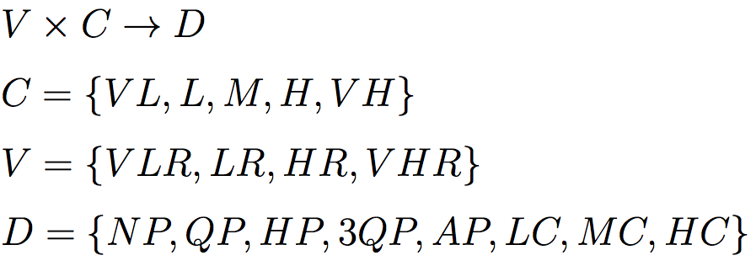
Adaptive Energy Management Policy.
Risk of violating starvation threshold:
How efficiently current resources are being used:
The relation of the fuzzy system can be described as the following:
Notes:
We used triangular membership function for all inputs and output variables. Also, we implemented the fuzzy system using a singleton fuzzifier, product infer- ence engine, and center of gravity defuzzifier

Slide 54
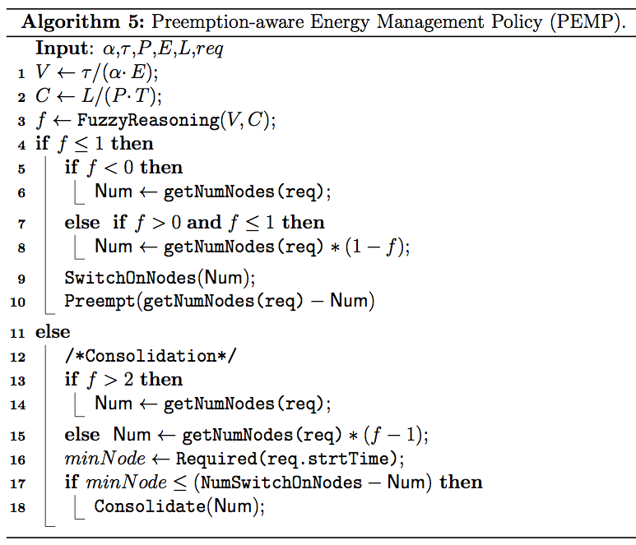
Decision for switching on and preemption
Decision for consolidation
Check if consolidation is possible
Notes:
THIS algorithm shows how we emplyed fuzzy logic for our energy saving policy. In line 3 the fuzzy engine is called. And then based on its result different decisions are made: lines 4 to 10 are related to preempting and switching on resources.
Lines 11 to 16 relates to switching off and consolidation.

Slide 55
Energy-aware Haizea
We extended the Haizea scheduler with energy-efficiency capabilities.
Restructured the architecture of the scheduler
New APIs were added.
Switching on/off resources on-demand.
Reschedule the reservations at the time of consolidation.
Available for download and extend your policy.
Incorporating and evaluating the proposed energy management policy into the extended Haizea scheduler.

Slide 56
Performance Evaluation
The objective of evaluation is to see the impact of proposed policy on the energy consumption and violation rate.
We use SDSC workload trace of parallel requests.
We consider a provider with 512 nodes.
30 days of job submissions from the trace and treat them as external requests.
An additional set of local requests are interleaved into the trace.
GESP: switches on the minimum number of resources required for local requests.
SESP: tries not to violate the starvation threshold.
If Violation risk ≥ 1, the policy switches on resources based on the number of resources required by the request.
Notes:
We use SDSC for experiments.
We implemented 2 baseline policies: GESP and SESP. Gesp in conservative and switch on few resources. SESP switches on whenever there is a violation risk.

Slide 57
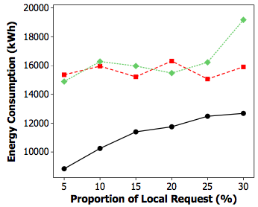
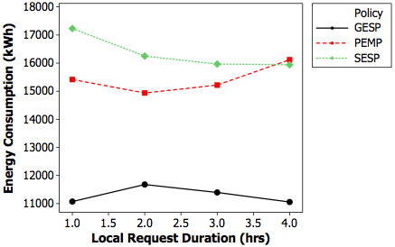
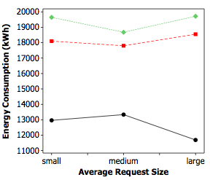
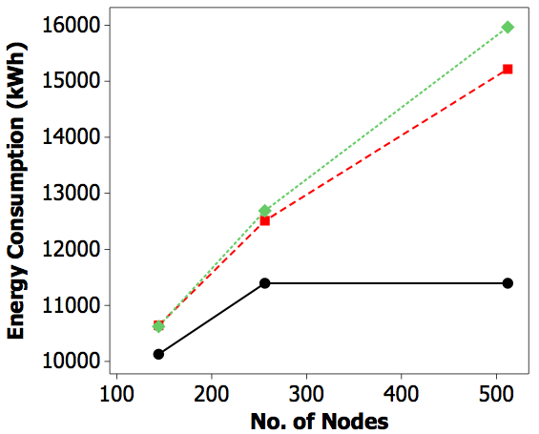
Energy Consumption
Notes:
when the proportion of local requests is low, preemption does not take place frequently and, therefore, external requests have more opportunity for running. Thus, policies that try to avoid violation do not come to the picture and result into the similar amount of consumed energy.
when the local requests are long, the external leases are postponed in scheduling for a long time. Therefore, the resources have to remain switched on for longer time which implies more energy consumption.

Slide 58
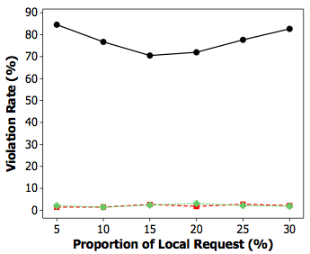
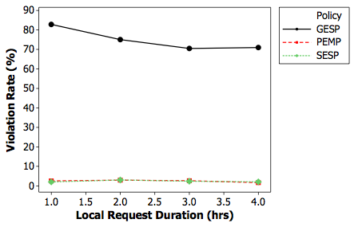
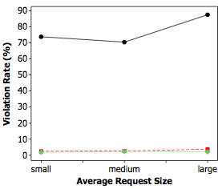
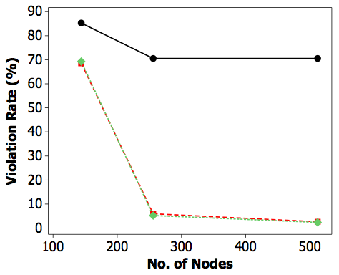
Violation Rate
Notes:
This experiment for best-effort requests shows the amount of violation rate from the starvation threshold. We can see SESP and PEMP perform very close in this experiments. However, we noticed in previous experiment that PEMP consumes remarkably less energy

Slide 59
Implementing Contention-awareness in InterGrid*
We enabled InterGrid to recognize the contention between requests.
Enabled lease preemption in the InterGrid in favour of local requests.
We adapted Haizea to work as the local scheduler of resource providers.
OpenNebula as the virtual infrastructure manager.
We implemented Preemption Policies: MLIP, MOV, MOML.
M. Amini Salehi, A. N. Toosi, and R. Buyya, Realizing Contention- aware Scheduling in the InterGrid, submitted to 5th International Conference on Utility and Cloud Computing (UCC’12), USA, 2012.

Slide 60
Experimental Scenario
External
User
IGG3
IGG2
IGG1
LRMS
Local
User
RP

Slide 61
Experiment Details
A four-node cluster as the provider:
Workers are 3 IBM machines
Quad-core Intel Xeon x3400
4 GB memory
CentOS 6.2 Linux distribution as the host OS
Qemu-KVM 0.12.1.2 is used as the hypervisor
The head node (LRMS)
Dell Optiplex 755 machine
Intel Core 2 Duo
2 GB memory
Ubunutu 12.4 as the OS
GlusterFS is used as the shared file system.

Slide 62
Evaluation Results

Slide 63
Outline
Introducing federated Grids as resource and resource contention.
What is the problem?
Positioning of the thesis
Contributions of this thesis
Conclusions and future directions

Slide 64
Conclusions
The challenge is: requests that contend to access resources in a resource sharing environment.
Our approach for the challenge is preemption mechanism.
Side-effects of preemption are considered.
We explored:
types of resource contention
approaches to resolve them
applicability of preemption mechanism
role of resource management Systems.

Slide 65
Conclusions
Preventative strategy for resource contention
In the local scheduler level:
We presented feasibility of the preemption approach.
Overhead time of preemption scenarios modeled.
Different preemption policies proposed.
In the IGG, a proactive scheduling policy proposed.
A dispatch policy reduces the likelihood of contention for more valuable external requests.

Slide 66
Conclusions
Handling strategy for resource contention:
We proposed an admission control policy
For situation that there is a surge in demand.
It determines the ideal number of external requests in a provider without starvation.
We propose an energy management policy
For situation that there is resource wastage.
It adapts energy consumption to users’ demand.
It considers contention and resource starvation.
We implemented preemption-based contention management in the InterGrid.

Slide 67
Future Directions
Contention-aware peering policy.
Dynamic preemption decisions.
Price-based contention management policies.
Contention management for co-allocation and adaptive requests.
IGG level admission control.

Slide 68
Publications and Outcomes
M. Amini Salehi, B. Javadi, and R. Buyya, QoS and preemption aware scheduling in federated and virtualized grid computing environments. Journal of Parallel and Distributed Computing (JPDC), 72(2):231– 245, 2012.
M. Amini Salehi, Jemal Abawajy, and R. Buyya, Taxonomy of Contention Management in Interconnected Distributed Computing Systems, Computing Handbook Set, CRC Press, 2012 (In Print).
M. Amini Salehi, B. Javadi, and R. Buyya, Resource provisioning based on leases preemption in InterGrid. submitted to Journal of Future Generation Computing Systems (FGCS), 2012.
M. Amini Salehi, B. Javadi, and R. Buyya, Resource provisioning based on leases preemption in InterGrid. In Proceedings of the 34th Australasian Computer Science Conference (ACSC’11), pages 25–34, Perth, Australia, 2011.
M. Amini Salehi, B. Javadi, and R. Buyya, Performance analysis of preemption-aware scheduling in multi-cluster grid environments. In Proceedings of the 11th International Conference on Algorithms and Architectures for Parallel Processing (ICA3PP’11), pages 419– 432, Australia, 2011.

Slide 69
Publications and Outcomes
M. Amini Salehi and R. Buyya, Contention-aware resource management system in a virtualized grid federation, in PhD Symposium of the 18th international conference on High performance computing (HiPC’11), India, 2011.
M. Amini Salehi, B. Javadi, and R. Buyya, Preemption-aware ad- mission control in a virtualized grid federation. In Proceeding of 26th International Conference on Advanced Information Networking and Applications (AINA’12), pages 854–861, Japan, 2012.
M. Amini Salehi, P. R. Krishna, K. S. Deepak, and R. Buyya, Preemption-aware energy management in virtualized datacenters, in Proceedings of 5th International Conference on Cloud Computing (IEEE Coud’12), USA, 2012.
M. Amini Salehi and R. Buyya. Adapting market-oriented scheduling policies for cloud computing. In Proceedings of the 10th international conference on Algorithms and Architectures for Parallel Processing-Volume Part I, pages 351–362. Springer-Verlag, 2010.
M. Amini Salehi, A. N. Toosi, and R. Buyya, Realizing Contention- aware Scheduling in the InterGrid, submitted to 5th International Conference on Utility and Cloud Computing (UCC’12), USA, 2012.

Slide 70
Publications and Outcomes
Awarded Post Doctorate Position in Colorado State University (Sep 2012).
Patent filed on implementing energy-aware resource scheduling in resource providers (Feb 2012).
Awarded Internship in Infosys, India (Oct 2011-Jan 2012).
Received Best intern award from Infosys, India (April 2012).
Ranked 3rd in IEEE Expo Competition for Applied Research (Nov 2009).
Extended Gridbus Broker to work with Cloud provider.
Extended energy-aware capability to Haizea scheduler

Slide 71
THANK YOU Any Question?
Thank you for attending
Any Question?

Slide 72
Acknowledgements

Slide 73
Appendix
Appendix

Slide 74
VMs advantages for Preemption Mechanism
Enable partitioning of a single physical machine into several virtual machines
Have their own software stack which can provide various execution environments for different users
Transparently suspend, resume, and migrate without affecting the computation inside them
Enables the scheduler to implement more complex placement strategies to reduce the resource contention.

Slide 75
Preemption Mechanism
Request-init
Contention
Origin-init
Contention
Managing
Wrong Estimations
Preemption
Usages
Scheduling
Improving Optimality
Energy
Saving
Managing Peak Load
Controlling
Thresholds

Slide 76
Local and Grid Request Rejection Rate

Slide 77
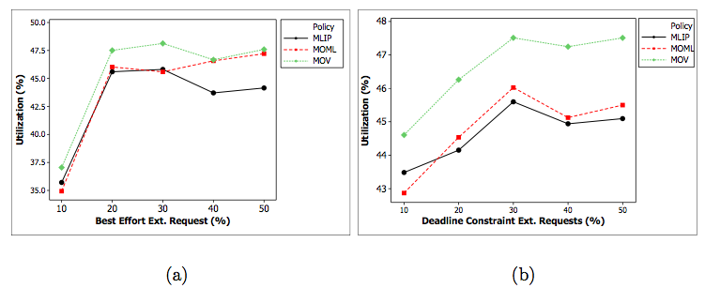
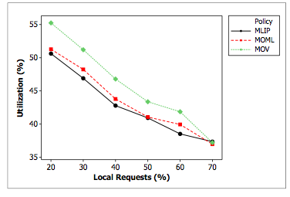
Resource Utilization

Slide 78
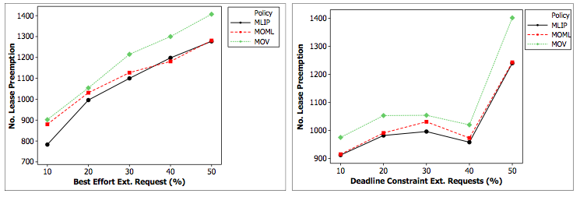
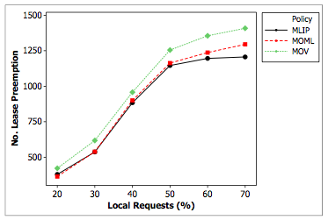
Number of Lease Preemptions

Slide 80
Analytical Model(2)
We assume that local requests follow M/G/1 model, then:
The average waiting time of external requests in the M/G/1/K queue is:
We have to figure out ρ^{j}_{e} and P^{j} _{d,k}
ρ^{j}_{e} is the queue utilization for external requests:
Notes:
Therefore average service time (execution time) ext. request depends on the number of preemptions (interruptions) and we have (formula 1 and 2 in this slide)
Therefore we could find out average service time for formula XXX
Now Average waiting time: since we consider m/g/1/k queue. The formula for average waiting time is known (formula 3 in this slide). However we should find the elements within this formula (rho and P)
Then in the last formula we describe how to work out rho

Slide 81
Analytical Model(3)
P^{j} _{d,k} is the probability that a newly arriving external request encounters k requests waiting in the queue of provider j:
Notes:
In this slide we work out P as decribed in the text above and the elements within that. Specifically “a”
A is dependent to b and other elements of that is known. Therefore, in the next slide we describe bj(t)

Slide 82
Analytical Model(4)
b_{j}(t) is the probability density function (PDF) of service time for external requests.
Gong et al.¹ prove the service time of ext. requests with preemption follows the Gamma distribution.
Based on Gamma distribution:
L. Gong, X.-H. Sun, and E. Watson. Performance modeling and prediction of
nondedicated network computing. IEEE Transactions on Computers,, 51(9):1041 – 1055, sep 2002.
Notes:
The describtion of b is clearly mentioned in the bullet points of this page
Alpha and betta are parameters of gamma distribution. We could find them out based on the average and variance of service time. And therefore they are known
For this slide just read through the text

Slide 83
Performance Metrics
We define D (starvation threshold) as:
rate_{l} is the proportion of low-urgency ext. requests and u_{l}, u_{h} are the deadline ratios.
Violation Rate (VR):
a and r are percentage of accepted and rejected requests. v is the deadline violation ratio.
Completed External Requests.
Notes:
D is how we defined the average deadline for ext. requests we considered high-urgency and low-urgency. This is not important. You can tell them to read the paper for that

Slide 84
Management and Monitoring
Communicator
Scheduler
(Provisioning and Peering)
Persistence
(Java Derby)
Virtual Machine Management
Emulator
OpenNebula
Eucalyptus
IaaS provider

Slide 85
Delegate
Provisioning Rights
LRMS
Delegate
Provisioning Rights
InterGrid Gateway (IGG)
LRMS
5. Allocation
Details
4. Allocate Resources
Based on Peering
arrangements
7. Deployment
LRMS
InterGrid Gateway (IGG)
3. Resource
Request
Delegate
Provisioning Rights
DVE Manager
6. Allocation
Details
2. External
User Request

Slide 87
Analysis: Optimal arrival Rate to each Resource Provider
Response time of External requests for each resource provider
j (M/G/1 queue with preemption):
The input arrival rate to each cluster by using Lagrange multiplier:

Slide 88
Analysis: Finding out Lagrange multiplier (z)
Since we have:
Z can be worked out from the below equation:

Slide 89
Analysis: Using bisection algorithm for finding z
Since:
Then:
upper bound also can be worked out as follows:

Slide 90
Preemption-aware Scheduling Policy
The analysis provided is based on the following assumption:
each cluster was an M/G/1 queue. However, in InterGrid we are investigating each cluster as a G/G/M_{j} j queue.
all requests needed one VM. InterGrid requests need several VMs for a certain amount of time.
each queue is run in FCFS fashion while we consider conservative backfilling.

Slide 91
Implementation details
To support several VMs, the service time of ext. and local requests on cluster j is calculated:
CV is used to obtain second moment:

Slide 92
Average Weighted Response Time

Slide 93
Haizea
Released in 2009 in Argonne National Laboratory, US.
Open-source, VM-based lease scheduler.
Consider all overheads related to VM preemption.
Runs on top of OpenNebula Cloud data-center manager.
Does not consider energy efficiency!
Notes:
The implementation of this research was done in Haizea. Here is some details on that

Slide 94
Fuzzy presentation and sample rules:
rule1:<if: ”V is L and C is VL” THEN ”D is HC" >
rule2:<if: "V is L and C is H” THEN ” D is LC”>
rule3:<if: "V is L and C is VH” THEN ” D is PA”>
rule4:<if: "V is M and C is VL” THEN ” D is MC”>
Notes:
The fuzzy system can be expressed in the above form. V is the violation risk input. The possible values for that are low (l)m medium (m), high (h) and very high (vh).
The possible values for the second input C (utilization of the resources) are very low, low, medium, high, veryhigh.
The output is expressed by D and can be no preemption (NP), quartile preemption (QP), half preemption (hp), 3 quartile preemption (3QP), All preemption (AP), low consolidation (LC), medium consolidation (MC), and High consolidation (HC).
Then there is a list of rules used in the fuzzy system: for example the first rule says if V is low and C is verylow then the output should be High consolidation.

Slide 95
Adaptive Energy Management Policy
The goal is adapting the energy consumption based on the user demand:
We define a Starvation Threshold for external requests.
Average waiting time of external requests should be less than the Threshold.
The possible decisions (outputs) of the policy can be:
Switching on new resources: when the starvation risk is high and energy consumption is low.
Partial preemption: when the starvation risk is more than the medium.
Full preemption: when the starvation risk is around medium.
Switching off resources (server consolidation): when starvation risk is low but energy consumption is high.

