Slide 1
Streamlining Application Development in the Next Cloud Era
Mohsen Amini Salehi
Director of High-Performance Cloud Computing (HPCC) Lab
Assoc. Prof. at Computer Science & Engineering Department
University of North Texas (UNT)

Slide 2
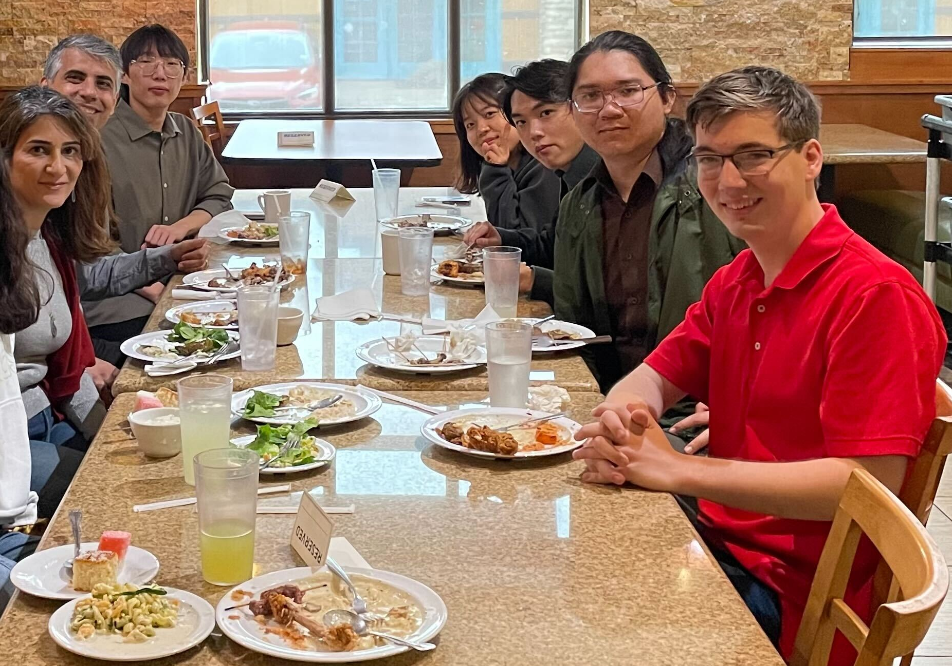
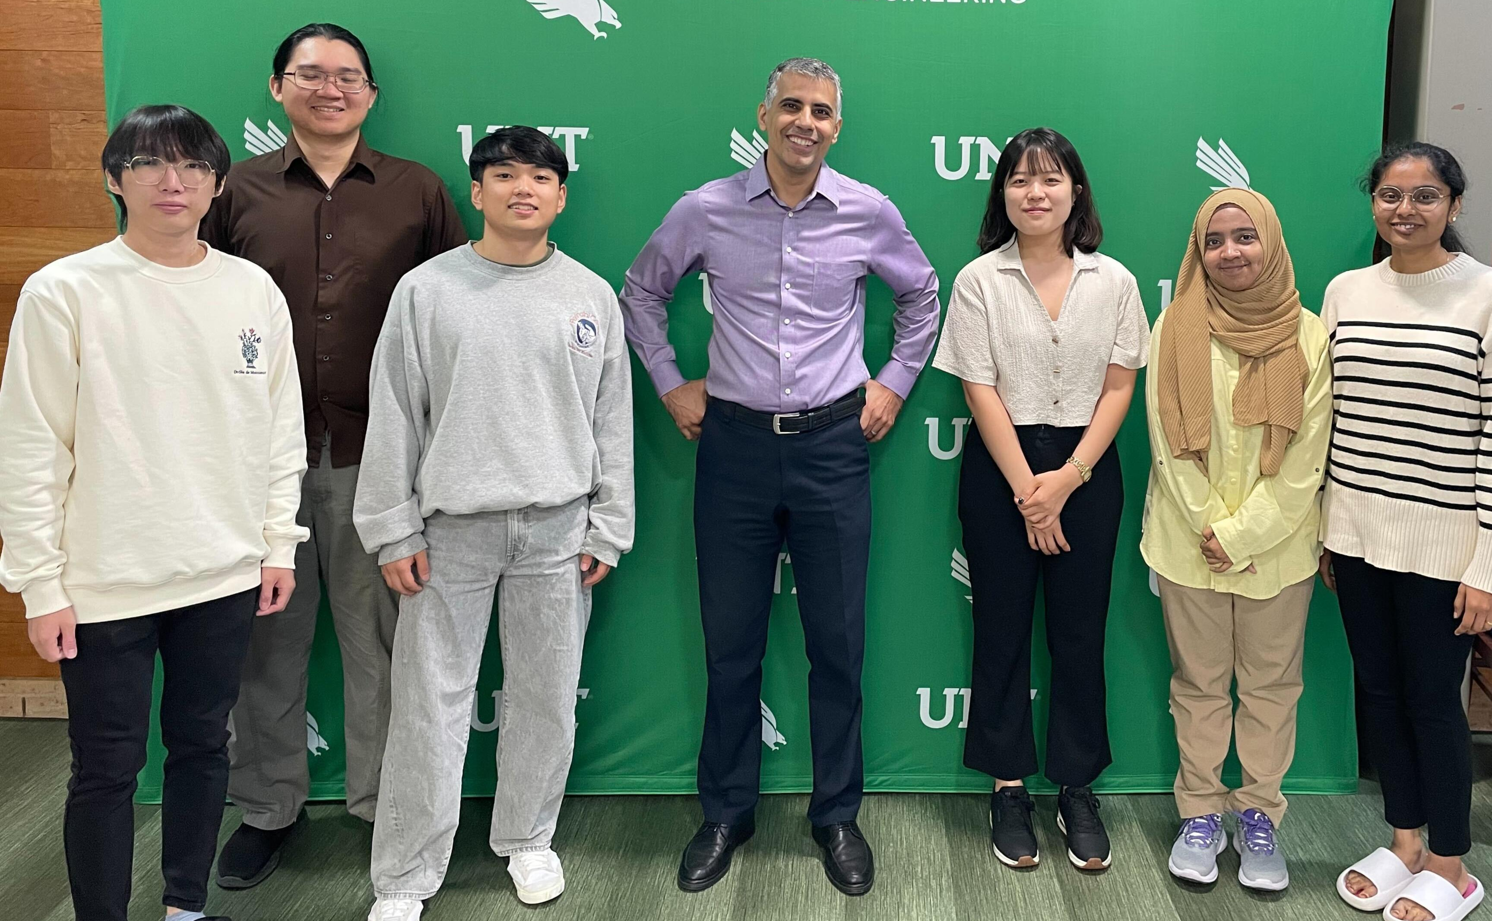


Introduction
Dr. Mohsen Amini Salehi
  PhD at Melbourne University 2012
  Associate Professor at UNT
Director of the HPCC Lab
    7 members: 4 PhD + 1 MS + 2 BS
    In total 33 students/postdoc/visitors
    > 70 peer-reviewed publications

Slide 3
Outline
Research Vision, Mission, and Scope
Two projects at HPCC lab
  Strategies to bridge the gap of ML & Clouds
  Democratizing cloud-native application development (OaaS)
Prospective research directions…
Notes:
Adapting ML algorithms to system characteristics
When ML hits the wall of system constrain

Slide 4

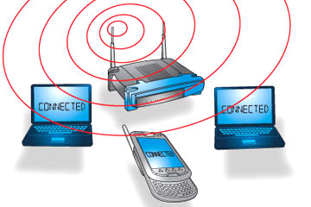

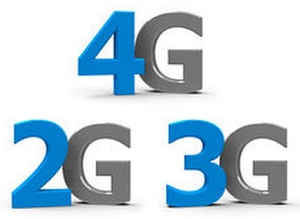

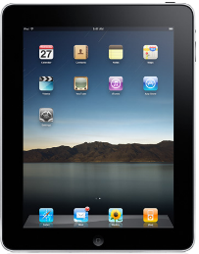

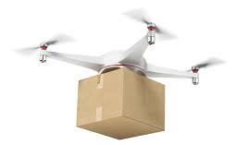
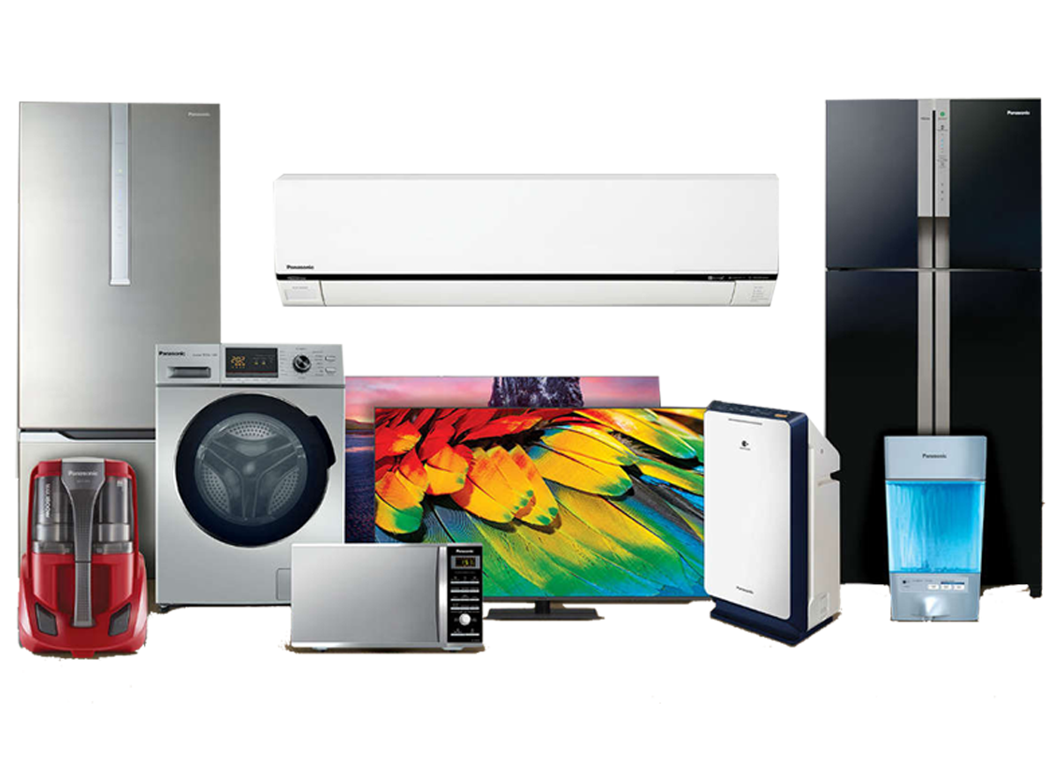
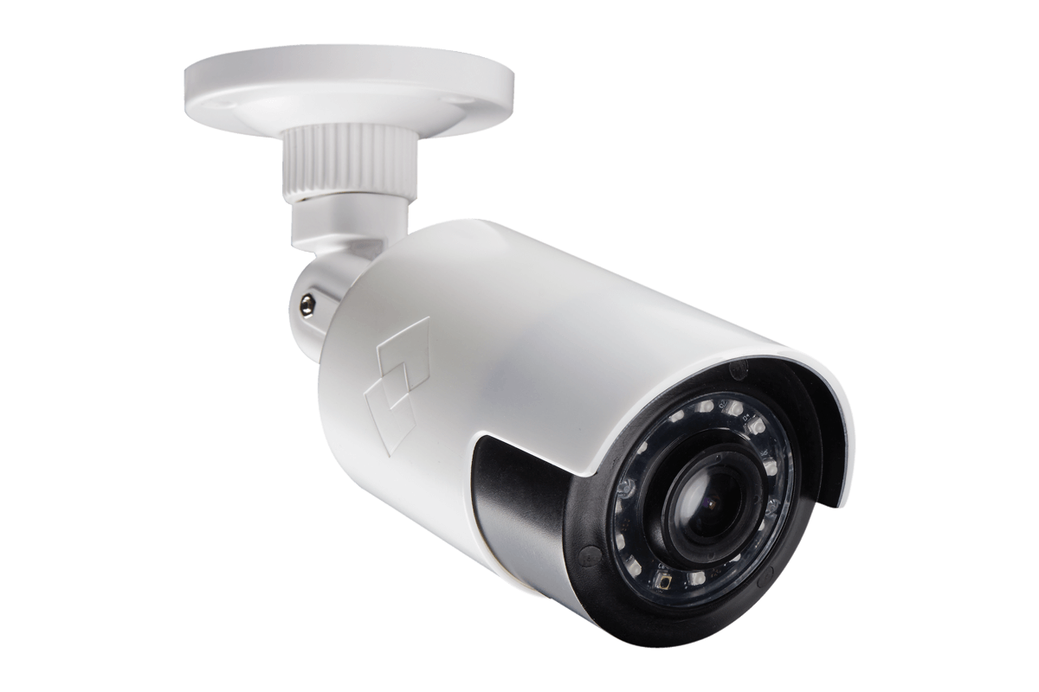
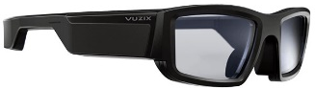
Research Vision
Past Decade
Communication Everywhere
Current Decade
Computing Everywhere
Cloud
Fog
Edge
IoT Device
Notes:
Ubiquitous computing in a spectrum of distributed systems

Slide 5
Research Vision: Cloud 2.0
AI-friendly
Ease of Use (Democratized Programming)
Domain-Specific
Cloud 2.0
Trustworthiness
Highly Heterogeneous (ASICs)
Distributed
(Liquid computing)
Notes:
Storage
Network → Intent-based network
Quantum → cloud-based Quantum; post quantum cloud security and cryptography; secure quantum enclaves
Carbon footprint (Energy aspects) → Neuro morphic architecture and biological functioning; nuclear energy sources
Cloud side-effects → Cloud and globalism; impacts of cloud on the communities; noise; nuclear side effects; energy shortage, etc.
Other areas:
Blockchain and cryptocurrency?
Web 3.0?

Slide 6
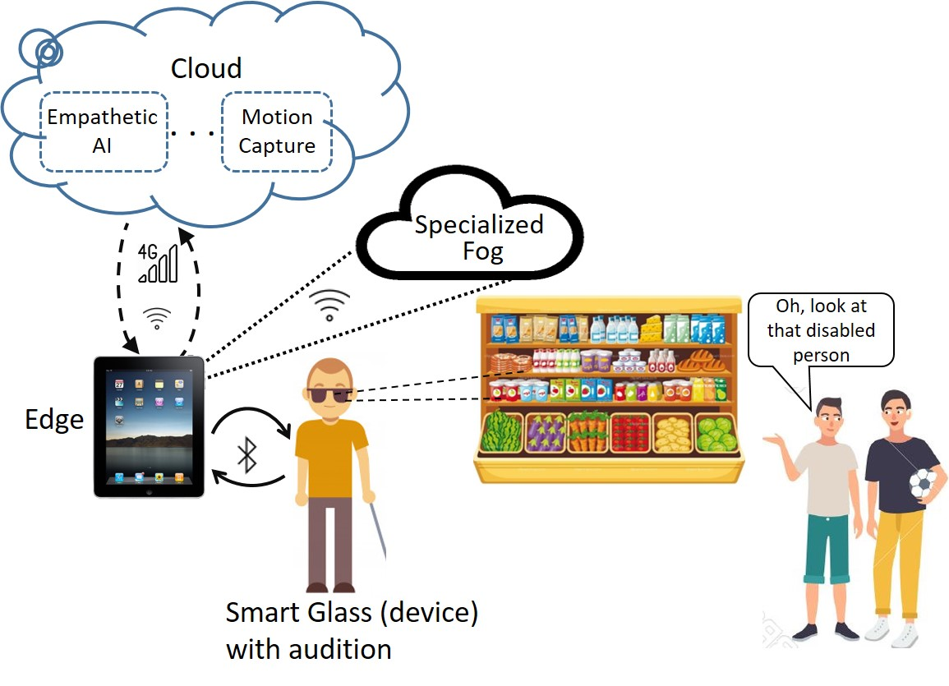
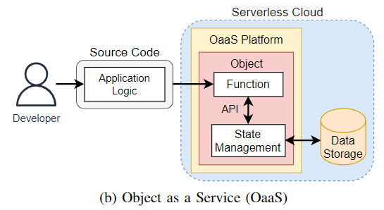
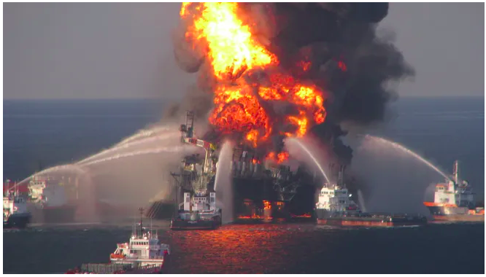
Our Research Mission at HPCC Lab
Help in the development of Cloud 2.0 to improve the quality of human life
Bridging the gap between AI and Cloud 2.0 (for assistive technology)
Providing abstractions to democratize
Cloud 2.0 application development
Establishing liquid computing across autonomous computing systems
(e.g., for disaster management)
Notes:
Innovate in the forefront of scientific discovery

Slide 7
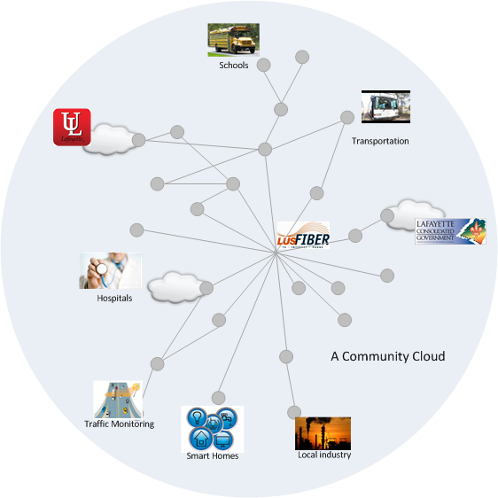
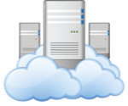
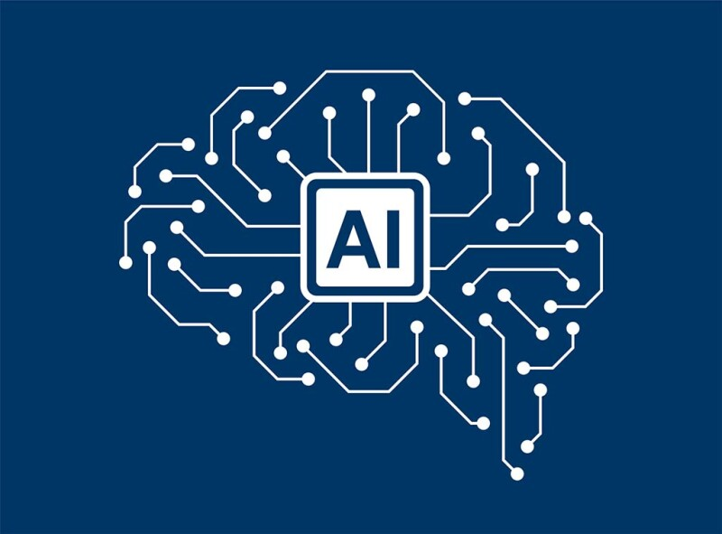

Research Scope
Cloud 2.0 Programming
Abstractions
Edge-to-Cloud Systems
SmartSight Ambient perception for blind and visually impaired people
Open-Source products:
E2C simulator
OaaS
UMS/NIMS
AI Applications

Slide 8
Research Thrust 1: Edge-to-Cloud Systems for ML Applications
ML applications and Edge-Cloud systems developed orthogonal to each other
Our vision: there is an infrastructural
gap to make ML usable across
Edge-to-Cloud
ML algorithm+system software
co-design (ML+Sys) is the key
to “usability”
Our ultimate goal is to enable
perception like a sighted person

Slide 9
ML Usability Challenges on Cloud 2.0
Inference Latency
Fairness
Resource Intensive
AI-Friendly Cloud 2.0 Challenges
Lifetime (Energy Use)
User Privacy
Robustness
Scalability (elasticity)
Accuracy

Slide 10
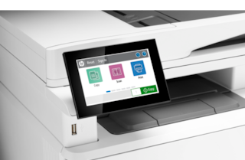
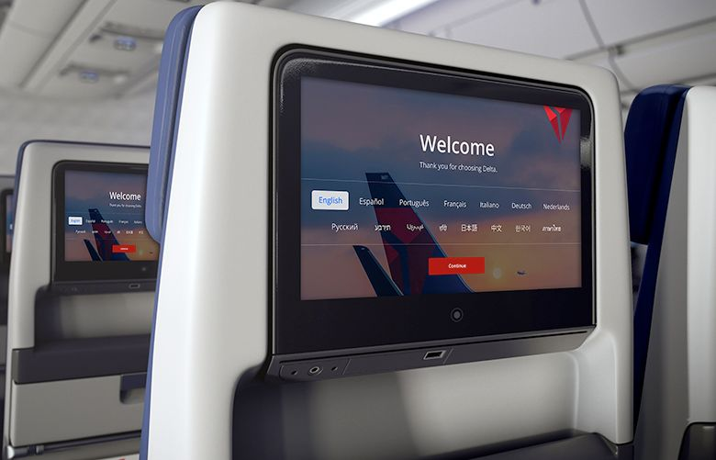
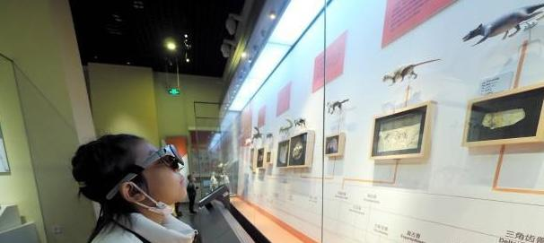
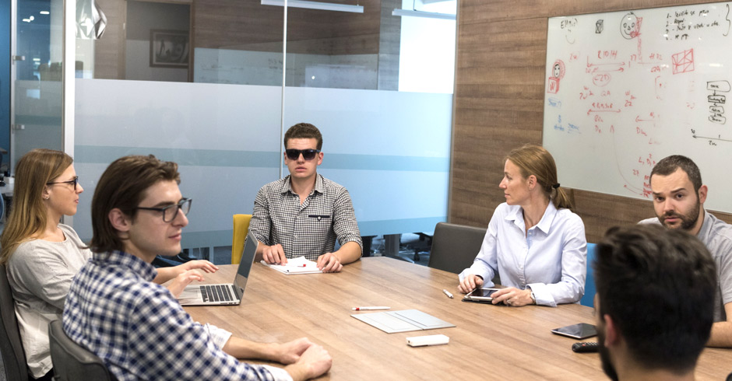
SmartSight: Ambient Perception for Blind and Visually Impaired Users

Slide 11
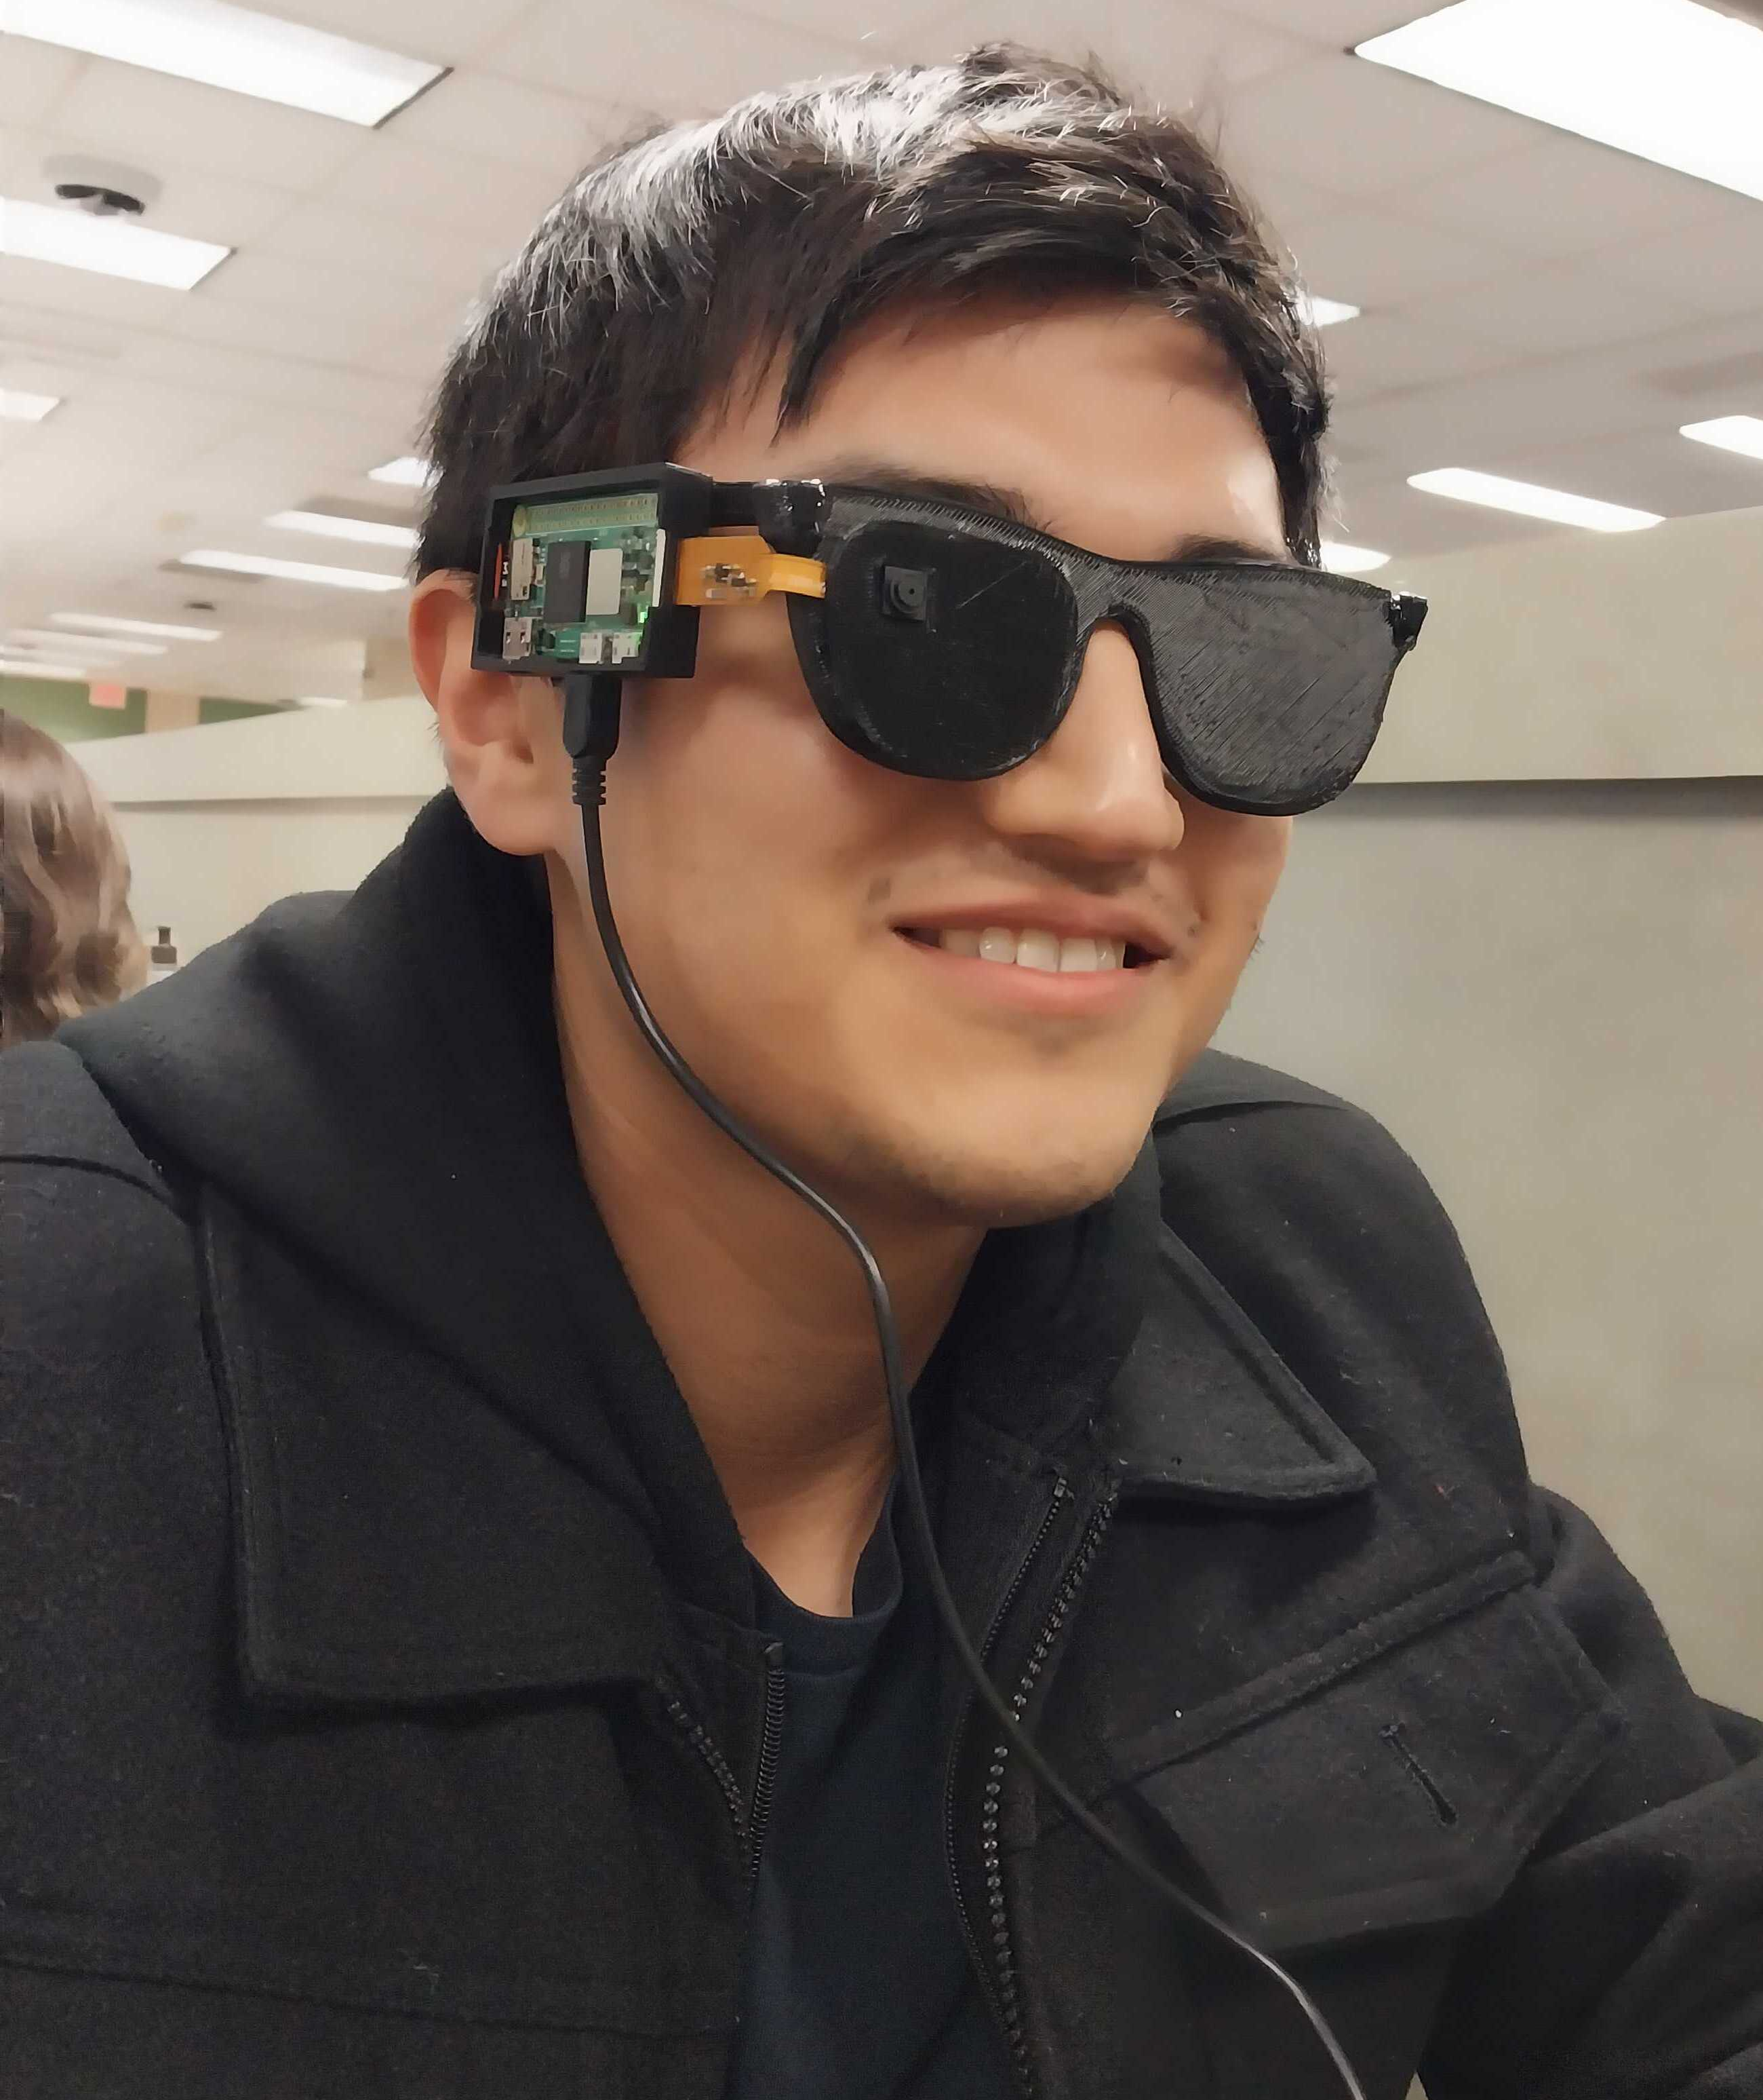
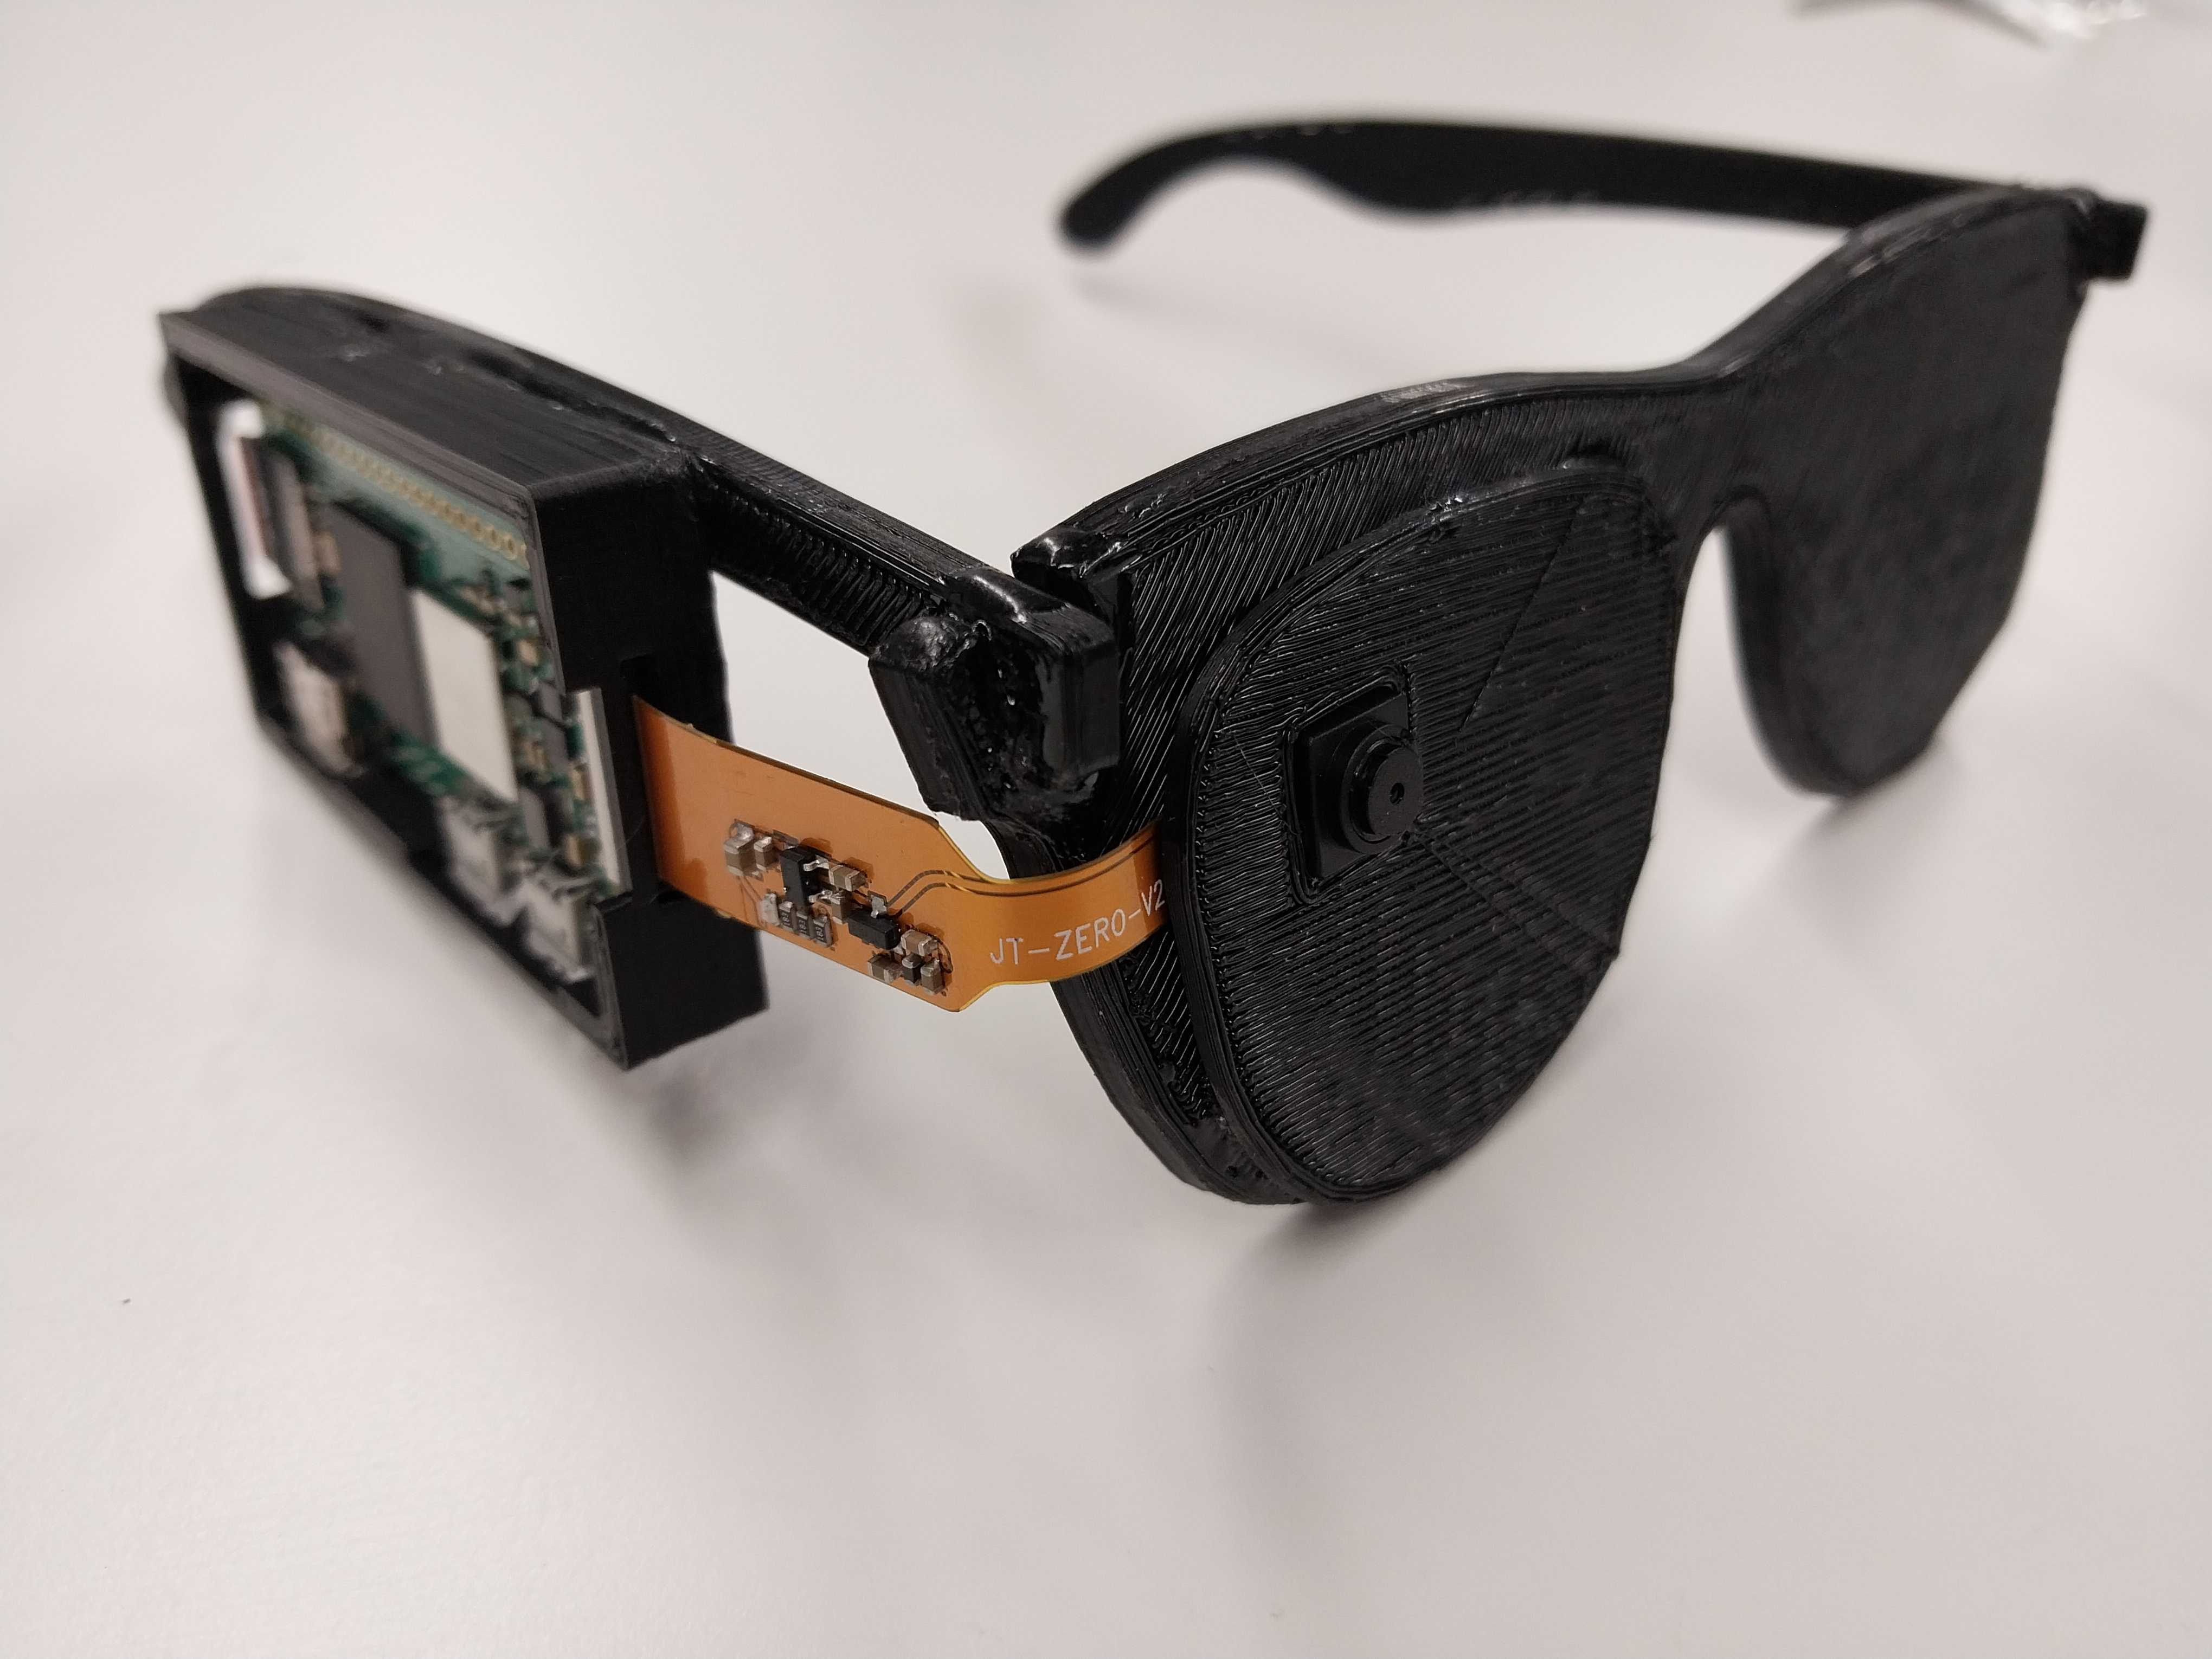
SmartSight: Enabling Ambient Perception

Slide 12

How to Provide Ambient Perception?
Ambient Perception
Passive Perception
Fusion
Active Perception
Answering questions
Performing tasks
…
Obstacle detection
Motion detection
Face detection
…
Guidance

Slide 13
Passive Perception
Notes:
So far, we tried to adapt ML and system
Next, we plan to use system knobs to unlock new level of smartness
How to enable concurrent perception on edge?
Shortage of memory on edge
Bias against some concurrent applications

Slide 14
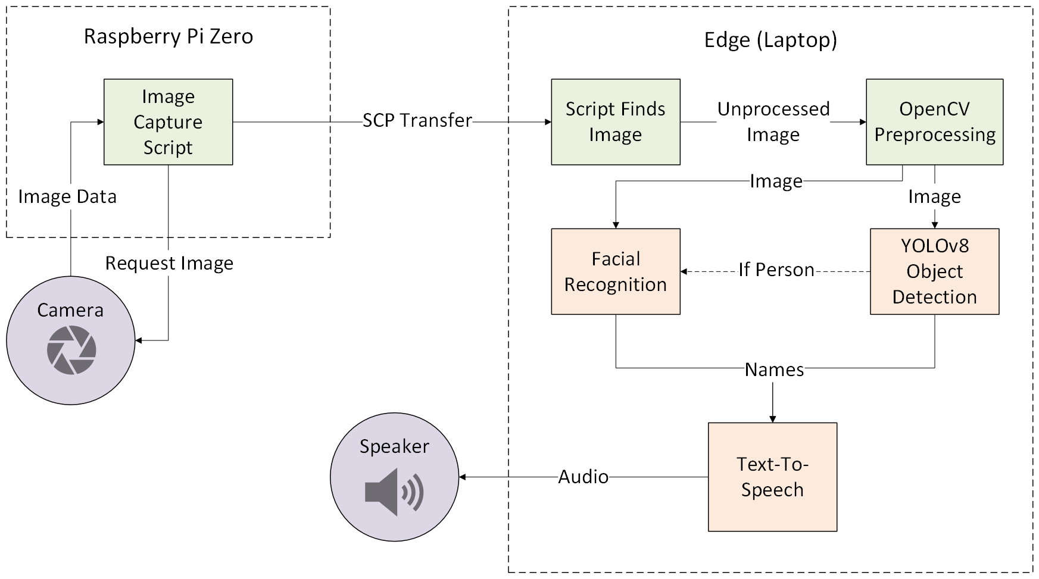
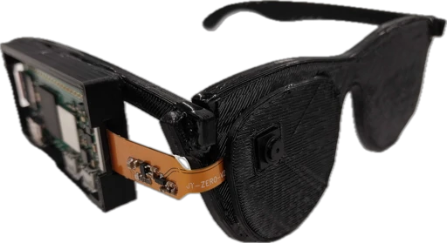
SmartSight for Passive Perception

Slide 15


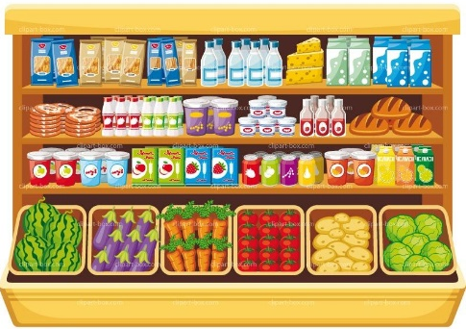
Active Perception: Ambient Interaction
Blind users prefer “talking” to the system!
  Configuring the system
  Giving it orders
what type of carrot is this?

Slide 16
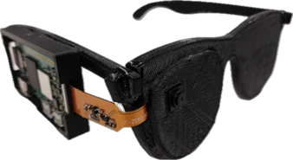
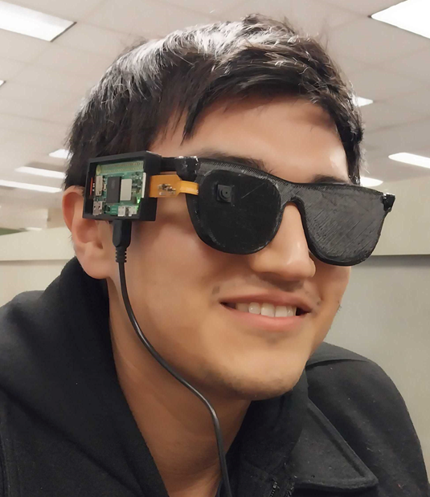

SmartSight for Active Perception
Fusion Hub
(matching image to voice, vocal sentiment analysis)
Latency Manager
Image Input
BVI-
Friendly Response Maker
Text
To
Speech
prosody-Text
Reasoning Engine
(adaptive multi- modal
LLM)
BVI-Friendly Prompt Manager
Voice Input
Image-to-Text
Input Management
Cognition Engine
Response Management

Slide 17
SmartSight for Active Perception
Fusion Hub
(matching image to voice, vocal sentiment analysis)
Latency Manager
Image Input
BVI-
Friendly Response Maker
Text
To
Speech
prosody-Text
Reasoning Engine
(adaptive multi- modal
LLM)
BVI-Friendly Prompt Manager
Voice Input
Image-to-Text
Input Management
Cognition Engine
Response Management

Slide 18
Cloud 2.0 Characteristics
AI-friendly
Ease of Use (Democratized Programming)
Domain-Specific
Cloud 2.0
Trustworthiness
Highly Heterogeneous (ASICs)
Distributed
(Liquid computing)

Slide 19
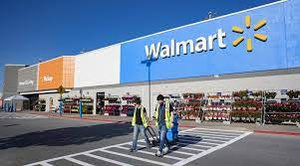
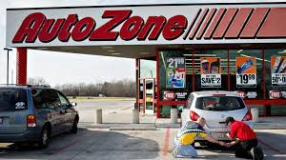

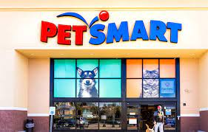
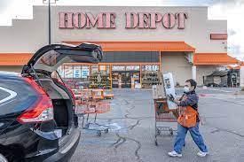
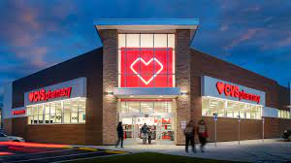
Research Thrust 2:
Cloud 2.0: Domain-Specific Serverless Clouds
Emergence of ASICs, domain-specific PLs, serverless (FaaS)
Our vision: Domain-specific serverless platforms operating across Edge-to-Cloud will be the next generation clouds
Specific platform needed to:
  Offer specialized services
  Programming abstractions
  Effectively utilize ASICs
  Provide built-in QoS & compliance
Notes:
Specialized billing
High-level apis
Advance resource allocation for reusing and cost-efficiency
Customized execution platforms (container vs bare metal vs VM vs unikernel vs mvm)
While the first gen of cloud focused on mitigating the burden for sys admins, the second generation will mitigate the burden for programmers
We envisage that in certain highly-demanded domains (ML, medical, video, mapping) there will be domain specific clouds

Slide 20
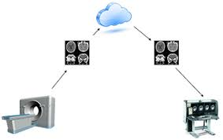
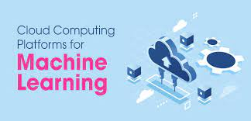


Research Thrust 2:
Domain-Specific Serverless Cloud Systems
Software development landscape will be changed to a mashup of service-calls across multi-specialized-clouds!
Abstraction is the centerpiece to democratize “cloud-native application development”
Notes:
A motivational scenario can be recording the video; transcoding on video processing cloud, annotate it to different languages on a ML cloud
2nd scenario: collect climate information from sensors, a data analytics service to predict the chance of flood, a mapping cloud to model the impact of flood

Slide 21
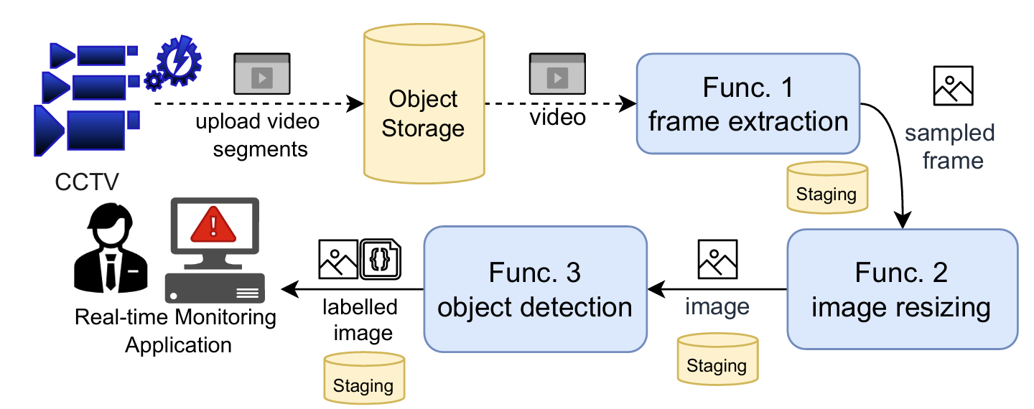
Existing Cloud Programming Abstraction: FaaS
Case Study: Real-time Monitoring System
  App. comes with Service-Level Agreements (SLA).
  Separate Abstractions!
  Need to manage external storage.
21

Slide 22
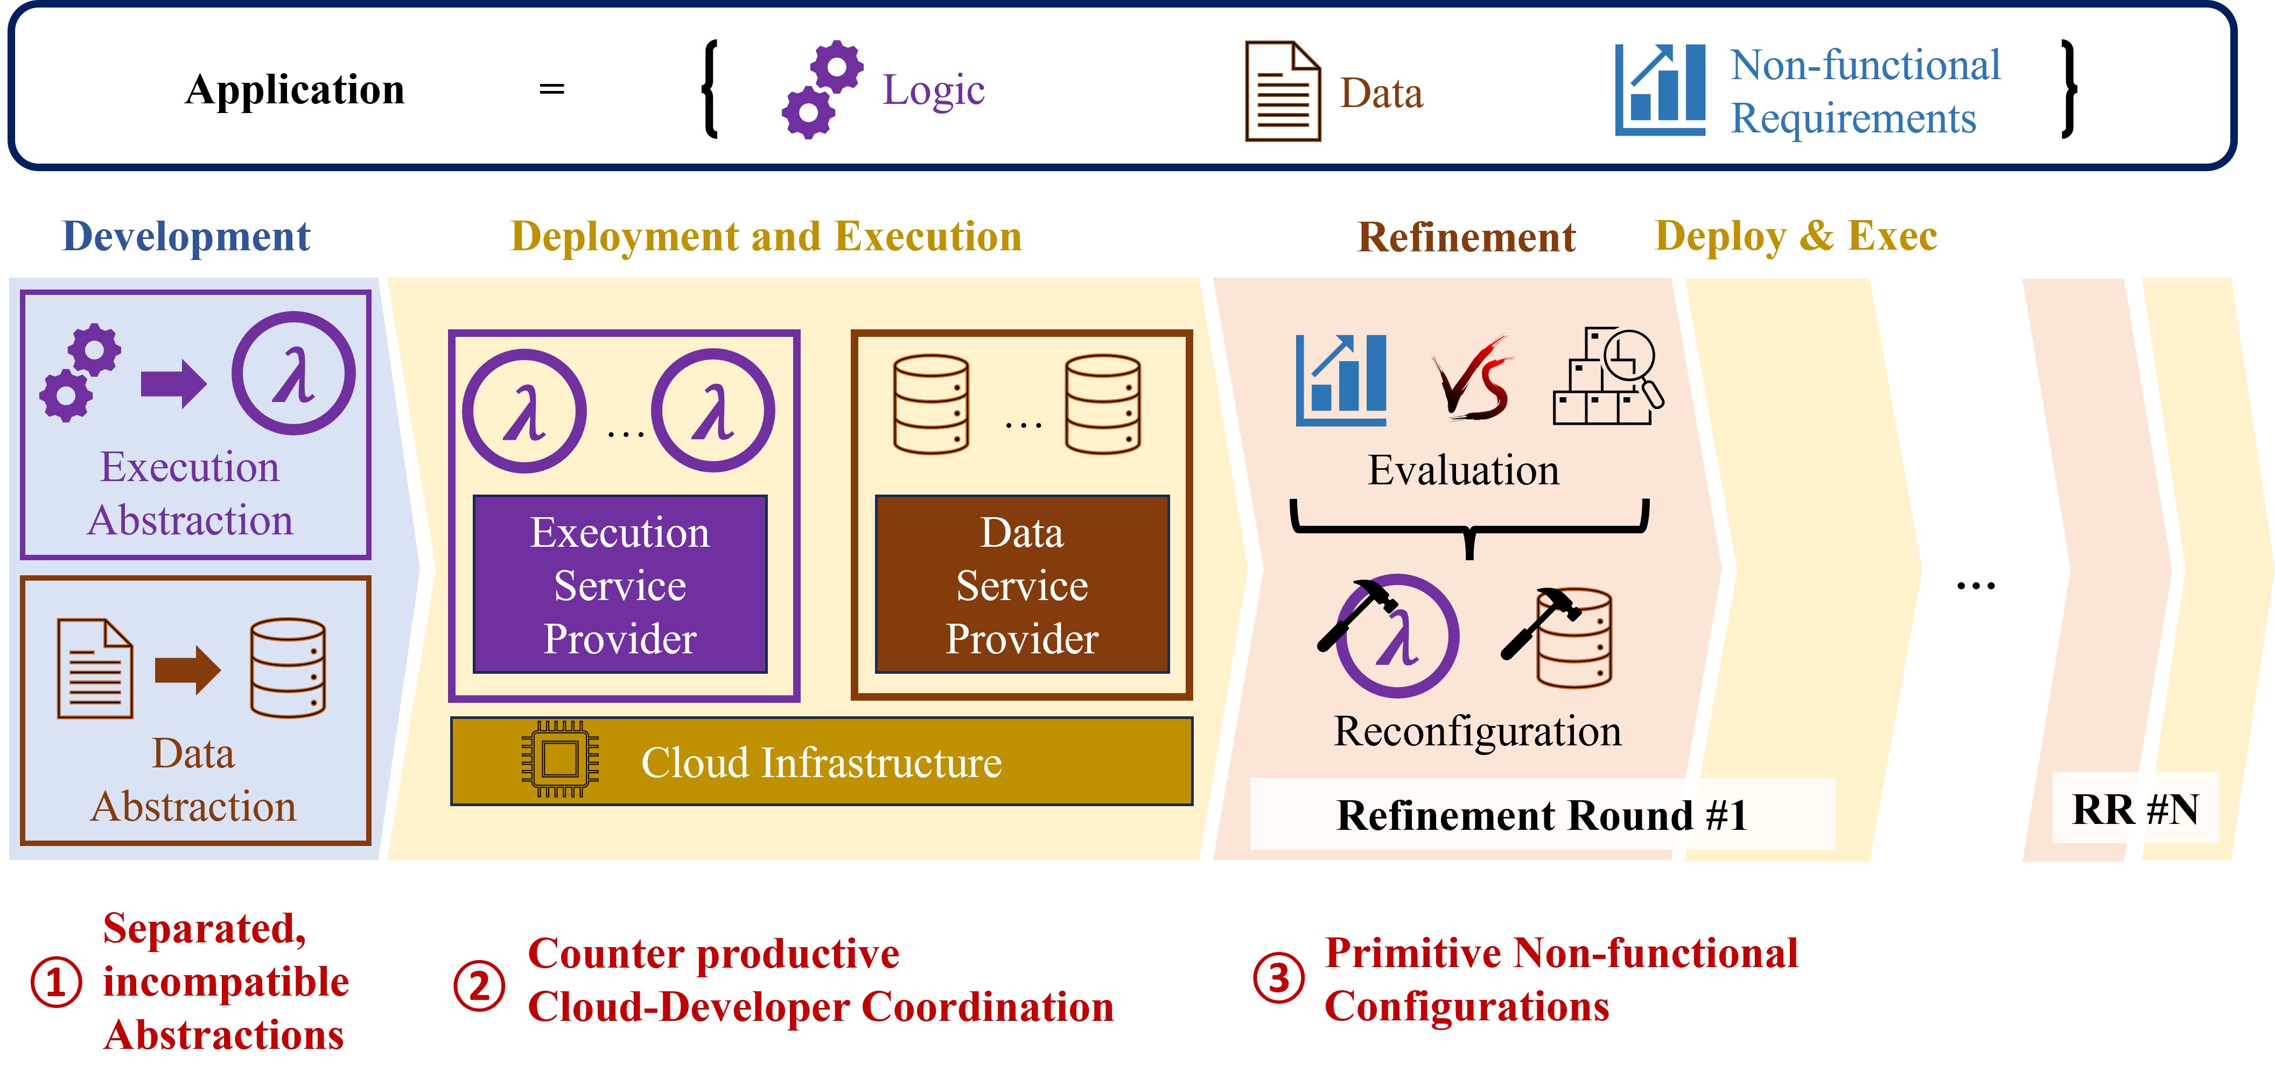
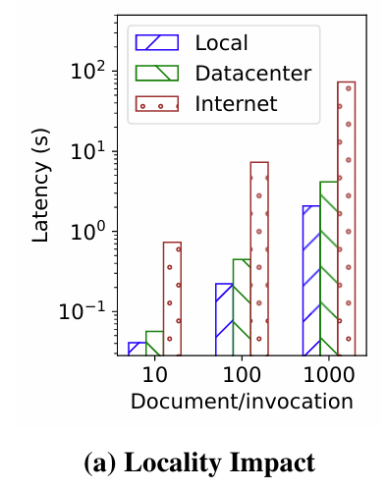
FaaS Problem 1:
Separate Abstractions
QoS requirements and constraints (SLA)
Function and Data on different hosts:
2x slower!
Function and Data on different datacenters:
35x slower!!

Slide 23
FaaS Problem 2:
Conflicting Objectives of Provider & User
QoS requirements and constraints
Developer optimization objective:
Meet SLO and reduce cost
Cloud provider objective:
Resource utilization
Over-subscription

Slide 24
FaaS Problem 3:
Multiple Round of Deployment Refinements
QoS requirements and constraints
Configuring such low-level parameters demands effort and expertise

Slide 25
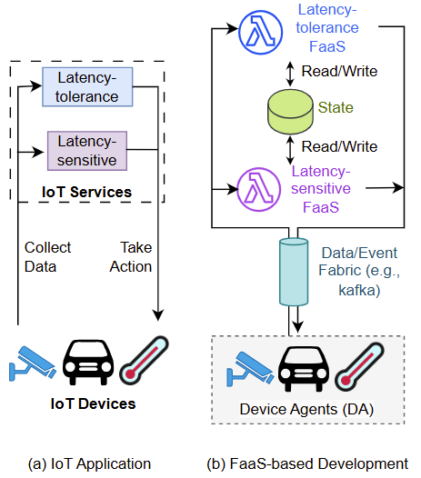
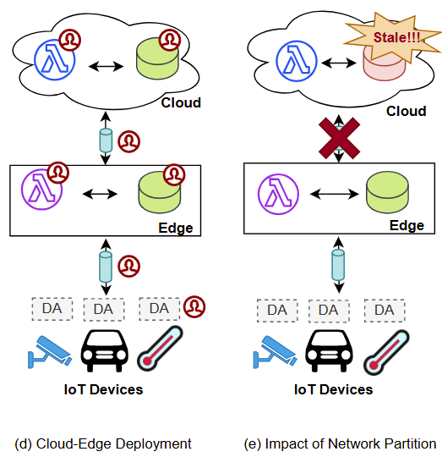
FaaS Shortage: IoT-Edge-Cloud Application Development

Slide 26
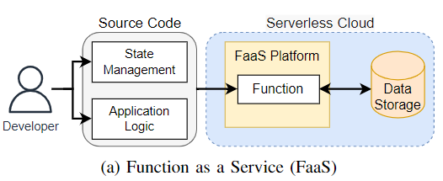
Our Solution: Function + State
Object as a Service (OaaS) Paradigm
OaaS encapsulates functions+data+QoS
  transparent resource & data mgmt
  enables access level (public/private…)
  enables software reuse (inheritance)
OaaS enables dataflow semantics
  built-in support for function workflows
  managing intermediate data across functions
OaaS encapsulates QoS, constraints, and location across multi-cloud
* OaaS is pen-source on Github
* Published in TPDS ’22 and IEEE Cloud ’23
26

Slide 27
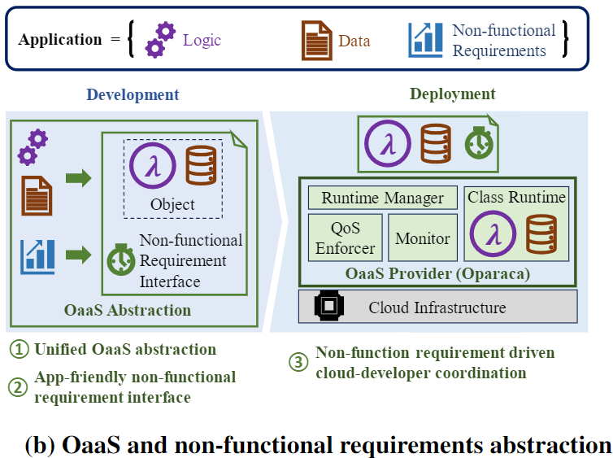
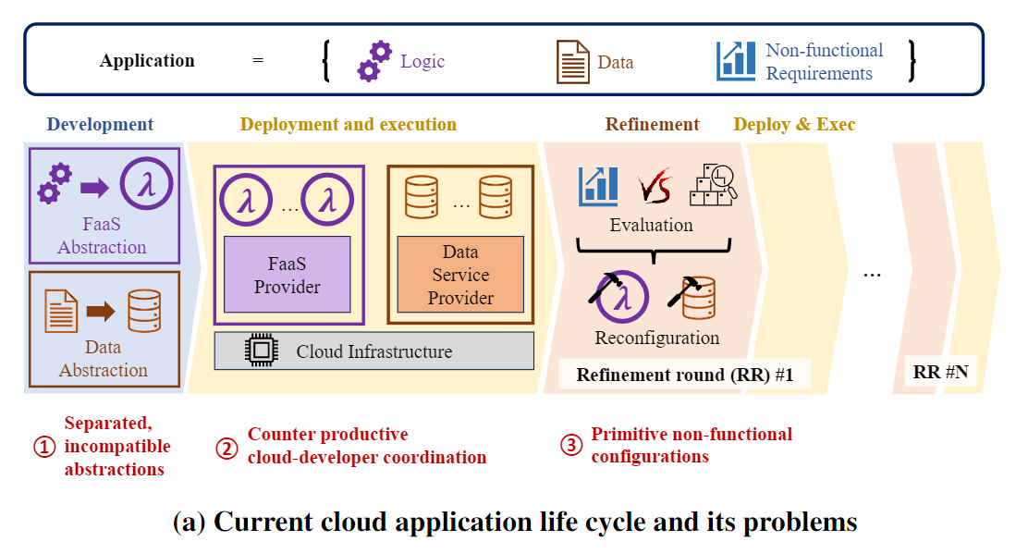
OaaS= Function + Data + QoS

Slide 28
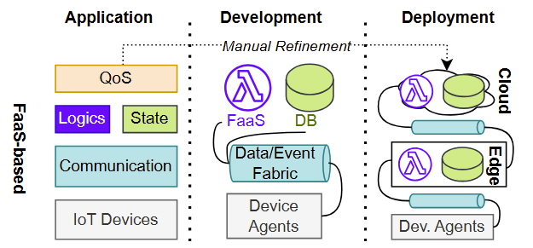
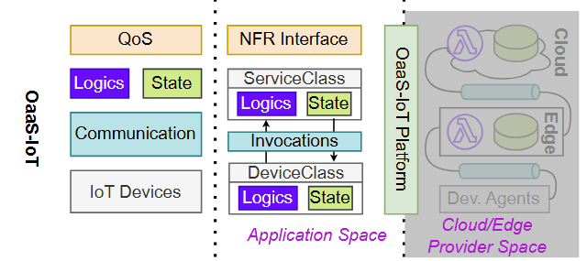
OaaS-IoT= Function + Data + QoS + Network

Slide 29
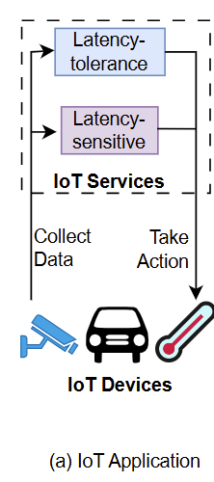
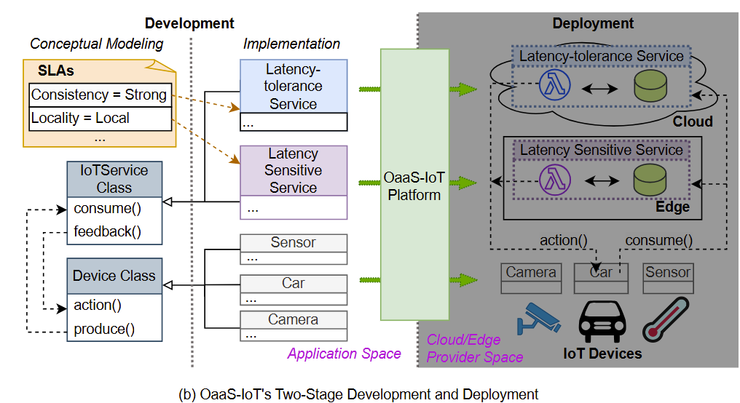
How Does OaaS Operate?
Notes:
Q: do we support ONE class/object with some functions on edge and some on the cloud? OR they have to be TWO classes/objects working with each other? The above pic says the latter, but the paper says the former!

Slide 30
OaaS-IoT: SLA interface
Name | Value Type | Unit | Example
Throughput | Int | Rps | 100 Rps
Availability | Real | Percent | 99.9 %
Locality | None Local | N/A | Local, None
Consistency | None Read Your Write (RYW) Bounded Staleness(Δ) Strong |  | Bounded Staleness(5s)

Slide 31
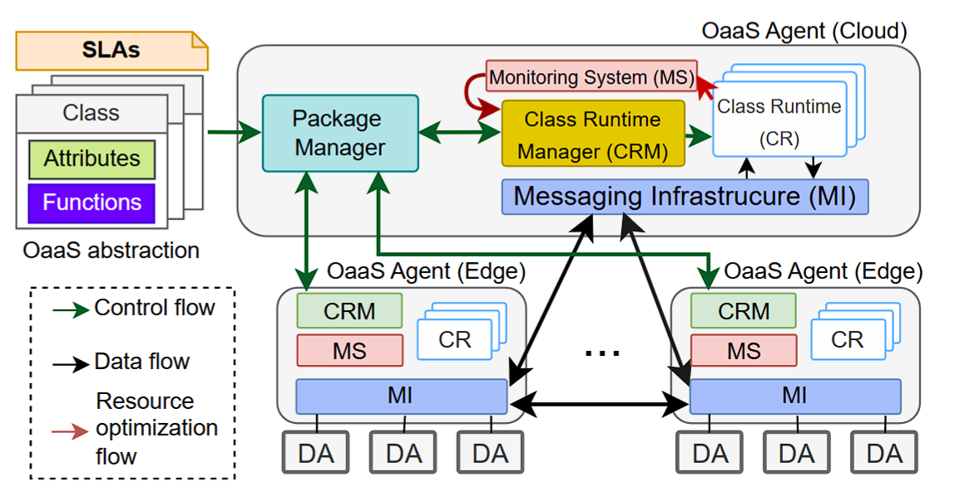
OaaS-IoT Architecture

Slide 32
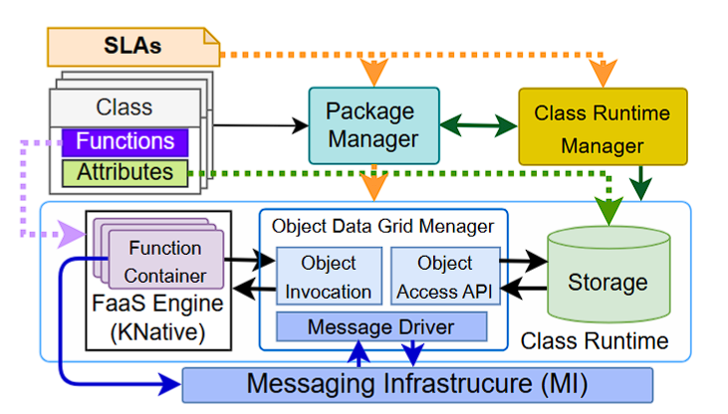
Class Deployment with
Class Runtime

Slide 33
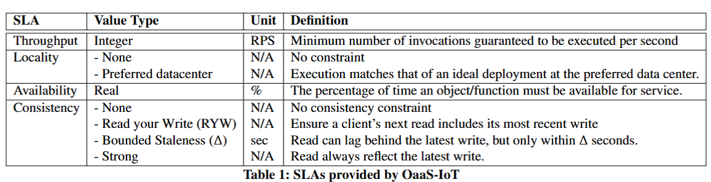
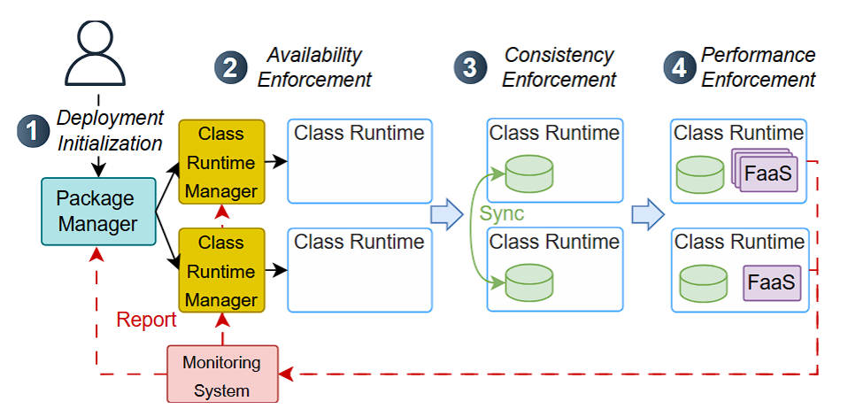
SLA Enforcement

Slide 34
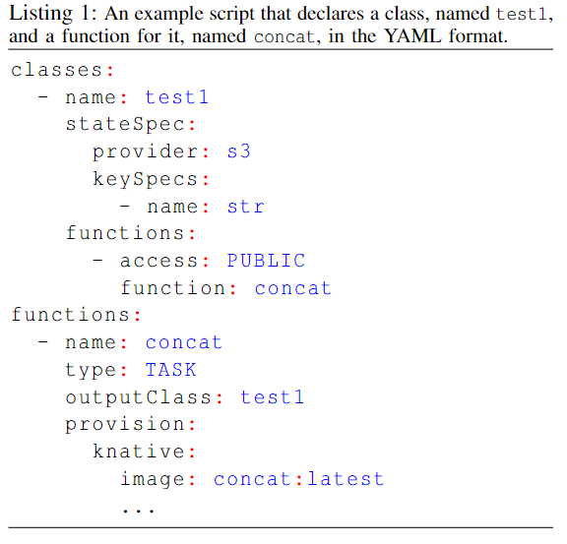
Use Case: Class Definition in OaaS
state
declaration
Example Object instantiation and call:
video
video1:constructor():persigned_URL
HTTP PUT(MY_VIDEO, persigned_URL)
transcode
video1:transcode(var=1024)
transcode
function
definition
transcode:latest

Slide 35


User Case:
Class Definition Interface in OaaS
NFR
State
Class
Func
State
Class
Func

Slide 36


Case Study:
Face Detection on a Given Video
FaaS

Slide 37

Case Study: OaaS for
Face Detection on a Given Video
class video{
state:
name: src_video
functions:
  video_split():video;
  extract_frame():image;
Workflow:
Wf_face_detect():json_rec;
}
OaaS:
class image{
state:
name: img
functions:
face_detect():json_record;
}
class json_record{
state:
name: json
}

Slide 38

OaaS-IoT Facing Network Partition
Strong needs quorum => throughput drops to zero.
RYW does not need quorum => can fall back to local invocation.
RYW-thr has throughput enforcement that has more stable performance
in the fallback stage.

Slide 39

Evaluation Result:
Implementation Efficiency
OaaS can operate with insignificant overhead

Slide 40
Case Study: OaaS for
Face Detection on a Given Video
class video{
state:
name: src_video
functions:
  video_split():video;
  extract_frame():image;
Workflow:
face_detect():json_record;
}
OaaS:
Still Hard to Program!!!!
class image{
state:
name: img
functions:
face_detect():json_record;
}
class json_record{
state:
name: json
}

Slide 41

The Last Mile to Cloud Programming Democratization…
Layman user has a generic query!
Object developer
Check mask
facing of
nurse in this video
Notes:
The OaaS platform is designed based on multiple self-contained microservices communicating over the network in a serverless cloud system.

Slide 42







Our Vision of Cloud Programming Democratization
Information Based
Search Engines (Pattern Matching)
Check mask
facing of
nurse in this video
Knowledge Based
Search Engines (GenerativeAI)
Processed
video
Action Engine!
Our approach of
Cloud Programming
Our System
(OaaS)
Notes:
Computers digest multiple hardware; Action engine will digest multiple software
Action engine:
فاذا اراد کن فیکون

Slide 43


Action Engine!
Object consumer (doctor, nurse) programs a camera object
Q: check
mask
facing of
nurse in
charge
use LLM to
instruct steps to handle
query
semantic
search
across
object
methods
Deploy
on Cloud
Notes:
Analogy with the convergence of computers (multiple hardware as different software within one computer)
Action engine is a step to elevate human to be god. فاذا اراد کن فیکون

Slide 44

Action Engine Architecture

Slide 45
Cloud 2.0 Characteristics
AI-friendly
Ease of Use (Democratized Programming)
Domain-Specific
Cloud 2.0
Trustworthiness
Highly Heterogeneous (ASICs)
Distributed
(Liquid computing)

Slide 46

Research Thrust 3:
Cloud-Like Services for Remote Industry 4.0
Industry 4.0= IIoT+Cloud+AI
No Cloud access in remote Industry sites!
Lack of elasticity in local Fog servers
How to establish Cloud-like elasticity in remote industries?
Notes:
O&G $73B to Louisiana’s 2019

Slide 47










Motivational Scenario:
Oil Spill in Remote Smart Oil Fields
Synchronization of various
activities
Satellite
Cloud Datacenter
High Latency
Fog System on Oil Rig
Fire
Oil Spill Incident
Notes:
Dispatch of Drones
Computing help by mobile fog
Data collection

Slide 48
Research Challenges
  How to dynamically augment compute resources without cloud access?
  How to handle oversubscribed situations while preserving privacy?
Our proposal:
  Forming a Federated fog
  Provision resources for Industry 4.0 Applications
  Privacy preserving resource sharing
Fog System on Oil Rig
Federated Fog Formed
Drone
Oil spill
Notes:
Synchronization – Dispatch drone, collect data, monitoring, coordinating emergency, evacuation, running simulation

Slide 49

Federated Fog Computing to Establish Cloud-Like Services in Remote Industrial Sites
Cross-fog workflow partitioning
Serverless application deployment
Live service migration across independent fogs
Dynamic Fog Federation formation

Slide 50


Workflow Partitioning across Federated Fog Computing
Application Graph (DAG)
Fog Federation

Slide 51


Slide 52
Summary
Cloud 2.0 is on the horizon!
  Challenges & opportunities of IoT+Edge+Cloud+AI
  Abstractions for cloud application development
    More than 26% reduction in line of code
  Making use of LLMs to democratize cloud application development

Slide 53

Thank you for your time…
Mohsen.aminisalehi@unt.edu

