Slide 1

Tutorial: Interactive Video Streaming Using Cloud Services
Dr. Mohsen Amini, Chavit Denninnart
High Performance Cloud Computing (HPCC) Lab
School of Computing and Informatics
University of Louisiana Lafayette
10th IEEE/ACM Conference on Utility and Cloud Computing
Dec. 2017

Slide 2

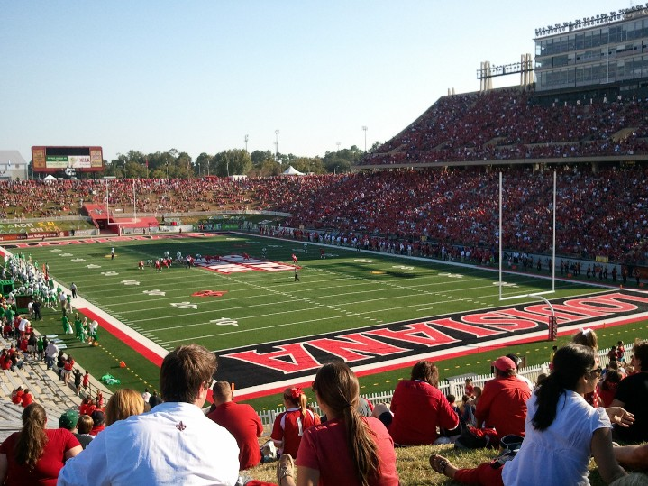


University of Louisiana Lafayette

Slide 3
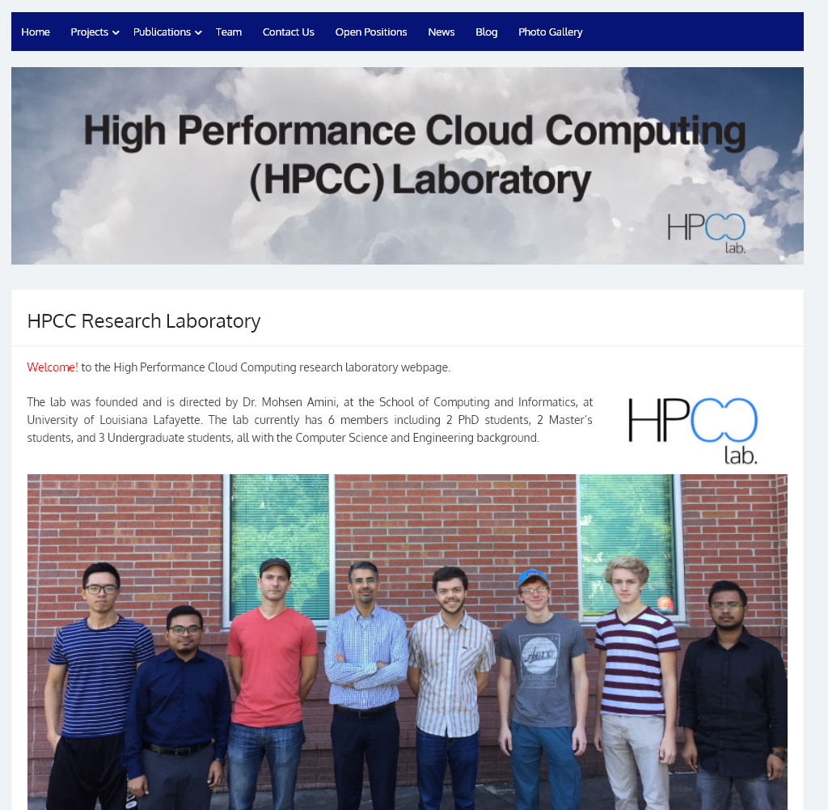
http://hpcclab.org

Slide 4




Research Interests
Data Sanitization in Cloud
Robust Cloud Resource Allocation for real time processing of big data

Slide 5
Acknowledgement
Our valuable team members
  Dr. Mohsen Amini Salehi
  Dr. Xiangbo Li
  Dr. Mahmoud Darwich
  Mr. Chavit Denninnart
  Mr. Vaughan Veillion

Slide 6
Agenda
How does video streaming work?
CVSE: Cloud-based Video Streaming Engine Architecture
Feasibility of meeting streaming QoS in the cloud
Analyzing video streaming execution using heterogeneous VMs
Achieving cost-efficient cloud-based streaming by making use of heterogeneous cloud VMs
Achieving cost-efficient streaming by efficient caching of streams
Current implementation of CVSE (Demo)
Achieving Cloud-based Live video streaming
Interactive cloud-based video streaming

Slide 7
Let us get some motivation…

Slide 8
















Slide 9
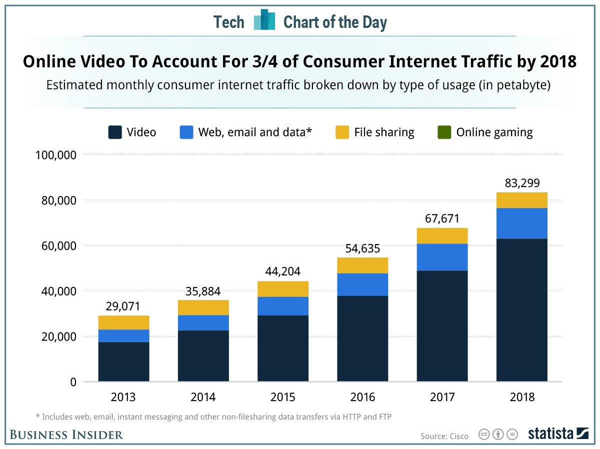
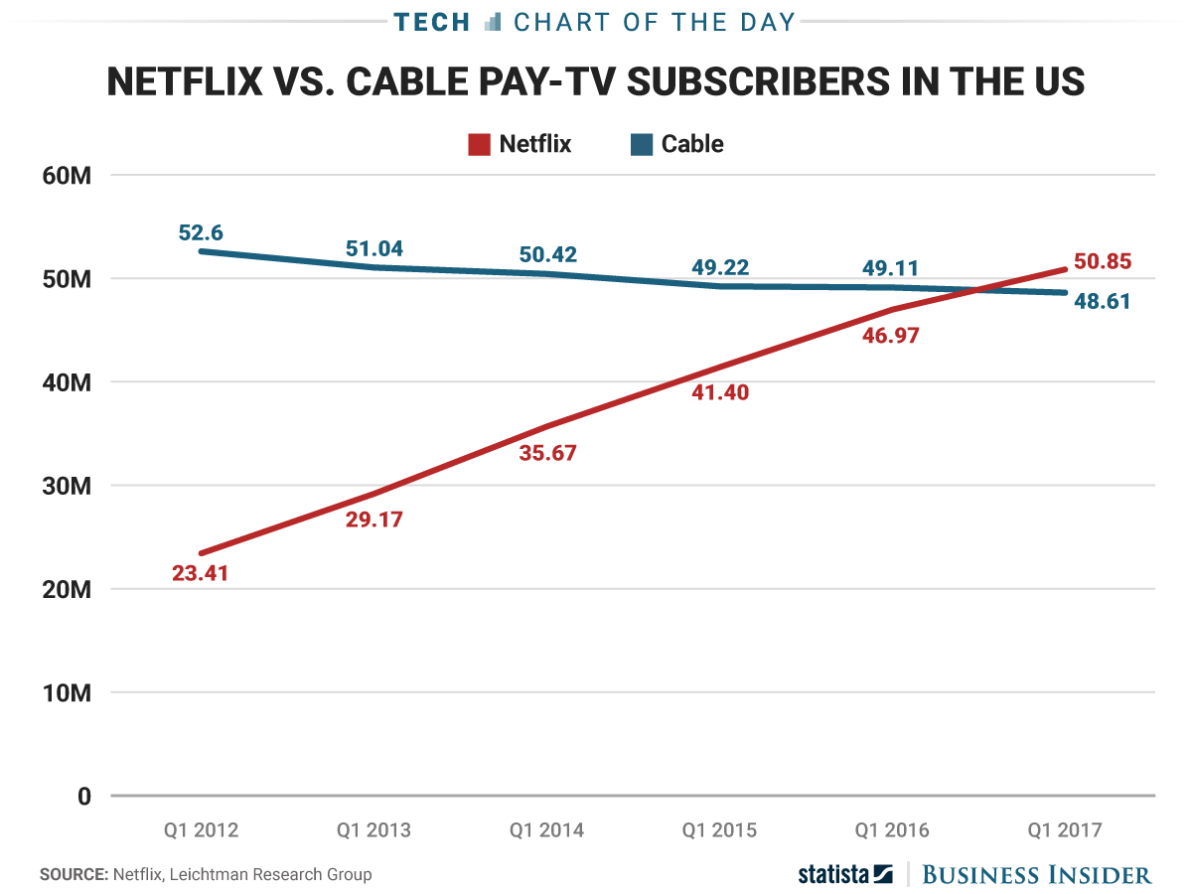
Current Status of the Video Streaming World
Video accounts for 70-80% Internet traffic
Streaming subscribers > Cable subscribers

Slide 10
A true story...

Slide 11





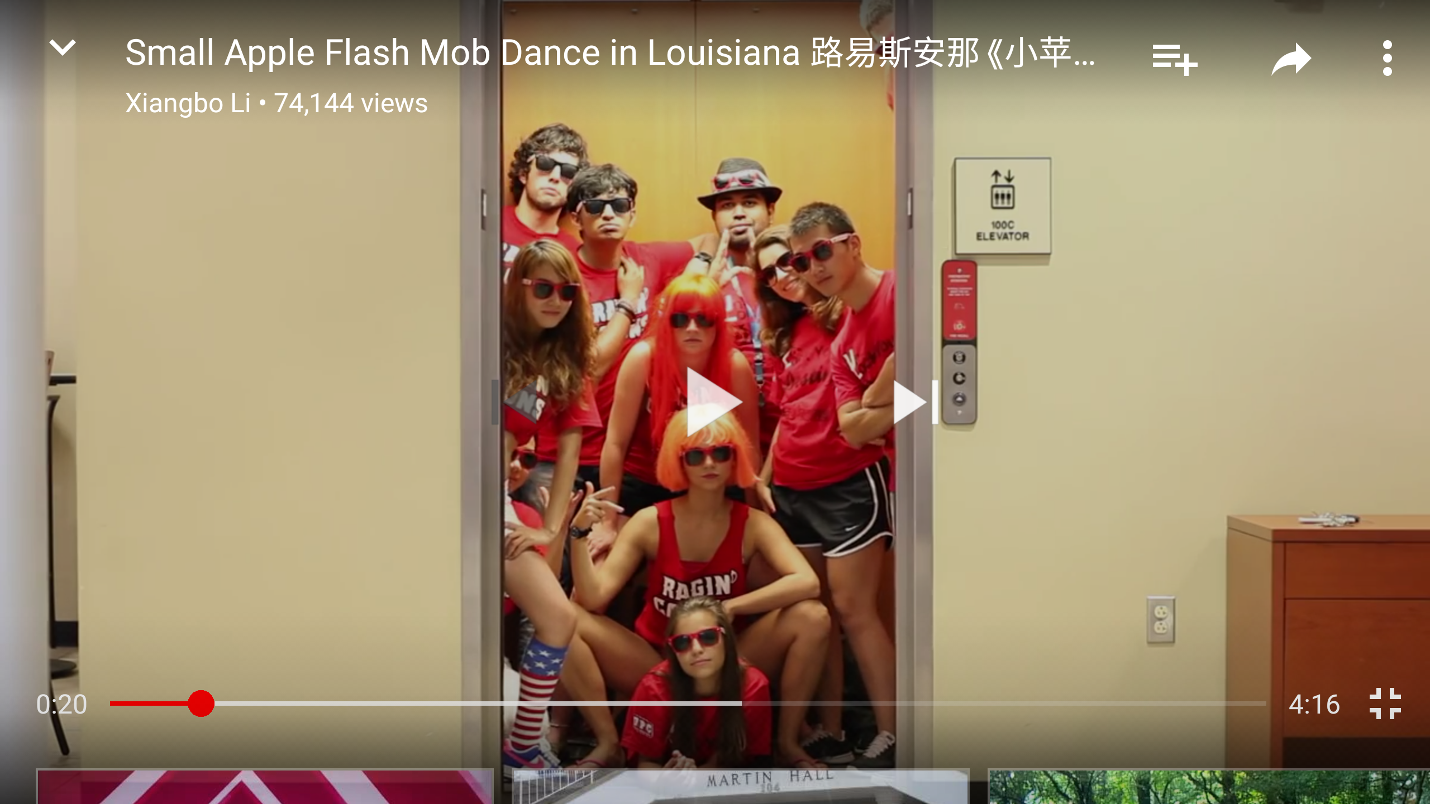
In 2014

Slide 12
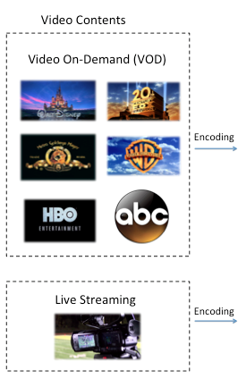
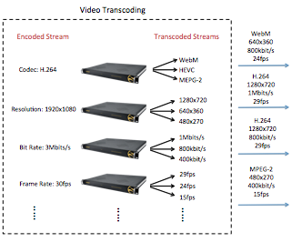
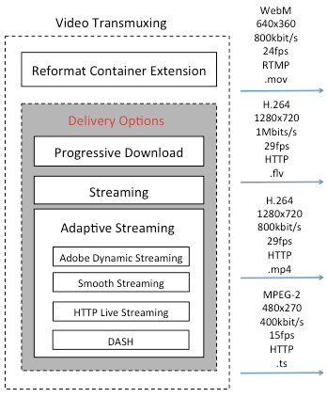
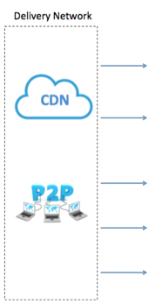
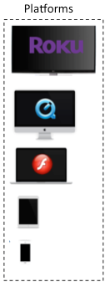
How Video Streaming Works?

Slide 13
Topics
Video Encoding
Video Transcoding
Video Transmuxing/Packaging
Digital Right Management (DRM)
Content Delivery Network (CDN) and P2P

Slide 14
Why to encode a video?

Slide 15
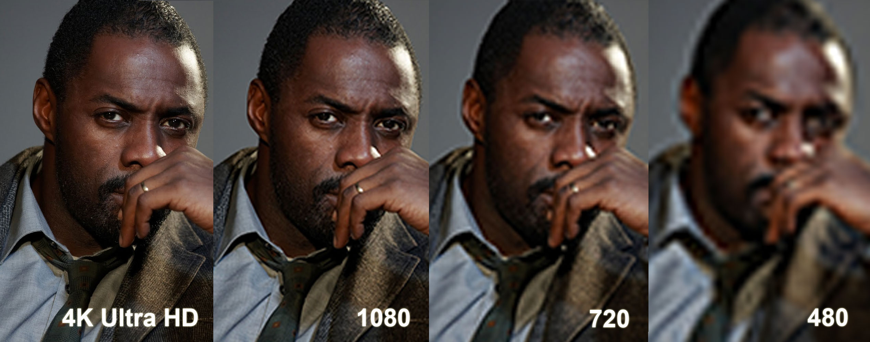
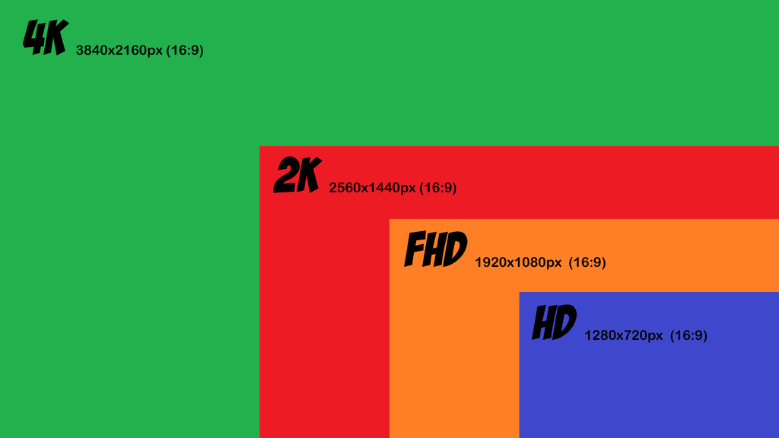

HDTV channel bandwidth: 20Mb/s
Common 720p video: 2GB

Slide 16
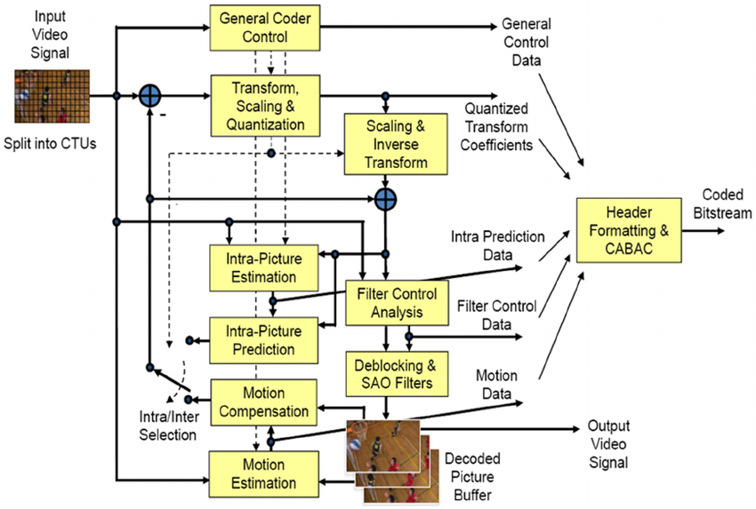
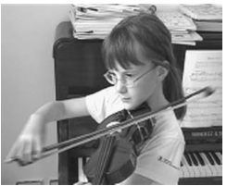

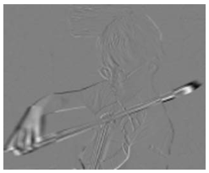
HEVC Encoder Architecture
Intra Prediction
Inter Prediction
Transform & Quantization
Entropy coding
Frame 2
Frame 1
Residue

Slide 17
Why transcode video?

Slide 18



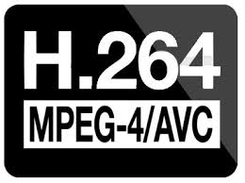

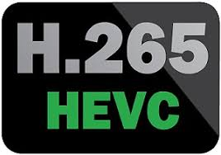








Video Codecs
Client Devices
Network Bandwidth

Slide 19
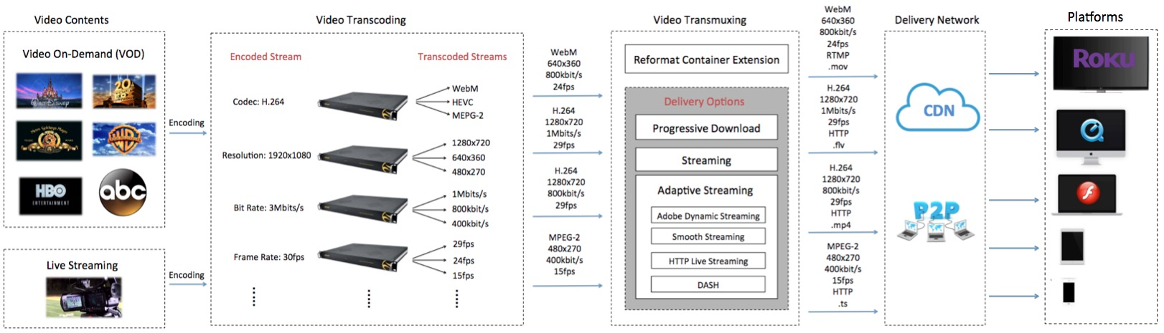
How Video Streaming Works?
2 codecs * 5 bit rate= 10

Slide 20
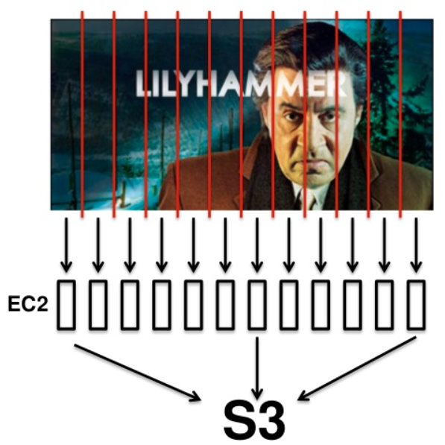
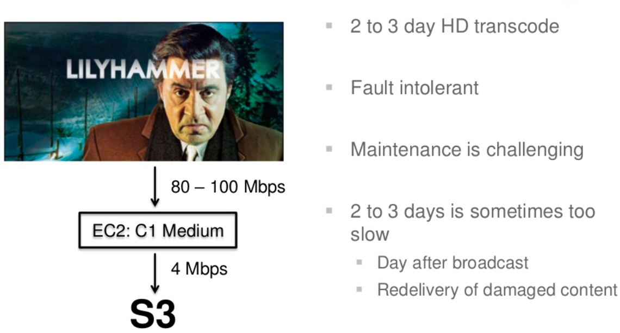
Video transcoding is computationally complex and time-consuming
What Does Video Transcoding Involve?
Former Video Decoder
New Video Encoder
It takes days to transcode
It only takes hours/minutes
20

Slide 21
Why to transmux a video?

Slide 22
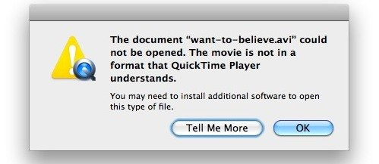

Internet Packet (e.g. TCP, UDP)
Transmitted through Internet
Container Format (e.g. .mp4, .ts)
Supported by players
Encoded Video (e.g. H.264)
Compressed

Slide 23
The evolution of streaming protocols…

Slide 24
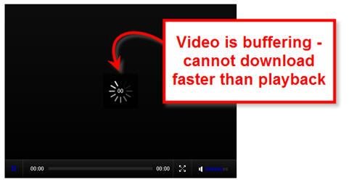

Progressive Download
Streaming

Slide 25
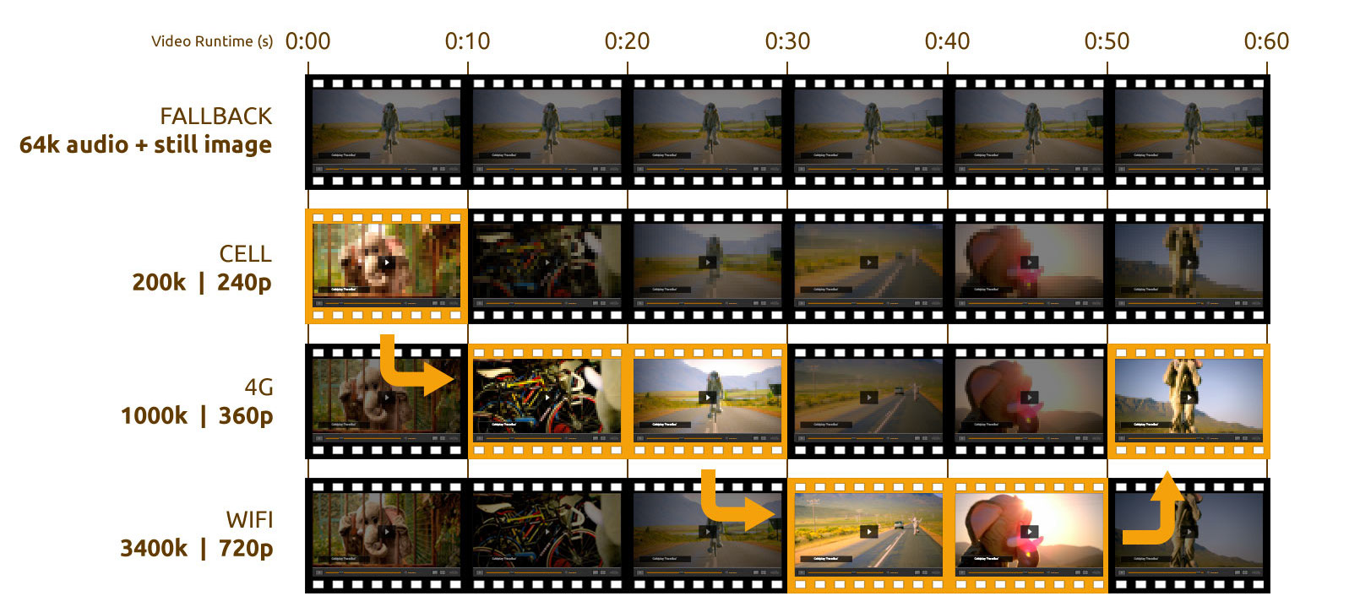
Adaptive Bitrate Streaming Concept

Slide 26

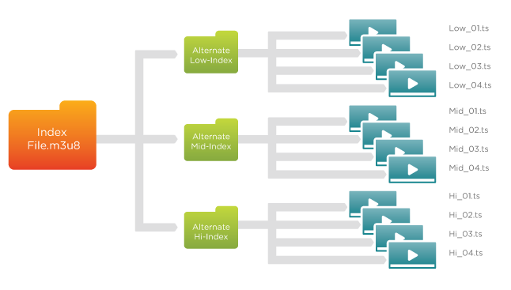

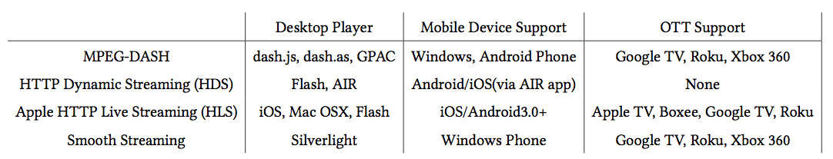
Adaptive Bitrate Streaming Protocols

Slide 27
How to protect video streams?

Slide 28
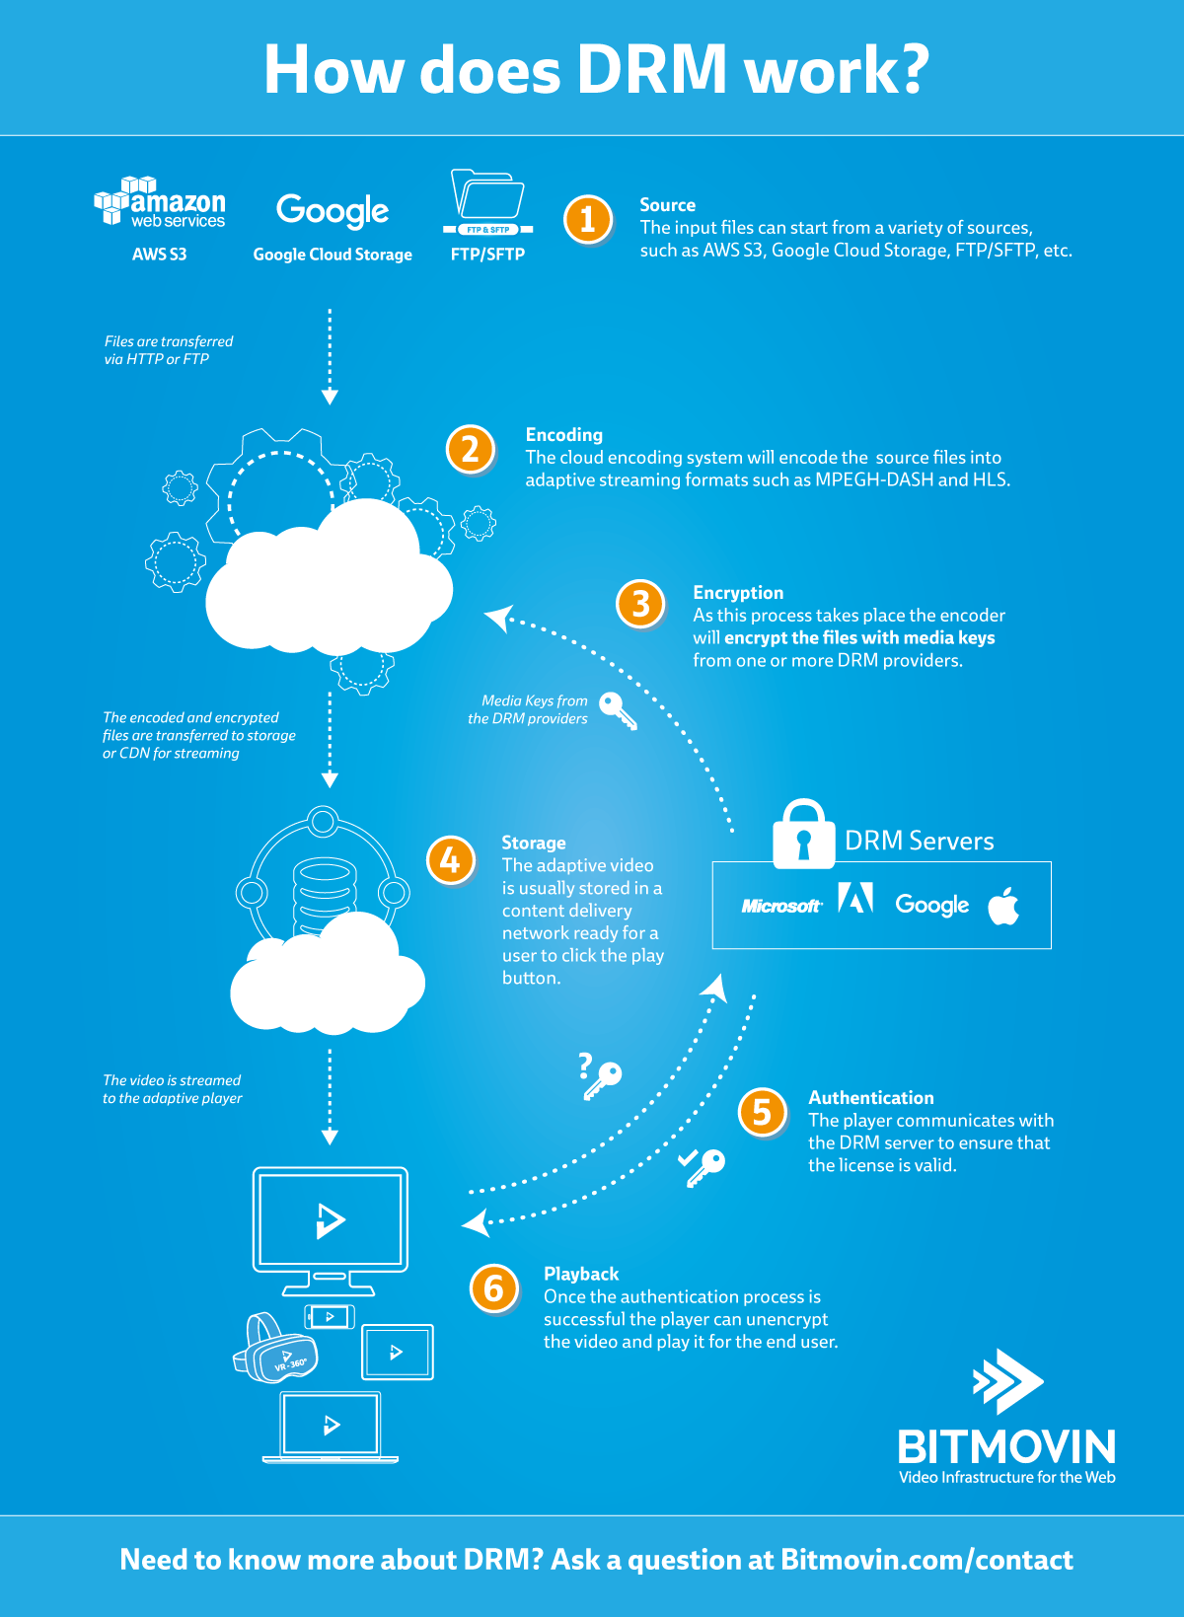
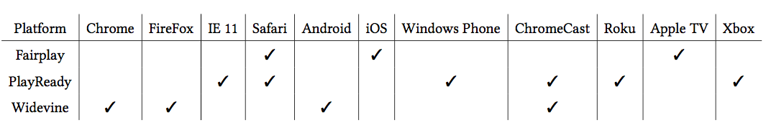

Slide 29
How Does Video Streaming Work?
2 codecs * 5 bit rate= 10
10 * 3 protocols * 3 DRM = 90

Slide 30
Why Content Delivery Network (CDN)?

Slide 31


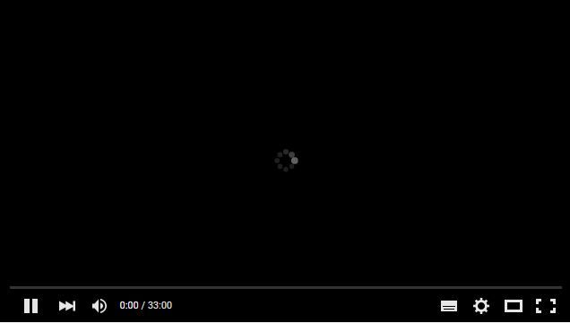

Customers in the US
Customers in Asia

Slide 32
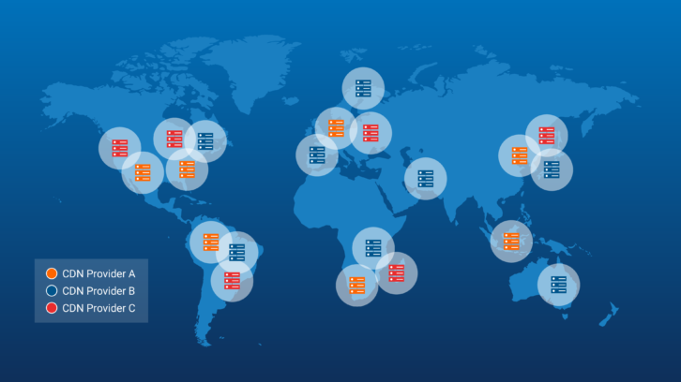

Slide 33
How Does Video Streaming Work?
2 codecs * 5 bit rate= 10
10 * 3 protocols * 3 DRM = 90
90 * 3 regional CDN = 270

Slide 34
Video is just cached, not stored forever…

Slide 35
What is P2P then?

Slide 36

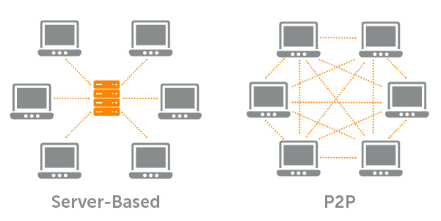
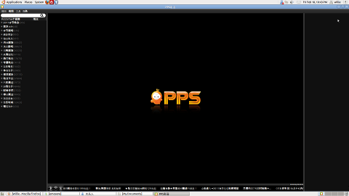

Slide 37
So what is in the black box?

Slide 38





Viewers
1. Request a video
Web Servers
2. Response to Check CDN
3. Request copy
requested video
to CDN
4. Download video
Video Encoding/Transcoding/Transmuxing Servers
Repository
CDN
Video Contents

Slide 39
Congratulations!
You have passed video streaming 101…

Slide 40
CVSE: Cloud-based Video Streaming Engine

Slide 41


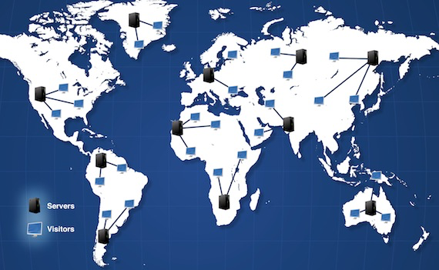
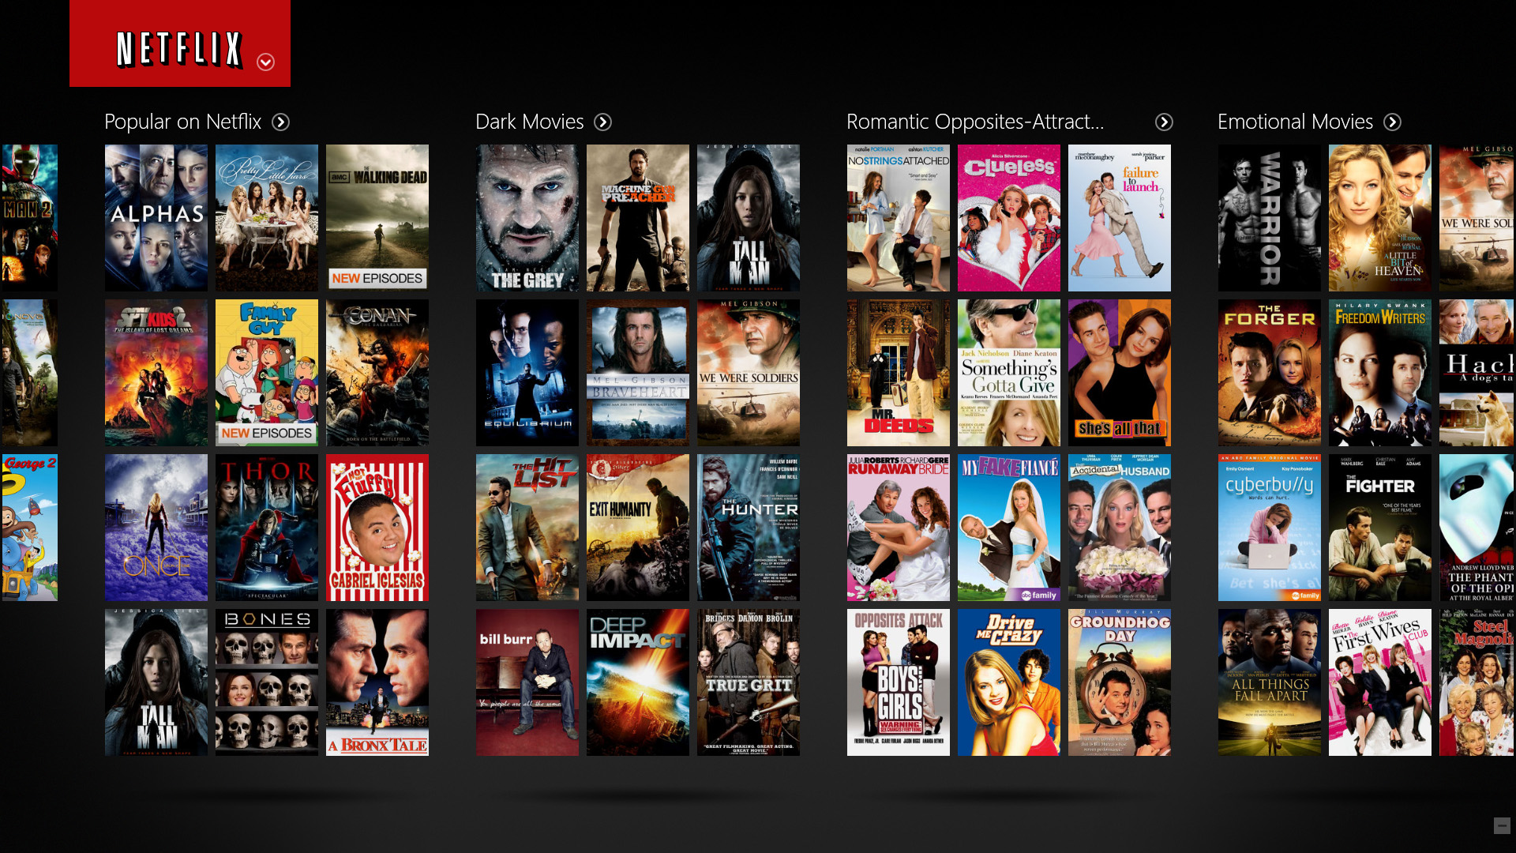
Client Reqest
Content Delivery Network (CDN)
Netflix Server

Slide 42
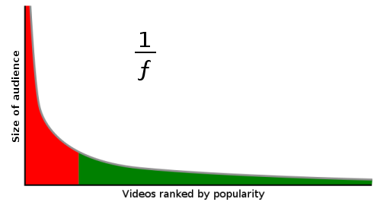

Long Tail Property of Video Streaming
Trendy videos

Slide 43
Why not transcode them on-demand (lazily)?

Slide 44
Questions
What is Video Transcoding?
Why “on-demand” video transcoding?
What are the challenges in on-demand video transcoding?
What have already been done by others?
What aspects does my thesis focus on?
What are the future directions?

Slide 45


Slide 46

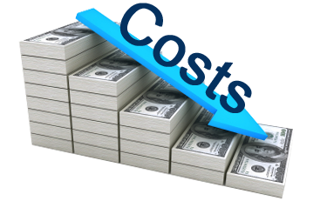
On-Demand Video Transcoding Challenges
Improve Quality of Service (QoS)?
  Startup delay
  Deadline miss rate
Minimize Cloud Resource Cost
  Computing cost
  Storage cost

Slide 47
Questions
What is Video Transcoding?
Why “on-demand” video transcoding?
What are the challenges in on-demand video transcoding?
What have already been done by others?
What aspects does my thesis focus on?
What are the future directions?

Slide 48
Video Transcoding on the Cloud
Video On Demand (VOD)
Live Streaming
Pre-Transcoding
On-Demand Video Transcoding
Video Segmentation
[1][2]
Load Balance
[3][4]
Resource Provisioning
[4][6]
Storage and Computation Trade-off [7]
QoS Violation
Resource Provisioning
Homogeneous Cloud
Heterogeneous Cloud

Slide 49
Questions
What is Video Transcoding?
Why “on-demand” video transcoding?
What are the challenges in on-demand video transcoding?
What have already been done by others?
What problems we are focusing on?
What are the future directions?

Slide 50
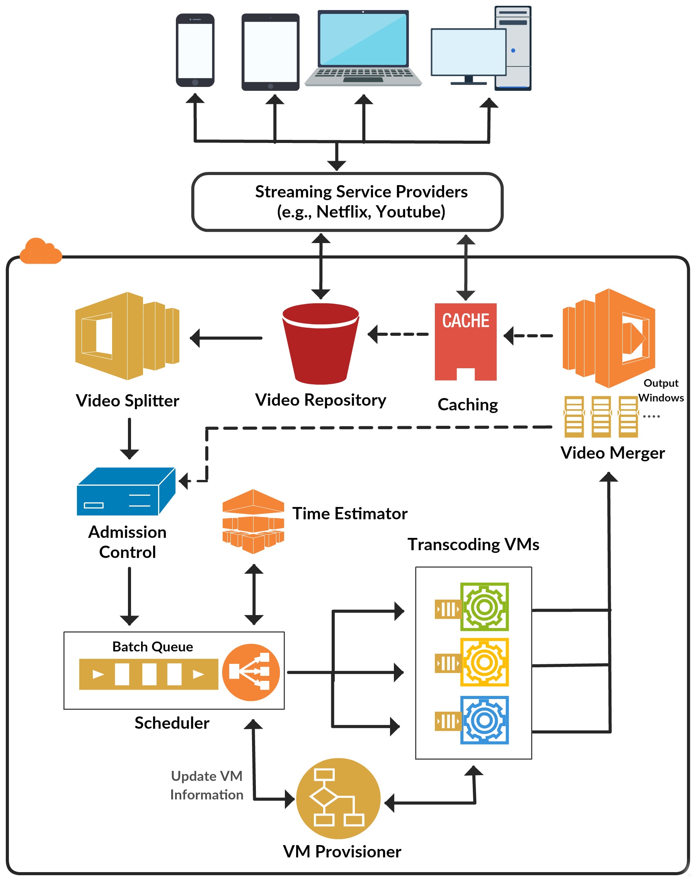
CVSE: Cloud-based Video Streaming Engine Architecture

Slide 51
CVSE: Cloud-based Video Streaming Engine Architecture

Slide 52
CVSE: Cloud-based Video Streaming Engine Architecture

Slide 53
CVSE: Cloud-based Video Streaming Engine Architecture

Slide 54
CVSE: Cloud-based Video Streaming Engine Architecture

Slide 55
CVSE: Cloud-based Video Streaming Engine Architecture

Slide 56
CVSE: Cloud-based Video Streaming Engine Architecture

Slide 57
Is it feasible to perform on-demand transcoding on the cloud?

Slide 58
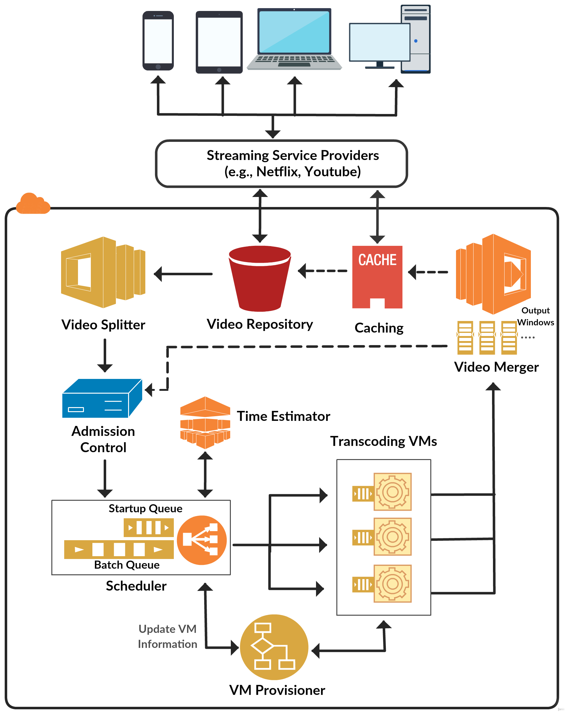
Video Segmentation and Transcoding Tool
QoS-Aware Scheduling Method
Dynamic cost-efficient provisioning policy

Slide 59
How to Segment Video?

Slide 60

Video Stream Architecture
Seq 1
Seq 2
Seq 3
Seq 4
Seq 5
Seq Header
GOP 1
GOP 2
GOP 3
…..
…..
GOP Header
I
P
P
B
P
Macroblock (MB)

Slide 61

Video Segmentation and Transcoding Tool
Split Video into GOPs
Perform Transcoding
Obtain Metadata
  GOP transcoding time
  GOP presentation time
  GOP frame number
  GOP input size
  GOP output size

Slide 62
On-Demand Video Transcoding Challenges
Guarantee Quality of Service (QoS)?
  Startup delay
  Deadline miss rate
Minimize Cloud Resource Cost
  Computing cost
  Storage cost

Slide 63
QoS-Aware Scheduling Method
G_{video#,GOP#}
VM1
Startup Queue
G_{4,1}
G_{4,0}
…..
15s
VM2
…..
G_{1,9}
G_{2,6}
G_{4,4}
G_{3,4}
G_{2,5}
G_{1,8}
10s
Batch Queue
VM3
20s

Slide 64
On-Demand Video Transcoding Challenges
Improve Quality of Service (QoS)?
  Startup delay
  Deadline miss rate
Minimize Cloud Resource Cost
  Computing cost
  Storage cost

Slide 65
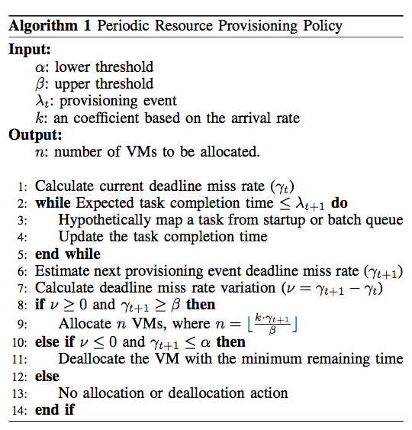
Dynamic Cost-Efficient Provisioning Policy
User define QoS violation tolerance
Predict deadline miss rate
Allocate/Deallocate VMs based on predicted deadline miss rate

Slide 66

Remedial Provisioning Policy
Startup Queue
G_{7,0}
G_{6,0}
G_{5,0}
G_{4,1}
G_{4,0}
Video number in the startup queue
…..
…..
…..
G_{1,9}
G_{2,6}
G_{4,4}
G_{3,4}
G_{2,5}
G_{1,8}
Batch Queue
Constant factor
QoS violation upper thredshold

Slide 67
Experiment Setup
We modeled our system based on the characteristics of VMs in Amazon EC2
Using CloudSim to model our system and evaluate the performance of scheduling and resource provisioning policies.
We uniformly selected videos from the range of [10 , 600] seconds from a set of benchmark videos which can be downloaded from https://goo.gl/TE5iJ5

Slide 68
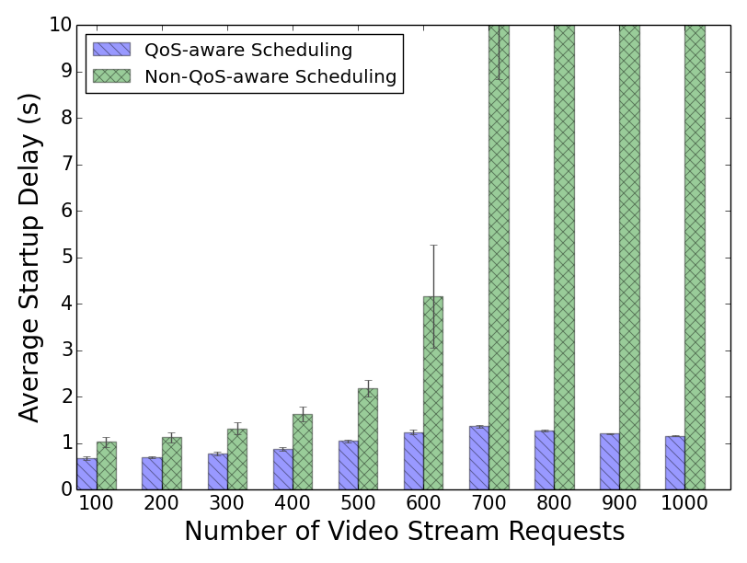
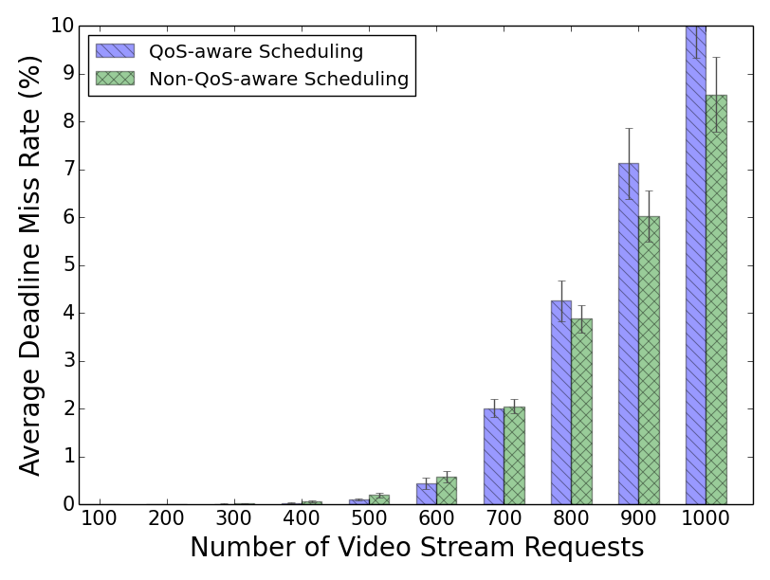
Performance Evaluation
Minimized startup delay without major impact on deadline miss rate

Slide 69
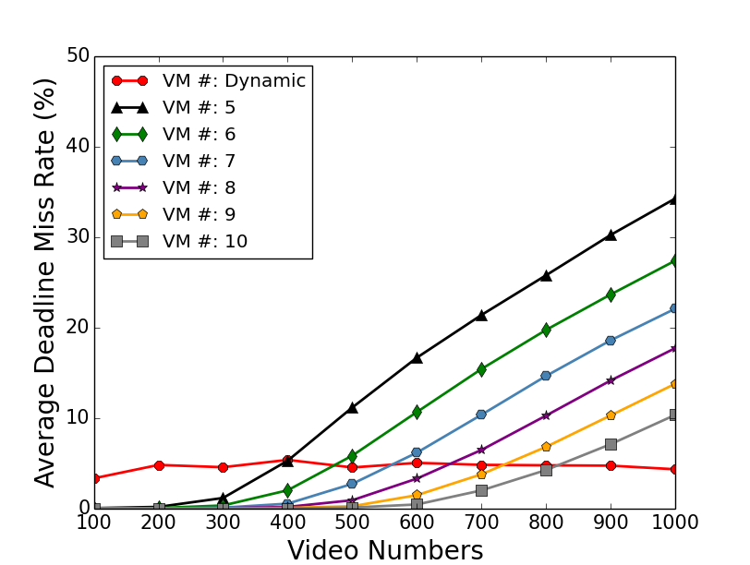
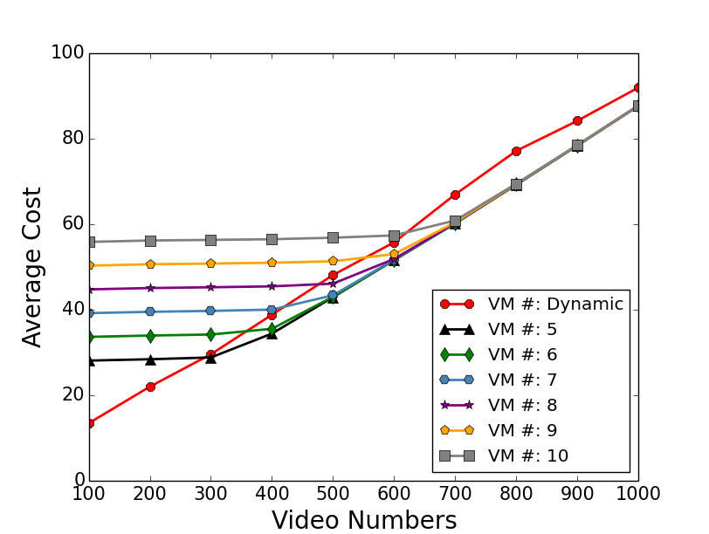
Static vs. Dynamic Resource Provisioning
Our dynamic system keeps the QoS
violation constantly low and Stable
in compare with static method.
Our method save the cost when
the system is not oversubscribed.
Notes:
We have run all transcoding operations on Amazon EC2 to get the real transcoding data, and then we use these data to simulate on CloudSim.
Our dynamic system keeps the QoS violation constantly low and stable in compare with static method
Our method save cost when the system is not oversubscribed.

Slide 70
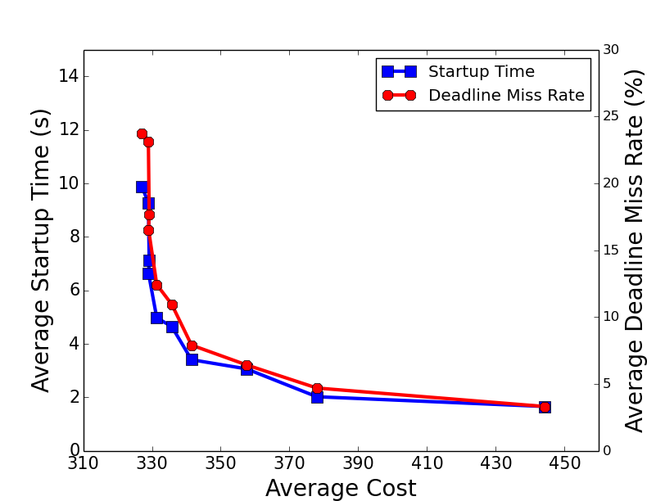
At some point, streaming service providers can pay reasonable
price to gain good QoS.
Notes:
The correlation between cost and QoS is not linear, that means at some point with our system, streaming service provider can pay low price to get good QoS.

Slide 71
Publications
Xiangbo Li, Mohsen Amini Salehi, Magdy Bayoumi, Rajkumar Buyya, “CVSS: A Cost-Efficient and QoS-Aware Video Streaming Using Cloud Services”, in the IEEE/ACM Cluster Cloud Grid Conference (CCGrid ’16), Columbia, May 2016.
Xiangbo Li, Mohsen Amini Salehi, Magdy Bayoumi, “High Performance On-Demand Video Transcoding Using Cloud Services”, in the IEEE/ACM Cluster Cloud Grid Conference (CCGrid ’16), Columbia, May 2016.
Xiangbo Li, Mohsen Amini Salehi, Magdy Bayoumi, “High Performance On-Demand Video Transcoding Using Cloud Services”, filed for Patent, Aug. 2016.
Xiangbo Li, Mohsen Amini Salehi, Magdy Bayoumi, “Cloud-Based Video Streaming for Energy- and Compute-Limited Thin Clients”, in Stream2015 Workshop at Indiana University, Indianapolis, USA, Oct. 2015.

Slide 72
Is there any benefit in using heterogeneous computational services (VMs) offered in the cloud ?

Slide 73
How to estimate transcoding time efficiently?!

Slide 74


















Video Streams
Streaming Providers
Client Devices

Slide 75

Amazon EC2 Instance - Families
Compute-Optimized
General Purpose
Micro Instances
Memory-Optimized
Storage-Optimized
GPU Instances

Slide 76
What’s the Affinity of Transcoding Operations on Heterogeneous VMs?
Problematic 1

Slide 77
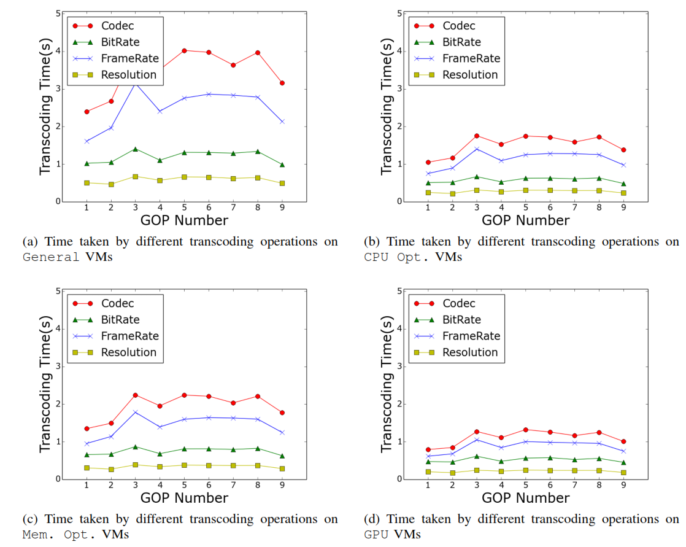
Analyzing the Execution Time of Different Video Transcoding Operations
Observations:
In general, transcoding time has the same pattern across on all VM types.
Codec transcoding
takes more time than
others
Changing resolution has the least transcoding time.
Notes:
This is because changing codec implies the whole original encoded video be decoded and then reencoded with new one codec.
------------------------
The reason is that the transcoding is achieved by utilizing ﬁltering and subsampling [35], [36] which works directly in the compressed domain and avoids the computationally expensive steps of converting to the pixel domain. Therefore, it takes less time than other transcoding operations.

Slide 78
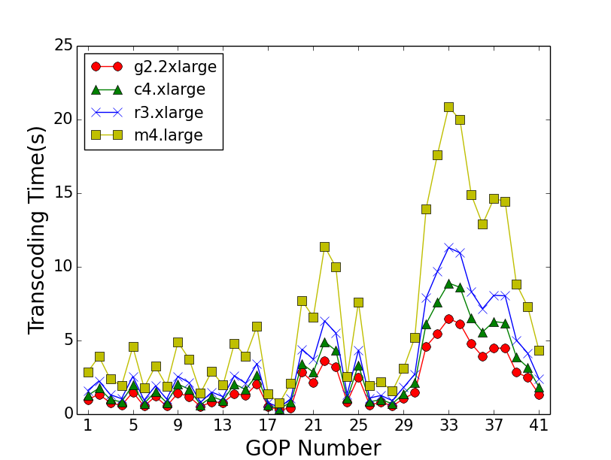
Analyzing the Afﬁnity of Transcoding on Heterogeneous Cloud VMs
In general, GPU is better
The difference is minor sometime
Transcoding Codec

Slide 79
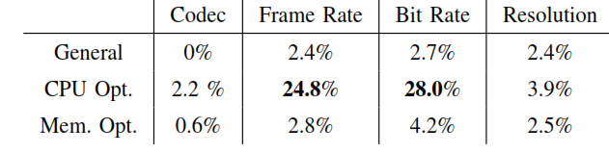
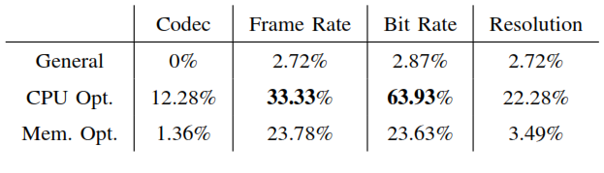
How GPU is Better than others VM Types?
Performance Ratio < 1
Performance Ratio < 1.2
Observation: other VM types outperform GPU when the execution time is low!
Why?

Slide 80
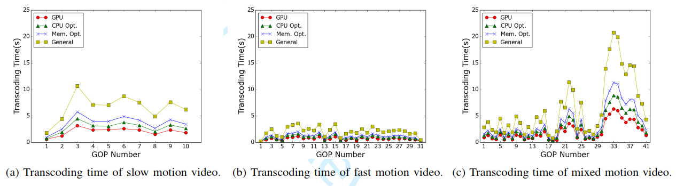
Video Content Type
Transcoding time variation is because of the content type of GOPs

Slide 81


Video Types
Fast motion videos consist of
many small tasks to process
Slow motion videos consist of
few large tasks to process
These tasks can take a better
advantage of CPU intensive
resources

Slide 82
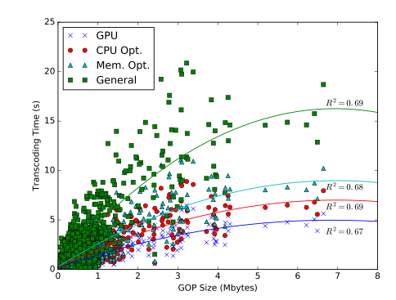
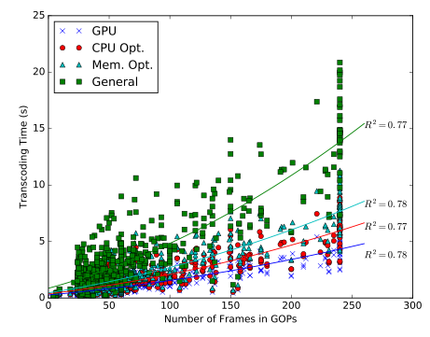
Number of frames in a GOP
provides a fairly reliable metric
to quickly estimate transcoding
execution time
Size of GOPs can be also used.

Slide 83
Problematic 2
We conclude that clouds offer two dimensional heterogeneity for video stream processing (performance and cost)
The challenge is how to handle the trade-off between performance and cost of heterogeneous VMs for transcoding?

Slide 84
Proposed Approach: Suitability Matrix
We propose a suitability matrix construct that shows the appropriateness of different VM types for different transcoding tasks
The construct can be used by VM provisioning component in CVSE
Determination of the trade-off between performance and cost for VMs depends on the business policy of the streaming provider

Slide 85
Proposed Approach
Performance Gap: the performance difference between GPU and a VM type
  Higher values show VM type i performs significantly worse than GPU (i.e., GPU is more suitable)
Performance gap threshold is the threshold of choosing GPU or other VM types
  Value of the threshold depends on the user performance versus cost preference

Slide 86




GOP Suitability Matrix
Notes:
P is the performance preference and c is the cost. These are determined by the users. We have p+c=1
Based on value of p and c we determine delta_th
High value of p results in low value of Delta_th. Therefore, a short performance difference gives more suitability to GPU.

Slide 87


Suitability Matrix
Save cost
The suitability of low cost m4.large increase
The suitability of high performance g2.xlarge decrease

Slide 88
Publications
Xiangbo Li, Yamini Joshi, Mahmoud K. Darwich, Brad Landreneau, Mohsen Amini Salehi, and Magdy Bayoumi, “Performance Analysis and Modeling of Video Transcoding Using Heterogeneous Cloud Services”, submited to IEEE Transaction on Parallel and Distributed Computing (TPDS), Oct. 2016

Slide 89
Cost-Efficient On-Demand Video Transcoding Using Heterogeneous Cloud Services

Slide 90
Heterogeneous Transcoding VMs
Utility Function Based Batch Scheduling Method
Adaptive
Elastic Resource Provisioning Policy

Slide 91
Why Remove Startup Queue?
Startup Queue
Priority
G_{4,1}
G_{4,0}
Priority
…..
GOP #
GOP #
…..
Startup Queue
Utility Function
G_{1,9}
G_{2,6}
G_{4,4}
G_{3,4}
G_{2,5}
G_{1,8}
Batch Queue
GOP utility function:
  where alpha is constant factor, i the order
  number of the GOP in that video

Slide 92
Utility Function Based
Batch Scheduling Method
G_{video#,GOP#}
G_{2,7}
G_{3,3}
G_{1,10}
G_{1,9}
G_{2,6}
G_{4,0}
G_{3,2}
G_{2,5}
G_{1,8}
…..
Batch Queue
G_{4,0}
G_{3,2}
G_{2,5}
G_{1,8}
Priority Queue
1.0
0.8
0.5
0.3

Slide 93
30s
25s
GPU
15s
G_{4,0}
G_{3,2}
G_{2,5}
G_{1,8}
CPU
Optimized
1.0
0.8
0.5
0.3
GPU: 10s
10s
CPU: 20s
Memory
Optimized
Memory: 25s
20s
MM: Minimum completion time, Minimum completion time
MSD: Minimum completion time, Shortest Deadline
MMU: Minimum completion time, Minimum utility
MMUT, MSDUT, MMUUT

Slide 94
Adaptive Elastic Heterogeneous VM Provisioning Policy
Goal of the VM Provisioner is to maintain a robust QoS while minimizing the cost
VM provisioning policy makes VM allocation and deallocation decisions
Our strategy to achieve robustness is to assure keeping QoS in a predefined range

Slide 95
Homogeneous versus Heterogeneous VM Provisioning
Homogeneous elastic VM provisioning needs to deal with two main questions:
  When to provision VMs?
  How many VMs to provision?
Heterogeneous VM provisioning introduces a third question:
  What type of VM(s) to provision?

Slide 96

Elastic Heterogeneous VM Allocation Policy
When to allocate?
What type of VM?
  Consider past and future
  of each type
  Weight is the linear
  combination of the two factors
How many VMs?
Last Period
Future
Current Time
How far is the weight from w_{th}
Arrival rate of task type
Deadline miss rate
GPU: 20%
CPU: 50%
Memory:30%
Portion in the bath queue
GPU: 60%
CPU: 20%
Memory:20%

Slide 97


Which VM to Deallocate in a Heterogeneous VM Cluster?
Should the one with minimum utilization should be deallocated?
  When the system tends to homogeneous configuration, VMs tend to have identical and high utilization (scheduler does not discriminate)
We need to know the degree of heterogeneity in the VM cluster
VM types
Ratio of type i to all types

Slide 98

Deallocation Policy
  When?
  Which one?
    Find the minimum utilization VMs
    Find the lowest cost ones (least powerful ones)
    Find the minimum remaining time VM
    If T2’s minimum utilization < 0.2
    Deallocate
T2, T2, C4, R3
T2, T2
T2

Slide 99

Early GOP Completion Time
The impact of utility based scheduling on minimizing completion/buffer time of GOPs, especially those in the beginning of the stream

Slide 100






Scheduling with Dynamic Provisioning
Notes:
The incurred cost has significantly reduced (up to ~80% when the system is not oversubscribed) regardless of the mapping heuristic applied.
Startup delay has in general increased (mainly in a) but it is more stable in compare with figure a in static. This is because the EM adapt itself to the workload intensity to satisfy QoS demands. However, in (d) even the startup delay is in a lower range.
Similarly, dmr has become more stable and low when we utility based mapping heuristics are used.
Why MSDUT and MMUUT perform better DMR than MSD and MMU?
The reason is not virtual queue base on old experiment. The reason is not heuristic nature because of static experiment e

Slide 101



Static GPU vs. Dynamic Heterogeneous
Low and stable Startup time
Low and stable deadline miss rate
Save up to 85% cost when system is not oversubscribed

Slide 102
Publications
Xiangbo Li, Mohsen Amini Salehi, Magdy Bayoumi, Nian-Feng Tzeng and Rajkumar Buyya, “Cost-Efficient and Robust On-Demand Video Transcoding Using Heterogeneous Cloud Services”, in IEEE Transaction on Parallel and Distributed Systems (TPDS), Aug. 2016

Slide 103
Achieving Cost-efficiency through Caching Video Streams

Slide 104
How to cache videos becoming Trendy?

Slide 105

Recap on Definitions
Two approaches for transcoding
  Pre- Transcode:
    store a format of video in repository.
  Re-transcode:
    transcode video format upon request

Slide 106

Problem Definition
When to pre-transcode a video?
When to re-transcode a video?
When to apply partial pre-transcoding on videos?
Notes:
Here are the problem definitions: when do we perform pre-transcoding on a video stream
When we re-transcode it, what are the criteria to apply partial pre-transcoding on video stream. In other other when we store a portion of a video and not the whole video stream. How can a video be hot? And if it is, how we can measure the percentage of its hotness

Slide 107
Intuitive Solution
Pre-transcode all hot videos
Re-transcode all cold (non-hot) videos
But, what is a hot video?
Is there any way to quantify the hotness of a video?

Slide 108
Summary of Contributions in this Part
Providing a formal method to measure hotness of video streams.
Proposing cost-saving methods to reduce the incurred cost of cloud-based video streaming using the hotness measure.
Analyzing the impact of the proposed methods on video streaming with different access models.

Slide 109
Definition of Hot Video Stream
  We define a video as hot, when it is worth to pre-transcode it
  Video i is called “hot” when:
  cost of pre-transcoding i ≤ cost of re-transcoding i
We define cost-ratio for video i (R_{i}) as:
R_{i} = (storage cost) _{i} / [(transcoding cost) _{i} .(views) _{i} ]
Video i is defined as “hot” when its cost-ratio ≤ 1

Slide 110

Quantifying Hotness of GOP
Hotness of a video stream depends on the hotness of its GOPs
  Thus, we extend the definition of hotness of video to GOP
We define cost-ratio for GOP j of video i (R_{ij}) as:
Pre-transcoding cost of GOP G_{ij}
Estimated views of GOP G_{ij}
Re-transcoding cost of GOP G_{ij}

Slide 111




Quantifying Hotness of a Video Stream
Hotness of GOP G_{ij} is defined as:

Slide 112

Access Pattern to Video Streams in a Repository
Distribution of access to video streams in a repository follow long-tail pattern
Few video streams in the beginning of curve are accessed frequently
Most of video streams are rarely accessed
Number of views
Frequently accessed videos
Videos in repository
Rarely accessed videos

Slide 113


  Access Pattern Within Each Video Stream
  Distribution of the views within a video (GOPs) stream follows a long tail distribution
  Beginning segments (GOPs) are watched more frequently then the rest of the video
  Therefore, we can estimate GOP view information using Power-Law distribution
Number of views
$G_{ij }$is GOP number j and alpha is constant
equal to 0.1
GOPs within video
Estimated number of views for GOP j in video i
Total number of views received by video I in a period time

Slide 114


Cost of Pre-transcoding of a Video Stream
Cost of pre-transcoding depends on GOP size and unit price:
Then, cost of pre-transcoding a video Stream is: $C_{S_{i}}=\sum_{j=1}^{m}{C_{S_{ij}}}$
In case, CDN is utilized we have: $C_{S_{i}}=\sum_{j=1}^{m}{C_{S_{ij}}+\sum_{j=1}^{m}{C_{{CDN}_{ij}}}}$
Pre-transcoding cost of GOP j of video i
Cloud storage unit price
Size of GOP j of video i

Slide 115


Cost of Re-transcoding of a Video Stream
Cost of re-transcoding a GOP depends on transcoding time and unit price
Re-transcoding cost of GOP j video i
Transcoding time of GOPj of video i
Cloud Transcoding
unit price
Cost of re-transcoding a video stream is: $C_{T_{i}}=\sum_{j=1}^{m}{C_{T_{ij}}}$

Slide 116


GOP-based Threshold algorithm (GBTh)
GOP information in each video and cloud price
Calculate the threshold point
Store GOPs before threshold and transcode
on demand GOPs after it

Slide 117

Video-based hotness algorithm (VBH)
GOP information in each video and cloud price
Hot part
Hi
Cold part
Calculate hotness of video
Pre-transcode the hot part of the video

Slide 118





  Video Stream Access Pattern – non Long Tail

Slide 119

GOP-based hotness algorithm (GBH)
GOP information in each video and cloud price
Calculate hotness of each GOP
Pre-transcode hot GOPs
Re-transcode non hot GOP

Slide 120
Methods Used For Comparison
VBH : Video Based Hotness
VLT: Video Level Transcoding
  Either store or re-transcode full video
  Predicting based on the usage
GBTh: GOP Based Threshold
  Traverse from the beginning until cost ratio is > 1
GBH: GOP Based Hotness

Slide 121

Experimental results: Impact of changing percentage of FAVs in repository
Proposed GBH outperforms all other methods and reduces the cost up by 15% over all other methods at 5% of FAVS .
As the percentage of FAVs in the repository increases, the outperformance decreases. When 30% of FAVs , GBH outperforms other by 6%
Notes:
This is because when a repository contains high percentage
of Frequently Accessed Video Streams , most of the
Frequently Accessed Video Streams are pre-transcoded
and partial pre-transcoding methods is applied on
few video streams, hence, reducing its impact.

Slide 122

Experimental results: Impact of changing percentage of video streams with non long tail access in repository
GBH has the least increase in the incurred cost when compared with other methods.
When percentage of video with non long tail access is 0: VBH, GBTh, and GBH perform equally
When this percentage increase till 100%, GBH outperforms all other methods up by 15%
Notes:
As mentioned earlier, the distribution of views within
some video streams do not follow the long-tail pattern.
That is, there are portions of the video streams that
are not necessarily in the beginning of it but receive a
large number of views in compare with the rest of the
video stream

Slide 123
Publications
Mahmoud Darwich, Ege Beyazit, Mohsen Amini Salehi, Magdy Bayoumi, Cost Efficient Repository Management for Cloud-Based On-Demand Video Streaming, in Proceedings of the 5th IEEE International Conference on Mobile Cloud Computing, Services, and Engineering (IEEE Mobile Cloud ’17), San Francisco, USA, Apr. 2017
Mahmoud Darwich, Mohsen Amini Salehi, Ege Beyazit, Magdi Bayoumi. Cost Efﬁcient Cloud-Based Video Streaming Based on Quantifying Video Stream Hotness, Submitted to The Computer Journal, Sep. 2017.

Slide 124
CVSE Implementation & Demo

Slide 125
CVSE Stack
Web Interface
1
4
CVSE Core
2
3
Video Processing Engine
Communicator
Processor
Notes:
Layered view
3 main layers
VPE contains communicator and processor

Slide 126

Video Processing Layer: FFmpeg
Notes:
Transcoding/ Transmuxing
Resize , change bit rate, framerate, and a lot more

Slide 127

Example of FFmpeg Command line
ffmpeg -hide_banner -y -i $path -vcodec libx264 -acodec copy -s $width:$height -copyts -muxdelay 0 $outdir/$filename

Slide 128
Video Processing Engine
JavaSocket
Local VM Queue
Video
StatRequest
(Ffmpeg) transcode
Upload / send finished video
Terminate
Saved Statistics
Get Execution Time statistics
Communicator
Video Processing (FFmpeg)
Resides either On a Worker VM/local thread/simulation

Slide 129


Cloud Based Video Streaming Engine (CVSE) Core
Config
CVSE Core
Notes:
Minimum execution time or minimum completion time
It’s flexible and configurable (config file & )… can be run just on local thread’s machine

Slide 130

Class Diagram of CVSE Core

Slide 131

Web Interface

Slide 132
Components
HLS video player
  Allows a video to be played in segments
  Plays video segment files directly from S3 bucket
Apache Tomcat
  Web Server used to host the Java Web App
Notes:
The video player only needs the next consecutive video segment in order to play. It does not need all of the segments to be present to start playing.

Slide 133
Java Servlets
Receive new user requests from the web interface using jQuery
Creates a new stream request and sends the request to the Java Streaming Engine
Changes the user’s video player’s source to the output directory of the Transcoding VMs

Slide 134
Demo

Slide 135
Live Streaming Video Transcoding
Using Cloud Services

Slide 136

Architecture for On-Demand Transcoding of Live-Stream Videos
Efficient transcoding time estimation model
Drop those GOPs who missed their deadline

Slide 137

Transcoding Time Prediction Model
Current GOP size
Startup Queue
Standard deviation
G_{4,1}
G_{4,0}
…..
…..
G_{1,9}
G_{2,6}
G_{4,4}
G_{3,4}
G_{2,5}
G_{1,8}
Average GOP transcoding time
Batch Queue
Average previous GOP size

Slide 138
QoS-Aware Scheduling Method
G_{video#,GOP#}
VM1
Startup Queue
G_{4,1}
G_{4,0}
…..
15s
VM2
…..
G_{1,9}
G_{2,6}
G_{4,4}
G_{3,4}
G_{2,5}
G_{1,8}
10s
Batch Queue
VM3
20s

Slide 139


Performance Evaluation
Low and stable startup time
Decrease video drop rate.
Notes:
We have run all transcoding operations on Amazon EC2 to get the real transcoding data, and then we use these data to simulate on CloudSim.
Our dynamic system keeps the QoS violation constantly low and stable in compare with static method
Our method save cost when the system is not oversubscribed.

Slide 140
Publications
Xiangbo Li, Mohsen Amini Salehi, Magdi Bayoumi, “VLSC: Video Live Streaming Based on Cloud Services”, accepted to the 6th IEEE International Conference on Big Data and Cloud Computing Conference (BDCloud ’16), Atlanta, GA, USA, Oct. 2016.
Mohsen Amini Salehi, Xiangbo Li, “HLSAAS: High-Level Live Video Streaming As a Service ”, in Stream2015 Workshop at Washington DC, USA, March 2016.

Slide 141

Hatef Esfahani:
When you pierce deep in any particle
You will see a sun shining there…

Slide 142
Questions
What is Video Transcoding?
Why “on-demand” video transcoding?
What are the challenges in on-demand video transcoding?
What have already been done by others?
What aspects does my thesis focus on?
What are the future directions?

Slide 143



Future Directions
Storage Cost
Computing Cost
Machine Learning

Slide 144
Reference
Garcia, Adriana, and Hari Kalva. "Cloud transcoding for mobile video content delivery." Proceedings of the IEEE International Conference on Consumer Electronics (ICCE). Vol. 379. 2011.
F. Jokhio, T. Deneke, S. Lafond, and J. Lilius, “Analysis of video segmentation for spatial resolution reduction video transcoding,” in Proceedings of IEEE International Symposium on Intelligent Signal Processing and Communications Systems (ISPACS), pp. 1–6, 2011.
S. Lin, X. Zhang, Q. Yu, H. Qi, and S. Ma, “Parallelizing video transcoding with load balancing on cloud computing,” in Proceedings of the IEEE International Symposium on Circuits and Systems (ISCAS), pp. 2864–2867, 2013.
Tewodors Deneke, Habtegebreil Haile, Se ́bastien La- fond, and Johan Lilius, “Video transcoding time pre- diction for proactive load balancing,” in Proceedings of IEEE International Conference on Multimedia and Expo (ICME), pp. 1–6, 2014.
F. Jokhio, A. Ashraf, S. Lafond, I. Porres, and J. Lilius, “Prediction- based dynamic resource allocation for video transcoding in cloud com- puting,” in Proceedings of the 21st Euromicro International Conference on Parallel, Distributed and Network-Based Processing (PDP), pp. 254–261, 2013.
A. Ashraf, F. Jokhio, T. Deneke, S. Lafond, I. Porres, and J. Lilius, “Stream-based admission control and scheduling for video transcoding in cloud computing,” in Proceedings of the 13th IEEE/ACM Interna- tional Symposium on Cluster, Cloud and Grid Computing (CCGrid), pp. 482–489, 2013
F. Jokhio, A. Ashraf, S. Lafond, and J. Lilius, “A computation and storage trade-off strategy for cost-efficient video transcoding in the cloud,” in Proceedings of the 39th IEEE Conference on Software Engineering and Advanced Applications (SEAA), pp. 365–372, 2013.

Slide 145


Slide 146
Thank You!

Slide 147
Appendix

Slide 148

Experiment Results

Slide 149


Slide 150




Slide 151


Slide 152


Slide 153


Slide 154


Slide 155


Slide 156




