Slide 1
Introduction
Ph.D (Aug ’12)
Melbourne University
Resource allocation in interconnected virtualized distributed systems
Academic Appointments
Assistant Professor at UL (Aug ’14 – present)
University of Miami (Aug ’13 – Aug ’14)
Colorado State University (Aug ’12 – Aug ’13)
Industry work experiences
Intern at Infosys research
Cloud consultant at Nexright ltd.

Slide 2
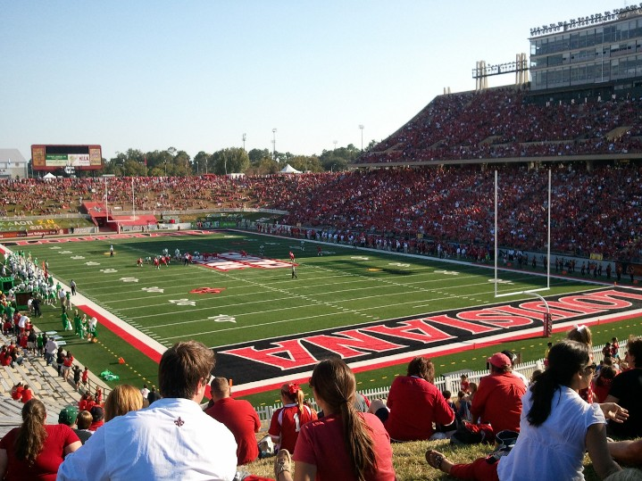
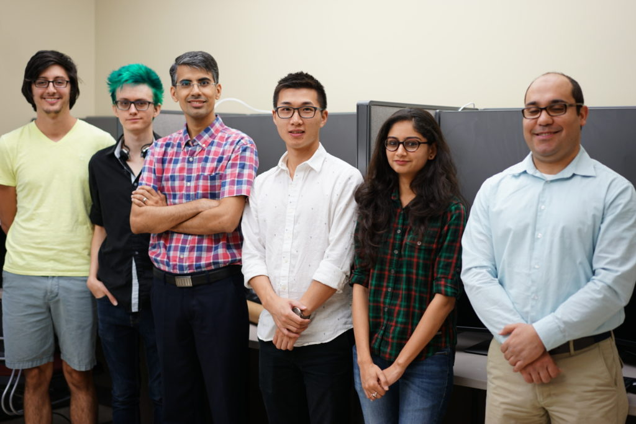
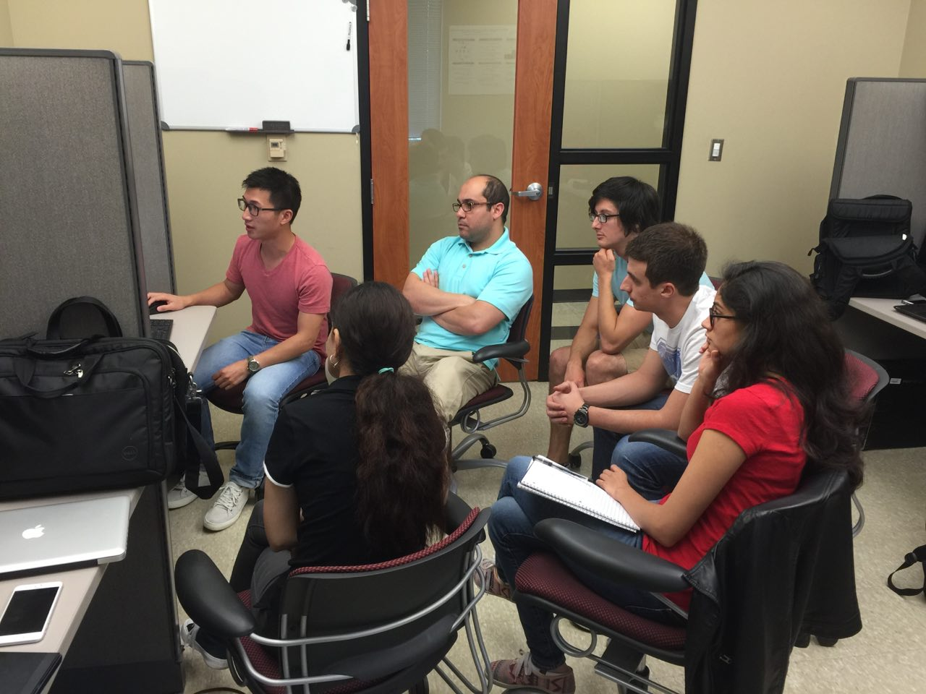
University of Louisiana Lafayette

Slide 3
High Performance On-Demand Video Transcoding Using Cloud Services
Dr. Mohsen Amini
High Performance Cloud Computing Lab (HPCC)
School of Computing and Informatics
University of Louisiana Lafayette
Dec. 2016

Slide 4
Agenda
What is Video Transcoding?
Why “on-demand” video transcoding?
What are the challenges in on-demand video transcoding?
What have already been done by others?
What are the future research directions?

Slide 5
Video Streams
Streaming Providers
Client Devices

Slide 6
Notes:
200+ devices, millions subscribers

Slide 7
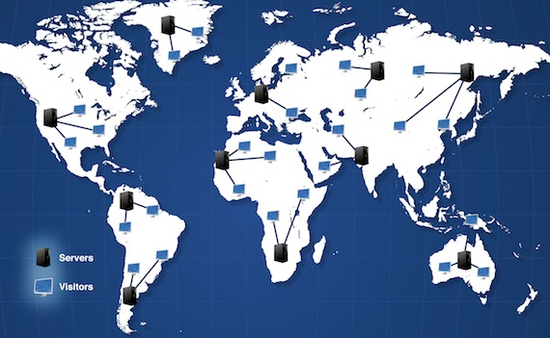
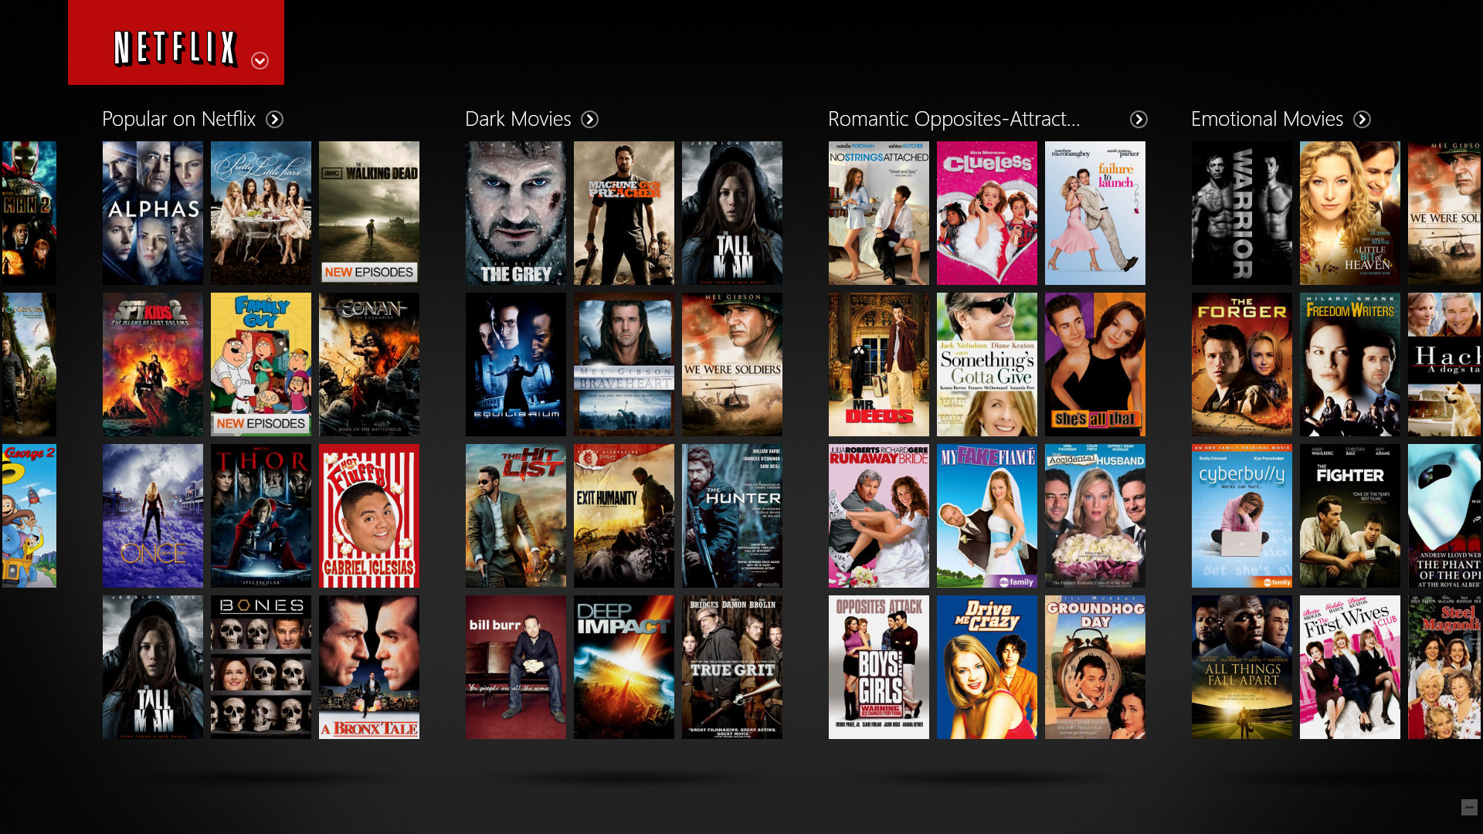
Client Reqest
Content Delivery Network (CDN)
Netflix Server

Slide 8
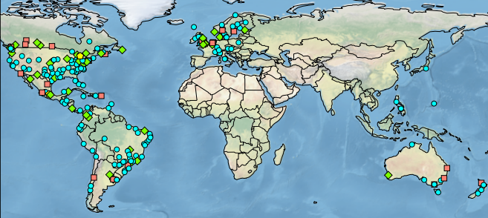
Netflix Solution
4 formats supported
Different codec (e.g., Mpeg, HD, etc.)
Multiple bit rate per format
40-50 versions of the original video
Several petabytes of storage

Slide 9
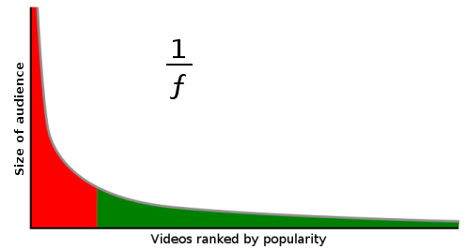
Long Tail Property of Video Streaming
Trendy videos

Slide 10
Why not transcode them on-demand (lazily)?

Slide 11
Questions
What is Video Transcoding?
Why “on-demand” video transcoding?
What are the challenges in on-demand video transcoding?
What have already been done by others?
What aspects does my thesis focus on?
What are the future directions?

Slide 13
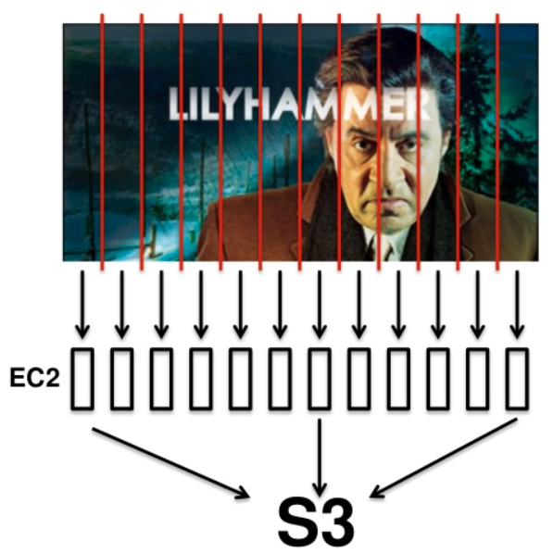
Video Transcoding is Time-Consuming
It takes days to transcode
It only takes hours/minutes

Slide 14
Virtual Machines are Heterogeneous
Compute-Optimized
General Purpose
Micro Instances
Memory-Optimized
Storage-Optimized
GPU Instances

Slide 15
On-Demand Video Transcoding Challenges
Improve Quality of Service (QoS)?
Startup delay
Deadline miss rate
Minimize Cloud Resource Cost
Computing cost
Storage cost

Slide 16
Questions
What is Video Transcoding?
Why “on-demand” video transcoding?
What are the challenges in on-demand video transcoding?
What have already been done by others?
What aspects does my thesis focus on?
What are the future directions?

Slide 17
Video Transcoding on the Cloud
Video On Demand (VOD)
Live Streaming
Pre-Transcoding
On-Demand Video Transcoding
Video Segmentation
[1][2]
Load Balance
[3][4]
Resource Provisioning
[4][6]
Storage and Computation Trade-off [7]
QoS Violation
Resource Provisioning
Homogeneous Cloud
Heterogeneous Cloud

Slide 18
Questions
What is Video Transcoding?
Why “on-demand” video transcoding?
What are the challenges in on-demand video transcoding?
What have already been done by others?
What problems we are focusing on?
What are the future directions?

Slide 19
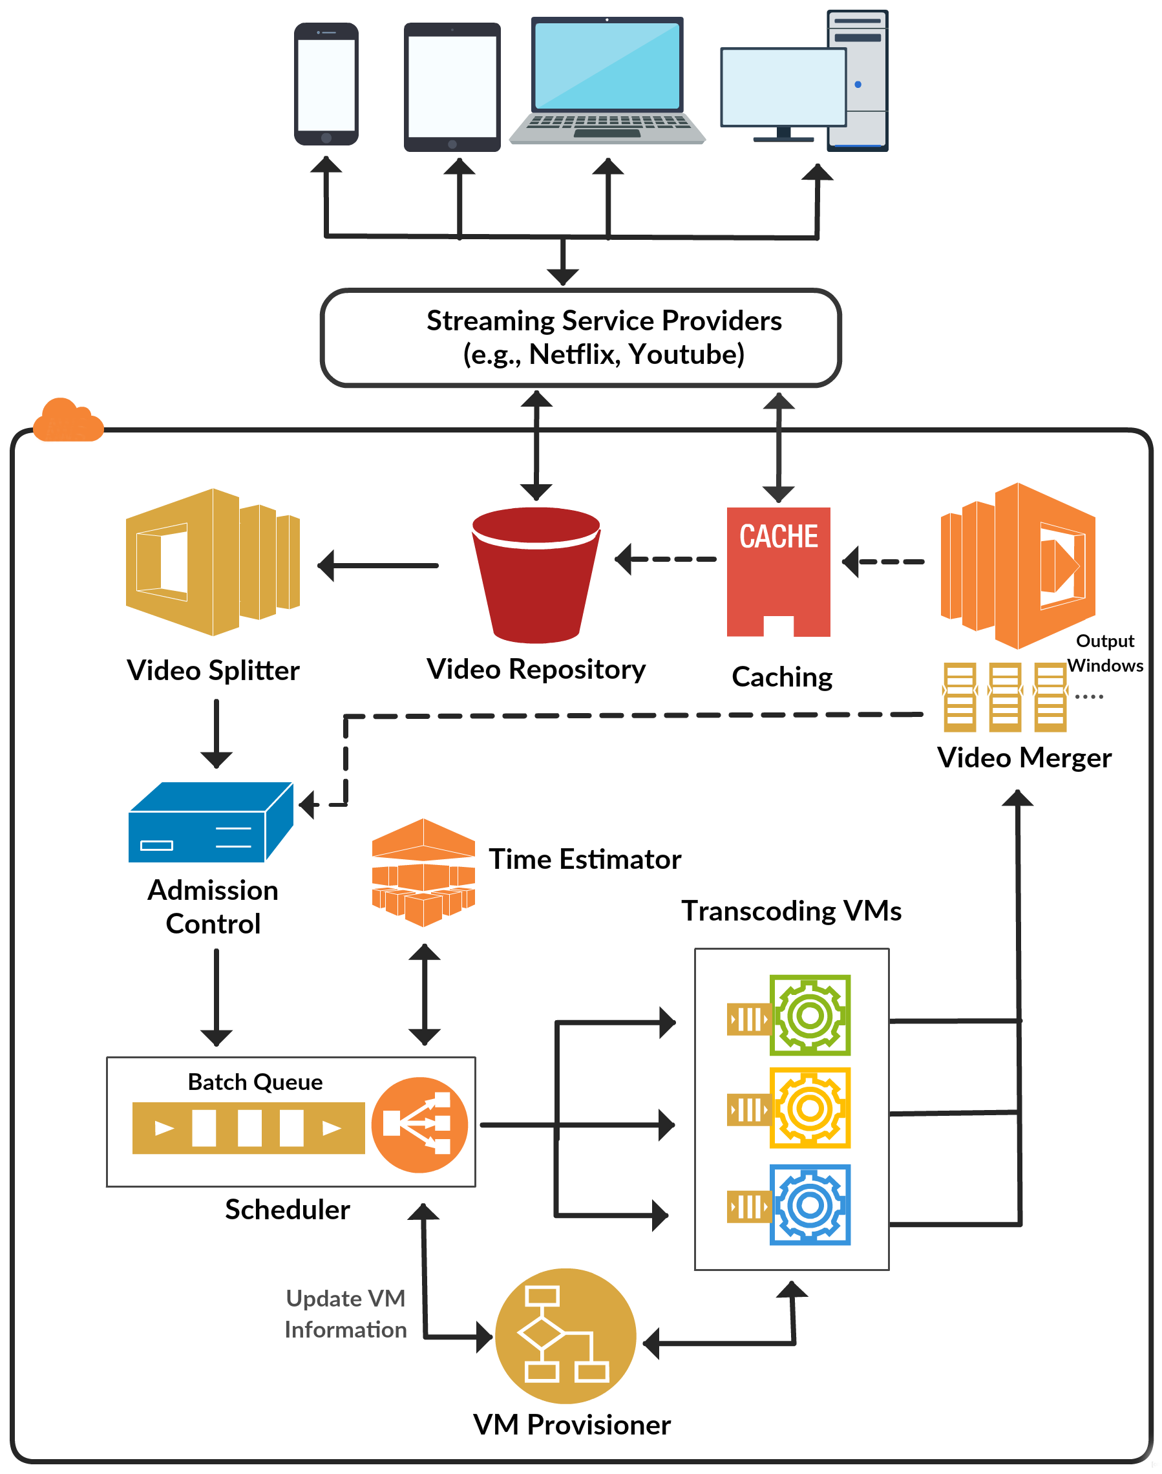
CVSS: Cloud-based Video Streaming Service Architecture

Slide 20
CVSS: Cloud-based Video Streaming Service Architecture

Slide 21
CVSS: Cloud-based Video Streaming Service Architecture

Slide 22
CVSS: Cloud-based Video Streaming Service Architecture

Slide 23
CVSS: Cloud-based Video Streaming Service Architecture

Slide 24
CVSS: Cloud-based Video Streaming Service Architecture

Slide 25
CVSS: Cloud-based Video Streaming Service Architecture

Slide 26
QoS-Aware On-Demand Video Transcoding Using Homogeneous Cloud Services

Slide 27
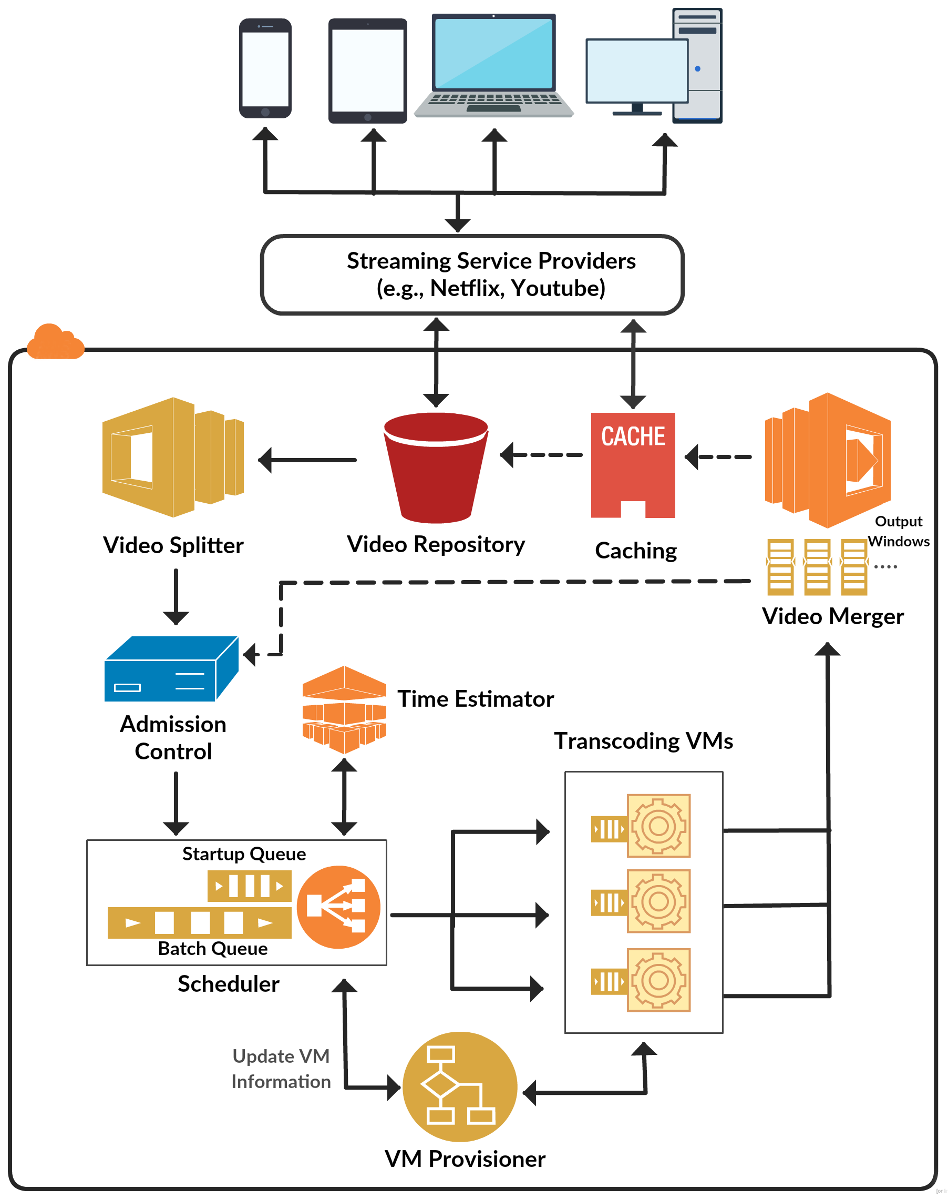
Video Segmentation and Transcoding Tool
QoS-Aware Scheduling Method
Dynamic cost-efficient provisioning policy

Slide 28
How to Segment Video?

Slide 29
Video Stream Architecture
Seq 1
Seq 2
Seq 3
Seq 4
Seq 5
Seq Header
GOP 1
GOP 2
GOP 3
…..
…..
GOP Header
I
P
P
B
P
Macroblock (MB)

Slide 30
Video Segmentation and Transcoding Tool
Split Video into GOPs
Perform Transcoding
Obtain Metadata
GOP transcoding time
GOP presentation time
GOP frame number
GOP input size
GOP output size

Slide 31
On-Demand Video Transcoding Challenges
Guarantee Quality of Service (QoS)?
Startup delay
Deadline miss rate
Minimize Cloud Resource Cost
Computing cost
Storage cost

Slide 32
QoS-Aware Scheduling Method
G_{video#,GOP#}
VM1
Startup Queue
G_{4,1}
G_{4,0}
…..
15s
VM2
…..
G_{1,9}
G_{2,6}
G_{4,4}
G_{3,4}
G_{2,5}
G_{1,8}
10s
Batch Queue
VM3
20s

Slide 33
On-Demand Video Transcoding Challenges
Improve Quality of Service (QoS)?
Startup delay
Deadline miss rate
Minimize Cloud Resource Cost
Computing cost
Storage cost

Slide 34
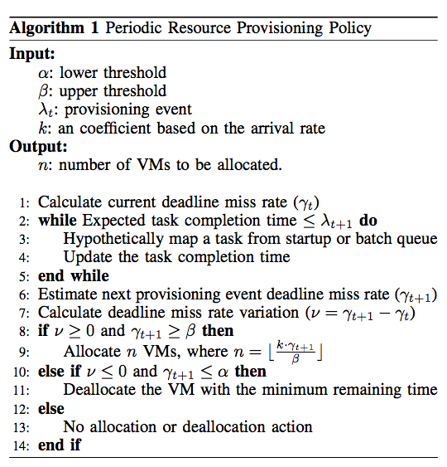
Dynamic Cost-Efficient Provisioning Policy
User define QoS violation tolerance
Predict deadline miss rate
Allocate/Deallocate VMs based on predicted deadline miss rate

Slide 35
Remedial Provisioning Policy
Startup Queue
G_{7,0}
G_{6,0}
G_{5,0}
G_{4,1}
G_{4,0}
Video number in the startup queue
…..
…..
…..
G_{1,9}
G_{2,6}
G_{4,4}
G_{3,4}
G_{2,5}
G_{1,8}
Batch Queue
Constant factor
QoS violation upper bound threshold

Slide 36
Experiment Setup
We modeled our system based on the characteristics of VMs in Amazon EC2
Using CloudSim to model our system and evaluate the performance of scheduling and resource provisioning policies.
We uniformly selected videos from the range of [10 , 600] seconds from a set of benchmark videos which can be downloaded from https://goo.gl/TE5iJ5

Slide 37
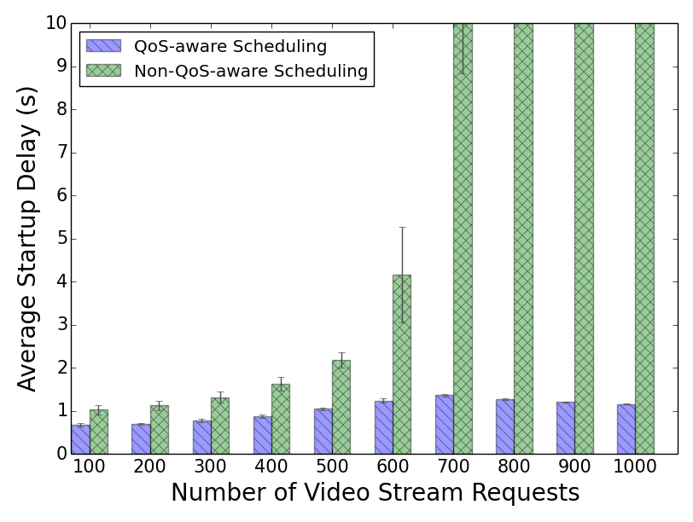
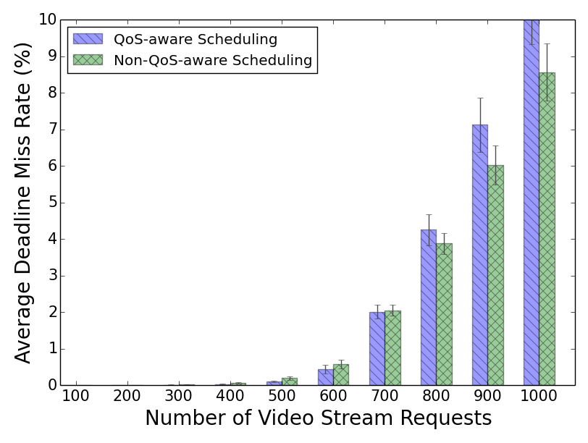
Performance Evaluation
Minimized startup delay without major impact on deadline miss rate

Slide 38
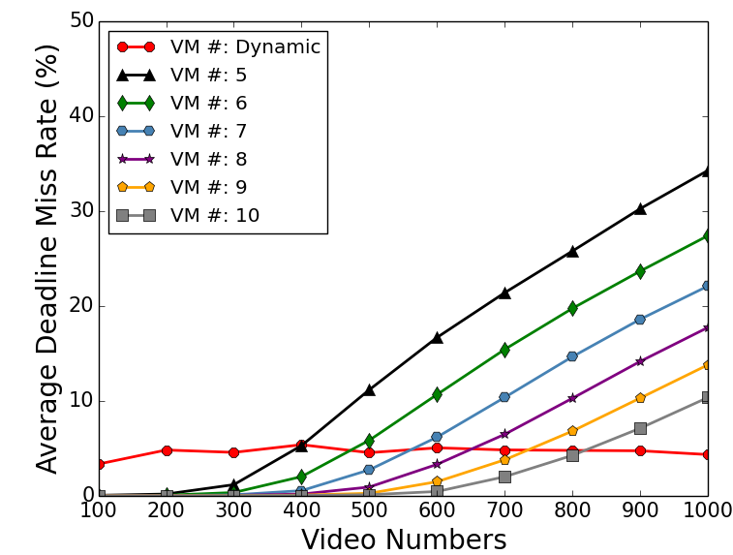
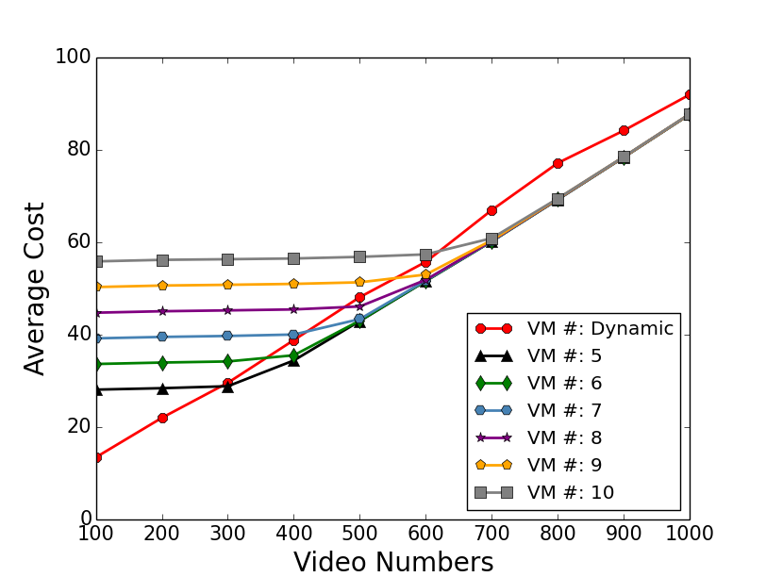
Static vs. Dynamic Resource Provisioning
Our dynamic provisioning keeps the QoS violation constantly low and Stable in compare with static method.
Our method saves the cost when
the system is not oversubscribed.
Notes:
We have run all transcoding operations on Amazon EC2 to get the real transcoding data, and then we use these data to simulate on CloudSim.
Our dynamic system keeps the QoS violation constantly low and stable in compare with static method
Our method save cost when the system is not oversubscribed.

Slide 39
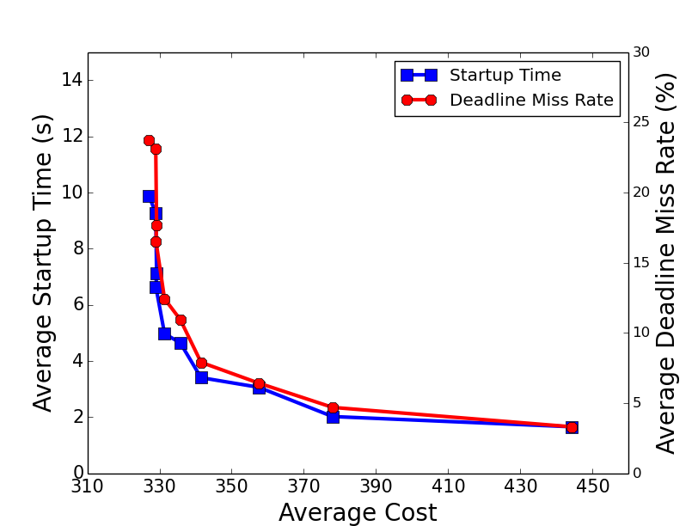
At some point, streaming service providers can pay reasonable
price to gain good QoS.
Notes:
The correlation between cost and QoS is not linear, that means at some point with our system, streaming service provider can pay low price to get good QoS.

Slide 40
Publications
Xiangbo Li, Mohsen Amini Salehi, Magdy Bayoumi, Rajkumar Buyya, “CVSS: A Cost-Efficient and QoS-Aware Video Streaming Using Cloud Services”, in the IEEE/ACM Cluster Cloud Grid Conference (CCGrid ’16), Columbia, May 2016.
Xiangbo Li, Mohsen Amini Salehi, Magdy Bayoumi, “High Performance On-Demand Video Transcoding Using Cloud Services”, in the IEEE/ACM Cluster Cloud Grid Conference (CCGrid ’16), Columbia, May 2016.
Xiangbo Li, Mohsen Amini Salehi, Magdy Bayoumi, “High Performance On-Demand Video Transcoding Using Cloud Services”, filed for Patent, Aug. 2016.
Xiangbo Li, Mohsen Amini Salehi, Magdy Bayoumi, “Cloud-Based Video Streaming for Energy- and Compute-Limited Thin Clients”, in Stream2015 Workshop at Indiana University, Indianapolis, USA, Oct. 2015.
All experiment results are available in Appendix

Slide 41
Performance Analysis and Modeling of Video Transcoding Using Heterogeneous Cloud Services

Slide 42
How to estimate transcoding time efficiently?!

Slide 43
Video Streams
Streaming Providers
Client Devices

Slide 44
Amazon EC2 Instance - Families
Compute-Optimized
General Purpose
Micro Instances
Memory-Optimized
Storage-Optimized
GPU Instances

Slide 45
What’s the Affinity of Transcoding Performance on Heterogeneous VMs?

Slide 46
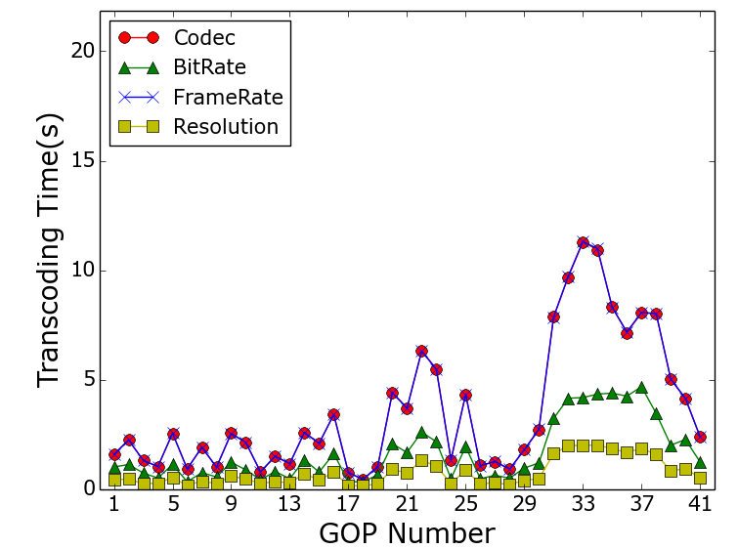
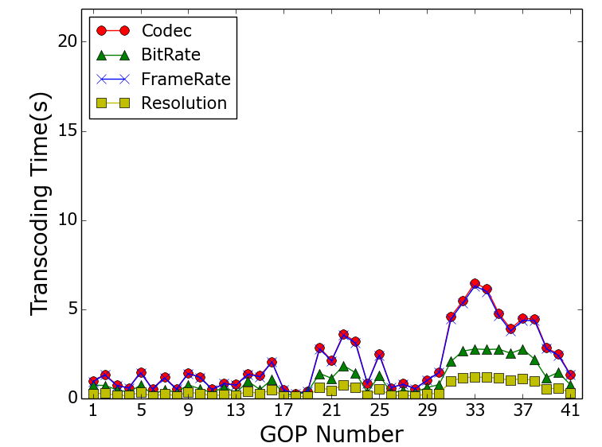
Transcoding Types
CPU-Optimized Instance
GPU Instance
Transcoding time follows a pattern
This pattern applies to all VM types

Slide 47
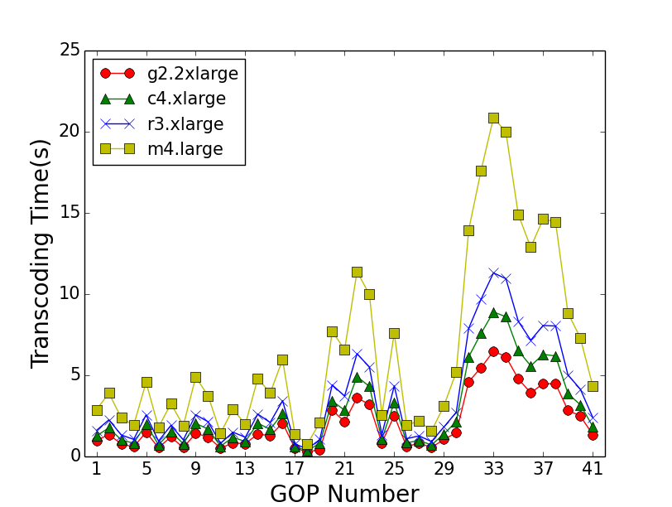
VM Instance Types
In general, GPU is better
The difference is minor sometime
Why?
Transcoding Codec

Slide 48
Video Types
Small time difference for fast motion video
Large time difference on slow motion video

Slide 49
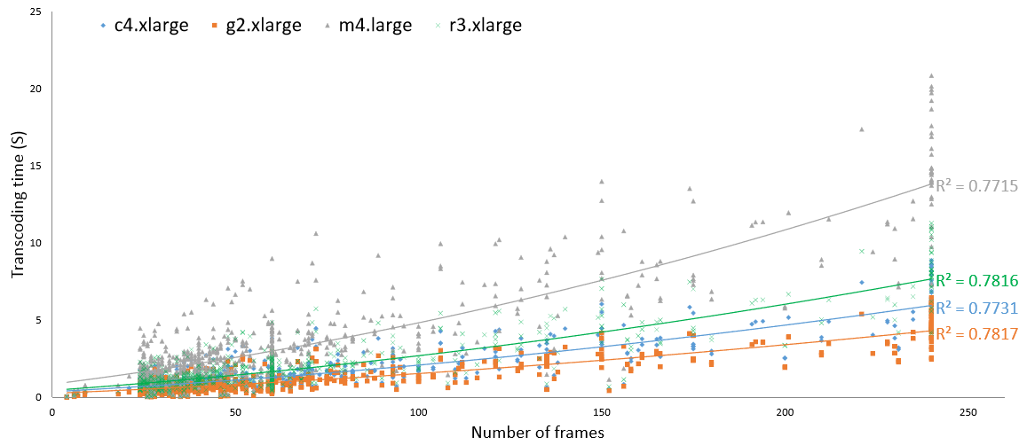
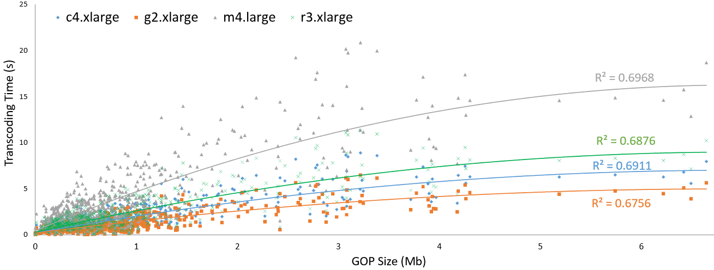

Slide 50
Cost-Efficient On-Demand Video Transcoding Using Heterogeneous Cloud Services

Slide 51
Heterogeneous Transcoding VMs
Utility Function Based Batch Scheduling Method
Adaptive
Elastic Resource Provisioning Policy

Slide 52
Why Remove Startup Queue?
Startup Queue
Priority
G_{4,1}
G_{4,0}
Priority
…..
GOP #
GOP #
…..
Startup Queue
Utility Function
G_{1,9}
G_{2,6}
G_{4,4}
G_{3,4}
G_{2,5}
G_{1,8}
Batch Queue
GOP utility function:
where alpha is constant factor, i the order
number of the GOP in that video

Slide 53
Utility Function Based
Batch Scheduling Method
G_{video#,GOP#}
G_{2,7}
G_{3,3}
G_{1,10}
G_{1,9}
G_{2,6}
G_{4,0}
G_{3,2}
G_{2,5}
G_{1,8}
…..
Batch Queue
G_{4,0}
G_{3,2}
G_{2,5}
G_{1,8}
Priority Queue
1.0
0.8
0.5
0.3

Slide 54
30s
25s
GPU
15s
G_{4,0}
G_{3,2}
G_{2,5}
G_{1,8}
CPU
Optimized
1.0
0.8
0.5
0.3
GPU: 10s
10s
CPU: 20s
Memory
Optimized
Memory: 25s
20s
MM: Minimum completion time, Minimum completion time
MSD: Minimum completion time, Shortest Deadline
MMU: Minimum completion time, Minimum utility
MMUT, MSDUT, MMUUT

Slide 55
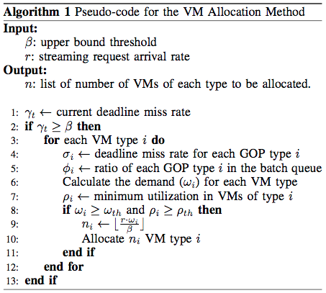
Adaptive Elastic Resource Provisioning Policy
Allocation Policy
When?
What type of VM?
How many?
Current Time
Last Period
Future
Deadline miss rate
GPU: 20%
CPU: 50%
Memory:30%
Portion in the bath queue
GPU: 60%
CPU: 20%
Memory:20%

Slide 56
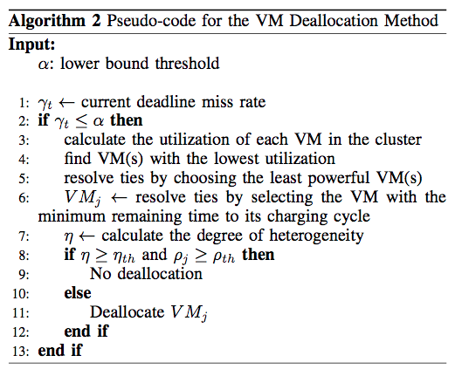
Deallocation Policy
When?
Which one?
Find the minimum utilization VMs
Find the lowest cost ones (least powerful ones)
Find the minimum remaining time VM
If T2’s minimum utilization < 0.2
Deallocate
T2, T2, C4, R3
T2, T2
T2

Slide 57
Performance Evaluation

Slide 58
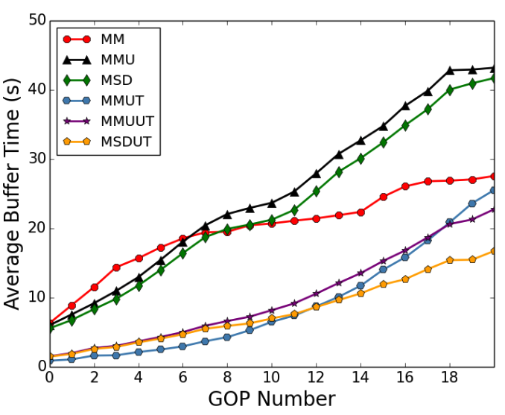
Early GOP Completion Time
The impact of utility based scheduling on minimizing completion/buffer time of GOPs, especially those in the beginning of the stream

Slide 59
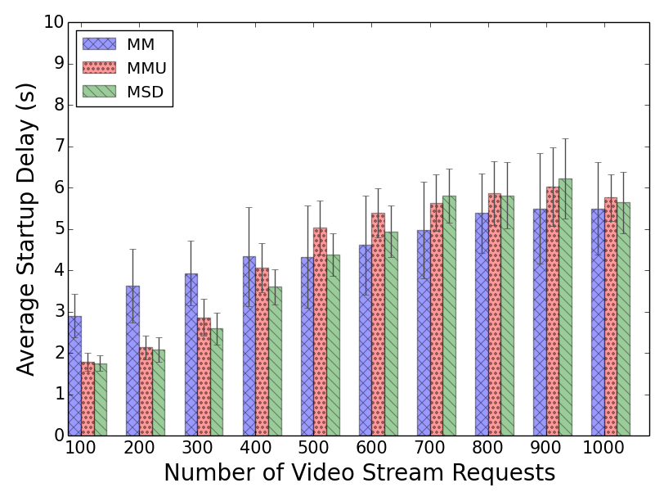
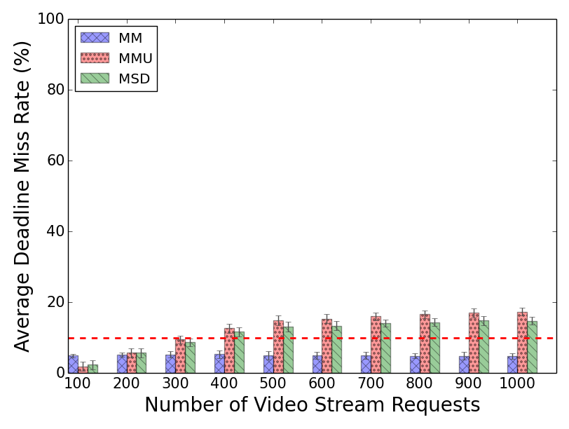
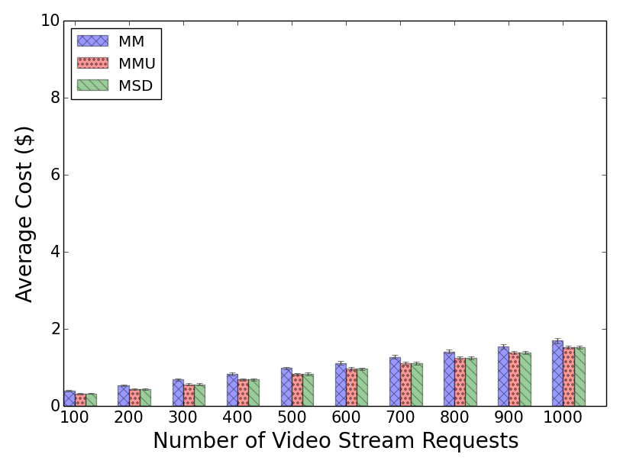
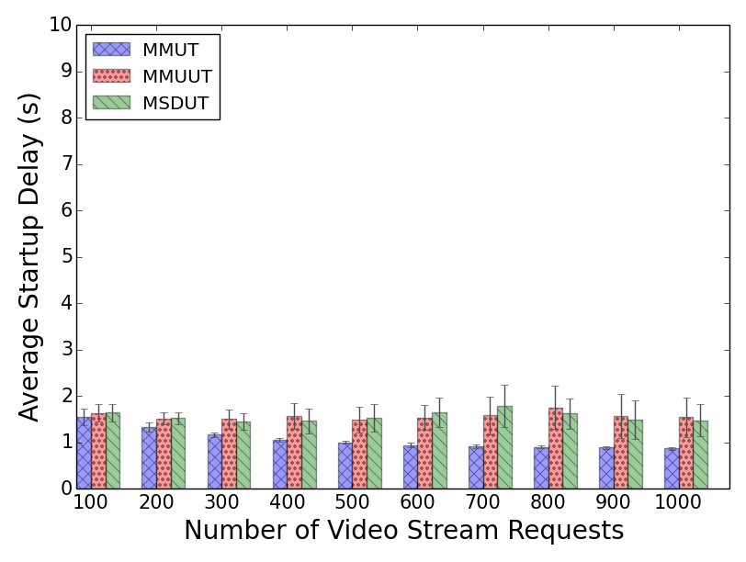
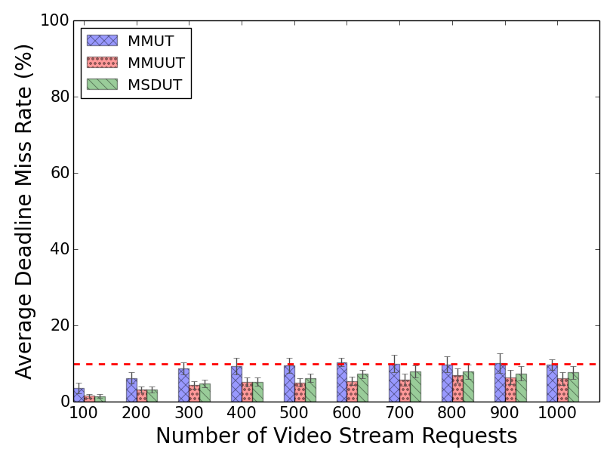
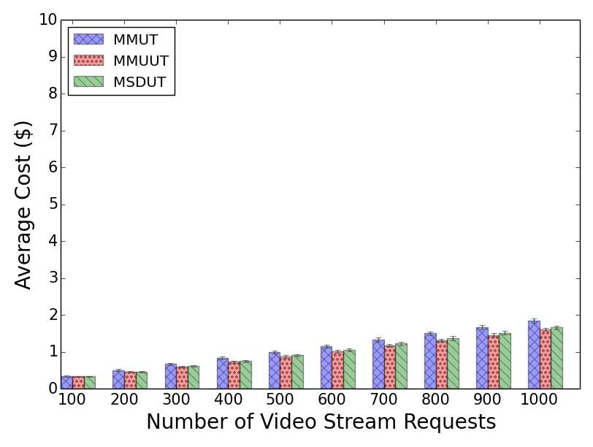
Scheduling with Dynamic Provisioning
Notes:
The incurred cost has significantly reduced (up to ~80% when the system is not oversubscribed) regardless of the mapping heuristic applied.
Startup delay has in general increased (mainly in a) but it is more stable in compare with figure a in static. This is because the EM adapt itself to the workload intensity to satisfy QoS demands. However, in (d) even the startup delay is in a lower range.
Similarly, dmr has become more stable and low when we utility based mapping heuristics are used.
Why MSDUT and MMUUT perform better DMR than MSD and MMU?
The reason is not virtual queue base on old experiment. The reason is not heuristic nature because of static experiment e

Slide 60
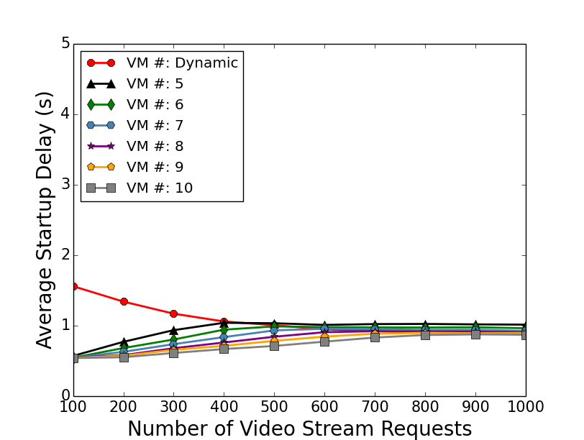
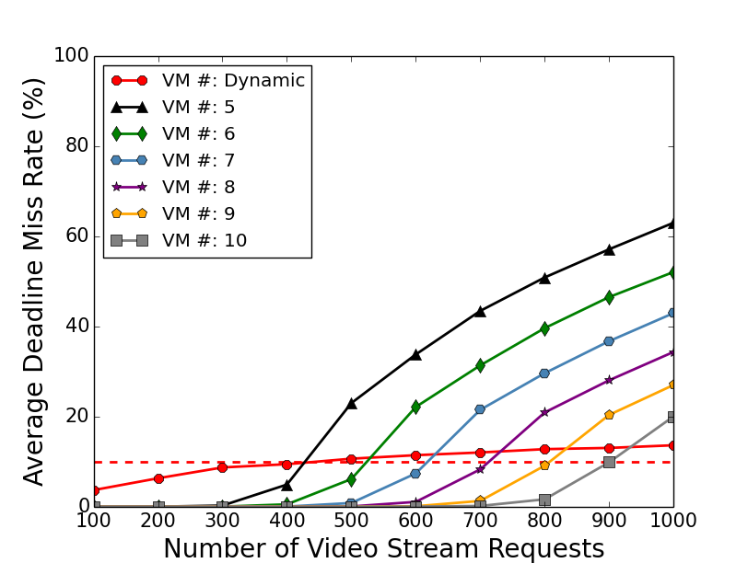
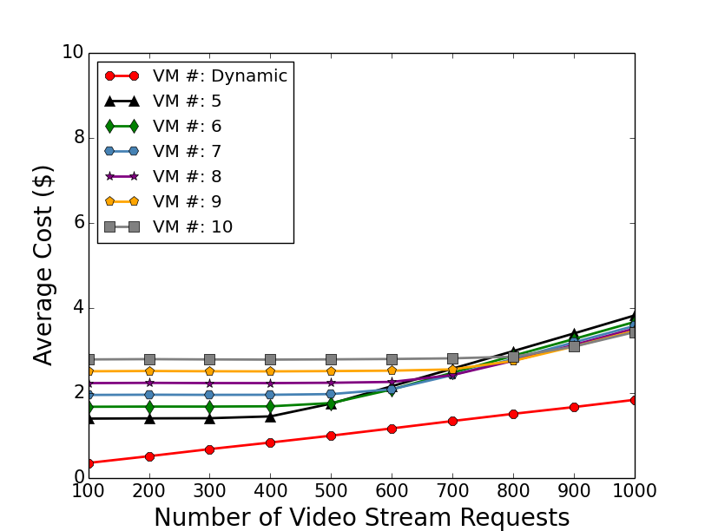
Static GPU vs. Dynamic Heterogeneous
Low and stable Startup time
Low and stable deadline miss rate
Save up to 85% cost when system is not oversubscribed

Slide 61
Publications
Xiangbo Li, Mohsen Amini Salehi, Magdy Bayoumi, Nian-Feng Tzeng and Rajkumar Buyya, “Cost-Efficient and Robust On-Demand Video Transcoding Using Heterogeneous Cloud Services”, submitted to IEEE Transaction on Parallel and Distributed Systems (TPDS), Aug. 2016
All experiment results are available in Appendix

Slide 62
Live Streaming Video Transcoding Using Cloud Services

Slide 63
Architecture for On-Demand Transcoding of Live-Stream Videos
Efficient transcoding time estimation model
Drop those GOPs who missed their deadline

Slide 64
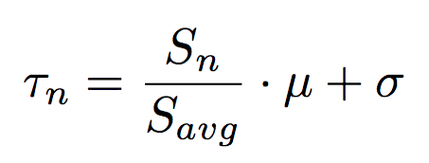
Transcoding Time Prediction Model
Current GOP size
Startup Queue
Standard deviation
G_{4,1}
G_{4,0}
…..
…..
G_{1,9}
G_{2,6}
G_{4,4}
G_{3,4}
G_{2,5}
G_{1,8}
Average GOP transcoding time
Batch Queue
Average previous GOP size

Slide 65
QoS-Aware Scheduling Method
G_{video#,GOP#}
VM1
Startup Queue
G_{4,1}
G_{4,0}
…..
15s
VM2
…..
G_{1,9}
G_{2,6}
G_{4,4}
G_{3,4}
G_{2,5}
G_{1,8}
10s
Batch Queue
VM3
20s

Slide 66
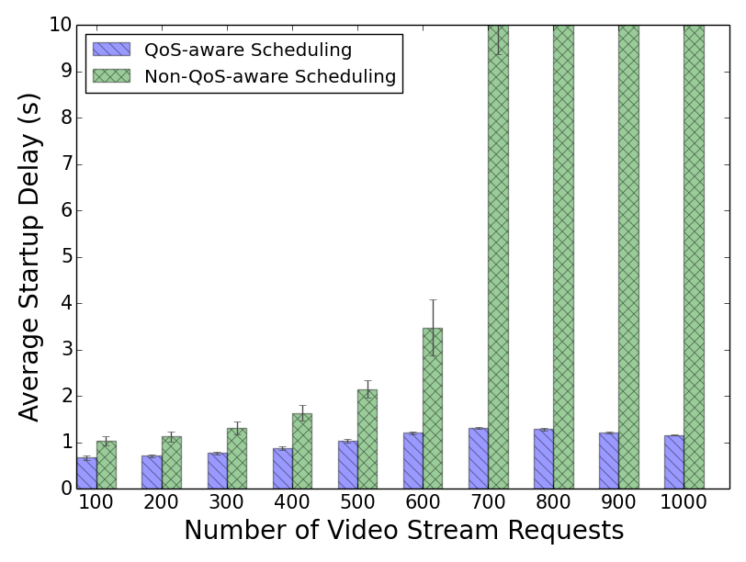
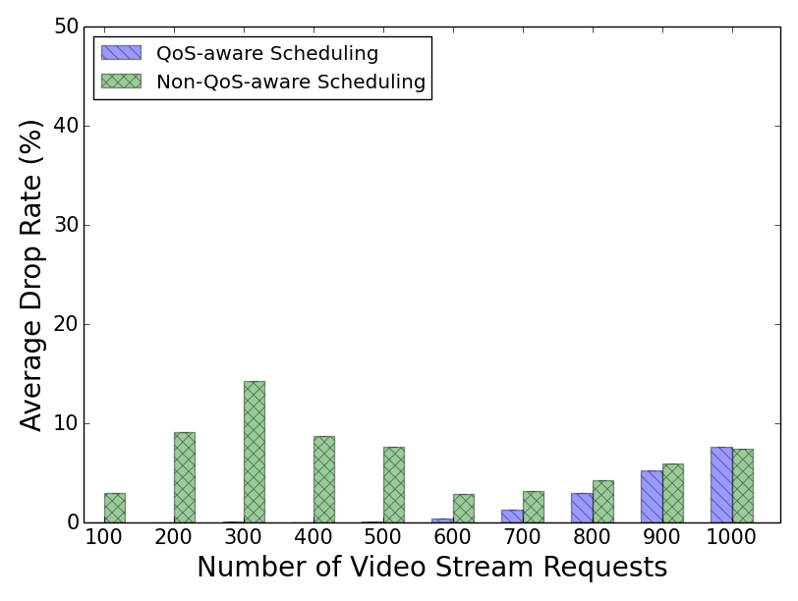
Performance Evaluation
Low and stable startup time
Decrease video drop rate.
Notes:
We have run all transcoding operations on Amazon EC2 to get the real transcoding data, and then we use these data to simulate on CloudSim.
Our dynamic system keeps the QoS violation constantly low and stable in compare with static method
Our method save cost when the system is not oversubscribed.

Slide 67
Publications
Xiangbo Li, Mohsen Amini Salehi, Magdi Bayoumi, “VLSC: Video Live Streaming Based on Cloud Services”, accepted to the 6th IEEE International Conference on Big Data and Cloud Computing Conference (BDCloud ’16), Atlanta, GA, USA, Oct. 2016.
Mohsen Amini Salehi, Xiangbo Li, “HLSAAS: High-Level Live Video Streaming As a Service ”, in Stream2015 Workshop at Washington DC, USA, March 2016.
All experiment results are availabe in Appendix

Slide 68
How to cache videos becoming Trendy?

Slide 69
Problem Definition
We should pre-transcode a video stream when it is “hot”. But….
How can we define a video as hot?
How can we quantify the hotness?
How should we manage caching of videos that are not too hot?

Slide 70
Contribution of This Part
We propose a method to quantify hotness of a video stream
We propose “partial pre-transcoding” for videos

Slide 71
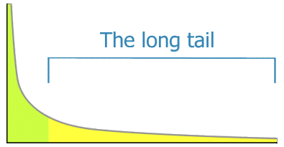
Estimation of Number of Views for a GOP
first 20% of video stream
Number of views
GOPs of one video
GOP access pattern follows a long tail distribution
Earlier GOPs in a video stream are watched more often
Notes:
Cite the paper that says videos have long tail view

Slide 72
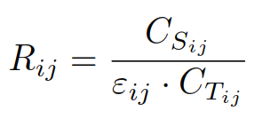
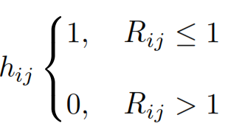
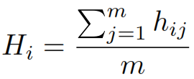
Quantifying Hotness of a Video Stream
We need to know the cost benefit of storing each GOP
For GOP j of video stream i, we have:
Hotness function:
Hotness value:

Slide 73
Partial pre-transcoding
Value of Hotness is between 0 and 1
Based on the value of hotness, we pre-transcode portion of a video

Slide 74
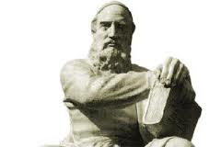
Hatef Esphahani:
When you pierce deep in any particle
You will see a sun shining there…

Slide 75
Questions
What is Video Transcoding?
Why “on-demand” video transcoding?
What are the challenges in on-demand video transcoding?
What have already been done by others?
What aspects does my thesis focus on?
What are the future directions?

Slide 76
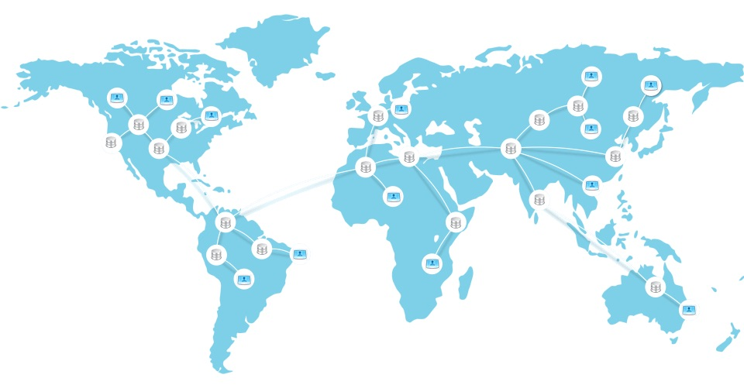
Future Directions

Slide 77
Reference
Garcia, Adriana, and Hari Kalva. "Cloud transcoding for mobile video content delivery." Proceedings of the IEEE International Conference on Consumer Electronics (ICCE). Vol. 379. 2011.
F. Jokhio, T. Deneke, S. Lafond, and J. Lilius, “Analysis of video segmentation for spatial resolution reduction video transcoding,” in Proceedings of IEEE International Symposium on Intelligent Signal Processing and Communications Systems (ISPACS), pp. 1–6, 2011.
S. Lin, X. Zhang, Q. Yu, H. Qi, and S. Ma, “Parallelizing video transcoding with load balancing on cloud computing,” in Proceedings of the IEEE International Symposium on Circuits and Systems (ISCAS), pp. 2864–2867, 2013.
Tewodors Deneke, Habtegebreil Haile, Se ́bastien La- fond, and Johan Lilius, “Video transcoding time pre- diction for proactive load balancing,” in Proceedings of IEEE International Conference on Multimedia and Expo (ICME), pp. 1–6, 2014.
F. Jokhio, A. Ashraf, S. Lafond, I. Porres, and J. Lilius, “Prediction- based dynamic resource allocation for video transcoding in cloud com- puting,” in Proceedings of the 21st Euromicro International Conference on Parallel, Distributed and Network-Based Processing (PDP), pp. 254–261, 2013.
A. Ashraf, F. Jokhio, T. Deneke, S. Lafond, I. Porres, and J. Lilius, “Stream-based admission control and scheduling for video transcoding in cloud computing,” in Proceedings of the 13th IEEE/ACM Interna- tional Symposium on Cluster, Cloud and Grid Computing (CCGrid), pp. 482–489, 2013
F. Jokhio, A. Ashraf, S. Lafond, and J. Lilius, “A computation and storage trade-off strategy for cost-efficient video transcoding in the cloud,” in Proceedings of the 39th IEEE Conference on Software Engineering and Advanced Applications (SEAA), pp. 365–372, 2013.

Slide 78
Appendix

Slide 79
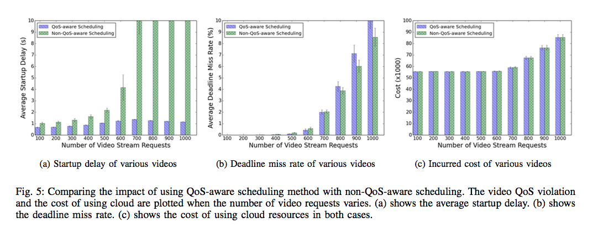
Experiment Results

Slide 80
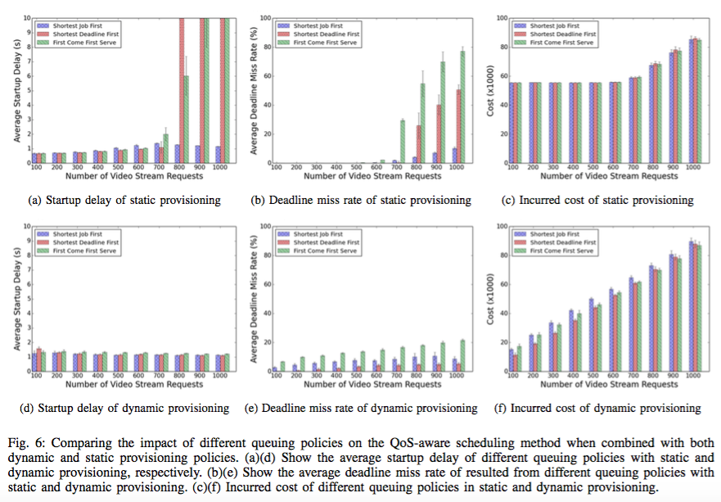

Slide 81
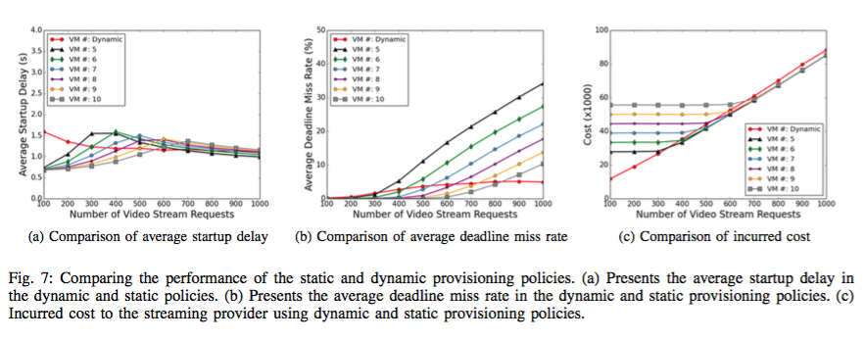
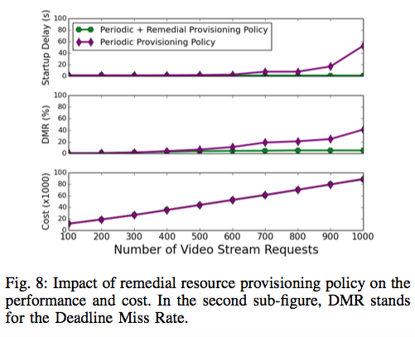
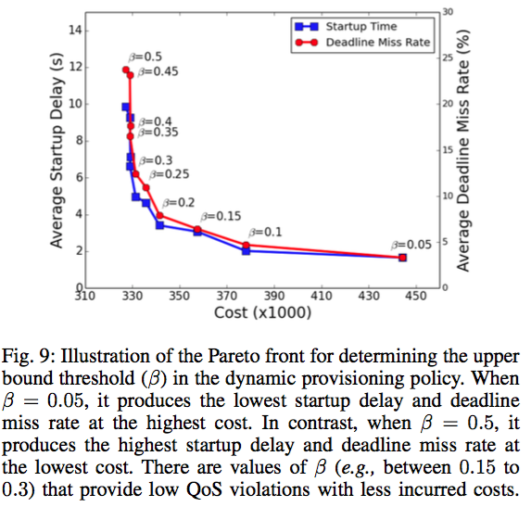

Slide 82
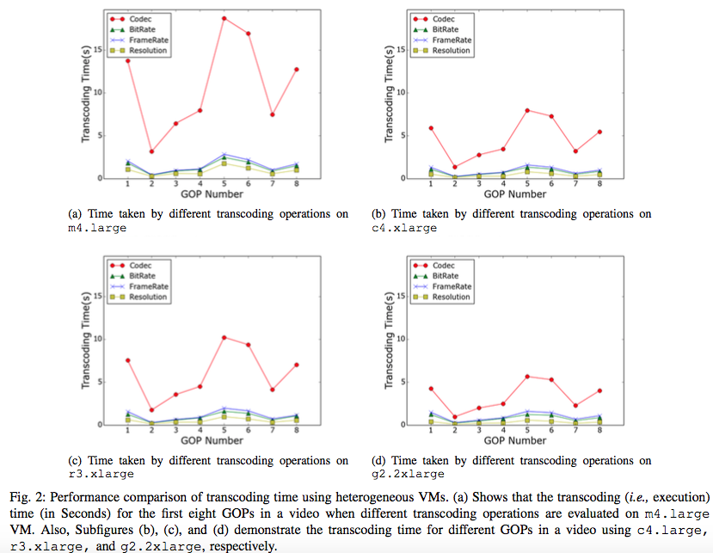

Slide 83
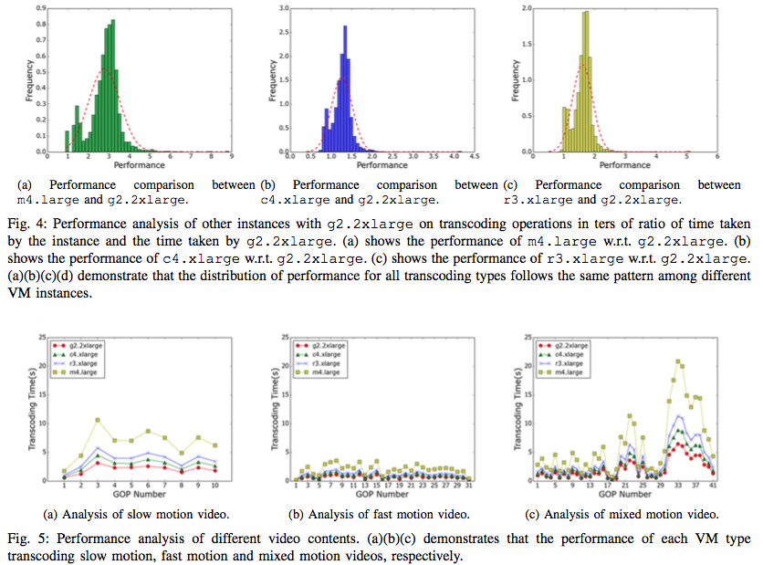

Slide 84
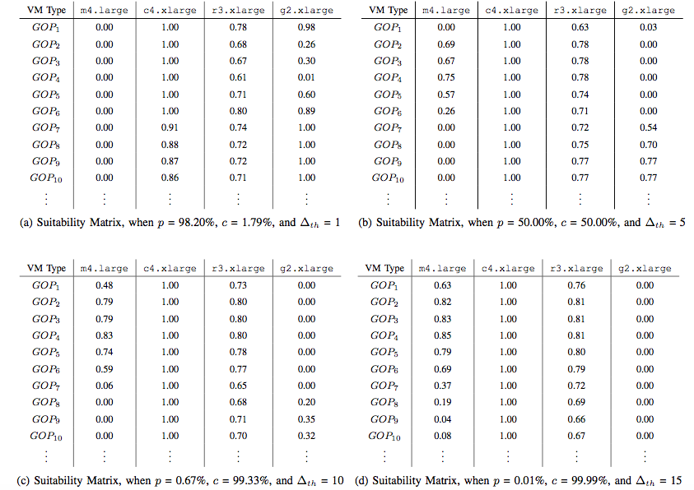

Slide 89
Thank You!

