Slide 1


Stochastic Robust Scheduling in Heterogeneous Computing Systems
Mohsen Amini Salehi
Assistant Professor
Computer Science Department
University of Louisiana Lafayette
Summer ’15

Slide 2
Introduction
Ph.D (Aug ’12)
  Melbourne University
    Resource allocation in interconnected virtualized distributed systems
Academic Appointments
  Assistant Professor at UL (Aug ’14 – present)
  University of Miami (Aug ’13 – Aug ’14)
  Colorado State University (Aug ’12 – Aug ’13)
  Lecturer and faculty member, Azad Uni. (Sep ’06 – Aug ’08)
Industry work experiences
  Intern at Infosys research
  Cloud consultant at Nexright ltd.

Slide 3
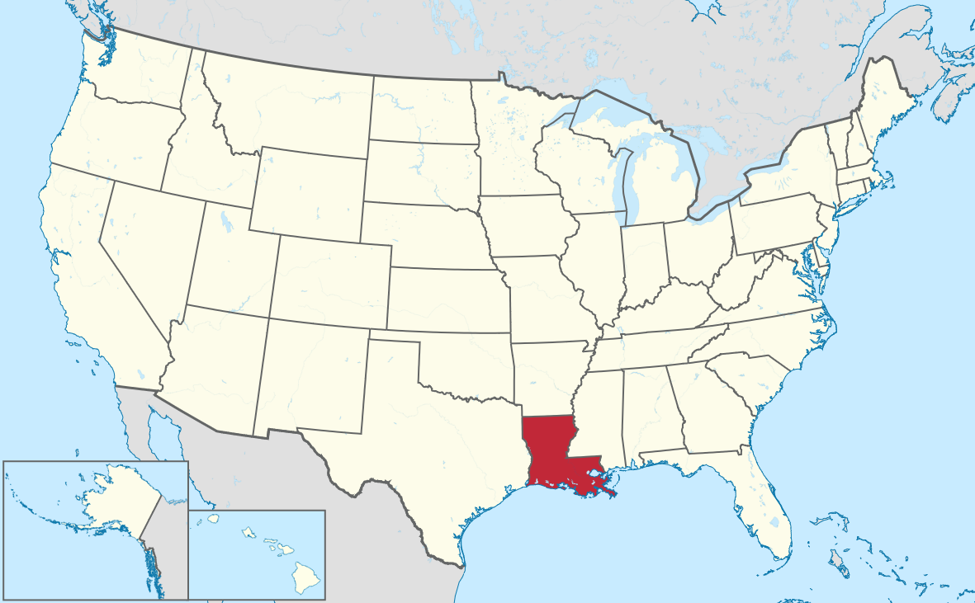
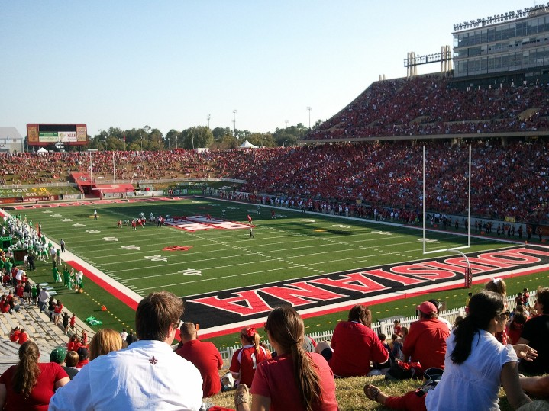

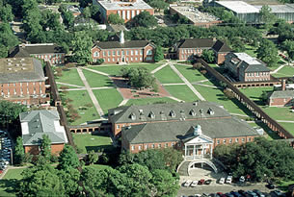
University of Louisiana Lafayette

Slide 4




Research Interests
Data Sanitization in Cloud
Robust Cloud Resource Allocation for real time processing of big data

Slide 5
Outline
Background
Stochastic Robust Scheduling in Heterogeneous systems
Summary of Current Collaborative Works
Future Research Plans

Slide 6
Stochastic Robust Scheduling in Heterogeneous systems
Definition and motivation
System model and problem definition
Theoretical (Bayesian) model
Heuristics and results

Slide 7

Heterogeneous Distributed Computing
Distributed systems that have resources of different types and capabilities
Many distributed systems (e.g., clusters) are formed incrementally over time

Slide 8



Heterogeneous Distributed Computing Example
Clouds offer different VM types
Users usually create a cluster of heterogeneous VMs
  To serve different task types (characteristics)
  e.g., graphical processing tasks, memory intensive, IO intensive, etc.

Slide 9
Two Types of Heterogeneity
Consistent heterogeneity:
  If machine A is always faster than machine B
Inconsistent heterogeneity
  Machine A is faster than machine B for task type x but machine B is faster than A for task type y
m4
m3
m2
m1

Slide 10
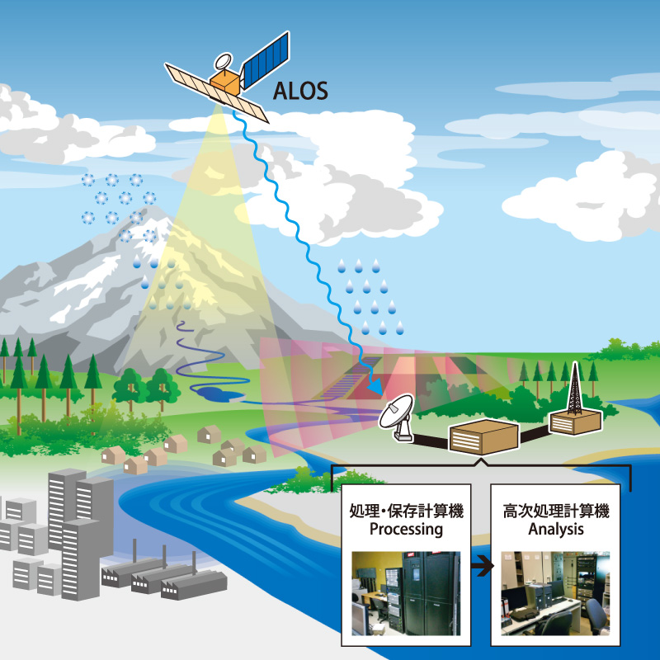
Motivation: A Satellite Example
A mapping satellite
(e.g. DigitalGlobe inc.)
Different operations are
performed on pictures
  Compressing
  Enhancing
  Rotating
Execution time of each
task is different based
on the operation
type and picture quality

Slide 11



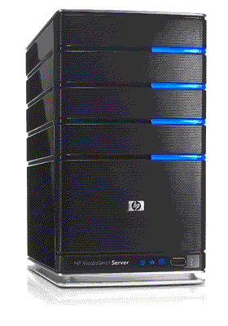
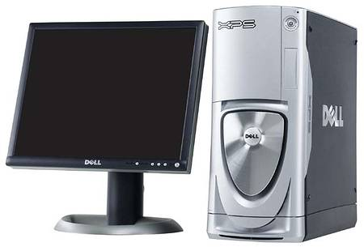
Motivation: Satellite Example
Every t time unit
Picture set
i+1
Picture set
i

Slide 12
Outline
Definition and motivation
System model and problem definition
Theoretical (Bayesian model)
Heuristics and results

Slide 13
System Model
There is uncertainty (stochasticity) in execution time of each task on each machine
Different ways to model uncertainty
A Probability Mass Function (PMF) models execution time of each task on each machine
1
0.4
Execution time
PMF
0.3
probability
0.2
0.05
0.05
0
time
1
2
3
4
5
6

Slide 14
System Model (cont.)
Each task has a hard deadline
  If a task cannot meet its deadline it is dropped
We consider 2 scenarios for dropping:
  Executing tasks cannot be dropped
  Executing task can be dropped if it misses deadline
Machine J
Machine J

Slide 15
Our Goal: Scheduling Robustness
Goal is to cope with uncertainty in a heterogeneous system (to have a robust system)
Robustness is the degree a system can perform correctly in presence of uncertainty
We define robustness as the “percentage of tasks that can meet their deadlines”

Slide 16
Problem Definition
How to maximize the number of tasks that are completed by their deadlines?
How to measure robustness in a distributed system?

Slide 17
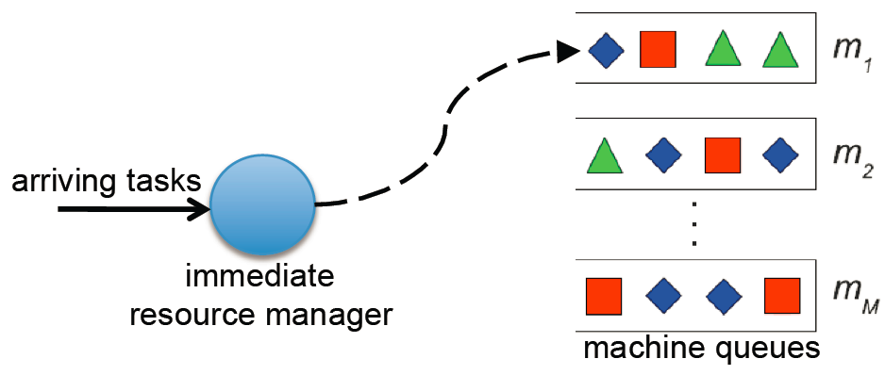
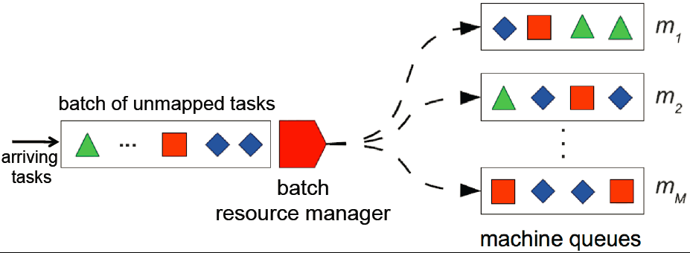
Possible Scheduling Scenarios
Immediate mode: tasks are assigned upon arrival
Batch mode: tasks are collected to form a batch for allocation

Slide 18
Outline
Definition and motivation
System model and problem definition
Theoretical (Bayesian) model
Heuristics and results

Slide 19
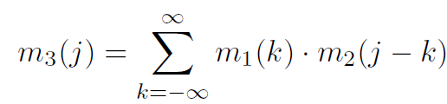
Recap from Statistics
If we know the distribution of random variables X and Y then:
  What is the distribution of Z where Z=X+Y ?
  Z is the convolution of X and Y and is shown as X*Y
  PMF of Z is:
Example: Z is the distribution of sum of rolling a dice for 2 times (X and Y)
1
p
0
2
3
4
5
6
7
8
9
10
11
12
sum

Slide 20
Task Completion Time based on Convolution
Machine J
Completion time PMF of task i is calculated by convolving:
  Completion time PMF of currently executing task
  Execution time PMF for tasks ahead of task i
Completion time PMF for a currently executing task:
  Impulses in the execution time PMF that have passed are removed
  The remaining distribution is renormalized to 1

Slide 21
Stochastic Task Completion Time
1
1
1
0.75
0.4
current time
0.4
probability
0.3
probability
probability
0.3
0.2
0.125
0.05
0.2
0.125
0.05
0.05
0.05
0
0
0
1
2
3
4
5
6
4
5
6
7
8
9
4
5
6
7
8
9
time
time
time
Execution time
PMF
Completion time
PMF
Completion time
PMF of
currently executing
task
Assume we know
start time is 3

Slide 22
Stochastic Task Completion Time in presence of Task Dropping
Calculating completion time pmf of task r_{i}
  Impulses in the completion time pmf of task r_{i-1} that are bigger than deadline of task r_{i} are not considered in the convolution
1
1
Excluded convolution
1
1
0.5
0.4
0.48
probability
0.3
probability
0.3
probability
0.31
0.2
0.2
probability
0.26
0.05
0.05
0.18
0.17
0.04
0.12
0.04
0
0
0
0
1
2
3
4
5
6
7
8
9
6
7
8
9
6
7
8
9
time
time
time
time
Execution r_{i}
Deadline 7
Completion
r_{i-1}
Completion r_{i}
Completion r_{i}
after merging

Slide 23
Stochastic Task Completion Time in presence of Task Dropping for Executing Task
1
1
1
excluded from convolution
0.5
0.4
probability
0.3
probability
0.3
probability
0.26
0.2
0.2
0.05
0.18
0.12
0.05
0.04
0
0
0
1
2
3
4
5
6
7
8
9
6
7
8
9
time
time
time
1
1
0.86
0.56
probability
probability
0.05
0.04
0.04
0.05
0
0
6
7
6
7
8
9
time
time

Slide 24
Stochastic Robustness Measure
Probability that task i completes by its deadline:
  Sum of pulses that are less than the individual deadline of task i
Robustness measure:
Sum of probabilities that all tasks meet their deadlines
1
Deadline
0.4
probability
0.3
0.2
0.05
0.05
0
4
5
6
7
8
9
time

Slide 25
Outline
Definition and motivation
System model and problem definition
Theoretical (Bayesian model)
Heuristics and results

Slide 26
Heuristics: Immediate Mode
Min. Expected Execution Time (MEET)
Min. Expected Completion Time (MECT)
K-Percent Best (KPB)
  K-percent of machines that provide the shortest expected execution time are selected
  Assign task based on the minimum expected completion time on these machines
Max. Robust (MR)
  Assigns the task to the machine with max. robustness

Slide 27
Heuristic: Batch Mode
Min Completion-Min Completion (MM)
Min Completion-Soonest Deadline (MSD)
Maximum On time Completions (MOC)

Slide 28
Batch Heuristic: Maximum On time Completions (MOC)
  For each task in the unmapped queue:
    determine the machine with the maximum probability of meeting deadline
  For each machine queue j:
    from the task-machine pairs, identify the task that has the highest probability of meeting deadline
    assign the selected task to the machine
    remove task from Q

Slide 29
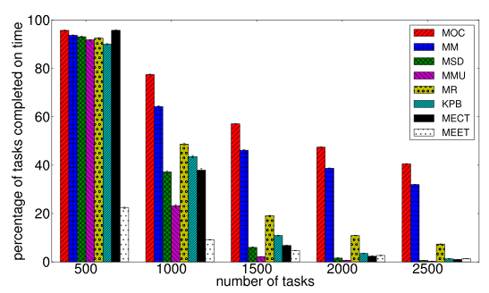
Arrival-Rate Analysis

Slide 30
Conclusion and Future Works
We proposed a measure for robustness in a heterogeneous distributed system
We proposed allocation algorithms based on the robustness measure
We observed that batch mode scheduling performs better, if the system is oversubscribed
How about delaying tasks before allocation? Maybe we come up with a better scheduling!

Slide 31
Research Interests
Data Sanitization in Cloud
Robust Cloud Resource Allocation for real time processing of big data

Slide 32
Growth of the Digital Universe and Emergence of Big Data
0.1 ZB in 2005
40 ZB in 2020
1 ZB in 2010
1.8 ZB in 2011
Source:
http://www.emc.com/
digital-universe/index.htm

Slide 33
What is Big Data?
Processing, storage, and management tools for datasets that cannot be handled by conventional methods/tools.
Big data Sources:
    Sensors
    Social networks
    Databases
    Cell phones
    etc.

Slide 34
What are the Challenges in Big Data?
How to store?
  There will be more than 40 ZB (40*2⁷⁰ Bytes) by 2020
  Wal-mart database > 2.5 petabyte
  LHC project at CERN generates 13petabytes simulation data per year
How to transfer?
  Fedex transfers big data much faster than the best network (Amazon solution for data transfer!)
  A 10Gbps network takes 2 hours to copy 1 TB and 83 days to copy 1 PB
Adapted from Edgar Gabriel Slides, at University of Houston

Slide 35
What are the Challenges in Big Data?
How to search?
  Assume that a process can search 1MB of data per second
    It will take ~12 days using 1 cpu to search 1 TB data
How to process?
  New scalable algorithms are required
  Platforms such as Cluster and Clouds must be utilized
How to protect?
  How to guarantee the security of the big data
Adapted from Edgar Gabriel Slides, at University of Houston

Slide 36

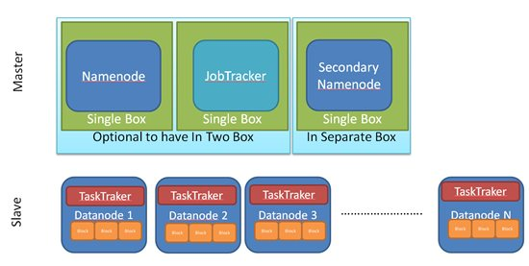
How to Process Big Data?
Processing platform (e.g., MapReduce and Hadoop)
Namenode
File1
1
2
3
4
1
2
1
3
2
1
4
2
4
3
3
4

Slide 37
How to Process Big Data?
Workflow management issues
Data locality issues
Data replication issues
Cost-efficient scheduling
Interactive scheduling
Memory management and in-memory processing

Slide 38
Big Data Search and Security
Problem:
  Users cannot trust storage clouds for their big data.
Solution?
  User-side Encryption!
  Clouds become dumb block storage
Disadvantages of encryption:
  Involves storage and processing overheads
  No search capabilities on the stored data

Slide 39
Keyword Search and Beyond
What if we need more than keyword search?
  We are looking for all documents authored by
  Andrew Stuart Tanenbaum
  A S Tanenbaum
  Andrew s Tanenbaum
RESeED our solution for this problem
(Andrew|A) \s*(stuart|s) \s*Tanenbaum

Slide 40

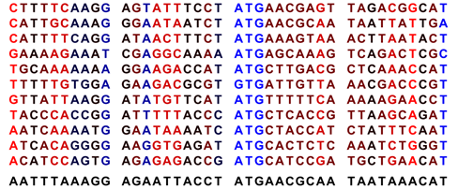
Search on Genomic Data
Collaborating with University of Cincinnati
Proteins have starting and stopping codons
  ATGTTCACTTAG
There is fuzziness in the coding of DNA sequences: N nucleotide can be {A,C,G,T,U}
ω₀C₀
C₁
C₂
ω₁

Slide 41
Research Interests
Data Sanitization in Cloud
Robust Cloud Resource Allocation for real time processing of big data

Slide 42
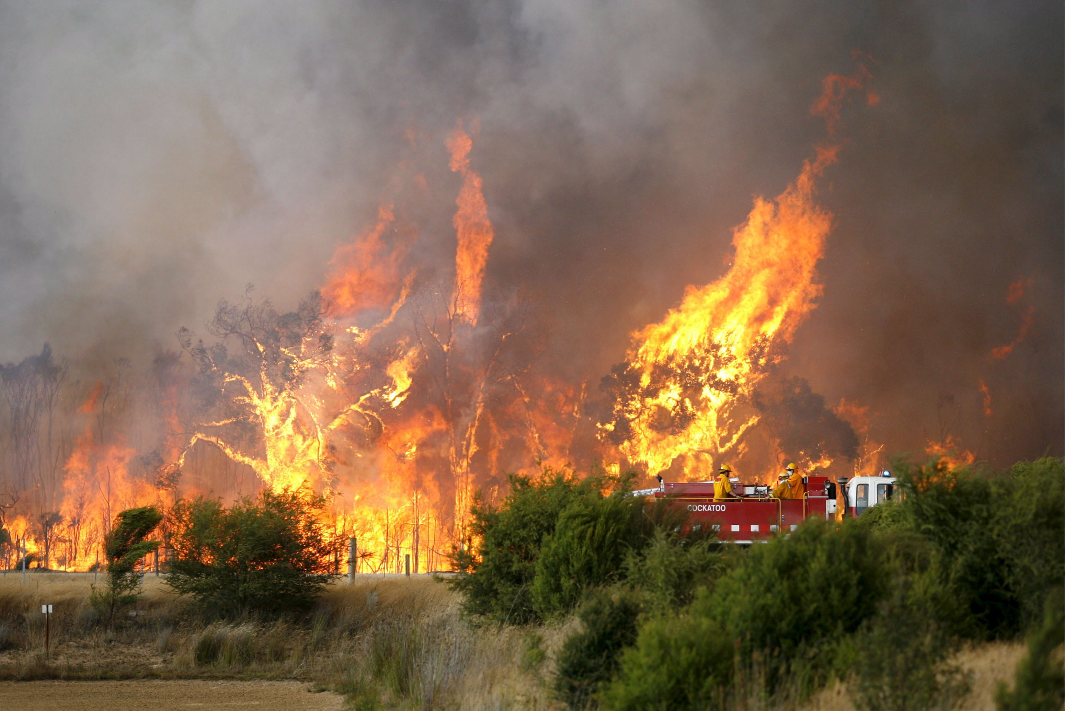
Natural Disaster Management
Disaster management
applications
  Process Big data
  Are real-time!
  Evacuation traffic
  modeling
  Fuel demand
  prediction

Slide 43

Can Public Clouds Help?
Local (organizational)
resources might not
be sufficient
Public Clouds cannot help!
  Insufficient band-width
  Clouds are not trustworthy
How to acquire
resources for Big data
applications at a disaster
time?
VM
VM
Public Cloud
Disaster Management Application
Gateway
G
VM
VM
VM
VM
Private Cloud

Slide 44
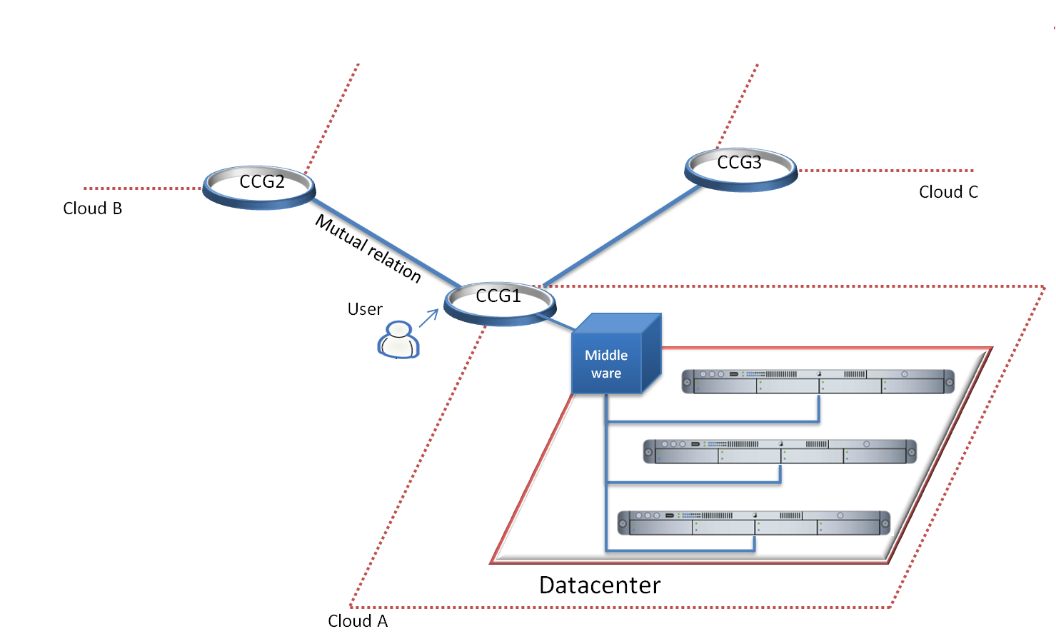
Community Cloud for Natural Disaster Management
Submitted as a proposal to NSF Ignite program

Slide 45
Research Interests
Data Sanitization in Cloud
Robust Cloud Resource Allocation for real time processing of big data

Slide 46
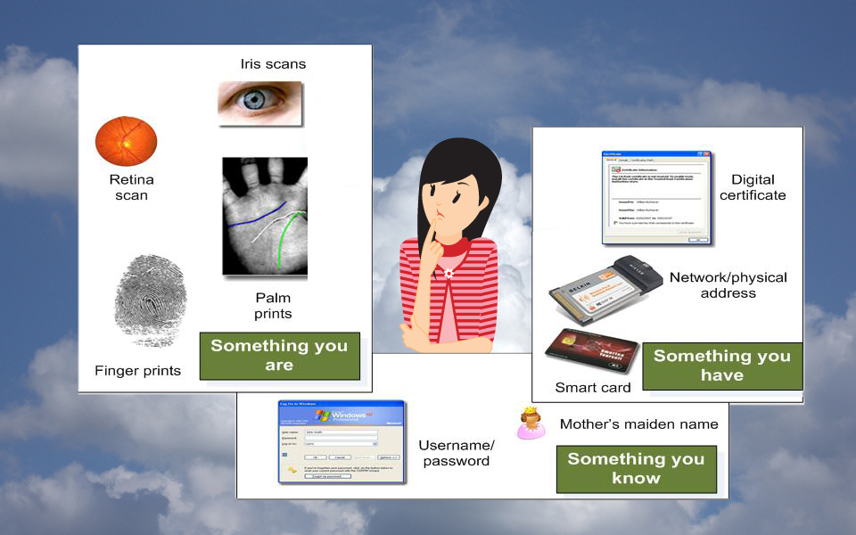
Effective Cloud Authentication
Simple authentication
are not secure
Multi-factor
authentication is
not user-friendly
How to come up with
an effective and secure authentication?

Slide 47
Cloud Authentication Architecture
Progressive authentication eases the user authentication
  Users are authenticated when they want to access higher level services
Implicit authentication eases and secures the authentication

Slide 48

Cloud Authentication Architecture
Explicit Authenticated Factors
Auth.
score
f
Auth slct
Access Level 1
Access Level 2
Remaining Explicit Auth.
Factors
Sandboxing
Implicit Authentication
.
.
Learning
Component
.
Implicit
Weight
Access Level N
Submitted to IEEE Cloud ’15 Conference

Slide 49
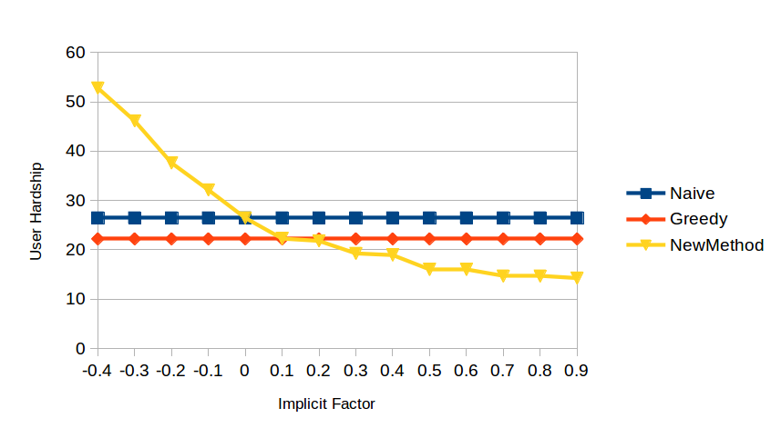
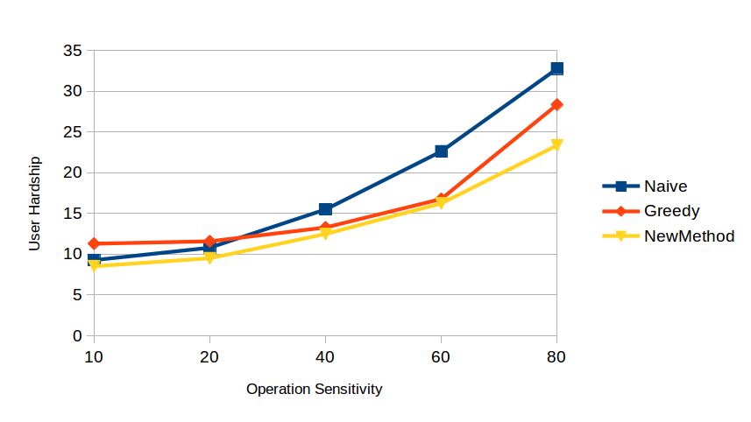
Evaluating User Perceived Hardship
User Hardship
User Hardship
Implicit Factor
Access Level
Adapting user hardship based on
the validity of implicit factors.
Our method decreases the perceived
user hardship .

Slide 50
Thank you for your time.
Any Question?

Slide 51
Appendix
Appendix

Slide 52
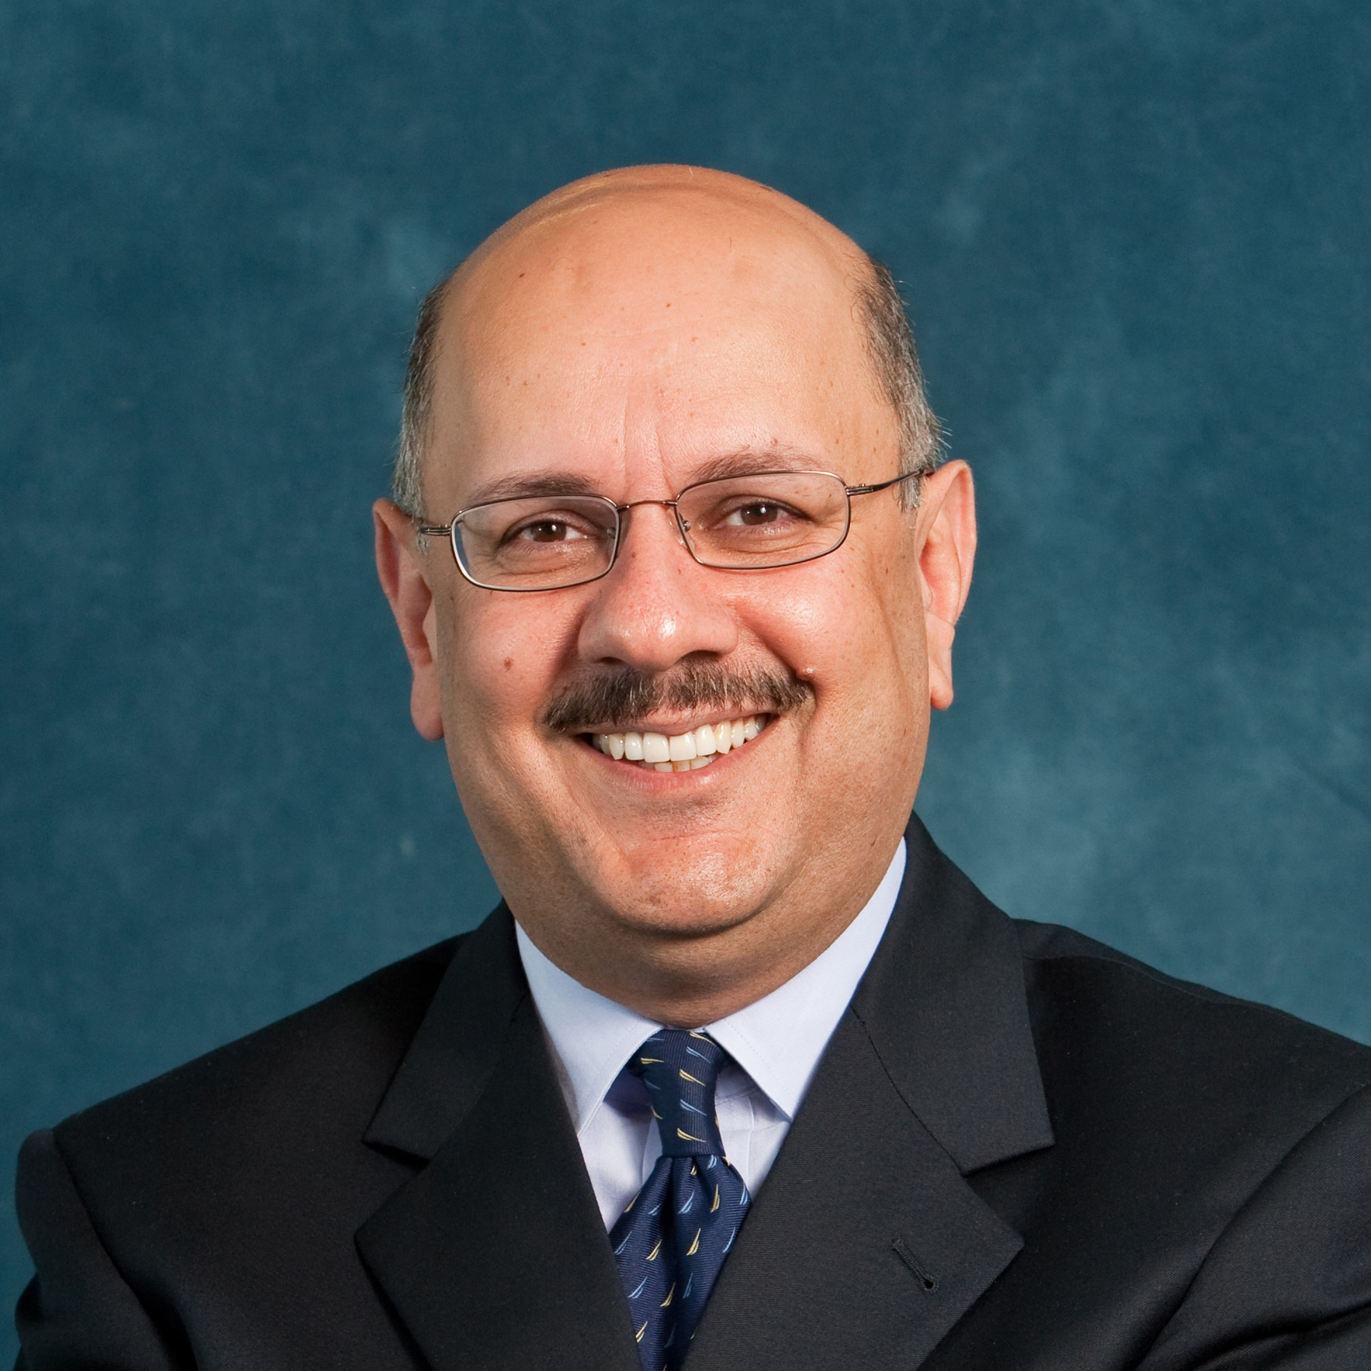
NSF CISE Chair
Short biography: Dr. Farnam Jahanian leads the National Science Foundation Directorate for Computer and Information Science and Engineering (CISE). He guides CISE in its mission to uphold the Nation's leadership in scientific discovery and engineering innovation through its support of fundamental research in computer and information science and engineering and of transformative advances in cyberinfrastructure. Dr. Jahanian is on leave from the University of Michigan, where he holds the Edward S. Davidson Collegiate Professorship and served as Chair for Computer Science and Engineering from 2007 - 2011 and as Director of the Software Systems Laboratory from 1997 - 2000. His research on Internet infrastructure security formed the basis for the Internet security company Arbor Networks, which he co-founded in 2001 and where he served as Chairman until its acquisition in 2010. He has testified before Congress on a broad range of topics, including cybersecurity and Big Data. Dr. Jahanian holds a master's degree and a Ph.D. in Computer Science from the University of Texas at Austin. He is a Fellow of ACM, IEEE and AAAS.

