Slide 1
Cloud 2.0: the Next Generation of Cloud Computing Systems
Mohsen Amini Salehi
Director of High-Performance Cloud Computing (HPCC) Lab
Assoc. Prof. at Computer Science & Engineering Department
University of North Texas (UNT)

Slide 2
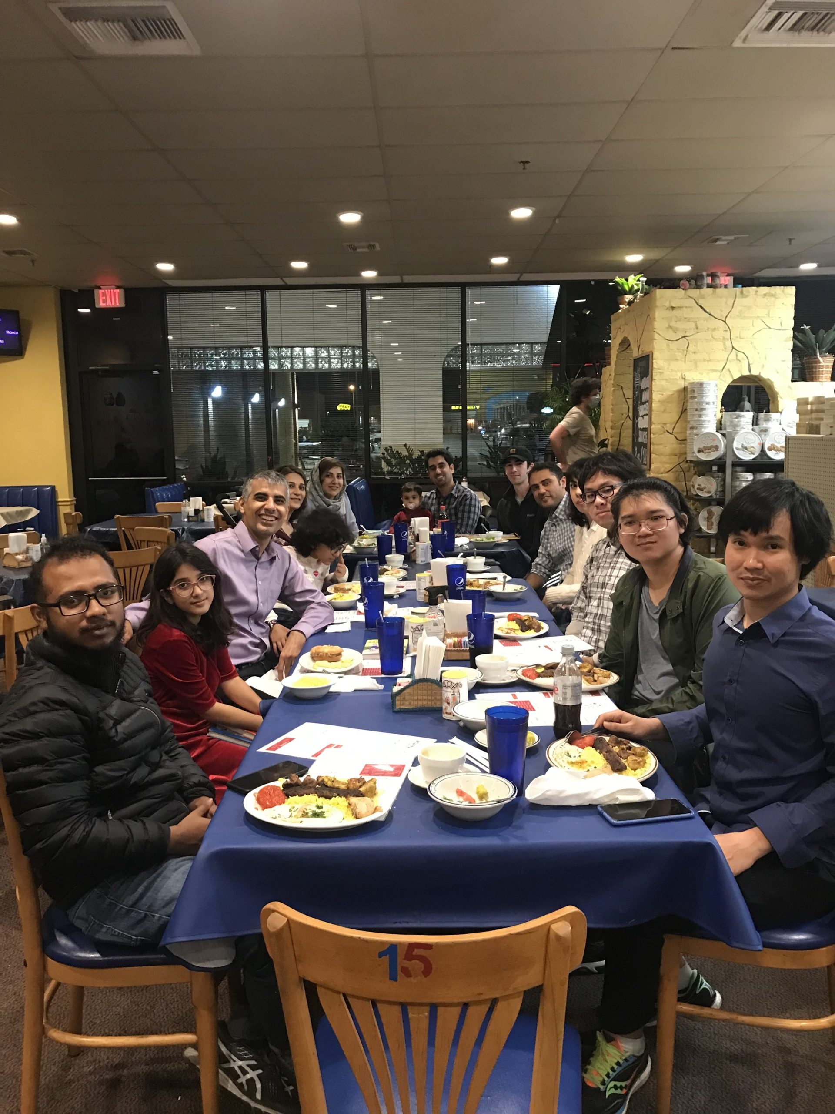
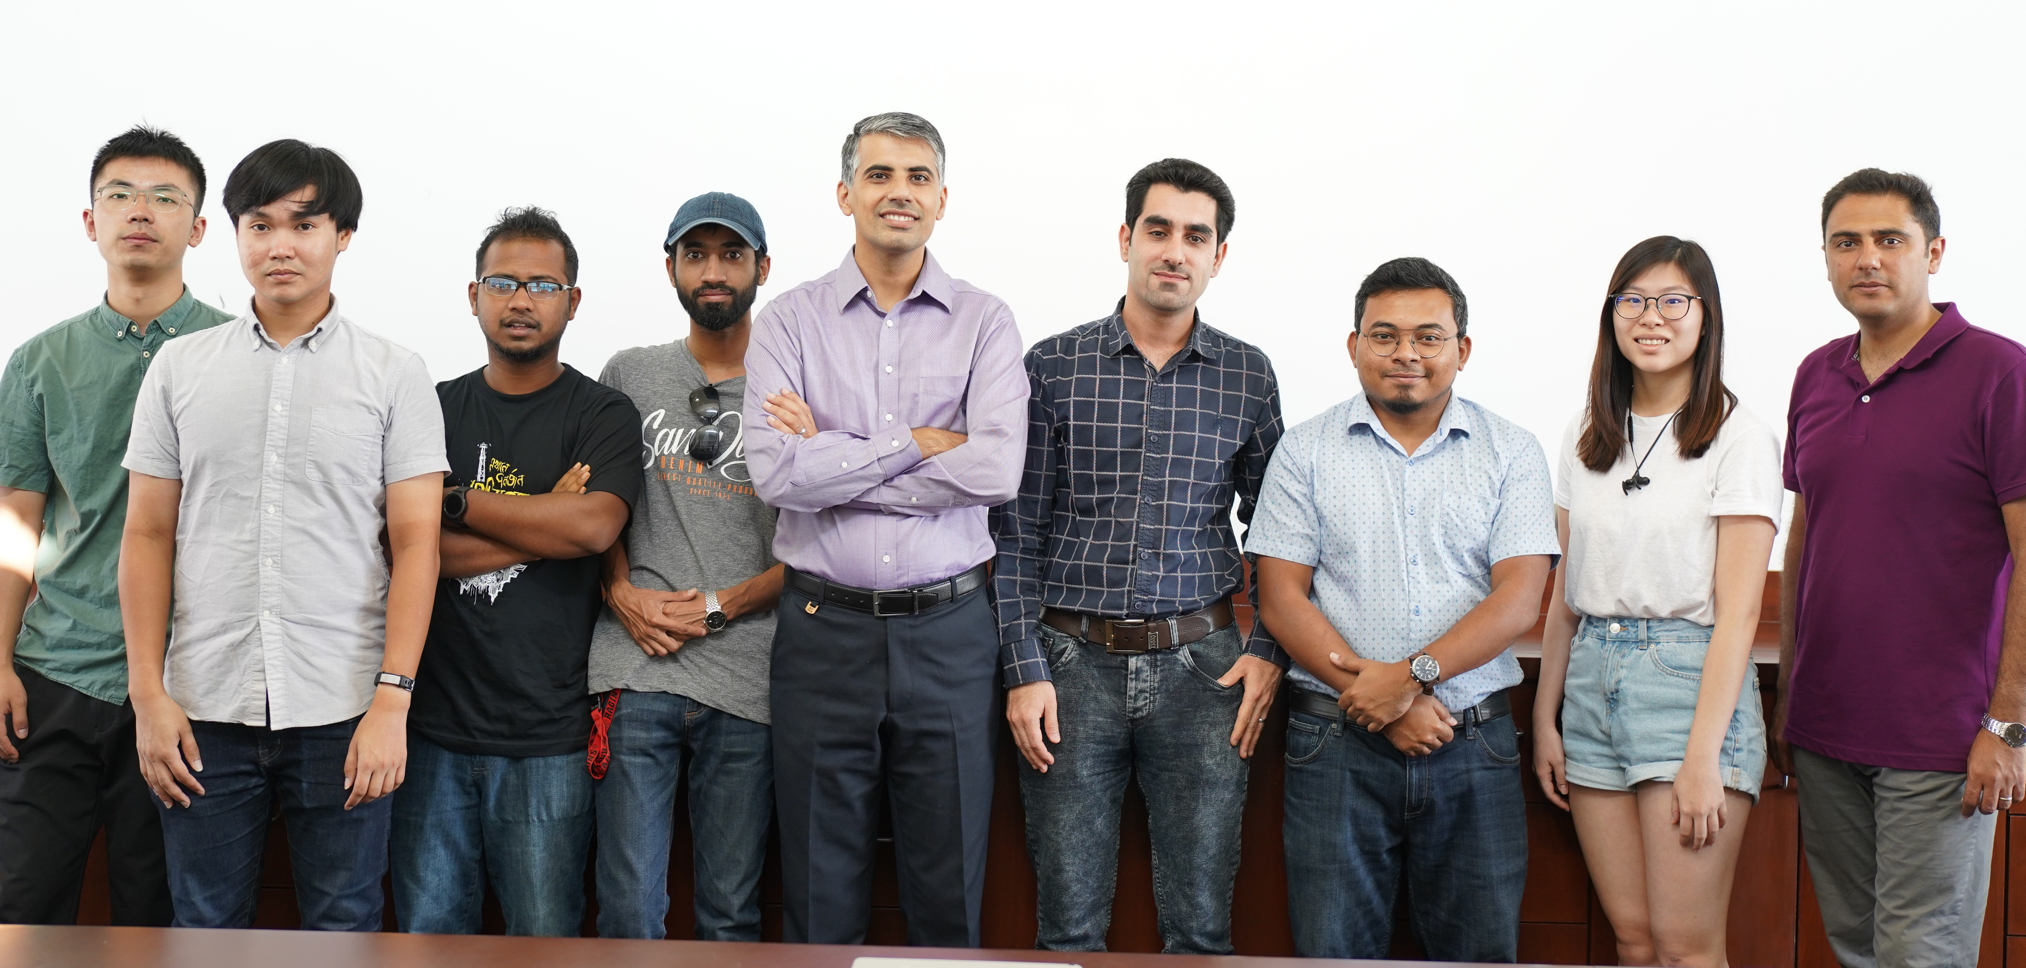
Introduction
Dr. Mohsen Amini Salehi
PhD at Melbourne University 2012
Associate Professor at UL Lafayette (2023)
Associate Professor at University of North Texas (present)
Director of the HPCC Lab
7 members: 6 PhD + 1 MS + 2 BS students
In total 33 students/postdoc/visitors
> 70 peer-reviewed publications

Slide 3
Outline
Research Vision, Mission, and Scope
Two recent projects at HPCC lab
Strategies to bridge the gap of ML & Clouds
Democratizing cloud-native application development (OaaS)
Prospective research directions…
Notes:
Adapting ML algorithms to system characteristics
When ML hits the wall of system constrain

Slide 4
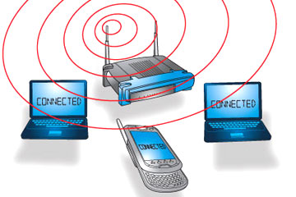
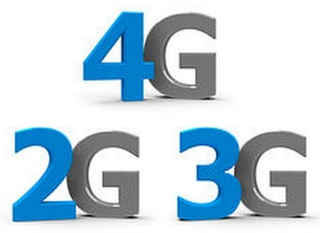
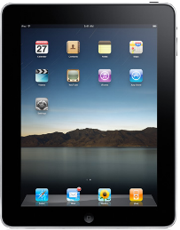
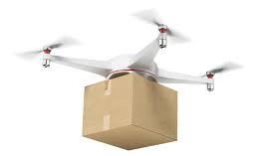
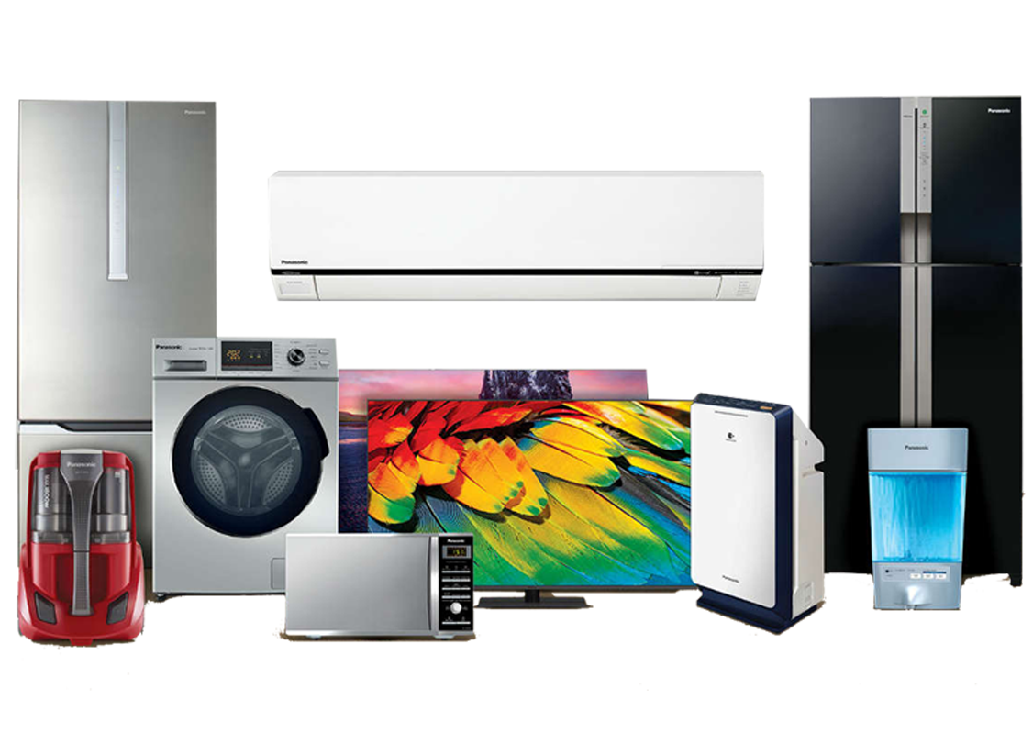
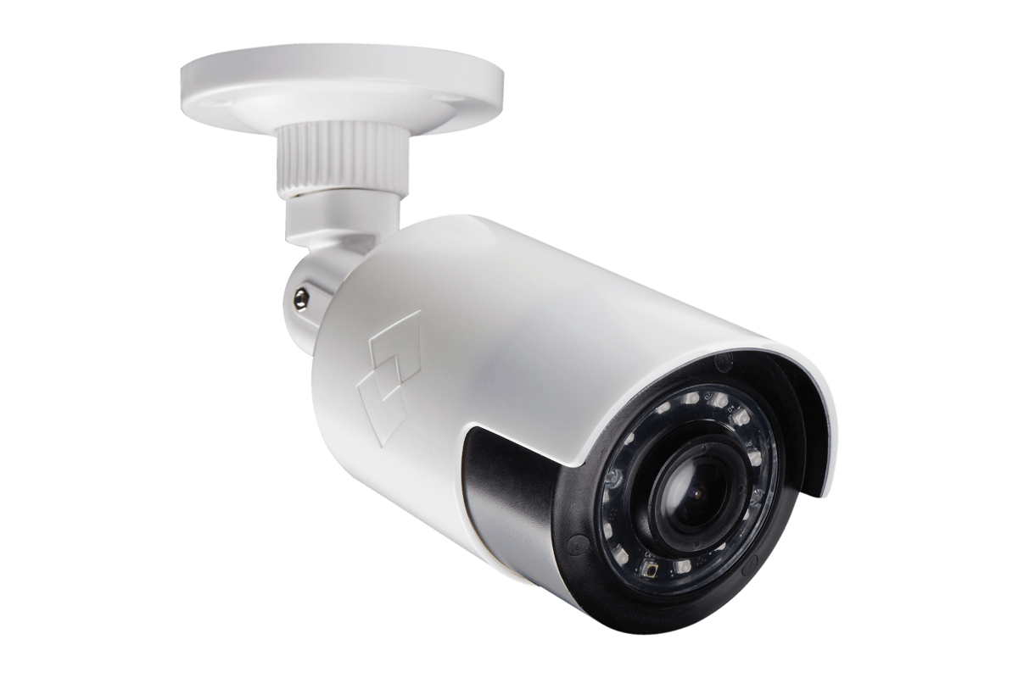
Research Vision
Past Decade
Communication Everywhere
Current Decade
Computing Everywhere
Cloud
Fog
Edge
IoT Device
Notes:
Ubiquitous computing in a spectrum of distributed systems

Slide 5
Research Vision: Cloud 2.0
AI-friendly
Ease of Use (Democratized Programming)
Domain-Specific
Cloud 2.0
Trustworthiness
Highly Heterogeneous (ASICs)
Distributed (Liquid computing)

Slide 6
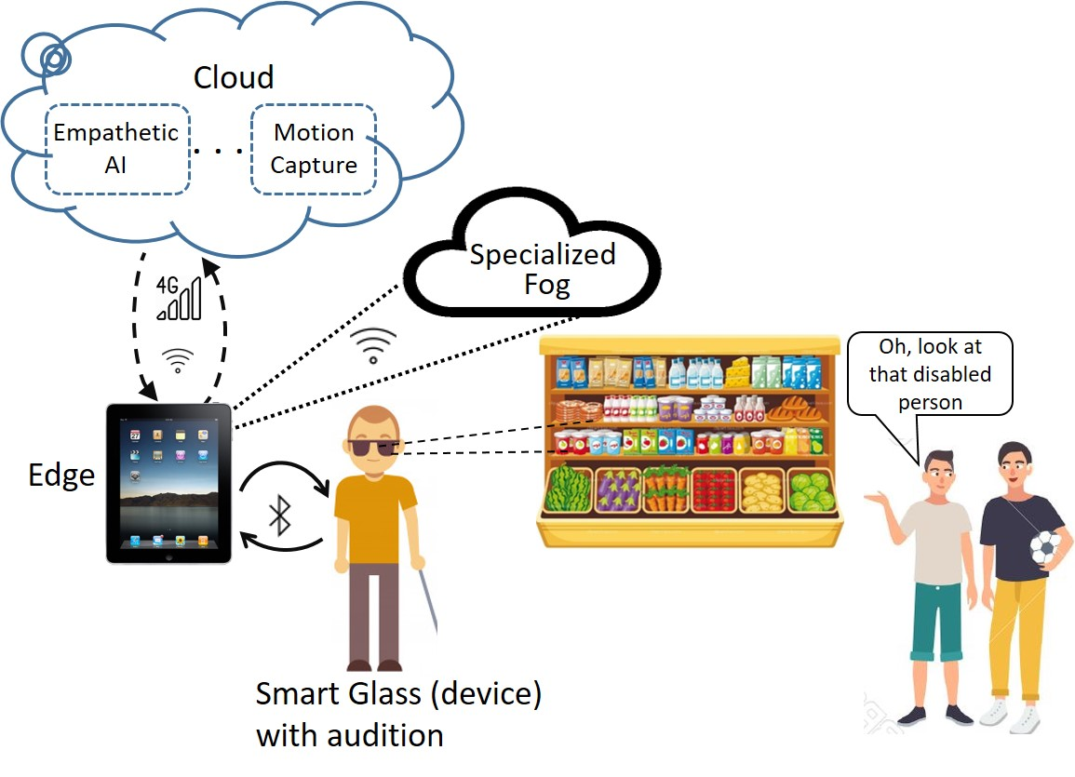
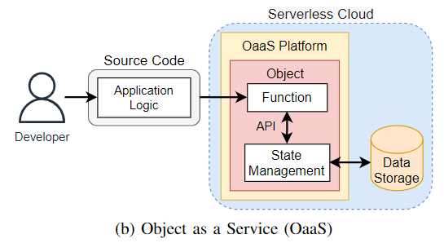
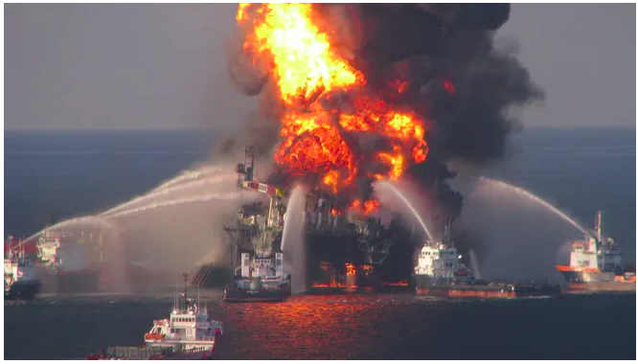
Our Research Mission at HPCC Lab
Help in the development of Cloud 2.0 to improve the quality of human life
Bridging the gap between AI and Cloud 2.0 (for assistive technology)
Providing abstractions to democratize Cloud 2.0 application development
Establishing liquid computing across autonomous computing systems (e.g., for disaster management)
Notes:
Innovate in the forefront of scientific discovery

Slide 7
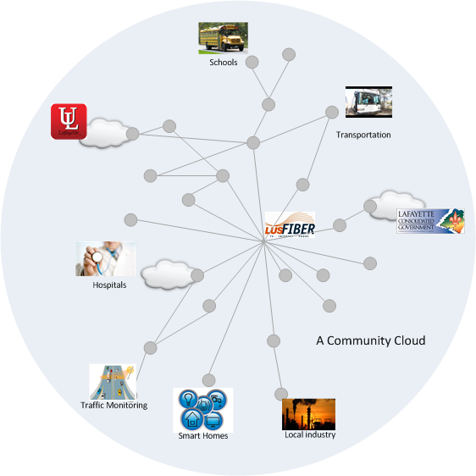
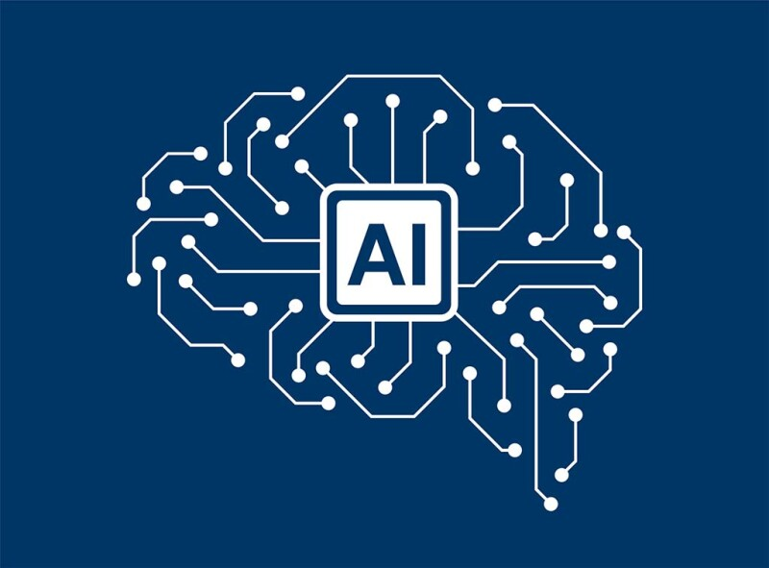
Research Scope
Cloud 2.0 Programming Abstractions
Edge-to-Cloud Systems
SmartSight Ambient perception for blind and visually impaired people
Open-Source products:
E2C simulator
OaaS
UMS/NIMS
AI Applications

Slide 8
Research Thrust 1: Edge-to-Cloud Systems for ML Applications
ML applications and Edge-Cloud systems developed orthogonal to each other
Our vision: there is an infrastructural gap to make ML usable across Edge-to-Cloud
ML algorithm+system software co-design (ML+Sys) is the key to “usability”
Our ultimate goal is to enable perception like a sighted person

Slide 9
ML Usability Challenges on Cloud 2.0
Inference Latency
Fairness
Resource Intensive
AI-Friendly Cloud 2.0 Challenges
Durability(Energy Use)
User Privacy
Robustness
Scalability (elasticity)
Accuracy

Slide 10
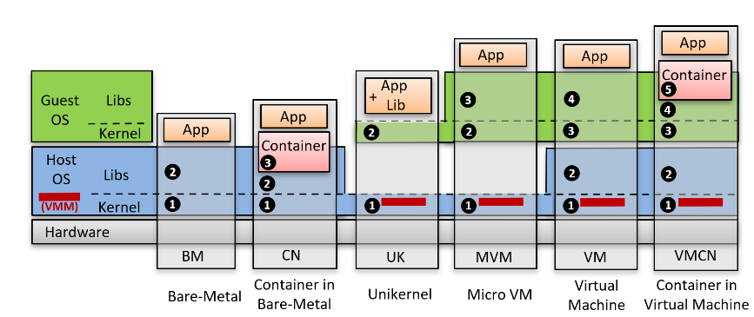
ML Inference + Cloud Virtualization = Latency Challenge
ML deployment → Virtualization overhead!
How to deploy ML apps on Edge and Cloud to maintain usability?
* Published in CCGrid ’22 and ICPP ’20

Slide 11
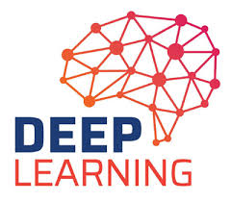
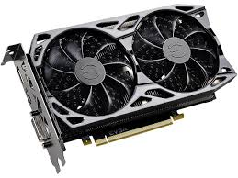
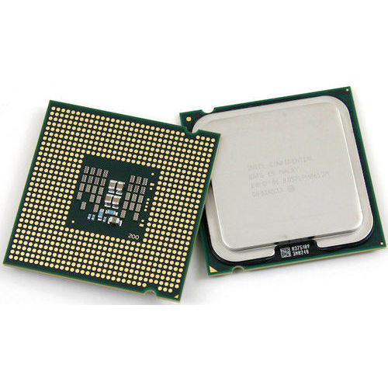
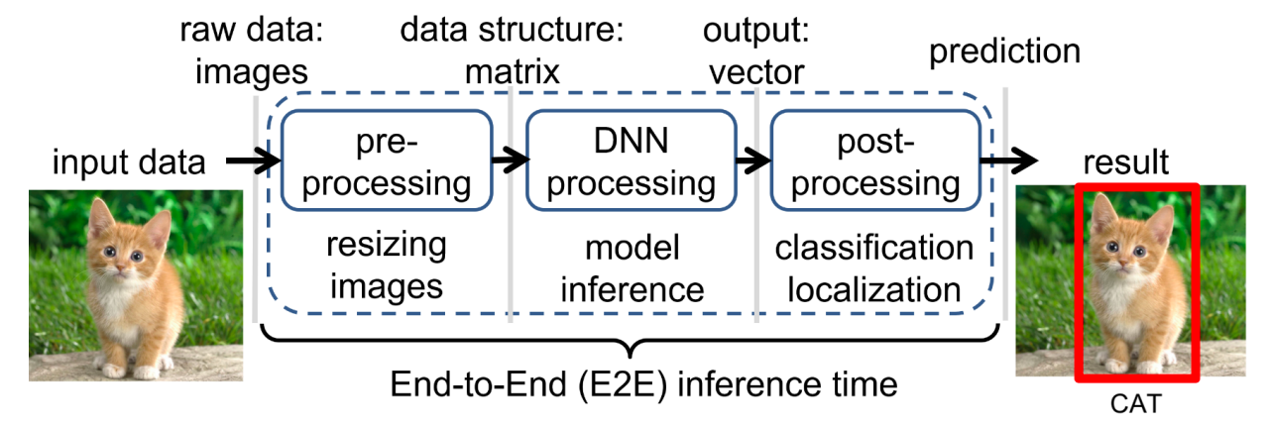
ML Deployment Decision Space
Deep Learning operation
Compute Unit
Execution Platform
Inference
GPU
Container
VM
MVM
VMCN
BM
X86
Training
CPU
ARM
End-to-End Inference Time
Notes:
Top image:
Introduce Deep Learning and its impact in people life
Talk about Increasing usage of DL in modern applications
Introduce different DL operations
Demonstrate computational requirements of DL applications (Compute units)
Various possibilities for execution platforms
Button image:
Introduce different execution stages of a DL application when perception an image in an image classification application and their functions

Slide 12
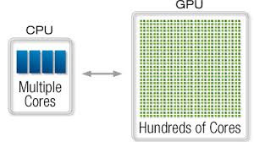
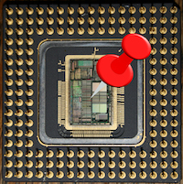
Questions for Low-Latency ML Deployment
Edge
What type of virtualization on Cloud and Edge for different ML apps?
Is it worth to
utilize GPU?
pin CPU cores?
Impact of scale-up on virtualization overhead?
When only CPU is used
When CPU+GPU is used
12
Notes:
Talk about the questions that a cloud architect needs to find an answer for, when planning the DL application deployment

Slide 13
Explored Scenarios
Computing Platform
Execution
Platforms
Benchmark Suit
(MLPerf)
Processor
config
CPU Cores
(Scale-up level)
4
CN
Image
Classfy.
Vanilla CPU
8
Cloud
Server
MVM
Speech Recog.
Pinned CPU
GPU+
Vanilla CPU
16
VM
NLP
GPU+
Pinned CPU
32
VMCN
Recom.
System
64
BM
13
Notes:
Introduce each column
As an example, talk about the bold black path experiment
Also demonstrate the red path for MVM
13

Slide 14
Deep Learning Apps and Models in MLPerf
Which applications to choose?
Commonly used in production
Related to end-user experience
Different input data type
Deep Learning apps and their NN Models
Vision --> ResNet50
Speech Recognition --> RNNT
Natural Language Processing --> BERT
Recommendation system --> DLRM
14
Notes:
Talk about what parameter are important for us to choose the applications
Introduce the 4 applications and their DNN models
On X86
On ARM

Slide 15
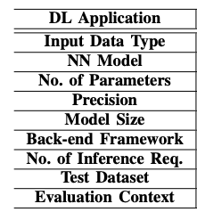
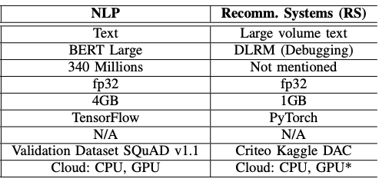
Examined Applications
15
Notes:
Quickly go over the ”DL Appication” column
Talk about the workload (the batch size)
Explain the “Evaluation Context” for all apps.

Slide 16
Infrastructure Setup
X86:
80 x Intel(R) Xeon(R) Gold 6138 CPU @ 2.00GHz
512GB DDR3 @ 2666 MT/s
GPU: Tesla k40c
ARM:
Quad core Cortex-A72 (ARM v8) 64-bit SoC @ 1.5GHz
8GB LPDDR4-3200 SDRAM
Notes:
- Demonstrate the Hardware specs of server and Raspberry Pi.
- Quickly go over the table, don’t need to read the whole. Just columns.

Slide 17
Analysis of Image Classification
Investigate the impact of scale-up
Scrutinize resource utilization patterns of the app before deployment
Upon scaleup, contention for copying data to the GPU, number of CPU and GPU interrupts, and cache misses are amplified
Scale-up improves the E2E inference time up to a certain number of cores
Counter-intuitive behavior of vanilla CN
CPU-GPU is not remarkably beneficial (pre- and post-processes are not GPU-enabled)
Notes:
Introduce the experiment and the X and Y axis in the figures
Different exec platforms
Scale-up
Inference avg execution time
Explain the second experiment with the granularity of different DL processing stages
Show that how scale up impact average executing of each stage (helps with CPU only, but hurts CPU-GPU)
Explain why scale-up for CPU-GPU is counter-intuitive
Explain Why CPU-GPU platform is not remarkably beneficial:
The complexity and overhead of data transfer between the main memory and the GPU memory increases upon scale-up
The number of cache-misses is increased upon scale up

Slide 18
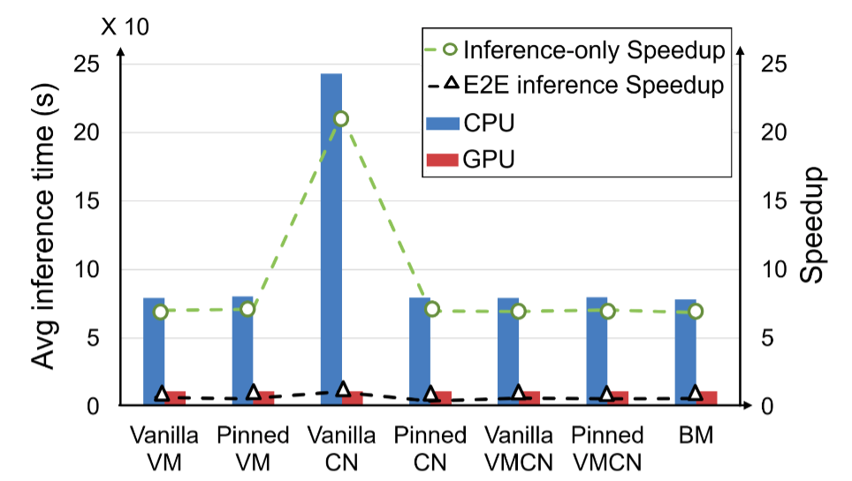
Are Pre- and Post-Processing Phases the Culprit for Slowdown on GPU?
If pre- and post- processing phase dominate the execution time, GPU won’t be helpful
Measure the speedup of all three execution phase of DL application (E2E), not only inference part
CPU-GPU offers 4× to 9× speedup for “inference-only”
18
Notes:
are pre- and post-processing the main reasons for slow-down when we have GPU as opposed to the same number of cores on CPU (e.g., 16 on both cases)? The answer is yes, because the speedup of inference-only is much higher than the speedup of e2e that includes pre and post
Note that speedup is calculated as: (time on 16 core cpu)/(time on 16 core GPU)
Image classification using DLBS on ResNet50 model
Illustrate both X axis (Avg inference time and Speedup) and Y axis.
Explain DL inference stages and why GPU is boosting performance

Slide 19
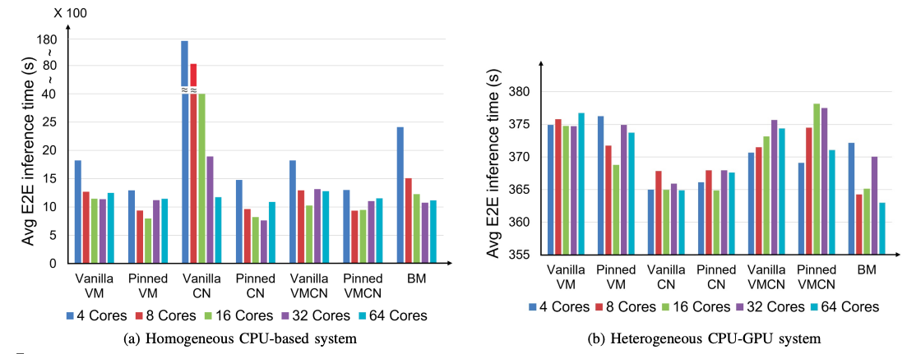
Analysis of NLP Application
NLP needs to load lots of small data, as opposed to image classification with few large data (image). Efficient storage can reduce pre-processing overhead. For NLP, SSD storage that have high IOPs are beneficial whereas for image, throughput-based (HDD) is enough
Scale-up level is not a decisive factor
Use high performance storage for DL applications with many small-size input file
CPU-GPU configuration: more than 3× speedup in the E2E execution time
Notes:
GPU causes more than 3× speedup in the E2E execution time. This is because, the inference time on GPU dominates the times of pre- and post-processing on CPU.
For the same reason Scale-up level and pinning are not important

Slide 20
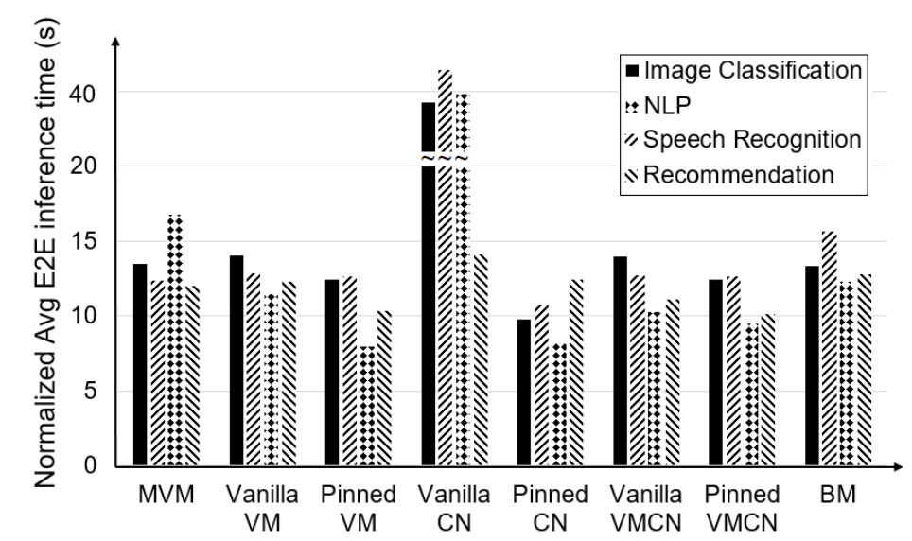
The Impact of CPU Pinning
Pinning CPU cores mitigates overhead particularly for vanilla CN
20
Notes:
E2E inference times of applications are normalized
MVM lacks the Qemu para-virtualization modules → lower performance than VM
Its the IO latency that causes MVM either does not offer performance superiority over vanilla VM
We conducted another experiment using Cassandra as the application (IO intensive) → VM remarkably outperforms MVM
MVM boots remarkably faster than vanilla VM however in terms of inference performance there is no major difference with Vanilla VM

Slide 21
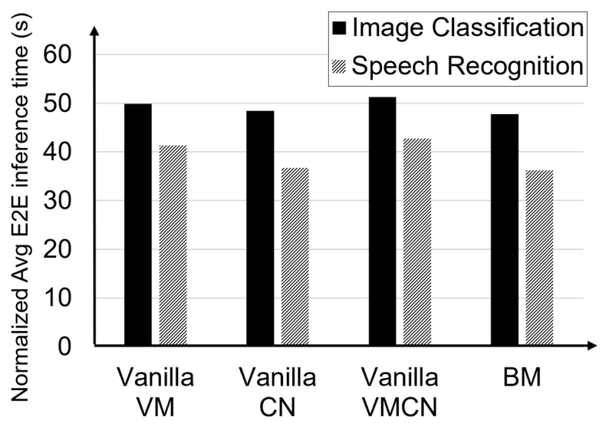
Edge device experiment results
Containers are suggested for ML deployments on the Edge

Slide 22
Future Directions: Cloud+MultiAI to Unlock New Levels of Smartness
Edge-Cloud to enable attention management
Human-like concentration
Progressive perception
Attention navigation (searching for objects)
Notes:
So far, we tried to adapt ML and system
Next, we plan to use system knobs to unlock new level of smartness
How to enable concurrent perception on edge?
Shortage of memory on edge
Bias against some concurrent applications

Slide 23
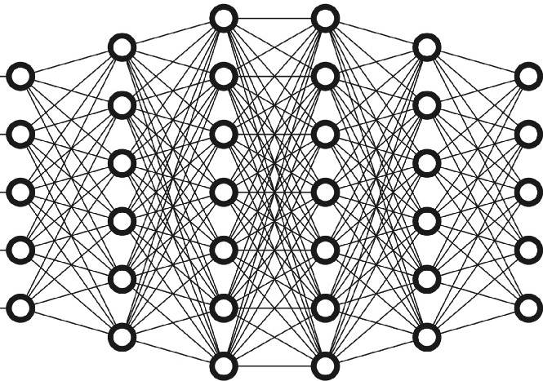
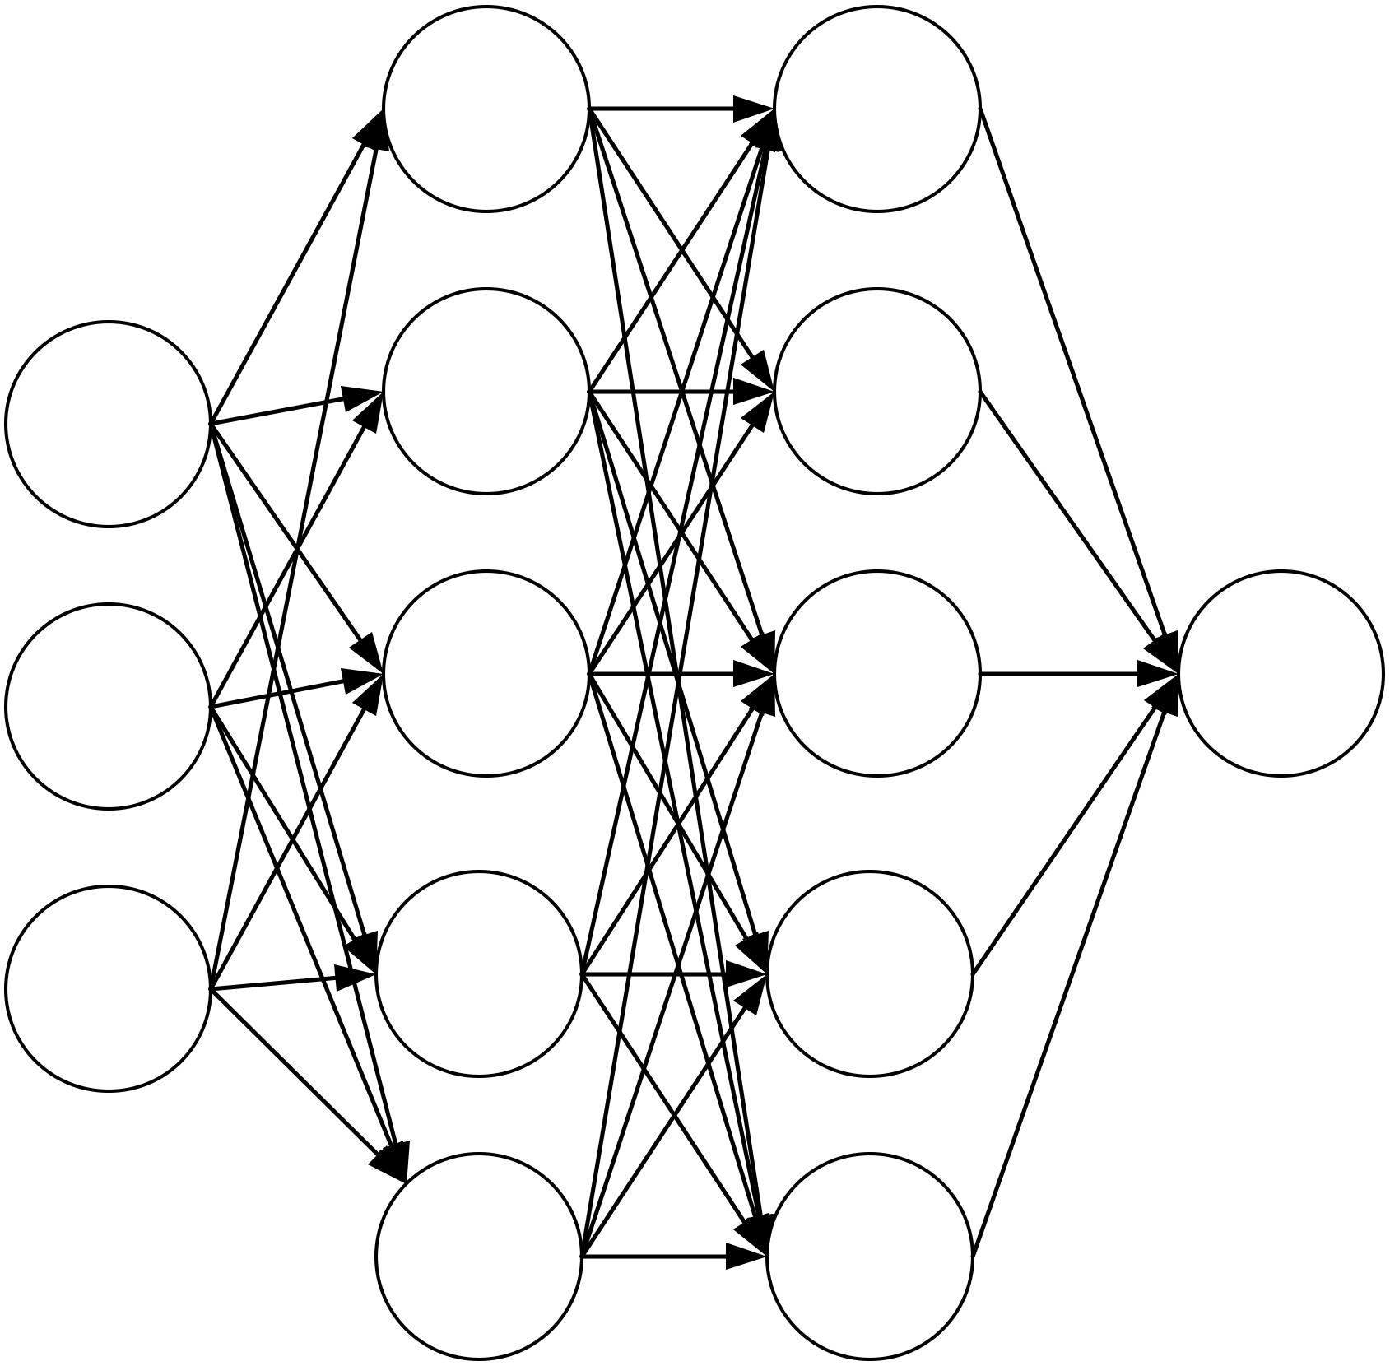
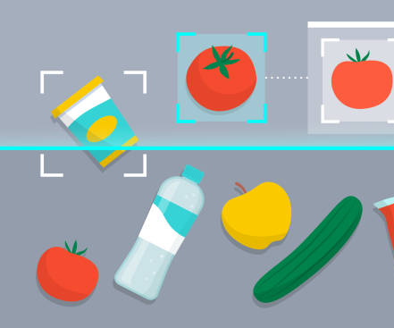
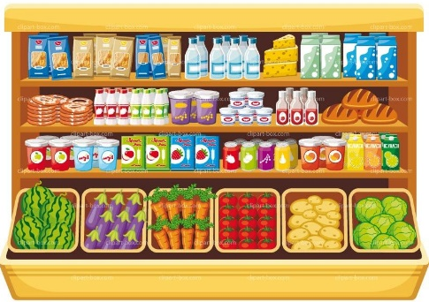
Future Direction: Edge-Cloud to Enable Human-Like Concentration
Unnecessary (disturbing) face detection
Concurrent Apps
Focus is shopping
Edge
Focus shifts to face detection
Notes:
So far, we tried to adapt ML and system
Next, we plan to use system knobs to unlock new level of smartness
How to enable concurrent perception on edge?
Shortage of memory on edge
Bias against some concurrent applications

Slide 24
Cloud 2.0 Characteristics
AI-friendly
Ease of Use (Democratized Programming)
Domain-Specific
Cloud 2.0
Trustworthiness
Highly Heterogeneous (ASICs)
Distributed (Liquid computing)

Slide 25
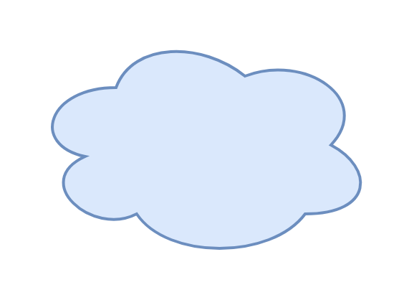
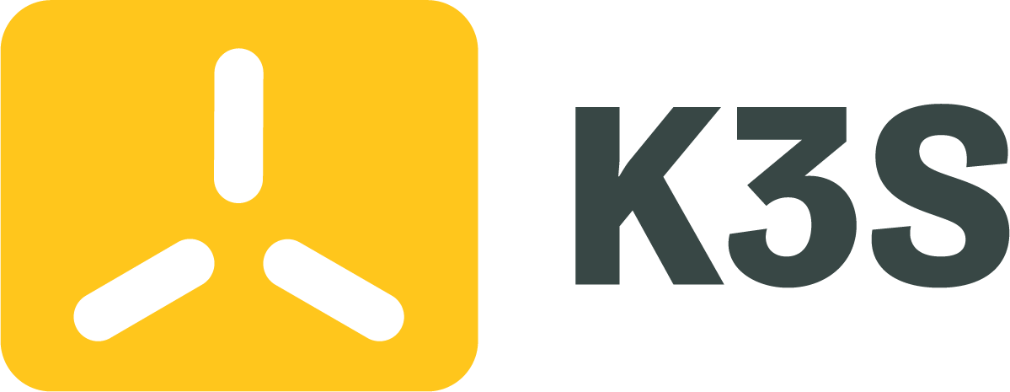
Research Thrust 2: Liquid Computing across Edge-Cloud
Demo video: http://y2u.be/BK_PyvRpr1A
Edge lacks elasticity!
Cloud ( )
UMS/NIMS
Edge ( )
Live Service
Migration
Image Recognition
. . .
Motion
Capture
Gaming
Service
Low-priority users playing
High priority user arrives
* Presented at SC ’22 and at Globecom ’23
Notes:
Let’s watch a demo video:
https://www.youtube.com/watch?v=BK_PyvRpr1A

Slide 26
Other Advantages of Live Service Migration (Liquid Computing)
For service elasticity, mobility, and load balancing purposes
To reduce cost, latency, and energy footprint
Let’s watch a motivational video: https://youtu.be/S-VNqfHmrws

Slide 27
Cloud 2.0 Characteristics
AI-friendly
Ease of Use (Democratized Programming)
Domain-Specific
Cloud 2.0
Trustworthiness
Highly Heterogeneous (ASICs)
Distributed (Liquid computing)

Slide 28
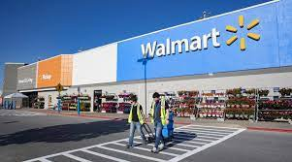
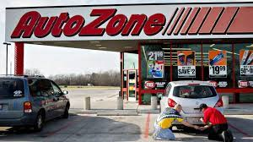
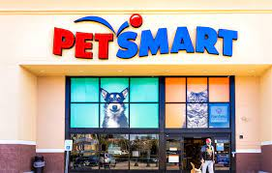
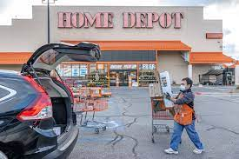
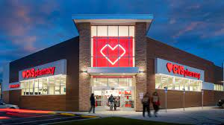
Research Thrust 3: Cloud 2.0: Domain-Specific Serverless Clouds
Emergence of ASICs, domain-specific PLs, serverless (FaaS)
Our vision: Domain-specific serverless platforms operating across Edge-to-Cloud will be the next generation clouds
Specific platform needed to:
Offer specialized services
Programming abstractions
Effectively utilize ASICs
Provide built-in QoS & compliance
Notes:
Specialized billing
High-level apis
Advance resource allocation for reusing and cost-efficiency
Customized execution platforms (container vs bare metal vs VM vs unikernel vs mvm)
While the first gen of cloud focused on mitigating the burden for sys admins, the second generation will mitigate the burden for programmers
We envisage that in certain highly-demanded domains (ML, medical, video, mapping) there will be domain specific clouds

Slide 29
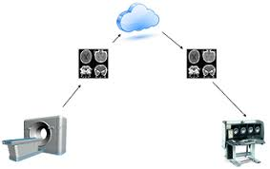
Research Thrust 3: Domain-Specific Serverless Cloud Systems
Software development landscape will be changed to a mashup of service-calls across multi-specialized-clouds!
Abstraction is the centerpiece to democratize “cloud-native application development”
Notes:
A motivational scenario can be recording the video; transcoding on video processing cloud, annotate it to different languages on a ML cloud
2nd scenario: collect climate information from sensors, a data analytics service to predict the chance of flood, a mapping cloud to model the impact of flood

Slide 30
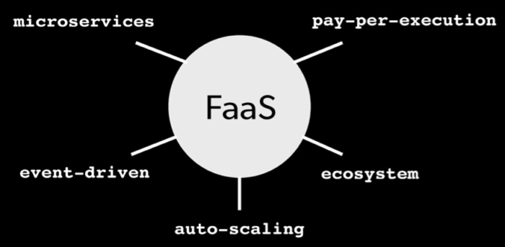
Existing Cloud Programming Abstraction: FaaS
Write a function and leaves the provisioning to cloud!
Automatic scaling & scale to zero
Truly pay-as-you-go
Low-cost deployment
Low computing load
Small data size
30

Slide 31
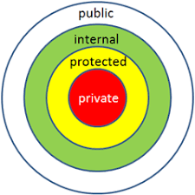
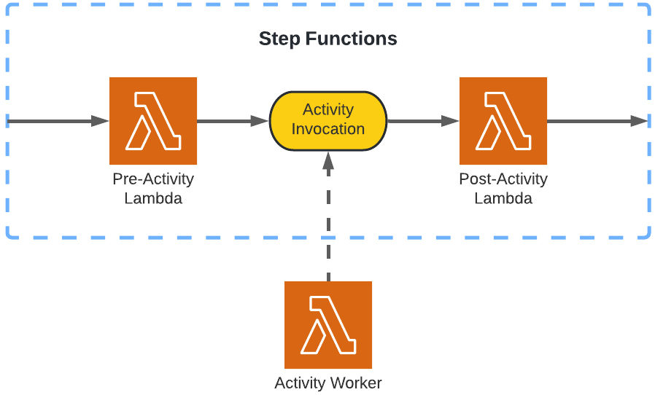
FaaS Shortages
Developers must manage the state (e.g., via cloud database)
Functions—state separation
Lack of encapsulation
Lack of built-in access control (private/protected/public)
Lack of dataflow semantics
Cannot manage the state across functions
Relies on external services for workflows

Slide 32
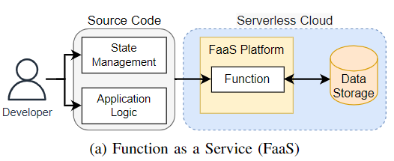
Our Proposal: Object as a Service (OaaS) Paradigm
OaaS encapsulates functions+data
transparent resource & data mgmt
enables access level (public/private…)
enables software reuse (inheritance)
OaaS enables dataflow semantics
built-in support for function workflows
managing intermediate data across functions
OaaS encapsulates QoS, constraints, and location across multi-cloud
* OaaS is pen-source on Github
* Published in TPDS ’22 and IEEE Cloud ’23
32

Slide 33
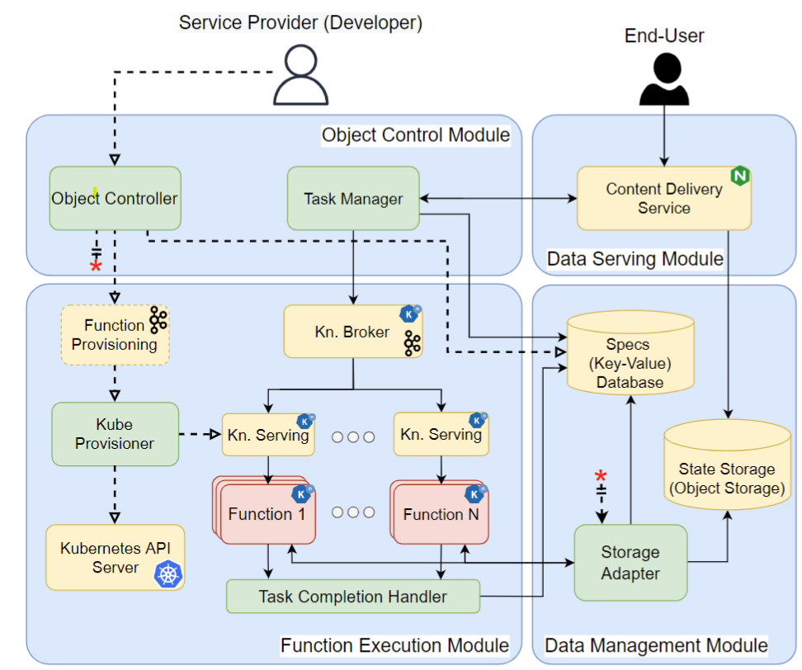
OaaS Architecture
Object developer
Object consumer
OaaS
33
Notes:
The OaaS platform is designed based on multiple self-contained microservices communicating over the network in a serverless cloud system.

Slide 34
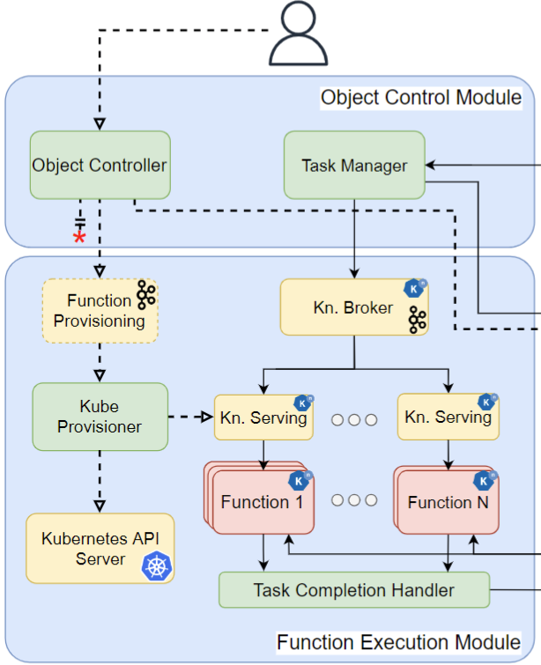
OaaS: Developing New Objects
Object developer
offers the object & class abstractions
managing their metadata
registering functions
enabling user to create objects
Deploying the containerized function
Notes:
The OaaS platform is designed based on multiple self-contained microservices communicating over the network in a serverless cloud system.
To avoid the bottleneck, Task Manager is stateless by maintaining the internal state on the key-value database.

Slide 35
OaaS: Consuming the Object
translates a func. call to a task
transparent access to object state and functions (OAI)
manage task ordering in a workflow
Object user (calling a function of an object)
routing the task to appropriate container
Autoscaling and scale-to-zero of functions
Notes:
The OaaS platform is designed based on multiple self-contained microservices communicating over the network in a serverless cloud system.
To avoid the bottleneck, Task Manager is stateless by maintaining the internal state on the key-value database.

Slide 36
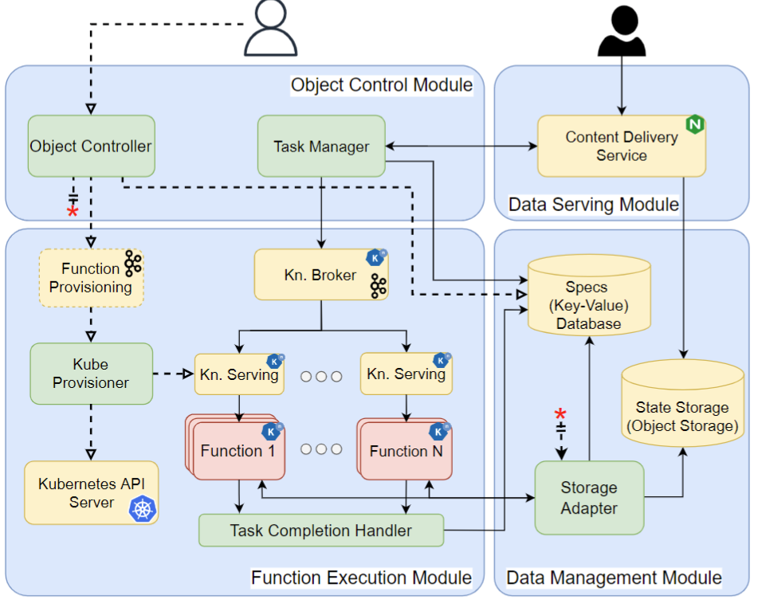
OaaS: Data Management Module
Object developer
Object consumer
gateway to access object & function
Implemented via Nginx
enabling efficient and secure access to object state
reduce data movement via HTTP redirect mech.
Notes:
Utilizing the S3 presigned URL to prevent the receiver can access the other data by analyzing the path.

Slide 37
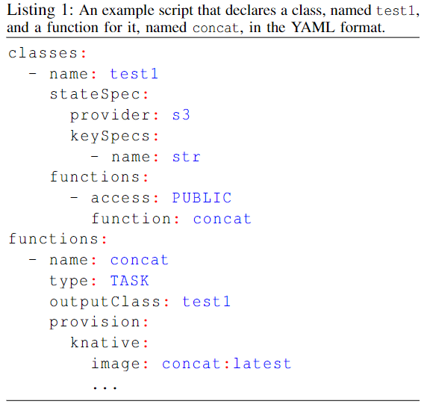
Use Case: Class Definition in OaaS
state
declaration
Example Object instantiation and call:
video
video1:constructor():persigned_URL
HTTP PUT(MY_VIDEO, persigned_URL)
transcode
video1:transcode(var=1024)
transcode
function
definition
transcode:latest

Slide 38
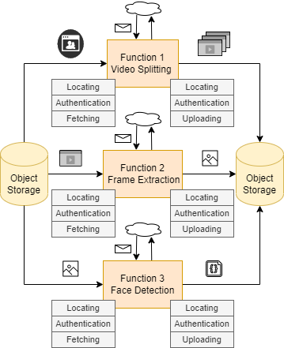
Case Study: Face Detection on a Given Video
FaaS

Slide 39
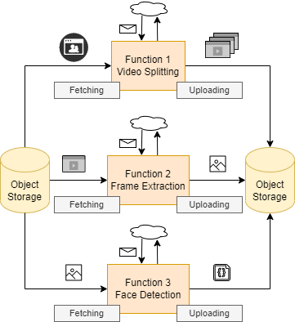
Case Study: OaaS for Face Detection on a Given Video
class video{
state:
name: src_video
functions:
video_split():video;
extract_frame():image;
Workflow:
Wf_face_detect():json_rec;
}
OaaS:
class image{
state:
name: img
functions:
face_detect():json_record;
}
class json_record{
state:
name: json
}

Slide 40
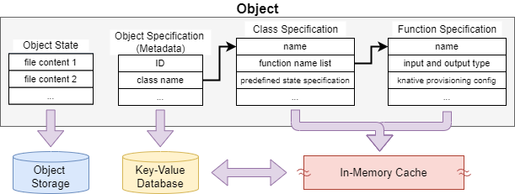
Data Modeling in OaaS
OaaS persists the four parts of the object data into the different data store based on the size and access frequency.

Slide 41
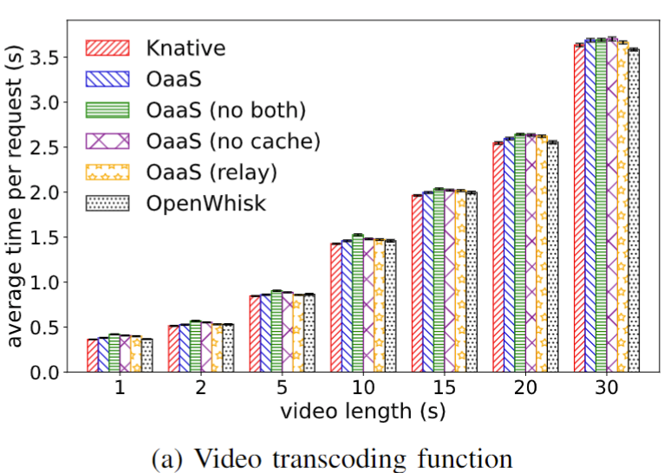
Evaluating OaaS Overhead
OaaS can operate with insignificant overhead, particularly, for unstructured data (e.g., video)
Notes:
Why OaaS no cache is better than Oaas for Json?

Slide 42
Evaluating OaaS Scalability
Demo Video:
https://www.youtube.com/watch?v=SIfIpPWZuls
Notes:
The reason is that StateFun is built on top of Apache Flink, a mature stream processing platform. While we observe that Knative speedup slows down at 12 VMs due to limitations in its internal mechanics, OaaS continues to scale
For OpenWhisk, even though more VMs added, its autoscaling stops deploying new workers after reaching a certain number of containers, thus, the speedup stops increasing after 6 VMs

Slide 43
Case Study: OaaS for Face Detection on a Given Video
class video{
state:
name: src_video
functions:
video_split():video;
extract_frame():image;
Workflow:
face_detect():json_record;
}
OaaS:
Still Hard to Program!!!!
class image{
state:
name: img
functions:
face_detect():json_record;
}
class json_record{
state:
name: json
}

Slide 44
Future Direction: The Last Mile to Cloud Programming Democratization…
Layman user has a generic query!
Object developer
Check mask facing of nurse in this video
Notes:
The OaaS platform is designed based on multiple self-contained microservices communicating over the network in a serverless cloud system.

Slide 45
Next Step: Our Vision of Cloud Programming Democratization
Information Based
Search Engines (Pattern Matching)
Check mask facing of nurse in this video
Knowledge Based
Search Engines (GenerativeAI)
Processed video
Action Engine! Our approach of Cloud Programming
Our System (OaaS)
Notes:
Computers digest multiple hardware; Action engine will digest multiple software
Action engine:
فاذا اراد کن فیکون

Slide 46
Next Step: Building Blocks of the Action Engine!
Object consumer (doctor, nurse) programs a camera object
Q: check mask facing of nurse in charge
use LLM to instruct steps to handle query
semantic search across object methods
Deploy on Cloud
Notes:
Analogy with the convergence of computers (multiple hardware as different software within one computer)
Action engine is a step to elevate human to be god. فاذا اراد کن فیکون

Slide 47
Summary
Cloud 2.0 is on the horizon!
Challenges & opportunities of Edge-Cloud+MultiAI
Democratized cloud programming
Action engine

Slide 48
Thank you for your time…
Mohsen.aminisalehi@unt.edu

