Slide 1
Realizing Fluid Computing in Cloud 2.0
Mohsen Amini Salehi
Director of High-Performance Cloud Computing (HPCC) Lab
Assoc. Prof. at Computer Science & Engineering Department
University of North Texas (UNT)

Slide 2
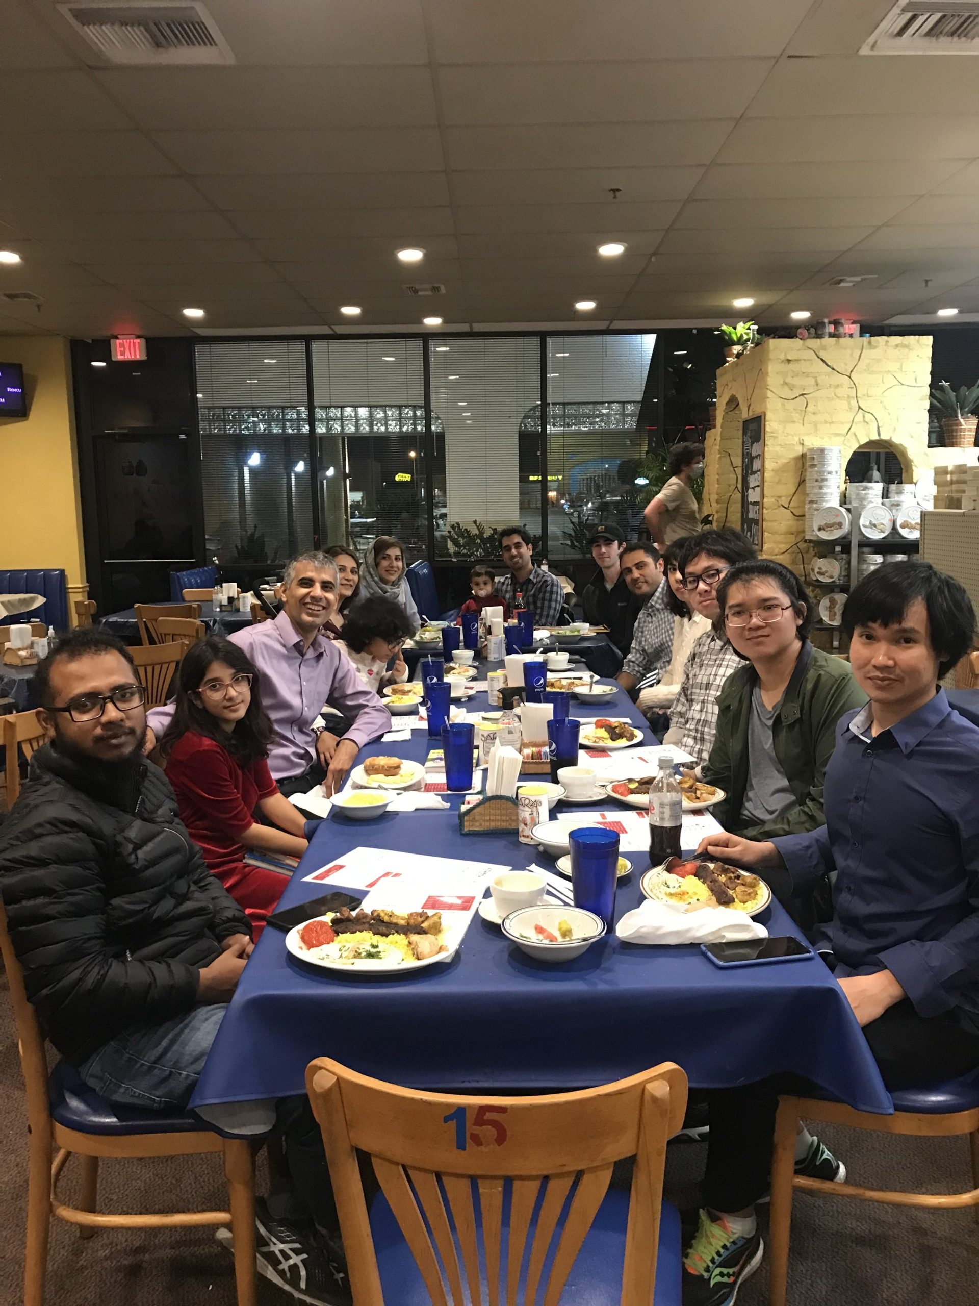
Introduction
Dr. Mohsen Amini Salehi
PhD at Melbourne University 2012
Associate Professor at University of North Texas (now)
Director of the HPCC Lab
7 members: 6 PhD + 1 MS + 2 BS students
In total 33 students/postdoc/visitors
> 70 peer-reviewed publications

Slide 3
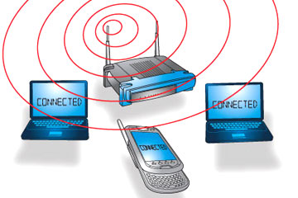
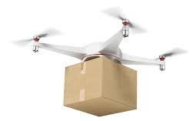
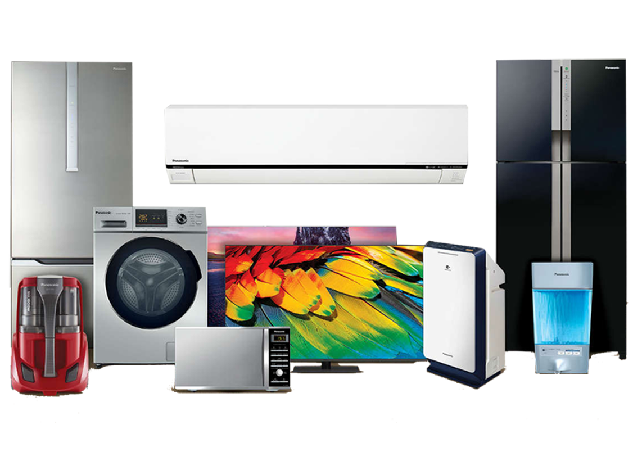
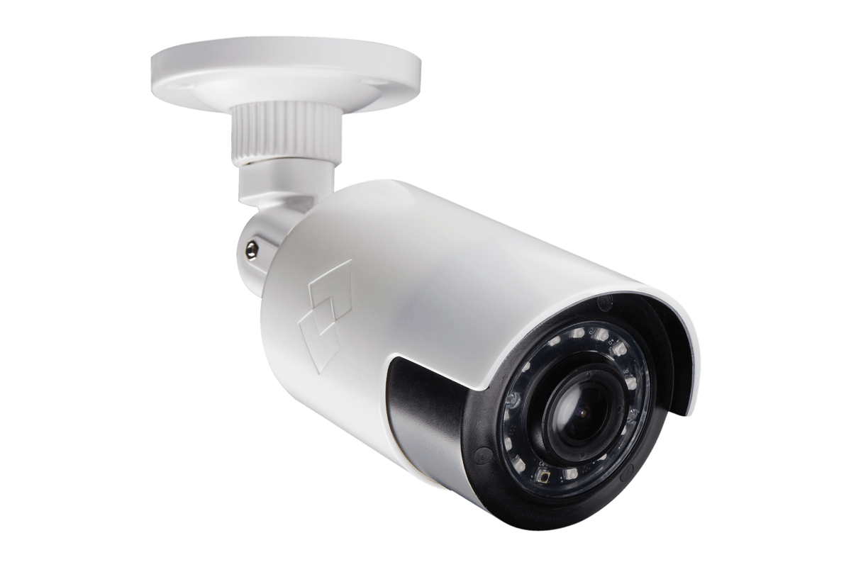
Research Vision
Past Decade
Communication Everywhere
Current Decade
Computing Everywhere
Cloud
Fog
Edge
IoT Device
Notes:
Ubiquitous computing in a spectrum of distributed systems

Slide 4
Research Vision: Cloud 2.0
AI-friendly
Ease of Use (Democratized Programming)
Domain-Specific
Cloud 2.0
Trustworthiness
Highly Heterogeneous (ASICs)
Distributed (Liquid computing)

Slide 5
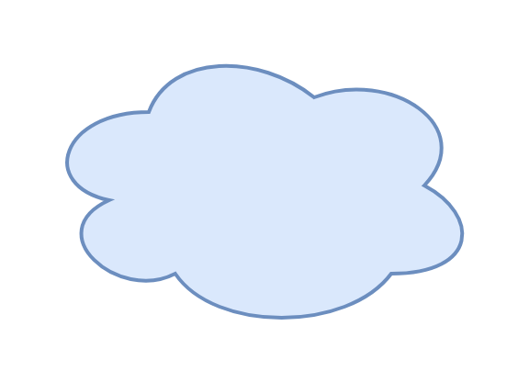
Liquid Computing across Edge-Cloud
Demo video: http://y2u.be/BK_PyvRpr1A
Edge lacks elasticity!
Cloud ( )
UMS/NIMS
Edge ( )
Live Service
Migration
Image Recognition
. . .
Motion
Capture
Gaming
Service
Low-priority users playing
High priority user arrives
* Presented at SC ’22 and at Globecom ’23
Notes:
Let’s watch a demo video:
https://www.youtube.com/watch?v=BK_PyvRpr1A

Slide 6
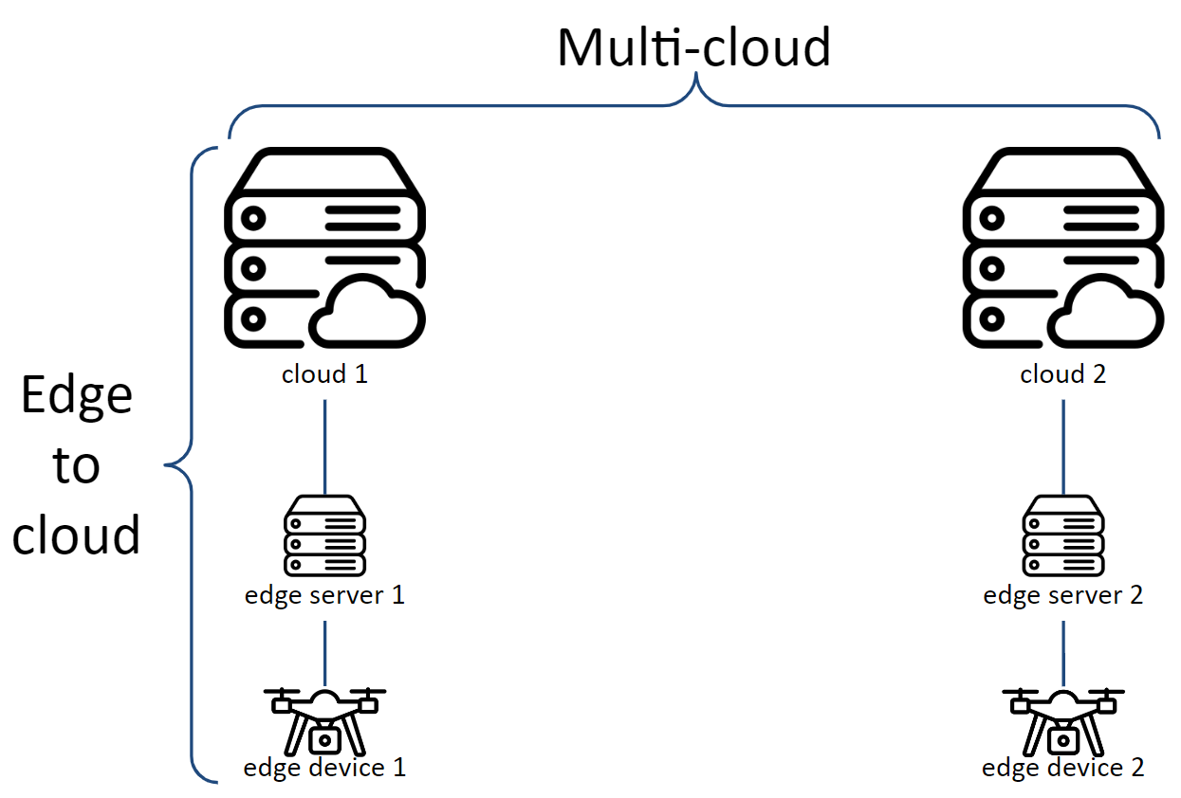
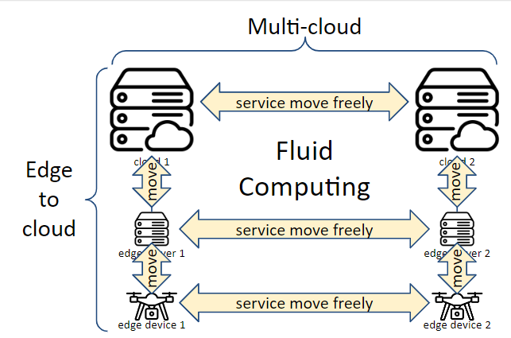
Our Research Goal

Slide 7
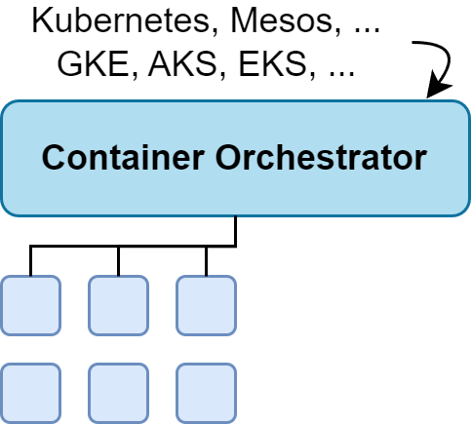
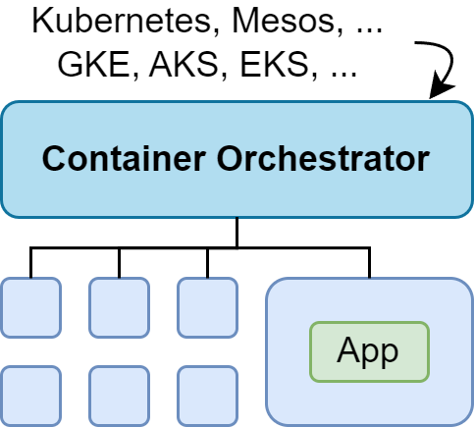
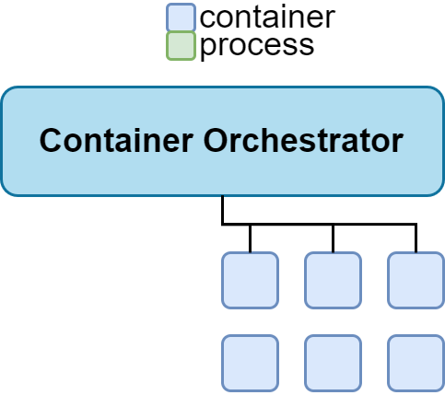
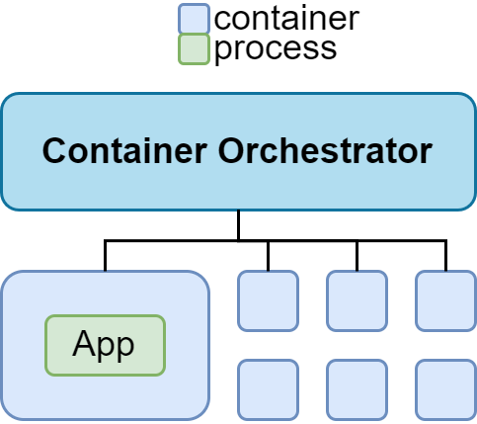
Service Restoration Problem
output #1
output #2
output #3
output #4
output #5
output #6
Notes:
migration
=
checkpointing + data-transfer + restoration
migration solution = migration
+ coordination​
+ transparency
+ dealing with platform heterogeneity
+ dealing with latency (overhead)

Slide 8
Research Question
We want a live service migration solution that can offer the best of both worlds:
(i) operating ubiquitously across autonomous systems and heterogeneous orchestrators;
(ii) maintaining the migration efficiency.

Slide 9
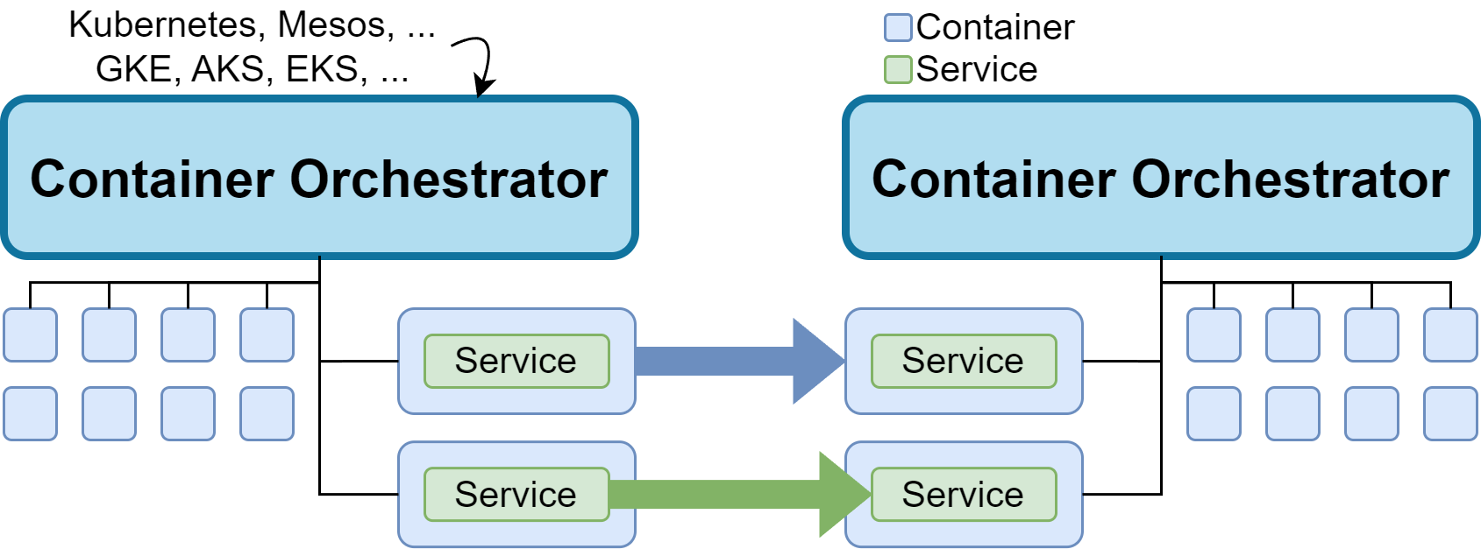
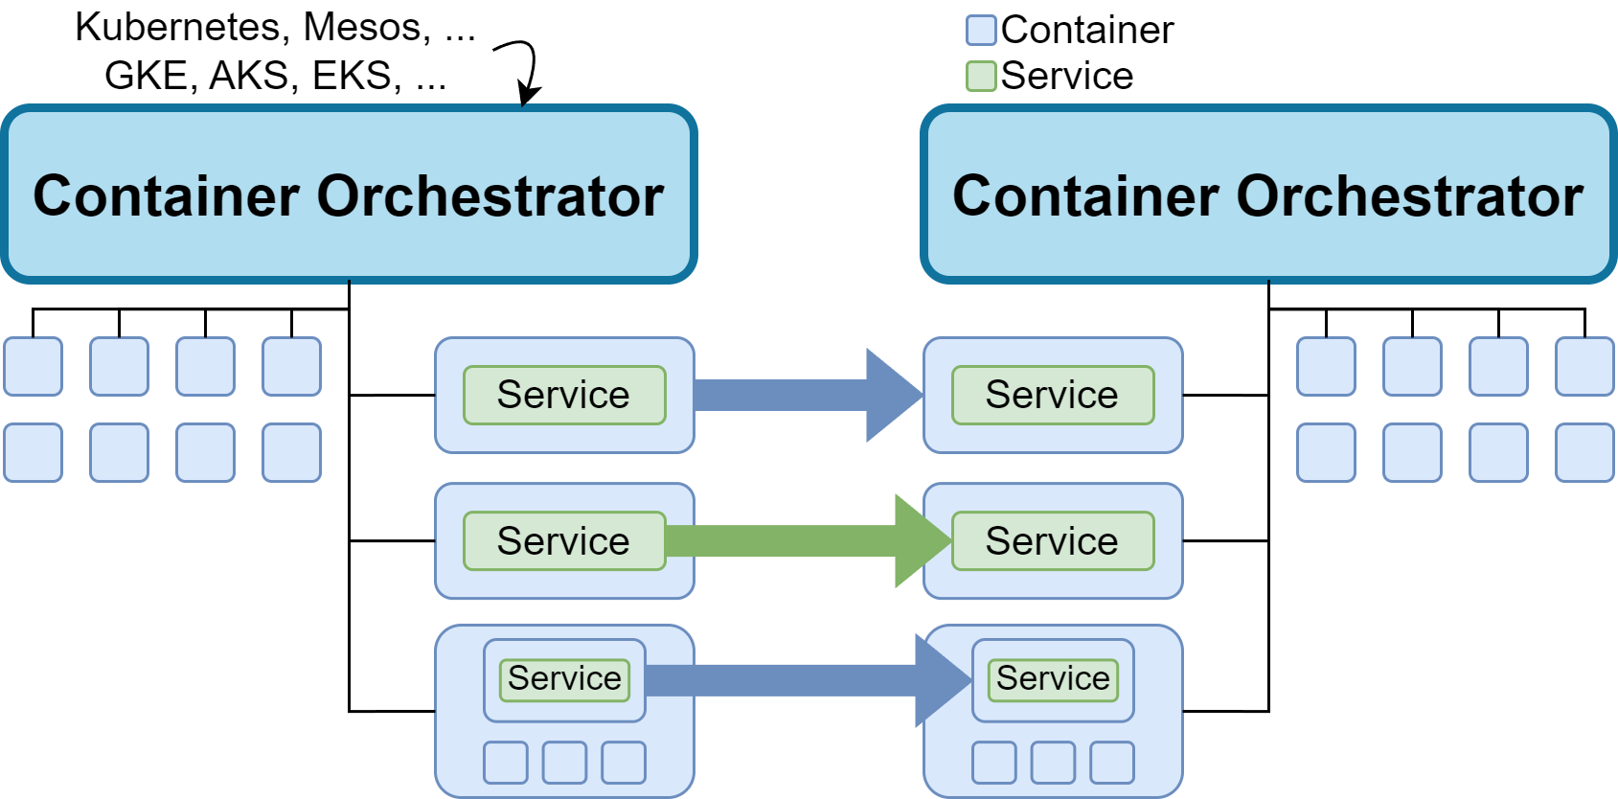
UMS: Ubiquitous Migration Solution
Notes:
So we develop a liberal approach
Efficiency-flexibility tradeoff
The developers must declare/know how far (aggressively) to be migrated by using matched migration approach

Slide 10
Contributions
Developing UMS, a framework that enables seamless and lightweight live migration of containerized services across autonomous computing systems with heterogeneous orchestrators
Developing live container migration approaches operating at the orchestrator, container, and service levels
Demonstrating the feasibility of live migration of containerized services across heterogeneous orchestrators (Kubernetes, Mesos, K3S, and Minishift) and between Microsoft Azure and Google Clouds

Slide 11
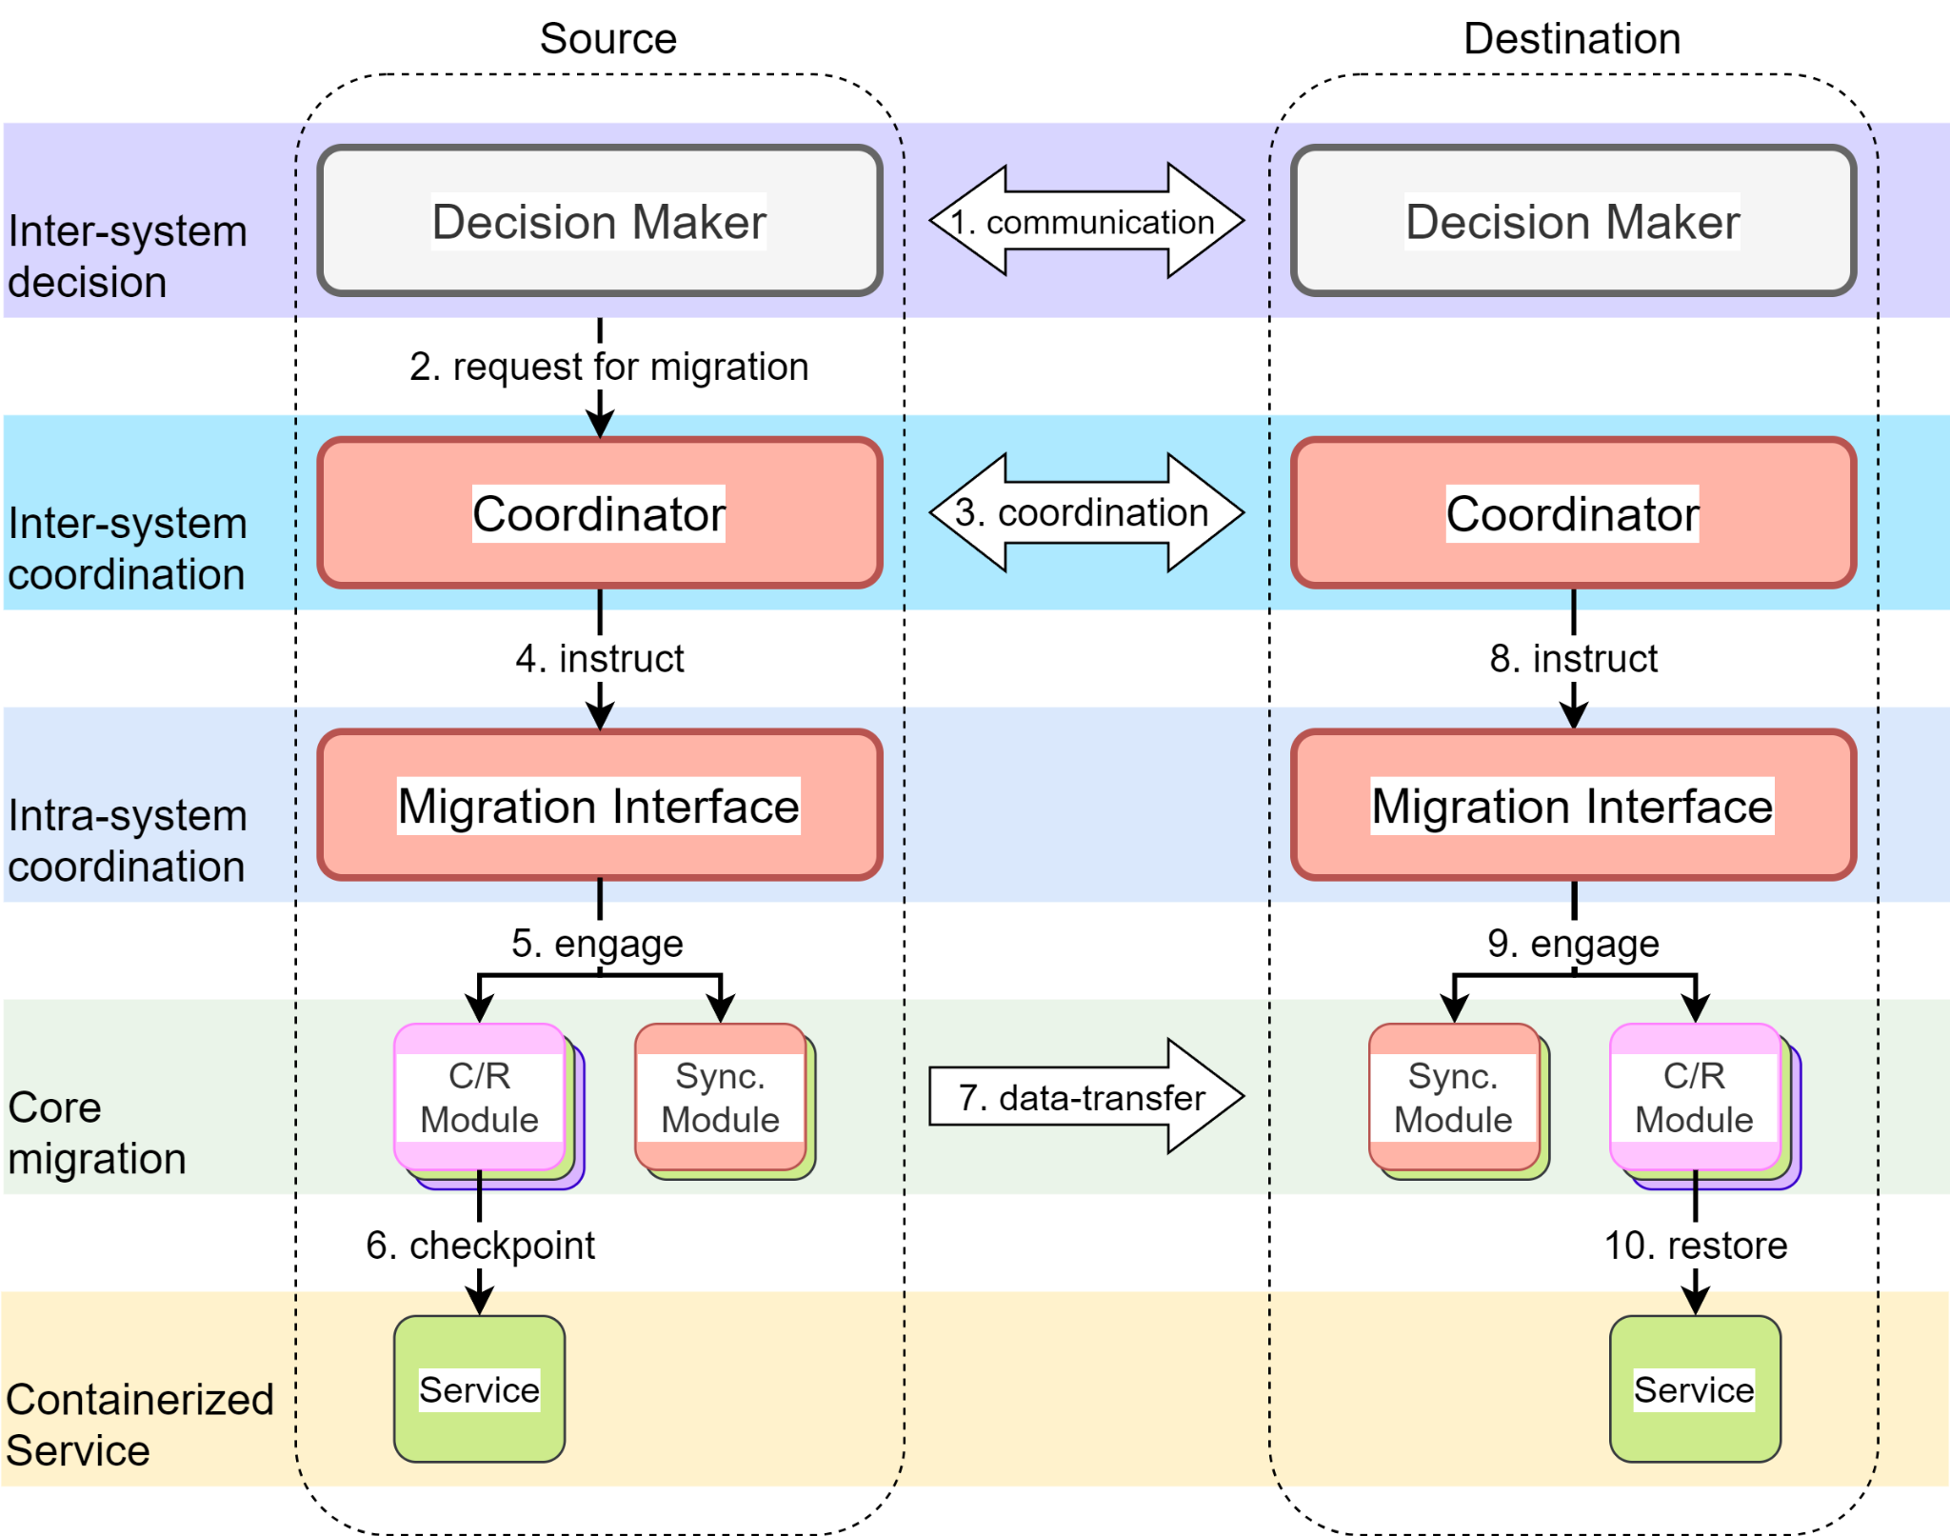
Architectural Overview of UMS

Slide 12
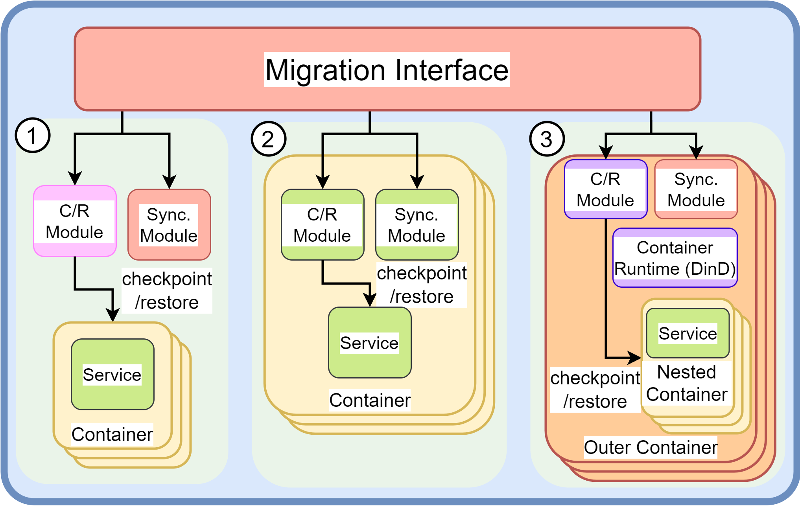
Establishing Service Migration Approaches Operating at Different Levels
CRIU
Rsync

Slide 13
Establishing Service Migration Approaches Operating at Different Levels
If there is a FastFreeze process in the container
FastFreeze
If there is a response from Docker port
Docker-in-Docker

Slide 14
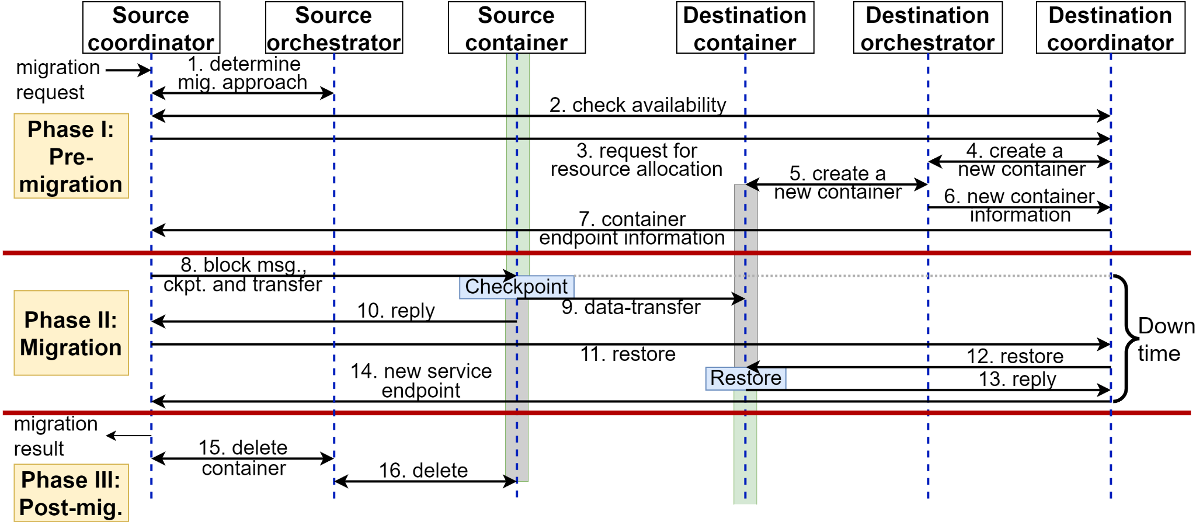
Mechanics of the Live Migration Coordination
Notes:
Coordination across AS e.g., authentication
Determine migration approach
medata copy at this layer (by create dest container)
Container reuse

Slide 15
memhog
A simple application that allocates static amount of memory and writes data randomly
Scale the memory size to measure overhead
Since its data cannot be compressed, may compare to data-compressible application e.g., Redis
Our version embed a looper

Slide 16
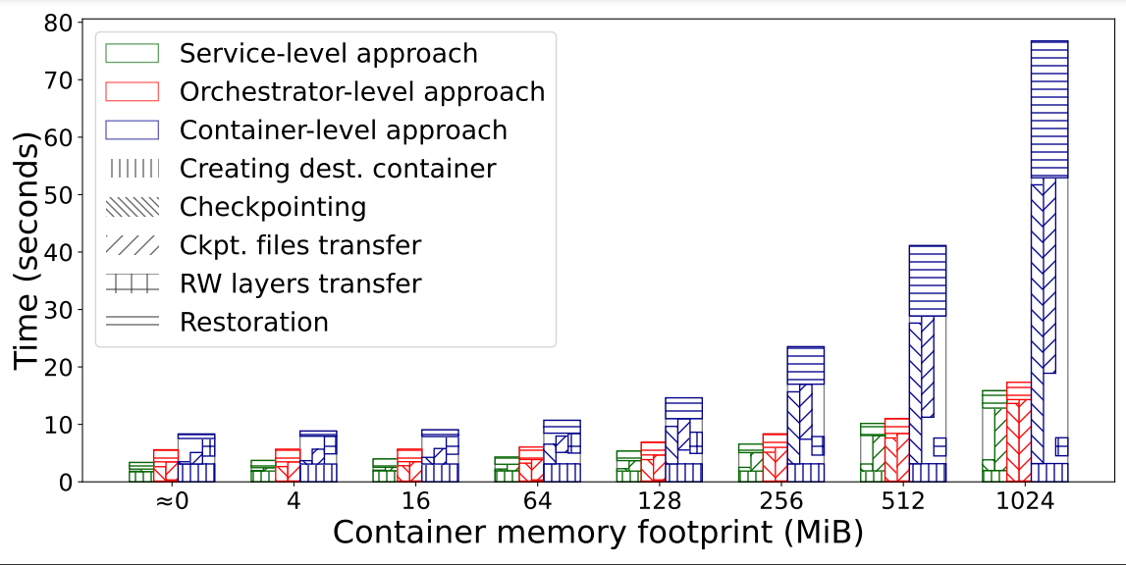
Overhead of Live Container Migration
The service-level migration outperforms other approaches.
The container-level approach is tolerable for small-size containers.

Slide 17
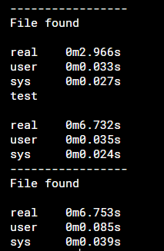
Docker Checkpoint Analysis
Docker
CLI
Docker
runtime
containerd
runc
CRIU
7s
total
2s
log
5s
unknown
3-4s
1s
<1s
Unnecessary io.Copy from /tmp/ctd-checkpoint<random_number> to /var/lib/docker/containers/<container_id>/checkpoints

Slide 18
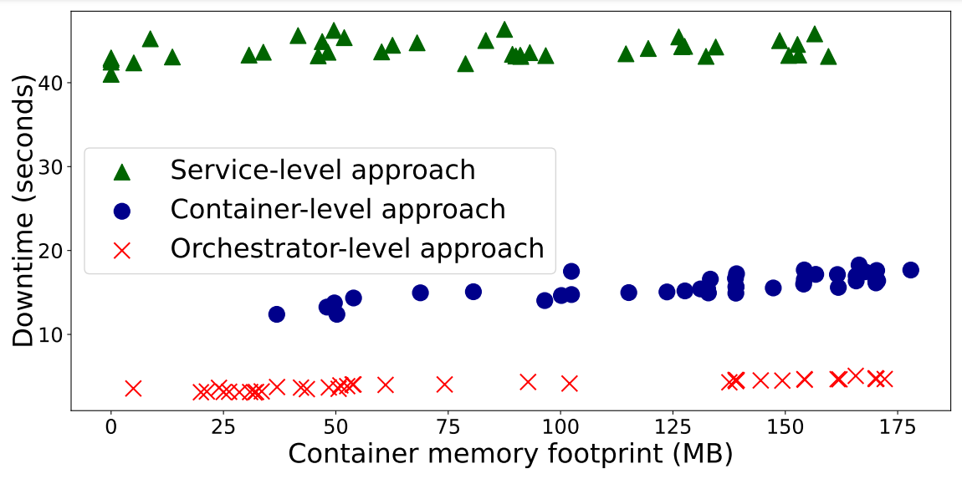
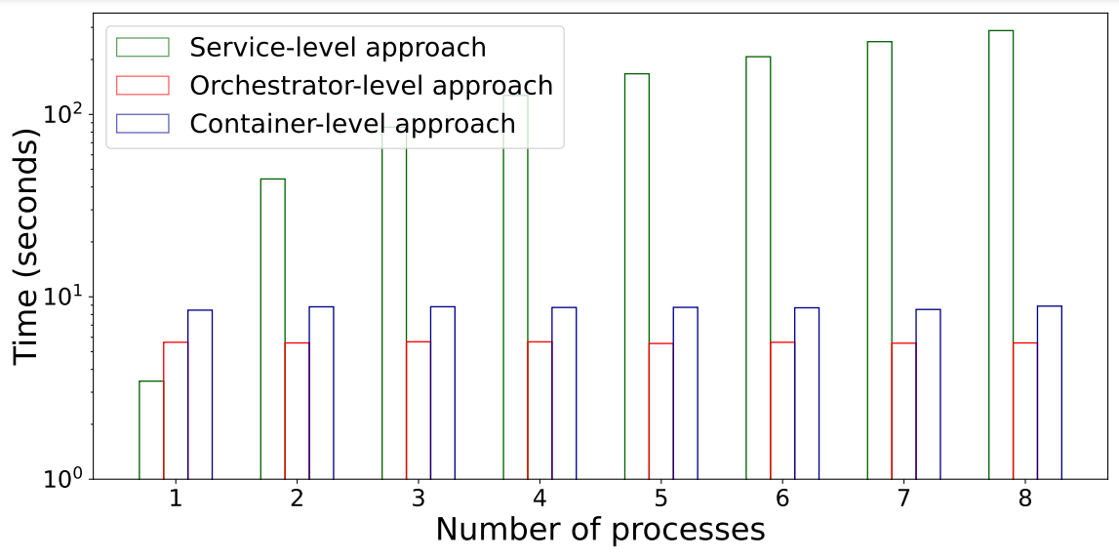
Impact of Dynamic Memory Footprint on the Migration
The service-level approach depends on the number of processes running in the container, rather than the container memory footprint.

Slide 19
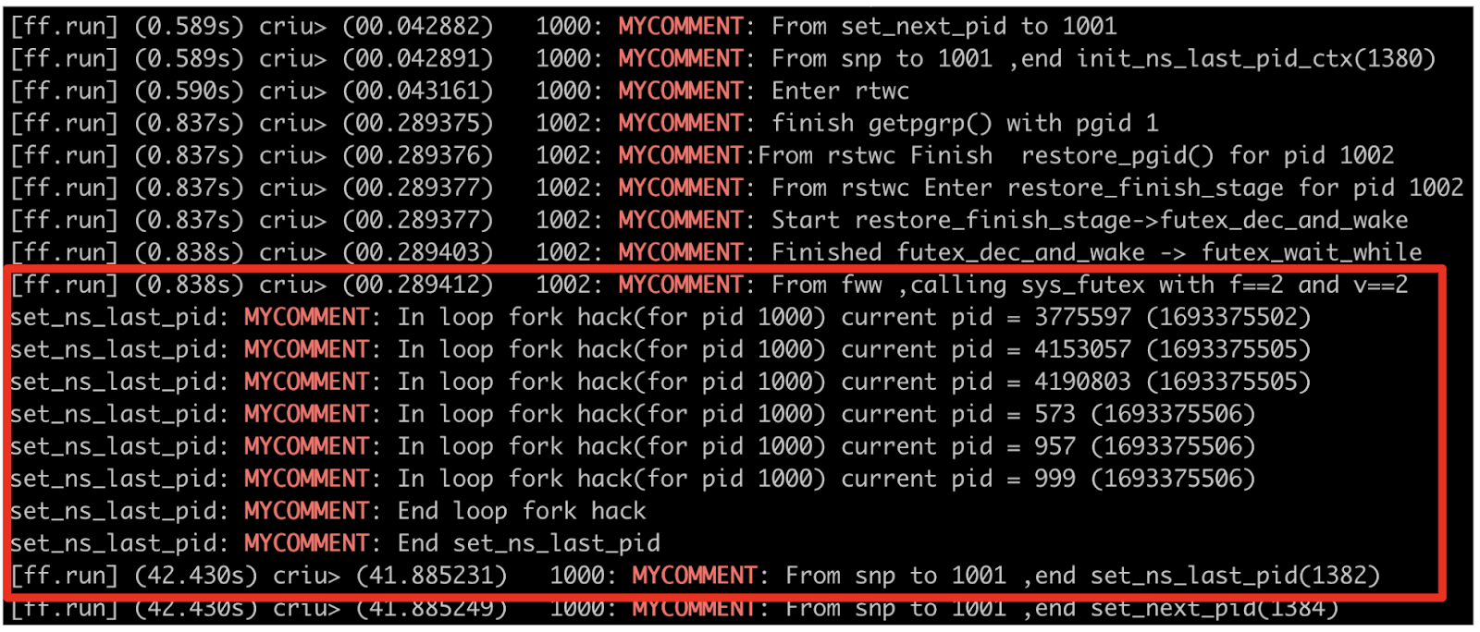
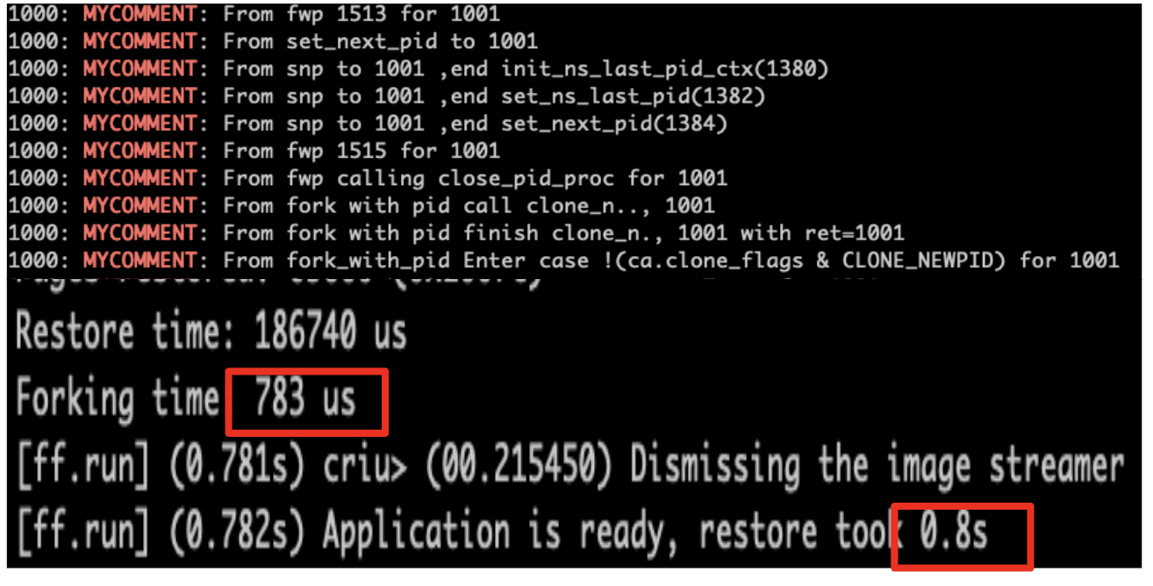
Improving FastFreeze

Slide 20
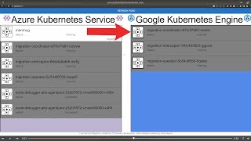
Live Migration across Heterogeneous Orchestrators

Slide 21
Further Resources
Demo videos
GitHub
How we fix FastFreeze
Contact us!
thanawat.chanikaphon1@louisiana.edu
mohsen.aminisalehi@unt.edu

