Slide 1
Quantifying Heterogeneity of Distributed Systems
Mohsen Amini
Joint work with Ali Mokhtari (UL Lafayette), Pooyan Jamshidi (USC), Saeid Ghafouri (QMU)
June 2023
Notes:
Present my works and studies that I’ve done so far towards my PhD program

Slide 2
Outline
Heterogeneity in Distributed Systems
Heterogeneity-aware Middleware Solutions
Quantifying System Heterogeneity
Characteristic Curve: QoS as a Function of Heterogeneity
Summary and Conclusions
Notes:
An introduction to heterogeneous computing systems
I’ll talk about the heterogeneous-native design for cost and qos aware distributed systems
Here, I’ll propose a performance-driven heterogeneity measure, then I used that measure to design a HC systems such that the desired QoS satisfied with minimum cost
Then, I’ll introduce a heterogeneity-aware task scheduling method that targets Fairness and Energy objectives in HC systems, and even improving the QoS
Next, I’ll employ a heterogeneity-aware admission control to maintain the robustness of HC systems against uncertainties in tasks’ execution time and arrival time
Finally, I conclude the presentation and talk about the remaining steps

Slide 3
Heterogeneity
What is heterogeneity in distributed computing systems?
Notes:
Let me give you some examples to clarify our definition of heterogeity, later I formally define what I mean by heterogeneous computing system

Slide 4
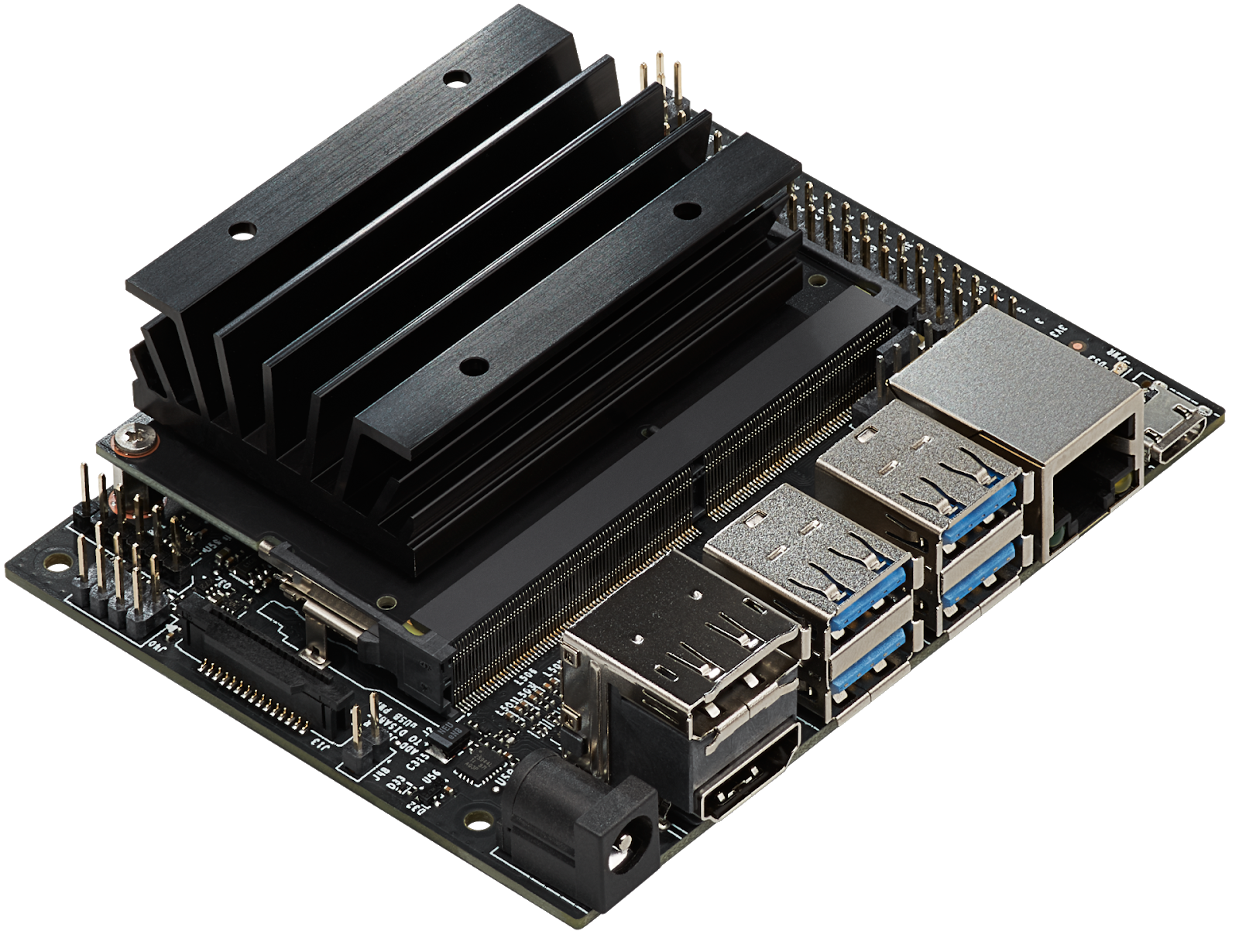
Machine Heterogeneity : Edge
GTX 20 series
GTX 30 series
GTX 40 series …
Inference
Variation in Execution Time across Het. Machines
Inference Time
Face Recognition
Edge Computing System
Jetson Nano
. . .

Slide 5
Machine Heterogeneity: Cloud
Inference Time
Variation in Execution Time across Het. Cloud Services
Inference
Face Recognition
. . .
Inference

Slide 6
Task Heterogeneity
20 msec
Face Recognition
Inference Time
Variation in Execution Time across different Apps.
60 msec
Speech Recognition
AWS EC2 Instance
200 msec
inference time
NLP

Slide 7
Machine and Task Heterogeneity
100,20, 50 msec
Face Recognition
Inference Time
120, 60, 80
Speech Recognition
AWS EC2 Instances
500, 200, 350
inference time
NLP

Slide 8
System Heterogeneity Dimensions
System Heterogeneity
Machine Heterogeneity
Task Heterogeneity
The variation in the execution times of a given task across all the machines
The variation in the execution times of tasks for a given machine
CPUs
GPUs
FPGA
Object Detection
Speech Recognition
Video Transcoding

Slide 9
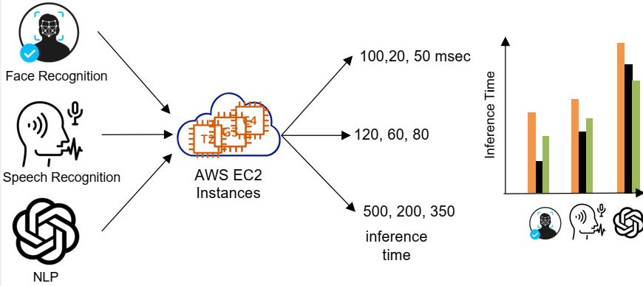
Heterogeneous Computing (HC) Systems
A computing system is heterogeneous if and only if :
“Execution time of at least one [task, machine] pair differs from others”
Variation in Execution Time
 | g3s.xlarge | t2.2xlarge | C4.xlarge
Face Recognition | 20 | 300 | 50
Speech Recognition | 50 | 400 | 100
ChatGPT | 100 | 1000 | 150
Variation in Execution Time

Slide 10
Performance Model of HC Systems
EET (Expected Execution Time) Matrix
Machine types
Machine Types Task Types | M₁ | M₂ | o o o | M_{m}
T₁ | $$e_{11}$$ | $$e_{12}$$ | o o o | $$e_{1m}$$
T₂ | $$e_{21}$$ | $$e_{22}$$ | o o o | $$e_{2m}$$
o o o | o o o | o o o | o o o | o o o
T_{n} | $$e_{n1}$$ | $$e_{n2}$$ | o o o | $$e_{nm}$$
Task types
Expected Execution Time (EET) of task type T₁ on machine type M₂

Slide 11
Heterogeneity in EET Matrix
EET (Expected Execution Time) Matrix
Machine Types Task Types | M-1 | M-2 | M-3 | M-4
TT-1 | 2.8 | 6.5 | 3.7 | 7.1
TT-2 | 2.5 | 6.4 | 5.0 | 6.5
TT-3 | 3.1 | 6.2 | 3.7 | 7.9
TT-4 | 3.1 | 8.1 | 4.5 | 7.8
Machine Heterogeneity
The execution time of a given task varies across machines
Task Heterogeneity
A given machine has different expected execution time for different tasks

Slide 12
Why Does Heterogeneity Matter?
Heterogeneity impacts the system performance
Homogeneous System A
Heterogeneous System B
Solution X
Solution Y
Solution X
Solution Y
System Performance concerning QoS/Cost objective

Slide 13
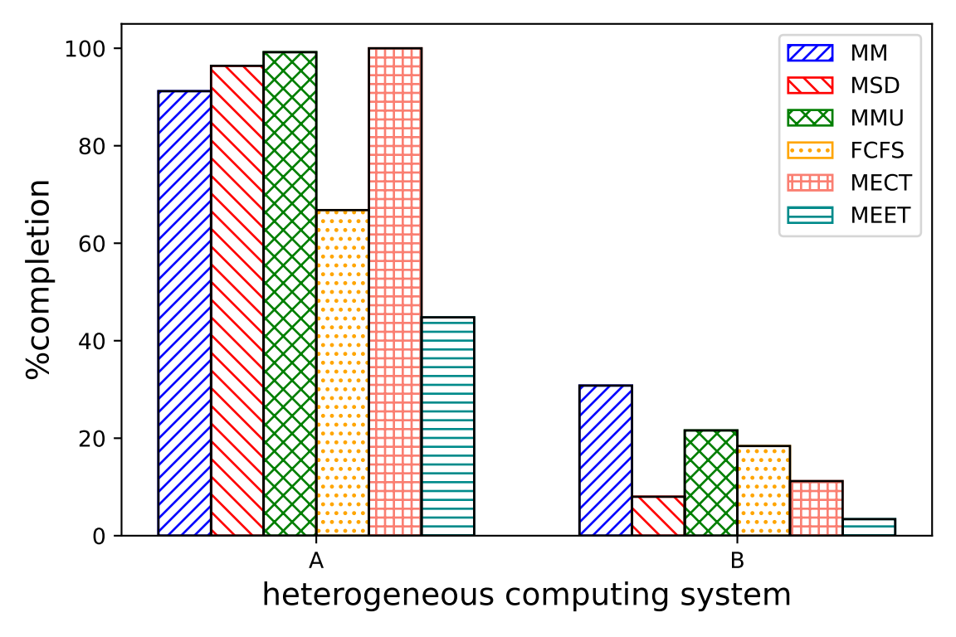
Heterogeneity Matters in Task Scheduling!
MMU > MSD > MM > FCFS
HC System A → B
MM > MMU > FCFS > MSD

Slide 14
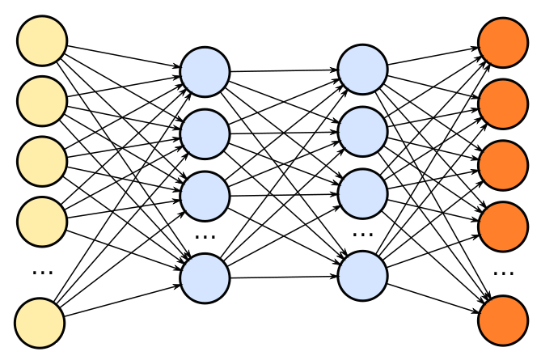
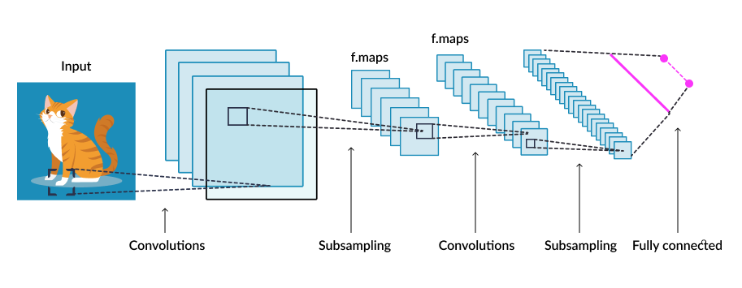
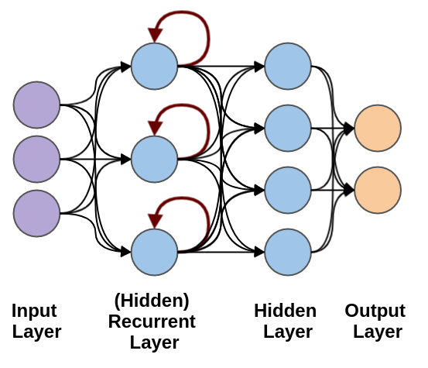
Why Heterogeneity is important?
Heterogeneity Matters in Cloud Elasticity!
ML Inference Queries
Heterogeneous Cloud VMs
Objectives
QoS Constraint
Minimized Cost
Notes:
In the context of cloud elasticity, for a given cloud-based application, solution architects need to know the implications of modifying
(i.e., adding, removing, or replacing) the allocated machines on the
application performance in terms of the QoS and the incurred cost.
The architects have to answer questions like “for a certain arriving
workload pattern, what type of machine(s) must be allocated to the
existing machines, so that the user-defined performance objective
(e.g., cost and QoS) are satisfied?” They need the ability to compare
performances of the two (potentially) heterogeneous systems in
terms of their performance objectives (e.g., incurred costs and QoS
satisfaction) prior to committing their allocation decisions.

Slide 15
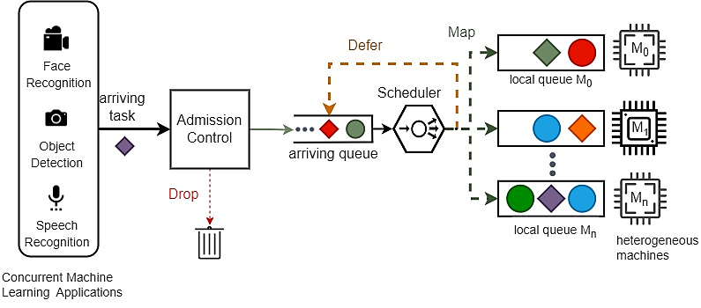
A Natively Heterogeneous Computing Platform
(2) Heterogeneity-aware Scheduler
(3) Heterogeneity-aware Admission Control
(1) A Natively Heterogeneous Design for Cost- and QoS-aware Distributed Systems
Notes:
Heterogeneous as First Class Citizen

Slide 16
How to Say Het. System A is better than Het. System B?
We need a measure to compare Het. systems
$$\hat{QoS_{B}}$$
$$QoS_{B}$$
Workload
?
Estimated QoS of HC systems can be a metric to measure impact of heterogeneity
$$≈$$
$$QoS_{A}$$
<
$$\hat{QoS_{B}}$$
HC System B
$$\hat{QoS_{A}}$$
$$QoS_{B}$$
Unknown prior completing the workload
$$QoS_{A}$$
$$\hat{QoS_{A}}$$
HC System A
Notes:
We can predict both HC systems will perform similarly without processing the workload

Slide 17
Research Goal and Questions
Goal: Quantifying heterogeneity of any computing system such that it reflects the system QoS
RQ 1: How to quantify heterogeneity of any computing system?
RQ 2: How can heterogeneity measure predict system’s QoS?

Slide 18
Summary of Contributions
A heterogeneity quantification measure that is descriptive of QoS
A systematic approach to analyze system heterogeneity
decoupling heterogeneity to machine and task dimensions
proving arithmetic mean and harmonic mean to measure the central tendency of speedup
Validating QoS as a function of the heterogeneity measure
demonstrating how the proposed measure helps setting the system heterogeneity WRT QoS.

Slide 19
EET is the Key to Quantify Heterogeneity
EET presents expected performance in terms of execution time
Using EET and a workload, we propose System Equivalent Execution-time (SEE) score to determine QoS
Our approach to obtain SEE is to transform a het. system to an equivalent homogeneous system. This simplifies predicting QoS
SEE is calculated based on how much the het system is better than the worst homogeneous system
Using EET, task and machine heterogeneity are measured separately to learn overall improvement heterogeneity causes

Slide 20
Approach: Transforming a Heterogenous Space into a Homogeneous Space
$$T^{∗}$$
$$M^{∗}$$
Face Recognition
transformation
$$T^{∗}$$
$$M^{∗}$$
Speech Recognition
$$M^{∗}$$
$$T^{∗}$$
NLP
Machines
Machines
Heterogeneous Computing System
Homogeneous Computing System
Notes:
Imaginery homo task and machiens have the same QoS of the het. Task and machines for a certain workload

Slide 21
How Does Transformation Help?
Simplification
Estimate the QoS
$$T^{∗}$$
$$M^{∗}$$
Face Recognition
QoS
$$T^{∗}$$
$$M^{∗}$$
$$\hat{QoS}$$
Speech Recognition
$$M^{∗}$$
$$T^{∗}$$
Transformation Function
Machines
NLP
Machines
Heterogeneous Computing System
Homogeneous Computing System
Notes:
Transformation makes the job of qos prediction (without examining workload) easily viable only through eet

Slide 22
How Transformation to Homo. Counterparts of Het. Systems Benefit Us?
Transforming Het. systems to their homo. counterparts makes it easier to compare their QoS
$$\hat{QoS_{B}}$$
$$QoS_{B}$$
Workload
?
Estimated QoS once HC systems mapped via mapping function
$$≈$$
$$QoS_{A}$$
<
$$\hat{QoS_{B}}$$
HC System B
$$\hat{QoS_{A}}$$
$$QoS_{B}$$
Unknown prior completing the workload
We can predict both HC systems will perform similarly without processing the workload
$$QoS_{A}$$
$$\hat{QoS_{A}}$$
HC System A
Notes:
Estimating QoS of the het. Systems (via transformation to a homo counterpart) enables us to compare het. Systems in terms of QoS….

Slide 23
How Good is a Heterogeneous System?
We exploit notion of speedup WRT the worst machine and task type
This shows the impact of heterogeneity on the execution time behavior
How much each task type benefits heterogeneous machines?
Calculating “gained speedup due to machine heterogeneity”
Row-wise analysis of the EET matrix → S^{M} matrix
How much each machine benefits heterogeneous tasks?
Calculating “gained speedup due to task heterogeneity”
Column-wise analysis of the EET matrix → S^{T} matrix

Slide 24
Speedup due to Machine Heterogeneity
Slowest machine type
$$M_{1}$$
$$t_{homo}$$
Inference Requests
Makespan
Workload
$$M_{2}$$
$$M_{1}$$
$$t_{hete}$$
Total time to complete the workload
$$M_{3}$$
$$M_{1}$$
$$Speedup due to heterogeneity=\frac{t_{homo}}{t_{hete}}$$
Machines
Homogeneous computing System
Heterogeneous computing System

Slide 25
Speedup due to Machine Heterogeneity
Baseline machine
The slowest machine type for that task type
Slowest machine type for task type “i”
$$S_{i,j}^{M}=\frac{\max_{j}{e_{i,j}}}{e_{i,j}}$$
Execution time of of task type “i” on machine type “j”
Notes:
Each entry 𝑆 𝑀 𝑖𝑗 denotes the speedup that the system can achieve when machine type 𝑗 executes task type 𝑖 as opposed to executing it on the slowest machine type.

Slide 26
Example
EET Matrix
Machine Tasks | M-1 | M-2 | M-3 | M-4
TT-1 | 2.8 | 6.5 | 3.7 | 7.1
TT-2 | 2.5 | 6.4 | 5.0 | 6.5
TT-3 | 3.1 | 6.2 | 3.7 | 7.9
TT-4 | 3.0 | 8.1 | 4.5 | 7.8
$$S_{1,1}^{M}=\frac{7.1}{2.8}=2.5$$
$$S_{1,2}^{M}=\frac{7.1}{6.5}=1.1$$

Slide 27
Speedup due to Task Heterogeneity
Slowest task type executing on machine
Inference Requests
$$t_{homo}$$
Makespan
$$M_{1}$$
$$t_{hete}$$
Total time to complete the workload
Workload trace of tasks
$$Speedup due to heterogeneity=\frac{t_{homo}}{t_{hete}}$$
Heterogeneous computing System
Homogeneous computing System

Slide 28
Speedup due to Task Heterogeneity
Baseline task type
The task which has the largest execution time on machine type “j”
Slowest task type on machine “j”
$$S_{i,j}^{T}=\frac{\max_{i}{e_{ij}}}{e_{i,j}}$$
Execution time of of task type “i” on machine type “j”

Slide 29
Example
EET Matrix
Machines Tasks | M-1 | M-2 | M-3 | M-4
TT-1 | 2.8 | 6.5 | 3.7 | 7.1
TT-2 | 2.5 | 6.4 | 5.0 | 6.5
TT-3 | 3.1 | 6.2 | 3.7 | 7.9
TT-4 | 3.0 | 8.1 | 4.5 | 7.8
$$S_{1,1}^{T}=\frac{3.1}{2.8}=1.1$$
$$S_{2,1}^{T}=\frac{3.1}{2.5}=1.2$$

Slide 30
Speedup Matrices due to Heterogeneity

Slide 31
Mean Speedup due to Heterogeneity
$$\overline{S^{M}}$$
Mean speedup due to machine heterogeneity
$$\overline{S^{T}}$$
Mean speedup due to task heterogeneity
Notes:
The interaction of variables in a complex stochastic system can be replaced by the average interactions between those variables
As such, we can use mean to represent the speedup behavior of the all (𝑡𝑎𝑠𝑘, 𝑚𝑎𝑐ℎ𝑖𝑛𝑒) pairs in both $S^{M}$ and $S^{T}$

Slide 32
Mean Speedup due to Heterogeneity
Central Tendency Measures
Arithmetic Mean
Geometric Mean
Harmonic Mean
Mean Speedup due to Machine Heterogeneity for a Task Type
Mean Speedup due to Task Heterogeneity for a Machine Type
Real speedup due to heterogeneity
Notes:
Real speed up: the actual speed up we get from executing a certain workload against a het. System and its slowest homo counterpart (e*)
Estimated speedup: the speedup calculated using a certain central tendency measure via leveraging S^M and S^T which themselves are derived from EET
This slides says how we can leverage eet to come up with a function that spits out Speedup and that speedup is equal to real speedup

Slide 33
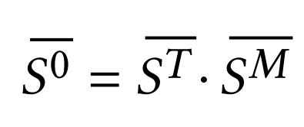
Overall Speedup due to System Heterogeneity
In practice, both machine and task heterogeneity coexists
Their speedup impacts on the QoS are compounded
The overall speedup due to system heterogeneity

Slide 34
Overall Speedup due to System Heterogeneity
Speedup matrix due to machine heterogeneity
Each row of $S^{M}$ is condensed to the arithmetic mean value
Arithmetic Mean
Harmonic Mean
Arithmetic Mean
Harmonic Mean
EET matrix that models the HC system
Speedup matrix due to task heterogeneity
Each column of $S^{T}$ is condensed to the harmonic mean value

Slide 35
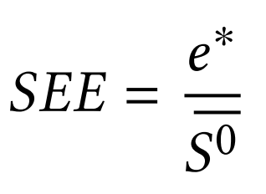
SEE Score: Our Measure of Heterogeneity
“SEE Score is a representative of the Execution Time Behavior of the Heterogeneous System”
expected execution time of the slowest counterpart homogeneous system
Overall Speedup due to heterogeneity

Slide 36
Mapping a Heterogenous Space into a Homogeneous Space
Heterogeneous System
Homogeneous System
 | $$M_{1}$$ | $$M_{2}$$ | $$M_{3}$$
$$T_{1}$$ | $$e_{11}$$ | $$e_{12}$$ | $$e_{13}$$
$$T_{2}$$ | $$e_{21}$$ | $$e_{22}$$ | $$e_{23}$$
$$T_{3}$$ | $$e_{31}$$ | $$e_{32}$$ | $$e_{33}$$
 | $$M^{∗}$$ | $$M^{∗}$$ | $$M^{∗}$$
$$T^{∗}$$ | $$SEE$$ | $$SEE$$ | $${SEE}^{∗}$$
$$T^{∗}$$ | $$SEE$$ | $$SEE$$ | $$SEE$$
$$T^{∗}$$ | $$SEE$$ | $$SEE$$ | $$SEE$$
QoS-wise
EET
EET

Slide 37
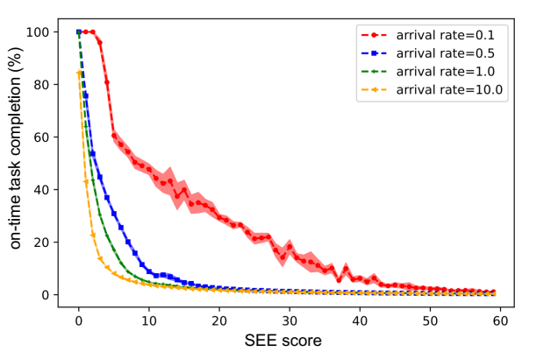
Validating SEE Score as a Heterogeneity Measure
Narrow Confidence Interval Proves that HC systems with similar SEE scores yield similar QoS value
SEE score as a measure to “compare different HC systems”
SEE1<SEE2 → QoS1= f(SEE1) ≤QoS2=f(SEE2)
QoS-SEE characteristic curves
Each point represents multiple HC System with the Same SEE Score
Lower SEE Score, Better Performance
Notes:
Results demonstrate QoS–SEE characteristic curves for heterogeneous systems with 4 machines.
In fact, QoS-SEE characteristic curves describe the QoS of systems with certain number of machines as a function of SEE score and the arrival rate

Slide 38
Speedup due to Heterogeneity vs. Task Arrival Rates
Speedup gradually increases
Similar Makespan for Heterogeneous and Homogeneous Systems
Proposed mathematical model can accurately describe the true speedup due to system heterogeneity
Heterogeneity is fully utilized
No Speedup due to Heterogeneity
Makespan is decreasing for HC systems but remains constant for homogeneous
Makespan Dominated by the Idle Times

Slide 39
SEE Score: How Does It Help in System Design?
SEE-Price Optimizer
Arrival rate
 |  |  |  | Price | SEE
6 | 0 | 0 | 0 | 5
1 | 1 | 4 | 1 | 15
o o o |  | . . .
4 | 0 | 2 | 1 | 8
Upper bound for SEE Score
QoS
Constraint
4 | 0 | 2 | 1
Optimal Configuration
Pool of Machine Types

Slide 40
Conclusion and Future Works
We provide SEE score to quantify the system heterogeneity
The measure is WRT a QoS metric and for a given workload
SEE score is a measure showing how fast a system is for a workload
It can compare the performance of different heterogeneous systems
SEE score can approximate QoS in error range of 1.4% to 22.9%
SEE score enables proactive configuration of a heterogeneous system (instead of try and error) to fulfill a given QoS
Notes:
We proved that
Speedup due to machine heterogeneity is measured by arithmetic mean
Speedup due to task heterogeneity is measured by harmonic mean

Slide 41
Acknowledgements
Ali Mokhtari
PhD student
UL Lafayette
Pooyan Jamshidi
Assistant Prof.
U. South Carolina
Saeid Ghafouri
PhD Student
Queen Mary University

Slide 42
Thank You!
Q&A

Slide 43
Appendix

Slide 44
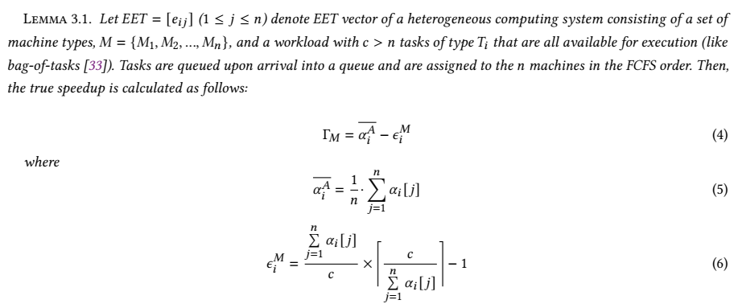
Mean Speedup due to Machine Heterogeneity

Slide 45
Heterogeneous Machines Single FCFS Queue
 | EET Matrix (Vector)
 | M1 | M2 | M3
Task Type | 0.1 | 1 | 10
M1
$$e_{1}=0.1$$
Arrival Time of all tasks is zero (bag of tasks)
M2
$$e_{2}=1$$
FCFS Queue
Tasks
M3
$$e_{3}=10$$
Machines

Slide 46
Slowest Homogeneous Counterpart System
M3
Task
$$e_{3}=10$$
M3
Task
$$e_{3}=10$$
1
M3
Task
$$e_{3}=10$$
3 tasks are executed by 3 machines at each moment

Slide 47
Heterogeneous System with One Task Type
100
M1
$$e_{1}=0.1$$
10
M2
$$e_{1}=1$$
1
M3
Task
$$e_{1}=10$$
Executing a task on machine 3 : 100 + 10 + 1 = 111 tasks execution

Slide 48
Arithmetic Mean of Speedup due to Machine Heterogeneity
 | EET Matrix (Vector)
 | M1 | M2 | M3
Task Type | 0.1 | 1 | 10
 | $$S^{M}$$
 | M1 | M2 | M3
Task Type | 100 | 10 | 1
heterogeneous system makespan = 2* 10 = 20
homogeneous system makespan = (222/3)*10 = 740
True Speedup = 740/20 = 37
Arithmetic mean of $S^{M}$ = (1/3) * (111) = 37
Given high arrival rate (e.g. bag of tasks), we prove that the true speedup due to machine heterogeneity for a task type is accurately represented by the arithmetic mean of $S^{M}$ for that task type

Slide 49
Mean Speedup due to Machine Heterogeneity: Low Task Arrival Rate

Slide 50
Mean Speedup due to Machine Heterogeneity: Low Task Arrival Rate
 | EET Matrix (Vector)
 | M1 | M2 | M3
Task Type | 0.1 | 1 | 10
M1
$$e_{1}=0.1$$
Low Arrival Rate
M2
$$e_{2}=1$$
FCFS Queue
Tasks
M3
$$e_{3}=10$$
Machines

Slide 51
Slowest Homogeneous Counterpart System (low arrival rate)
M3
$$e_{3}=10$$
M3
$$e_{3}=10$$
1
M3
Task
$$e_{3}=10$$
1 tasks are executed by only 1 machines at each moment

Slide 52
Heterogeneous System with One Task Type (low arrival rate)
M1
$$e_{1}=0.1$$
M2
$$e_{1}=1$$
M3
$$e_{1}=10$$
Executing only one task at any given time

Slide 53
Heterogeneous System with One Task Type (low arrival rate)
M1
$$e_{1}=0.1$$
M2
$$e_{1}=1$$
M3
$$e_{1}=10$$
Executing only one task at any given time

Slide 54
Heterogeneous System with One Task Type (low arrival rate)
M1
$$e_{1}=0.1$$
M2
$$e_{1}=1$$
M3
Task
$$e_{1}=10$$
Executing only one task at any given time

Slide 55
Harmonic Mean of Speedup due to Machine Heterogeneity (low arrival rate)
 | EET Matrix (Vector)
 | M1 | M2 | M3
Task Type | 0.1 | 1 | 10
 | $$S^{M}$$
 | M1 | M2 | M3
Task Type | 100 | 10 | 1
heterogeneous system makespan = (222/3)*0.1 + (222/3)*1 + (222/3)*100= 821.4
homogeneous system makespan = 222*10 = 2220
True Speedup = 2220/821.4 = 2.70
Harmonic mean of $S^{M}$ = 2.70
Given low arrival rate (e.g. only one busy machine at any time), we prove that the true speedup due to machine heterogeneity for a task type is accurately represented by the harmonic mean of $S^{M}$ for that task type

Slide 56
Map Heterogeneous Machines to Homogeneous Machines
Heterogeneous Machines for $T_{i}$
Homogeneous Equivalent Machines for $T_{i}$
 | $$M_{1}$$ | $$M_{2}$$ | $$M_{3}$$
$$T_{i}$$ | $$e_{i,1}$$ | $$e_{i,2}$$ | $$e_{i,3}$$
 | $$M^{∗}$$ | $$M^{∗}$$ | $$M^{∗}$$
$$T_{i}$$ | $$\overline{e_{i,:}}$$ | $$\overline{e_{i,:}}$$ | $$\overline{e_{i,:}}$$
Speedup due to machine heterogeneity
$$\overline{e_{i,:}}=\frac{e_{i,:}^{∗}}{\overline{S_{i}^{M}}}$$
$$e_{i,:}^{∗}=\max_{j}{e_{i,j}}$$
 | $$M_{1}$$ | $$M_{2}$$ | $$M_{3}$$
$$T_{i}$$ | $$\frac{e_{i,:}^{∗}}{e_{i,1}}$$ | $$\frac{e_{i,:}^{∗}}{e_{i,1}}$$ | $$\frac{e_{i,:}^{∗}}{e_{i,1}}$$
Arithmetic Mean
 | $$M^{∗}$$ | $$M^{∗}$$ | $$M^{∗}$$
$$T_{i}$$ | $$\overline{S_{i}^{M}}$$ | $$\overline{S_{i}^{M}}$$ | $$\overline{S_{i}^{M}}$$
$$\overline{S_{i}^{M}}=\frac{e_{i,:}^{∗}}{n}\sum_{j=1}^{n}{e_{i,j}}$$

