Slide 1
Stochastic Robust Scheduling in Heterogeneous Computing Systems
Mohsen Amini Salehi
Assistant Professor
HPCC Lab.
Computer Science Department
University of Louisiana Lafayette
Nov’15

Slide 2
Outline
Introduction and motivation
System model and problem definition
Theoretical (Bayesian) model plus Heuristics
Simulation results, conclusion, and future works

Slide 3
Heterogeneous Distributed Computing
Distributed systems that have resources of different types and capabilities
Many distributed systems (e.g., clusters) are formed incrementally over time

Slide 4
Heterogeneous Distributed Computing: Examples
Clouds offer different VM types
Users usually create a cluster of heterogeneous VMs
To serve different task types (characteristics)
e.g., graphical processing tasks, memory intensive, IO intensive, etc.

Slide 5
Two Types of Heterogeneity
Consistent heterogeneity:
If machine A is always faster than machine B
Inconsistent heterogeneity
Machine A is faster than machine B for task type x but machine B is faster than A for task type y
m4
m3
m2
m1

Slide 6
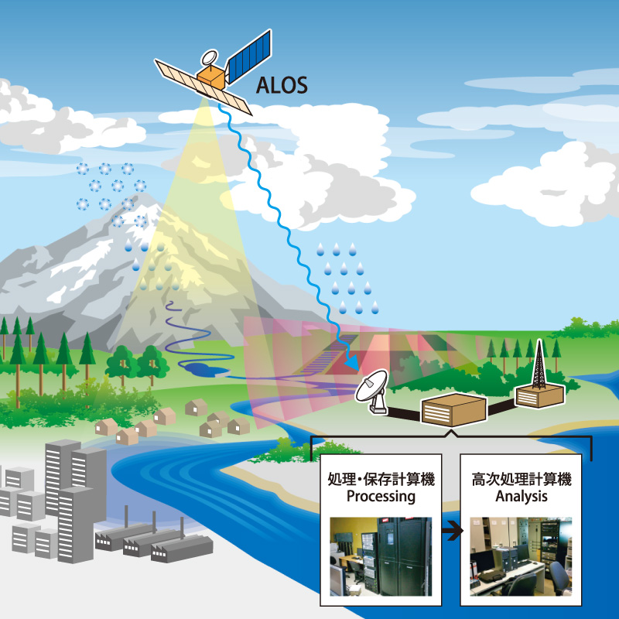
Motivation1: A Satellite Example
A mapping satellite (e.g., NASA satellites)
Different operations are performed on pictures
Compressing
Enhancing
Rotating
Execution time of each task is different based on the operation type and picture quality

Slide 7
Motivation1: Satellite Example
Every t time unit
Picture set i+1
Picture set i

Slide 8
Motivation2: Video On-Demand Streaming (e.g., Netflix, YouTube)
time unit
video frames i+1
video frames i
Video Repository

Slide 9
Outline
Definition and motivation
System model and problem definition
Theoretical (Bayesian model)
Heuristics and results

Slide 10
System Model
There is uncertainty (stochasticity) in execution time of each task on each machine
Different ways to model uncertainty
A Probability Mass Function (PMF) models execution time of each task on each machine
1
0.4
Execution time PMF
0.3
probability
0.2
0.05
0.05
0
time
1
2
3
4
5
6

Slide 11
System Model (cont.)
Each task has a hard deadline
If a task cannot meet its deadline it is dropped
We consider 2 scenarios for dropping:
Executing tasks cannot be dropped
Executing task can be dropped if it misses deadline
Machine J
Machine J

Slide 12
Our Goal: Scheduling Robustness
Goal is to cope with uncertainty in a heterogeneous system (to have a robust system)
Robustness is the degree a system can perform correctly in presence of uncertainty
We define robustness as the “percentage of tasks that can meet their deadlines”

Slide 13
Problem Definition
How to maximize the number of tasks that are completed by their deadlines?
How to measure robustness in a distributed system?

Slide 14
Possible Scheduling Scenarios
Immediate mode: tasks are assigned upon arrival
Batch mode: tasks are collected to form a batch for allocation
machine queues
M₁
arriving tasks
M₂
immediate scheduling
M_{m}
machine queues
M₁
arriving tasks
M₂
Batch queue
batch scheduling
M_{m}

Slide 15
Outline
Definition and motivation
System model and problem definition
Theoretical (Bayesian) model
Heuristics and results

Slide 16
Recap from Statistics
If we know the distribution of random variables X and Y then:
What is the distribution of Z where Z=X+Y ?
Z is the convolution of X and Y and is shown as X*Y
PMF of Z is:

Slide 17
An Example of Convolution
Example: Z is the distribution of sum of rolling a dice for 2 times (X and Y)
X
Y
1
1
+
=
P
P
0
1
2
3
4
5
6
0
1
2
3
4
5
6
Z
1
P
0
2
3
4
6
5
7
8
9
10
11
12
sum

Slide 18
Task Completion Time based on Convolution
Machine J
Completion time PMF of task i is calculated by convolving:
Completion time PMF of currently executing task
Execution time PMF for tasks ahead of task i
Completion time PMF for a currently executing task:
Impulses in the execution time PMF that have passed are removed
The remaining distribution is renormalized to 1

Slide 19
Stochastic Task Completion Time
1
1
1
0.75
0.4
current time
0.4
probability
0.3
probability
probability
0.3
0.2
0.125
0.05
0.2
0.125
0.05
0.05
0.05
0
0
0
1
2
3
4
5
6
4
5
6
7
8
9
4
5
6
7
8
9
time
time
time
Execution time PMF
Completion time PMF
Completion time PMF of currently executing task
Assume we know start time is 3

Slide 20
Stochastic Task Completion Time in presence of Task Dropping
Calculating completion time pmf of task r_{i}
Impulses in the completion time pmf of task r_{i-1} that are bigger than deadline of task r_{i} are not considered in the convolution
1
1
Excluded convolution
1
1
0.5
0.4
0.48
probability
0.3
probability
0.3
probability
0.31
0.2
0.2
probability
0.26
0.05
0.05
0.18
0.17
0.04
0.12
0.04
0
0
0
0
1
2
3
4
5
6
7
8
9
6
7
8
9
6
7
8
9
time
time
time
time
Execution r_{i} Deadline 7
Completion r_{i-1}
Completion r_{i}
Completion r_{i} after merging

Slide 21
Stochastic Task Completion Time in presence of Task Dropping for Executing Task
1
1
1
excluded from convolution
0.5
0.4
probability
0.3
probability
0.3
probability
0.26
0.2
0.2
0.05
0.18
0.12
0.05
0.04
0
0
0
1
2
3
4
5
6
7
8
9
6
7
8
9
time
time
time
1
1
0.86
0.56
probability
probability
0.05
0.04
0.04
0.05
0
0
6
7
6
7
8
9
time
time

Slide 22
Stochastic Robustness Measure
Probability that task i completes by its deadline:
Sum of pulses that are less than the individual deadline of task i
Robustness measure: Sum of probabilities that all tasks meet their deadlines
1
Deadline
0.4
probability
0.3
0.2
0.05
0.05
0
4
5
6
7
8
9
time

Slide 23
Outline
Definition and motivation
System model and problem definition
Theoretical (Bayesian model)
Heuristics and results

Slide 24
Heuristics: Immediate Mode
Min. Expected Execution Time (MEET)
Min. Expected Completion Time (MECT)
K-Percent Best (KPB)
K-percent of machines that provide the shortest expected execution time are selected
Assign task based on the minimum expected completion time on these machines
Max. Robust (MR)
Assigns the task to the machine with max. robustness

Slide 25
Heuristic: Batch Mode
Min Completion-Min Completion (MM)
Min Completion-Soonest Deadline (MSD)
Min Completion- Max Urgency (MMU)
Maximum On time Completions (MOC)

Slide 26
Batch Heuristic: Maximum On Time Completions (MOC)
For each task in the unmapped queue:
determine the machine with the maximum probability of meeting deadline
For each machine queue j:
from the task-machine pairs, identify the task that has the highest probability of meeting deadline
assign the selected task to the machine
remove task from Q

Slide 27
Simulation Setup
The arrival pattern includes burst intervals
Tasks’ data sizes are generated based on Normal distribution
Each trial includes 1200 tasks during a fixed time period
Each experiment result is obtained based on the average of 100 evaluations

Slide 28
Machine Queue Size Analysis
Batch scheduling performs better than immediate one.

Slide 29
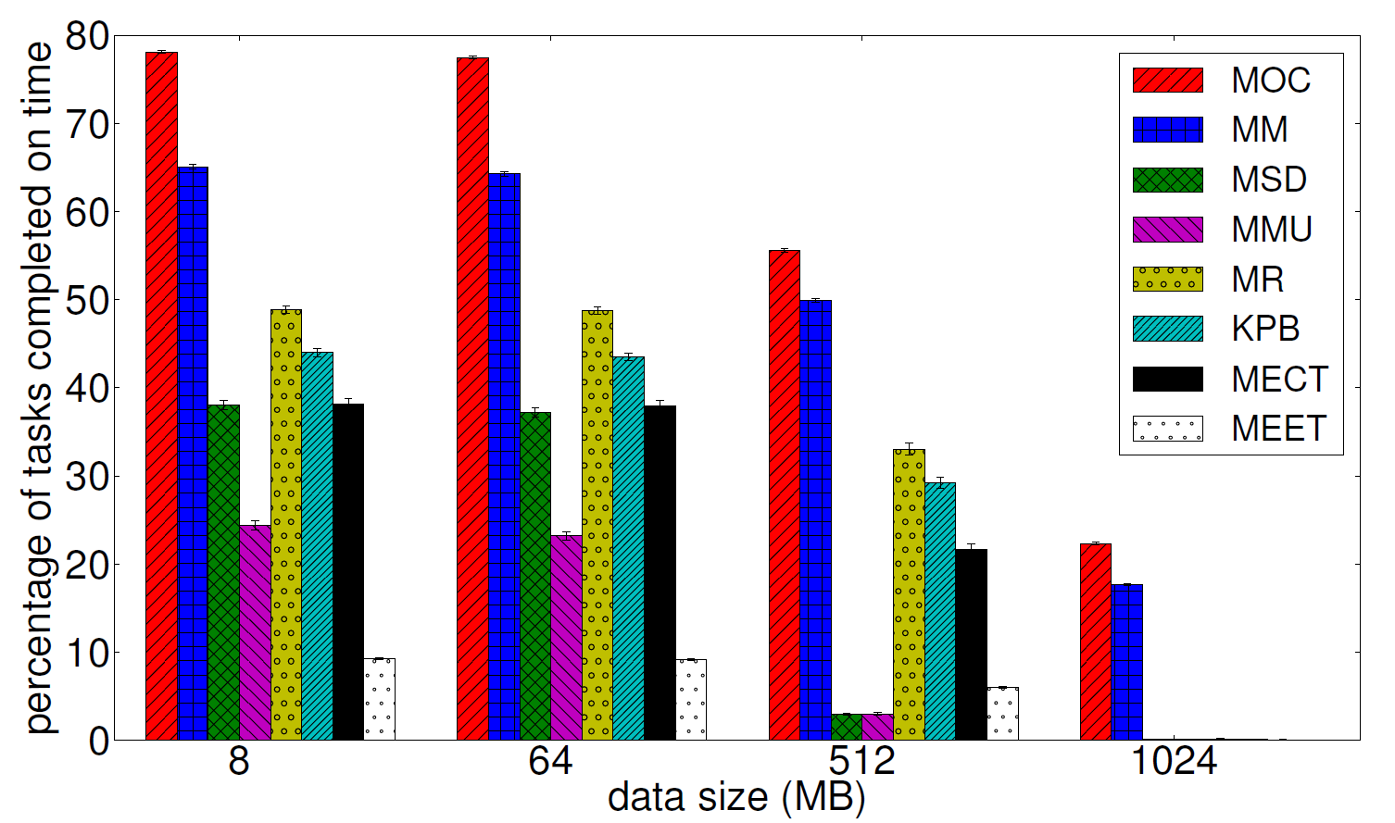
Analyzing the Impact of Task Data Size
Deadline and urgency are not appropriate factors for scheduling!

Slide 30
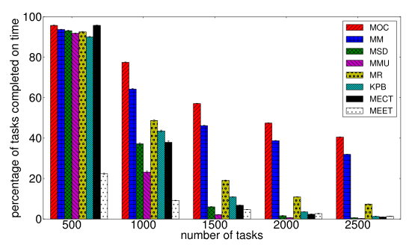
Arrival-Rate Analysis
When the system is not over-subscribed we do not need to use Batch scheduling methods!

Slide 31
Conclusion and Future Works
We proposed a measure for robustness in a heterogeneous distributed system
We proposed allocation algorithms based on the robustness measure
We observed that batch mode scheduling performs better, if the system is oversubscribed

Slide 32
Avenues of Future Research
Allocate a task in a scheduling event or delay it?
If the task waits, a machine with better affinity may get available!
Probabilistic dropping:
If we drop tasks that do not have chance to meet their deadlines we may get a better performance

Slide 33
Avenues for Future Research (2)
Theoretically find a definition for oversubscription
When can we call a system oversubscribed?
We can apply appropriate mapping methods dynamically
What is the optimal size of the machine queue?
We still get accurate completion time information
We can buffer (preload) as many task as possible

Slide 34
Thank you for your time.
Any Question?

