Slide 1
HEET: A Performance Measure to Quantify Heterogeneity in Distributed Computing Systems
Ali Mokhtari, Saeid Ghafouri, Pooyan Jamshidi, Mohsen Amini Salehi
December 2024

Slide 2
Outline
Heterogeneity in Distributed Computing Systems
Homogenization: Heterogeneity to Homogeneity Transformation
HEET: System Heterogeneity Score
Experimental Evaluation of HEET
Summary and Future Works
Notes:
“We will begin by understanding the concept of heterogeneity in computing systems, explaining its significance and impact on distributed computing.
"Next, I will explain a homogenization algorithm that transforms a complex heterogeneous computing system into a simplified equivalent homogeneous system
“Following that, I proposed a high-level performance-driven heterogeneity score HEET, that can be used to guide us in designing cost- and QoS-aware distributed systems.“
”Then, I’ll present the experimental evaluation of HEET.“
"To wrap up, I will conclude the presentation by summarizing the key findings and their implications. I’ll also explore potential avenues for future research in this domain."

Slide 3
Heterogeneity in Distributed Computing Systems

Slide 4
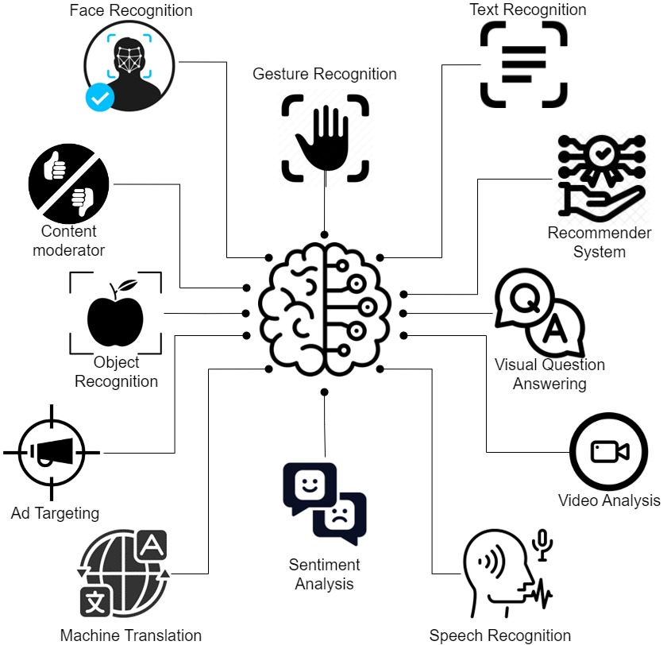
AI-Powered Solutions
AI Assistance for Visually Impaired People
Notes:
Nowadays, thanks to advances in AI technologies, there are many different deep learning models with different purposes, that an AI-powered solution utilizes one or more of them to serve its tasks.
For example, YouTube uses:
Content Moderation: To maintain a safe and clean environment
Video Analysis: For understanding content within videos.
Recommendation Systems: To personalize content recommendations.
Ad Targeting: To serve targeted advertisements.
Language Understanding: For generating captions and translations.
Another example, an AI-based assistance for visually impaired people can employ:
Face Recognition: To identify individuals.
Object Recognition: To recognize objects and obstacles.
Visual Question Answering: To answer questions about their surroundings.
Speech Recognition: To convert spoken language into text.
These deep learning models form the backbone of AI-powered solutions, enhancing the capabilities and accessibility of various applications.

Slide 5
Computing Infrastructure
ML Inference Queries
ML Inference Output
John
“Your mug is on the kitchen counter”
“Where is my mug?”
Computing Infrastructure
Machines
Call Ali
Dog
Notes:
Once you have trained and integrated the ML models into your application, in production, you need to design the computing infrastructure
that can efficiently serve the ML inference queries and provide timely output.
The choice of computing infrastructure will play a significant role in the success of your AI-powered application in production.

Slide 6
Homogeneous Computing
Homogeneous Computing
Q: HOW MANY do you need?
A: a Scalar (1D)
Notes:
You might have a cost budget and a preferred GPU type in mind.
Here, in homogeneous computing environment, the key question becomes: "How many GPUs are sufficient for your purpose?“
Your decision centers on finding the right scalar value, representing the number of GPUs needed to balance cost and performance.
Choosing the right number of GPUs ensures cost-effectiveness and optimal performance for your AI workloads.

Slide 7
Heterogeneous Computing
WHICH TYPE do you need?
HOW MANY do you need?
Cloud Provider Infrastructure as a Service
(AWS EC2)
2D Decision Space
Notes:
However, In a heterogeneous computing environment, you explore other cost-effective options, not only the expensive GPU instance, to balance your budget while maintaining performance.
For example, when using a hyperscaler cloud provider like AWS EC2, a multitude of Virtual Machine instance types are available, each with unique characteristics.
Here, your decision space expands to selecting the right instance types and the appropriate number of each.

Slide 8
Homogeneous vs. Heterogeneous Decision Space
Cost Budget: $7.5 / hour
Homogeneous
Heterogeneous
#g3s.xlarge (0.75)
1
2
3
O O O
9
10
#t2.xlarge (0.1856) | #c4.xlarge (0.199) | #c5.2xlarge (0.308) | #g3s.xlarge (0.75)
0 | 0 | 0 | 1
0 | 0 | 0 | 2
O O O | O O O
4 | 7 | 3 | 5
4 | 7 | 4 | 5
O O O | O O O
10 Configurations
100,000+ Configurations
Notes:
In our example, let's compare the decision space in homogeneous and heterogenous environments:
Homogeneous Environment:
Cost Budget: $7.5/hr
GPU Instance Type: g3s.xlarge
Configurations: 10 different setups within budget constraints.
Heterogeneous Environment:
Inclusion of 3 Additional Instance Types: t2.xlarge, c4.xlarge, and c5.2xlarge.
There are ver 100,000 distinct setups with varying costs and performance levels.
Finding the optimal configuration demands exploring an extensive number of possibilities, which may be practical for homogeneous environments but becomes a formidable task in heterogeneous systems.

Slide 9
0/1 Heterogeneous Metric
Machines are architecturally diverse?
No/0
Yes/1
Homogeneous
Heterogeneous
(0, 0, 0,10)
(20, 0, 0, 0)
(0,10, 0, 0)
(10, 2 ,0, 9)
(0,10, 5, 4)
(20,10, 5, 0)
Notes:
So far, we have utilized a binary heterogeneity metric that categorizes computing systems based on the machines’s architectural diversity.
If all machines share the same architecture, the computing system is homogeneous.
If there's architectural diversity, the system is considered heterogeneous.
However, the 0/1 heterogeneity metric may not accurately capture the intricacies of diverse and multifaceted systems.
This emphasizes the need for a more nuanced metric to inform decision-making, and navigate through the vast decision space.

Slide 10
Heterogeneity Spectrum
(1, 7 ,2, 9)
(1, 5 ,5, 4)
Slow
Fast
Heterogeneity Spectrum
Notes:
In essence, we aim to move beyond a binary heterogeneity metric and embrace a more nuanced approach—the heterogeneity spectrum.
This spectrum attributes a heterogeneity score to each heterogeneous system, offering a representation of its performance relative to others.
In this manner, the position of computing systems in heterogeneity spectrum serves as a guiding metric, and navigate the expansive decision space, ultimately aiding in making well-informed decisions.
Let's delve deeper into heterogeneity.

Slide 11
Heterogeneity
What is heterogeneity in distributed computing systems?
Notes:
In our earlier discussion on the 0/1 heterogeneity metric, we highlighted that heterogeneity arises from diversity. In the upcoming slides, we'll explore various dimensions of diversity in distributed computing systems that can impact system performance.

Slide 12
Machine Heterogeneity
Inference Time
Variation in Execution Time
Inference
Face Recognition
Inference
Notes:
One dimension of system heterogeneity arises from machine diversity, and we refer to it as machine heterogeneity.
For instance, when examining a task like face recognition, there's a noticeable variation in inference times across different machines—be it GPU instances, compute-optimized instances, or general-purpose instances.
This variability in execution time highlights a crucial aspect of system heterogeneity resulted from the diversity of machines.

Slide 13
Task Heterogeneity
20 msec
Face Recognition
Inference Time
Variation in Execution Time
60 msec
Speech Recognition
AWS EC2 Instance
200 msec
inference time
Question Answering
Notes:
Another fundamental dimension of system heterogeneity arises from task type diversity, and we refer to it as task heterogeneity.
To illustrate, let's consider three distinct task types: face recognition, speech recognition, and question answering.
The variation in inference time of task types on a specific instance type, such as G3s.xlarge, highlights another dimension of system heterogeneity, we call it task heterogeneity.

Slide 14
Machine and Task Heterogeneity
100,20, 50 msec
Face Recognition
Inference Time
120, 60, 80
Speech Recognition
AWS EC2 Instances
500, 200, 350
inference time
NLP
Notes:
When we combine these two dimensions, we encounter the synergy of diverse task types executed on a wide array of machine types.
This interplay between task and machine heterogeneity paints a comprehensive picture of the system’s heterogeneity nature.

Slide 15
Heterogeneous Computing (HC) Systems
A computing system is heterogeneous if and only if :
“Expected Execution time of at least one [task, machine] pair differs from others”
Variation in Execution Time
 | g3s.xlarge | t2.2xlarge | C4.xlarge
Face Recognition | 20 | 300 | 50
Speech Recognition | 50 | 400 | 100
ChatGPT | 100 | 1000 | 150
Variation in Execution Time
Notes:
In this context, we establish a definition for a heterogeneous computing system:
A computing system is considered heterogeneous if and only if there exists at least one [task, machine] pair with an execution time distinct from that of others.
This definition can be represented in matrix form, where rows correspond to the expected execution times of specific task types on various machine types, and each column represents the execution times of different task types on specific machine types.

Slide 16
Performance Model of HC Systems
EET (Expected Execution Time) Matrix
Machine types
Machine Types Task Types | M₁ | M₂ | o o o | M_{m}
T₁ | $$e_{11}$$ | $$e_{12}$$ | o o o | $$e_{1m}$$
T₂ | $$e_{21}$$ | $$e_{22}$$ | o o o | $$e_{2m}$$
o o o | o o o | o o o | o o o | o o o
T_{n} | $$e_{n1}$$ | $$e_{n2}$$ | o o o | $$e_{nm}$$
Task types
Expected Execution Time (EET) of task type T₁ on machine type M₂
Notes:
In this research work, we refer to this matrix as the "Expected Execution Time" matrix (EET).
Within the EET matrix, each entry at position (i, j) represents the expected execution time of task type i on machine type j.
We will use the EET matrix to model the performance behavior of a distributed computing system.

Slide 17
Heterogeneity in EET Matrix
EET (Expected Execution Time) Matrix
Machine Types Task Types | M-1 | M-2 | M-3 | M-4
TT-1 | 2.8 | 6.5 | 3.7 | 7.1
TT-2 | 2.5 | 6.4 | 5.0 | 6.5
TT-3 | 3.1 | 6.2 | 3.7 | 7.9
TT-4 | 3.1 | 8.1 | 4.5 | 7.8
Machine Heterogeneity
The execution time of a given task varies across machines
Task Heterogeneity
A given machine has different expected execution time for different tasks
Notes:
Here, an example of EET matrix is shown.
The row-wise variation in the execution time of a given task across machines represents the machine heterogeneity
The column-wise variation in the execution time of a given machine across task types represents the task heterogeneity

Slide 18
HEET:
Quantifying The Heterogeneity Spectrum
Notes:
In this section, we introduce HEET, a Heterogeneity Score, designed to quantify the differences across distributed computing systems.
Generally speaking, HEET serves as a high-level representation of system performance

Slide 19
Homogenization: Heterogeneity to Homogeneity
$$T^{∗}$$
$$M^{∗}$$
Face Recognition
Homogenization Function
$$T^{∗}$$
$$M^{∗}$$
Speech Recognition
$$M^{∗}$$
$$T^{∗}$$
NLP
Machines
Machines
Heterogeneous Computing System
Homogeneous Computing System
Notes:
In pursuit of developing a heterogeneity score, we present a method for transforming a heterogeneous computing system into a hypothetical equivalent homogeneous system.
This homogenization ensures that the equivalent homogeneous system exhibits similar performance behavior as the original heterogeneous system for the purpose of assessment and comparison.

Slide 20
The Role of Homogenization in the Heterogeneity Score
Simplification
Estimate the QoS
$$T^{∗}$$
$$M^{∗}$$
Face Recognition
QoS
$$T^{∗}$$
$$M^{∗}$$
$$\hat{QoS}$$
Speech Recognition
$$M^{∗}$$
$$T^{∗}$$
Homogenization
Machines
NLP
Machines
Heterogeneous Computing System
Homogeneous Computing System
Notes:
What is the purpose of the homogenization?
The homogenization process simplifies the system, converting a heterogeneous computing environment into a homogenous model.
This simplified representation of the system significantly facilitates accurate predictions of the QoS for specific workloads.

Slide 21
The Role of Homogenization in the Heterogeneity Score
Heterogeneity Measure
Comparison across HC systems
$$\hat{QoS_{B}}$$
$$QoS_{B}$$
Workload
?
Estimated QoS once HC systems mapped via mapping function
$$≈$$
$$QoS_{A}$$
<
$$\hat{QoS_{B}}$$
HC System B
$$\hat{QoS_{A}}$$
$$QoS_{B}$$
Unknown prior completing the workload
We can predict both HC systems will perform similarly without processing the workload
$$QoS_{A}$$
$$\hat{QoS_{A}}$$
HC System A
Notes:
In addition, this homogenization allows for meaningful comparisons between entirely distinct heterogeneous computing systems in terms of their performance.
For instance, when faced with the task of determining the optimal heterogeneous configuration for a specific workload, this high-level understanding of expected performance becomes crucial.
Before processing the workload on each system, we often lack knowledge of the QoS of the systems.
However, through homogenization, we gain the capability to predict the QoS of both system A and B.
This, in turn, empowers us to strike a balance between cost and performance, facilitating informed decision-making.

Slide 22
Problem Statement
Given a heterogeneous computing system, $S$, consisting of a set of machines, $M=\left\{M_{1}, M_{2},…, M_{n}\right\},$ executing a set of task types, $T=\left\{T_{1},T_{2}, …, T_{m}\right\}$, where $EET=\left[e_{ij}\right]$ denote the Expected Execution Time of task type "i" on machine type "j".
We aim to find the homogenization function, $H\left(EET\right)$ that:
$$HEET=H\left(EET\right)$$
where $HEET$ represents the Homogeneous Equivalent Execution Time (HEET) of homogenized system, $S^{∗}$, consists of “n” machines of the same type, $M^{∗}$, executing homogeneous tasks of type T*, such that
$$makespan\left(W_{S}\right)=makespan\left(W_{S^{∗}}\right)$$
$W_{s}$ denotes a workload of tasks of types $T$, and $W_{S^{∗}}$ is the homogenized workload where all tasks are of type $T^{∗}.$
Notes:
Here, we have the problem statement:
The transformed homogeneous system is considered valid if the makespan of the homogenized workload on the homogeneous equivalent system remains the same as executing the original workload on the heterogenous system
This criteria ensures that the homogenization does not impact the system’s performance behavior.

Slide 23
Homogenization Strategy
Baseline Homogeneous System
Slower than heterogeneous system
Speedup Factor Calculation
Quantifying how much faster the heterogeneous system is compared to the baseline
Equivalent Homogeneous System
Utilizing the speedup factor relative to the baseline to determine the equivalent homogeneous system
Notes:
The strategy for homogenization process is like that:
We first establish a baseline homogeneous system, which is generally slower than the heterogeneous system.
Then, we calculate the speedup factor, which quantifies how much faster the heterogeneous system is compared to the baseline.
Finally, utilizing the speedup factor relative to the baseline, we determine the equivalent homogeneous system.
This allows us to capture the essence of heterogeneity while simplifying the system for analysis and comparison.

Slide 24
Homogenization Dimensions
Machine Homogenization:
Replace diverse machine types with a hypothetical homogeneous machine.
Task Homogenization:
Replace task types with hypothetical equivalent tasks.
Notes:
As previously discussed, system heterogeneity arises from the dimensions of machine heterogeneity and task heterogeneity. To perform the desired homogenization, we focus on these two key dimensions:

Slide 25
Machine Homogenization(MH)
Slowest machine type
$$M_{1}$$
$$t_{homo}$$
Inference Requests
Makespan
Workload
$$M_{2}$$
$$M_{1}$$
$$t_{hete}$$
Total time to complete the workload
$$M_{3}$$
$$M_{1}$$
$$Speedup factor=\frac{t_{homo}}{t_{hete}}$$
Machines
Homogeneous computing System
Heterogeneous computing System
Notes:
Assume a workload of the certain task type is executing on diverse machines M_1, M_2, and M-3.
The total time to complete all tasks in the workload, call it makespan, on the heterogeneous machines is t_hete, colored as green.
Then, if we replace all machines with the slowest one, executing the same workload on the homogeneous machines will result in greater makespan, colored as red.
Here, the speedup factor due to machine heterogeneity with is t_homo divided by t_hete.
The speedup factor determines how much a heterogeneous system becomes slower due to machine homogenization process.

Slide 26
Task Homogenization(TH)
Slowest task type executing on machine
Inference Requests
$$t_{homo}$$
Makespan
$$M_{1}$$
$$t_{hete}$$
Total time to complete the workload
Workload trace of tasks
$$Speedup Factor=\frac{t_{homo}}{t_{hete}}$$
Heterogeneous computing System
Homogeneous computing System
Notes:
Similarly, assume a heterogeneous workload of tasks where task types are different ( red, green, and blue) executing on a certain machine type, M_1.
The total time to complete all heterogenous tasks in the workload on M_1 is t_hete, colored as green.
Then, if we replace all task types with the slowest task type on M_1, executing the workload of the same size as before on M_1 will result in higher makespan, which is t_homo, colored as red.
Here, the speedup factor due to task heterogeneity with is again t_homo divided by t_hete.
This speedup factor determines how much a heterogeneous system becomes slower due to task homogenization process.

Slide 27
Speedup Vector For MH
Baseline machine
The slowest machine type for that task type
Slowest machine type for task type “i”
$$α_{j}^{(i)}=\frac{\max_{j}{e_{ij}}}{e_{ij}}$$
Expected Execution time of of task type “i” on machine type “j”
Speedup Vector For MH
Notes:
For speedup factor in MH and TH, we first need to determine the speedup vectors.
The speedup vector in MH represents how much each machine is faster than the slowest machine for a given task type.
Here, max_e_ij is the expected execution time of the slowest machine for task type T_i
and e_ij is expected exuetion time of task i on machine j.
So, alpha sub j determines how much machine j is faster than the slowest machine for task i

Slide 28
Example
EET Matrix
Machine Tasks | M-1 | M-2 | M-3 | M-4
TT-1 | 2.8 | 6.5 | 3.7 | 7.1
TT-2 | 2.5 | 6.4 | 5.0 | 6.5
TT-3 | 3.1 | 6.2 | 3.7 | 7.9
TT-4 | 3.0 | 8.1 | 4.5 | 7.8
$$α_{1}^{(1)}=\frac{7.1}{2.8}=2.5$$
$$α_{2}^{(1)}=\frac{7.1}{6.5}=1.1$$

Slide 29
Speedup Vector For TH
Baseline task type
The task which has the largest execution time on machine type “j”
Slowest task type on machine “j”
$$β_{(j)}^{i}=\frac{\max_{i}{e_{ij}}}{e_{i,j}}$$
Expected Execution time of of task type “i” on machine type “j”
Speedup Vector For TH

Slide 30
Example
EET Matrix
Machines Tasks | M-1 | M-2 | M-3 | M-4
TT-1 | 2.8 | 6.5 | 3.7 | 7.1
TT-2 | 2.5 | 6.4 | 5.0 | 6.5
TT-3 | 3.1 | 6.2 | 3.7 | 7.9
TT-4 | 3.0 | 8.1 | 4.5 | 7.8
$$β_{(1)}^{1}=\frac{3.1}{2.8}=1.1$$
$$β_{(1)}^{2}=\frac{3.1}{2.5}=1.2$$

Slide 31
How to Infer Speed Factor from Speedup Vector?
Speedup Vector For MH
Arithmetic Mean
Speedup Factor For MH
$${\overline{α}}^{(i)}$$
Speedup Vector For TH
Harmonic Mean
Speedup Factor For TH
$${\overline{β}}_{(j)}$$
Notes:
We proved that ….

Slide 32
Speedup Factor for MH
EET
 | $$M_{1}$$ | $$M_{2}$$ | $$M_{3}$$
T | 10 | 2 | 1
Slowest machine type
$$M_{1}$$
$$t_{160}$$
$$…$$
$$t_{2}$$
$$t_{1}$$
$$M_{2}$$
Unbounded FCFS Queue
$$M_{3}$$
Machines

Slide 33
Speedup Factor for MH
EET
Speedup Vector
 | $$M_{1}$$ | $$M_{2}$$ | $$M_{3}$$
T | 10 | 2 | 1
 | $$M_{1}$$ | $$M_{2}$$ | $$M_{3}$$
T | 1 | 5 | 10
$$t_{1}$$
$$M_{1}$$
Slowest machine type
$$t_{160}$$
$$…$$
$$t_{17}$$
$$M_{2}$$
$$t_{14}$$
$$t_{11}$$
$$t_{8}$$
$$t_{5}$$
$$t_{2}$$
5 times faster
Unbounded FCFS Queue
$$t_{16}$$
$$t_{15}$$
$$t_{13}$$
$$t_{12}$$
$$t_{10}$$
$$t_{9}$$
$$t_{7}$$
$$t_{6}$$
$$t_{4}$$
$$t_{3}$$
$$M_{3}$$
$$t_{hete}= \frac{160}{16}×10=100$$
10 times faster
Machines
Time = 10
#completed = 16

Slide 34
Speedup Factor for MH
EET
Speedup Vector
 | $$M_{1}$$ | $$M_{2}$$ | $$M_{3}$$
T | 10 | 2 | 1
 | $$M_{1}$$ | $$M_{2}$$ | $$M_{3}$$
T | 1 | 5 | 10
Slowest machine type
$$M_{1}$$
$$t_{c}$$
$$…$$
$$t_{2}$$
$$t_{1}$$
$$M_{1}$$
Unbounded FCFS Queue
$$M_{1}$$
Machines

Slide 35
Speedup Factor for MH
EET
Speedup Vector
 | $$M_{1}$$ | $$M_{2}$$ | $$M_{3}$$
T | 10 | 2 | 1
 | $$M_{1}$$ | $$M_{2}$$ | $$M_{3}$$
T | 1 | 5 | 10
Slowest machine type
$$t_{1}$$
$$M_{1}$$
$$t_{c}$$
$$…$$
$$t_{2}$$
$$t_{1}$$
$$M_{1}$$
$$t_{2}$$
Unbounded FCFS Queue
$$t_{3}$$
$$M_{1}$$
$$t_{homo}= \frac{160}{3}×10=533.33$$
Machines
Time = 10
#completed = 3

Slide 36
Speedup Factor for MH
EET
Speedup Vector
 | $$M_{1}$$ | $$M_{2}$$ | $$M_{3}$$
T | 10 | 2 | 1
 | $$M_{1}$$ | $$M_{2}$$ | $$M_{3}$$
T | 1 | 5 | 10
$$arithmetic mean of speedup vector= \frac{1+5+10}{3}=5.33$$
$$t_{homo}= \frac{160}{3}×10=533.33$$
$$speedup factor= \frac{533.33}{100}=5.33$$
$$t_{hete}= \frac{160}{16}×10=100$$

Slide 37
MH and TH
MH:
$$equivalent execution time= \frac{\max_{j}{e_{ij}}}{{\overline{α}}^{(i)}}$$
TH:
$$equivalent execution time= \frac{\max_{i}{e_{ij}}}{{\overline{β}}_{(j)}}$$

Slide 39
HEET: System Heterogeneity Score
A representative of the Expected Execution Time Behavior of the Heterogeneous Computing System

Slide 40
Heterogeneous System Transformation into a Homogeneous System
Heterogeneous System
Homogeneous System
 | $$M_{1}$$ | $$M_{2}$$ | $$M_{3}$$
$$T_{1}$$ | $$e_{11}$$ | $$e_{12}$$ | $$e_{13}$$
$$T_{2}$$ | $$e_{21}$$ | $$e_{22}$$ | $$e_{23}$$
$$T_{3}$$ | $$e_{31}$$ | $$e_{32}$$ | $$e_{33}$$
 | $$M^{∗}$$ | $$M^{∗}$$ | $$M^{∗}$$
$$T^{∗}$$ | $$HEET$$ | $$HEET$$ | $${HEET}^{∗}$$
$$T^{∗}$$ | $$HEET$$ | $$HEET$$ | $$HEET$$
$$T^{∗}$$ | $$HEET$$ | $$HEET$$ | $$HEET$$
Equivalent
EET
EET

Slide 41
Estimated Makespan and Throughput
Total Number of Tasks
$$τ=\frac{c}{n}∙HEET$$
Estimated Makespan
Total Number of Machines
$$θ=\frac{n}{HEET}$$
Estimated Throughput

Slide 42
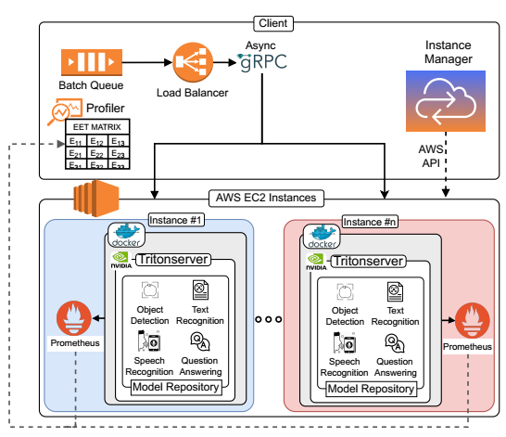
Experimental Setup
Task Types
Image Classification (Resnet50)
Object Recognition (YoloV5)
Question Answering (DistilBERT)
Speech Recognition (Wav2Vec2)
Machine Types
t2.large
c5.2xlarge
g4dn.xlarge
Model Server: NVIDIA Tritonserver

Slide 43
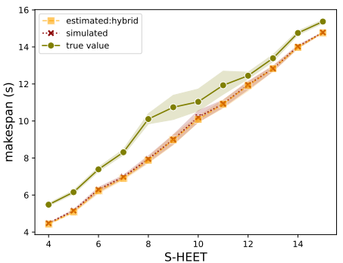
Validating HEET Score
Each point in the graph shows the mean makesapan of executing a certain workload on different heterogeneous computing systems ( at least 5 ) with similar HEET score

Slide 44
Validating HEET Score
Narrow Confidence Interval Proves that HC systems with similar HEET scores yield similar makespan.
The estimated makespan using HEET score predict the true values with an average accuracy of 84%.
We run a simulation with zero uncertainty in the expected execution times to demonstrate the root cause of the error

Slide 45
Validating HEET Score
The makespan calculated using HEET score accurately estimates the makespan of the simulation.
Thus, heterogeneous systems with low levels of uncertainty in execution times, estimating makespan using HEET score is an accurate method

Slide 46
Summary
MH and TH are accurate techniques to transform a complex heterogeneous computing system to a simple homogeneous equivalent
HEET provides a metric for the heterogeneity spectrum
HEET can be used to estimate throughput of a heterogeneous computing system
HEET score predict the true values with an average accuracy of 84%
HEET is more accurate for less uncertain heterogeneous computing systems

Slide 47
Future Works
Cost- and QoS-aware Heterogeneous System Configuration
Utilizing heterogeneity score to recommend new configurations minimizing cost under user-defined QoS constraints
Probabilistic HEET Score
Proposed enhancement by incorporating stochastic execution time into HEET calculation

Slide 48
Future Works
Energy-aware Heterogeneity Measure
Expanding the dimensions of system heterogeneity to include variations in energy consumption among different machine types
Transformation of HEET into a two-dimensional (2D) metric
Incorporating expected energy consumption alongside homogeneous equivalent execution time.

Slide 49
Thank you!

