Slide 1
Edge-MultiAI: Multi-Tenancy of Latency-Sensitive Deep Learning Applications on Edge
SM Zobaed¹ , Ali Mokhtari¹ , Jaya Prakash Champati² , Mathieu Kourouma³ , Mohsen Amini Salehi¹
December 2022

Slide 2
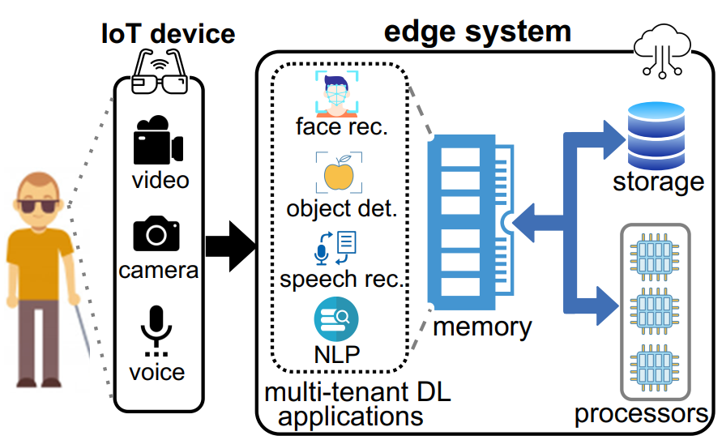
Deep Learning (DL) Applications in Smart Edge Computing Systems
IoT-based smart systems offer multiple smart services
The system should serve the user’s request withing a short latency
The system should serve ML tasks concurrently and continuously

Slide 3
Motivation: SmartSight Project
SmartSight: IoT-based system that
continuously receives various inputs from smart glass
processes them via multi-tenant DL applications running on edge

Slide 4
Resource Limited Edge Systems
Edge computing systems are resource limited
DL applications function based on bulky neural network (NN) models
Model loading time affects latency
Cannot be simultaneously maintained in the limited memory space of the edge

Slide 5
Model Compression to Enhance Multi-Tenancy
Multi-Tenancy
Accuracy (Model Size)

Slide 6
Problem Statement
How to maximize warm-start inferences or multi-tenant DL apps execution with maximum accuracy on a resource limited edge system?

Slide 7
Objective Function
Cold-start events
Inference Accuracy
Memory Constraint

Slide 8
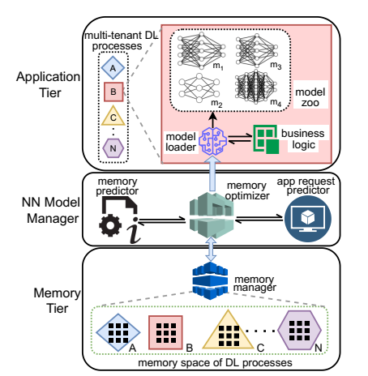
Edge-MultiAI: Overview
incoming multi-modal inputs from the connected IoT devices trigger execution of multi-tenant DL applications
The model zoo for each DL app acts as a repository that contains NN models with different compression levels (sizes) and inference accuracy

Slide 9
Edge-MultiAI: Overview
App request predictor collects historical requests to each application and trains a lightweight (edge-friendly) RNN model, to periodically foresee the inference request arrivals for each application.

Slide 10
Edge-MultiAI: Overview
“memory manager” that keeps track of the currently loaded models, the available memory spaces, and the current status of the applications

Slide 11
Heuristics to Manage Models of Multi-tenant Applications
The NN models of applications that are unlikely to be requested in the near future should be assigned a lower priority to remain in the memory
Due to uncertainty in request prediction, we consider a request time window (∆) around each predicted request time
There is a time overhead ($θ_{i}$) to load the chosen NN model of an application $A_{i}$into the memory
To prevent a cold-start for $A_{i}$, its model has to be loaded in memory at $t_{i}−∆−θ_{i}$, and kept until $t_{i}+∆$

Slide 12
Minimal and Maximal State
Applications in Minimal State:
The set of applications whose NN models are retained in memory outside of their predicted request time window
Applications in Maximal State:
the set of applications that are in their request time window
To resolve the memory contention, the policy can be based on scavenging memory from the minimalist applications to provide the required memory space for the maximalist ones

Slide 13
Heuristics to Manage Models of Multi-tenant Applications
Maximal State
Minimal State
Minimal State
Maximal State
Minimal State

Slide 14
iWS-BFE Heuristic
This policy is inspired from the widely adopted LRU-K cache management policy
least recently used (i.e., requested) applications are not likely to be requested in the near future
Only considers Minimal applications as eviction candidates, that have not been requested in a recent history time window (H)

Slide 15
Heuristics to Manage Models of Multi-tenant Applications
Maximal State
Minimal State
Minimal State
Maximal State
Minimal State

Slide 16
iWS-BFE Heuristic
The most appropriate application for eviction
the one that has not been recently requested
Predicted to be requested the latest in future
The request time predictions are uncertain, and the system can receive an unexpected request

Slide 17
iWS-BFE Heuristic
Distance between predicted request time and current time
Fitness score of $A_{j}$ for eviction :
$r_{j}$: unexpected request for $A_{j}$
$t_{j}$: predicted request time for $A_{j}$
$t_{i}$: current time
$t_{k}$: latest predicted request time across all applications
Probability of unexpected request for $A_{j}$ at current time
(Bayesian Analysis)

Slide 18
Experiments: Applications

Slide 19
Degree of Multi-tenancy
Employing Edge-MultiAI is more effective for higher degrees of multi-tenancy
iWS-BFE achieves ≈130% higher satisfaction rate than no policy for higher degree
multi-tenancy satisfaction rate: the percentage of warm-start inferences out of the total incoming requests during the simulation time

Slide 20
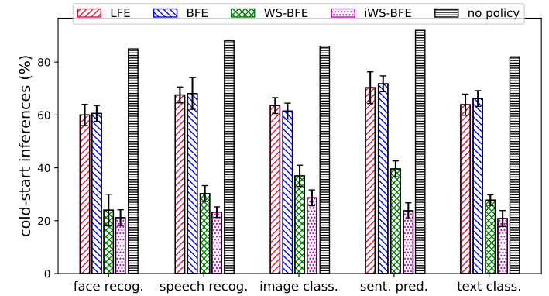
Cold-start Inference & Inference Accuracy
The rate of cold-start inferences and accuracy are fairly distributed across different applications
For each policy, cold-start and accuracy do not fluctuate significantly from one application to the other

Slide 21
Bi-Objective Analysis
the percentage of cold-start inferences versus the model error for different policies and ∆ values
iWS-BFE dominates other policies

Slide 22
Conclusion
We proposed NN model management framework, Edge-MultiAI for edge-friendly executions
Aims to maximize multi-tenancy
Edge-MultiAI accelerates multi-tenant DL executions without compromising latency & accuracy
Edge-MultiAI provides 2x multi-tenancy and 60% more warm-start inferences
We implemented a simulator to support future research

Slide 23
Future Work
Inclusion of energy in model management heuristics
Current bi-objective (latency vs. cold-start) does not consider energy

Slide 24
THANK YOU

