Slide 1
Heterogeneous Edge to Cloud Simulator
By:
Ali Mokhtari, Mohsen Amini Salehi
December 2022

Slide 2
Heterogeneity across Edge to Cloud
GTX 10 series
GTX 16 series
GTX 20 series
GTX 30 series
GTX 40 series
RTX 6000
RTX A5500
T1000
T600
Google Glass Enterprise Edition 2
SoC: Qualcomm’s Snapdragon XR1
XR1: the ARM-based multicore CPU, GPU and AI Engine supporting computer vision and machine learning use cases

Slide 3
Why Heterogeneity is important?
Heterogeneity impacts the system performance
Homogeneous
Heterogeneity
Solution A
Solution B
Solution A
Solution B
System Performance concerning QoS/Cost objective

Slide 4
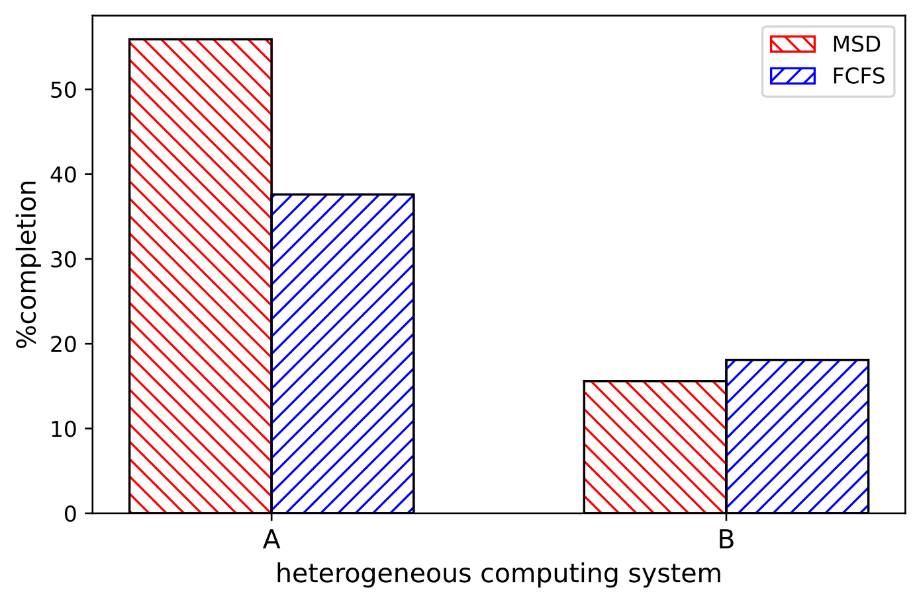
Why Heterogeneity is important?
Scheduling is a system-level solution affected by heterogeneity
Heterogeneity A → B
MSD > FCFS
MSD ≤ FCFS

Slide 5
System Heterogeneity Dimensions
System Heterogeneity
Machine Heterogeneity
Task Heterogeneity
The variation in the execution times of a given task across all the machines
The variation in the execution times of tasks for a given machines
CPUs
GPUs
FPGA
Object Detection
Speech Recognition
Video Transcoding

Slide 6
Expected Execution Time Matrix
EET (Expected Execution Time) Matrix
Machine Types Task Types | M-1 | M-2 | M-3 | M-4
TT-1 | 2.8 | 6.5 | 3.7 | 7.1
TT-2 | 2.5 | 6.4 | 5.0 | 6.5
TT-3 | 3.1 | 6.2 | 3.7 | 7.9
TT-4 | 3.1 | 8.1 | 4.5 | 7.8

Slide 7
EET Matrix: Machine Heterogeneity
EET (Expected Execution Time) Matrix
Machine Types Task Types | M-1 | M-2 | M-3 | M-4
TT-1 | 2.8 | 6.5 | 3.7 | 7.1
TT-2 | 2.5 | 6.4 | 5.0 | 6.5
TT-3 | 3.1 | 6.2 | 3.7 | 7.9
TT-4 | 3.1 | 8.1 | 4.5 | 7.8
Task
Machine Heterogeneity:
The execution time of a given task varies across machines

Slide 8
EET Matrix: Task Heterogeneity
EET (Expected Execution Time) Matrix
Machine Types Task Types | M-1 | M-2 | M-3 | M-4
TT-1 | 2.8 | 6.5 | 3.7 | 7.1
TT-2 | 2.5 | 6.4 | 5.0 | 6.5
TT-3 | 3.1 | 6.2 | 3.7 | 7.9
TT-4 | 3.1 | 8.1 | 4.5 | 7.8
Task Heterogeneity:
A given machine has different expected execution time for different tasks
Machine

Slide 9
E2C: Overview

Slide 10
E2C: Overview
Heterogeneous Machines

Slide 11
E2C: Overview
Energy Supply

Slide 12
E2C: Overview
Local Queues

Slide 13
E2C: Overview
Task Arrivals

Slide 14
E2C: Overview
Scheduler

Slide 15
Installation Guide
Install Anaconda
Create virtual environment with python3.9
Download the Repository:
https://github.com/hpcclab/E2C-Sim
Install the requirements from requirements.txt
$ conda create –n env python=3.9
$ pip install –r requirements.txt

Slide 16
Launch E2C
Navigate to V1/ directory
Run main.py

Slide 17
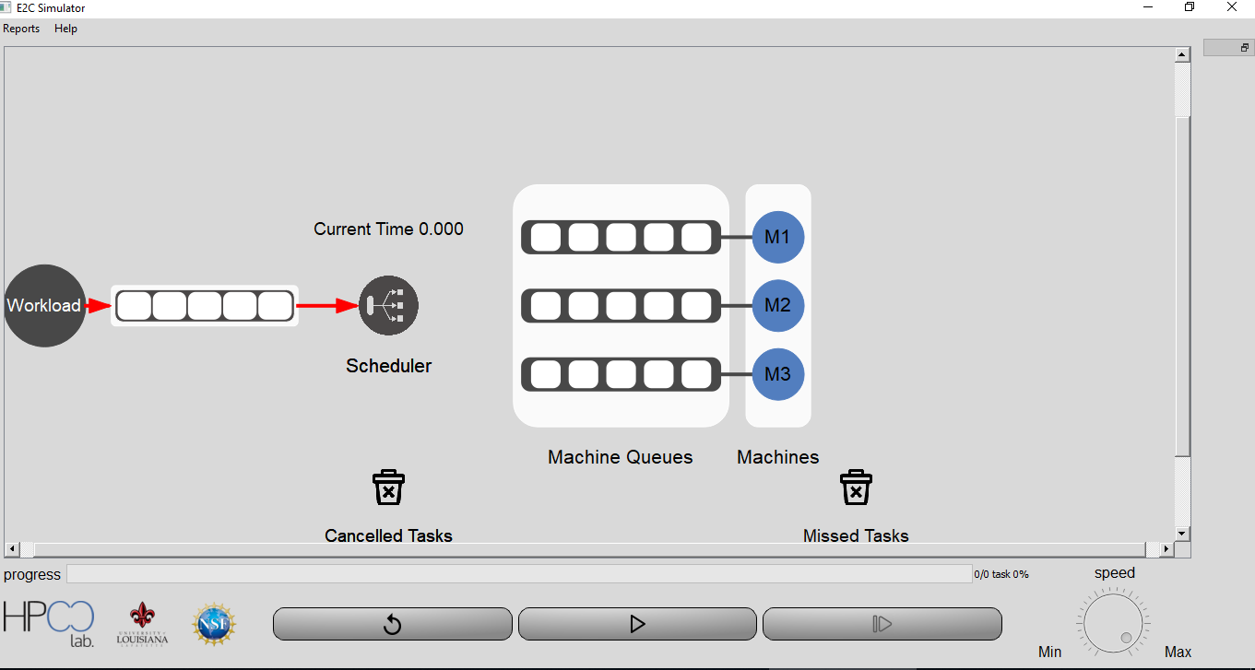
E2C GUI Window

Slide 18
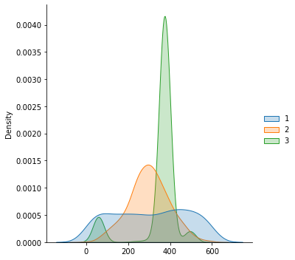
Task Flow in E2C
event_list
Event objects
arriving
time: 2.2
arriving
time: 2
arriving
time: 0.5
arriving
time: 0
WorkloadGenerator()
get_first_event()
m_1
execute()
map()
choose()
put()
Completion_time= 1.5
“ARRIVING“ event
batch_queue
Running_task
unmapped_task

Slide 19
Task Flow in E2C
“COMPLETION” event should insert @1.5
Task objects
arriving
time: 2.2
arriving
time: 2
arriving
time: 0.5
arriving
time: 0
m_1
execute()
map()
choose()
put()
Completion_time= 1.5
batch_queue
Running_task
unmapped_task

Slide 20
Task Flow in E2C
event_list
Event objects
arriving
time: 2.2
arriving
time: 2
completion
time: 1.5
arriving
time: 0.5
arriving
time: 0
get_first_event()
m_1
execute()
map()
choose()
put()
Completion_time= 1.5
“ARRIVING“ event
batch_queue
Running_task
unmapped_task

Slide 21
Task Flow in E2C
event_list
Event objects
arriving
time: 2.2
arriving
time: 2
completion
time: 1.5
get_first_event()
m_1
terminate()
@time = 1.5
“COMPLETION“ event
Running_task

Slide 22
Workload: Scenario
We consider that the system would work in different environments with different demands as workload

Slide 23
Workload: Scenarios
To synthesize the workload, we can consider different scenario
Each scenario has:
start time
end time
Task type
Distribution Pattern

Slide 24
Workload Distributions
The arrival times of a task type within a scenario is a sample drawn from one of the following distributions:
Uniform
Normal
Exponential
Spiky

Slide 25
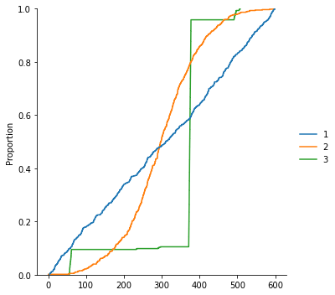
An Workload Example

