Slide 1
Streamlining Cloud-Native Application Development and Deployment with Robust Encapsulation
Pawissanutt Lertpongrujikorn,
Hai Duc Nguyen*, Mohsen Amini Salehi

Slide 2
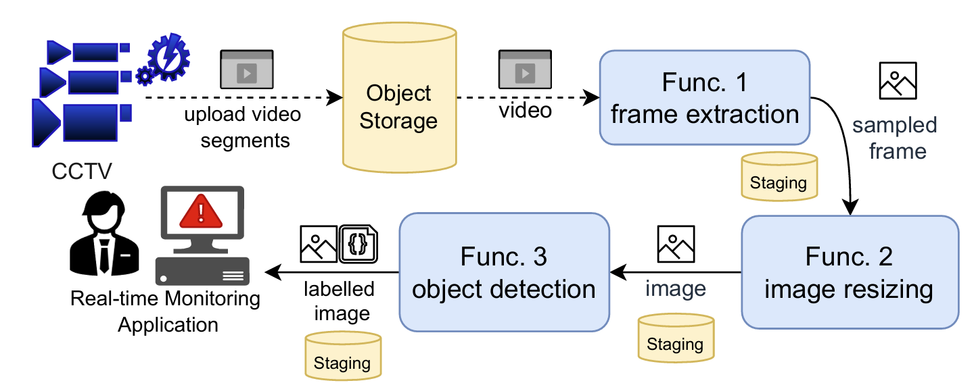
Case Study: Real-time Monitoring System
App. comes with Non-function requirements (NFR).
Separate Abstractions!
Need to manage external storage.

Slide 3
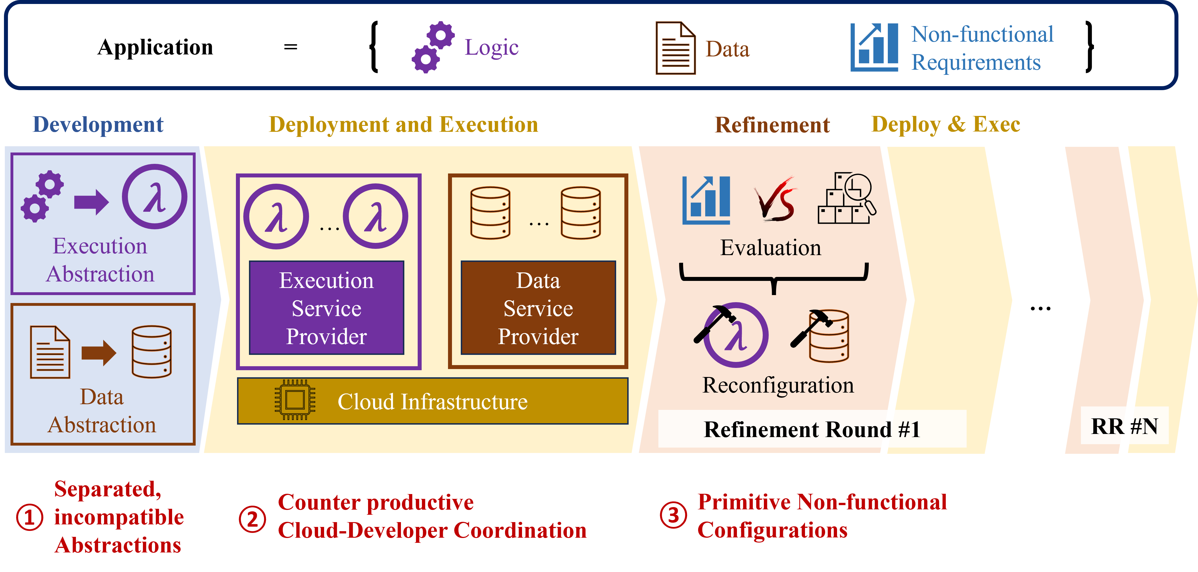
FaaS Problem 1: Separate Abstractions
QoS requirements and constraints
Function and Data on different hosts: 2x slower!
Function and Data on different datacenters:
35x slower!!

Slide 4
FaaS Problem 2: Conflicting Objectives of Provider & User
QoS requirements and constraints
Developer optimization objective:
Meet SLO and reduce cost
Cloud provider objective:
Resource utilization
Over-subscription

Slide 5
FaaS Problem 3: Multiple Round of Deployment Refinements
QoS requirements and constraints
Configuring such low-level parameters demands effort and expertise

Slide 6
Our Solution: OaaS Abstraction

Slide 7
Non-functional Requirements
QoS
Name | Value Type | Unit | Example
Throughput | Int | Rps | 100 Rps
Availability | Real | Percent | 99.9 %
Locality | Enum | N/A | Local, None
Constraints
Name | Value Type | Unit | Example
Persistent | Yes/No | N/A | Yes
Geographical | List | N/A | [DC1, DC2]

Slide 8
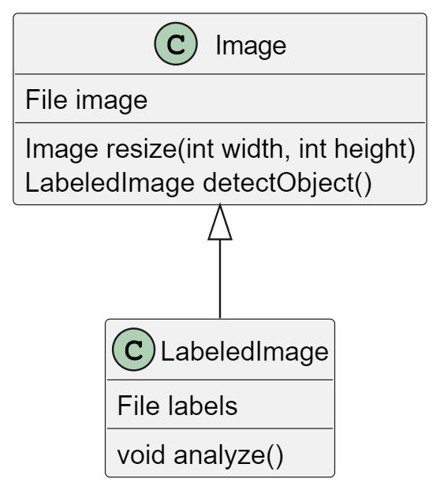
OaaS Abstraction Interface
State
Class
Func
State
Class
Func

Slide 9
OaaS Abstraction Interface
NFR
State
Class
Func
State
Class
Func

Slide 10
How to enforce NFR?
Numerous possible NFR combinations!

Slide 11
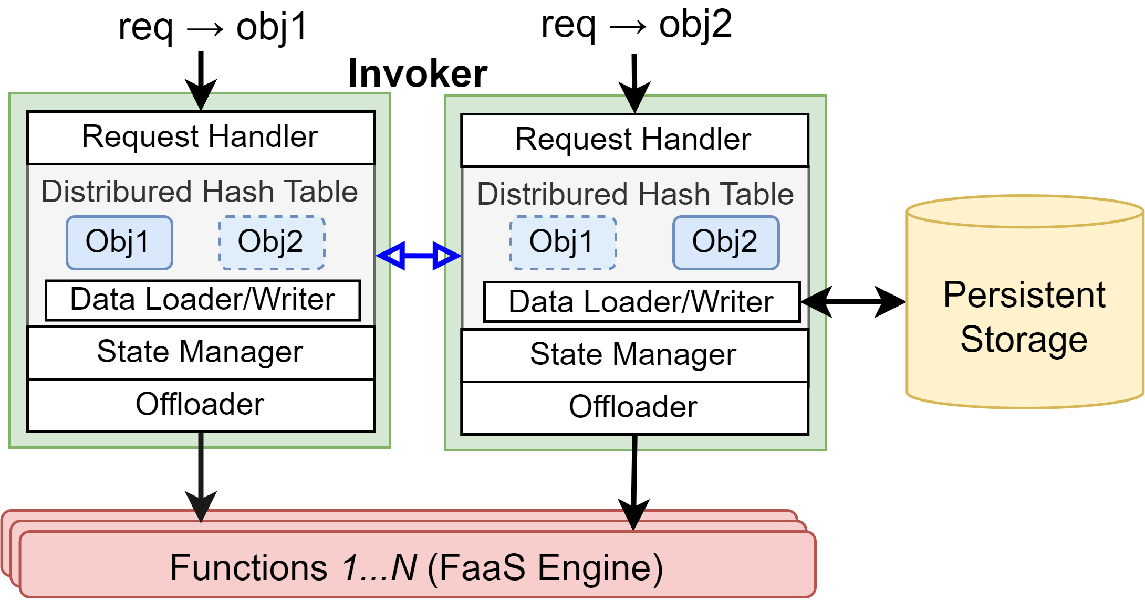
Class Runtime
Routing with Consistent Hashing
Scaling
Periodic Trigger
Control Plane to manage the object data
Monitoring
Resource
Estimation
Scaling
Reallocation
Execute the developer code via FaaS Engine

Slide 12
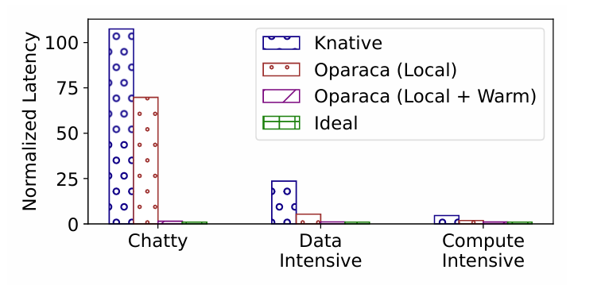
QoS Enforcement: Latency Overhead
Oparaca is OaaS implementation
1.5x
46x
4x
Unlike traditional FaaS, Oparaca can automatically reconfigure to enforce various NFRs,
eliminating the need for manual refinement

Slide 13
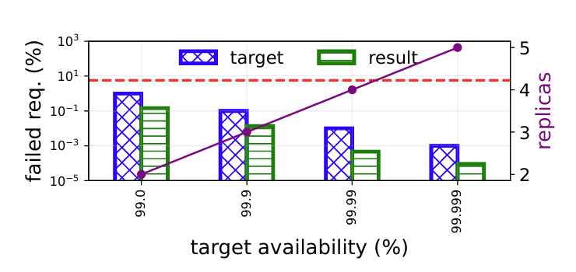
QoS Enforcement: Availability
Emulate the failure by making each individual pod fail every 180s (MTBF)
~94%
Oparaca can enforce the desired availability with
right-sizing resource

Slide 14
Conclusion and Future Works
OaaS
Unify abstraction
Enable requirement-driven cloud-developer coordination
NFR interface
Oparaca
Prototype of OaaS
NFR enforcement
Future Works
Add more parameters for NFR enforcement
OaaS for distributed cloud

Slide 15
Thank you for Attention
Source code:
hpcclab/oaas
ACM SoCC 24:
Contact: PawissanuttLertpongrujikorn@my.unt.edu
Acknowledgments

Slide 16
Backups

Slide 17
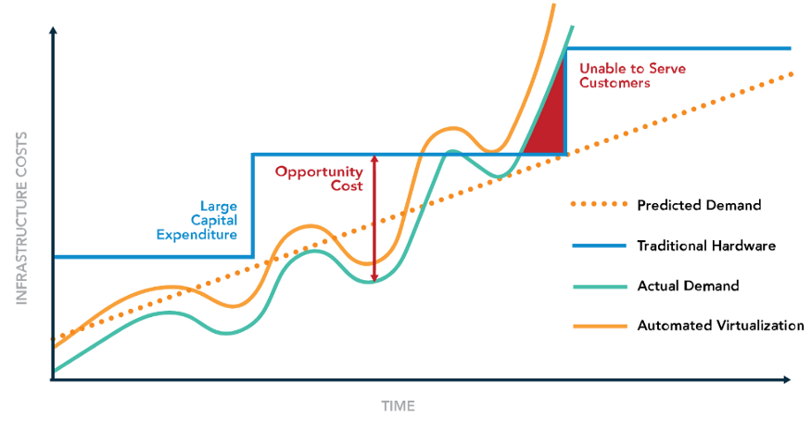
Serverless : FaaS Paradigm
FaaS Controller
Function
Event Sources
Runtime
Event Sources
Event Sources
Function
Runtime
Sync. or Async. Invocation
Function
Runtime
17

Slide 18
FaaS Problem 3: Multiple Round of Deployment Refinements
QoS requirements and constraints
Configuring such low-level parameters demands effort and expertise
Configuring such low-level parameters demands effort and expertise

Slide 19
Our solution: OaaS Abstraction
QoS requirements and constraints

Slide 20
Our solution: OaaS Abstraction
QoS requirements and constraints

Slide 21
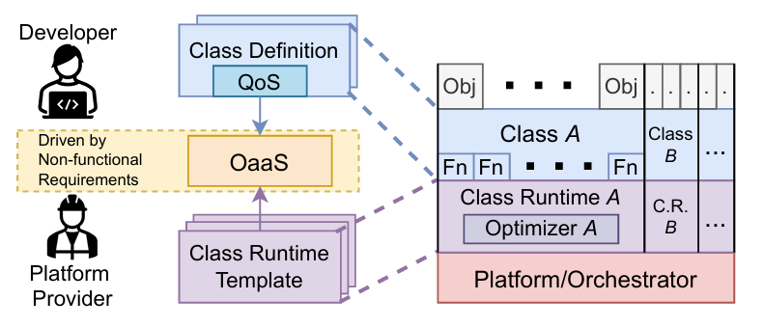
OaaS Implementation: Oparaca
NFR Enforcement
Numeral possible NFR combinations
Class runtime template
Configurable class runtime for a specific set of NFR combinations
Choose the most suitable template to realize the requirement

Slide 22
How to enforce NFR?
Numerous possible NFR combinations!
Choose the most suitable template to realize requirements
Deployment script of class for a specific set of NFR combinations

Slide 23
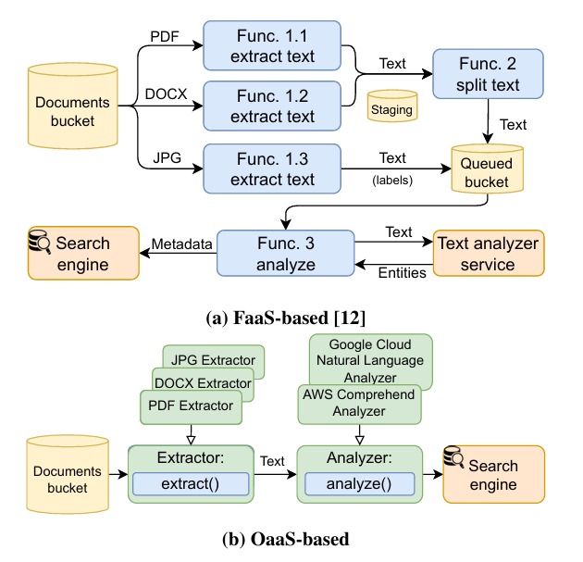
Case Study: Searchable Enterprise Document Repository
FaaS drawbacks
Explicit storage management
Require heterogeneous deployment
OaaS advantages
Hiding storage service
Clean organization with polymorphism
NFR enforcement

Slide 24
NFR Enforcement
Throughput
Given target throughput = T invocation per seconds
Oparaca ensures sufficient resources that
1 invocation can start immediately every 1/T seconds
Availability
Enforce the object availability
$$N=1 −{\left(1 −P\right)}^{A}$$
N = replica, P = resource stability, A = target requirement
Latency
Cold start: throughput enforcement
Communication: locality enforcement
Monitoring
Resource
Estimate
(Real-time Serverless)
Reallocation
Load changed

Slide 25
Experimental Setup
Oparaca Implementation
FaaS engine => Knative
Control plane => Java + Kubernetes
Monitoring => Prometheus
Workload:
Chatty JSON document randomization
Data Intensive Image resizing
Compute Intensive Video transcoding
Baseline:
Knative: vanilla
Knative-con: + container concurrency
Knative-rts: + real-time serverless
Oprc: Oparaca

Slide 26
Object NFR Enforcement
Periodic Trigger
Monitoring
Resource
Estimation
Reallocation

Slide 27
QoS Enforcement: Throughput

Slide 28
Efficiency of Oparaca
Invocation Efficiency
Enforcement Efficiency

