Slide 1
Performance Analysis of Preemption-aware
Scheduling in Multi-Cluster Grid Environments
Mohsen Amini Salehi , Bahman Javadi, Rajkumar Buyya
Cloud Computing and Distributed Systems (CLOUDS) Laboratory,
Department of Computer Science and Software Engineering,
The University of Melbourne, Australia
mohsena,bahmanj,raj@csse.unimelb.edu.au

Slide 2
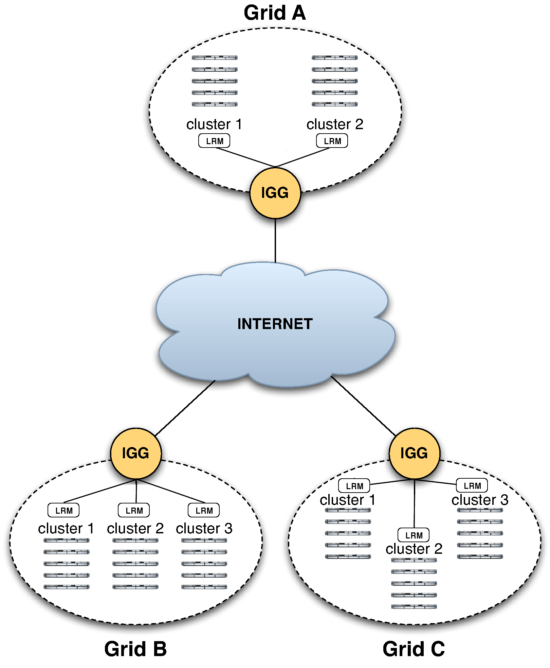
Introduction: InterGrid
provides an architecture and policies for inter-connecting different Grids.
Computational resources in each RP are shared between grid users and local users.
Provisioning rights of the resources in a Grid are delegated to the InterGrid Gateway (IGG).
Local users vs External users.
Local users have priority!

Slide 3
Contention between Local and External users
When contention happens?
Lack of resource
Solution for Contention:
Preemption of Ext. requests in favor of local requests
Drawbacks of Preemption:
overhead to the underlying system (degrades utilization)
increases the response time of the grid requests

Slide 4
Contention Scenario in InterGrid

Slide 5
Lease based Resource Provisioning in InterGrid
A lease is an agreement between resource provider and resource consumer whereby the provider agrees to allocate resources to the consumer according to the lease terms presented.
Virtual Machine (VM) technology is a way to implement lease-based resource provisioning.
VMs are able to get suspended, resumed, stopped, or even migrated.
InterGrid makes one lease for each user request.
Best-Eort (BE)
Cancelable
Suspendable
Deadline-Constraint (DC)
Migratable
Non-preemptive

Slide 6
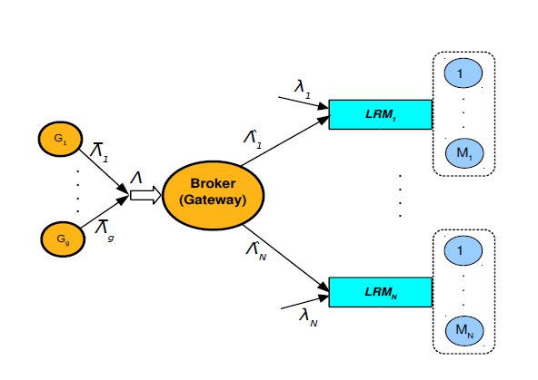
Problem Statement
How to decrease the number of preemptions that take place in a multi-cluster Grid?
Analytical modeling of preemption in a multi-cluster Grid environment based on routing in parallel queues

Slide 7
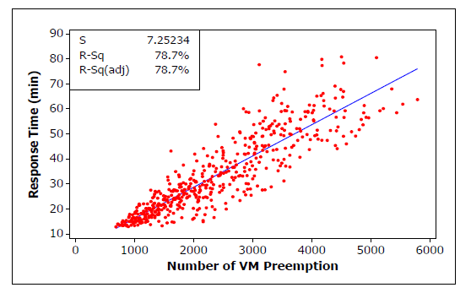
Analysis: Correlation of Response time and Number of preemption
Therefore, if we decrease response time the number of preemption also decreased!

Slide 8
Analysis: Minimize Response Time
Where the constrain is:

Slide 9
Analysis: Optimal arrival Rate to each Cluster
Response time of Ext. requests for each cluster j (M/G/1 queue with preemption):
The input arrival rate to each cluster by using Lagrange multiplier:

Slide 10
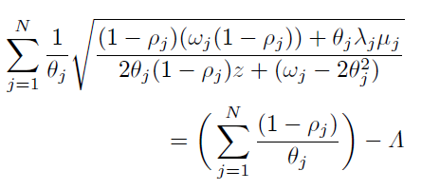
Analysis: Finding out Lagrange multiplier (z)
Since we have:
Z can be worked out from the below equation:

Slide 11
Analysis: Using bisection algorithm for finding z
Since:
Then:
upper bound also can be worked out as follows:

Slide 13
Preemption-aware Scheduling Policy
The analysis provided is based on the following assumption:
each cluster was an M/G/1 queue. However, in InterGrid we are investigating each cluster as a G/G/M_{j} j queue.
all requests needed one VM. InterGrid requests need several VMs for a certain amount of time.
each queue is run in FCFS fashion while we consider conservative backfilling.

Slide 14
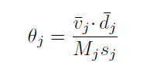
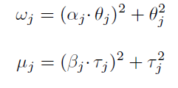
Implementation details
To support several VMs, the service time of ext. and local requests on cluster j is calculated:
CV is used to obtain second moment:

Slide 15
Experiment Set up
GridSim Simulator
3 clusters with 32, 64, and 128 nodes
Conservative backfilling scheduler as LRM
100 Mbps network bandwidth
Different ext. request types:
BE-Suspendable:40% and BE-Cancelable:10%
DC-Nonpreemptable:40% and DC-Migratable:10%.

Slide 16
Baseline Policies
Round Robin Policy (RRP)
Least Rate Policy (LRP)
DAS-2 workload model

Slide 17
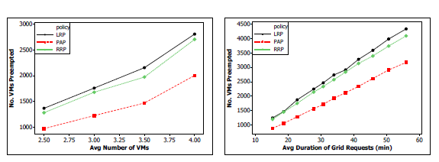
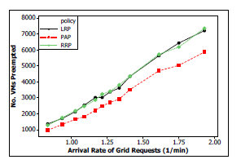
Experimental Results: Number of VM Preemptions

Slide 18
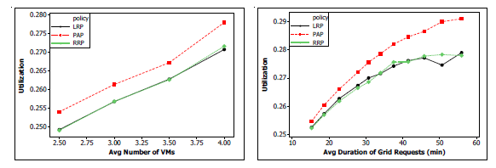
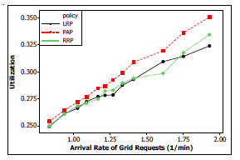
Experimental Results: Resource Utilization

Slide 19
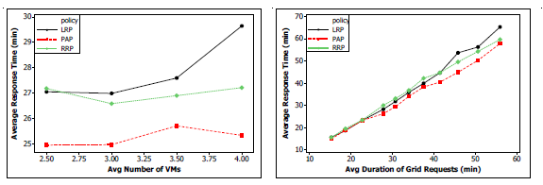
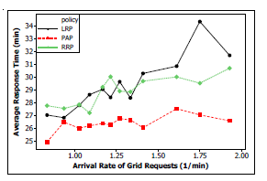
Experimental Results: Average Response Time

Slide 20
Conclusions and Future Work
we explored how we can minimize the number of preemptions in InterGrid.
We proposed a preemption-aware scheduling policy (PAP)
Experiments show that PAP resulted in up to 1000 less VM preemptions (22.5% improvement) comparing with other policies.

Slide 21
Questions?

