Slide 1

Tutorial: Interactive Video Streaming Via Special Purpose Serverless Cloud
Dr. Mohsen Amini, Vaughan Vellion, Chavit Denninnart
High Performance Cloud Computing (HPCC) Lab
University of Louisiana Lafayette
19th IEEE/ACM Conference on Cluster Cloud and Grid Computing (CCGrid ’19), May 2019, Cyprus

Slide 2
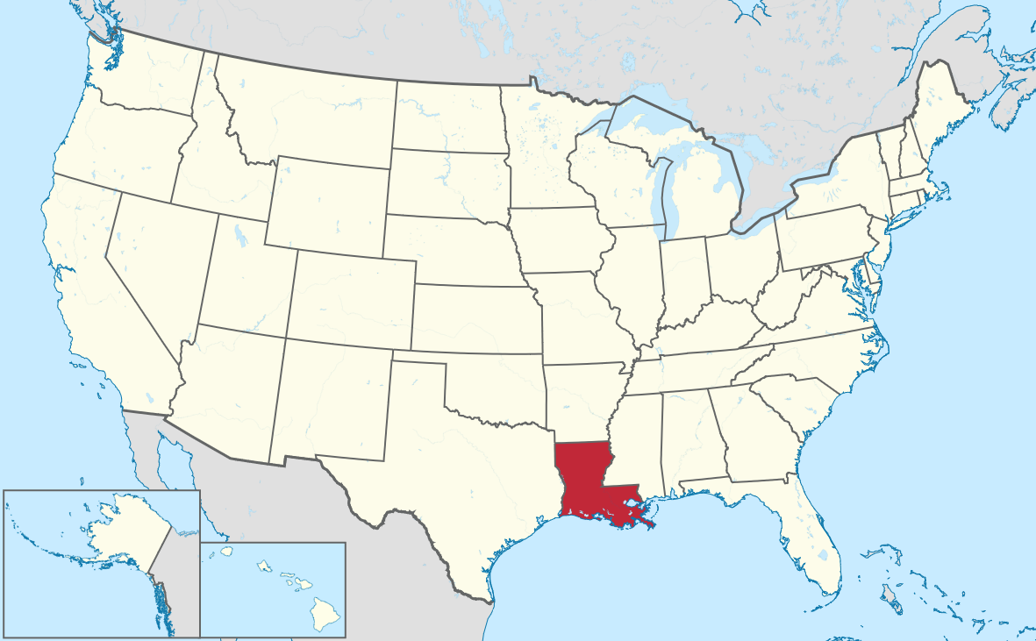
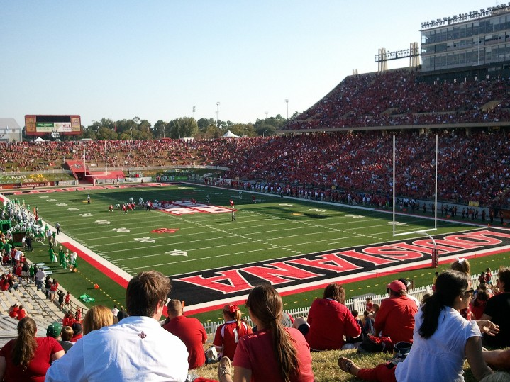


University of Louisiana Lafayette

Slide 3
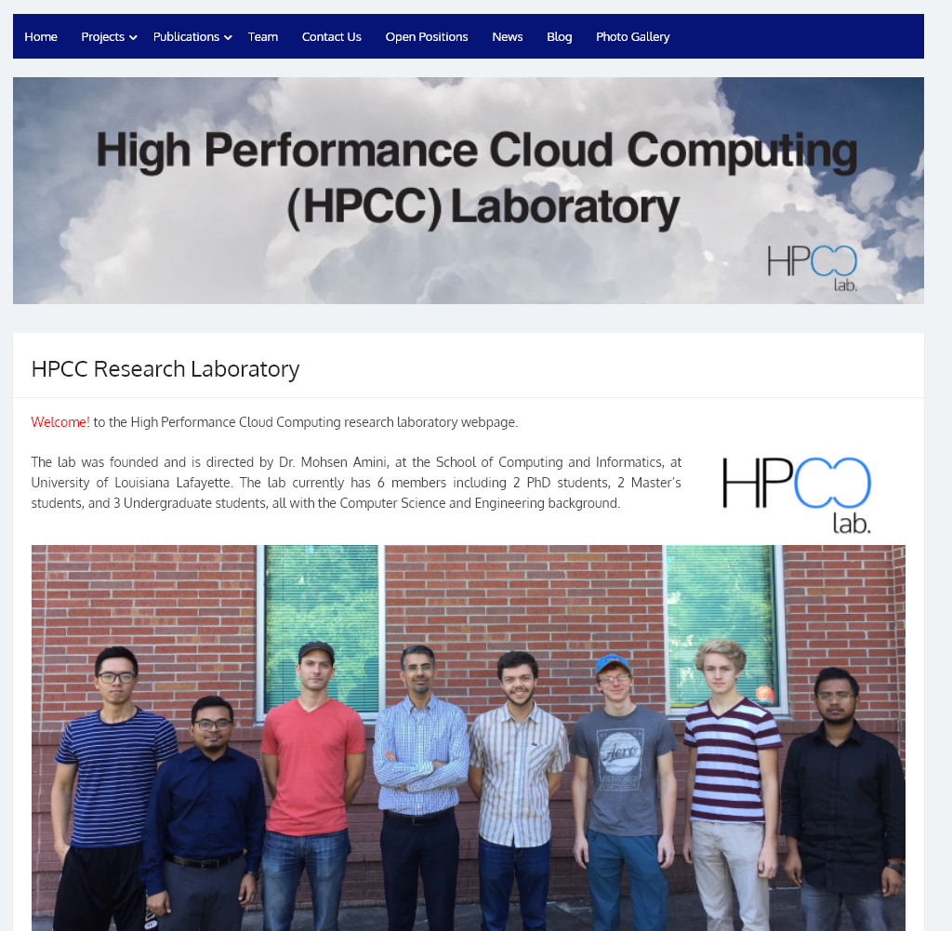
http://hpcclab.org

Slide 4
Acknowledgement
Our valuable team members
  Dr. Mohsen Amini Salehi
  Dr. Xiangbo Li
  Dr. Mahmoud Darwich
  Mr. Chavit Denninnart
  Mr. Vaughan Veillion
  Mr. James Gentry

Slide 5
Agenda
How does video streaming work?
What is interactive Video Streaming?
Feasibility of meeting interactive streaming QoS in the cloud
Analyzing video streaming execution using heterogeneous VMs
Achieving cost-efficient cloud-based streaming by making use of heterogeneous cloud VMs
Achieving cost-efficiency via reusing computation
Achieving cost-efficient streaming by efficient caching of streams
Current implementation of CVSE (Demo)
Achieving Cloud-based Live video streaming (if we have time)

Slide 6
Let us get some motivation…

Slide 7
















Slide 8
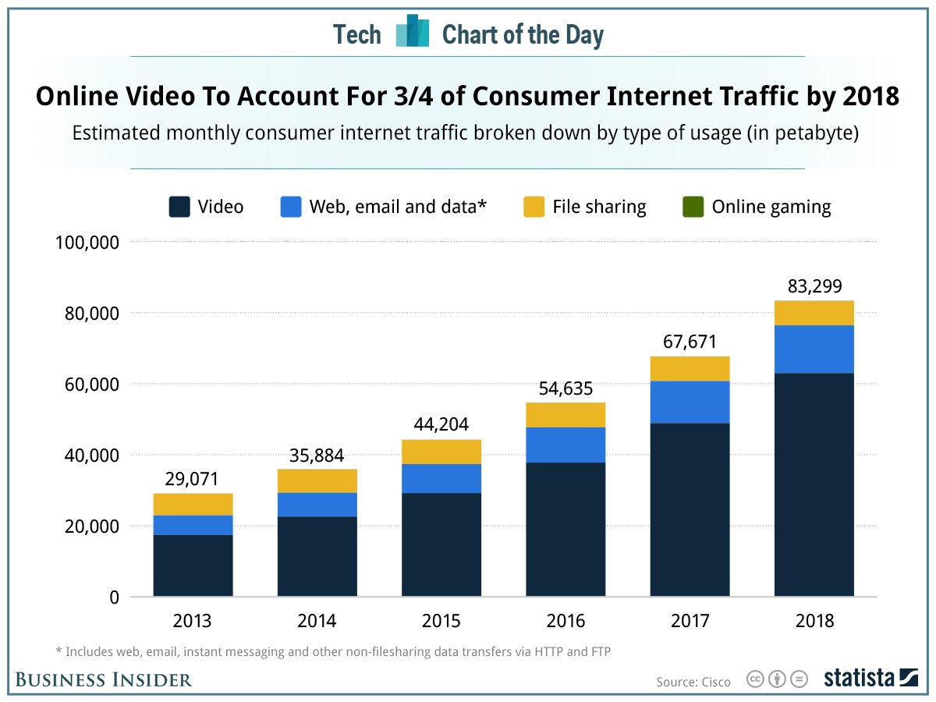
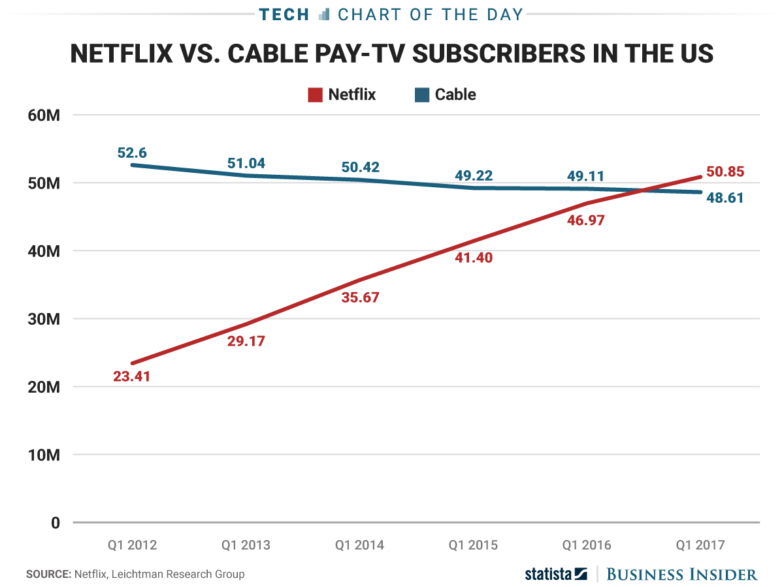
Current Status of the Video Streaming World
Video accounts for 70-80% Internet traffic
Streaming subscribers > Cable subscribers

Slide 9
A true story...

Slide 10





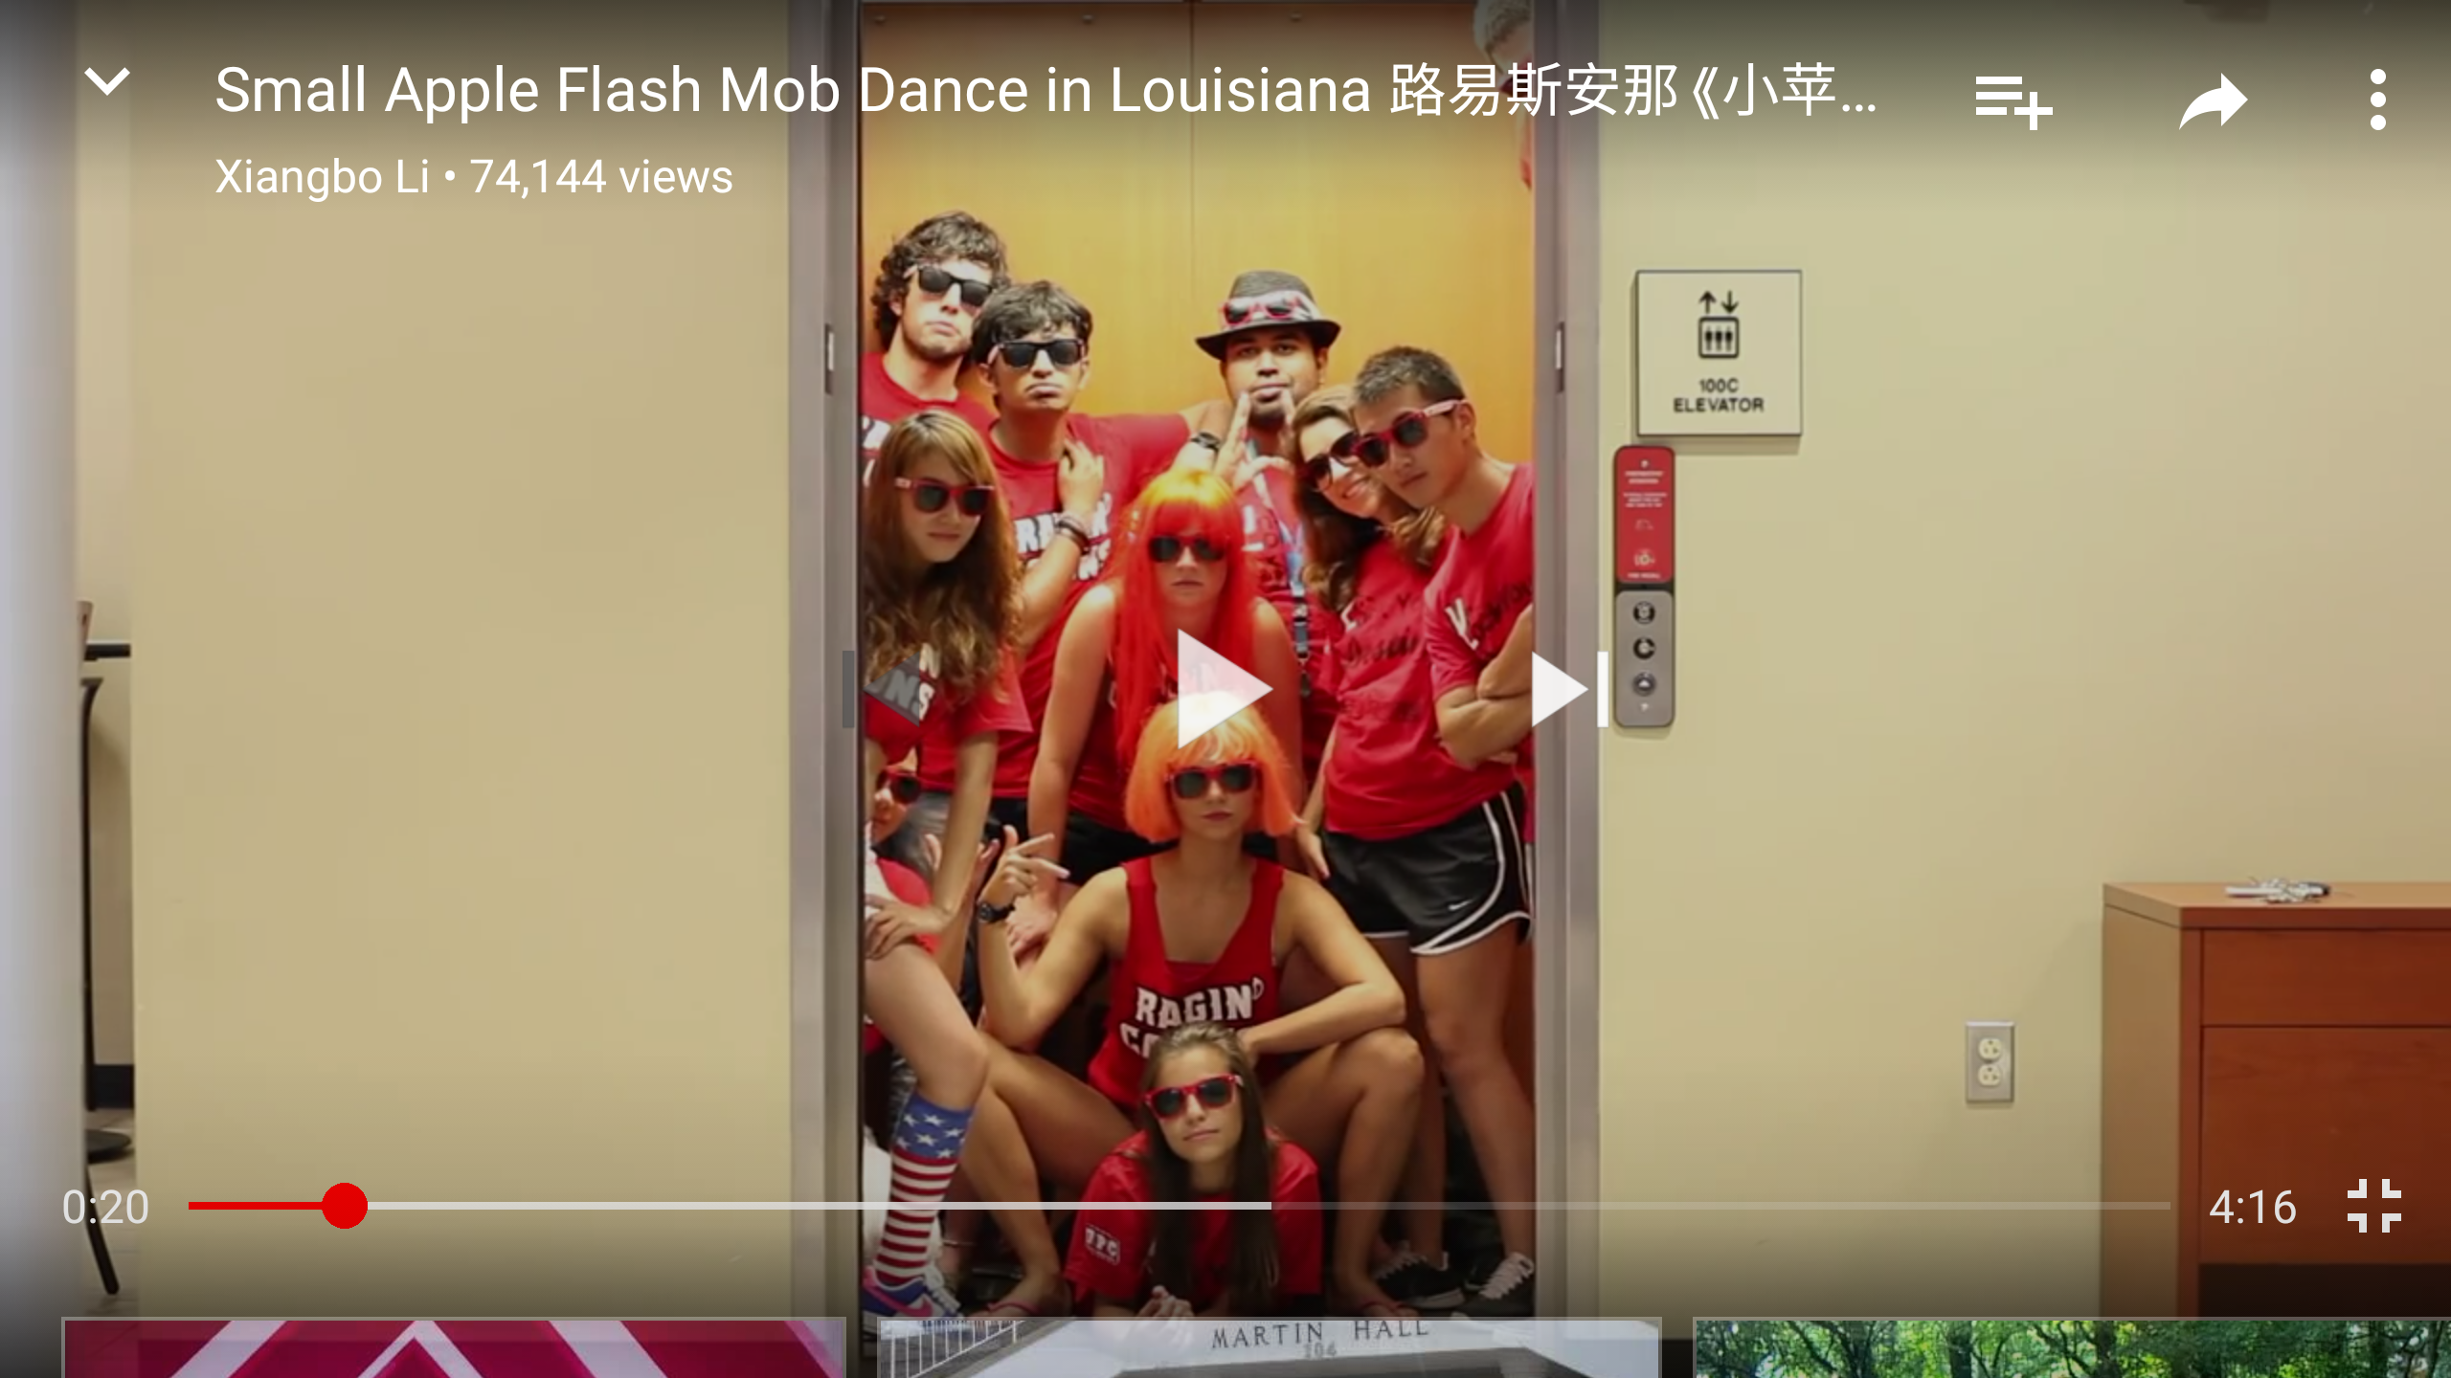

Slide 11
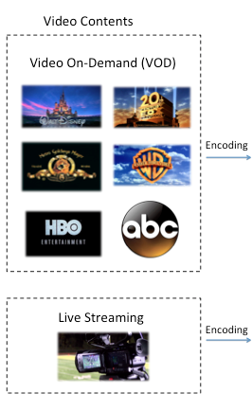
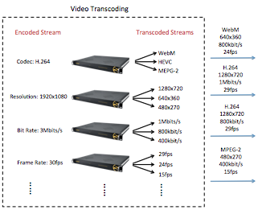
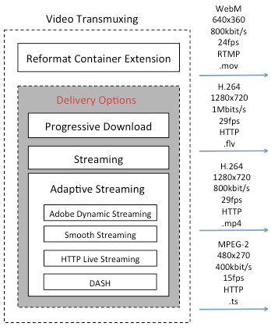
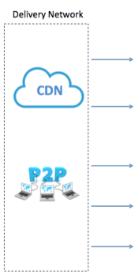
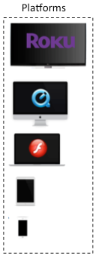
How Video Streaming Works?

Slide 12

How to Segment Video?
Seq 1
Seq 2
Seq 3
Seq 4
Seq 5
Seq Header
GOP 1
GOP 2
GOP 3
…..
…..
GOP Header
I
P
P
B
P
Macroblock (MB)

Slide 13
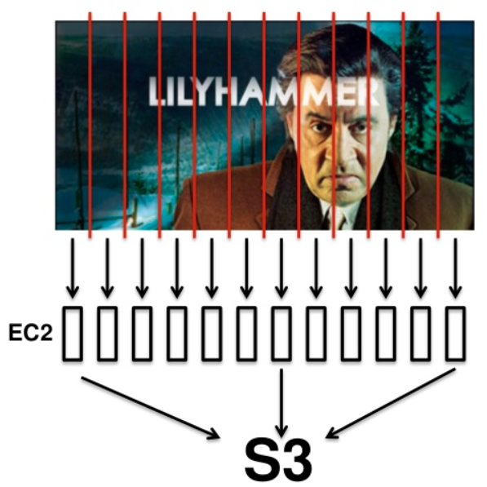

Video Segmentation
Split Video into GOPs
Perform Transcoding
Obtain Metadata
  GOP transcoding time
  GOP presentation time
  GOP frame number
  GOP input size
  GOP output size

Slide 14
Video Streaming Steps
Video Encoding
Video Transcoding
Video Transmuxing/Packaging
Digital Right Management (DRM)
Content Delivery Network (CDN) and P2P

Slide 15
Why to encode a video?

Slide 16

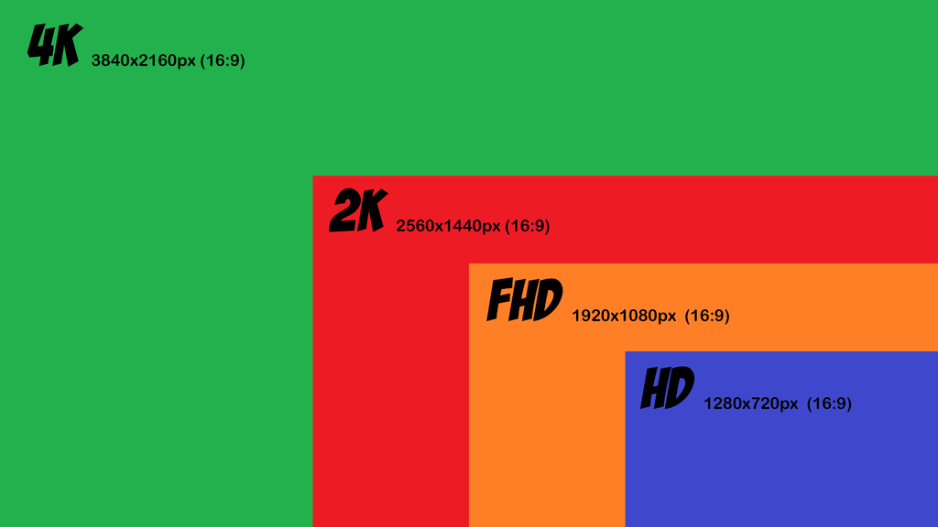

HDTV channel bandwidth: 20Mb/s

Slide 17
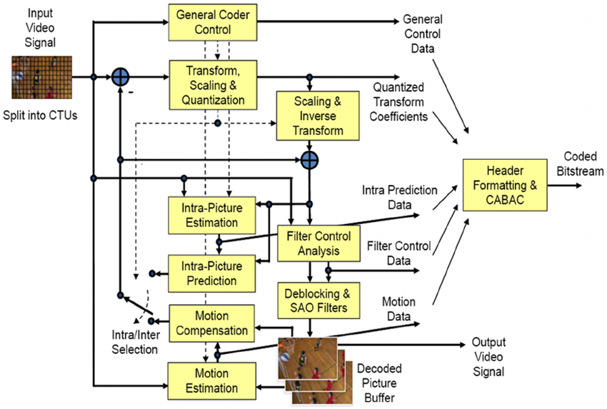
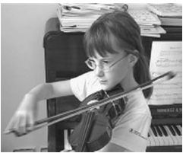

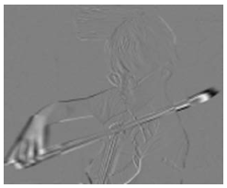
HEVC Encoder Architecture
Intra Prediction
Inter Prediction
Transform & Quantization
Entropy coding
Frame 2
Frame 1
Residue

Slide 18
Why transcode video?

Slide 19



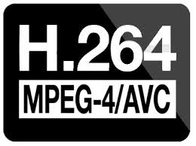










Video Codecs
Client Devices
Network Bandwidth

Slide 20
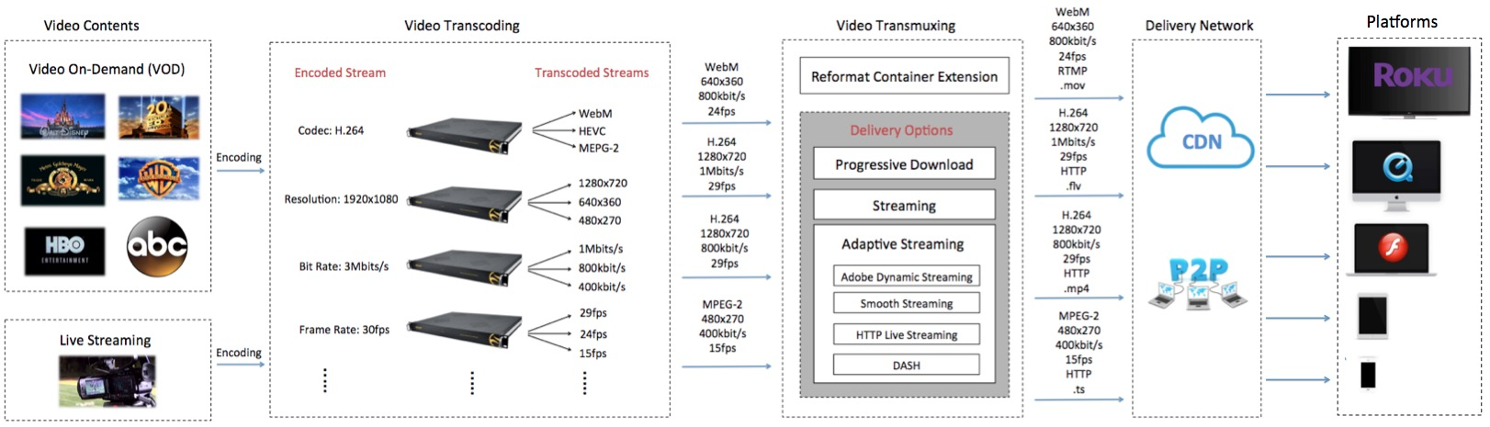
How Video Streaming Works?
2 codecs * 5 bit rate= 10

Slide 21
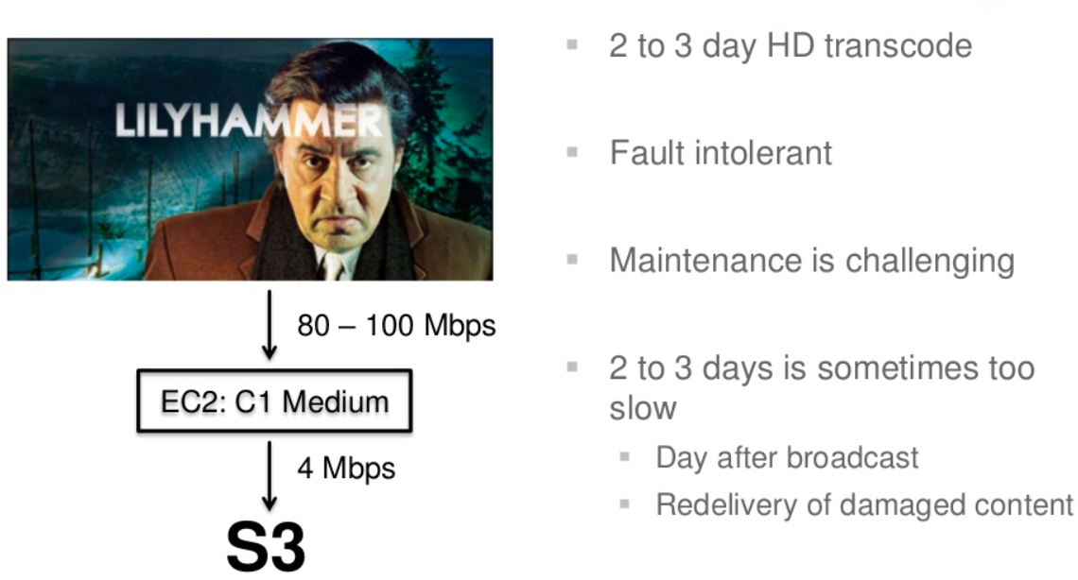
Video transcoding is computationally complex and time-consuming
What Does Video Transcoding Involve?
Former Video Decoder
New Video Encoder
It takes days to transcode
It only takes hours/minutes
21

Slide 22
Why to transmux a video?

Slide 23
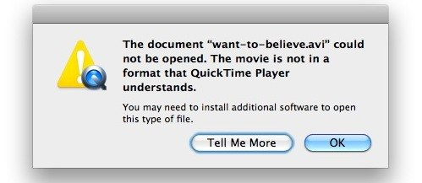

Internet Packet (e.g. TCP, UDP)
Transmitted through Internet
Container Format (e.g. .mp4, .ts)
Supported by players
Encoded Video (e.g. H.264)
Compressed

Slide 24
The evolution of streaming protocols…

Slide 25
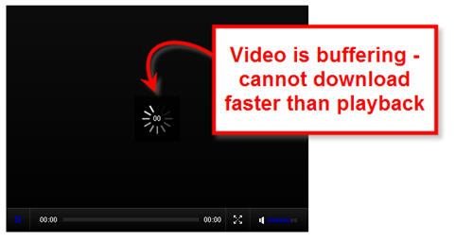

Progressive Download
Streaming

Slide 26
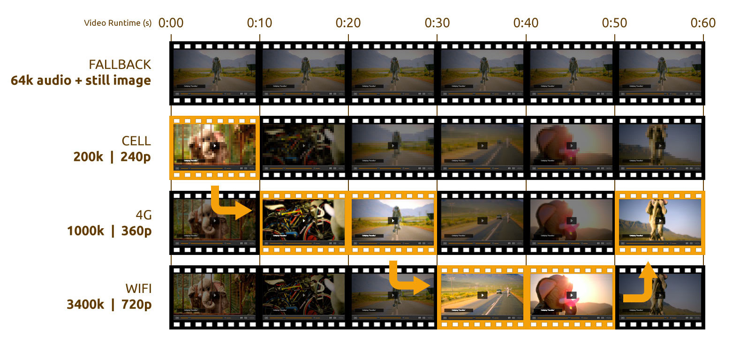
Adaptive Bitrate Streaming Concept

Slide 27

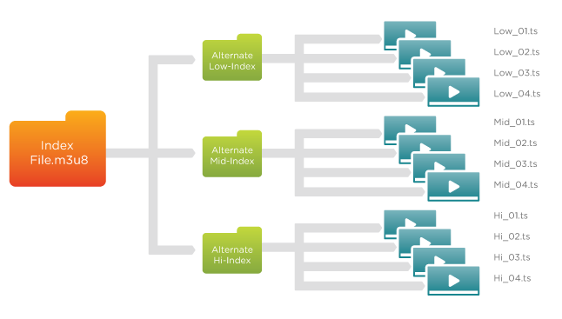

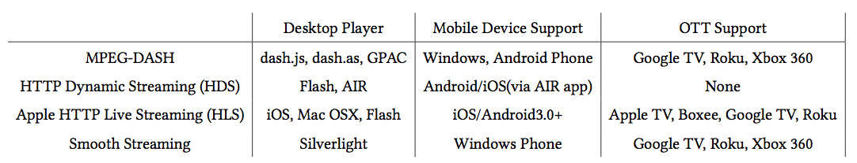
Adaptive Bitrate Streaming Protocols

Slide 28
How to protect video streams?

Slide 29
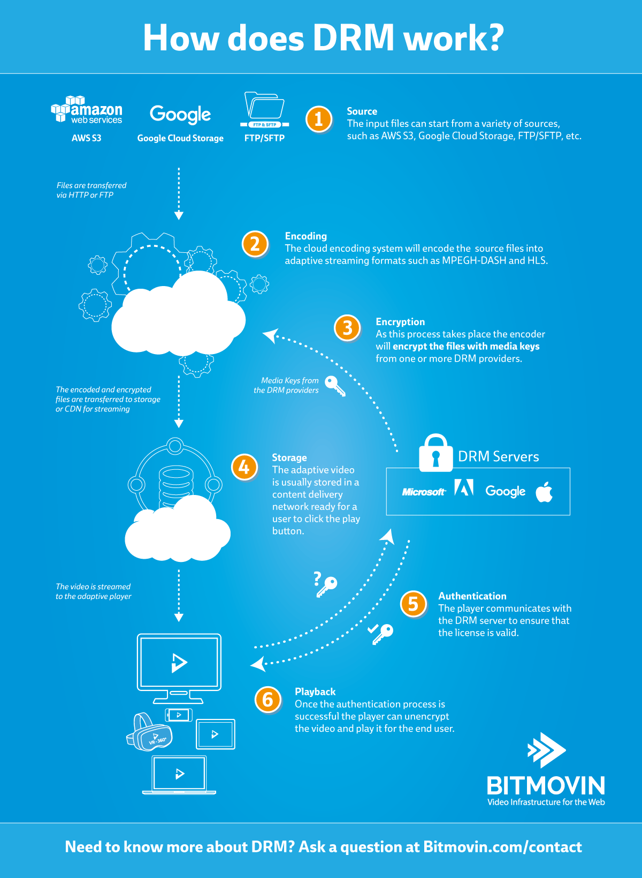
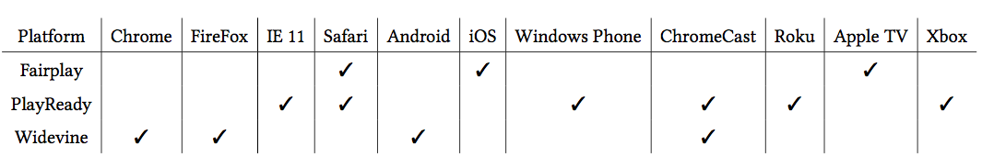

Slide 30
How Does Video Streaming Work?
2 codecs * 5 bit rate= 10
10 * 3 protocols * 3 DRM = 90

Slide 31
Why Content Delivery Network (CDN)?

Slide 32




Customers in the US
Customers in Asia

Slide 33
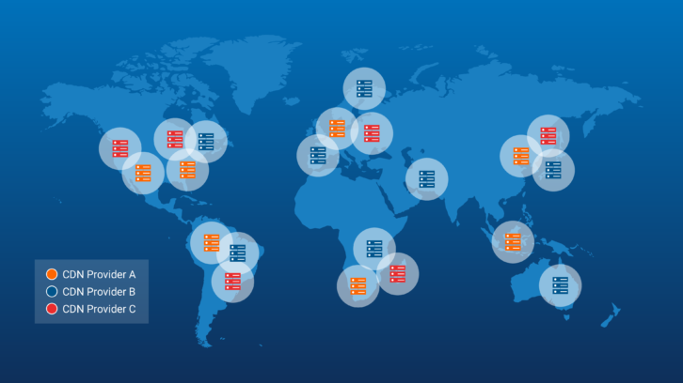

Slide 34


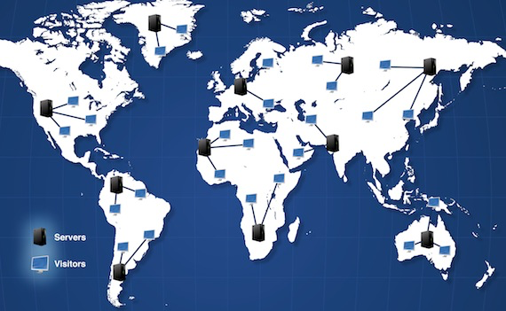
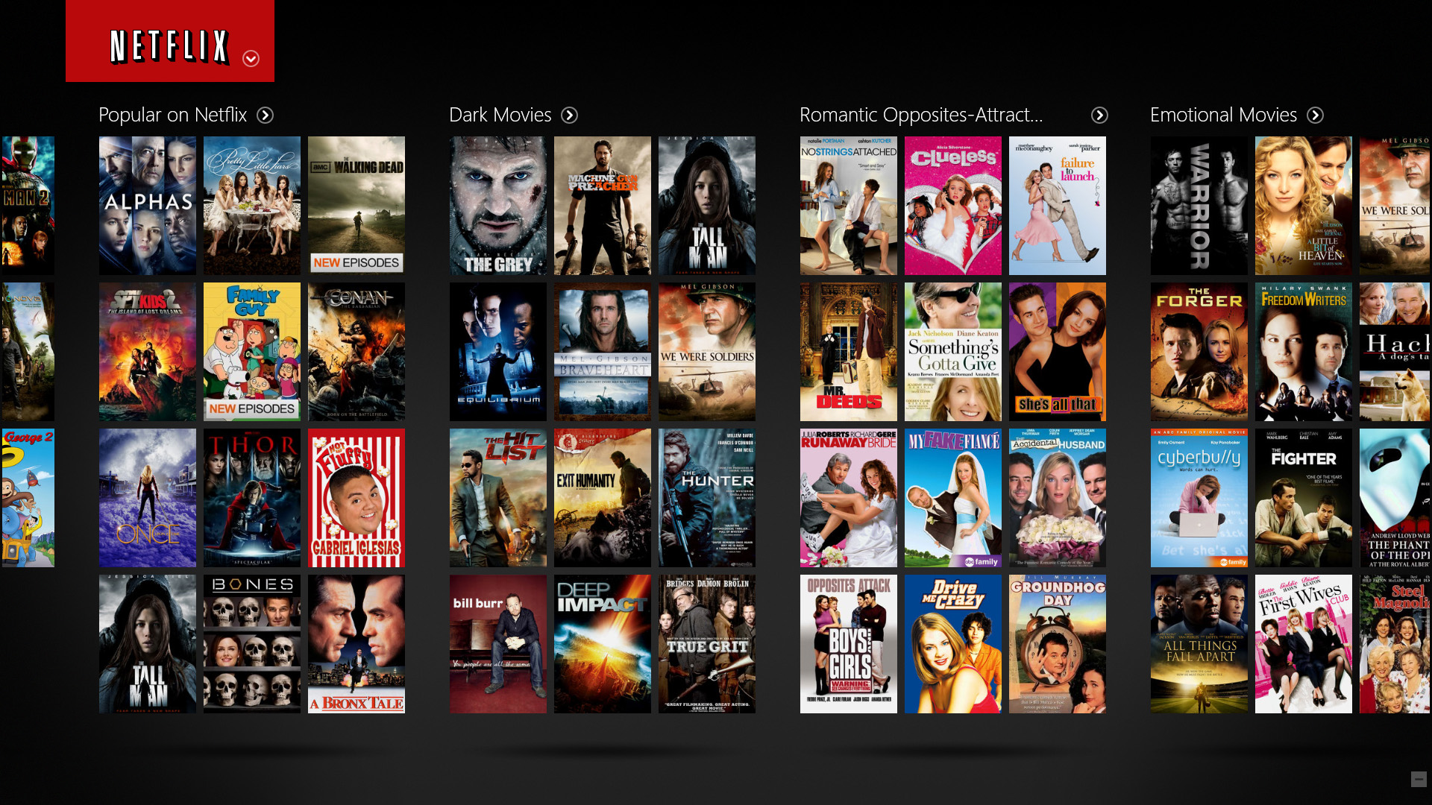
Client Reqest
Content Delivery Network (CDN)
Netflix Server

Slide 35
How Does Video Streaming Work?
2 codecs * 5 bit rate= 10
10 * 3 protocols * 3 DRM = 90
90 * 3 regional CDN = 270

Slide 36

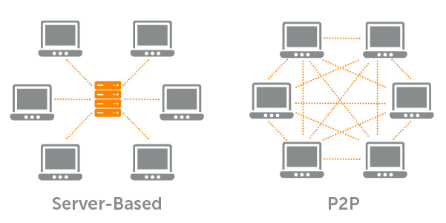
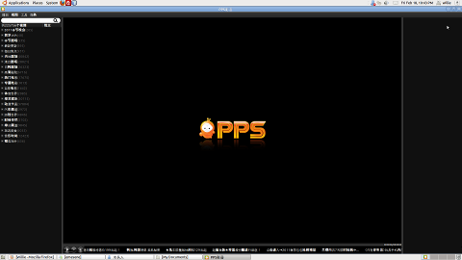
What is P2P Streaming?

Slide 37





So What is Inside the Black Box?
Viewers
1. Request a video
Web Servers
2. Response to Check CDN
3. Request copy
video to CDN
4. Download video
Video Encoding/Transcoding/Transmuxing Servers
Repository
CDN
Video Contents

Slide 38
Congratulations!
You have passed video streaming 101…

Slide 39
What is Interactive Cloud-based Video Streaming?

Slide 40
What is Interactive Video Streaming?
Dynamic addition of services on video streams (by viewers or stream providers)
  Dynamic subtitles
  Facial recognition
  Object Tracking
  Dynamic video content classification
Service development is achieved in serverless manner (streamingless?)

Slide 41
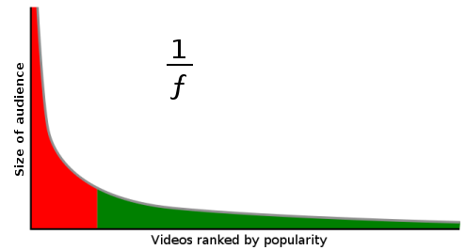

Long-Tail Property of Video Streaming
Trendy videos
Interactive video streaming is not feasible, unless we can
process video streams On-Demand!

Slide 42
Challenges of Interactive Video Streaming
1) Is it feasible to offer on-demand video processing?
  How to maintain QoS (QoE)?
  How to maintain cost-efficiency?
  How to achieve extensibility?
2) How to achieve interactive streaming independent of viewers’ locations?

Slide 43


On-Demand Video Processing Challenges
Improve Quality of Service (QoS)?
  Startup delay
  Deadline miss rate
Minimize Cloud Resource Cost
  Computing cost
  Storage cost

Slide 44








Special-Purpose Cloud for Interactive Video Streaming: CVSE
Features of CVSE
Cloud Provider
1) On-demand processing
2) Partial caching of popular videos
3) Extendable video processing services
Video Contents
Cloud Storage
billing
Video Streaming
Service Providers
Viewers
Streaming Requests
CVSE
Middleware
CVSE
Chosen CVS Services
Processed Streams
Newly defined or chosen Video Processing Service
Computational Resources
Defined Video Processing Services
(Service Types)

Slide 45











CVSE Architecture
Streaming service req
Viewers’ devices
Streaming provider
Video Streaming Distribution System
Extended video processing service
CVSE services
Service repository
Video Repository
Caching
Admission
Control
Time Estimator
Resource Provisioner
Video
Merger &
Output
Windows
CVSE Core
Streaming tasks
Scheduler
Compute Engine

Slide 46
Challenge #1:
Is it feasible to perform interactive video streaming on the cloud?

Slide 47
On-Demand Video Processing Challenges
Guarantee Quality of Service (QoS)?
  Startup delay
  Deadline miss rate
Minimize Cloud Resource Cost
  Computing cost
  Storage cost

Slide 48
Viewers’ devices
Streaming provider
Video Streaming Distribution System
Extended video processing service
CVSE services
QoS-Aware Scheduling Method
Service repository
Video Repository
Caching
Admission
Control
Time Estimator
Resource Provisioner
Video
Merger &
Output
Windows
Dynamic cost-efficient provisioning policy
Streaming tasks
Task Scheduler
Compute Engine
CVSE Core

Slide 49
QoS-Aware Scheduling Method
G_{video#,GOP#}
VM1
Startup Queue
G_{4,1}
G_{4,0}
…..
15s
VM2
…..
G_{1,9}
G_{2,6}
G_{4,4}
G_{3,4}
G_{2,5}
G_{1,8}
10s
Batch Queue
VM3
20s

Slide 50
On-Demand Video Transcoding Challenges
Improve Quality of Service (QoS)?
  Startup delay
  Deadline miss rate
Minimize Cloud Resource Cost
  Computing cost
  Storage cost

Slide 51
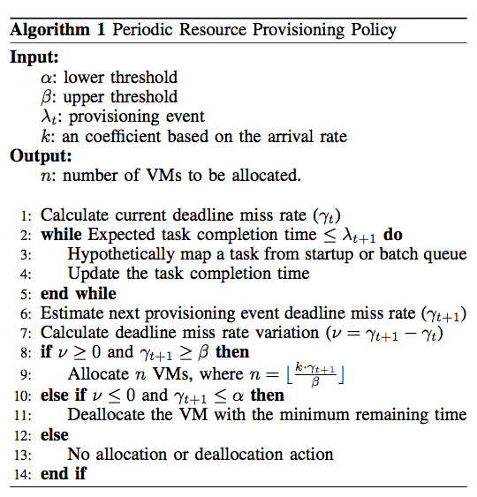
Dynamic Cost-Efficient Provisioning Policy
User define QoS violation tolerance
Predict deadline miss rate
Allocate/Deallocate VMs based on predicted deadline miss rate

Slide 52

Remedial Provisioning Policy
Startup Queue
G_{7,0}
G_{6,0}
G_{5,0}
G_{4,1}
G_{4,0}
Video number in the startup queue
…..
…..
…..
G_{1,9}
G_{2,6}
G_{4,4}
G_{3,4}
G_{2,5}
G_{1,8}
Batch Queue
Constant factor
QoS violation upper threshold

Slide 53
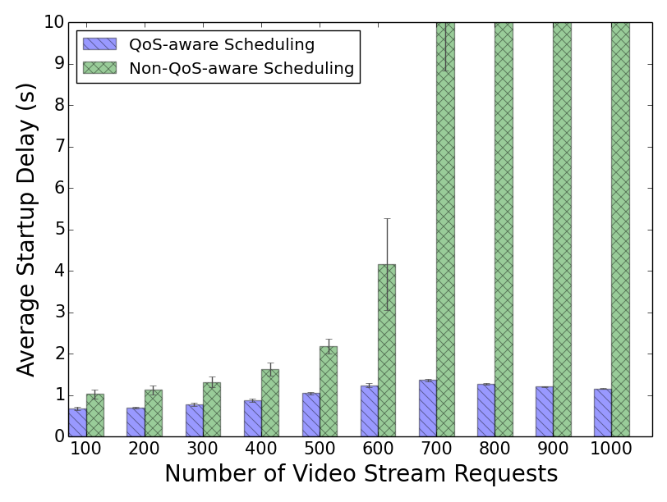
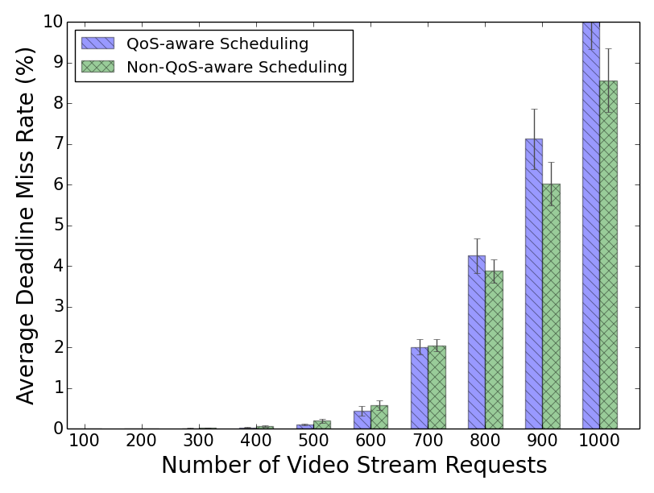
Performance Evaluation
Minimized startup delay without major impact on deadline miss rate

Slide 54
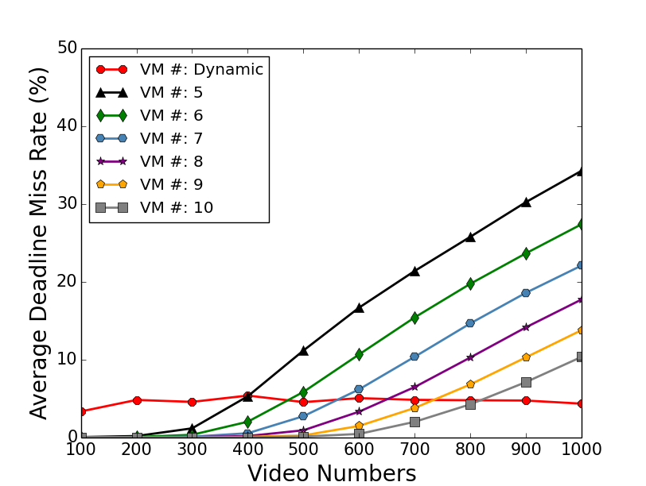
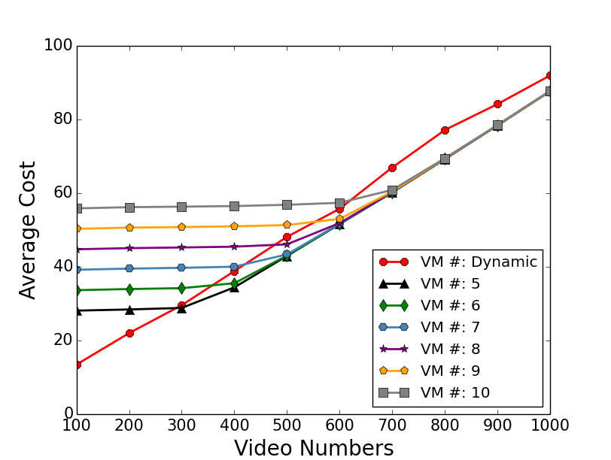
Static vs. Dynamic Resource Provisioning
Our dynamic system keeps the QoS
violation constantly low and Stable
in compare with static method.
Our method save the cost when
the system is not oversubscribed.
Notes:
We have run all transcoding operations on Amazon EC2 to get the real transcoding data, and then we use these data to simulate on CloudSim.
Our dynamic system keeps the QoS violation constantly low and stable in compare with static method
Our method save cost when the system is not oversubscribed.

Slide 55
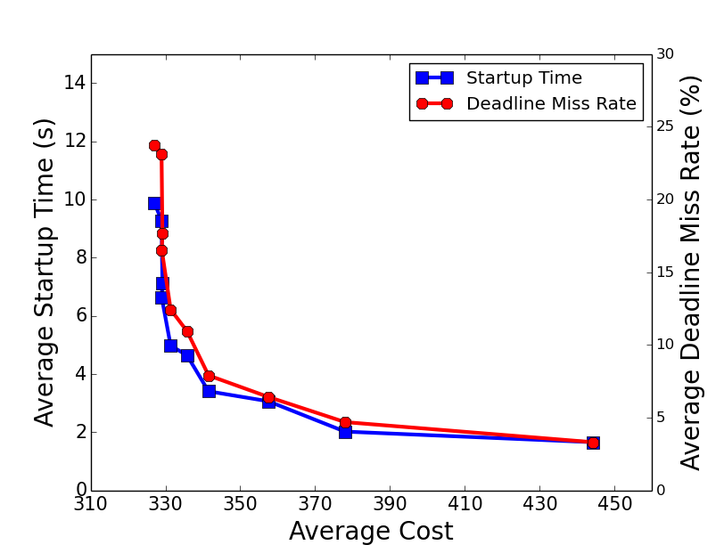
At some point, streaming service providers can pay reasonable
price to gain good QoS.
Notes:
The correlation between cost and QoS is not linear, that means at some point with our system, streaming service provider can pay low price to get good QoS.

Slide 56
Publications
Xiangbo Li, Mohsen Amini Salehi, Magdy Bayoumi, Rajkumar Buyya, “CVSS: A Cost-Efficient and QoS-Aware Video Streaming Using Cloud Services”, in the IEEE/ACM Cluster Cloud Grid Conference (CCGrid ’16), Columbia, May 2016.
Xiangbo Li, Mohsen Amini Salehi, Magdy Bayoumi, “High Performance On-Demand Video Transcoding Using Cloud Services”, in the IEEE/ACM Cluster Cloud Grid Conference (CCGrid ’16), Columbia, May 2016.
Xiangbo Li, Mohsen Amini Salehi, Magdy Bayoumi, “High Performance On-Demand Video Transcoding Using Cloud Services”, filed for Patent, Aug. 2016.
Xiangbo Li, Mohsen Amini Salehi, Magdy Bayoumi, “Cloud-Based Video Streaming for Energy- and Compute-Limited Thin Clients”, in Stream2015 Workshop at Indiana University, Indianapolis, USA, Oct. 2015.

Slide 57
Is there any benefit in using Heterogeneous Computing services (VMs) offered by the cloud?

Slide 58

Heterogeneous EC2 VMs
Compute-Optimized
General Purpose
Micro Instances
Memory-Optimized
IO Optimized
Storage-Optimized
GPU Instances

Slide 59


















Video Streams
Streaming Providers
Client Devices

Slide 60
How to estimate execution time on heterogeneous VMs?!
Viewers’ devices
Streaming provider
Video Streaming Distribution System
Extended video processing service
CVSE services
Service repository
Video Repository
Caching
Admission
Control
Time Estimator
Resource Provisioner
Video
Merger &
Output
Windows
Streaming tasks
Task Scheduler
Compute Engine
Should heterogenous VMs be utilized?
CVSE Core

Slide 61
What’s the Affinity of Video Processing Operations on Heterogeneous VMs?
Problem 1

Slide 62
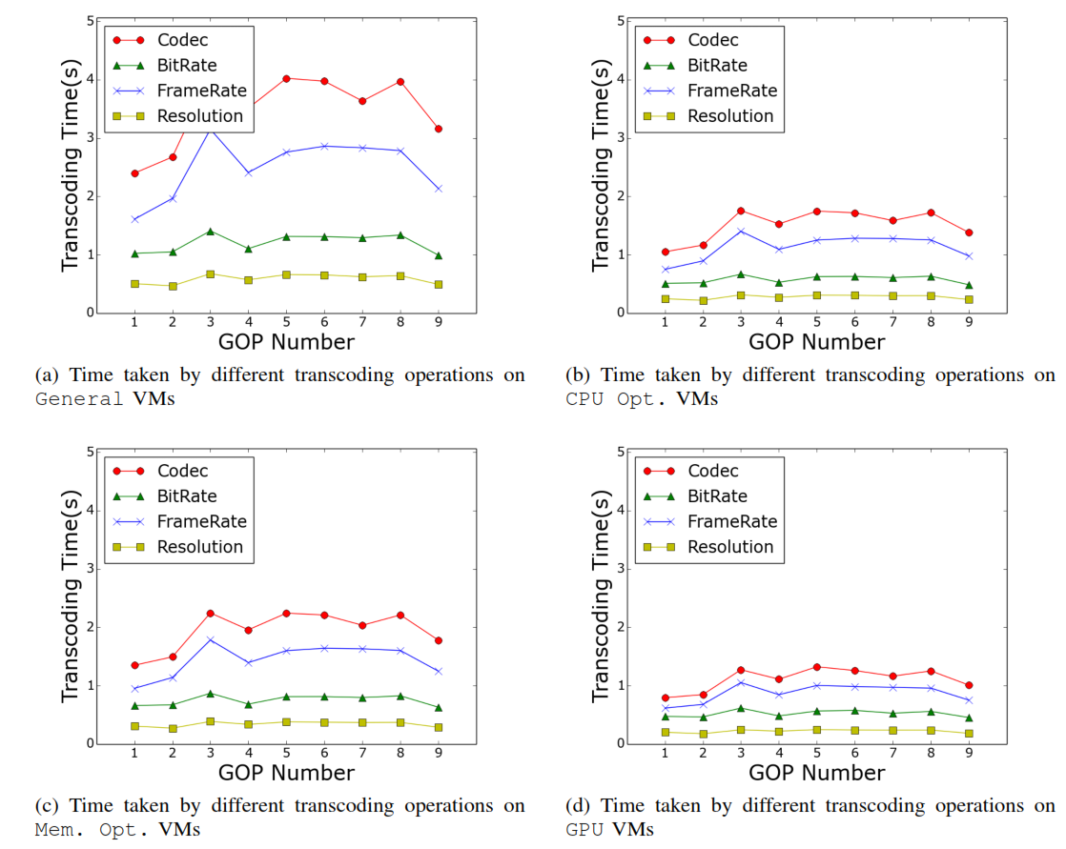
Analyzing the Execution Time of Different Video Transcoding Operations
Observations:
Transcoding time has the same pattern across on all VM types.
Codec transcoding
takes more time than
others
Changing resolution has the least transcoding time.
Notes:
This is because changing codec implies the whole original encoded video be decoded and then reencoded with new one codec.
------------------------
The reason is that the transcoding is achieved by utilizing ﬁltering and subsampling [35], [36] which works directly in the compressed domain and avoids the computationally expensive steps of converting to the pixel domain. Therefore, it takes less time than other transcoding operations.

Slide 63
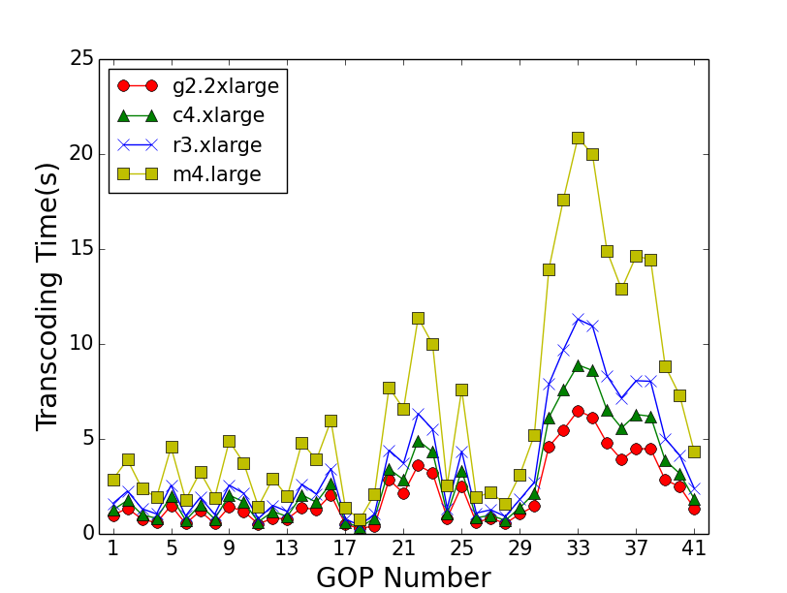
Analyzing the Afﬁnity of Transcoding on Heterogeneous Cloud VMs
In general, GPU is better
The difference is minor sometime
Transcoding Codec

Slide 64
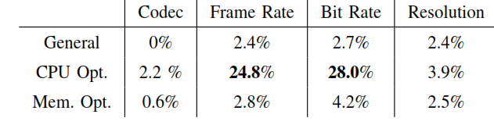
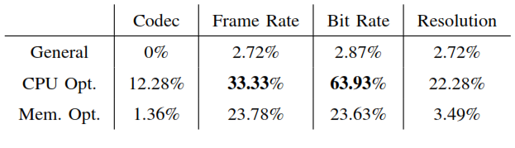
How GPU is Better than others VM Types?
Performance Ratio < 1
Performance Ratio < 1.2
Observation: other VM types outperform GPU when the execution time is low!
Why?

Slide 65
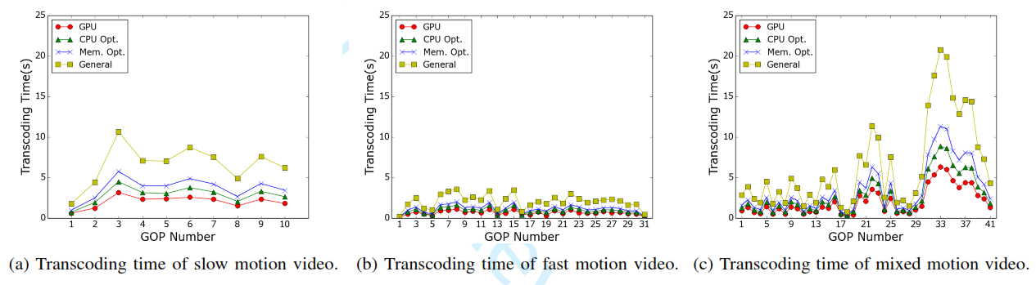
Video Content Type
Transcoding time variation is because of the content type of GOPs

Slide 66


Video Types
Fast motion videos consist of
many small tasks to process
Slow motion videos consist of
few large tasks to process
These tasks can take a better
advantage of CPU intensive
resources

Slide 67
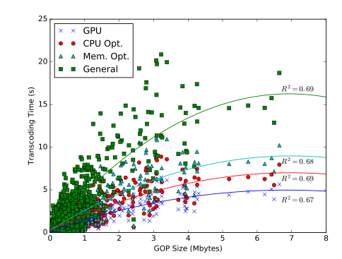
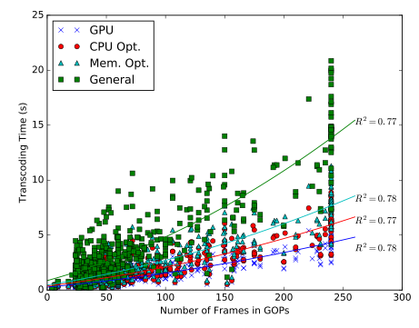
Number of frames in a GOP
is a reliable metric to estimate
execution time
Size of GOPs can be also used

Slide 68
Problem 2
Clouds offer two dimensional heterogeneity
  performance heterogeneity
  Cost heterogeneity
How can we handle the trade-off between heterogeneous performance and cost?

Slide 69
Proposed Solution:
Suitability Matrix
We propose a suitability matrix construct to show the appropriateness of heterogeneous VM types for different transcoding tasks
  The construct can be used by VM provisioning component in CVSE
Trade-off determination between performance and cost of VMs depends on business policy of stream provider

Slide 70
Handling Trade-off Based on the Performance Gap
Performance Gap: the performance difference between GPU and a VM type
  Higher values show VM type i performs significantly worse than GPU (i.e., GPU is more suitable)
Performance gap threshold is the threshold of choosing GPU or other VM types
  Value of the threshold depends on the user performance versus cost preference

Slide 71
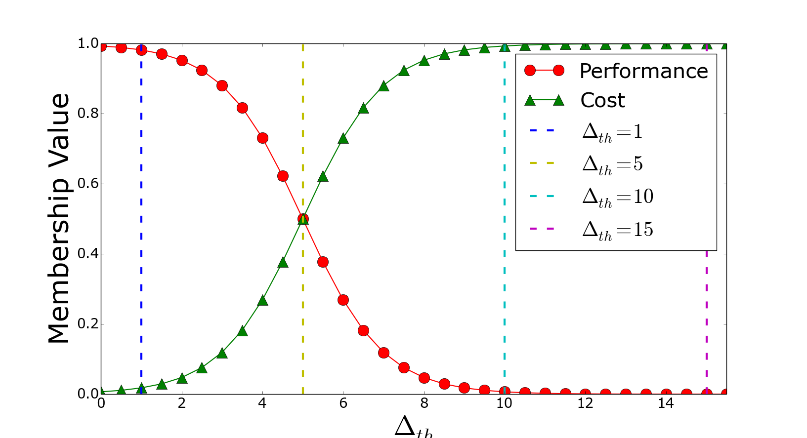
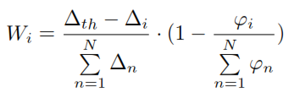


GOP Suitability Matrix
Notes:
P is the performance preference and c is the cost. These are determined by the users. We have p+c=1
Based on value of p and c (vertical axis) we determine delta_th
High value of p results in low value of Delta_th. Therefore, a short performance difference gives more suitability to GPU.
From the value of delta_th we obtain W_i (which is a weight) and then use it to find suitability of VM type i (shown as S_i).
S_i is just for normalization (0<S_i<1)

Slide 72
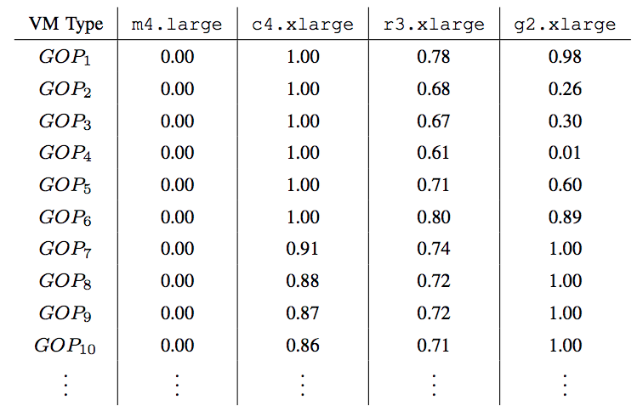
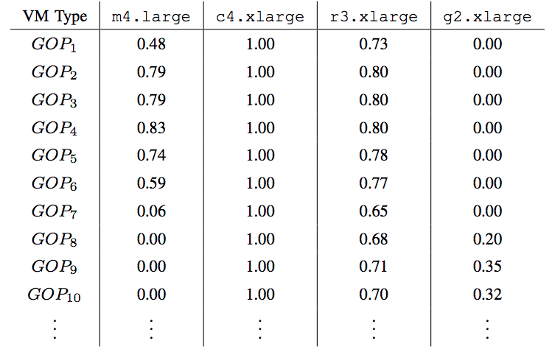
Suitability Matrix
Save cost
The suitability of low cost m4.large increase
The suitability of high performance g2.xlarge decrease

Slide 73
Publications
Xiangbo Li, Yamini Joshi, Mahmoud K. Darwich, Brad Landreneau, Mohsen Amini Salehi, and Magdy Bayoumi, “Performance Analysis and Modeling of Video Transcoding Using Heterogeneous Cloud Services”, IEEE Transaction on Parallel and Distributed Computing (TPDS), Sep. 2018

Slide 74
Cost-Efficient On-Demand Video Transcoding Using Heterogeneous Cloud Services

Slide 75
Viewers’ devices
Streaming provider
Adaptive
Elastic Resource Provisioning Policy
Video Streaming Distribution System
Extended video processing service
CVSE services
Utility Function Based Batch Scheduling Method
Service repository
Video Repository
Caching
Admission
Control
Time Estimator
Resource Provisioner
Video
Merger &
Output
Windows
Heterogeneous Cloud Resources
Streaming tasks
Task Scheduler
Compute Engine
CVSE Core

Slide 76
Why Remove Startup Queue?
Startup Queue
Priority
G_{4,1}
G_{4,0}
Priority
…..
GOP #
GOP #
…..
Startup Queue
Utility Function
G_{1,9}
G_{2,6}
G_{4,4}
G_{3,4}
G_{2,5}
G_{1,8}
Batch Queue
GOP utility function:
  where alpha is constant factor, i the order
  number of the GOP in that video

Slide 77
Utility Function Based
Batch Scheduling Method
G_{video#,GOP#}
G_{2,7}
G_{3,3}
G_{1,10}
G_{1,9}
G_{2,6}
G_{4,0}
G_{3,2}
G_{2,5}
G_{1,8}
…..
Batch Queue
G_{4,0}
G_{3,2}
G_{2,5}
G_{1,8}
Priority Queue
1.0
0.8
0.5
0.3

Slide 78
30s
25s
GPU
15s
G_{4,0}
G_{3,2}
G_{2,5}
G_{1,8}
CPU
Optimized
1.0
0.8
0.5
0.3
GPU: 10s
10s
CPU: 20s
Memory
Optimized
Memory: 25s
20s
MM: Minimum completion time, Minimum completion time
MSD: Minimum completion time, Shortest Deadline
MMU: Minimum completion time, Minimum utility
MMUT, MSDUT, MMUUT

Slide 79
Elastic Heterogeneous VM Provisioning
Provisioner Goal is to maintain a robust QoS while minimizing the cost
  To achieve robustness we assure to keep QoS in a predefined range
Homogeneous elastic provisioning:
  When to provision VMs?
  How many VMs to provision?
Heterogeneous provisioning:
  What type of VM(s) to provision?

Slide 80
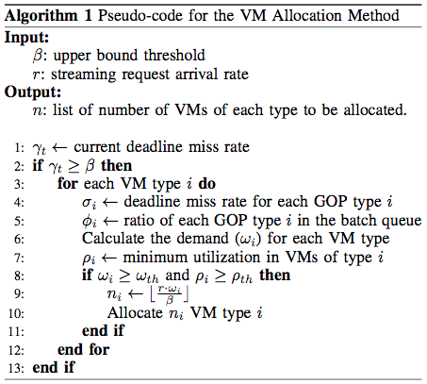
Elastic Heterogeneous VM Allocation
When to allocate?
What type of VM?
  Consider past and future
  of each type
  Weight is the linear
  combination of the two factors
How many VMs?
Last Period
Future
Current Time
How far is the weight from w_{th}
Arrival rate of task type
Deadline miss rate
GPU: 20%
CPU: 50%
Memory:30%
Portion in the bath queue
GPU: 60%
CPU: 20%
Memory:20%

Slide 81


Which VM to Deallocate in a Heterogeneous VM Cluster?
Should the one with minimum utilization be deallocated?
  When the system tends to homogeneous configuration, VMs tend to have identical and high utilization (scheduler does not discriminate)
We need to measure degree of heterogeneity in a VM cluster
VM types
Ratio of type i to all types

Slide 82

VM Deallocation Policy
  When?
  Which one?
    Find the minimum utilization VMs
    Find the lowest cost ones (least powerful ones)
    Find the minimum remaining time VM
    If T2’s minimum utilization < 0.2
    Deallocate
T2, T2, C4, R3
T2, T2
T2

Slide 83

Early GOP Completion Time
The impact of utility based scheduling on minimizing completion/buffer time of GOPs, especially those in the beginning of the stream

Slide 84






Scheduling with Dynamic Provisioning
Notes:
The incurred cost has significantly reduced (up to ~80% when the system is not oversubscribed) regardless of the mapping heuristic applied.
Startup delay has in general increased (mainly in a) but it is more stable in compare with figure a in static. This is because the EM adapt itself to the workload intensity to satisfy QoS demands. However, in (d) even the startup delay is in a lower range.
Similarly, dmr has become more stable and low when we utility based mapping heuristics are used.
Why MSDUT and MMUUT perform better DMR than MSD and MMU?
The reason is not virtual queue base on old experiment. The reason is not heuristic nature because of static experiment e

Slide 85



Static GPU vs. Dynamic Heterogeneous
Low and stable Startup time
Low and stable deadline miss rate
Save up to 85% cost when system is not oversubscribed

Slide 86
Publications
Xiangbo Li, Mohsen Amini Salehi, Magdy Bayoumi, Nian-Feng Tzeng and Rajkumar Buyya, “Cost-Efficient and Robust On-Demand Video Transcoding Using Heterogeneous Cloud Services”, in IEEE Transaction on Parallel and Distributed Systems (TPDS), Aug. 2016

Slide 87


Hatef Esfahani (18th Century):
When you pierce deep in any particle
You will see a sun shining there…
دل هر ذره را که بشکافی
آفتابیش در میان بینی
هاتف اصفهانی

Slide 88
Computational Reuse to Achieve Cost-efficiency and Performance

Slide 89
Viewers’ devices
Streaming provider
Video Streaming Distribution System
Extended video processing service
CVSE services
Service repository
Video Repository
Caching
Admission
Control
Time Estimator
Resource Provisioner
Video
Merger &
Output
Windows
Reusing via Admission Control
Streaming tasks
Task Scheduler
Compute Engine
CVSE Core

Slide 90

Goals and Assumptions
Heterogeneous tasks
Homogeneous computing resources
Identical or similar task exists
The goal is to:
  Reduce usage costs via task merging
  Coping with resource oversubscription
…
Notes:
Heterogeneous in both task type and size

Slide 91




How Merging Works
VMs
Merged Task
Time Estimator
Merge-Aware Admission Control
Arriving Task
...
Scheduler
Batch Queue

Slide 92
Tasks’ Similarity Levels
X
Task-Level Similarity
  Same GOP, same process, same parameters
Operation-Level Similarity
  Same GOP, same Process
Data-Level Similarity
  Same GOP
Notes:
Operation level: Ffmpeg -I inputfile –r resolution1 output1 resolutions2 output2

Slide 93
Steps of Achieving Computational Reuse
Find mergeable task pairs
Determine merge appropriateness
  (optional) determine position to place merged task back to the queue
Perform task merging
Notes:
Focus on first two
Not task aggregation: it is application-specific. We have impeleted for on-demand vi

Slide 94
Detecting Mergeable Tasks
Using three hash tables with keys queued tasks
Merge upon arrival to Admission Control
O(1)
UPDATE
Merge-Aware Admission Control
Batch queue

Slide 95

Merge Module Architecture

Slide 96
Position Finder
Where to place merged tasks in batch queue?
Does scheduling policy restricts task positioning in batch queue?
  Example: Pool based X Shortest-Job-First ✔

Slide 97
Position Choices
Merge in the position of existing task
Merge in the position of new task
Finding a new position
  Logarithmic search
  Linear search

Slide 98
Impact of Task Positioning
Merged task starts execution later,
Delay less number of other tasks
Merged task starts its execution earlier, delay execution of more tasks
Batch queue

Slide 99
Logarithmic Probe for Positioning
Merged tasks is on time, miss# is not high -> found a position
Merged tasks miss, miss# is not high -> Consider Right half
Merged tasks is on time, miss # is too high -> Consider Left half
Merged tasks miss, miss# is too high -> inappropriate merging
Consider
Consider
Consider
Probe
Probe
Probe
Batch queue
Cost= log(n)×complexity of scheduling

Slide 100
Linear Probe for Task Positioning
Find last position that merged task is not missing its own deadline and then stop
  probe positions with memorization
One search through the list O(n)
Search
Batch queue

Slide 101

Merging Aggressiveness Factor
Under oversubscription, merging (despite causing deadline miss) can be beneficial
How to measure oversubscription?
  Based on how much time after the deadline queued tasks are expected to complete
  OL=$\frac{1}{n }$ $\sum_{i=0}^{n}{\frac{\left(Ci−Di\right)}{W_{i}}}$, C=completion, D=deadline, W= slack time
How to use the Aggressiveness factor?

Slide 102
Usage of Aggressiveness Factor
Via allowable miss
  Adding the number of allowed deadline misses for merging
Via relaxing completion time estimation
  Normally, deadline misses are counted based on worst-case analysis of tasks’ completion times

Slide 103

Impact of Merging on Resource Usage Time
14% Saving
less amount of VM time for the same amount of work
Notes:
14% saving
Makespan in Seconds

Slide 104

Impact of Merging on QoE
Notes:
DMR = Dealine Miss Rate

Slide 105
Achieving Cost-efficient Interactive Video Streaming through Caching

Slide 106
Interactive Streaming Request
Viewers’ devices
How to cache videos becoming Trendy?
Streaming provider
Video Streaming Distribution System
Extended video processing service
CVSE services
Service repository
Video Repository
Caching
Admission
Control
Time Estimator
Resource Provisioner
Video
Merger &
Output
Windows
Streaming tasks
Task Scheduler
Compute Engine
CVSE Core

Slide 107


Recap on Definitions
Two approaches to offer interactive streaming
  Pre- processing (Caching)
  Re-process (on-demand processing)
Questions:
  When to pre-process a video?
  When to re-process a video?
  How about partially pre-preprocess videos?

Slide 108
Intuitive Solutions
Pre-process all hot video services
Re-process all cold (non-hot) video services
BTW, what is a hot video service?
Is there any way to quantify the hotness
of a video streaming service?

Slide 109
Definition of Hot Video Stream
  We define a video as hot, when it is worth to pre-processing it
  cost of pre-processing video service i ≤ cost of re-processing it
We define cost-ratio for video i (R_{i}) as:
R_{i} = (storage cost) _{i} / [(transcoding cost) _{i} .(views) _{i} ]
A video is “hot” if its cost-ratio ≤ 1

Slide 110




Quantifying Hotness of GOP
Hotness of a video depends on the hotness of its GOPs
  Cost-ratio for GOP j of video i (R_{ij}) as:
Hotness of GOP G_{ij} is measured by:
Hotness of video i is measured by:

Slide 111


Access Pattern to Video Streams
Repository level and GOP level access pattern
Within each video
  We can estimate GOP view
  information using Power-Law distribution
Number of views
Number of views
Videos in repository
GOPs within video

Slide 112


Cost of Pre-processing of a Video Stream Service
Cost of pre-processing depends on GOP size and unit price:
Then, cost of pre-processing a video Stream is:
$$C_{S_{i}}=\sum_{j=1}^{m}{C_{S_{ij}}}$$
Pre-processing cost of GOP ij
Cloud storage unit price
Size of GOP ij

Slide 113


Cost of Re-Processing of a Video Stream Service
Cost of re-processing a GOP depends on processing time and unit price
Re-transcoding cost of GOP ij
Processing time of GOPij
Cloud processing
unit price
Cost of re-processing a video stream is: $C_{T_{i}}=\sum_{j=1}^{m}{C_{T_{ij}}}$

Slide 114





  Video Stream Access Pattern – non Long Tail

Slide 115

GOP-Based Hotness Heuristic (GBH)
GOP information in each video and cloud price
Calculate hotness of each GOP
Pre-transcode hot GOPs
Re-transcode non hot GOP

Slide 116
Pre-Processing Heuristics
VLT: Video Level Transcoding
  Either store or re-transcode full video
  Predicting based on the usage
VBH : Video Based Hotness
GBTh: GOP Based Threshold
  Traverse from the beginning until cost ratio is > 1
GBH: GOP Based Hotness

Slide 117

Impact of Changing Percentage of Hot Videos in a Repository
GBH outperforms other methods and reduces the cost by up to 15%
By increasing hot videos, the outperformance decreases
Notes:
This is because when a repository contains high percentage
of Frequently Accessed Video Streams , most of the
Frequently Accessed Video Streams are pre-transcoded
and partial pre-transcoding methods is applied on
few video streams, hence, reducing its impact.

Slide 118

Impact of Increasing Non-Long-Tail Video Streams in a Repository
GBH has the least increase in the incurred cost when compared with other methods.
At 0: VBH, GBTh, and GBH perform equally
Notes:
As mentioned earlier, the distribution of views within
some video streams do not follow the long-tail pattern.
That is, there are portions of the video streams that
are not necessarily in the beginning of it but receive a
large number of views in compare with the rest of the
video stream

Slide 119
Publications
Mahmoud Darwich, Ege Beyazit, Mohsen Amini Salehi, Magdy Bayoumi, Cost Efficient Repository Management for Cloud-Based On-Demand Video Streaming, in Proceedings of the 5th IEEE International Conference on Mobile Cloud Computing, Services, and Engineering (IEEE Mobile Cloud ’17), San Francisco, USA, Apr. 2017
Mahmoud Darwich, Mohsen Amini Salehi, Ege Beyazit, Magdi Bayoumi. Cost Efﬁcient Cloud-Based Video Streaming Based on Quantifying Video Stream Hotness, Submitted to The Computer Journal, Sep. 2017.

Slide 120
Challenge #2:
How to achieve low-latency interactive video streaming while independent of viewers’ location?

Slide 121
Concerns When Using Clouds for Interactive Video Streaming
Centrally located clouds causes latency, especially in distant areas
To address this challenge, we develope F-FDN (Federated-Fog Delivery Networks)

Slide 122

Netflix CDN Infrastructure
OCA servers circa 2016
Notes:
CITE IMAGE

Slide 123
Limitations of Existing CDN Platforms
Edge servers
  File transfer
  File caching
  Only caches entire video (0-1)
  No processing is performed at edge
  Entire video streamed is delivered from the same edge server

Slide 124
Federated: Fog Delivery Networks
Perform processing at edge level through CVSE deployment
Provide partial video caching
Leverage neighboring FDN cached contents

Slide 125





High Level of F-FDN
FDN
Viewers
Video Content
Central Cloud
Local Cache
Processed On-Demand
Streaming decisions are made on a segment-by-segment basis
Each viewer can receive its stream from multiple sources
Neighboring Cache

Slide 126






F-FDN Architecture
Central Cloud
Video Stream Requests
Ingestion Processor
Metadata Manager
Fog Monitor
Video Repository
FDN
Segment Cost Estimator
Request Queue
Request Processor
Viewers
Neighboring FDN
Video Merger and Output Window
Worker Nodes
Final Video Content
CVSE
Cached Video

Slide 127
Streaming Decisions
3 ways a video segment can be streamed
  1) Local FDN’s cache
  2) Processed on-demand by local FDN
  3) Retrieved from Neighboring FDN to local FDN, then streamed to viewer
FDN evaluates each option for each GOP
  It chooses the option with highest likelihood of streaming a GOP on time
  End-to-end latency is considered
    In case 2 and 3, convolve multiple distributions into a single comparable distribution

Slide 128

On-demand Processing in Local FDN
Criteria to account for:
  The execution time to process segment i on local FDN j
  The transfer time to deliver segment i from local FDN j to viewer v

Slide 129
Retrieved from Neighboring FDN then streamed from Local FDN
Criteria to account for:
  Transfer time of segment i from neighboring FDN k to local FDN j
  The transfer time to deliver segment i from local FDN j to viewer v

Slide 130

Evaluating F-FDN: Alternative Streaming Methods
CDN represents the standard video streaming architecture
Robust F-FDN is our fully featured F-FDN platform

Slide 131

Evaluating F-FDN: Suitable Cache Size for FDNs
We consider a caching level of 30% for FDN systems in later experiments

Slide 132

Evaluating F-FDN: Impact of Oversubscription
On average, Robust F-FDN performs 52% better than CDN
Robust F-FDN
CDN
Notes:
Comparing CDN to Central Cloud
Comparing I-FDN to CDN
Comparing Det F-FDN to Robust F-FDN

Slide 133

Evaluating F-FDN: Impact of Network Latency
Retrieval from Neighboring FDN is less reliable, so on-demand processing is more utilized as the latency increases
As the average latency increases, the difference between the FDN systems decreases
Notes:
Comparing CDN to I-FDN
Comparing Det F-FDN to Robust F-FDN

Slide 134
CVSE Implementation & Demo

Slide 135
CVSE Stack
Web Interface
1
4
CVSE Core
2
3
Video Processing Engine
Communicator
Processor
Notes:
Layered view
3 main layers
VPE contains communicator and processor

Slide 136

Video Processing Layer: FFmpeg
Notes:
Transcoding/ Transmuxing
Resize , change bit rate, framerate, and a lot more

Slide 137

Example of FFmpeg Command line
ffmpeg -hide_banner -y -i $path -vcodec libx264 -acodec copy -s $width:$height -copyts -muxdelay 0 $outdir/$filename

Slide 138
Video Processing Engine
Processed Video
JavaSocket
Worker Queue
Service Processing Engine
(Ffmpeg)
Task Req
StatRequest
Terminate
Saved Statistics
Get Execution Time statistics
Communicator
Video Processing (FFmpeg)
Resides either On a worker container/local thread/emulation

Slide 139
CVSE Architecture
Viewers’ devices
Streaming provider
F-FDN
Extended video processing service
CVSE services
Service repository
Video Repository
Caching
Admission
Control
Time Estimator
Resource Provisioner
Video
Merger &
Output
Windows
CVSE Core
Streaming tasks
Task Scheduler
Compute Engine

Slide 140
Extensibility of CVSE
Monthly
Pay as you watch
Key CVSE features:
Billing Policy Interface
1) Modular
CVSE CORE
Local
2) Dynamic
Extended 3rd Party Service
Video Segment Caching Service
Streaming Task Scheduling Service
Video Segment Admission Control
Service
Cloud
Resolution
Video Processing Interface
Deployment Interface
Video Service Repository
Edge
Subtitles
Federated
Elastic Resource Provisioning Service
Compute Engine Interface
Emulation
Local Thread
Cloud
VM
Container

Slide 141

Analyzing Worker Node Cluster Size
Crucial for Resource Provisioner to allocate enough worker nodes
26%
0%

Slide 142
Web Interface
Coded in Java
Runs as webservice that receives streaming requests
Stream requests sent from web page hosted by local web server

Slide 143

Examples of Video Processing

Slide 144

Examples of Video Processing

Slide 145
Demo

Slide 146
Questions
What is Video Transcoding?
Why “on-demand” video transcoding?
What are the challenges in on-demand video transcoding?
What have already been done by others?
What aspects does my thesis focus on?
What are the future directions?

Slide 147


Future Directions
Storage Cost
Computing Cost
Machine Learning

Slide 148
Heterogeneous Container Types
Currently, each container is general, all-purpose use
Provide a mixture container types in compute engine:
  Often used, long running containers
  Specialized containers for processing types that are requested less often
    Created when needed, and destroyed when processing is completed

Slide 149

On-demand Processing of 360 degree videos
360 degree videos are becoming more common
Consists of multiple viewing areas stitched together
All viewing areas are not observed at the same time
Process the actively observed area on-demand at full resolution
Use assumptions and historical data to predict likely viewing area of videos

Slide 150
Dynamic Billing
Enable stream service providers to offer pay-as-you-watch model when charging customers
Many factors that would affect billing:
  Availability of video version
  Resources used for processing
  Duration of viewing session

Slide 151

Multi-Tier F-FDN Platform
Central Cloud
Caching
Security
Regional FDN
Processing
Power
Latency
Local FDN

Slide 152


Molana Rumi (13th Century):
You should set fire to your agarwood
To see your fragrance releasing!
آتش زدی بر عود ما
نظاره کن بر دود ما
مولانا

Slide 153


Slide 154
Live Streaming Video Transcoding
Using Cloud Services

Slide 155

Architecture for On-Demand Transcoding of Live-Stream Videos
Efficient transcoding time estimation model
Drop those GOPs who missed their deadline

Slide 156

Transcoding Time Prediction Model
Current GOP size
Startup Queue
Standard deviation
G_{4,1}
G_{4,0}
…..
…..
G_{1,9}
G_{2,6}
G_{4,4}
G_{3,4}
G_{2,5}
G_{1,8}
Average GOP transcoding time
Batch Queue
Average previous GOP size

Slide 157
QoS-Aware Scheduling Method
G_{video#,GOP#}
VM1
Startup Queue
G_{4,1}
G_{4,0}
…..
15s
VM2
…..
G_{1,9}
G_{2,6}
G_{4,4}
G_{3,4}
G_{2,5}
G_{1,8}
10s
Batch Queue
VM3
20s

Slide 158


Performance Evaluation
Low and stable startup time
Decrease video drop rate.
Notes:
We have run all transcoding operations on Amazon EC2 to get the real transcoding data, and then we use these data to simulate on CloudSim.
Our dynamic system keeps the QoS violation constantly low and stable in compare with static method
Our method save cost when the system is not oversubscribed.

Slide 159
Robust Dynamic Resource Allocation via
Probabilistic Task Pruning in Heterogeneous
Computing Systems
The ART of Saying NO!
James Gentry, Chavit Denninnart, Mohsen Amini Salehi
High Performance Cloud Computing Lab (HPCC)
School of Computing and Informatics
University of Louisiana Lafayette
May, 2019

Slide 160
Why to Prune Tasks?
Continued processing of low-chance tasks
  Adds to cost, without getting benefit
  Delays processing of other tasks
Deployment of additional resources are not always possible
  Budget, resource, energy limitation may exist
Notes:
Task Dropping: When a task misses its deadline, it is no longer useful

Slide 161

Pruning Mechanism
Pruning Mech
Drop
Defer

Slide 162
Pruning = Deferring + Dropping
On every mapping event: Defer
  Tasks whose chance of success is below Deferring Threshold are deferred to next mapping event
When system is oversubscribed: Drop
  Tasks whose chance of success is below Dropping Threshold are dropped
  Dropping improves chance of remaining tasks
  Dropping reduces compound uncertainty

Slide 163



Why Task Dropping Works?
The Art of Saying NO!

Slide 164
Why Task Deferring Works?
The Art of Saying: Not Now!
Deferred tasks wait for next mapping event
  The task may be mapped to a machine with higher affinity
  Deferring can raise chance of success for a task

Slide 165
Three Questions about Pruning
What are thresholds to drop or defer tasks?
  Are these thresholds system level or task-specific?
When to begin and cease task dropping?
  When transition to aggressive dropping mode?
How to prevent unfairness in dropping?

Slide 166
Pruning Mechanism
Addressing Question 3
Addressing Question 1
Fairness
Pruner
Mapping
Metadata
Deferring
Pruning Decisions
Accounting Info.
Pruning Config.
Dropping
Toggle
Addressing Question 2

Slide 167
1. Determining Dynamic
Per-Task Dropping Threshold
Factors influence dropping threshold:
  Task position in the queue
  Skewness of PMF effect proper dropping threshold of each task
X
X
Notes:
For unmapped tasks there is no such thing as position in the queue

Slide 168


Per-task Dropping Threshold:
The Impact of Skewness
probability
probability
probability
time
time
time
probability
probability
probability
time
time
time

Slide 169

1. Determining Dynamic
Per-Task Dropping Threshold (Cont.)
Dropping threshold is adjusted on a per-task basis
  Dropping threshold decreases for tasks later in the queue
  Dropping threshold increases for right-skewed tasks
Deferring threshold is inferred from dropping threshold
  Deferring threshold must be higher than dropping threshold
Notes:
Because skewness is considered large at +/- 1, we clamp s between -1 and 1
The effect is inversely correlated to the sign of s

Slide 170

Results: Decoupling Dropping and Deferring Threshold
Notes:
http://www.itl.nist.gov/div898/handbook/eda/section3/eda35b.htm

Slide 171
2. When Transition to Aggressive Dropping Mode?
Dropping is engaged when the system is oversubscribed
The Toggle should not react to acute spikes in deadline misses
Oversubscription is measured based on deadline violation in recent mapping events

Slide 172

3. How to Establish Fairness in Task Pruning
Certain task types may suffer from pruning
Upon pruning a task, fairness compensation is given to pruning threshold of that type
Fairness Factor determines
how quickly to respond to
unfairness
Notes:
Heuristics that optimized for highest number of tasks finished are bias toward certain task type (short tasks)

Slide 173

Impact of Pruning on Robustness

Slide 174

Cost benefit Analysis of Pruning
Pruning helps not to process tasks that are unlikely to be successful
Notes:
http://www.itl.nist.gov/div898/handbook/eda/section3/eda35b.htm

Slide 175
Conclusion
Pruning is effective in increasing robustness
Robustness always benefits from task deferring
  Always think of saying: Not Now!
When the system is oversubscribed, low-chance tasks must be dropping
  Sometimes practice saying: No!

Slide 176
Publications
Xiangbo Li, Mohsen Amini Salehi, Magdi Bayoumi, “VLSC: Video Live Streaming Based on Cloud Services”, accepted to the 6th IEEE International Conference on Big Data and Cloud Computing Conference (BDCloud ’16), Atlanta, GA, USA, Oct. 2016.
James Gentry, Chavit Denninnart, Mohsen Amini Salehi, “Robust Dynamic Resource Allocation via Probabilistic Task Pruning in Heterogeneous Computing Systems“, Accepted in 33rd IEEE International Parallel & Distributed Processing Symposium (IPDPS ’19), Rio de Janeiro, Brazil, May 2019 .
Chavit Denninnart, James Gentry, Mohsen Amini Salehi, “Improving Robustness of Heterogeneous Serverless Computing Systems Via Probabilistic Task Pruning”, Accepted in 27th International Heterogeneity in Computing Workshop (workshop as part of IPDPS '19 conference), Rio de Janeiro, Brazil, May 2019
Mohsen Amini Salehi, Xiangbo Li, “HLSAAS: High-Level Live Video Streaming As a Service ”, in Stream2015 Workshop at Washington DC, USA, March 2016.

Slide 177
Thank You!

Slide 178
Appendix

Slide 179

Experiment Results

Slide 180


Slide 181




Slide 182


Slide 183


Slide 184


Slide 185


Slide 186


Slide 187




Slide 188
Experiment Setup
We modeled our system based on the characteristics of VMs in Amazon EC2
Using CloudSim to model our system and evaluate the performance of scheduling and resource provisioning policies.
We uniformly selected videos from the range of [10 , 600] seconds from a set of benchmark videos which can be downloaded from https://goo.gl/TE5iJ5

Slide 189
Merge Appropriateness Evaluation
Non-Existence -> Always merge if possible
ICSOC18 -> Basic Merge
  Respect task scheduling’s placing policy
  Use aggressiveness=0 (no merge if it cause additional misses)
Enhanced components in journal version:
  Merged Task Position Finder
  Scalable merge aggressiveness factor
    Scale between aggregate tasks more aggressively to save more overall computing power, or be conservative and do not cause deadline violation to involved tasks

Slide 190
ICSOC18
Merge Appropriateness Evaluation
Procedure:
  Two scenarios will be checked:
    candidate tasks are merged
    another where candidate tasks stay separated (i.e. not aggregated).
  Estimate completion time of each task
    Merging imposes additional deadline misses over non-merged scenario.
      DO NOT MERGE
    Merging does not cause additional deadline misses.
      MERGE

Slide 191


GOP-based Threshold algorithm (GBTh)
GOP information in each video and cloud price
Calculate the threshold point
Store GOPs before threshold and transcode
on demand GOPs after it

Slide 192

Video-based hotness algorithm (VBH)
GOP information in each video and cloud price
Hot part
Hi
Cold part
Calculate hotness of video
Pre-transcode the hot part of the video

