Slide 1
UMS: Live Migration of Containerized Services across Autonomous Computing Systems
Mohsen Amini Salehi
High Performance Cloud Computing Lab (HPCC)
Department of Computer Science & Engineering
University of North Texas
12/05/2023
Notes:
Department of Computer Science & Engineering
University of North Texas
SAC/CC 1: Migration and Scheduling in Edge Computing chaired by Rami Langar from Tue, December 5, 2023 08:30 +08 until 10:00 (2nd paper) in Room 407 (18 min.)

Slide 2
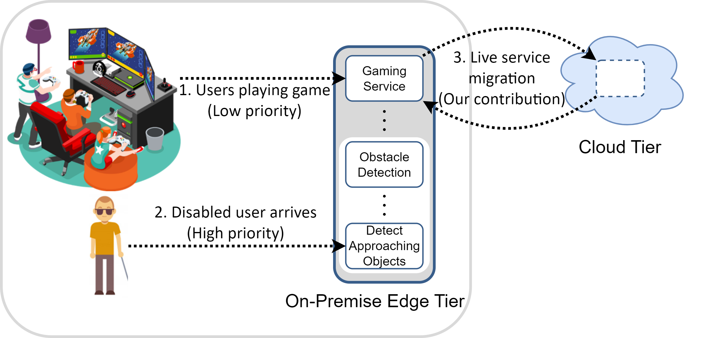
Motivation

Slide 3
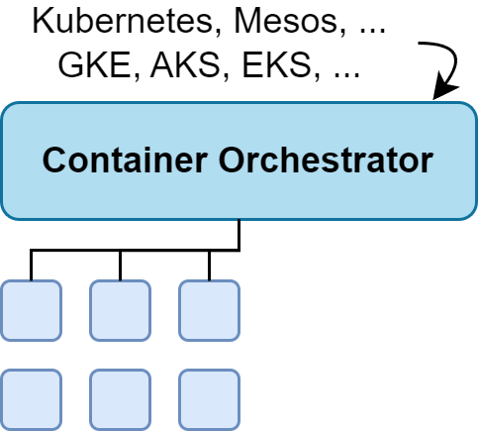
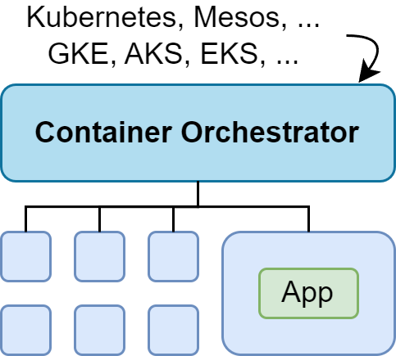
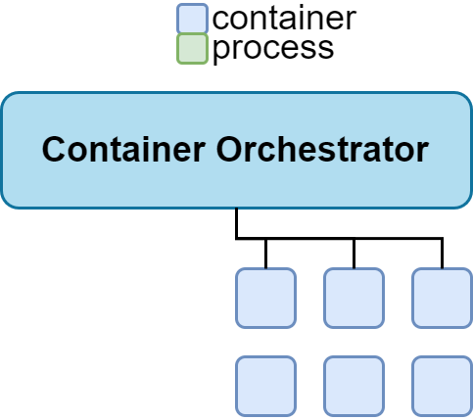
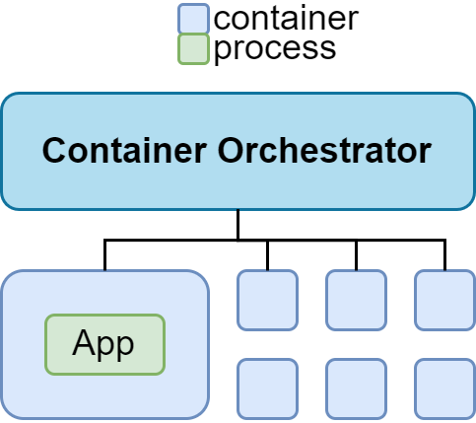
Restoration Problem
output #1
output #2
output #3
output #4
output #5
output #6
Notes:
migration
=
checkpointing + data-transfer + restoration
migration solution = migration
+ coordination​
+ transparency
+ dealing with platform heterogeneity
+ dealing with latency (overhead)

Slide 4
Research Question
We want a live service migration solution that can offer the best of both worlds:
(i) operating ubiquitously across autonomous systems and heterogeneous orchestrators;
(ii) maintaining the migration efficiency.

Slide 5
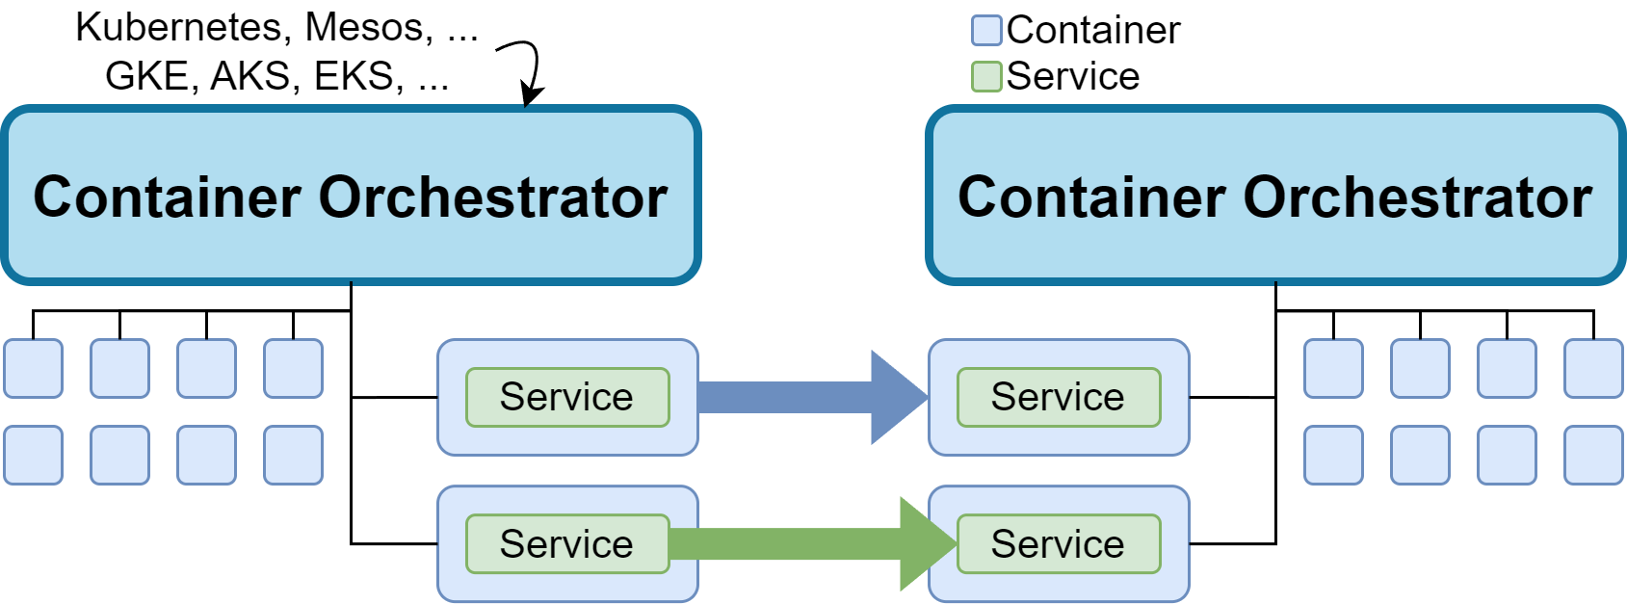
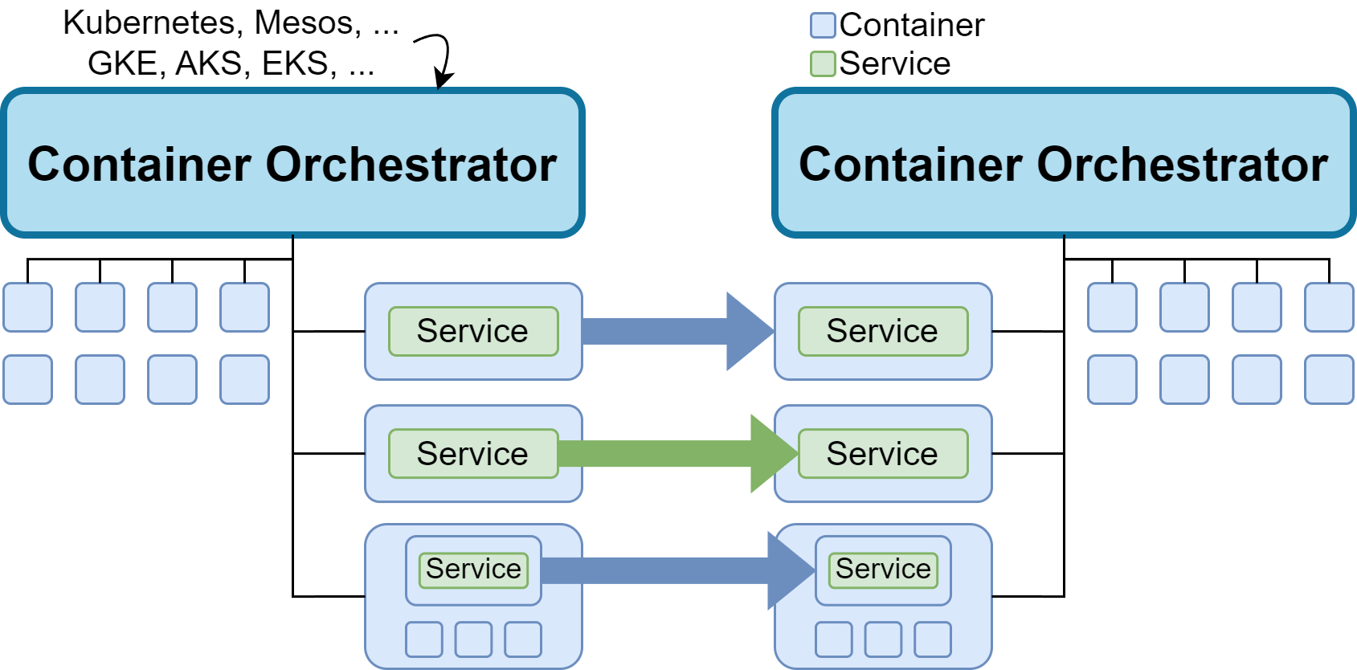
UMS: Ubiquitous Migration Solution
Notes:
So we develop a liberal approach
Efficiency-flexibility tradeoff
The developers must declare/know how far (aggressively) to be migrated by using matched migration approach

Slide 6
Contributions
Developing UMS, a framework that enables seamless and lightweight live migration of containerized services across autonomous computing systems with potentially heterogeneous orchestrators
Developing live container migration approaches operating at the orchestrator, container, and service levels
Demonstrating the feasibility of live migration of containerized services across heterogeneous orchestrators (Kubernetes, Mesos, K3S, and Minishift) and between Microsoft Azure and Google Clouds

Slide 7
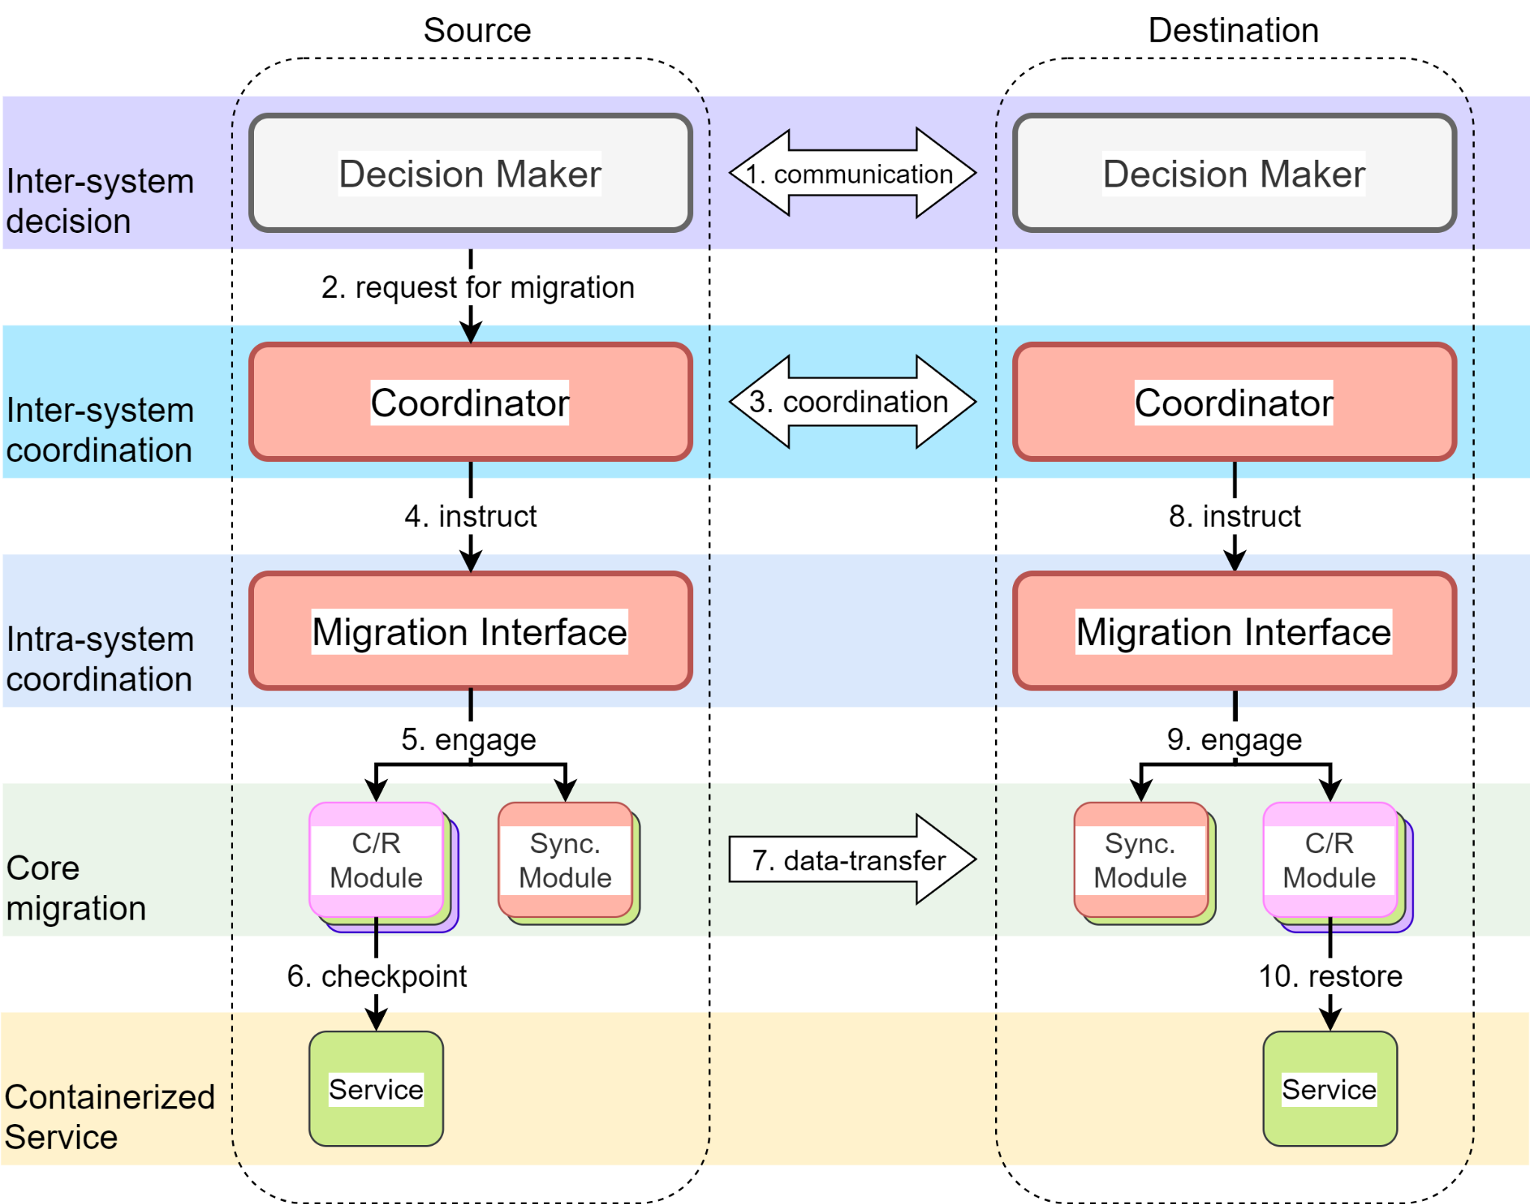
Architectural Overview of UMS

Slide 8
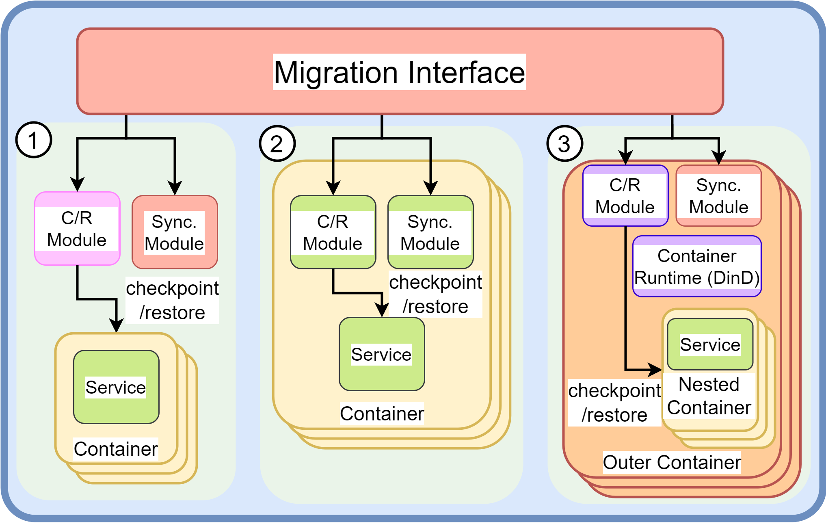
Establishing Service Migration Approaches Operating at Different Levels
CRIU
Rsync

Slide 9
Establishing Service Migration Approaches Operating at Different Levels
If there is a FastFreeze process in the container
FastFreeze
If there is a response from Docker port
Docker-in-Docker

Slide 10
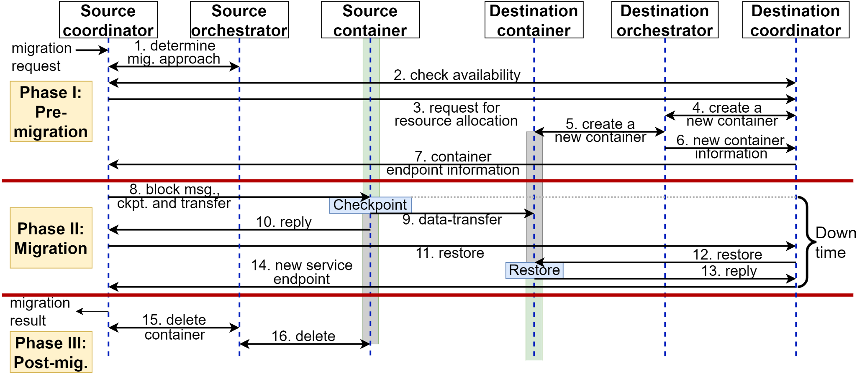
Mechanics of the Live Migration Coordination
Notes:
Coordination across AS e.g., authentication
Determine migration approach
medata copy at this layer (by create dest container)
Container reuse

Slide 11
memhog
A simple application that allocates static amount of memory and writes data randomly
Scale the memory size to measure overhead
Since its data cannot be compressed, may compare to data-compressible application e.g., Redis
Our version embed a looper

Slide 12
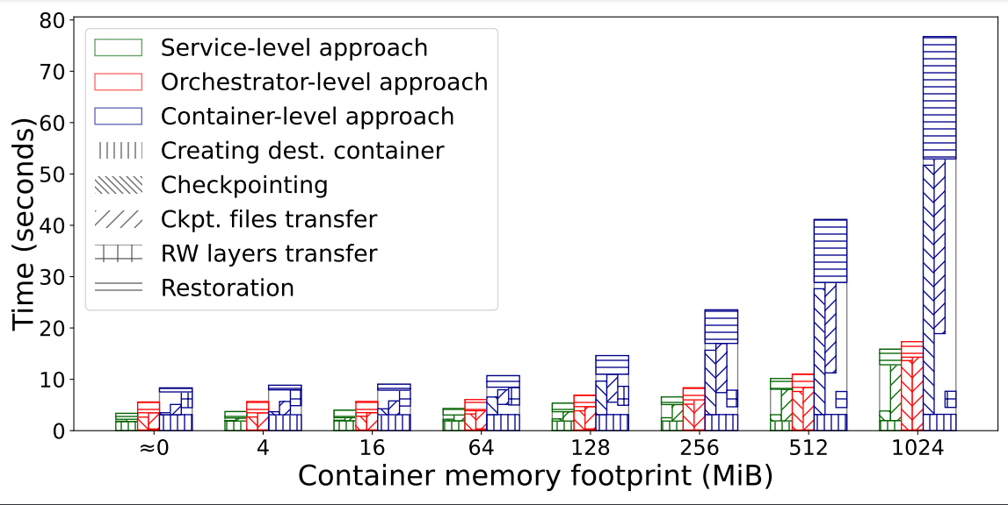
Overhead of Live Container Migration
The service-level migration outperforms other approaches.
The container-level approach is tolerable for small-size containers.

Slide 13
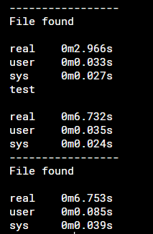
Docker Checkpoint Analysis
Docker
CLI
Docker
runtime
containerd
runc
CRIU
7s
total
2s
log
5s
unknown
3-4s
1s
<1s
Unnecessary io.Copy from /tmp/ctd-checkpoint<random_number> to /var/lib/docker/containers/<container_id>/checkpoints

Slide 14
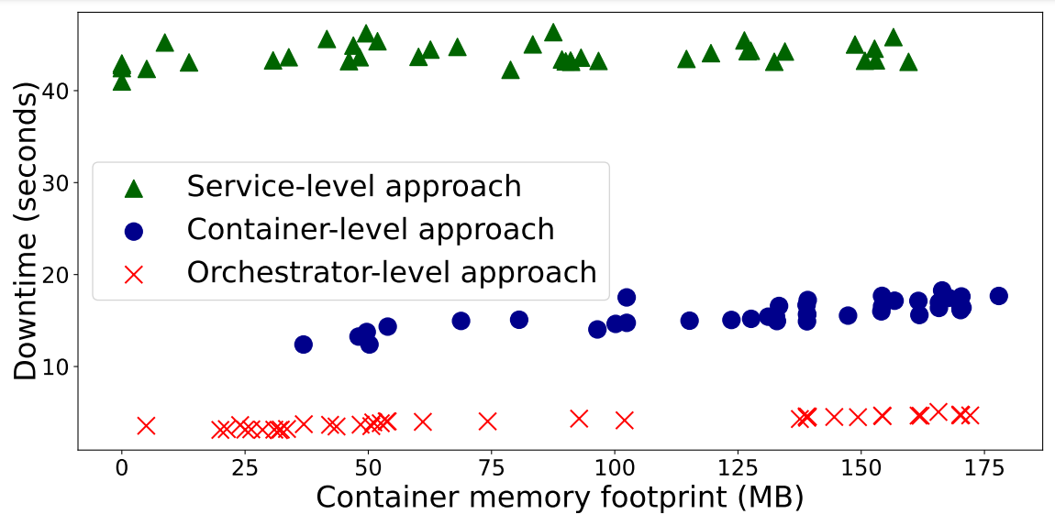
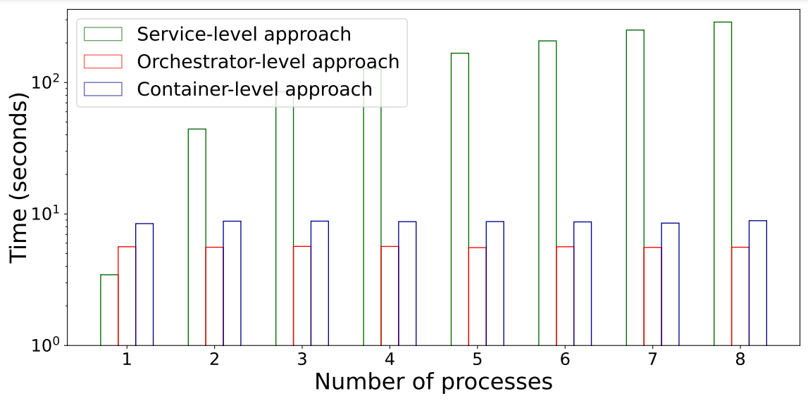
Impact of Dynamic Memory Footprint on the Migration
The service-level approach depends on the number of processes running in the container, rather than the container memory footprint.

Slide 15
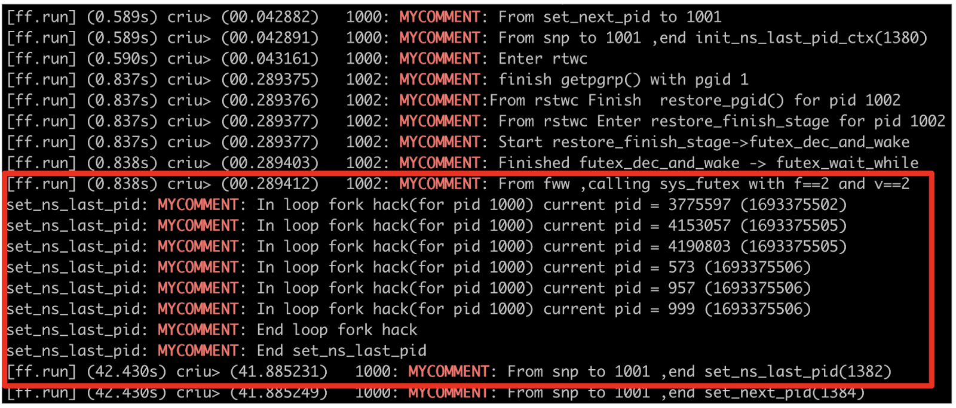
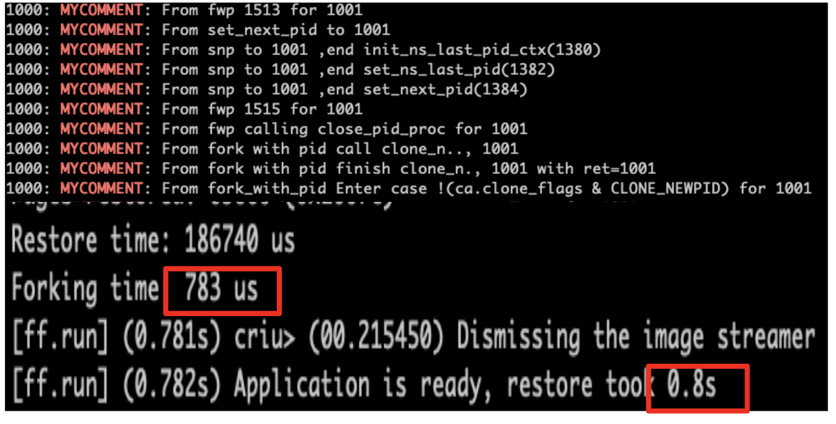
Improving FastFreeze

Slide 16
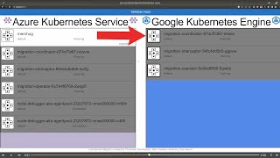
Live Migration across Heterogeneous Orchestrators

Slide 17
Further Resources
Demo videos
GitHub
How we fix FastFreeze
Contact us!
thanawat.chanikaphon1@louisiana.edu
mohsen.aminisalehi@unt.edu

