Slide 1
E2C: A Visual Simulator to Reinforce Education of Heterogeneous Computing Systems
Ali Mokhtari, Drake Rawls, Tony Huynh, Jeremiah Green, Mohsen Amini Salehi
May 2023

Slide 2
Heterogeneity in Distributed Computing Systems

Slide 3
Heterogeneity
What is heterogeneity in distributed computing systems?

Slide 4
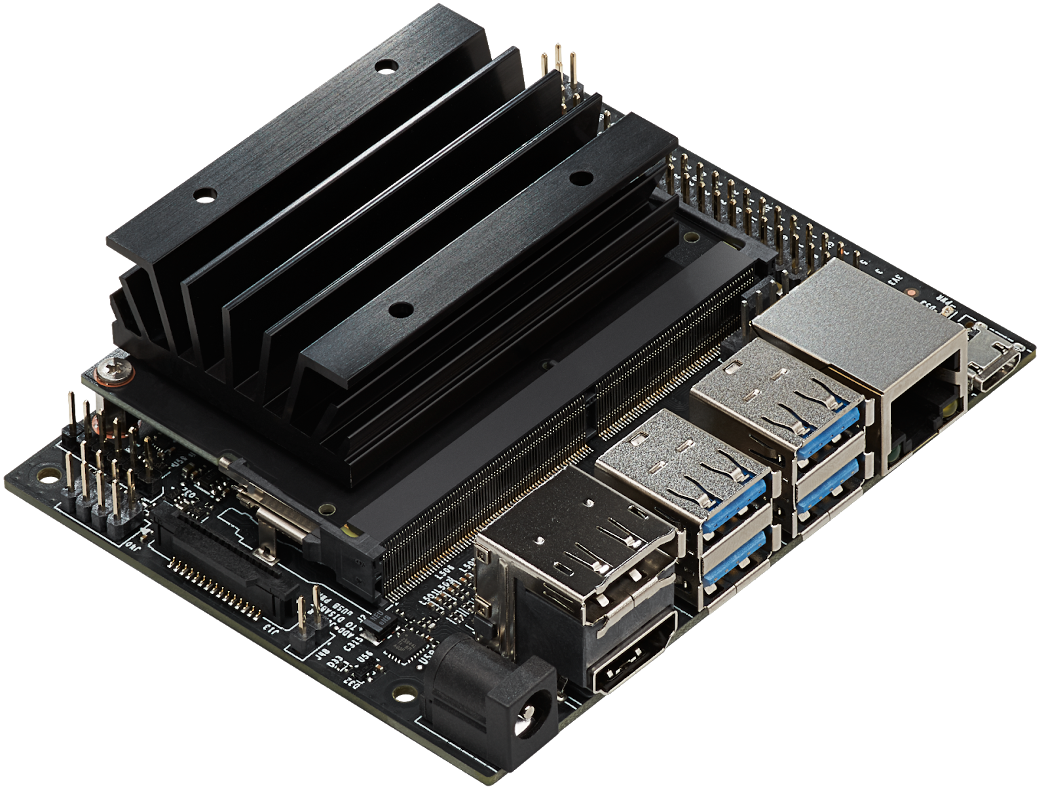
Machine Heterogeneity : Edge
GTX 20 series
GTX 30 series
GTX 40 series …
Inference
Inference Time
Variation in Execution Time
Face Recognition
Edge Computing System
Jetson Nano
. . .

Slide 5
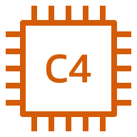
Machine Heterogeneity : Cloud
Inference Time
Variation in Execution Time
Inference
Face Recognition
. . .
Inference

Slide 6
Task Heterogeneity
20 msec
Face Recognition
Inference Time
Variation in Execution Time
60 msec
Speech Recognition
AWS EC2 Instance
200 msec
inference time
NLP

Slide 7
Machine and Task Heterogeneity
100,20, 50 msec
Face Recognition
Inference Time
120, 60, 80
Speech Recognition
AWS EC2 Instances
500, 200, 350
inference time
NLP

Slide 8
System Heterogeneity Dimensions
System Heterogeneity
Machine Heterogeneity
Task Heterogeneity
The variation in the execution times of a given task across all the machines
The variation in the execution times of tasks for a given machines
CPUs
GPUs
FPGA
Object Detection
Speech Recognition
Video Transcoding

Slide 9
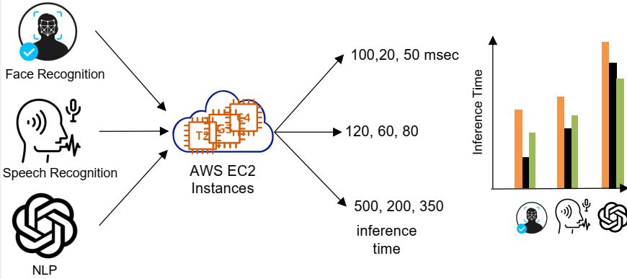
Heterogeneous Computing (HC) Systems
A computing system is heterogeneous if and only if :
“Execution time of at least one [task, machine] pair differs from others”
Variation in Execution Time
 | g3s.xlarge | t2.2xlarge | C4.xlarge
Face Recognition | 20 | 300 | 50
Speech Recognition | 50 | 400 | 100
ChatGPT | 100 | 1000 | 150
Variation in Execution Time

Slide 10
Performance Model of HC Systems
EET (Expected Execution Time) Matrix
Machine types
Machine Types Task Types | M₁ | M₂ | o o o | M_{m}
T₁ | $$e_{11}$$ | $$e_{12}$$ | o o o | $$e_{1m}$$
T₂ | $$e_{21}$$ | $$e_{22}$$ | o o o | $$e_{2m}$$
o o o | o o o | o o o | o o o | o o o
T_{n} | $$e_{n1}$$ | $$e_{n2}$$ | o o o | $$e_{nm}$$
Task types
Expected Execution Time (EET) of task type T₁ on machine type M₂

Slide 11
Heterogeneity in EET Matrix
EET (Expected Execution Time) Matrix
Machine Types Task Types | M-1 | M-2 | M-3 | M-4
TT-1 | 2.8 | 6.5 | 3.7 | 7.1
TT-2 | 2.5 | 6.4 | 5.0 | 6.5
TT-3 | 3.1 | 6.2 | 3.7 | 7.9
TT-4 | 3.1 | 8.1 | 4.5 | 7.8
Machine Heterogeneity
The execution time of a given task varies across machines
Task Heterogeneity
A given machine has different expected execution time for different tasks

Slide 12
Why Heterogeneity Matters in System Design?
Heterogeneity impacts the system performance
Homogeneous System
Heterogeneous System
Solution A
Solution B
Solution A
Solution B
Solution A
Solution B
System Performance concerning QoS/Cost objective

Slide 13
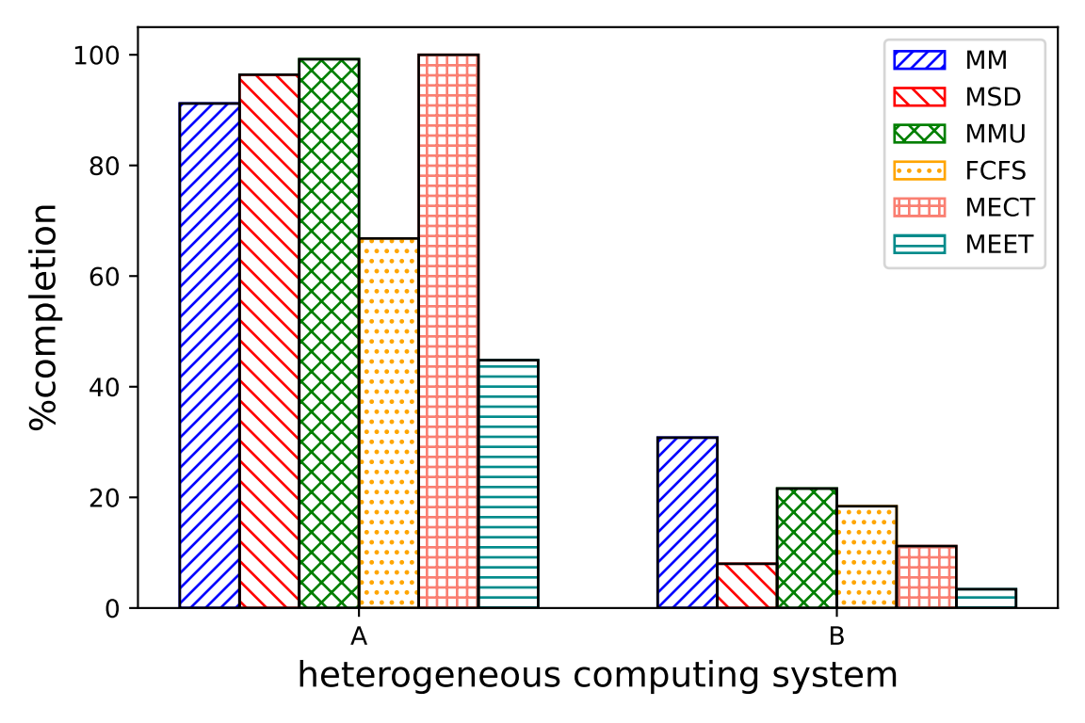
Heterogeneity Matters in Task Scheduling!
MMU > MSD > MM > FCFS
HC System A → B
MM > MMU > FCFS > MSD

Slide 14
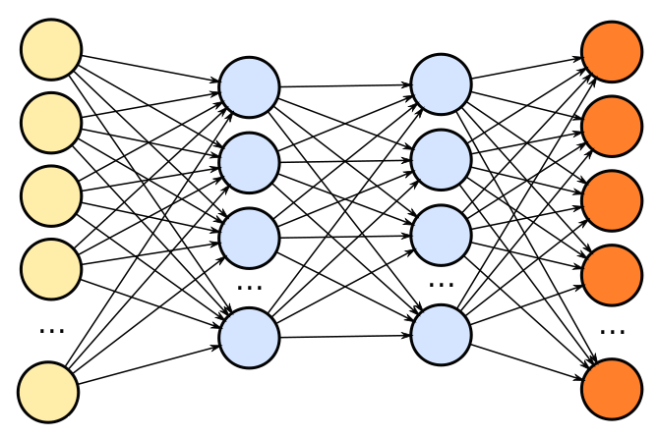
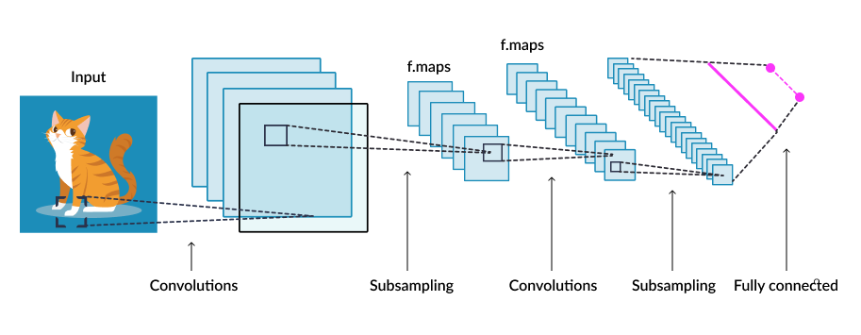
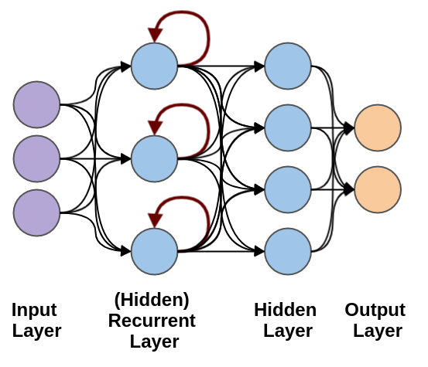
Why Heterogeneity is important?
Heterogeneity Matters in System Configuration!
ML Inference Queries
Heterogeneous Cloud VMs
Objectives
QoS Constraint
Minimized Cost

Slide 15
How E2C Simulator Helps in Heterogeneous-native System Design?
Estimate an HC System QoS
Face Recognition
QoS
$$\hat{QoS}$$
Speech Recognition
Expensive
Time Consuming
NLP
Machines
Heterogeneous Computing System

Slide 16
How E2C Simulator Helps in Heterogeneous-native System Design?
Comparison across HC systems
$$\hat{QoS_{B}}$$
$$QoS_{B}$$
Workload
?
$$≈$$
$$QoS_{A}$$
<
$$\hat{QoS_{B}}$$
HC System B
$$\hat{QoS_{A}}$$
$$QoS_{B}$$
Cost- and Time Prohibitive
Estimated QoS using E2C
We can estimate both HC systems will perform similarly without using real infrastructure
$$QoS_{A}$$
$$\hat{QoS_{A}}$$
HC System A

Slide 17
E2C Architecture Overview
Local Queues
Energy Supply
Heterogeneous Machines
Task Arrivals
Scheduler

Slide 18
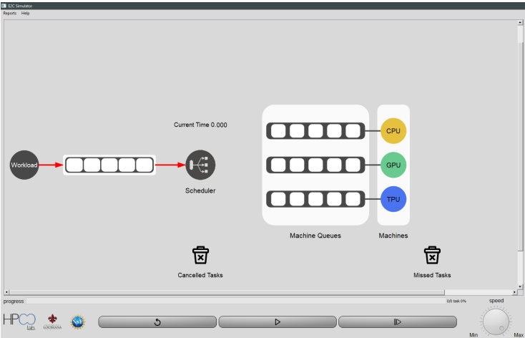
E2C Main Window
Set Scheduling Method
Show a Machine Specs and Performance
Load or Generate Workload and EET
Show Missed Tasks
Show Cancelled Tasks
Start Simulation
Reset Simulation
Set the Speed of Simulation
Incremental Simulation

Slide 19
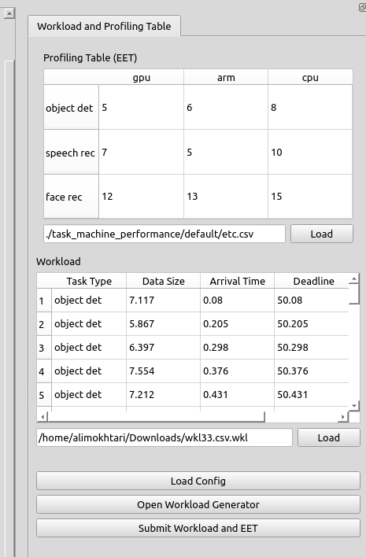
Loading Workload, EET and Configuration
EET Matrix
Workload
Configuration

Slide 20
New Workload, EET, and Configuration

Slide 21
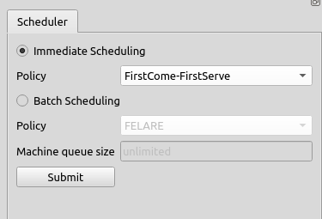
Scheduling Method
Immediate Scheduling:
FCFS
MEET
MECT
Batch Scheduling:
MinCompletion-MinCompletion
MinCompletion-SoonestDeadline
MinCompletion-MaxUrgency
Fair Energy- and Latency-aware (FELARE)

Slide 22
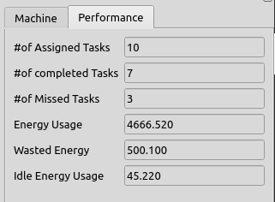
Machines

Slide 23
Missed Tasks

Slide 24
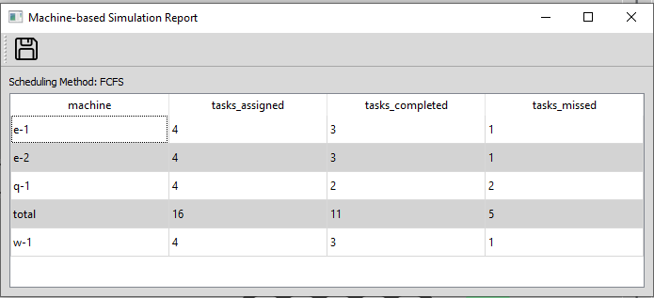
E2C Reports
The users can save simulations logs that includes simulation information with different granularities

Slide 25
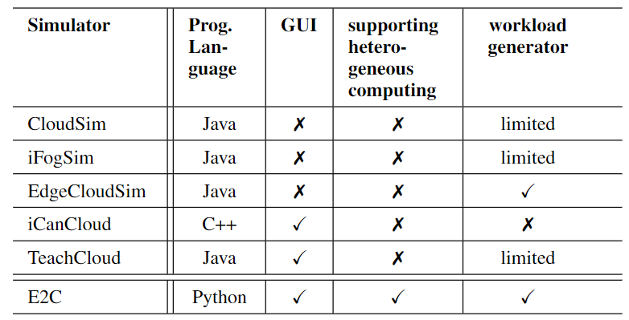
Positioning of E2C with respect to other simulators

Slide 26
E2C as an Assignment in Distributed and Cloud Course
Undergraduate students practiced different scheduling methods those for real-time response time
Learning about Task Types, Machine Types, arrival intensity, and their impacts
Graduate students also develop new scheduling methods
Students report their observations
Arrival rate impact
Difference between batch and immediate scheduling
Analysis of various scheduling algorithms

Slide 27
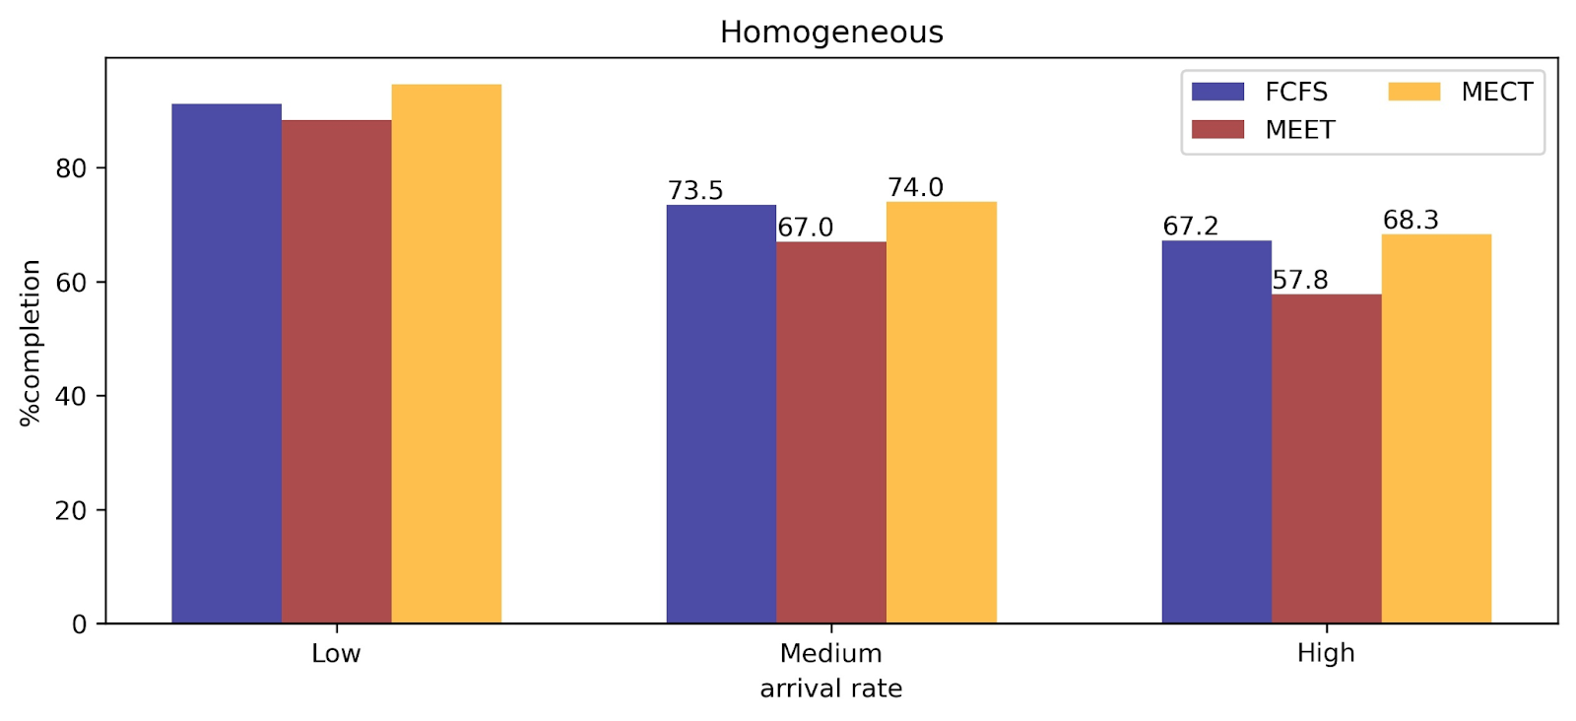
Examining Scheduling of Homogeneous Systems
Immediate Scheduling Methods
FCFS (Round Robin)
Minimum Expected Execution Time (MEET)
Minimum Expected Completion Time (MECT)

Slide 28
Examining Scheduling on Heterogeneous Systems
Immediate Scheduling Methods
FCFS (Round Robin)
Minimum Expected Execution Time (MEET)
Minimum Expected Completion Time (MECT)
Batch Scheduling Methods
MinCompletion-MinCompletion (MinMin)
MinCompletion-Soonest Deadline (MSD)
MinCompletion-Max Urgency (MMU)

Slide 29
Demographic Information of the Evaluation
23 students (14 UG and 9 G) participated in this survey study.
73.9% male and 26.1% female
60.9% BSc and 39.1% master graduate students
Mean programming experience 3.8 years
43.5% passed OS

Slide 30
User Interaction Experience with E2C

Slide 31
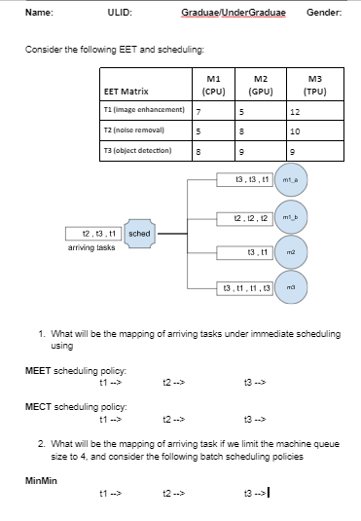
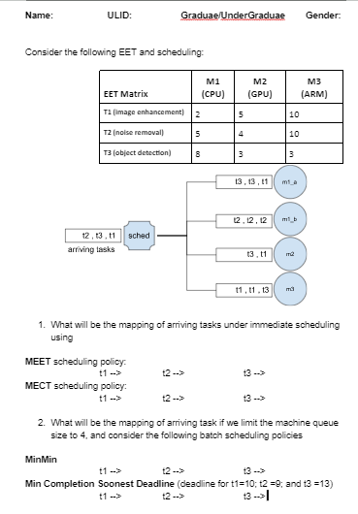
Pre- and Post-Assignment Class Quizzes
Pre-assignment
Quiz
Post-assignment
Quiz

Slide 32
Evaluating Learning Outcomes of E2C

Slide 33
Conclusion and Future Works
E2C is an open-source learning tool for students and researchers
Intuitive way to simulate heterogeneous and homogeneous systems.
Students gain insight about performance of scheduling methods
No need to use and expend for real infrastructure.
E2C reduces the widening educational gap nationally, and globally
E2C has a user-friendly GUI for quick usage by beginners
Based on the feedback from our students, we plan to extend E2C
Communication paradigms
The ability to drag and drop components into the simulator

Slide 34
Availability
E2C documentation can be accessed at:
https://hpcclab.github.io/E2C-Sim-docs/#/
YouTube Channel:
https://www.youtube.com/playlist?list=PL7jhdCPVrCHh49PvIglDEY2Xs4v2ivrsw

