Slide 1
Object as a Service (OaaS): Enabling Object Abstraction in Serverless Clouds
Pawissanutt Lertpongrujikorn and Dr. Mohsen Amini Salehi
High Performance Cloud Computing Lab (HPCC)
School of Computing and Informatics
University of Louisiana Lafayette

Slide 2
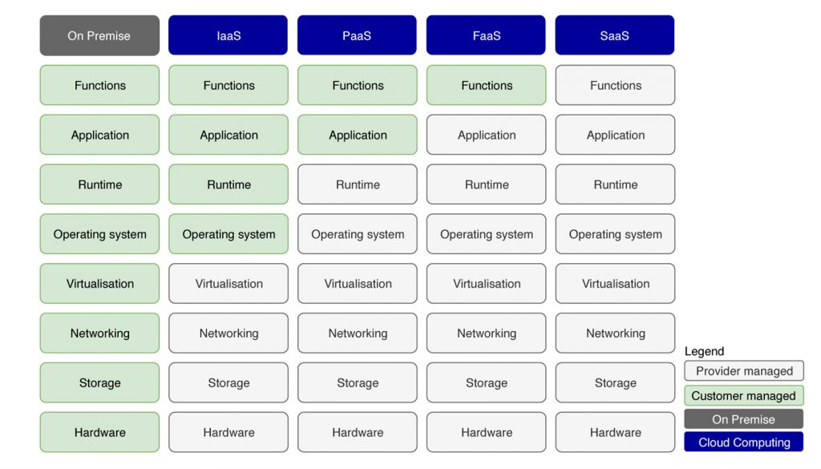
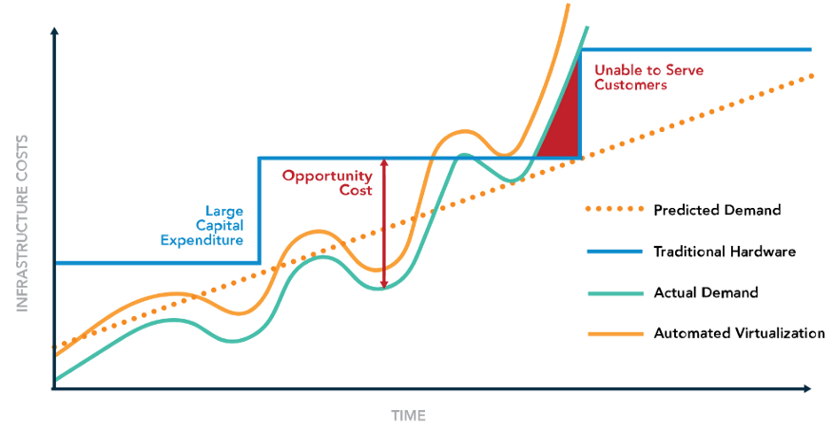
Introduction: FaaS
Developers just write a function
Transparent resource provisioning
Automatic scaling & Scale to zero (truly pay-as-you-go)
Rapid development and deployment
2

Slide 3
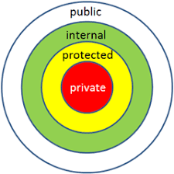
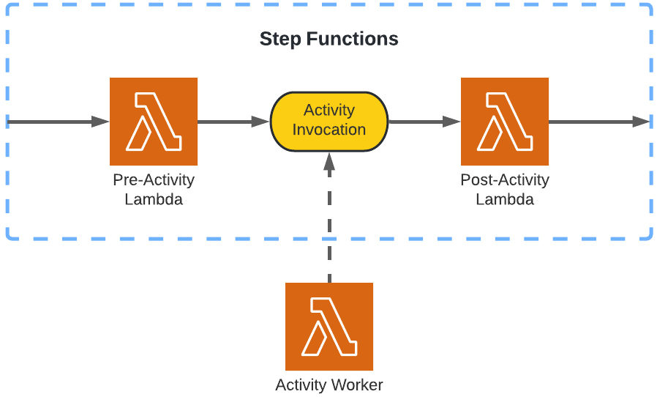
FaaS Shortages
Developers have to manage the application state (data)
e.g., via AWS RDS, S3
Lack of encapsulation
Functions and data are separate
Lack of built-in access control
No private/protected/public semantics
Lack of built-in dataflow semantics
No state management across functions
Relies on external services to construct workflows

Slide 4
Our Proposal: Object as a Service (OaaS) Paradigm
OaaS encapsulates functions and data in one entity
makes both resource and data management transparent
enables access level (public/private…)
enables software reuse (inheritance)
built-in support to define the workflow of functions as a function
managing intermediate data across functions
4

Slide 5
Existing Approaches for Stateful FaaS
Classifying by where to keep the state and how to access the state
Notes:
Show 1 by 1

Slide 6
Stateful Serverless Comparison Cont.
Actor
Data locality
System Complication
Datastore abstraction
Similar to traditional service development
More control over data access
In some cases, It might not help to improve the development experience
Pure function
Clear separation between each layer
No lazy data access
More overhead due to more data transfer
Entanglement between state management and execution runtime
actor >= datastore abstraction > pure function

Slide 7
OaaS Challenges
Offering object abstraction for cloud-native programming
Minimizing the overhead of OaaS
Scalability of concurrent object access
Our solution: Class system, access modifier, and dataflow!
Our solution: Data tiering and HTTP redirection mechanisms!
Our solution: Designing OaaS to support immutable objects!

Slide 8
Contributions
Developing the OaaS paradigm
Devising mechanisms based on data tiering and caching to mitigate the OaaS overhead
Developing a dataflow programming mechanism and exploiting object immutability
Implementing a prototype of the OaaS platform that can support structured and unstructured state data
Analyzing overhead and scalability of the OaaS platform

Slide 9
Design Goals of the OaaS Paradigm
Developing the concept of object to encapsulate data and function
developing the notion of class to bind a group of objects with the same characteristics
Providing transparency in accessing an object
offering the object access interface to access an object in the workflow without knowledge of its status
Providing support for both structured and unstructured data
structured => JSON, unstructured => media file
Providing the ability to define dataflow of functions
allow developers to define macro functions without dealing with the concurrency and synchronization complexities
Notes:
video1:transcode(var=1024)

Slide 10
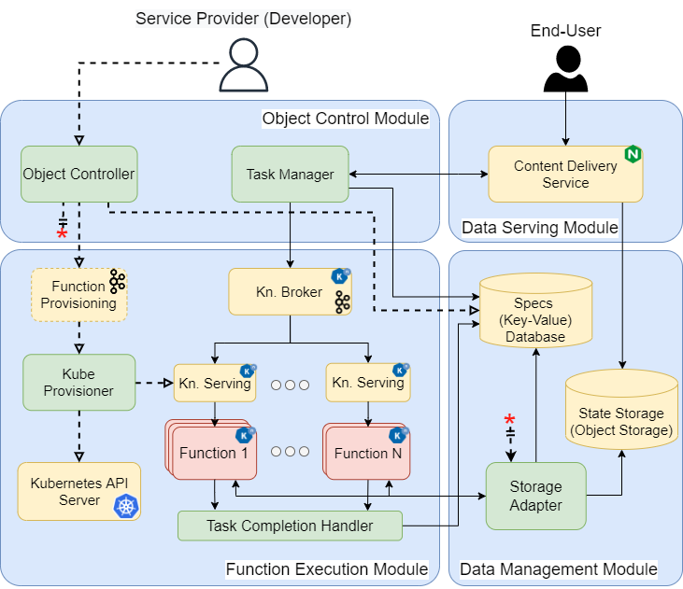
OaaS Architecture
OaaS Platform
Notes:
The OaaS platform is designed based on multiple self-contained microservices communicating over the network in a serverless cloud system.

Slide 11
OaaS: Object Control Module
translates a function call to a task
transparent access to object state and functions (OAI)
manage task ordering in a workflow via an invocation graph
offers the object and class abstractions
managing their metadata
registering class and functions
Notes:
The OaaS platform is designed based on multiple self-contained microservices communicating over the network in a serverless cloud system.
To avoid the bottleneck, Task Manager is stateless by maintaining the internal state on the key-value database.

Slide 12
OaaS: Function Execution Module
routing the task to appropriate container
Deploying the containerized function
Autoscaling and
scale-to-zero of functions
Notes:
The OaaS platform is designed based on multiple self-contained microservices communicating over the network in a serverless cloud system.
To avoid the bottleneck, Task Manager is stateless by maintaining the internal state on the key-value database.

Slide 13
OaaS: Data Management Module
gateway to access object & function
enabling efficient and secure access to object state
reduce data movement via HTTP redirect mech.
Notes:
Utilizing the S3 presigned URL to prevent the receiver can access the other data by analyzing the path.

Slide 14
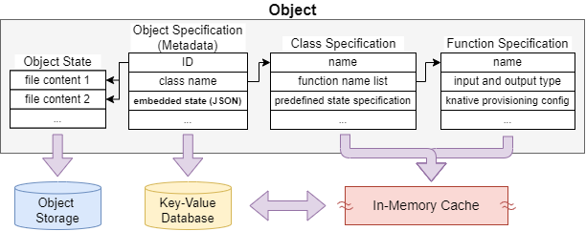
Data Modeling in OaaS
OaaS persists the four parts of the object-related data into the different data stores based on the size and access frequency.

Slide 15
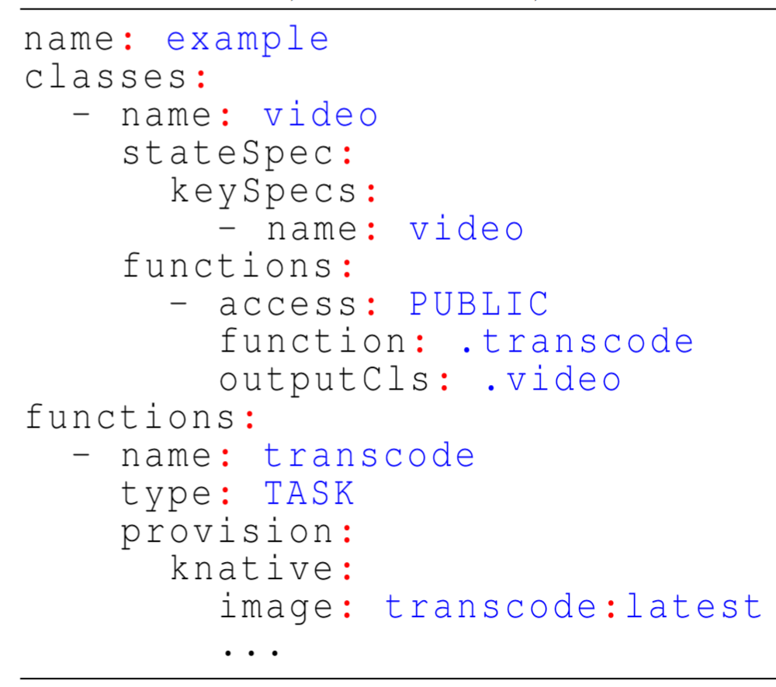
Class Definition in OaaS
Example call via Object Access Interface:
video1:transcode(var=1024)
state
declaration
function
definition

Slide 16
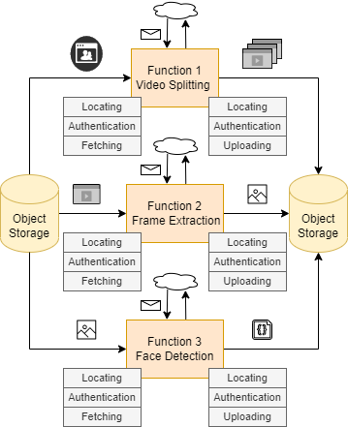
Case Study: Face Detection on a Given Video
FaaS

Slide 17
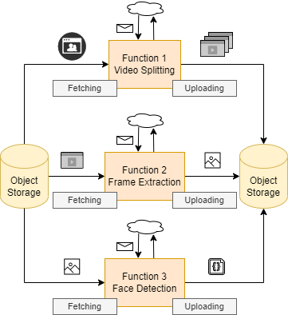
Case Study: OaaS for Face Detection on a Given Video
class video{
state:
name: src_video
functions:
video_split():video;
extract_frame():image;
Workflow:
face_detect():json_record;
}
OaaS:
class image{
state:
name: img
functions:
face_detect():json;
}
class json_record{
state:
name: json
}

Slide 18
Case Study: FaaS vs OaaS
FaaS:
OaaS:

Slide 19
Experiments: Baselines
Baselines (structured data)
OaaS
Underneath Knative (+ Kafka)
Full functionality
Disabled redirection
Disabled redirection and data tiering
Apache Flink StateFun + Knative (no Kafka)
OpenWhisk + Infinispan
Baselines (Unstructured data)
OaaS
Underneath Knative
Full functionality
Disabled redirection
Disabled redirection and data tiering
OpenWhisk + S3-Compatible

Slide 20
Experiments: Baselines
Structured data
Underneath Knative + Kafka
Apache Flink StateFun + Knative (no Kafka)
OpenWhisk + Infinispan
Unstructured data
Underneath Knative + Kafka
OpenWhisk + S3

Slide 21
Experiments: Metrics and Scenarios
Metrics
Latency
Scalability
Scenarios
JSON Update (structured data)
Video transcoding (unstructured data)
Text file concatenation (unstructured data)

Slide 22
Experiments: Scenarios
Overhead (latency)
state size
run 100 requests per state size
JSON update: change number of entry
Video transcoding: change video length
Text file concatenation: change file size
Concurrency
run 1 minute
JSON update: 10 entries
Video transcoding: 1 second
Text file concatenation: 10 KB
Scalability (Throughput)
run with multiple concurrency and find the maximum for each cluster size.

Slide 23
Experiments: JSON Update Explanation
Each JSON entry has 10 chars of key and 40 chars of value.
Sending 2 requests:
1st request: Write a new JSON with a predefined number of entries.
2nd request : Load the previous JSON , put more data with a predefined number of entries, and save the new JSON.
The first request is not counting in statistic.
Example: 10 entries
1st request : Write 10 entries of JSON
2nd request : Load 10 entries of JSON, add another 10 entries, and save it with total of 20 entries.

Slide 24
Experiments: Statefun Workaround
Statefun was build for stream processing and only has asynchronous function call.
We delay each request by 100 ms to simulate the synchronous API call.
However, we disable the delay in throughput measurement.
We measure the execution time by calculating the difference between the timestamps of request record and result record in Kafka.

Slide 25
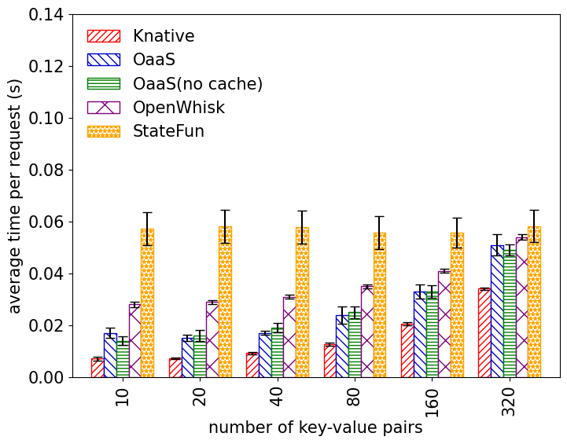
Evaluation Result: Latency / data size (JSON)
Overall, Knative has the least response time, followed by OaaS.
After entries > 80, response time starts to noticeably increase
Statefun has an asynchronous state persistent
Notes:
* the execution time of Statefun does not increase when we increase the data size because Statefun was built on top of Apache Flink, which stores the state on the local datastore without involving the external database. However, Statefun also has the fault tolerance mechanism by state snapshotting to external object storage, but it performs asynchronously and does not count to the execution time.

Slide 26
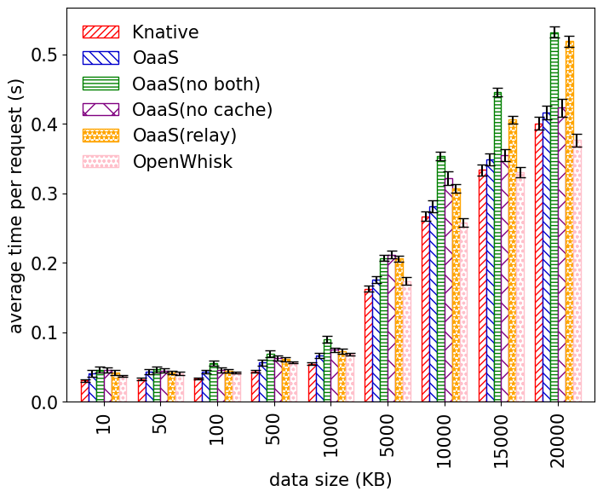
Evaluation Result: Latency / data size (Text)
OaaS perform slightly worse than Openwhisk because it has an additional layer of data access (Storage Adapter).
Overall, the latency starts to grow up after 5000KB.
The redirect mechanism of OaaS is notably reducing response time on larger data sizes.

Slide 27
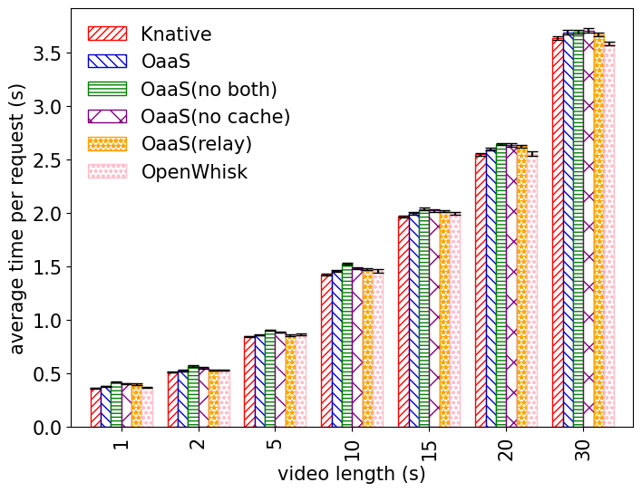
Evaluation Result: Latency / data size (Video)
OaaS perform slightly better than Openwhisk, but the difference is minimal because the computation time is dominant.

Slide 28
Evaluation Result: Latency / data size
VIDEO
TEXT
JSON
VIDEO:
OaaS perform slightly better than OpenWhisk, but the difference is minimal because the computation time is dominant
TEXT:
OaaS perform slightly worse than OpenWhisk because of an additional layer (Storage Adapter)
The redirect mechanism of OaaS is notably reducing response time on larger data sizes
JSON:
Overall, Knative has the least response time, followed by OaaS.
Statefun maintains the response time at large state because of an asynchronous state persistent

Slide 29
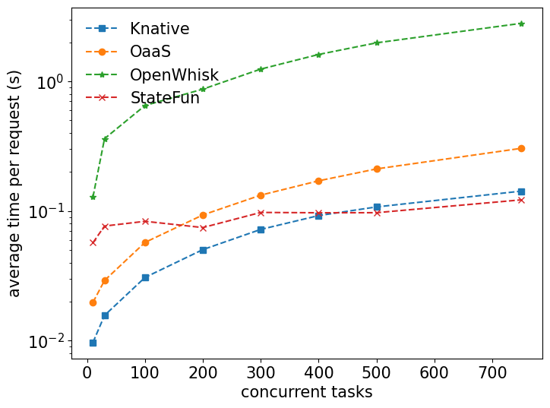
Evaluation Result: Latency / concurrency (JSON)
Statefun has the best throughput and latency on high concurrency.
Asynchronous state persistent mechanism
Protobuf
Openwhisk Python runtime can only execute a task at a time in each container
The gap between OaaS and Knative is growing with concurrency.
OaaS needs to persist object state while the Knative function is real stateless.
Notes:
* We add 100 ms of delay to simulate the synchronous API call.
* Statefun has the best throughput and latency on high concurrency. Apache Flink is based on the actor model that keep the working data on worker This is coming from the asynchronous state persistent mechanism that batch multiple state into one operation. Also, Statefun uses Protobuf, but the others uses JSON.

Slide 30
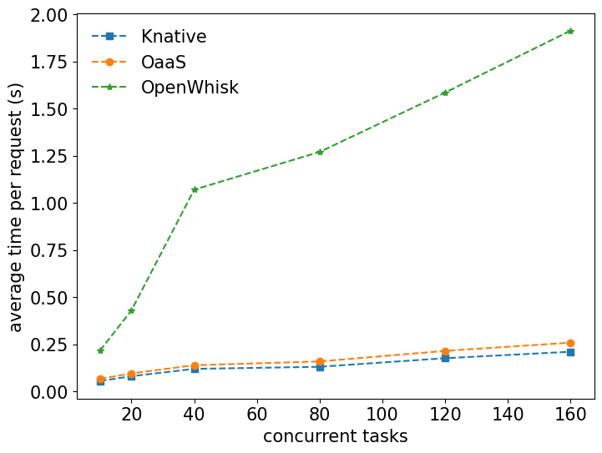
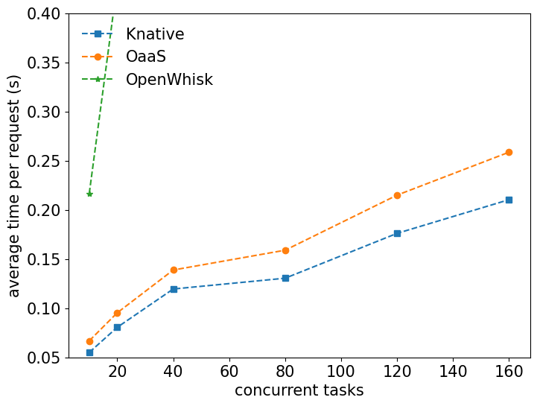
Evaluation Result: Latency / concurrency (Text)
Like the previous slides, Openwhisk Python runtime can only execute a task at a time in each container.
The Knative is not stateless in this case. However, the concat function requires more I/O and network bandwidth and fights over the resource with the object state persisting operation of OaaS.

Slide 31
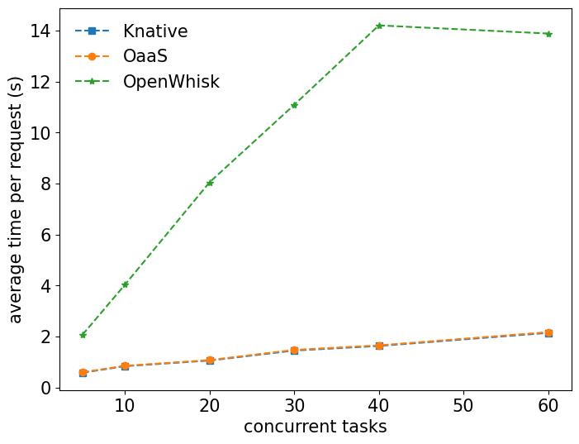
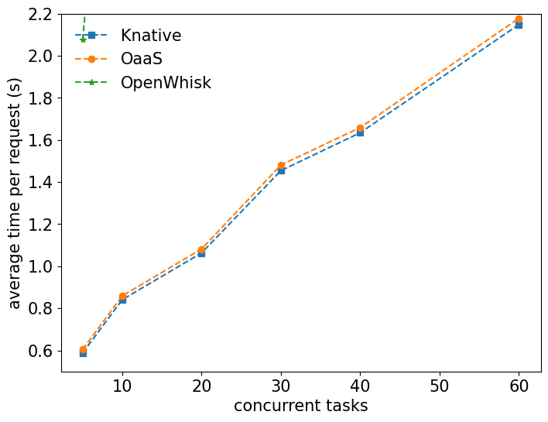
Evaluation Result: Latency / concurrency (Video)
Openwhisk auto-scaling is not aware of long tasks. The auto-scaling performs based on the number of incoming tasks.
The gap between OaaS and Knative is negligible because it is dominated by transcoding time.

Slide 32
Evaluation Result: Latency / concurrency
VIDEO
TEXT
JSON
VIDEO:
The gap between OaaS and Knative is negligible because it is dominated by transcoding time
Openwhisk auto-scaling is not aware of long tasks. The auto-scaling performs based on the number of incoming tasks.
TEXT:
OaaS perform slightly worse than OpenWhisk because of an additional layer (Storage Adapter)
Openwhisk Python runtime can only execute a task at a time in each container
JSON:
Statefun has the best throughput and latency on high concurrency because of an asynchronous state persistent
The gap between OaaS and Knative is growing with concurrency

Slide 33
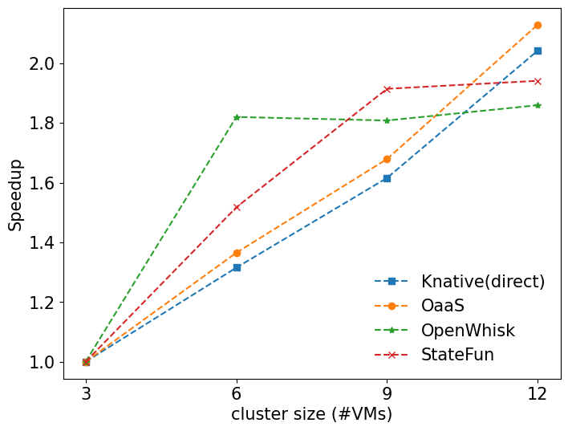
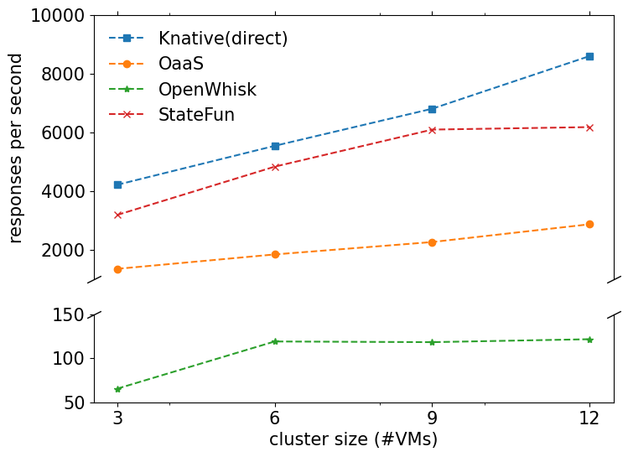
Evaluation Result: scalability (JSON)
We use Knative as the upper line.
OaaS and Knative have similar speedup factor
Statefun outperforms the others regarding throughput, but it is slowing down at 12 VMs.
Openwhisk stops to scale the worker when it reaches a certain threshold.

Slide 34
Evaluation Conclusion
OaaS perform well on low loads. However, it still lacks optimization on high loads.
In OaaS, the embedded JSON is suitable for data that is not too big. The developer should consider storing it in object storage to handle extensive data. Adding the automatic storage selection to OaaS can be interesting future work.
Sending the task data past Kafka induces the additional cost and does not give many benefits on synchronous function calls. We consider the hybrid between direct request and Kafka as future work.

Slide 35
Conclusion
Incorporates state management into functions and offers object abstraction on cloud
Improves state access performance using presigned URL and redirection mechanism
Has scalability by making the object state immutable.

Slide 36
Future Works
Improve the performance by further exploiting the data locality
Transactional guarantee across functions within a dataflow.

Slide 37
Thank you for your attention!
https://github.com/hpcclab/OaaS

Slide 38
Backup Slides
Appendix

Slide 39
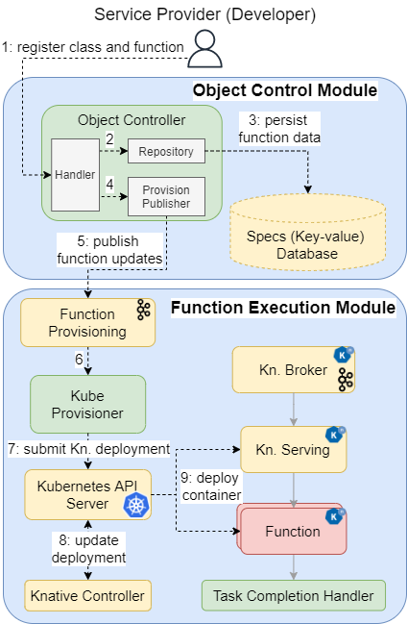
Interactions Between Components: Deploying a function

Slide 40
Interactions Between Components: invoking a function

Slide 41
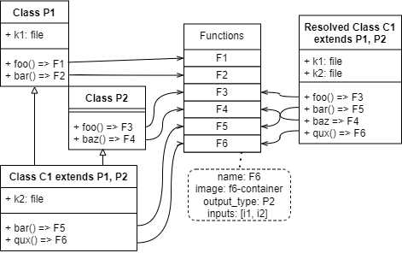
Class Inheritance
Why do we detach function from class?
Reduce duplication of function
Duplication of function => Redundancy of container deployment
Allow manipulating the input variable while using the same function container
ex., Change the default value
Lower the cost of updating the function in the class (No need actually to remove it)

Slide 42
Invocation: Task Conversion

Slide 43
Improved Architecture

