Slide 1
Exploring the Impact of Virtualization on the Usability of Deep Learning Applications
Davood G.Samani, Mohsen Amini Salehi
High Performance Cloud Computing Lab (HPCC)
School of Computing and Informatics
University of Louisiana Lafayette
CCGRid 2022
1

Slide 2
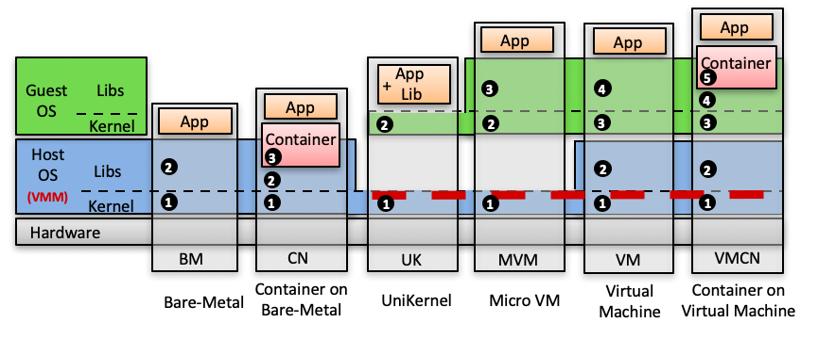
Introduction
App
App
App
App Lib
Container
Guest OS
Libs
+
3
4
5
App
App
4
Kernel
Container
2
2
3
3
Host OS
Libs
2
3
2
2
(VMM)
2
1
Kernel
1
1
1
1
1
Hardware
BM
CN
UK
MVM
VM
VMCN
Bare-Metal
Container on Bare-Metal
UniKernel
Micro VM
Virtual
Machine
Container on Virtual Machine
Available Execution Platforms as Underlying Compute Infrastructure
Notes:
The variety of execution platforms
Introduce Hardware, Host OS, VMM, Libraries, Kernel and then Guest OS
Talk about the numbers that demonstrate the abstraction layers
Start from BM to VMCN and describe the abstraction layer in way of an App to access hardware resources.

Slide 3
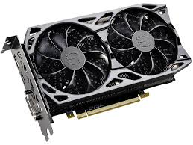
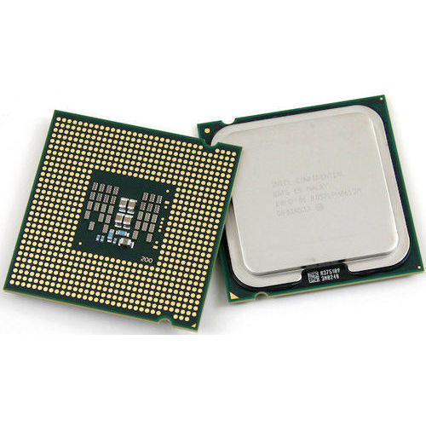
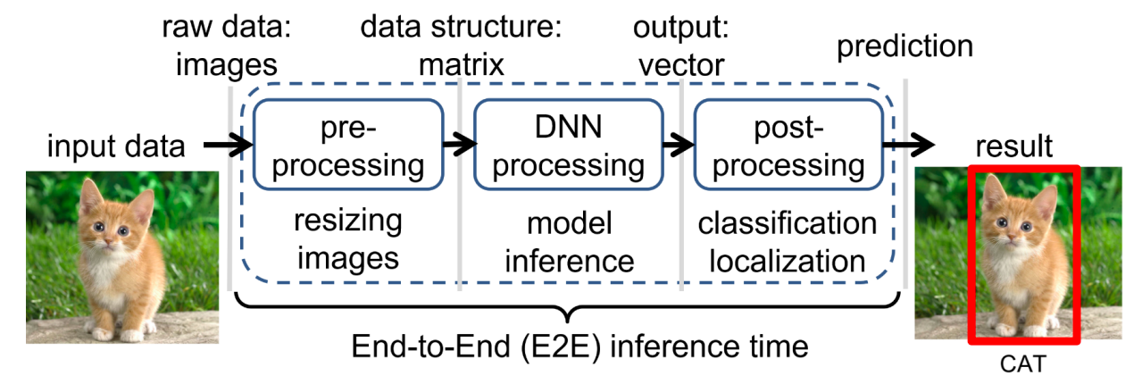
Introduction
DL operation
Compute Unit
Execution Platform
Inference
GPU
CN
VM
MVM
VMCN
BM
X86
Training
CPU
ARM
Notes:
Top image:
Introduce Deep Learning and its impact in people life
Talk about Increasing usage of DL in modern applications
Introduce different DL operations
Demonstrate computational requirements of DL applications (Compute units)
Various possibilities for execution platforms
Button image:
Introduce different execution stages of a DL application when perception an image in an image classification application and their functions

Slide 4
Research Questions
As a Cloud Solution Architect:
Which execution platform to choose for DL apps
Cloud infrastructure
Edge infrastructure
To get shorter E2E inference results, does it worth to
Pin CPU cores?
Use GPU for DL apps?
How the overhead of a given execution platform varies in the presence of scale-up
With CPU as processing unit
With GPU as processing unit
Cloud Solution Architect Challenges
Which platform
Which Compute Unit
To what extent scale-up
4
Notes:
Talk about the questions that a cloud architect needs to find an answer for, when planning the DL application deployment

Slide 5
DL benchmarking platform: MLPerf vs DLBS
Properties\Benchmarking applications | MLPerf | DLBS
GitHub | 1400 Stars, 97 contributors, Last update hours ago | 113 Stars, 4 contributors, Last update 6 months
Contributors | Alibaba, Facebook AI, Google, Intel, NVIDIA | HPE
Phases | Training, Inference | Training, Inference
Benchmarking results | Updated periodically by community | Not available
Supported Applications | Vision: detection and classification/ Language processing/ Recommendation systems/ Vision: Medical Imaging/ Speech recognition | Object detection/ Image classification/ Speech recognition
Supported Models | 7 Models | 21 Models
Supported Frameworks | TensorFlow (TensorRT), PyTorch, ONNX | TensorFlow (TensorRT), Caffe, Caffe2, MXNet, PyTorch
Approach | Application based | Model Based
Same model, different Framework deployment | No | Yes
Datasets | ImageNet, COCO, SQuAD, Criteo Terabyte, BraTS, OpenSLR LibriSpeech Corpus | ImageNet
Special Inference Features | Introducing “Scenarios” and some other QoS controls like latency, accuracy and etc.
Datacenter/Edge/Mobile deployment | Yes | No
5
Notes:
Introduce two DL benchmarking platforms and compare their specifications.
Stress on
GitHub contributors and stars
Supported applications
Approach

Slide 6
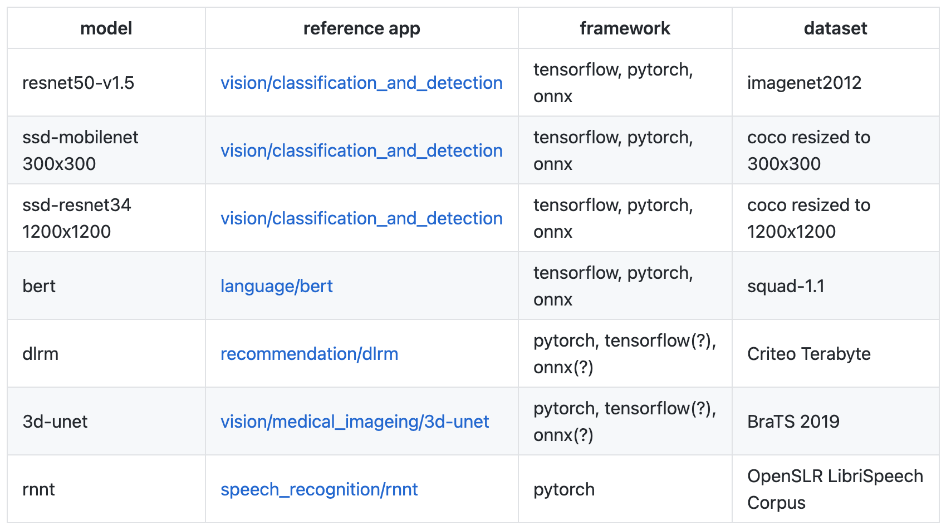
DL applications supported by MLPerf
6
Notes:
Quickly talk about the 7 applications supported by MLPerf. Don’t talk about details, they will be presented in next slide

Slide 7
Selected DL Apps and models
Which applications to choose
Commonly used in production
Related to end user experience
Different input data type
Deep Learning applications and their NN Models
Vision --> ResNet50
Speech Recognition --> RNNT
Language Processing --> BERT
Recommendation system --> DLRM
For ARM:
Custom Python script --> ResNet50 (same data set)
Notes:
Talk about what parameter are important for us to choose the applications
Introduce the 4 applications and their DNN models
On X86
On ARM

Slide 8
Experiment Setup: Infrastructure
X86:
80 x Intel(R) Xeon(R) Gold 6138 CPU @ 2.00GHz
512GB DDR3 @ 2666 MT/s
GPU: Tesla k40c
ARM:
Quad core Cortex-A72 (ARM v8) 64-bit SoC @ 1.5GHz
8GB LPDDR4-3200 SDRAM
Notes:
- Demonstrate the Hardware specs of server and Raspberry Pi.
- Quickly go over the table, don’t need to read the whole. Just columns.

Slide 9
Experiment setup: Scenarios
Computing Platform
Execution
Platforms
Benchmark Suit
(MLPerf)
Processor
config
CPU Cores
(Scale-up level)
4
CN
Image
Classfy.
Vanilla CPU
8
Cloud
Server
MVM
Speech Recog.
Pinned CPU
GPU+
Vanilla CPU
16
VM
NLP
GPU+
Pinned CPU
32
VMCN
Recom.
System
64
BM
Notes:
Introduce each column
As an example, talk about the bold black path experiment
Also demonstrate the red path for MVM
9

Slide 10
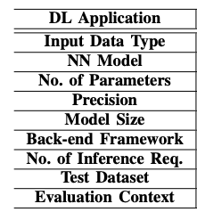
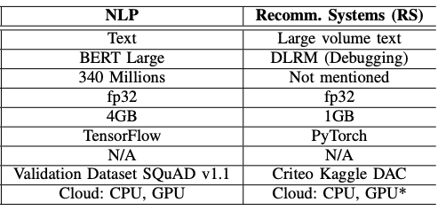
Experiment Setup
10
Notes:
Quickly go over the ”DL Appication” column
Talk about the workload (the batch size)
Explain the “Evaluation Context” for all apps.

Slide 11
Image Classification experiment results
Different level of computing demands for pre-processing, inference, and post-processing phases decide for scale-up and deployment
The parallelization techniques used in pre-processing and post-processing phases define efficacy of scale-out
Investigate the impact of scale-up
Scrutinize resource utilization patterns of the app before deployment
Scale-up improves the E2E inference time up to a certain number of cores
Counter-intuitive behavior of vanilla CN
CPU-GPU platforms is not remarkably beneficial
Notes:
Introduce the experiment and the X and Y axis in the figures
Different exec platforms
Scale-up
Inference avg execution time
Explain the second experiment with the granularity of different DL processing stages
Show that how scale up impact average executing of each stage (helps with CPU only, but hurts CPU-GPU)
Explain why scale-up for CPU-GPU is counter-intuitive
Explain Why CPU-GPU platform is not remarkably beneficial:
The complexity and overhead of data transfer between the main memory and the GPU memory increases upon scale-up
The number of cache-misses is increased upon scale up

Slide 12
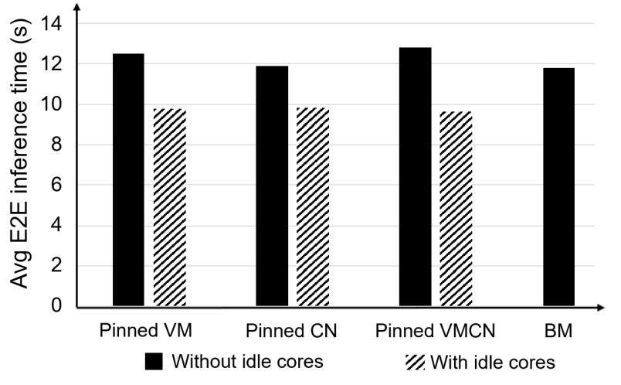
Odd BM behavior
Idle cores in the hypervisor considerably help with the performance
Notes:
Here we explain why in the figure BM performance is sometime worse than other platforms.
Describe “without idle core” and ”With idle cores”

Slide 13
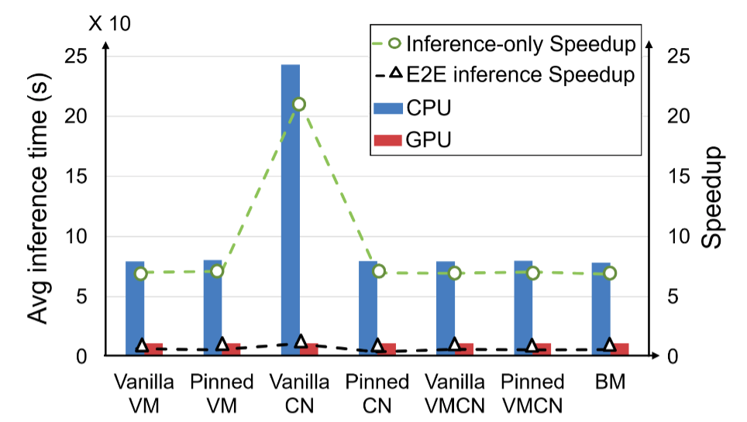
The impact of Pre- and Post-Processing Phases on the Speedup
If pre- and post- processing phase dominate the execution time, GPU won’t be helpful
Measure the performance of all three execution phase of DL application (E2E), not only inference part
CPU-GPU speedup is much evident when only considering “inference” execution phase (4× to 9× speedup)
Notes:
Image classification using DLBS on ResNet50 model
Illustrate both X axis (Avg inference time and Speedup) and Y axis.
Explain DL inference stages and why GPU is boosting performance

Slide 14
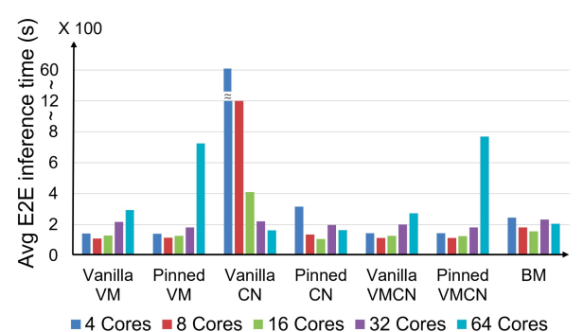
Voice recognition experiment results
Our server in the experiment has 2 NUMA with 32 CPU cores on each
Lower values of the container cores to the host cores (CHR) remarkably increase the imposed overhead of vanilla CN
E2E inference time has skyrocketed on VM/64/PIN/CPU and VMCN/64/PIN/CPU
E2E inference time is reduced upon scale-up to 8 CPU core
14
Notes:
Point out VM/64/PIN/CPU and VMCN/64/PIN/CPU, and why the E2E inference time has skyrocketed → our server has 2 NUMA with 32 CPU cores on each
E2E inference time is reduced upon scale-up to 8 CPU core → observed in other applications as well → multi-thread deployment in the code

Slide 15
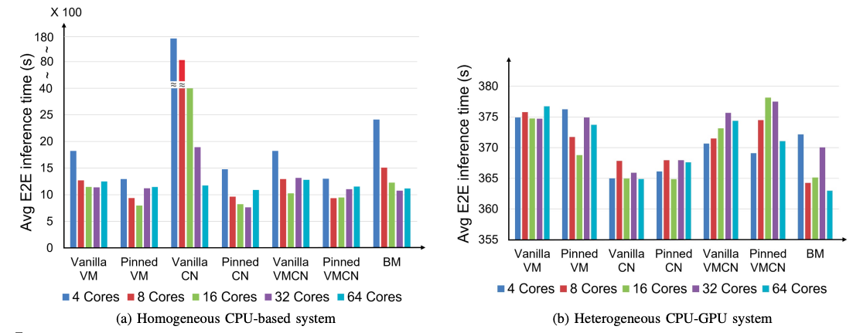
NLP experiment results
The input data type of DL applications amplify the overhead of virtualization
Scale-up level is not a decisive factor
Use high performance storage for DL applications with many small-size input file
CPU-GPU configuration: more than 3× speedup in the E2E execution time
Notes:
GPU causes more than 3× speedup in the E2E execution time. This is because, the inference time on GPU dominates the times of pre- and post-processing on CPU.
For the same reason Scale-up level and pinning are not important

Slide 16
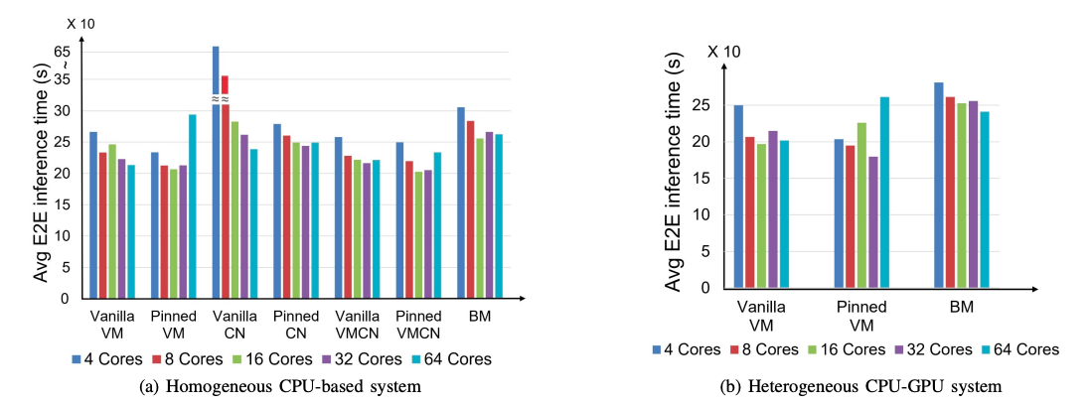
Recommendation System experiment results
The positive impact of CPU pinning
GPU does not significantly improve the E2E inference time
16
Notes:
Second one: inference operation (that utilizes GPU) constitutes only a fraction of the E2E inference time, whereas, the pre- and post- processing phases (that utilize CPU) dominate the E2E inference time

Slide 17
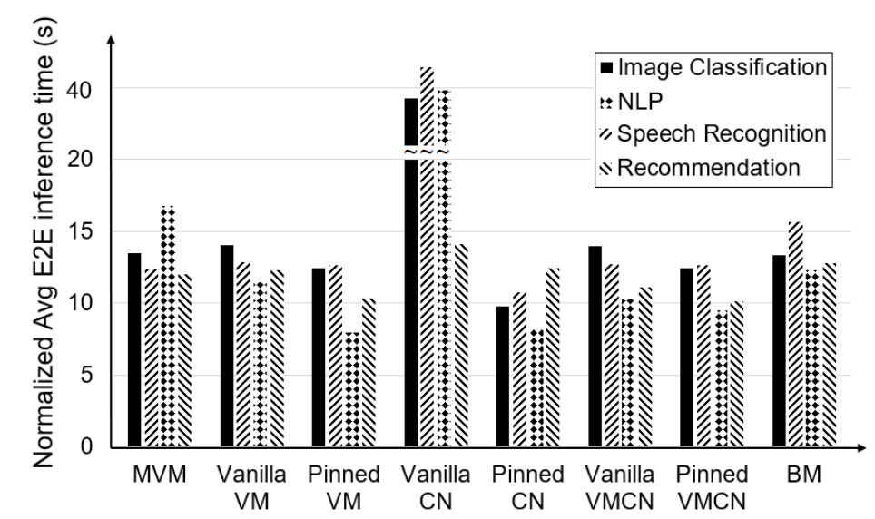
MicroVM vs other execution platforms
Pinning CPU cores mitigates the imposed overhead of execution platforms, particularly, when the DL application is deployed on vanilla CN
Almost the same performance
MVM boots remarkably faster than vanilla VM
Notes:
E2E inference times of applications are normalized
MVM lacks the Qemu para-virtualization modules → lower performance than VM
Its the IO latency that causes MVM either does not offer performance superiority over vanilla VM
We conducted another experiment using Cassandra as the application (IO intensive) → VM remarkably outperforms MVM

Slide 18
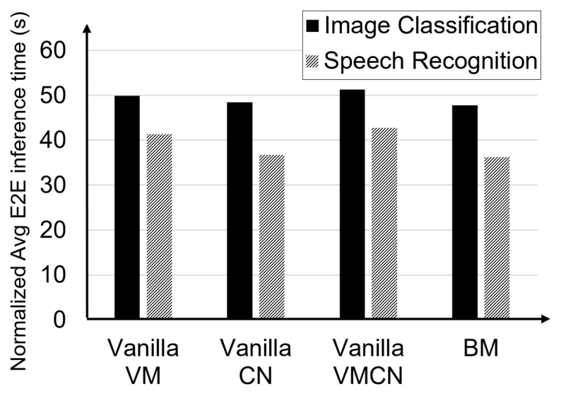
Edge device experiment results
The low overhead of CN: CHR of 1-1
- CN is suggested as the suitable virtualization platform for DL deployments on the Edge

Slide 19
Thank You!
Many thanks to my advisor, Dr. Amini, for going along with students days and nights!
Questions?

